Slide 1
THE ONTARIO LIBRARY RESEARCH CLOUD (OLRC)

Slide 2
Service Objectives
  Provide cost-effective subscription-based scalable storage for Ontario’s academic libraries to house valuable and expanding digital collections
  Provide preservation services for that content to ensure long-term access
  Develop new tools for researchers to be able to explore and analyze that content at scale

Slide 3
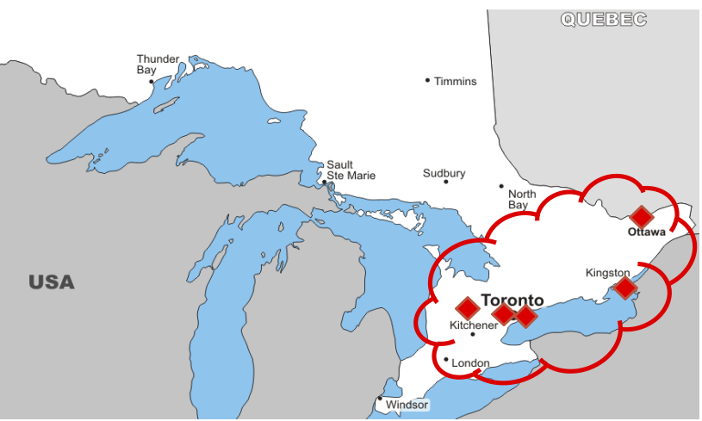
Notes:
Multi-site, widely distributed. ~420 km between most distant nodes, as crow flies

Slide 4
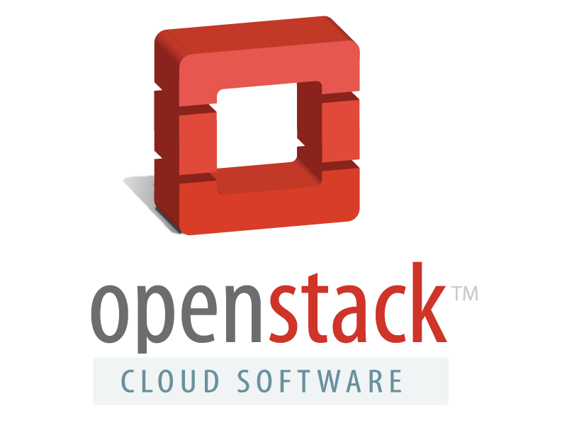
The Cloud
Utilizes high-speed virtual network running on ORION and GTAnet to provide 10G connectivity between 5 hosting sites: Toronto, Ottawa, Queens, York, & Guelph
Digital objects are replicated in the cloud at least three times to ensure redundancy (no single point of failure)
Powered by OpenStack Object Storage (Swift) software

Slide 5
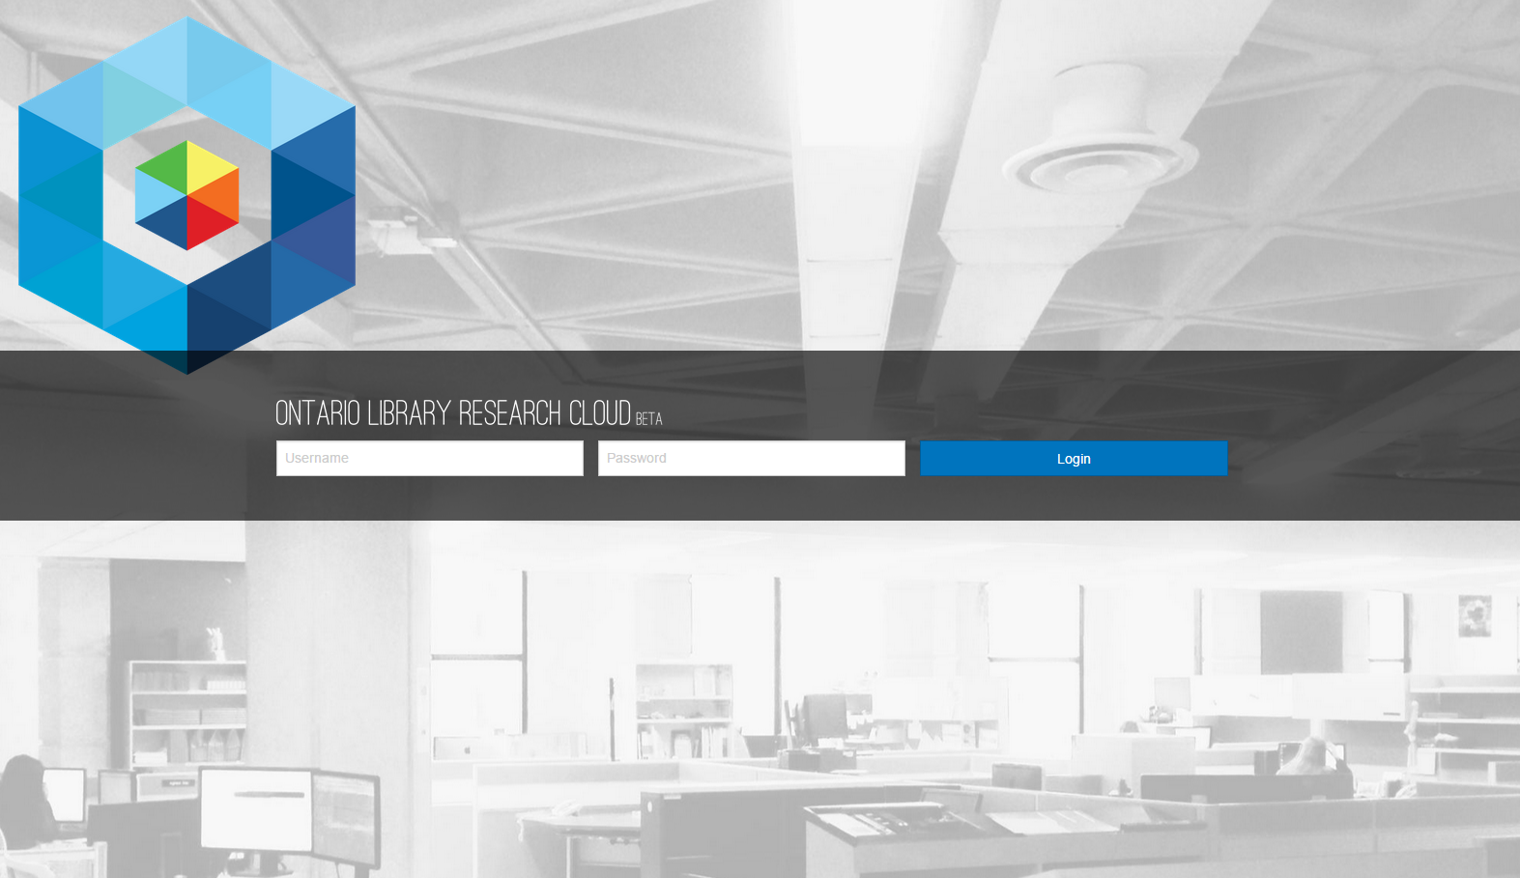
Swiftbrowser

Slide 6
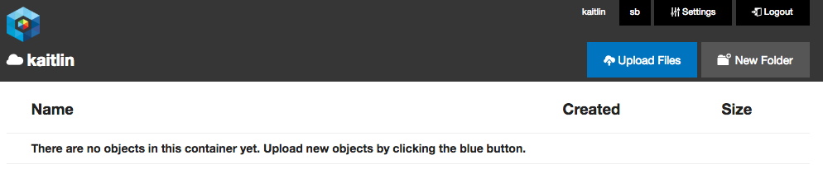
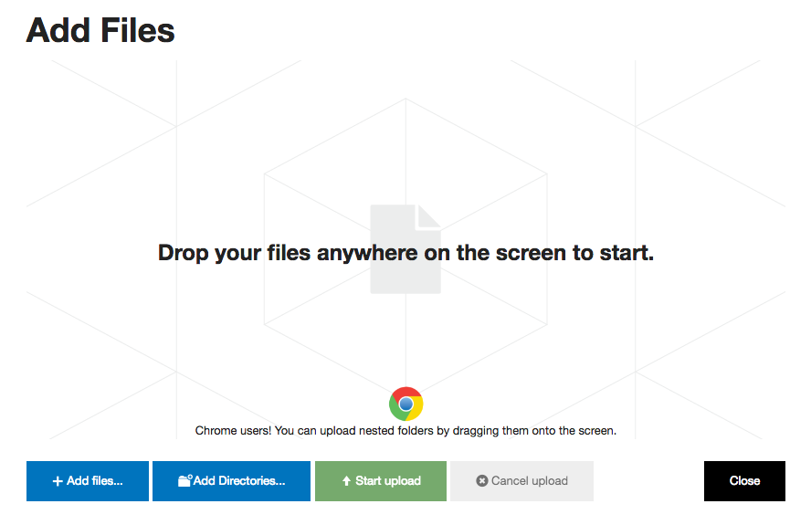
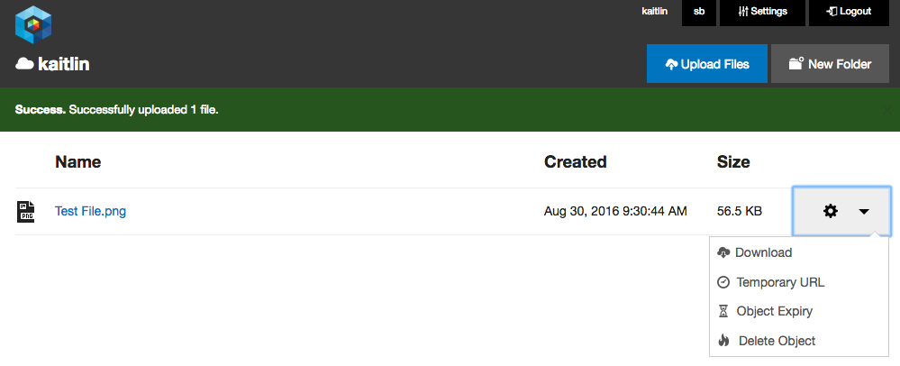
Swiftbrowser

Slide 7
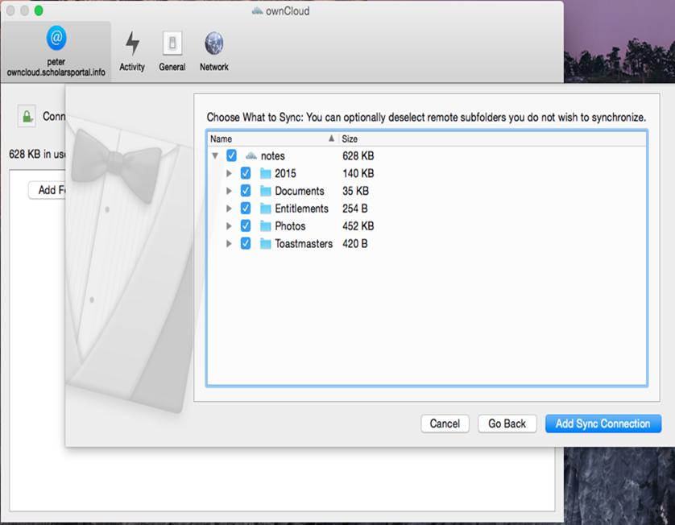

OwnCloud

Slide 8
Cost per TB as of May 2017
Annual subscription: $320/TB for OCUL members, $790/TB for non-OCUL
OCUL schools pay a $1600/yr 5TB minimum, Non-OCUL clients pay a $3950/yr 5TB minimum
3% discount for 10TB block
6% discount for 50TB block
Free 5TB Trial until April 2017
Notes:
These are unpublished, but approved by the Executive.
These figures place us solidly above some commercial services such as Amazon Glacer et al. as we heard about yesterday and all generally know about. For a variety of reasons, most of us in Ontario are not interested in using those as they are hosted in data centres outside Canada, among other reasons. Happy to speak more about why we want a Canadian solution in Q&A if there is interest.
At the other end of the cost spectrum there are DuraCloud, DPN, and others. Granted, we are not including the costs of operating OCUL and Scholars Portal. Those are in some sense existing costs to which OLRC adds a small increment.

