Slide 1
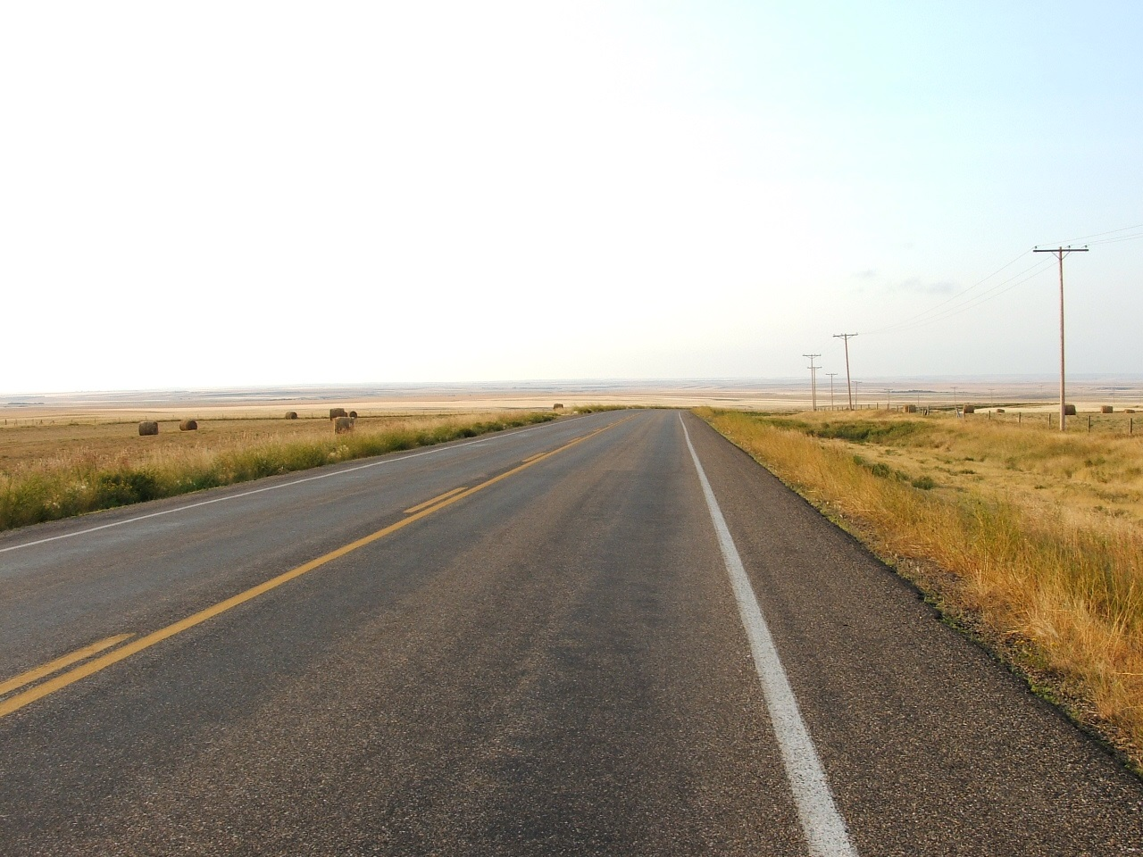
Scholars Portal Roadshow 2016
Kingston
Queen’s University
September 26, 2016
#SPonTheRoad
Notes:
-Welcome
-Acknowledgement
We [I] would like to begin by acknowledging that the land on which we gather is the traditional territory of the Anishinaabeg and Haudenosaunee Peoples.
Pronunciation:
Ah-nee-shee-NAW-bay
Ho-dee-no-SHOW-nee
-Hosting
Thank you to Queen’s University for hosting and to their OCUL-SP rep Michael Vandenburg for his help in the planning.
-Run through agenda
-Introduce OCUL and SP staff
-Audience interaction
We encourage you to tweet throughout the presentation! Our hashtag is #SPonTheRoad. We have set aside about a half hour at the end of our presentation for questions, so please keep them in mind if they come up while we’re speaking – we’d love to hear from you.
-wifi? (Eduroam?)

Slide 2
INTRODUCTION TO OCUL AND SCHOLARS PORTAL

Slide 3
Introduction to OCUL

Slide 4
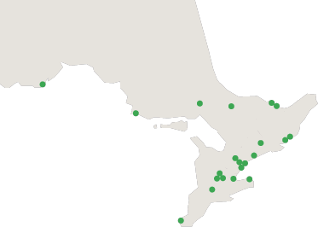
Ontario Council of University Libraries
OCUL is a consortium of Ontario’s 21 university libraries.
Nipissing
Laurentian
Algoma
Lakehead
Trent
York
Guelph
Waterloo
Wilfrid Laurier
Western
Windsor
Carleton
Ottawa
Queen’s
RMC
UOIT
Ryerson
Toronto
OCADU
Brock
McMaster
Notes:
OCUL, or the Ontario Council of University Libraries, is a consortium of all the libraries at Ontario’s 21 universities. It has a province wide reach from Lakehead University to the University of Windsor in the south and reaching as far east as Ottawa and Carleton in Ottawa and of course all the universities in between.

Slide 5
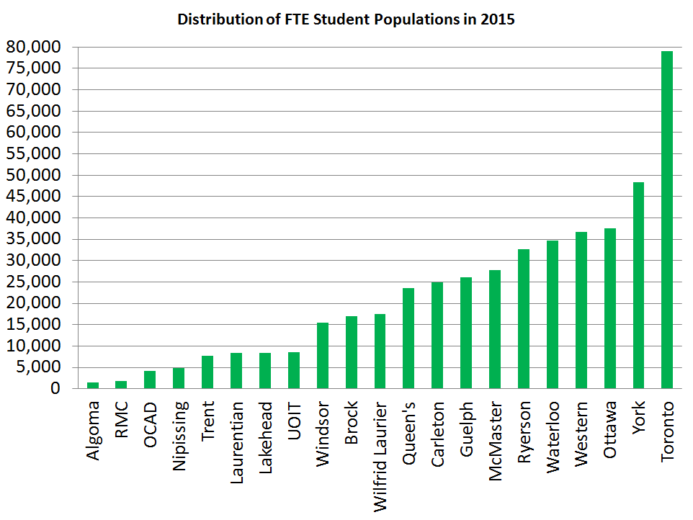
Notes:
The total university student population in Ontario is over 466,000 – this is about 1/3 of all the university students in Canada.
As you can see the population at the Ontario universities varies considerably. So there is a diversity of needs for our members and their communities.

Slide 6
OCUL Mission and Vision
Our Mission is to collaborate in the development and delivery of enhanced, innovative, and effective information services and resources for Ontario’s universities.
Our Vision is to be a recognized leader, provincially, nationally and globally, in the transformative development and delivery of scholarly resources and innovative services.
Notes:
The universities come together through OCUL to do many things, all focused around three core principles: Collaboration, Innovation and Service Delivery.
You can see this reflected in our Mission and Vision statements. The key OCUL activities include:
Collections - Licensing eresources on behalf of members
Scholars Portal - shared technological infrastructure
Member services - which includes collaborative planning, advocacy, professional development, partnerships and research.

Slide 7
Thinking OCULy
Thinking and working together for common benefit
OCUL Collaborative Futures
spotdocs.scholarsportal.info/display/OCF
Notes:
The impact of OCUL’s collaboration isn’t just about the collective outcomes. By coming together and discussing ideas, innovations, practices, this knowledge is also often taken back to individual institutions and implemented at a local level. OCUL is a hub for innovation and knowledge sharing that then moves outwards and is put into a local context.
Like any organization of this type, OCUL’s success is due to committed member involvement. OCUL endeavors to make it as easy as possible for all university libraries to be involved, and for its activities to be fair and equitable.

Slide 8
Governance Structure
21 OCUL Directors
OCUL Executive
OCUL Executive Director
OCUL-SP
OCUL-PA
OCUL-IR
OCUL Communities
Notes:
This is a diagram of how OCUL is governed and I want to talk briefly about these groups and their roles to give you an idea of how OCUL works. Each of the libraries in OCUL is represented by its Chief Librarian or University Librarian who sit on the Council, and these representatives are also known as the OCUL Directors. The Directors make all the substantive long term decisions about OCUL activities and directions. They approve the budgets and distribution of fund and also decide what OCUL will not be doing anymore
OCUL also has three standing committee that are concerned with operational aspects, and on organizational planning and assessment. Then there is also the OCUL Communities of Interest.

Slide 9
Executive Committee
Chair: Vivian Lewis, McMaster University
Vice-Chair: Ken Hernden, Algoma University
Treasurer: Brent Roe, Laurentian University
Past-Chair: Rebecca Graham, University of Guelph
Secretary: Pascal Calarco, University of Windsor
Executive Director: John Barnett (ex officio)
Notes:
The Executive Committee is made up of five OCUL directors and the OCUL Executive Director is charged with making sure the decisions and priorities identified by the Council are implemented.

Slide 10
Planning and Assessment
(OCUL-PA)
Strategic oversight of OCUL and Scholars Portal activities
Facilitates Strategic Plan
Reviews and develops proposals for new services and annual priorities in collaboration with OCUL-IR and OCUL-SP
Notes:
The first of the Standing Committees, OCUL Planning and Assessment, is charged with strategic oversight of OCUL and Scholars Portal activities.
The committee, which is made up of the chairs of OCUL SP and OCUL IR, the OCUL Chair, OCUL Treasurer, the OCUL Executive Director and four other representatives from the Directors group, facilitates OCUL’s strategic plan and measures its success. It meets to discuss new opportunities; it looks forward to new advise the Directors of new OCUL priorities and evaluates how OCUL is doing in relation to its strategic goals.

Slide 11
Information Resources Committee (OCUL-IR)
Operational oversight of consortial e-resources activities
Collective licensing
  180 electronic resources
  from 70 different vendors
  ejournals, ebooks, streamed media, data files, databases, digitized primary sources
Notes:
Both OCUL IR and OCUL SP are concerned with those things OCUL does that are critical to the operations of each of our member libraries. Therefore it is important that each of these committees has a representative from each OCUL member school.
The OCUL Information Resources Committee provides operational guidance for OCUL’s consortial eresources activities. This includes:
Collective licensing of our 180 electronic resources from around 70 different vendors renewing annually
In addition to licensing OCUL IR is also concerned with issues of Scholarly Communication and broad collections issues

Slide 12
Scholars Portal Committee
(OCUL-SP)
Assessment and development of services
Generating ideas for new services
Promoting local awareness of Scholars Portal
Ensuring Scholars Portal services meet user needs
Identifying opportunities for training and knowledge sharing
Notes:
OCUL Scholars Portal Committee provides guidance to Scholars Portal.
This includes:
Assessment and development of services
Generating ideas for new services
Promoting local awareness of Scholars Portal
Ensuring Scholars Portal services meet users needs
Identifying opportunities for training and knowledge sharing
An example of this is OCUL SP committee helped us get Scholars Portal on the road this year.

Slide 13
OCUL Communities
Communities of interest
Sharing information
Generating ideas
Open membership
Representation from at least 7 OCUL schools
Over 200 community members
Notes:
While there are around 50 people from across OCUL sitting on these Standing Committees, by far the majority of people who are involved with OCUL are part of the OCUL Communities. So these groups are communities of interest that focused on information sharing and the generation of ideas.
These communities are often where people first become involved with OCUL and are where they are able to contribute to and maintain interest in a topic they are either directly responsible for at the schools, or one they have a keen interest in.
Membership in the OCUL Communities is open to anyone within an OCUL institution and unlike the Standing Committees it is unrestricted. It is at the discretion of each school as to how many people involved, but OCUL welcomes anyone who is interested.

Slide 14
OCUL Communities
Accessibility
Assessment
Data
Digital Curation
Geo
Government Information
Information Technology
Public Service Renewal
Publishing/Hosting
Quality Assurance
Resource Sharing
Video ocul.on.ca/committees
Notes:
There are currently 12 OCUL communities; covering a broad cross-section topics. The collective membership of these communities is over 200 people.
You can find out more about these communities on the OCUL website at: ocul.on.ca/committees
You can find out what each of these communities is working on by checking out their SPOTdocs wiki space or by keeping up to date with the Annual Reports they submit to the Directors each year.
A couple of examples include the Geo Community Historical Map Digitization project and the Government Information document Digitization project.
But the work of the communities is not just about projects it is also about information sharing through webinar (eg the current series of Publishing Hosting community webinars profiling the new PKP OJS and OMP, or providing expert knowledge to other groups at request as the Accessibility Community is often asked to do.
.

Slide 15
OCUL Staff
Executive Director
Business Officer
Admin & Communications Coordinator
Project Officer: eResources (on leave)
Admin Assistant: eResources
Electronic Resources Licensing Consultant
Collaborative Futures Project Manager
Procurement Consultant
Notes:
Supporting all of this work is the staff of the OCUL office and the Scholars Portal Operations Team or SPOT. We will talk about SPOT shortly but here is a look at who we have in the OCUL office.
You can see in addition to the Executive Director (John Barnett), the Business Officer (Nur Artok) and the Admin Comms Coordinator (Anika Ervin-Ward) we have people supporting the licensing and eresources work of OCUL (Jackie Cato and Carol Stephenson) and the Collaborative Futures Project (Amy Greenberg and Mabel Wang). We’ll talk more about Collaborative Futures a bit later.

Slide 16
Stay in touch
OCUL website: ocul.on.ca
SPOTdocs wiki: spotdocs.scholarsportal.info
Member access OCUL website
Webinars
Mailing lists
email us anytime: ocul@ocul.on.ca
Notes:
Here are some ways you can join the conversation or keep up to date with what is going on OCUL’y and at Scholars Portal.

Slide 17
Introduction to Scholars Portal

Slide 18
What is Scholars Portal?
Scholars Portal is the service arm of OCUL.
Scholars Portal was established in 2002 as a way to implement OCUL’s planning and direction.
We provide a wide variety of services to students, librarians, faculty and staff at OCUL member institutions.
Notes:
Scholars Portal is the service arm of OCUL.
Scholars Portal was established in 2002 as a way to implement OCUL’s planning and direction.
We provide a wide variety of services to students, librarians, faculty and staff at OCUL member institutions.

Slide 19
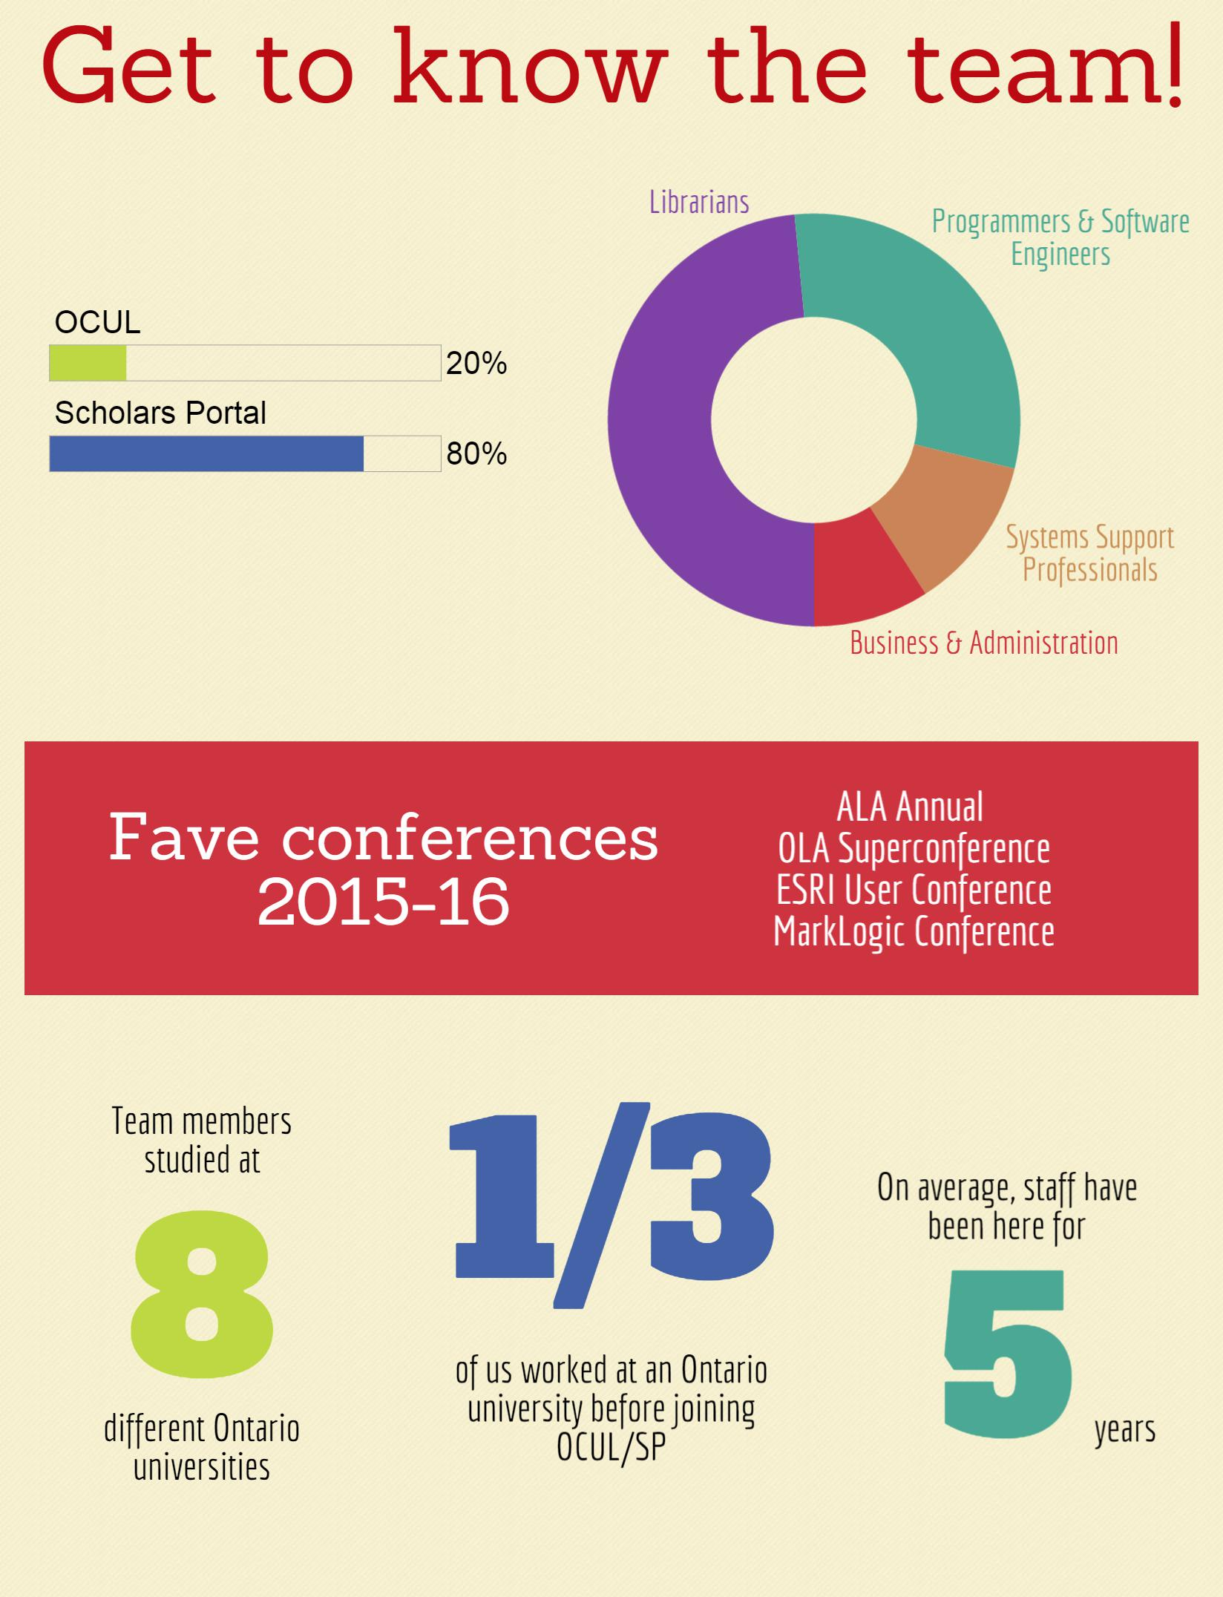
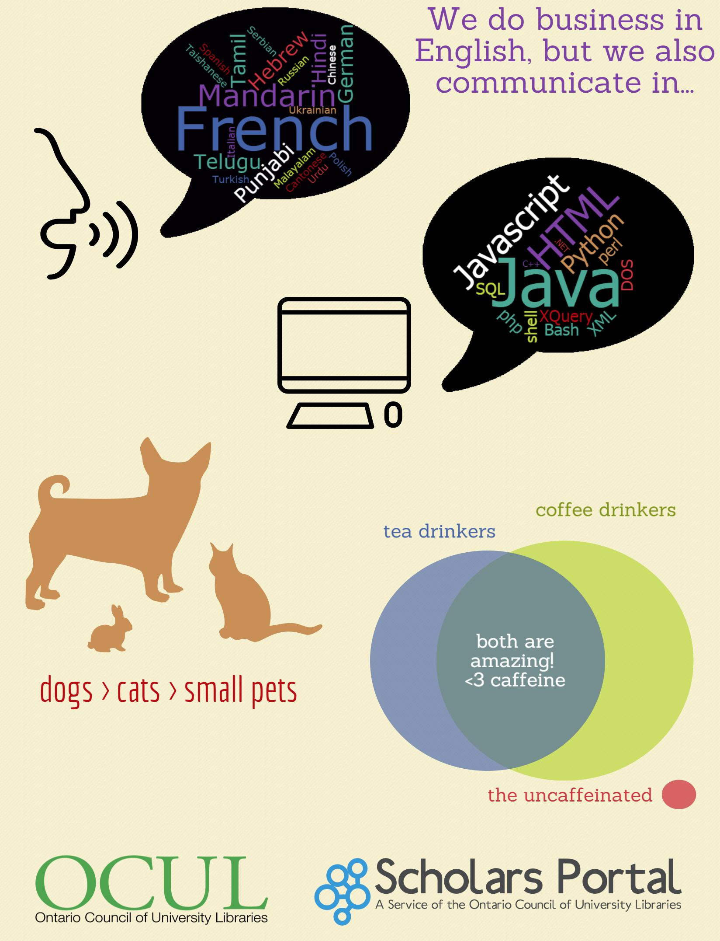
Notes:
Infographic about the team at Scholars Portal and OCUL!
We wanted to share with you a little bit about us. As you can see, about half of SP/OCUL staff are librarians by training. The rest are mostly tech people -- programmers, software engineers, systems support -- and OCUL also has some business and administration professionals. On a more personal level, you can also see here that most of us are dog people.
Scholars Portal staff are also known as the Scholars Portal Operational Team, or SPOT.

Slide 20
How is Scholars Portal governed?
21 OCUL Directors
OCUL Executive
OCUL Executive Director
OCUL-SP
OCUL-PA
OCUL-IR
OCUL Communities
Notes:
The Scholars Portal Operational Team (SPOT) gets direction from a few places. The OCUL Directors meet twice a year to set the course and budget for the coming term.
Highlighted in red is our more direct support line, and that’s the OCUL-Scholars Portal committee.
The central SP budget comes from OCUL via membership fees determined according to the SP cost allocation formula. This is used for core services (services that everyone uses).Other services are not part of the central budget because schools can either opt-in or opt-out. We also have projects funded by grants, such as the Enabling Change Grant from the Ontario Government used to fund ACE. Also there are some services that SP provides to schools outside of OCUL. For example, CRKN schools have access to EBOUND/ACUP titles on SP Books, and a number of schools subscribe to our data services. These schools pay for the service on a cost-recovery basis, so this funding gets rolled into the central budget.

Slide 21
OCUL-SP: Working for you!
SPOT gets direction and feedback from OCUL-SP, a committee with representation from every OCUL school.
Notes:
SP acts on the strategic directions determined by OCUL

Slide 22
Your Reps
Queen’s University
Royal Military College
OCUL Director:
Martha Whitehead
OCUL-SP Member: Michael Vandenburg
OCUL-IR Member:
Anne Smithers
OCUL Director:
Sarah Toomey
OCUL-SP Member:
Lisa Bechard
OCUL-IR Member:
Lisa Bechard

Slide 23
OVERVIEW OF SCHOLARS PORTAL SERVICES

Slide 24
2002
2008
2010
2011
2012
2014
2015
RACER
Scholars Portal Journals
Scholars Portal Books
ODESI
Scholars GeoPortal
Ask a Librarian
Dataverse
ACE
Content Repositories
OJS hosting
Member Services
OLRC
Notes:
Content repositories
Member services – services for libraries and end users

Slide 25



Member Services
Ask a Librarian: consortial chat reference service, started in 2011
French service, Clavardez avec nosbibliothecaires, launched in 2014
Contact: chat@scholarsportal.info
Accessible Content ePortal (ACE): repository of accessible texts for library users with registered print disabilities
Piloted in 2012, became a service in 2014, expanded to include Ontario colleges in 2015
Contact: ace@scholarsportal.info
Rapid Access to Collections through Electronic Requesting (RACER): Interlibary Loan management system, started in 2003
Contact: racer-support@scholarsportal.info
Notes:
-Ask a Librarian began five years ago
-Consortial chat reference service which fourteen schools now participate in. When the service is open, students see a “click to chat” button. They fill out their status and question, and then all online operators will see the question come into the system. If there is a staff member from that students’ library online, they will take the chat. Otherwise, whoever’s available will take it.
-French pilot service
-ACE was a pilot project starting in 2012 when we got an Enabling Change grant, and became a service in 2014. Currently 18 participating universities.
-The concept behind ACE is very simple: students across the province are using their accessibility offices to request scanning of library materials. Why don’t we do this collaboratively?
-We’ve taken it a step further than that and centralized a lot of the work. Books are scanned here at the University of Toronto by our partners, the Internet Archive (mostly from U of T collections, sometimes shipped to us by the requesting library).
-This may look familiar to you – it is built on top of the Scholars Portal books infrastructure.
-RACER is a very well-known and well-used service – it was the second service of Scholars Portal.
-Interlibrary loan management system.
-For the most part, those that work with RACER know how it works, and the rest of us are blissfully oblivious, but suffice it to say – it is a huge system that automates a lot of the interlibrary loan process.

Slide 26

Member Services
Cloud services: the Ontario Library Research Cloud (OLRC) provides preservation storage for Ontario’s scholarly material on five regionally distributed nodes.
Launched October 2015
Contact: cloud@scholarsportal.info
OJS & OMP: we host Open Journal System (OJS) & Open Monograph Press (OMP) instances for eight schools
OCUL is a development partner of the Public Knowledge Project (PKP)
Contact: ojs@scholarsportal.info
Notes:
OLRC
-five geographically distributed nodes across the province
-each file you upload is copied and stored at three different nodes for additional preservation security
-working on more user-friendly interfaces… kind of like Dropbox for your library
-OJS is the Open Journal System and OMP is the Open Monograph Press.
-Both of these free and open source systems were developed by the Public Knowledge Project, based at Simon Fraser University.
-Schools can and do host their own instances of these tools, but they also have the option to pay Scholars Portal a hosting fee, which means we manage the infrastructure and support.
-OCUL is a development partner with PKP so we, and in fact staff from OCUL schools, have done work on the interface, and on a number of plug-ins. Also a node on the PKP-PLN
-Our first OMP instance is from the University of Windsor. It is very good looking.

Slide 27
Content Repositories
Journals
Our first service! Started in 2002
Loading commercial and open access content – over 45 million articles
Certified as a Trustworthy Digital Repository in 2013
COUNTER-compliant usage reports available
Contact: journals@scholarsportal.info
Books
Began in 2009, now hosting over 700,000 titles
Content from commercial vendors, university presses, public domain collections
eBOUND Canadian University Press titles available to CRKN subscribers
Contact: books@scholarsportal.info
Notes:
Journals
Our first service! Started in 2002
Loading commercial and open access content – over 45 million articles
Certified as a Trustworthy Digital Repository in 2013
COUNTER-compliant usage reports available
Books
Began in 2009, now hosting over 700,000 titles (mostly public domain)
Content from commercial vendors, university presses, public domain collections (Internet Archive)
eBOUND Canadian University Press titles available to CRKN subscribers

Slide 28


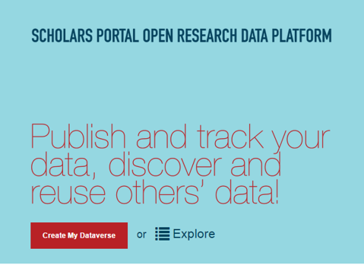
Content Repositories
<odesi>
Began in 2007, first collaborative SP community project
Contains data from Statistics Canada, polling companies, ICPSR metadata
New interface will integrate with Dataverse
Contact: odesi-help@scholarsportal.info
GeoPortal
Allows users to search, preview, add layers, clip, and download geospatial data
Went live 2012, collection has expanded rapidly since.
New: historical topographical maps!
Contact: geoportal@scholarsportal.info
Dataverse
Research data preservation tool, began 2011
Store, share, and version data
Contact: dataverse@scholarsportal.info
Notes:
odesi
-A social science microdata repository with 3,000 downloadable datasets and freely available metadata records for over 10,000 other sets
Since much of the data is publicly available elsewhere, the datasets can be viewed freely online by anyone but the large datasets are only downloadable to OCUL users
Dataverse
-over 600 studies deposited from researchers at 13 Ontario universities
-upgraded interface -- will be hearing about that in update
GeoPortal
-our GIS interface
-Allows users to search, preview, add layers, clip, and download geospatial data
-went live in 2012, collection has expanded rapidly since. Loaded local collections for some OCUL members.
New: we’re in the process of loading a large collection of historical topographical maps so watch out for those!

Slide 29
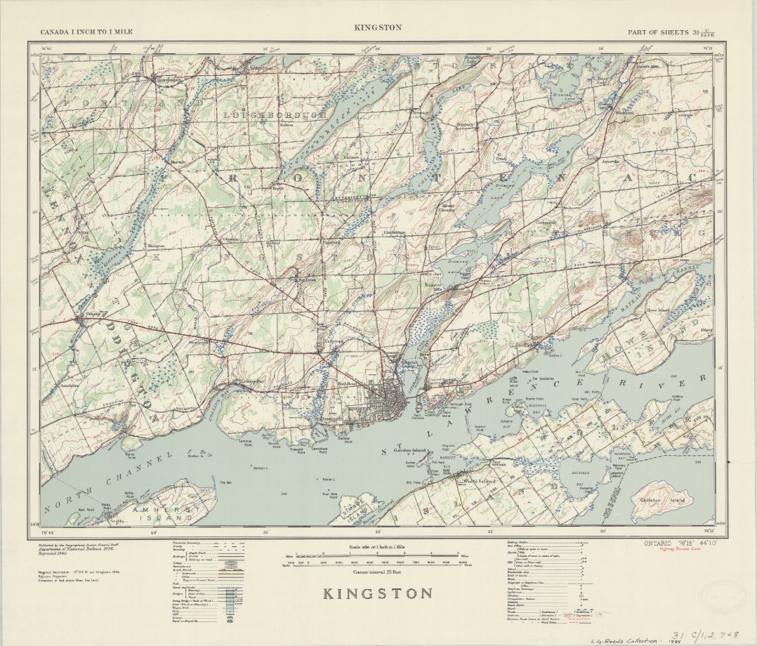
Notes:
OCUL Historical Topographic Map Digitization Project
The project aims to make over 1000 historical topographic maps of Ontario available through the GeoPortal.
These maps date from between 1906 and 1977, and show both natural and man-made features such as terrain, administrative boundaries, roads, railways, waterways, buildings, and land formations.
The maps are extremely valuable to researchers as they document change over time; however, they had been scattered and were not readily available at all OCUL Geo Community Institutions.
Since beginning this project, maps have been located, scanned and georeferenced by members of the OCUL Geo community, with the help of student staff.
Metadata and service creation is ongoing – we hope to have the collection available on the GeoPortal in early 2017.
This map shows Kingston in 1940

Slide 30
Get involved with OCUL & Scholars Portal!
Join an OCUL Community
Talk to your OCUL-SP rep
Visit the Scholars Portal wiki (spotdocs.scholarsportal.info)
Join a listserv
Follow us on Twitter! @scholarsportal
Notes:
This is now you can become involved:
Join one of the OCUL Communities
Talk to your Standing Committee reps
Attend another OCUL or Scholars Portal webinar
Consider making it know within your library that you are willing to do OCUL projects
Answer one of our surveys
Join one of our listservs
Attend in person or watch the live stream of our annual Scholars Portal Day

Slide 31
REDEVELOPING THE SCHOLARS PORTAL BOOKS PLATFORM

Slide 32
Books Platform Background
2008 OCUL procures eBrary platform (ISIS)
2009 Scholars Portal launches Books
2011 ProQuest buys eBrary. Support stops.
2013 Adobe Content Server
2014 Accessible Content E-Portal (ACE)
2016 Still using ISIS. Fingers crossed!

Slide 33
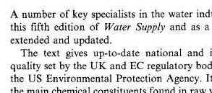
High time to move forward
Aside from the lack of support:
A lot has changed since 2008.
Aging system is difficult to maintain.
Rasterized page images can be blurry.

Slide 34
Things we need.
More robust usage tracking and statistics gathering
A flexible entitlement models that would support individual ebook purchase models and demand driven acquisition
An accessible interface
Searching that works consistently

Slide 35
More things we need.
A better browsing and reading experience for mobile device users
Integration of Books with the TDR
Integration of Books with the new OLRC cloud
Interlibrary loan options for ebooks

Slide 36
Even more things we need.
Offline reading capabilities and concurrent user management without the need for an Adobe ID

Slide 37
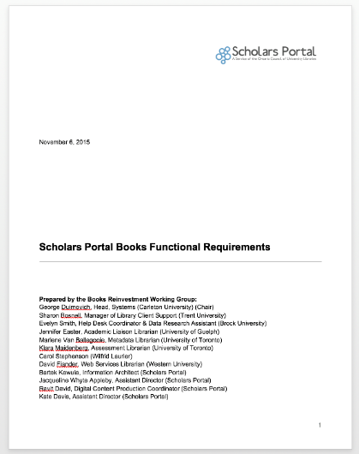
Functional Requirements Doc
https://goo.gl/aKbTZX

Slide 38
3 areas in progress
Content
  Transformation (publisher to BITS, ISIS to BITS, pdf to html)
  Loading (document db, OLRC, etc.)
Backend
  Set up and manage collections, clients, entitlements, and licenses
Frontend
  Search and reading

Slide 39
1. Content
The Great BITS Migration of 2016

Slide 40
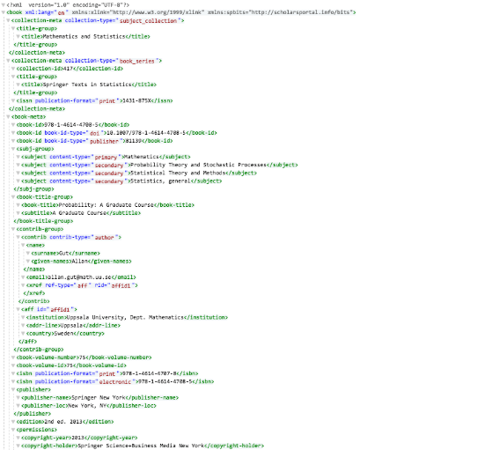
1. Content - BITS

Slide 41
1. Content - BITS
BITS loaders have been written for most publishers.
Initial migration will transform data directly from ISIS to BITS.
New data will be transformed to BITS.
Old data will be enhanced retroactively if necessary (reloaded from publisher data).

Slide 42
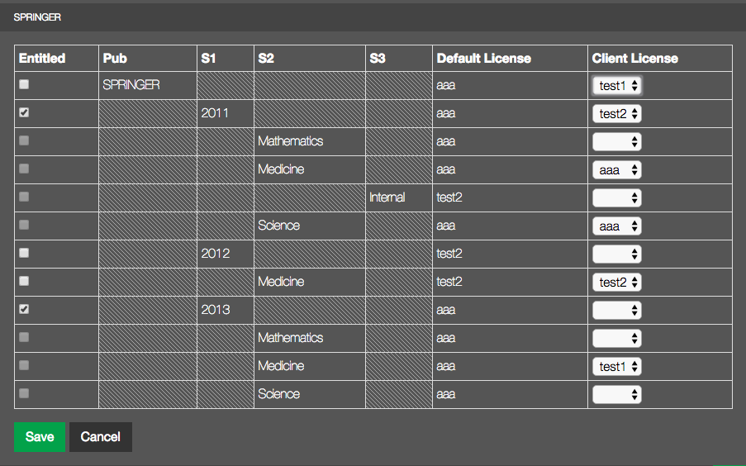
2. Backend
Notes:
People are buying books in more granular ways. Need backend that supports this. Title by title access.

Slide 43
2. Backend
Library administrator account system
  view entitled collections
  license details
  download KBART
  MARCs
  usage logs

Slide 44
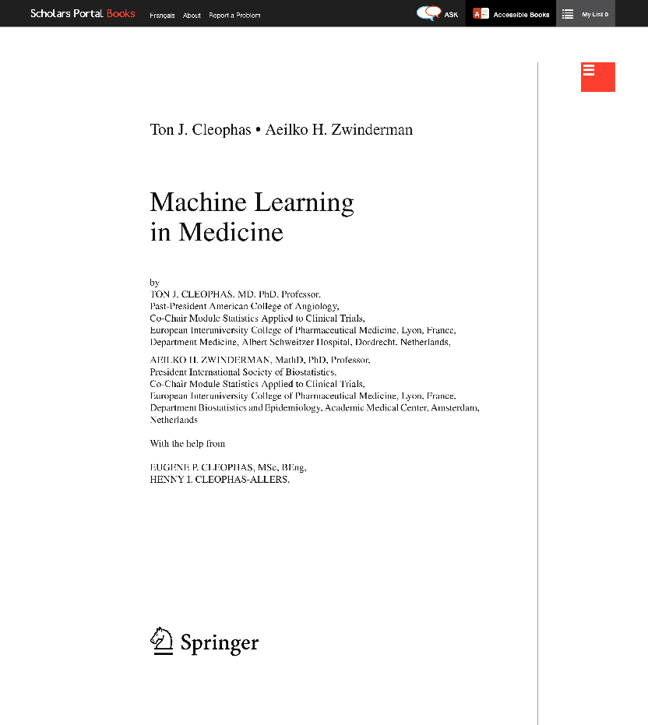
3. Frontend
Features:
HTML rendering of PDF
Infinite scrolling
Scalable & selectable text
Similar behaviour to reading a PDF in your browser

Slide 45
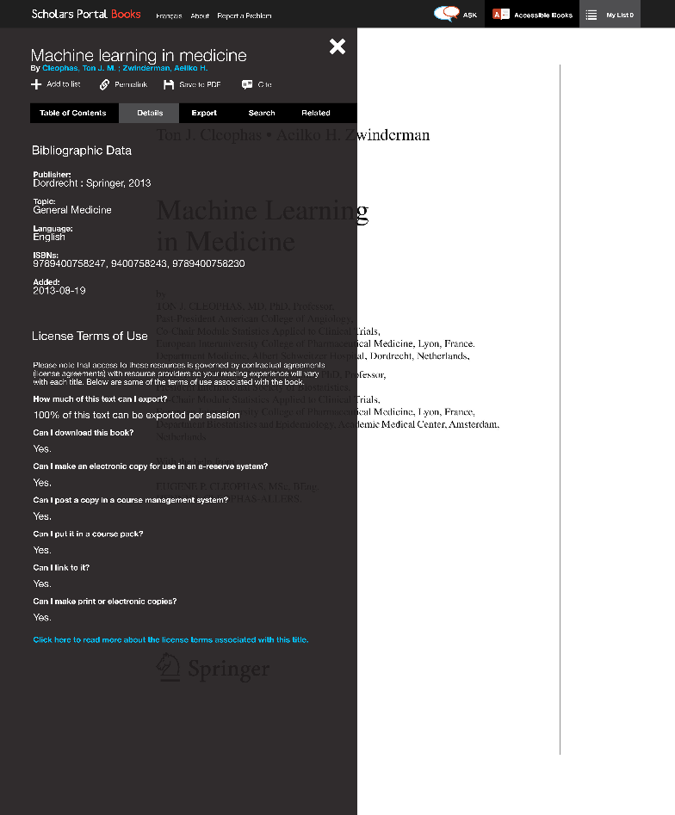
3. Frontend
Features:
Table of Contents
Licensing information (from OUR)
Export to PDF
Search within book
Citation

Slide 46
Questions?
bartek@scholarsportal.info

Slide 47
THE ONTARIO LIBRARY RESEARCH CLOUD (OLRC)

Slide 48
Service Objectives
  Provide cost-effective subscription-based scalable storage for Ontario’s academic libraries to house valuable and expanding digital collections
  Provide preservation services for that content to ensure long-term access
  Develop new tools for researchers to be able to explore and analyze that content at scale

Slide 49
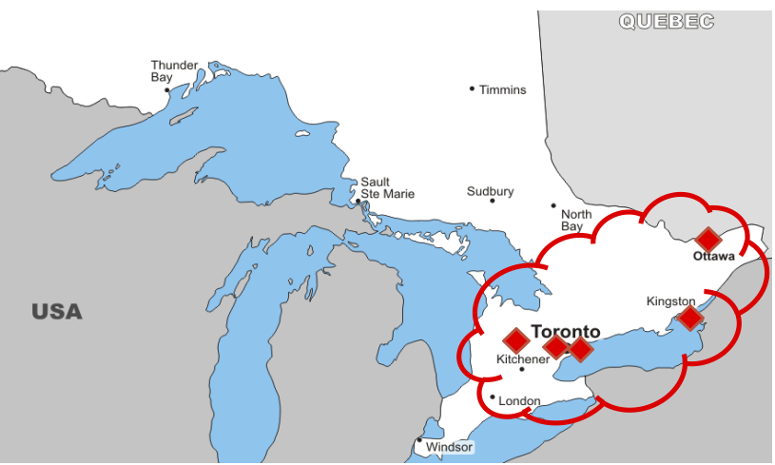
Notes:
Multi-site, widely distributed. ~420 km between most distant nodes, as crow flies

Slide 50

The Cloud
Utilizes high-speed virtual network running on ORION and GTAnet to provide 10G connectivity between 5 hosting sites: Toronto, Ottawa, Queens, York, & Guelph
Digital objects are replicated in the cloud at least three times to ensure redundancy (no single point of failure)
Powered by OpenStack Object Storage (Swift) software

Slide 51
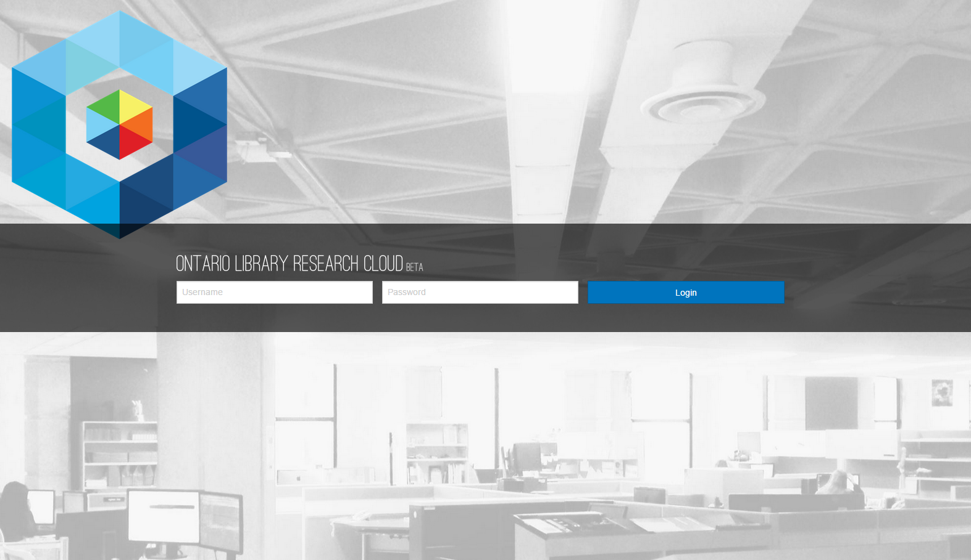
Swiftbrowser

Slide 52
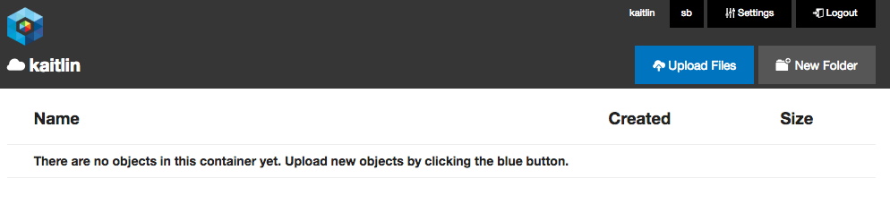
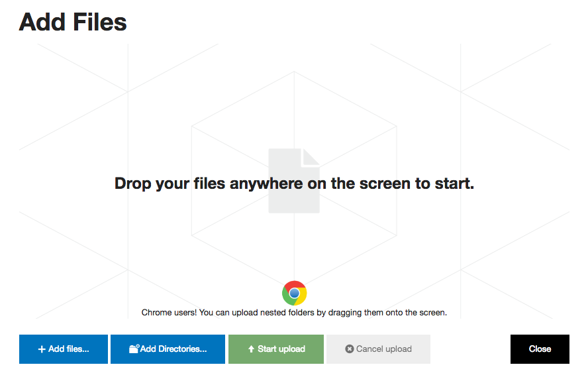
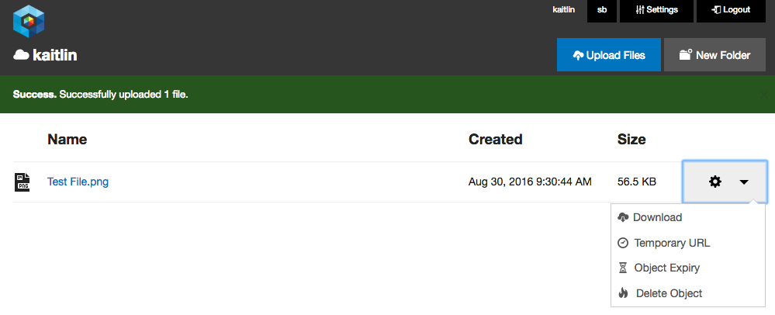
Swiftbrowser

Slide 53
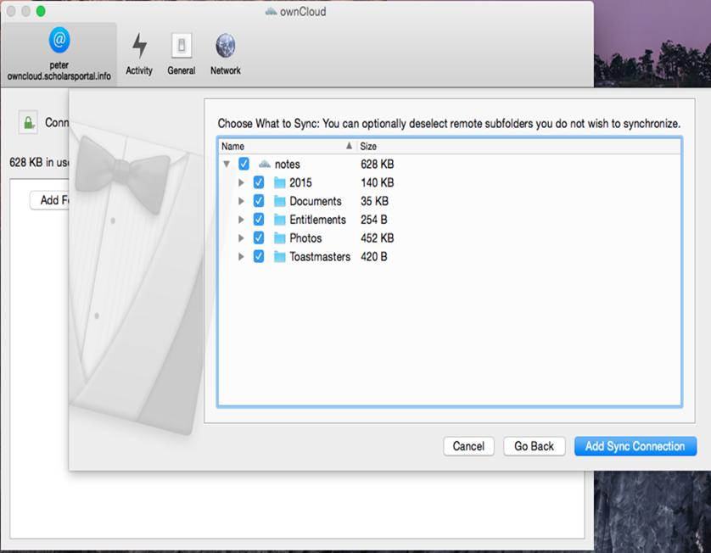

OwnCloud

Slide 54
Cost per TB as of May 2017
Annual subscription: $320/TB for OCUL members, $790/TB for non-OCUL
OCUL schools pay a $1600/yr 5TB minimum, Non-OCUL clients pay a $3950/yr 5TB minimum
3% discount for 10TB block
6% discount for 50TB block
Free 5TB Trial until April 2017
Notes:
These are unpublished, but approved by the Executive.
These figures place us solidly above some commercial services such as Amazon Glacer et al. as we heard about yesterday and all generally know about. For a variety of reasons, most of us in Ontario are not interested in using those as they are hosted in data centres outside Canada, among other reasons. Happy to speak more about why we want a Canadian solution in Q&A if there is interest.
At the other end of the cost spectrum there are DuraCloud, DPN, and others. Granted, we are not including the costs of operating OCUL and Scholars Portal. Those are in some sense existing costs to which OLRC adds a small increment.

Slide 55
DATAVERSE AND RESEARCH DATA MANAGEMENT

Slide 56

Scholars Portal Dataverse Service
Dataverse is an online platform to share, preserve, cite, explore and analyze research data
Scholars Portal hosts an instance since 2012
Open source web application developed at Harvard University
Open to anyone, but primarily for students, faculty, and staff of Ontario universities
Researchers can directly deposit data, create metadata for data, and release and share data openly or privately
Contact: dataverse@scholarsportal.info

Slide 57
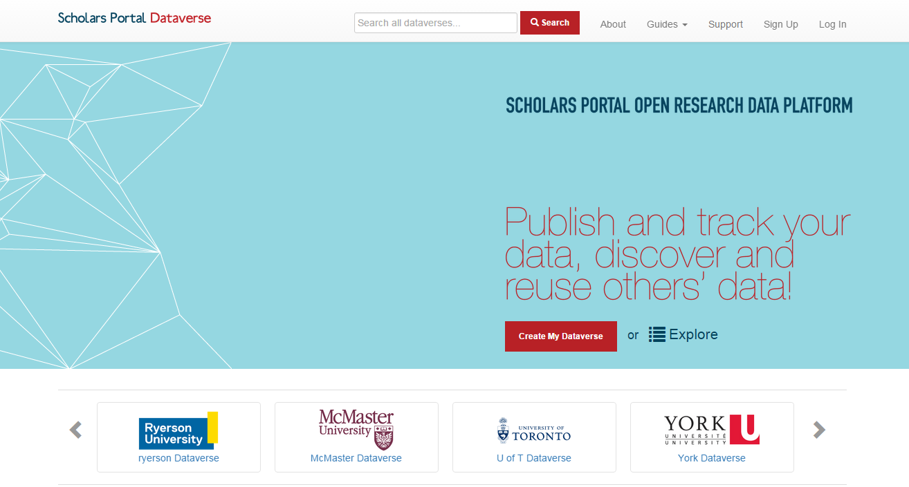
Dataverse 4.5 is here!
Notes:
Released at end of September

Slide 58
New Features - Dataverse 4.5
DataCite Canada DOIs
  DOI minting for new data deposits
  Currently provided free for OCUL
  DOIs get indexed in DataCite Search http://search.datacite.org/ (API support)
Extended metadata support
  Health & Life Sciences, Geosciences, Social Sciences, Astronomy, Journals
  Standards supported: DDI, Dublin Core, DataCite, other-local JSON
  Harvesting and Export support (OAI-PMH, API support)
Institutional Dataverses
  Scholars Portal Dataverse is now setup with Institutional Dataverses
  Dataverses within Dataverses now supported

Slide 59
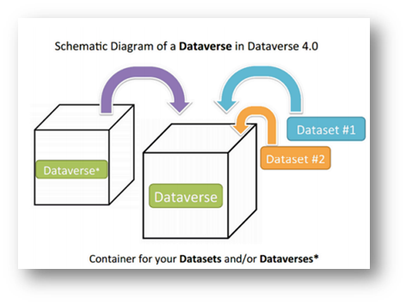

Institutional Dataverses
Setup for institutional containers:
All data organized by institution (general root Dataverse available for non-affiliates);
Automated deposit in Institutional Dataverses (defined by user affiliation);
Libraries will administer institutional space;
Customizable features (branding, featured Dataverses, facets, etc.)
Notes:
Support for institutional dataverses can be provided by SP
Hide for Trent/UOIT

Slide 60
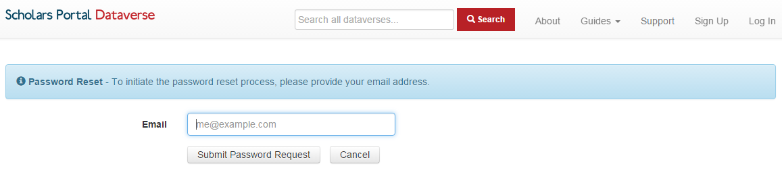
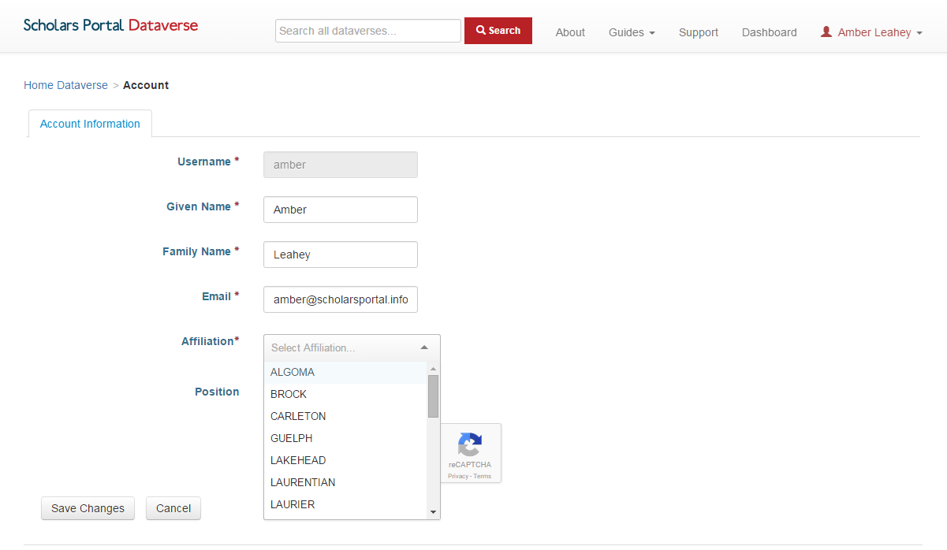
What to expect?
Password reset required
Add your institutional affiliation from your general account settings
Notes:
For those that already have accounts
Hide for Trent/UOIT

Slide 61
Dataverse Upgrade Working Group
Big thanks!
George Duimovich (Carleton), Jane Fry (Carleton), Carrie Breton (Guelph), Carol Perry (Guelph), Jason Brodeur (McMaster), Vivek Jadon (McMaster), Alexandra Copper (Queens), Leanne Trimble (UofT), Andrew Nicholson (UofT), Steve Marks (UofT), Jess Whyte (UofT), Kathy Szigeti (Waterloo), and Genny Jon (York) Kaitlin Newson (SP), Kevin Worthington (SP), Bikramjit Singh (SP), and Amber Leahey (SP)
Dataverse LibGuide updates - *coming soon*
http://guides.scholarsportal.info/dataverse
Customizable Dataverse promotional materials available
Contact dataverse@scholarsportal.info
Notes:
Formed June 2016
Hide for Trent/Peterborough

Slide 62
Development updates
Internationalization
  Translations provided by Universite de Montreal
  BETA French toggle released with SP Dataverse upgrade (September 2016)
  Next steps -- Continue work with Harvard IQSS Team
Archivematica - Dataverse Integration (2015 - current)
  Dataverse API retrieves datasets + metadata for ingest into Archivematica
  Archivematica processes and packages data for long-term preservation
  Standards including: METS, PREMIS, AIPS, used to process and document preservation tasks
  Next steps -- continue to test for scalability and preservation of research data
Notes:
Internationalization next steps
Establish framework for internationalization in the main code base
Add support for configuring languages upon installation
Explore options for multilingual field entry (metadata)
Testing and ongoing translation maintenance issues
Archivematica Next Steps --
Improvements required to the Dataverse API (DDI Metadata Export coming in version 4.5; needs testing)
Improvements required to Archivematica to process large number of files at once; build to scale out across multiple VMs needed
Report on testing for Portage - Preservation WG
Other integrations
Improve support for disciplinary data
Geospatial data
Explore potential for integration with Scholars GeoPortal
Large datasets (>2GB)
Searching in <odesi>
Search for data in Canadian Dataverses: including SP Dataverse, UBC’s Abacus, and University of Alberta instance
Release coming in late fall 2016
Open Science Framework integration testing
OSF for data and project management
Integration with Dataverse version 4.x --

Slide 63

CARL Portage & OCUL
OCUL Libraries are involved in Portage Expert Groups
  Data Discovery, Preservation, Curation, Training, Data Management Planning
Scholars Portal plans to continue to develop key integrations with Portage
  OLRC - Portage
  Dataverse - Portage
Notes:
OCUL is working closely to support the Portage vision for a national research data management framework
OLRC for archival data storage

Slide 64
Data Management Planning -- DMP Assistant
DMP Assistant is a tool for researchers to document and plan their data management activities
DMP Assistant Expert Group, Customization Guide released July 2016
DMP Assistant Training webinar and materials being planned
DMP SSHRC Pilot - Fall 2016
For more information about DMP Assistant or to sign up for an institutional account, contact rdm@scholarsportal.info
Notes:
Data management planning assistant, tool
Portage started
SSHRC doing pilot with some researchers to create data management plans as part of the SSHRC application process

Slide 65
RDM Training
Hiring new RDM Librarian co-appointed Queen’s & SP
OCUL RDM Summit
  Call for a RDM Summit in 2015 (OCUL Libraries, workshops, presentations, etc.)
  New RDM Librarian would help coordinate this
  Opportunity for collaboration with Portage for RDM training
Scholars Portal Dataverse Webinar (November)
SP Digital Preservation Webinar series
  Research Data topic in early 2017
New Portage Expert Group
  Creation of online materials for RDM
  Facilitate training across Canadian libraries
  Jane Fry, Carleton University (chair)

Slide 66
DIGITAL PRESERVATION SERVICES AT SCHOLARS PORTAL

Slide 67
What is Digital Preservation?
Digital objects (both born digital and digitized) need active management to ensure ongoing access
Quickly-changing technological norms create risks that must be managed from the object’s creation
Avoid this
Notes:
The field of digital preservation responds to the basic need to ensure that digital objects (both born digital and digitized) can be accessed into the future.
This need extends from the fact that quickly-changing technological norms create risks for access that must be managed early – from the time of the object’s creation onward.
It is no longer assumed that a digital object, unlike a physical object, can survive years of benign neglect before preservation processes kick in.

Slide 68

What is Digital Preservation?
Digital preservation is a set of theories and practices that work to keep digital objects authentic, available and reliable over time.
File with integrity
Lost integrity (700 random bytes deleted)
Checksum: 6fa90ede6e160a0ed0c847b83a7140047cd3d2a
Checksum shows a change: 42d911eb382ae265d9366908cdf35a4569d676a5
Notes:
Digital preservation is a set of interlocking theories and practices that work to keep digital objects authentic, available and reliable over time.
Authenticity means maintaining the record’s identity (what it is, where it came from) and integrity (its unaltered state) over time. This is achieved through contextual metadata that describes the object and using fixity checksums and other processes that verify it remains unchanged. A checksum will tell you a file has been altered somehow – signaling that you need to retrieved a non-corrupted copy from a backup or other source.
Availability ensures that records are accessible into the future by periodically migrating copies of digital objects to new formats.
Reliability is a combination of these two ideas: a reliable digital object can be trusted when proof of authenticity and availability are transparent. Part of this trust comes from the policies, processes and workflows of the digital repository that holds these objects. The need for reliability has led to standards such as the Trusted Digital Repository certification standard, which will be discussed in a moment.

Slide 69
Scholars Portal’s Digital Preservation Services
Current Services
Certified Trusted Digital Repository
Journals preservation
OLRC for replicated storage
Forthcoming Services
Books preservation
Research data preservation
Hosted preservation pilot
Notes:
Scholars Portal has a number of digital preservation services that are in operation and development to continue the preservation of member resources into the future.

Slide 70
Current: Trusted Digital Repository
Scholars Portal’s repository was the first TDR to be certified in Canada in 2013.
Auditing was completed by the Center for Research Libraries (CRL)
Certification stands as commitment to the long-term stewardship of digital materials
Documentation is public online at
https://spotdocs.scholarsportal.info/display/OAIS/Home
Documentation refresh in progress
Notes:
As the first Trusted Digital Repository to be certified in Canada in 2013, the achievement of certification was a major milestone. It provides a guiding foundation of policy, infrastructure, and practice upon which future preservation initiatives and services can be built.
Auditing was completed by the Center for Research Libraries. TDR status is an ongoing process and stands as a commitment to the long-term stewardship of valuable digital materials.
TDR documentation is available online through SpotDocs. The documentation is currently undergoing a refreshing process to ensure documentation reflects current practice and new projects, and to maintain TDR status. The process is being conducted with input from the OCUL digital curation community.

Slide 71
Current: Journals Preservation
Includes over 30 million articles
Uses scripts developed in-house to capture articles and process for preservation
The preservation status of an article is visible to users via the Journals platform
Notes:
The content in the journals platform was the first to be preserved using the TDR. Currently, over 30 million articles are preserved.
The preservation workflow uses scripts developed in-house to capture articles and metadata and process them for preservation.
The preservation status of an article is visible to users via the journals platform – when looking at an article, users can click on the “Preservation Status” button to see the associated preservation metadata about that article, including fixity checksums.

Slide 72
Forthcoming: Books Preservation
Taking place as part of broader books redevelopment project
Currently investigating best practices to inform policy, procedures and workflows
Goal is to fully integrate eligible books content into TDR
Notes:
A project-in-progress is the preservation of e-books, which is taking place as part of the broader books redevelopment project.
We are currently investigating e-books preservation best practices to help design policies, procedures and workflows for books preservation.
The goal is to fully integrate eligible books content into the TDR

Slide 73
Forthcoming: Research Data Preservation
Contracted Artefactual Systems to integrate Dataverse and Archivematica
Functional requirements developed in cooperation with Canadian Dataverse users (e.g. UAL, SFU, UBC)
Goal is to automate transfer of studies from Dataverse to Archivematica for long-term preservation
Addresses a preservation gap in Dataverse
The results of this test will be reported on for the broader research data community
Notes:
Another in-progress project is the preservation of research data.
Scholars Portal contracted Artefactual systems to integrate dataverse and Archivematica. Functional requirements were developed in cooperation with Canadian dataverse users.
The goal is to automate the transfer of studies from Dataverse to Archivematica and then onto storage for long-term preservation. Dataverse does not have any robust native preservation capabilities.
The integration is currently being tested. The results of this test will be reported on for the broader research data community in Canada.

Slide 74
Forthcoming: Hosted Preservation Pilot
Currently seeking pilot partner to determine needs, develop terms, and scope services
Vision is hosted instance of Archivematica connected to the OLRC
Pilot will (hopefully) begin in Spring 2017
Notes:
Finally, a new project in the early stages of development is to enable cloud-hosted preservation for OCUL members.
SP is currently seeking a pilot partner through the OCUL digital curation community to determine needs, develop terms, and scope out what hosted preservation services might look like. There are lots of options and ways to design hosted preservation services, so we are interested in finding out how to best meet member needs with this service.
The core vision is a hosted instance of Archivematica that is available to members. Storage will use the OLRC.
After the initial scoping process, the pilot is set to hopefully begin in Spring 2017.

Slide 75
THE COLLABORATIVE FUTURES PROJECT

Slide 76

Collaborative Futures Overview & Update
Scholars Portal Roadshow 2016
#SPonTheRoad

Slide 77
How we got to Collaborative Futures
2012-13, understanding the landscape
  Questions about the future of some consortial services: SFX (link resolver) and RACER (ILL)
  Some members anticipating replacing their systems
  Web Scale Library Systems / URM Summit in Toronto, Feb. 22, 2013
  Directors established Collaborative Approaches Task Force (CATF)
2013-14, articulating opportunities/challenges
Notes:
Have been thinking /exploring for a while...
In 2012/13 the idea of a Universal Resource Mgmt (URM) was taking hold within OCUL partly because there were questions about the long-term future of SFX and RACER within SP. Also, some member libraries were anticipating replacing their library management systems.
We knew that other libraries and other consortia had made the decision to proceed with the web scale systems but the OCUL Directors weren’t sure what direction to be taking. So we started a number of conversations within OCUL, and held a Summit in Feb. 2013
The summit led to a Report to Directors and then to the formation of the Collaborative Approaches Task Force.
That task force did more consultations in 2013/14 and produced a report, after which it became apparent that we needed a full-blown project to move forward

Slide 78
The Vision
By 2020, OCUL envisions our users experiencing a large, diverse Ontario-wide library collection rather than the collection at their specific institution. They can move seamlessly between different types of content (electronic and print, books and journals, etc.) using multiple interoperable platforms whose design is evidence-based. Via search engine optimization and advanced authentication, many users experience OCUL resources from outside of Ontario. Users have access to more books and specialized content than ever before, and these resources are incorporated into their research, learning and teaching workflows.
Notes:
In the Fall of 2014 a project charter was developed which included this vision statement for the project
(copied on this slide and the next. )
I wont read the slides, in the interests of time, but I will note a couple of things:
The vision incorporates both the user end and the staff end.
For the users the emphasis is on seamless use of and access to all types of content from an Ontario-wide library collection. The resources in this collection are incorporated into their research, learning and teaching activities.

Slide 79
The Vision cont’d
By 2020, OCUL library employees will perceive collaborative work as a given – they are part of a network and naturally work within it. They are likely to work on a daily basis with staff at other OCUL libraries, and are familiar with OCUL wide standards and policies. They may be doing work on behalf of another institution for the good of the OCUL community, and participate in opportunities for job sharing, secondments and exchanges within OCUL libraries.
Notes:
On the staff side the vision is that collaboration has become a natural way to work for OCUL library staff. And this could mean several things : working with library staff at other insts, working on common OCUL-wide policies for everyone, or working on behalf of another inst for the good of the OCUL community
Notice no mention of specific technology – this is deliberate

Slide 80
Keys to achieving the vision
Implement shared next generation library services platforms
Collaborate to manage and preserve print resources in a sustainable system
Collaborate to effectively use shared systems to manage electronic and print resources
Notes:
3 key things to achieve the vision and what we are hoping to achieve with this project

Slide 81
Project Timeline
Preparation and Phase I: Developing the ‘business case’/feasibility study (2014-15)
Phase 2: Developing System Requirements and Preparing for Procurement (Summer 2015 – Fall 2016)
Phase 3: Procurement and implementation (Fall 2016 – Spring 2018)
Notes:
Going in to some details about the project…
Overall timeline:
Phase 1 began in the Fall of 2014 with recruiting a project manager, writing a project charter and populating the working groups and steering committee.
The main goal of Phase 1 was to conduct a feasibility study and develop a compelling business case for the Directors, and that work took from January – July.
In July, 18 of 21 libraries decided to opt in to phase 2. 3 libraries chose not to participate but have expressed support for the project
We are currently in P2 which began last August and will end this Fall with a business plan presented to Directors and their decision to move ahead with P3
And then P3 the procurement and implementation phase, which will probably take about 18 months to complete
Now will go into some details of work that was done in P1 and P2

Slide 82

Project Phase 1
1

Slide 83

Project Team & Activities
Market Research
Total Cost of Ownership
Shared Print Management
Shared Workflow
Communications
Models
Surveys
Internal
External
Consultations
Examination of existing programs
Survey and Analysis
Consultations
RFI
Models
Shared Vision Task Force
Project
Manager
Notes:
* note for each school who participated where possible*
Our Phase 1 Project Team consisted of 5 working groups, + the steering committee (Shared Vision Task Force)
Project Manager participated in all of the working groups and was on the steering committee
Steering Committee - Shared Vision Task Force
Formation and oversight of working groups
Submitted a Business Case to directors, incorporating information from the working groups
Market Research
Request For Information (RFI) issued and results analyzed
Consultations with consortia
Literature review
Development of collaboration models
Total Cost of Ownership
TCO survey asking about
Hardware
Software
Human Resources
Facilities
Affiliated Institutions (colleges, hospitals)
18 responses collated and analyzed
Shared Workflow/Business Processes
This WG focused on member libraries’ current workflow and business process: to identify commonalities and differences, and to develop sample models
They did 2 surveys
Some themes which emerged from Survey #1: (identifying current workflows and pain points)
the impact on workflow of decreased print ordering
the challenge of maintaining current processes and staff knowledge as staffing numbers decrease
an increasing focus on managing the end of the print material lifecycle as available space diminishes
Survey #2 focused on potential opportunities for more collaboration in workflow. Some of the areas we identified included:
1. Authority control
2. Expanded knowledge base
3. Record loading
4. Display OCUL collections in one search interface (shared Discovery)
Shared Print Management and Preservation
Consultations within OCUL, including
E-Resources librarians
Groups within OCUL participating in smaller-scale collaborations (shared ILS, print storage)
Library staff specializing in law and government documents
Examination of existing shared print programs
Suggestions for matches based on takeaways and needs from consultations
Communications
Communications Team focused on internal communications for the Project, as well as some external stakeholder:

Slide 84
Models of Collaboration
Coordination
Cooperation
Collaboration
Partial Integration
Total Integration
Notes:
One other important outcome from Phase 1 was outlining models for Collaboration. In Phase 1 we were still considering how deeply to collaborate and so we envisaged a continuum and presented these options to the directors [read]
The project team recommended that we consider the 3 more collaborative levels in the continuum [Collaboration, Partial Integration, Total Integration). One reason for this is that Cooperation and Coordination were essentially describing many existing ways that OCUL libraries already worked together -- we needed to be thinking about new ways.
now that we are well along with P2 it’s been confirmed from the library directors that they would like us to be as collaborative as possible, so we really have landed on the deeper collaboration end of things. Finalizing and articulating what this might look like was part of the work that occurred in the beginning of Phase 2.

Slide 85
Project Phase 2
2
Notes:
So let’s move on to talk about P2, the current phase of the project

Slide 86
Keys to achieving the vision
Implement shared next generation library services platforms
Collaborate to manage and preserve print resources in a sustainable system
Collaborate to effectively use shared systems to manage electronic and print resources
Notes:
In the context of achieving the vision, Phase 2 is focusing on the 1st key– namely, implementing shared next gen LSPs.
It was agreed by the directors at the end of P1 that a shared system is the foundation that will enable OCUL to move ahead with the other pieces of the vision – collaboratively managing, preserving and using all of our resources. The project team is well aware that getting to a shared system is being done with these ultimate goals in mind.

Slide 87

Phase 2
18 libraries participating
Deliverables:
  Business plan (budget plan, funding models, etc.)
  RFI follow-up (market updates, costing, product demonstrations)
  User and technical requirements for shared LSP
  Memorandum of understanding
Notes:
As mentioned, 18 libraries are participating in this phase.
The main focus of Phase 2 is producing a business plan for the OCUL directors. The business plan will lay out the details of how the goals of Collaborative Futures are to be achieved and will include a budget, metrics for success,, various funding models.
To support the business plan the project team is having conversations with potential suppliers to get pricing estimates and to arrange for product demonstrations that will be made available to the wider OCUL community.
Additional deliverables from Phase 2 are:
technology and functional requirements; draft templates for Memoranda of Understanding (MOU)
In the fall of this year, directors will meet to review the business plan and decide whether their inst will participate in P3.

Slide 88
Project Team
Shared LSP Requirements
MOU / Participant Agreements
Communications
Draft MOU
Survey
Internal
External
Consultations & survey
Shared Vision Task Force
Models & outcomes
Market update
Procurement Consultant
Business Plan Writer
Project
Manager
Notes:
Structure of the project team in Phase 2 is very similar to Phase 1, with a steering committee and several working groups, project manager. For this phase we have 3 WGs: Shared LSP Requirements, MOU/Participant Agreements, and Communications.
We also have 2 individual positions ‘at large’:
Business Plan Writer –James Ciesla from Western
Procurement Consultant – Mabel Wang

Slide 89
Incorporating your feedback
Priority Collaboration Outcomes
https://spotdocs.scholarsportal.info/display/OCF/Priority+Collaboration+Outcomes
Shared LSP Requirements
https://spotdocs.scholarsportal.info/display/OCF/LSP+Requirements+-+For+Consultation
Memorandum of Understanding
https://spotdocs.scholarsportal.info/display/OCF/MOU+Draft+Planning
Notes:
Hopefully many of you are aware that over the summer the project team drafted documentation and then sought feedback for:
Priority Collaboration Outcomes (these are the high-level goals we want to achieve from a shared LSP)
List of functional/user requirements
MOU
This slide has links to where you can find the most updated versions of these, which incorporate the feedback received. The outcomes and requirements may be further refined following meetings and presentations from suppliers; the MOU is just about ready to be sent to the Directors for comment

Slide 90
What’s Next?
Project Schedule Fall 2016
Supplier consultations & presentations:
  September 29 (Ex Libris) October 5 (Innovative)
  September 30 (EBSCO) October 6 (Relais)
  October 4 (OCLC) October 11 (SirsiDynix)
Business plan & financial information to OCUL Directors - October
Prepare “roadmap to procurement” – mid-Nov.
Close out Phase 2 and begin Phase 3 – late November/early December
Notes:
For the short-term…here’s what’s happening.
check your email for information about attending the presentations online (Oct. 6 date for Relais not final)
OCUL directors have stated that they need financial information by October in order to prepare 2017-2018 budgets
Information needed on implementation and ongoing costs but also on how OCUL will staff the shared aspects of the LSP
Simultaneously in the fall we will work with our procurement consultant to determine our path forward – how do we procure this system?

Slide 91

“It will take a lot of work to get us where we want but the end result should be the envy of libraries across the nation.”
Notes:
Leave you with this thought - from the survey results ☺

Slide 92
Thanks!
More info
  Visit the Collaborative Futures wiki: https://spotdocs.scholarsportal.info/display/OCF/OCUL+Collaborative+Futures
  Contact us:
    john.barnett@ocul.on.ca
    amy.greenberg@ocul.on.ca
Astronaut images by New Haircut
Available via The Noun Project https://thenounproject.com/newhaircut/

Slide 93
Contact us!
Today’s presenters:
  Anika Ervin-Ward anika.ervin.ward@ocul.on.ca
  Kate Davis kate@scholarsportal.info
  Bartek Kawula bartek@scholarsportal.info
  Alan Darnell alan@scholarsportal.info
  Amy Greenberg amy@scholarsportal.info
General:
  Scholars Portal help@scholarsportal.info
  OCUL ocul@ocul.on.ca
Today’s featured topics:
  Scholars Portal Books books@scholarsportal.info
  OLRC cloud@scholarsportal.info
  Dataverse dataverse@scholarsportal.info
  Research Data Management rdm@scholarsportal.info
  Digital Preservation grant@scholarsportal.info
  Collaborative Futures ocul@ocul.on.ca

Slide 94

Q&A

