Slide 1
OVERVIEW OF SCHOLARS PORTAL SERVICES

Slide 2
2002
2008
2010
2011
2012
2014
2015
RACER
Scholars Portal Journals
Scholars Portal Books
ODESI
Scholars GeoPortal
Ask a Librarian
Dataverse
ACE
Content Repositories
OJS hosting
Member Services
OLRC
Notes:
Content repositories
Member services – services for libraries and end users

Slide 3



Member Services
Ask a Librarian: consortial chat reference service, started in 2011
French service, Clavardez avec nosbibliothecaires, launched in 2014
Contact: chat@scholarsportal.info
Accessible Content ePortal (ACE): repository of accessible texts for library users with registered print disabilities
Piloted in 2012, became a service in 2014, expanded to include Ontario colleges in 2015
Contact: ace@scholarsportal.info
Rapid Access to Collections through Electronic Requesting (RACER): Interlibary Loan management system, started in 2003
Contact: racer-support@scholarsportal.info
Notes:
-Ask a Librarian began five years ago
-Consortial chat reference service which fourteen schools now participate in. When the service is open, students see a “click to chat” button. They fill out their status and question, and then all online operators will see the question come into the system. If there is a staff member from that students’ library online, they will take the chat. Otherwise, whoever’s available will take it.
-French pilot service
-ACE was a pilot project starting in 2012 when we got an Enabling Change grant, and became a service in 2014. Currently 18 participating universities.
-The concept behind ACE is very simple: students across the province are using their accessibility offices to request scanning of library materials. Why don’t we do this collaboratively?
-We’ve taken it a step further than that and centralized a lot of the work. Books are scanned here at the University of Toronto by our partners, the Internet Archive (mostly from U of T collections, sometimes shipped to us by the requesting library).
-This may look familiar to you – it is built on top of the Scholars Portal books infrastructure.
-RACER is a very well-known and well-used service – it was the second service of Scholars Portal.
-Interlibrary loan management system.
-For the most part, those that work with RACER know how it works, and the rest of us are blissfully oblivious, but suffice it to say – it is a huge system that automates a lot of the interlibrary loan process.

Slide 4
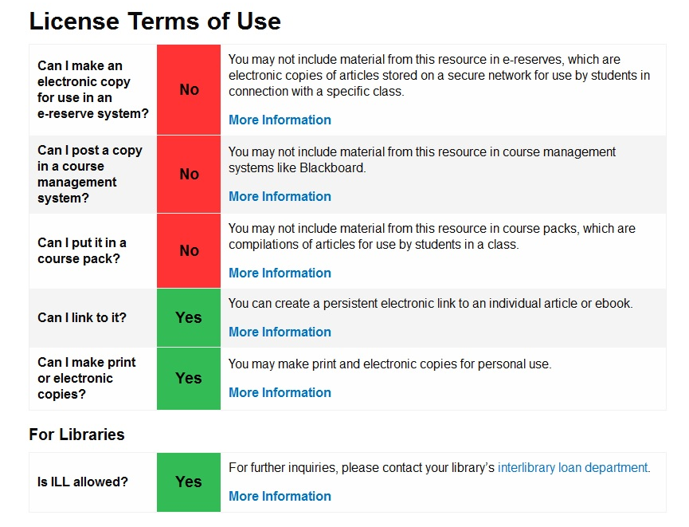
Member Services
SFX is an OpenURL resolver, connecting metadata records to full text articles
Scholars Portal manages the knowledge base that powers SFX for most OCUL schools
Began with SP Journals in 2002
Contact: admin@scholarsportal.info
OUR provides licensing rights to users through SFX or other link resolver
Started in 2011, now used by OCUL, BCI, CAUL, COPPUL, and OCLS
Contact: licenses@scholarsportal.info
Notes:
SFX
OpenURL resolver, connects metadata records to full-text articles
SP manages the knowledge base that powers SFX for most OCUL schools that use it
SFX started in 2002 to help power SP Journals
OUR
OUR keeps track of licenses and displays permissions for common copying & sharing activities.
-This info can be pulled in to SFX or 360 Link resolver, so that at the article level a user can see their permissions
-This is another service that has moved beyond OCUL. Because so many licenses are negotiated at the CRKN level, schools across the country get a database full of their own licenses. So the other big consortiums in Canada – COPPUL, CAUL and BCI, now used it. We recently created an instance for OCLS which they have named College Library Electronic Access Rights or CLEAR.

Slide 5

Member Services
Cloud services: the Ontario Library Research Cloud (OLRC) provides preservation storage for Ontario’s scholarly material on five regionally distributed nodes.
Launched October 2015
Contact: cloud@scholarsportal.info
OJS & OMP: we host Open Journal System (OJS) & Open Monograph Press (OMP) instances for eight schools
OCUL is a development partner of the Public Knowledge Project (PKP)
Contact: ojs@scholarsportal.info
Notes:
OLRC
-five geographically distributed nodes across the province
-each file you upload is copied and stored at three different nodes for additional preservation security
-working on more user-friendly interfaces… kind of like Dropbox for your library
-OJS is the Open Journal System and OMP is the Open Monograph Press.
-Both of these free and open source systems were developed by the Public Knowledge Project, based at Simon Fraser University.
-Schools can and do host their own instances of these tools, but they also have the option to pay Scholars Portal a hosting fee, which means we manage the infrastructure and support.
-OCUL is a development partner with PKP so we, and in fact staff from OCUL schools, have done work on the interface, and on a number of plug-ins. Also a node on the PKP-PLN
-Our first OMP instance is from the University of Windsor. It is very good looking.

Slide 6
Content Repositories
Journals
Our first service! Started in 2002
Loading commercial and open access content – over 45 million articles
Certified as a Trustworthy Digital Repository in 2013
COUNTER-compliant usage reports available
Contact: journals@scholarsportal.info
Books
Began in 2009, now hosting over 700,000 titles
Content from commercial vendors, university presses, public domain collections
eBOUND Canadian University Press titles available to CRKN subscribers
Contact: books@scholarsportal.info
Notes:
Journals
Our first service! Started in 2002
Loading commercial and open access content – over 45 million articles
Certified as a Trustworthy Digital Repository in 2013
COUNTER-compliant usage reports available
Books
Began in 2009, now hosting over 700,000 titles (mostly public domain)
Content from commercial vendors, university presses, public domain collections (Internet Archive)
eBOUND Canadian University Press titles available to CRKN subscribers

Slide 7


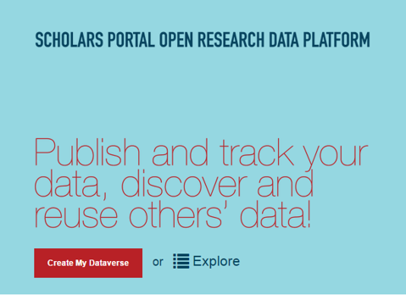
Content Repositories
<odesi>
Began in 2007, first collaborative SP community project
Contains data from Statistics Canada, polling companies, ICPSR metadata
New interface will integrate with Dataverse
Contact: odesi-help@scholarsportal.info
GeoPortal
Allows users to search, preview, add layers, clip, and download geospatial data
Went live 2012, collection has expanded rapidly since.
New: historical topographical maps!
Contact: geoportal@scholarsportal.info
Dataverse
Research data preservation tool, began 2011
Store, share, and version data
Contact: dataverse@scholarsportal.info
Notes:
odesi
-A social science microdata repository with 3,000 downloadable datasets and freely available metadata records for over 10,000 other sets
Since much of the data is publicly available elsewhere, the datasets can be viewed freely online by anyone but the large datasets are only downloadable to OCUL users
Dataverse
-over 600 studies deposited from researchers at 13 Ontario universities
-upgraded interface -- will be hearing about that in update
GeoPortal
-our GIS interface
-Allows users to search, preview, add layers, clip, and download geospatial data
-went live in 2012, collection has expanded rapidly since. Loaded local collections for some OCUL members.
New: we’re in the process of loading a large collection of historical topographical maps so watch out for those!

Slide 8

Notes:
OCUL Historical Topographic Map Digitization Project
The project aims to make over 1000 historical topographic maps of Ontario available through the GeoPortal.
These maps date from between 1906 and 1977, and show both natural and man-made features such as terrain, administrative boundaries, roads, railways, waterways, buildings, and land formations.
The maps are extremely valuable to researchers as they document change over time; however, they had been scattered and were not readily available at all OCUL Geo Community Institutions.
Since beginning this project, maps have been located, scanned and georeferenced by members of the OCUL Geo community, with the help of student staff.
Metadata and service creation is ongoing – we hope to have the collection available on the GeoPortal in early 2017.

Slide 9
Get involved with OCUL & Scholars Portal!
Join an OCUL Community
Talk to your OCUL-SP rep
Visit the Scholars Portal wiki (spotdocs.scholarsportal.info)
Join a listserv
Follow us on Twitter! @scholarsportal
Notes:
This is now you can become involved:
Join one of the OCUL Communities
Talk to your Standing Committee reps
Attend another OCUL or Scholars Portal webinar
Consider making it know within your library that you are willing to do OCUL projects
Answer one of our surveys
Join one of our listservs
Attend in person or watch the live stream of our annual Scholars Portal Day

