Slide 1
INTRODUCTION TO OCUL AND SCHOLARS PORTAL

Slide 2
Introduction to OCUL

Slide 3
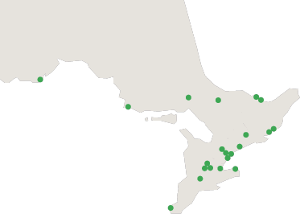
Ontario Council of University Libraries
OCUL is a consortium of Ontario’s 21 university libraries.
Nipissing
Laurentian
Algoma
Lakehead
Trent
York
Guelph
Waterloo
Wilfrid Laurier
Western
Windsor
Carleton
Ottawa
Queen’s
RMC
UOIT
Ryerson
Toronto
OCADU
Brock
McMaster
Notes:
OCUL, or the Ontario Council of University Libraries, is a consortium of all the libraries at Ontario’s 21 universities. It has a province wide reach from Lakehead University to the University of Windsor in the south and reaching as far east as Ottawa and Carleton in Ottawa and of course all the universities in between.

Slide 4
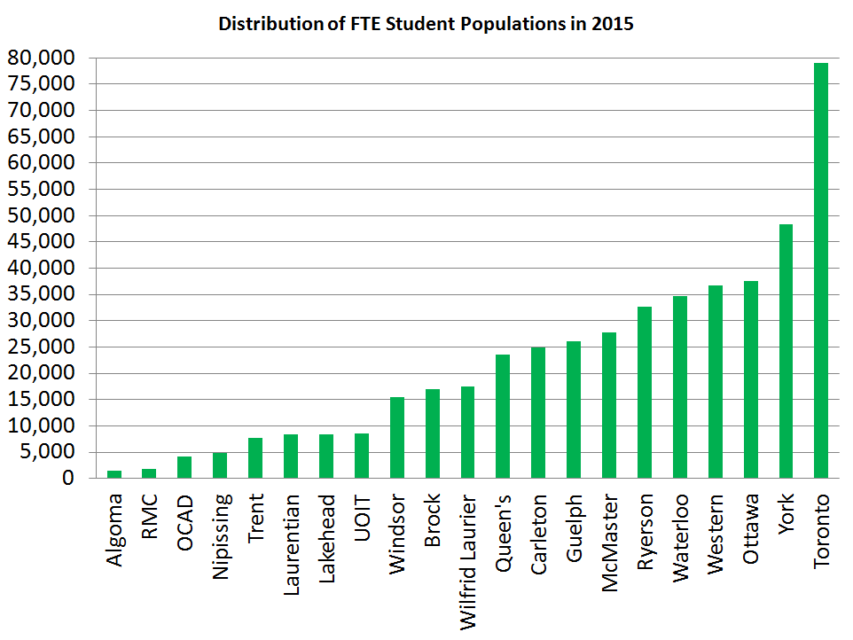
Notes:
The total university student population in Ontario is over 466,000 – this is about 1/3 of all the university students in Canada.
As you can see the population at the Ontario universities varies considerably. So there is a diversity of needs for our members and their communities.

Slide 5
OCUL Mission and Vision
Our Mission is to collaborate in the development and delivery of enhanced, innovative, and effective information services and resources for Ontario’s universities.
Our Vision is to be a recognized leader, provincially, nationally and globally, in the transformative development and delivery of scholarly resources and innovative services.
Notes:
The universities come together through OCUL to do many things, all focused around three core principles: Collaboration, Innovation and Service Delivery.
You can see this reflected in our Mission and Vision statements. The key OCUL activities include:
Collections - Licensing eresources on behalf of members
Scholars Portal - shared technological infrastructure
Member services - which includes collaborative planning, advocacy, professional development, partnerships and research.

Slide 6
Thinking OCULy
Thinking and working together for common benefit
OCUL Collaborative Futures
spotdocs.scholarsportal.info/display/OCF
Notes:
The impact of OCUL’s collaboration isn’t just about the collective outcomes. By coming together and discussing ideas, innovations, practices, this knowledge is also often taken back to individual institutions and implemented at a local level. OCUL is a hub for innovation and knowledge sharing that then moves outwards and is put into a local context.
Like any organization of this type, OCUL’s success is due to committed member involvement. OCUL endeavors to make it as easy as possible for all university libraries to be involved, and for its activities to be fair and equitable.

Slide 7
Governance Structure
21 OCUL Directors
OCUL Executive
OCUL Executive Director
OCUL-SP
OCUL-PA
OCUL-IR
OCUL Communities
Notes:
This is a diagram of how OCUL is governed and I want to talk briefly about these groups and their roles to give you an idea of how OCUL works. Each of the libraries in OCUL is represented by its Chief Librarian or University Librarian who sit on the Council, and these representatives are also known as the OCUL Directors. The Directors make all the substantive long term decisions about OCUL activities and directions. They approve the budgets and distribution of fund and also decide what OCUL will not be doing anymore
OCUL also has three standing committee that are concerned with operational aspects, and on organizational planning and assessment. Then there is also the OCUL Communities of Interest.

Slide 8
Executive Committee
Chair: Vivian Lewis, McMaster University
Vice-Chair: Ken Hernden, Algoma University
Treasurer: Brent Roe, Laurentian University
Past-Chair: Rebecca Graham, University of Guelph
Secretary: Pascal Calarco, University of Windsor
Executive Director: John Barnett (ex officio)
Notes:
The Executive Committee is made up of five OCUL directors and the OCUL Executive Director is charged with making sure the decisions and priorities identified by the Council are implemented.

Slide 9
Planning and Assessment
(OCUL-PA)
Strategic oversight of OCUL and Scholars Portal activities
Facilitates Strategic Plan
Reviews and develops proposals for new services and annual priorities in collaboration with OCUL-IR and OCUL-SP
Notes:
The first of the Standing Committees, OCUL Planning and Assessment, is charged with strategic oversight of OCUL and Scholars Portal activities.
The committee, which is made up of the chairs of OCUL SP and OCUL IR, the OCUL Chair, OCUL Treasurer, the OCUL Executive Director and four other representatives from the Directors group, facilitates OCUL’s strategic plan and measures its success. It meets to discuss new opportunities; it looks forward to new advise the Directors of new OCUL priorities and evaluates how OCUL is doing in relation to its strategic goals.

Slide 10
Information Resources Committee (OCUL-IR)
Operational oversight of consortial e-resources activities
Collective licensing
  180 electronic resources
  from 70 different vendors
  ejournals, ebooks, streamed media, data files, databases, digitized primary sources
Notes:
Both OCUL IR and OCUL SP are concerned with those things OCUL does that are critical to the operations of each of our member libraries. Therefore it is important that each of these committees has a representative from each OCUL member school.
The OCUL Information Resources Committee provides operational guidance for OCUL’s consortial eresources activities. This includes:
Collective licensing of our 180 electronic resources from around 70 different vendors renewing annually
In addition to licensing OCUL IR is also concerned with issues of Scholarly Communication and broad collections issues

Slide 11
Scholars Portal Committee
(OCUL-SP)
Assessment and development of services
Generating ideas for new services
Promoting local awareness of Scholars Portal
Ensuring Scholars Portal services meet user needs
Identifying opportunities for training and knowledge sharing
Notes:
OCUL Scholars Portal Committee provides guidance to Scholars Portal.
This includes:
Assessment and development of services
Generating ideas for new services
Promoting local awareness of Scholars Portal
Ensuring Scholars Portal services meet users needs
Identifying opportunities for training and knowledge sharing
An example of this is OCUL SP committee helped us get Scholars Portal on the road this year.

Slide 12
OCUL Communities
Communities of interest
Sharing information
Generating ideas
Open membership
Representation from at least 7 OCUL schools
Over 200 community members
Notes:
While there are around 50 people from across OCUL sitting on these Standing Committees, by far the majority of people who are involved with OCUL are part of the OCUL Communities. So these groups are communities of interest that focused on information sharing and the generation of ideas.
These communities are often where people first become involved with OCUL and are where they are able to contribute to and maintain interest in a topic they are either directly responsible for at the schools, or one they have a keen interest in.
Membership in the OCUL Communities is open to anyone within an OCUL institution and unlike the Standing Committees it is unrestricted. It is at the discretion of each school as to how many people involved, but OCUL welcomes anyone who is interested.

Slide 13
OCUL Communities
Accessibility
Assessment
Data
Digital Curation
Geo
Government Information
Information Technology
Public Service Renewal
Publishing/Hosting
Quality Assurance
Resource Sharing
Video ocul.on.ca/committees
Notes:
There are currently 12 OCUL communities; covering a broad cross-section topics. The collective membership of these communities is over 200 people.
You can find out more about these communities on the OCUL website at: ocul.on.ca/committees
You can find out what each of these communities is working on by checking out their SPOTdocs wiki space or by keeping up to date with the Annual Reports they submit to the Directors each year.
A couple of examples include the Geo Community Historical Map Digitization project and the Government Information document Digitization project.
But the work of the communities is not just about projects it is also about information sharing through webinar (eg the current series of Publishing Hosting community webinars profiling the new PKP OJS and OMP, or providing expert knowledge to other groups at request as the Accessibility Community is often asked to do.
.

Slide 14
OCUL Staff
Executive Director
Business Officer
Admin & Communications Coordinator
Project Officer: eResources (on leave)
Admin Assistant: eResources
Electronic Resources Licensing Consultant
Collaborative Futures Project Manager
Procurement Consultant
Notes:
Supporting all of this work is the staff of the OCUL office and the Scholars Portal Operations Team or SPOT. We will talk about SPOT shortly but here is a look at who we have in the OCUL office.
You can see in addition to the Executive Director (John Barnett), the Business Officer (Nur Artok) and the Admin Comms Coordinator (Anika Ervin-Ward) we have people supporting the licensing and eresources work of OCUL (Jackie Cato and Carol Stephenson) and the Collaborative Futures Project (Amy Greenberg and Mabel Wang). We’ll talk more about Collaborative Futures a bit later.

Slide 15
Stay in touch
OCUL website: ocul.on.ca
SPOTdocs wiki: spotdocs.scholarsportal.info
Member access OCUL website
Webinars
Mailing lists
email us anytime: ocul@ocul.on.ca
Notes:
Here are some ways you can join the conversation or keep up to date with what is going on OCUL’y and at Scholars Portal.

Slide 16
Introduction to Scholars Portal

Slide 17
What is Scholars Portal?
Scholars Portal is the service arm of OCUL.
Scholars Portal was established in 2002 as a way to implement OCUL’s planning and direction.
We provide a wide variety of services to students, librarians, faculty and staff at OCUL member institutions.
Notes:
Scholars Portal is the service arm of OCUL.
Scholars Portal was established in 2002 as a way to implement OCUL’s planning and direction.
We provide a wide variety of services to students, librarians, faculty and staff at OCUL member institutions.

Slide 18
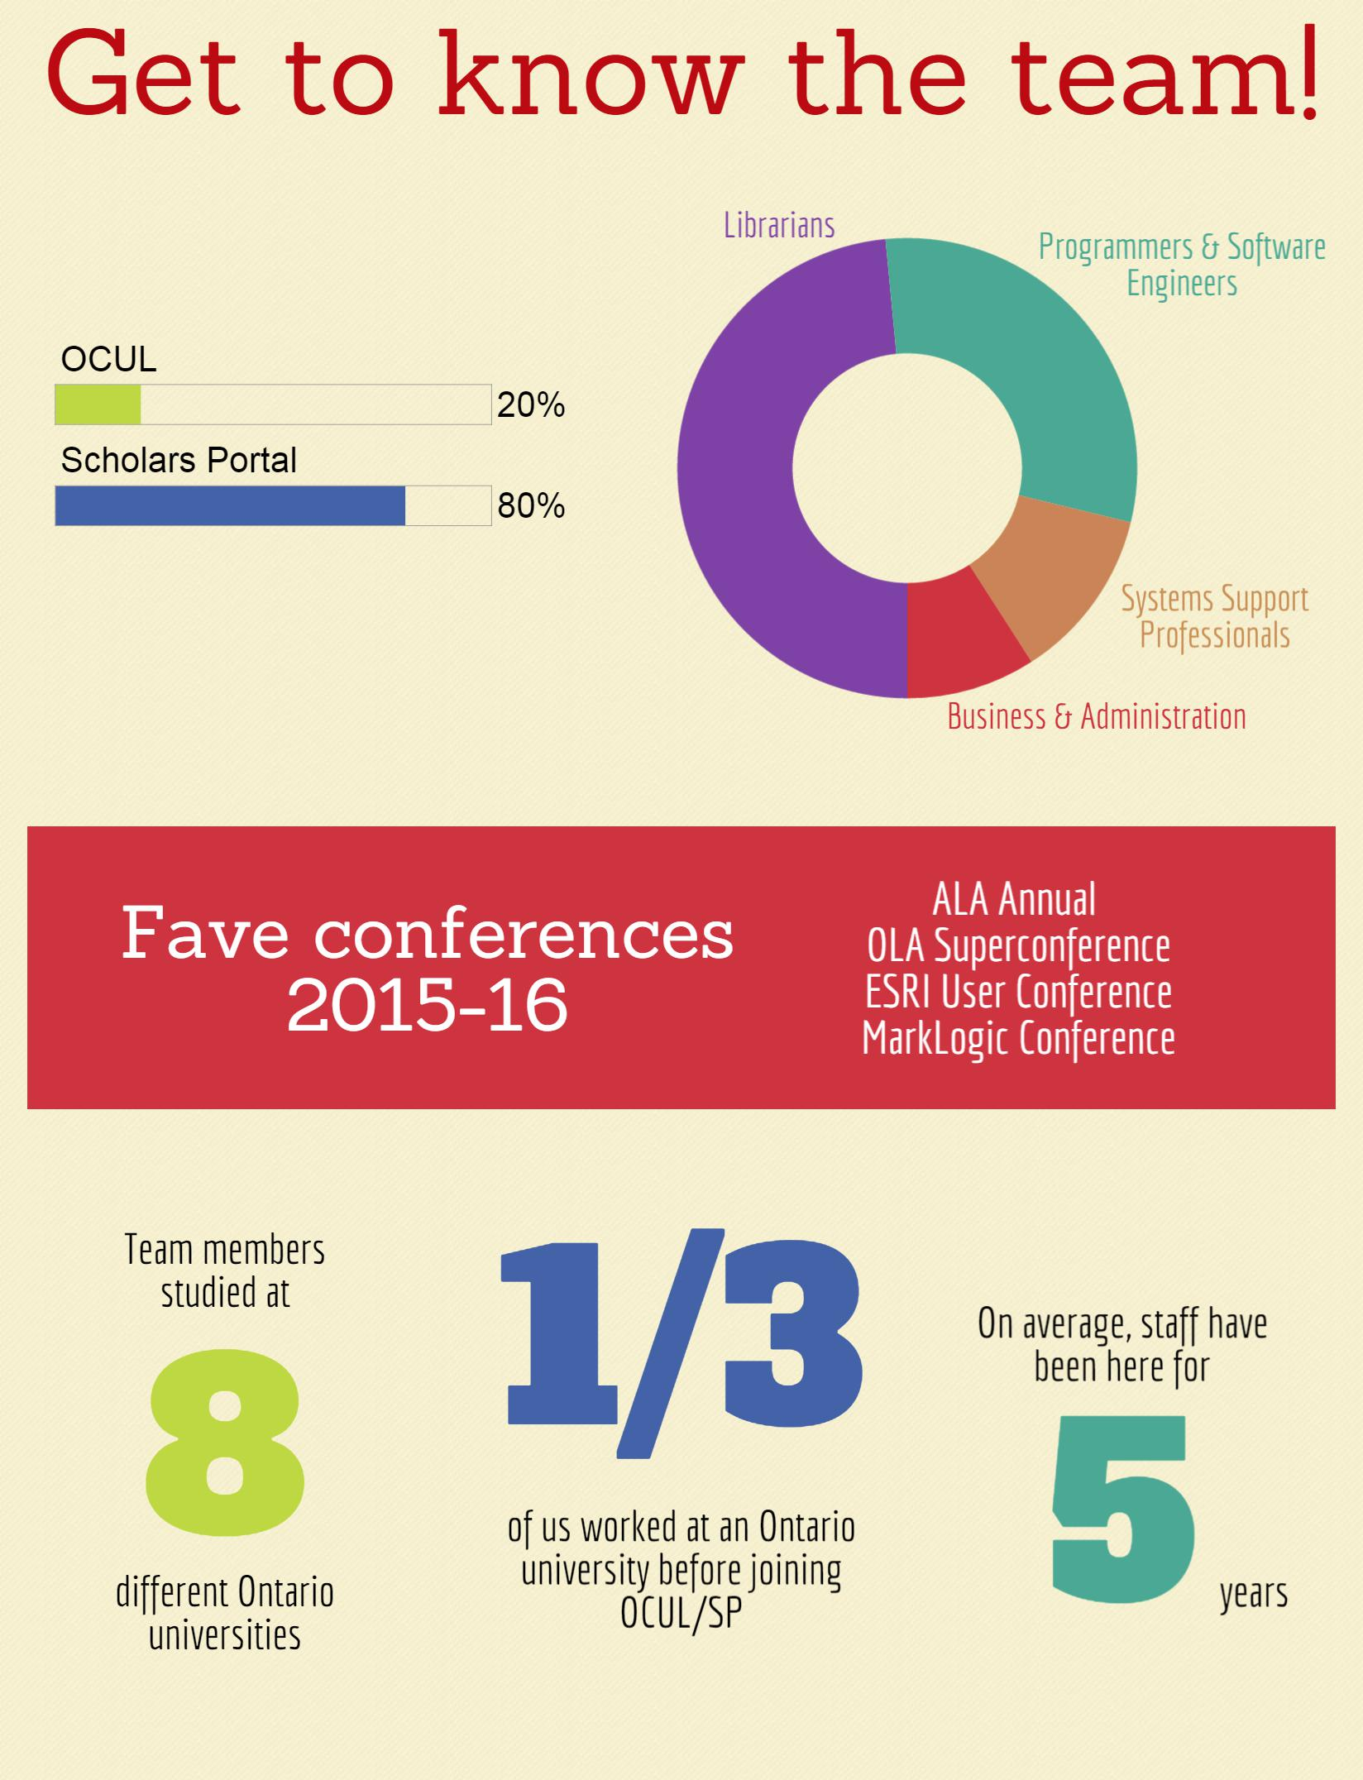

Notes:
Infographic about the team at Scholars Portal and OCUL!
We wanted to share with you a little bit about us. As you can see, about half of SP/OCUL staff are librarians by training. The rest are mostly tech people -- programmers, software engineers, systems support -- and OCUL also has some business and administration professionals.
Also good to note that about 1/3 of us previously worked at an OCUL school before joining the team.
Scholars Portal staff are also known as the Scholars Portal Operational Team, or SPOT.

Slide 19
How is Scholars Portal governed?
21 OCUL Directors
OCUL Executive
OCUL Executive Director
OCUL-SP
OCUL-PA
OCUL-IR
OCUL Communities
Notes:
The Scholars Portal Operational Team (SPOT) gets direction from a few places. The OCUL Directors meet twice a year to set the course and budget for the coming term.
Highlighted in red is our more direct support line, and that’s the OCUL-Scholars Portal committee.
The central SP budget comes from OCUL via membership fees determined according to the SP cost allocation formula. This is used for core services (services that everyone uses).Other services are not part of the central budget because schools can either opt-in or opt-out. We also have projects funded by grants, such as the Enabling Change Grant from the Ontario Government used to fund ACE. Also there are some services that SP provides to schools outside of OCUL. For example, CRKN schools have access to EBOUND/ACUP titles on SP Books, and a number of schools subscribe to our data services. These schools pay for the service on a cost-recovery basis, so this funding gets rolled into the central budget.

Slide 20
OCUL-SP: Working for you!
SPOT gets direction and feedback from OCUL-SP, a committee with representation from every OCUL school.
Notes:
SP acts on the strategic directions determined by OCUL

Slide 21
Your OCUL-SP reresentative
Algoma Robin Isard (on leave)
Brock Laurie Morrison
Carleton George Duimovich
Guelph Barbara McDonald
Lakehead Valerie Gibbons
Laurentian Dan Scott
McMaster Anne Pottier (Chair)
Nipissing Nancy Black
OCADU Ling He
Ottawa Joan Cavanagh
UOIT Gabor Feurer
Queen’s Michael Vandenburg
RMC Lisa Béchard
Ryerson Gillian Byrne
Toronto Sian Meikle
Trent Dwayne Collins
Waterloo Alison Hitchens
Western Bobby Glushko
Wilfrid Laurier Gordon Bertrand
Windsor Joan Dalton
York Andrea Kosavic

