Slide 1
DATAVERSE AND RESEARCH DATA MANAGEMENT

Slide 2

Scholars Portal Dataverse Service
Dataverse is an online platform to share, preserve, cite, explore and analyze research data
Scholars Portal hosts an instance since 2012
Open source web application developed at Harvard University
Open to anyone, but primarily for students, faculty, and staff of Ontario universities
Researchers can directly deposit data, create metadata for data, and release and share data openly or privately
Contact: dataverse@scholarsportal.info

Slide 3
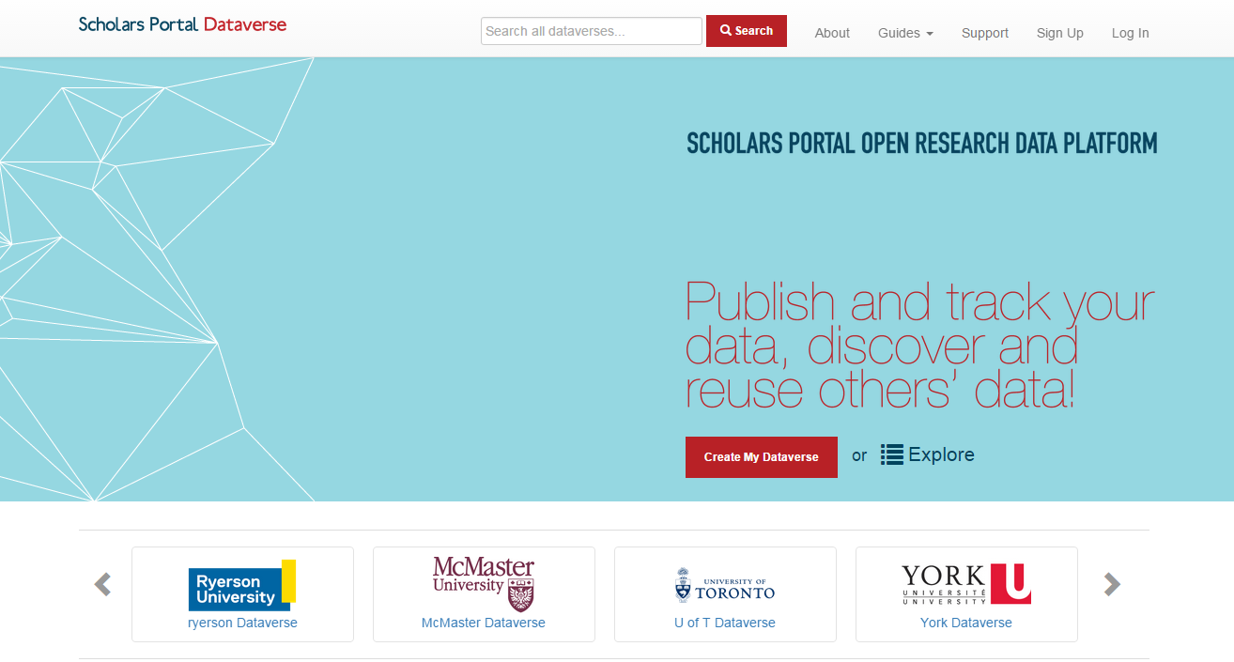
Dataverse 4.5 is here!
Notes:
Released at end of September

Slide 4
New Features - Dataverse 4.5
DataCite Canada DOIs
  DOI minting for new data deposits
  Currently provided free for OCUL
  DOIs get indexed in DataCite Search http://search.datacite.org/ (API support)
Extended metadata support
  Health & Life Sciences, Geosciences, Social Sciences, Astronomy, Journals
  Standards supported: DDI, Dublin Core, DataCite, other-local JSON
  Harvesting and Export support (OAI-PMH, API support)
Institutional Dataverses
  Scholars Portal Dataverse is now setup with Institutional Dataverses
  Dataverses within Dataverses now supported

Slide 5
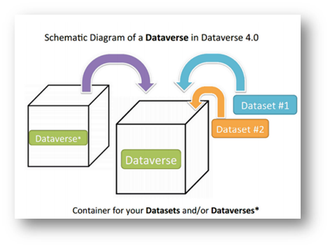

Institutional Dataverses
Setup for institutional containers:
All data organized by institution (general root Dataverse available for non-affiliates);
Automated deposit in Institutional Dataverses (defined by user affiliation);
Libraries will administer institutional space;
Customizable features (branding, featured Dataverses, facets, etc.)
Notes:
Support for institutional dataverses can be provided by SP
Hide for Trent/UOIT

Slide 6
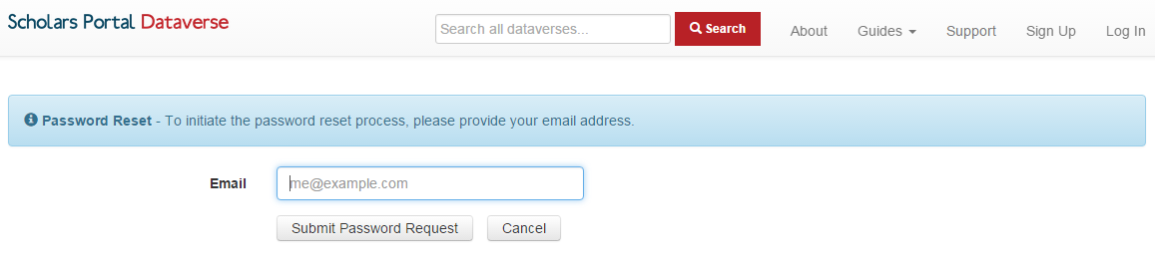
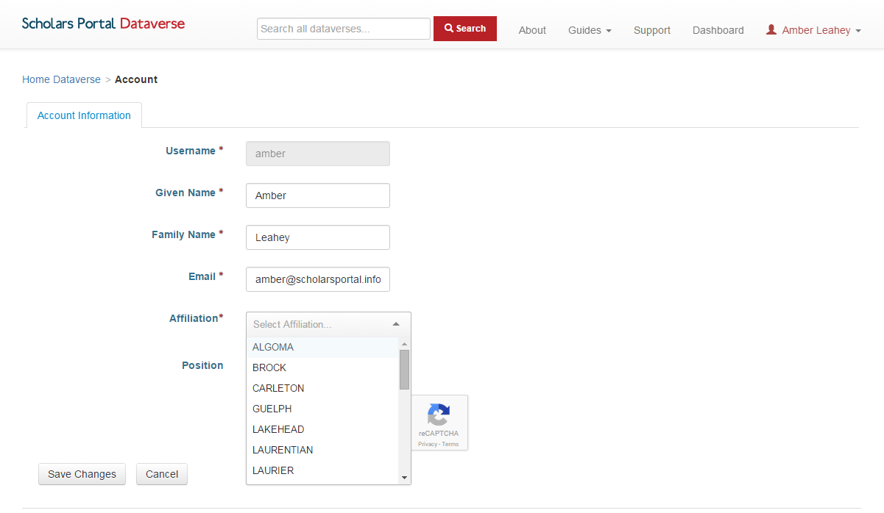
What to expect?
Password reset required
Add your institutional affiliation from your general account settings
Notes:
For those that already have accounts
Hide for Trent/UOIT

Slide 7
Dataverse Upgrade Working Group
Big thanks!
George Duimovich (Carleton), Jane Fry (Carleton), Carrie Breton (Guelph), Carol Perry (Guelph), Jason Brodeur (McMaster), Vivek Jadon (McMaster), Alexandra Copper (Queens), Leanne Trimble (UofT), Andrew Nicholson (UofT), Steve Marks (UofT), Jess Whyte (UofT), Kathy Szigeti (Waterloo), and Genny Jon (York) Kaitlin Newson (SP), Kevin Worthington (SP), Bikramjit Singh (SP), and Amber Leahey (SP)
Dataverse LibGuide updates - *coming soon*
http://guides.scholarsportal.info/dataverse
Customizable Dataverse promotional materials available
Contact dataverse@scholarsportal.info
Notes:
Formed June 2016
Hide for Trent/Peterborough

Slide 8
Development updates
Internationalization
  Translations provided by Universite de Montreal
  BETA French toggle released with SP Dataverse upgrade (September 2016)
  Next steps -- Continue work with Harvard IQSS Team
Archivematica - Dataverse Integration (2015 - current)
  Dataverse API retrieves datasets + metadata for ingest into Archivematica
  Archivematica processes and packages data for long-term preservation
  Standards including: METS, PREMIS, AIPS, used to process and document preservation tasks
  Next steps -- continue to test for scalability and preservation of research data
Notes:
Internationalization next steps
Establish framework for internationalization in the main code base
Add support for configuring languages upon installation
Explore options for multilingual field entry (metadata)
Testing and ongoing translation maintenance issues
Archivematica Next Steps --
Improvements required to the Dataverse API (DDI Metadata Export coming in version 4.5; needs testing)
Improvements required to Archivematica to process large number of files at once; build to scale out across multiple VMs needed
Report on testing for Portage - Preservation WG
Other integrations
Improve support for disciplinary data
Geospatial data
Explore potential for integration with Scholars GeoPortal
Large datasets (>2GB)
Searching in <odesi>
Search for data in Canadian Dataverses: including SP Dataverse, UBC’s Abacus, and University of Alberta instance
Release coming in late fall 2016
Open Science Framework integration testing
OSF for data and project management
Integration with Dataverse version 4.x --

Slide 9

CARL Portage & OCUL
OCUL Libraries are involved in Portage Expert Groups
  Data Discovery, Preservation, Curation, Training, Data Management Planning
Scholars Portal plans to continue to develop key integrations with Portage
  OLRC - Portage
  Dataverse - Portage
Notes:
OCUL is working closely to support the Portage vision for a national research data management framework
OLRC for archival data storage

Slide 10
Data Management Planning -- DMP Assistant
DMP Assistant is a tool for researchers to document and plan their data management activities
DMP Assistant Expert Group, Customization Guide released July 2016
DMP Assistant Training webinar and materials being planned
DMP SSHRC Pilot - Fall 2016
For more information about DMP Assistant or to sign up for an institutional account, contact rdm@scholarsportal.info
Notes:
Data management planning assistant, tool
Portage started
SSHRC doing pilot with some researchers to create data management plans as part of the SSHRC application process

Slide 11
RDM Training
Hiring new RDM Librarian co-appointed Queen’s & SP
OCUL RDM Summit
  Call for a RDM Summit in 2015 (OCUL Libraries, workshops, presentations, etc.)
  New RDM Librarian would help coordinate this
  Opportunity for collaboration with Portage for RDM training
Scholars Portal Dataverse Webinar (November)
SP Digital Preservation Webinar series
  Research Data topic in early 2017
New Portage Expert Group
  Creation of online materials for RDM
  Facilitate training across Canadian libraries
  Jane Fry, Carleton University (chair)

