Slide 1

Scholars Portal Days 2022
Currents of Change
Thursday, May 12 & Friday, May 13, 2022

Slide 2
Housekeeping
This session is being recorded; recording and slides will be shared
Captions are available
Please keep your mic and camera off; if it is on, we may forcibly mute you
Use the chat to ask questions and the Reactions feature to show appreciation
Use our hashtag for Twitter conversations: #SPDay22

Slide 3
Land Acknowledgement
We wish to acknowledge the land on which Scholars Portal operates, and upon which most Scholars Portal staff live and work. For thousands of years it has been the traditional land of the Huron-Wendat, the Seneca, and the Mississaugas of the Credit. Today, this meeting place is still the home to many Indigenous people from across Turtle Island and we are grateful to have the opportunity to work on this land.
We encourage you to reflect on the land from which you’re joining us today:
https://native-land.ca/

Slide 4
Agenda: Thursday
Opening Remarks
Keynote
Break + some retro looks!
OCUL Update
Lightning Talks: Client & User Services
SP Day en français

Slide 5
Scholars Portal Days 2022
Opening Remarks
Beth Namachchivaya, Chair of SPOD

Slide 6
Scholars Portal Days 2022
Keynote: Leslie Weir
Librarian & Archivist of Canada

Slide 7
Scholars Portal Days 2022
Break!
Back at 11:30

Slide 8
Scholars Portal Days 2022
Throwback Thursday
Remember these interfaces from the past?

Slide 9
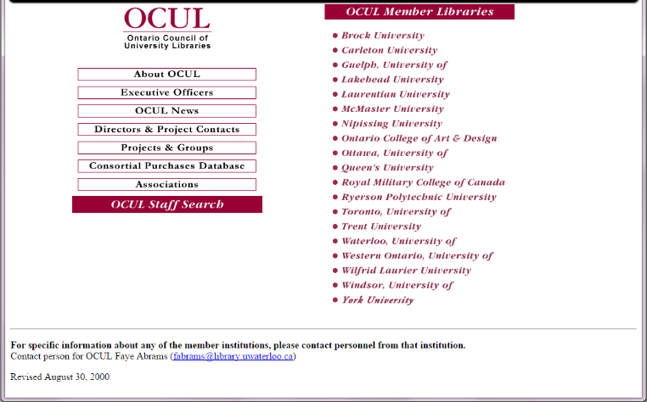
OCUL website,
2000
Notes:
Only 19 OCUL members! (no Ontario Tech or Algoma)

Slide 10
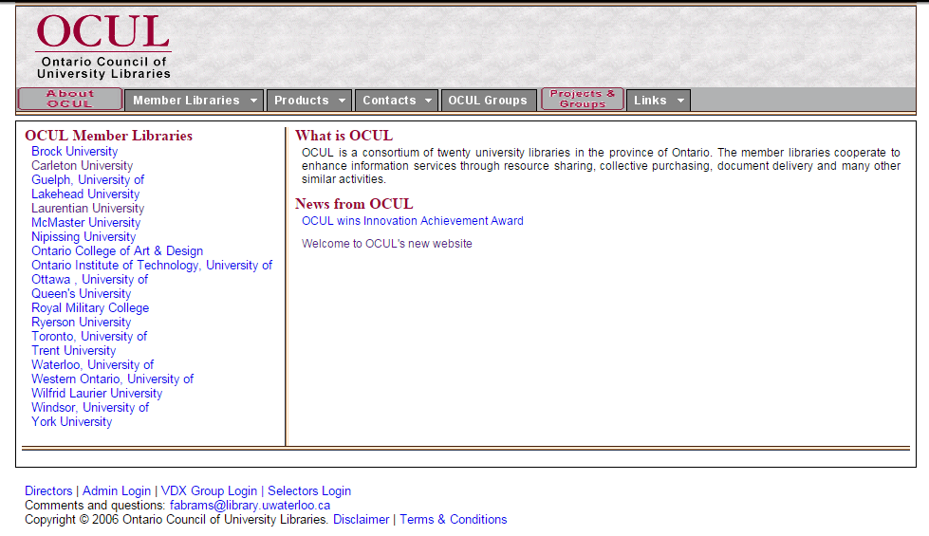
OCUL website,
2006
Notes:
20 members!

Slide 11
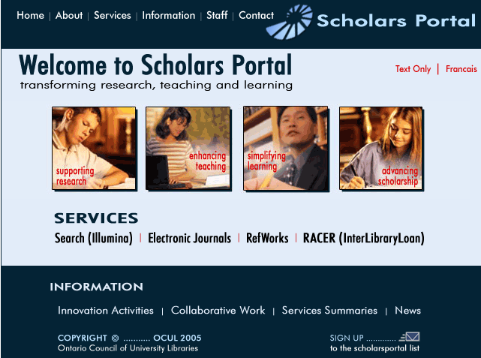
Scholars Portal homepage
2005

Slide 12
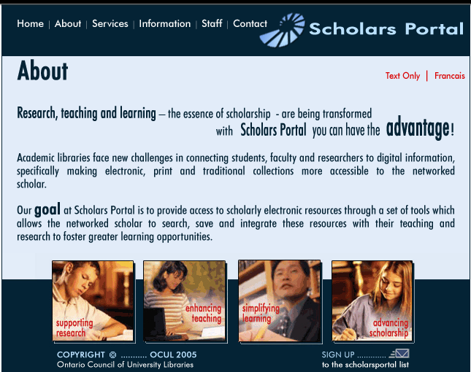
Scholars Portal
“About” page,
2006

Slide 13
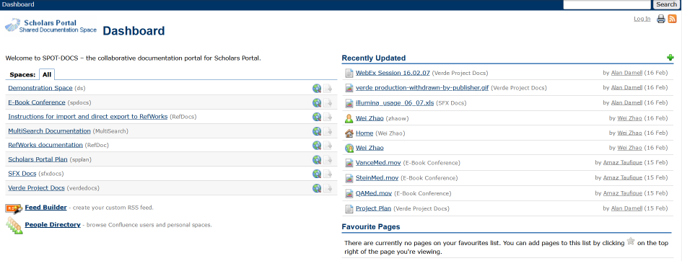
SpotDocs landing page, 2007

Slide 14
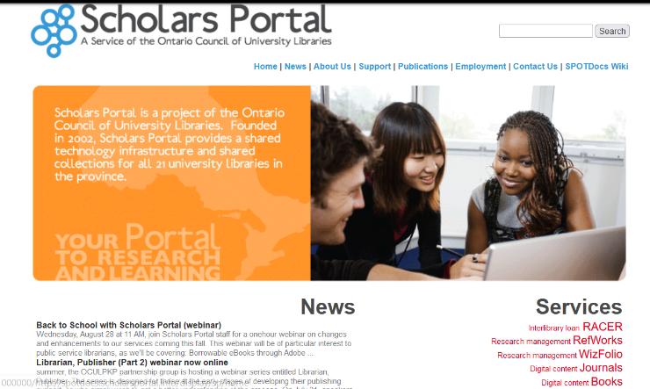
Scholars Portal homepage,
2013

Slide 15
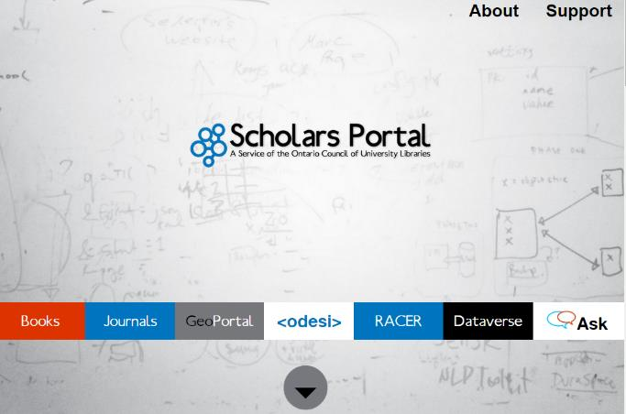
Scholars Portal homepage, 2014

Slide 16
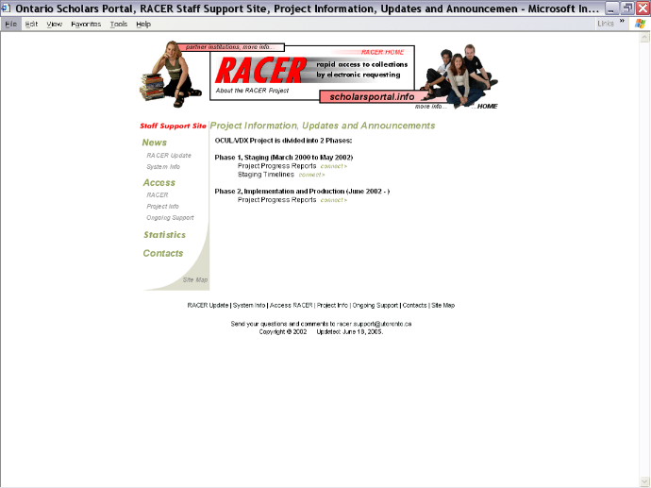
RACER project page,
2002

Slide 17
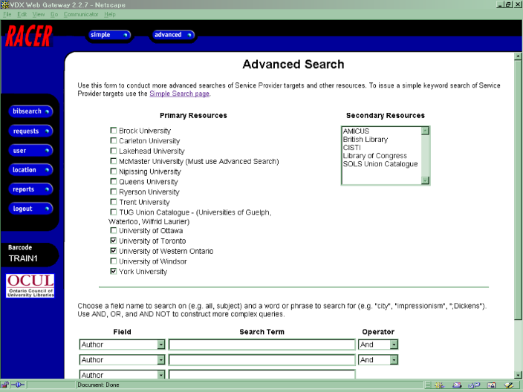
RACER advanced search,
2003

Slide 18
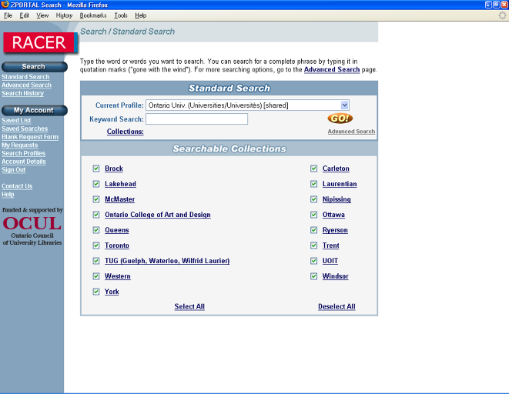
RACER patron interface,
2007

Slide 19
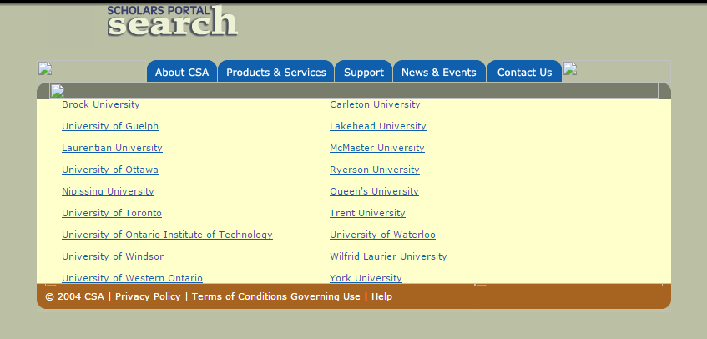
Scholars Portal Search 2007

Slide 20
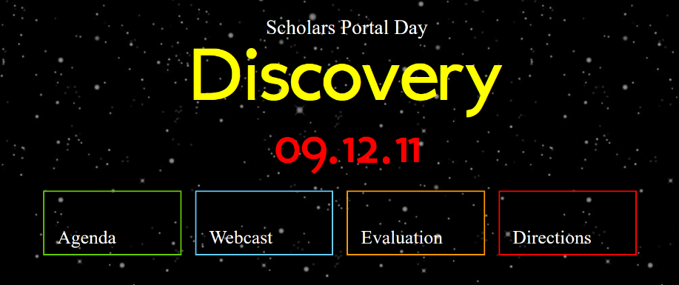
Scholars Portal Day 2011

Slide 21

Scholars Portal Day 2012

Slide 22
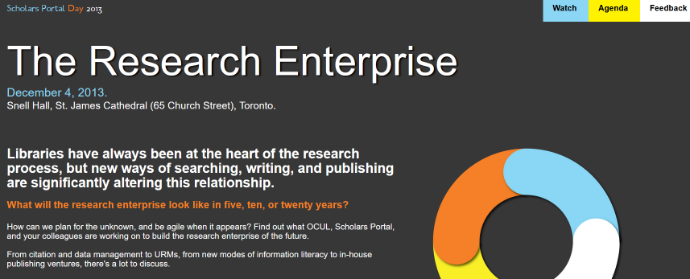
Scholars Portal Day 2013

Slide 23
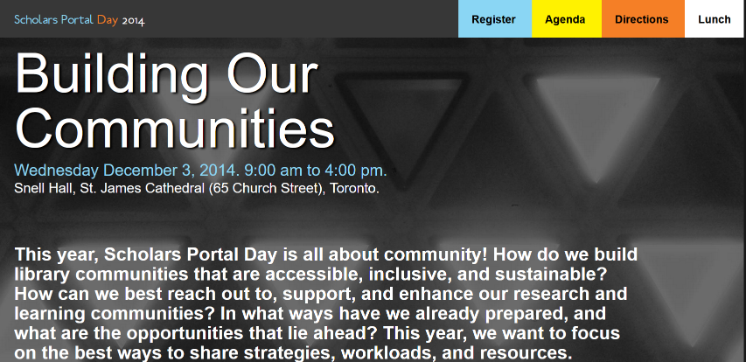
Scholars Portal Day 2014

Slide 24

Scholars Portal Day 2015

Slide 25
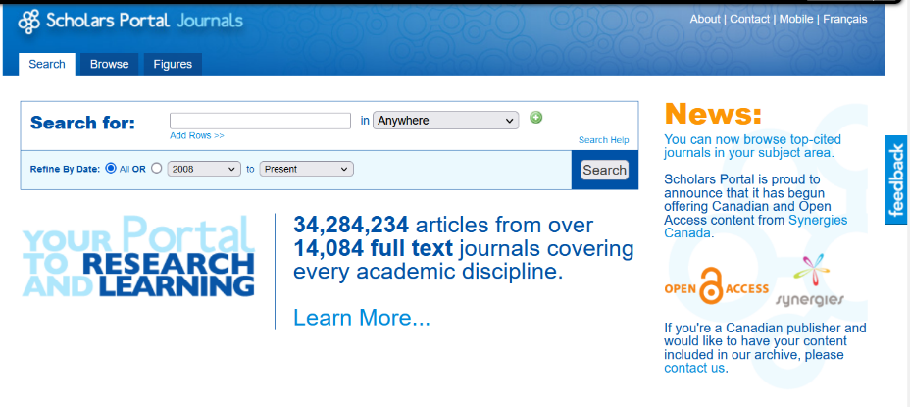
SP Journals, 2013

Slide 26
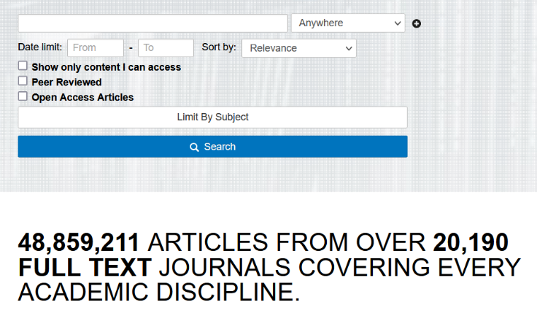
SP Journals,
2017

Slide 27
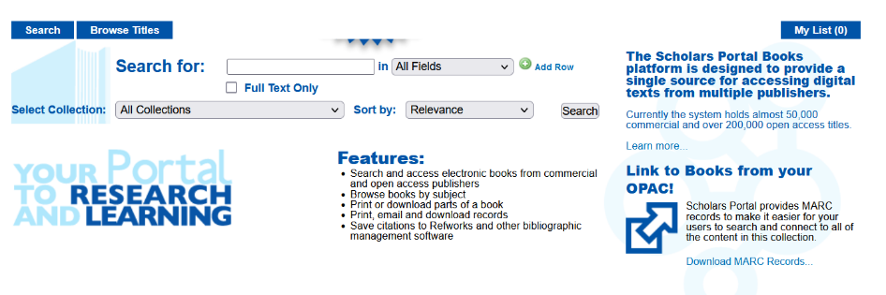
SP Books, 2010

Slide 28
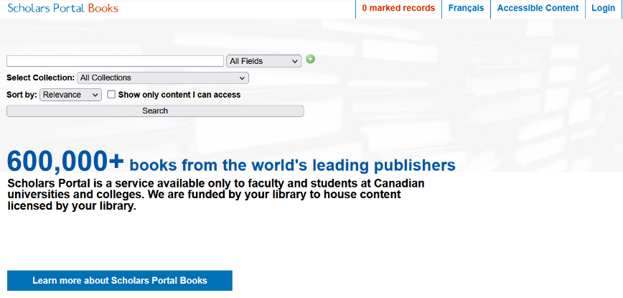
SP Books, 2017

Slide 29
Scholars Portal Days 2022
OCUL Update
Michael Vandenburg, Interim Executive Director

Slide 30
Scholars Portal Days 2022
Client Services
ACE
Publishing Services
Ask a Librarian
RACER

Slide 31
Scholars Portal Day 2022 -
Harnessing Alma work orders to support the
Accessible Content E-Portal (ACE)
Susan Bond (she/her)
Discovery Systems Librarian; and
Harjinder Rana (he/him)
Resource Sharing and Accessibility Librarian

Slide 32
ACE and UTL
ACE provides digitized, accessible versions of library holdings at OCUL and OCLS
The copy of first resort for digitization is the UTL copy
Aside from Downsview, UTM, and UTSC, ACE staff need to visit UTSG libraries (up to 30) to borrow material for IA scanning
Notes:
ACE = Accessible Content E-Portal
UTL = University of Toronto Libraries
OCUL = Ontario Council of University Libraries
OCLS = Ontario Colleges Library Service
UTM = University of Toronto Mississauga
UTSC = University of Toronto Scarborough
UTSG = University of Toronto St. George
IA = Internet Archive
https://ace.scholarsportal.info/

Slide 33
ACE and UTL during the pandemic
Libraries closed to visitors, ACE staff working remotely
Curbside pickup to identify books for IA scanning
Leaned on IA and Robarts staff working on site
Not all libraries participating so not perfect, but we’re on to something…

Slide 34
UTL and Alma
UTL went live with Alma January 7, 2021
Unlearning many old workflows, including a vast network of “department cards” and pseudo-patrons
Limitations of patron physical item requesting, Alma digitization
Work orders and rethinking our relationship with Scholars Portal

Slide 35
Lessons
Embrace Alma-native processes
Rethink our relationships with our partners
harjinder.rana@utoronto.ca
susan.bond@utoronto.ca

Slide 36
Scholars Portal Journal Hosting:
A Service Provided to Carleton University
Alisdair MacRae and Valerie Critchley
Scholarly Communications
Carleton University

Slide 37
Introduction
In the recent past, Scholars Portal took over the hosting of Open Journal Systems from MacOdrum Library at Carleton University
The change streamlined the workflow and maintenance of both the software and associated hardware
Open Journal Systems (OJS) is an important aspect of the Open Access movement, and the following lightning talk will draw attention to how Scholars Portal has greatly facilitated that effort

Slide 38
Intro to Open Access
“Open Access (OA) is the provision of free access to peer-reviewed, scholarly and research information to all. It requires that the rights holder grants worldwide irrevocable right of access to copy, use, distribute, transmit, and make derivative works in any format for any lawful activities with proper attribution to the original author.”
“The rising cost of journal subscription is a major force behind the emergence of the OA movement. The emergence of digitisation and Internet has increased the possibility of making information available to anyone, anywhere, anytime, and in any format.”
-Sanjaya Mishra, Introduction, Policy Guidelines For the Development
and Promotion of Open Access, UNESCO, 2012

Slide 39
Carleton and OA
4. Open Access is the principle that all research and creative work, particularly from publicly funded institutions, should be freely accessible via the internet.
5. Carleton University is committed to the principle of disseminating academic knowledge as widely and in as timely a way as possible thereby increasing the impact of this research and expanding the scholarly discourse.
In facilitating researchers to disseminate new knowledge, all methods are encouraged including traditional commercial and learned society publications and newer supplementary methods such as network sharing and open access methods.
The quality of the research at Carleton is the paramount consideration, normally realized through the peer review process, regardless of the publishing method. “
From Carleton University’s Open Access Policy, in effect January 1, 2012

Slide 40
Number of Journals Added by DOAJ, 2000-2021
Source: https://doaj.org/csv

Slide 41
What is Open Journal Systems (OJS)?
1998, John Willinsky founded the Public Knowledge Project at UBC, to improve the scholarly and public quality of research
2001, Open Journal Systems (OJS) released as open source software
2005, OJS 2.0 released, and OJS 3.0 released in 2016
25,000 journals using OJS worldwide (https://pkp.sfu.ca/ojs/), numerous languages available
“OJS is free and open source software released under the open source GPL v2 license. You are free to download, use, and modify it at no charge. OJS is made freely available to journals worldwide for the purpose of making open access publishing a viable option for more journals, as open access can increase a journal’s readership as well as its contribution to the public good on a global scale.” (https://pkp.sfu.ca/ojs/)

Slide 42
When did Carleton adopt OJS?
2009-2010, supported by IT Team in Library for 10 years
Library Technology Services (LTS) also supported numerous other platforms in-house, including Omni (library catalogue), Artudis (institutional repository) and Pressbooks (CMS for creating books)
For all of these platforms, maintaining a firewall and general security/stability was a big issue
LTS Staff didn’t have time for learning specific aspects of OJS, especially in light of staffing changes and varying demands

Slide 43
Why did Scholars Portal take over OJS hosting?
Library gradually moved from data storage to cloud solutions
2020, Scholars Portal was approached to host OJS, maintaining the software and hardware
Easier to update, maintain security, especially since it is open source

Slide 44
Why did Scholars Portal take over OJS hosting?
“Open source is great, but there must be engagement with community that supports it. Different than buying MS Word, open source done by the people, hence, more overhead.”
– Valerie Critchley, Systems and Copyright Librarian, Carleton University
Opportunity to move hosting to Scholars Portal provided for reasonable cost
They keep software and hardware up to date, more secure; they’re specialists

Slide 45
How was this arranged?
Carleton is part of Ontario Council of University Libraries (OCUL) Consortium
Scholars Portal, technological infrastructure provided to OCUL libraries, offering a range of services
Scholars Portal hosts Open Journal Systems and Open Monograph Press for 11 institutions within OCUL, with approximately 125 active journals containing over 30,000 published articles
Service includes software hosting, troubleshooting, upgrades, and Crossref sponsorship

Slide 46
What is the result?
Achieve Open Access, very economical way for libraries to set up their own journal hosting platform
External hosting, less stress for Carleton LTS
Maintain and upgrade server, software, changes to software or requests for information
  “Bart Kawula and Kaitlin Newson allow us to provide a better service for our clients by focusing on their specific needs and providing guidance as needed.”
  – Valerie Critchley, Systems and Copyright Librarian, Carleton University

Slide 47
What is the result?
Upgrade to OJS 3.3; they ran it first, they found bugs, they found the easiest way to upgrade; all we had to was communicate with clients about what was happening
Efficiency, since they’re providing service for so many libraries, they can advise on common issues, rather than responding to each library
Conclusion: Improved support for OJS and Open Access

Slide 48



From Zero to Hero:
Carleton’s Texting Service: A Success Story
Aleksandra Blake
Sherri Sunstrum

Slide 49
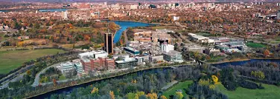
Background information about Carleton University
•Carleton is a mid-sized comprehensive and research-intensive public university.
•Student population
•Undergraduate students Total 2020-2021 (fall and winter terms)
•Total: 27,829
•Graduate students Total 2020-2021 (fall and winter terms)
•Total: 4,287
•Carleton offers a diverse range of academic programs, and is organized into six faculties

Slide 50

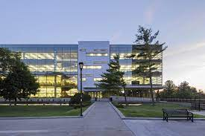
MacOdrum Library
•The Library maintains a collection of approximately 1.8 million print items, 161,396 cartographic materials, and 872,396 ebooks. 82% of total collection budget is allocated to e-resources
•https://library.carleton.ca/ (general overview of where students and faculty can find help)

Slide 51
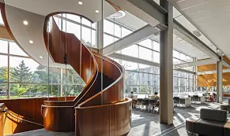
Research Support Services
What we do :
Liaison (faculty)
Research help (desk and virtual chat)
  Instruction (course related, workshops for graduate and undergraduate levels)
  Creating and maintaining subject guides, course guides and help guides
  Individual research assistance
  Support of faculty research

Slide 52


The Ask the Librarian Service rolled out with Carleton staff in the fall of 2017

Slide 53
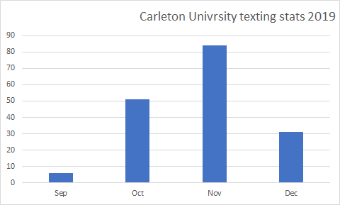
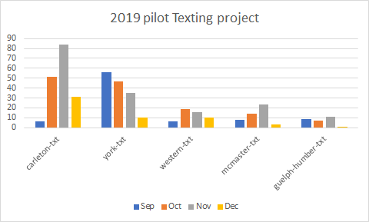
Off to a slow start
Texting Pilot began in September 2019
Five libraries participated

Slide 54

Promotion : bookmark

Slide 55
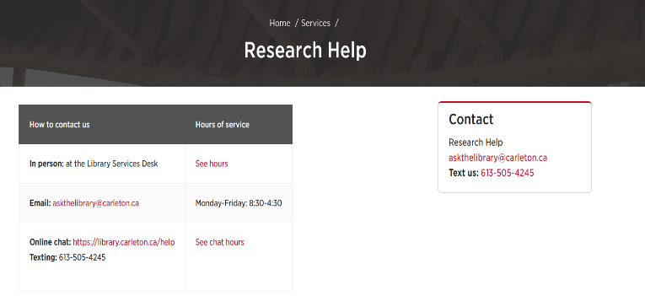
Promotion: library website

Slide 56
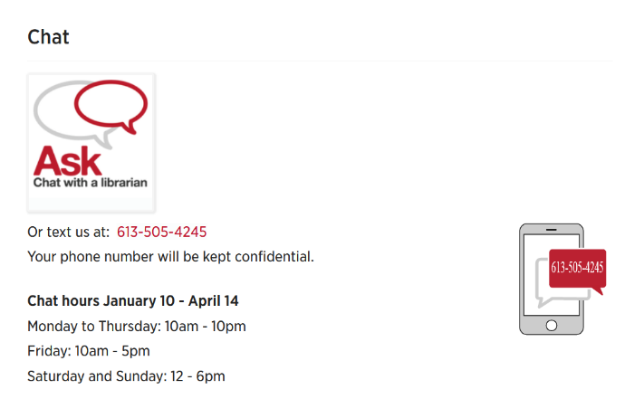
Library website

Slide 57

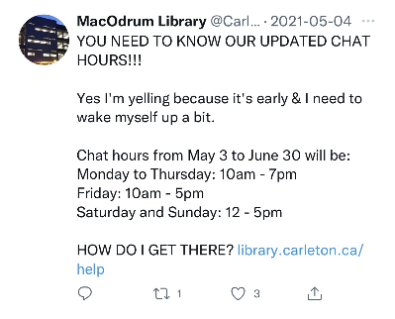
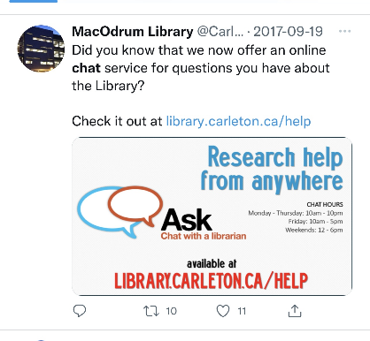
Promotion: social media

Slide 58
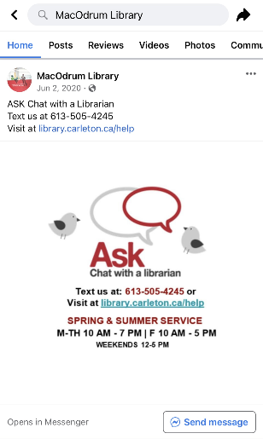

Promotion: Social media

Slide 59
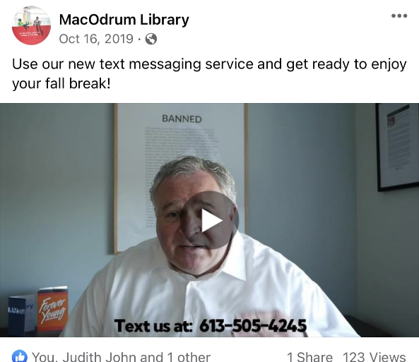
Promotion: videos

Slide 60
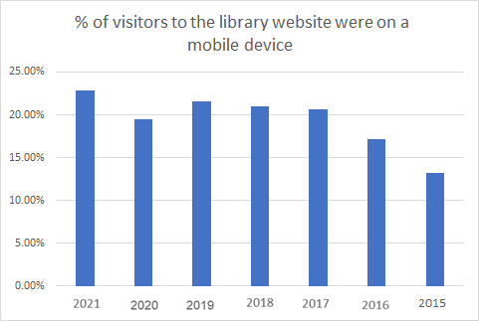
Use of mobile devices

Slide 61
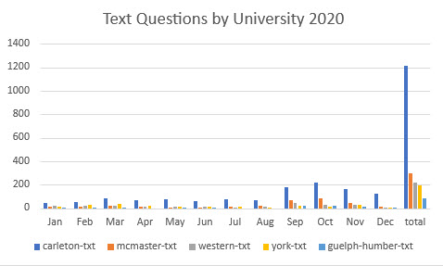
Text Usage in 2020 (I don’t like this title)
Successful campaign sees a huge increase in Ask a librarian users, accessing help via text and puts us at #1 among the 5 Universities

Slide 62
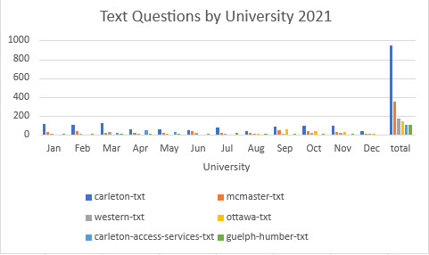
2021

Slide 63
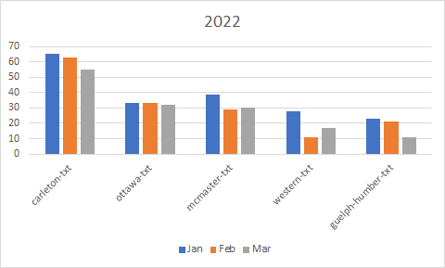
Off to a good start in 2022

Slide 64
Thank you
Aleksandra Blake aleksandra.blake@carleton.ca
Sherri Sunstrum
sherri.sunstrum@carleton.ca

Slide 65
Completing a Quality Assurance Assessment of the Ask a Librarian Reference Service
Guinsly Mondesir, guinsly@scholarsportal.info
Erik Rayment, erayment@uwo.ca
Chelsie Lalonde, chelsie.lalonde@ontariotechu.ca

Slide 66
VIRTUAL REFERENCE QUALITY ASSURANCE ASSESSMENT
Ask a Librarian is a consortial service staffed by operators from participating schools and Scholars Portal interns.
In March 2021 we assembled a working group which met bi-weekly to review operator chat transcripts to assess the service quality.
Previous transcript assessments were made by individual institutions or through User Satisfaction Survey feedback collected at the end of chats.
WORKING GROUP MEMBERS
Aleksandra Blake (Carleton)
Erik Rayment (Western)
Michele Chittenden (Queen’s)
Guinsly Mondesir (Scholars Portal)
Sabina Pagotto (Scholars Portal)
Chelsie Lalonde (Ontario Tech)
Lisl Schoner-Saunders (Algoma)

Slide 67
PROJECT GOALS
Quality of Service
Assess quality of service provided by operators in accordance with ALA RUSA guidelines.
Service Standard
Ensure that our consortial service offers a consistent reference interview across participating institutions.
Training Gaps
Identify knowledge gaps and areas for additional training.

Slide 68
TIMELINE
Consulted with OCLS AskOn chat coordinator to find out about their transcript review process
Creating and updating the codebook
Test runs to establish agreement
Analysis of results
MAR
APR
MAY
JUN
JUL
AUG
SEP
OCT
NOV
DEC
JAN
FEB
MAR
APR
<=2021=>
2022 =>
Formed working group
Creating and updating the form
Assigned chats and reviewed transcripts
Notes:
In March 2021 we assembled a working group
We reached out to OCLS to find about their transcript review process
Than later that year created a Codebook which I will talk about later in the next slides
We started to work on a survey that will help each member review the transcripts
We constantly did test runs and update the form
In Feb 2022 we started the Transcript Review process
And in Mach 2022 we produce a report

Slide 69
DEVELOPING THE CODEBOOK
Codebook based on RUSA guidelines to assess the quality of chat responses in 5 categories:
Approachability
Interest
Teaching (reference questions only)
Answering
Wrapping up
Multiple rounds of testing
inter-rater reliability
common understanding of what did and did not count as a “yes” for meeting standards.
Notes:
The working group developed a rubric and codebook based on RUSA guidelines to assess the quality of chat responses in 5 categories:
Each of those RUSA guidelines categories were considered to set our service standard, as well as training materials, user experience of chat, and other factors.
Multiple rounds of testing were done to ensure our codebook encapsulated different scenarios, inter-rater reliability, and common understanding of what did and did not count as a “yes” for meeting standards.

Slide 70
REVIEWING THE TRANSCRIPTS
A script was run to download a random sample of chat transcripts and files containing 60 chats were created for each reviewer
An additional 80 transcripts were downloaded as spares for transcripts that could not be reviewed
All seven members reviewed at least 55 chats, with the total number reaching 387

Slide 71
THE TRANSCRIPT REVIEW FORM
Created using Microsoft Forms
  Each questions was Yes/No
  ‘No’ responses required feedback
    Analyzed trends from feedback
Tested form by reviewing random sample of the same chats
  Goal was to meet 80% threshold for agreement using a pairwise reliability calculator
  Criteria was met for all variables

Slide 72
TRANSCRIPT REVIEW RESULTS
Approachability | Was the operator approachable? | 93% Yes
Interest | Did the operator maintain word contact? | 94% Yes
Teaching | Were teaching opportunities used? | 89% Yes
Answering | Did the operator answer the visitor's question? | 98% Yes
Wrapping up | Did any wrap-up occur? | 96% Yes
 | Did the operator invite the user back to the service? | 64% Yes

Slide 73
CONCLUSION
Results were positive but we found some opportunities for improvement
Training materials can be updated to include or emphasize opportunities for improvement
Periodic review of transcripts every two years

Slide 74

CUrrents of Change
HUJMA CHOWDHURY
KARINA ESPINOSA

Slide 75
No one cared about copyright.
Interest in copyright law immersed with the expansion of the internet
" copyright industry’s hyperbolic claims about the damage that sharing online material causes, and its calls for absurdly serious punishments for infringing on copyright monopolies." (Moody, 2021)
Large collective societies (Access Copyright) exacerbating these fears
Notes:
Moody, G (2021). https://walledculture.org/widespread-copyright-anxiety-leading-to-copyright-chill-means-something-is-deeply-wrong/

Slide 76
How do our current realities stack up against the visions, or the fears, of the past?
What new and unexpected challenges or triumphs have arisen in our present?
How can we prepare ourselves for the future when the pace of change is too rapid for us to predict what the landscape will look like in another twenty years?
New copyright challenges following the pandemic
Immense pressure to make items accessible digitally as soon as possible
Roadblocks such as DRMs, not everything is available to purchase, especially textbooks
Books locked away in libraries
Copyright anxiety/copyright chill

Slide 77
New and Unexpected Challenges:
York U vs Access Copyright
Case in divided in two issues:
Is an interim tariff, and a tariff in general, mandatory?
  Are York’s Fair Dealing Guidelines sufficient to ensure that it is in compliance with the law?
Overturning the trial decision, the Federal Court of Appeal found that a tariff issued by the Copyright Board was not mandatory, and that users could choose to be copyright compliant in other ways
Like in the trial decision, the Federal Court of Appeal agreed that the Fair Dealing Guidelines were not sufficient
Neither side got what they wanted.
SSC hearing was in May 2021, concluded in July 2021 but continuous lobbying from author and publisher groups
Notes:
Moody, G (2021). https://walledculture.org/widespread-copyright-anxiety-leading-to-copyright-chill-means-something-is-deeply-wrong/

Slide 78
New and Unexpected Challenges:
Amendments to the (Copyright) Act in The Budget Implementation Act
proposed changes to the Copyright Act as announced in the Government of Canada’s Budget 2022 (p.328-330)
As part of the negotiation of the Canada-United States-Mexico Agreement (CUSMA) the Canadian federal government agreed to extend the general copyright term of life-plus-50 years by an additional 20 years
substantial shift in the balance between the rights of users and rights-holders
"Sustainable educational publishing industry"
Notes:
Shrink the public domain
https://www.ic.gc.ca/eic/site/693.nsf/eng/00305.html

Slide 79
Preparing for the future; the role of the librarian in Canada’s copyright system
“Librarians operate at the core of copyright's balance: they reward the creator through the purchase of works and other copyrighted subject matter and they disseminate knowledge and encourage learning, thus fulfilling the purpose of copyright law as set out by the Supreme Court of Canada in CCH.”
Owen, V. (2014). The librarian's role in the interpretation of copyright law: Acting in the public interest. Feliciter, 60(5), 8-12.

Slide 80
Preparing for the future.
Routinely revisiting fair dealing guidelines to affirm they match current environment and context
Ensuring the guidelines are prioritizing the students right (users) over the institution and continue to lobby for stronger user rights
Managing institutional risk
Copyright education across the board
Explore different avenues of resource sharing such as CDL

Slide 81
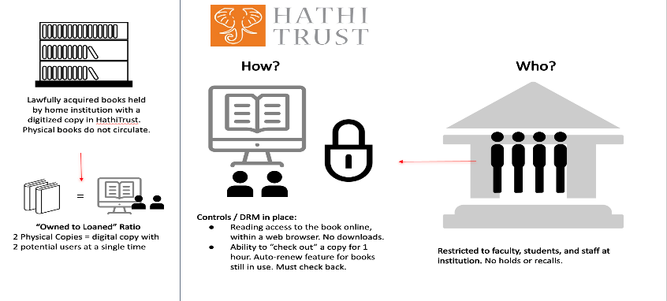
Controlled Digital Lending
Graphic created by Stephanie Orfano

Slide 82
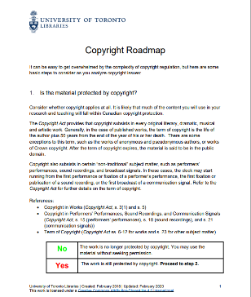
Currents of Change
Changes to the copyright roadmap
Notes:
The Copyright Roadmap is designed to assist in decision making when selecting resources and potentially copying material for use in teaching and research activities
Move away from traditional libguides something more interactive and engaging, really good uptake with the getting published challenge hosted on quercus created on articulate 360

Slide 83
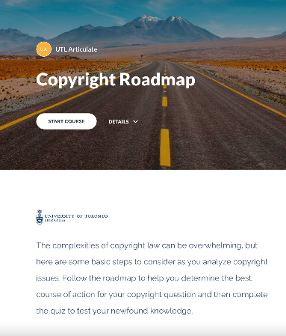
COPYRIGHT ROADMAP 2.0:
Interactive Learning Modules in Rise 360
Notes:
-

Slide 84
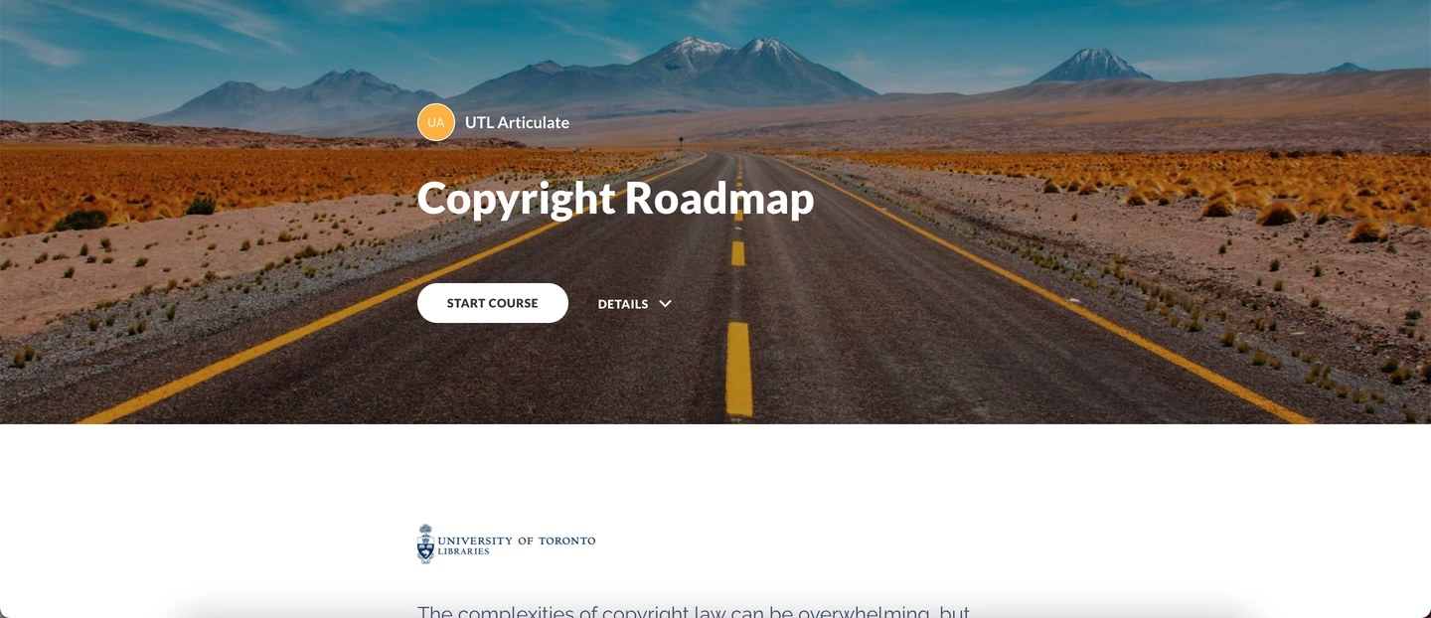
COPYRIGHT ROADMAP IN rise 360

Slide 85
Scholars Portal Days 2022
Scholars Portal en français !

Slide 86
Scholars Portal Days 2022
Mise à jour sur Scholars Portal
Session en français!
Notes:
Ceci c’est un experiment ! SVP soyez patients et nous donner vos commentaires si vous trouvez cette presentation utile.
Je vais commencer avec un peu de contexte au sujet du soutien et de la service en langue francaise a SP et puis je vais vous donner un court resume de quelques des differents presentations que mes collegues de Scholars Portal vont faire demain en plus de detail en anglais

Slide 87












Dépôts de contenu
Services de données
Services aux clients
Services de préservation et de stockage

Slide 88
Scholars Portal Journals
Scholars Portal Périodiques
RACER
Books
Scholars Portal Livres
ODESI
Scholars GeoPortal
Ask
Clavardez avec nos bibliothécaires
Scholars Portal Dataverse
Interface en anglais seulement
ACE
Portail de contenu accessible
Interface en français disponible
Service de publication
OLRC
Pergélisol*
2002
2004
2006
2008
2010
2012
2014
2016
2018
2020
Notes:
Maintenant, un peu d’histoire avec cette chronologie.
La première fois que SP a offert un service en français, c’est en 2005. RACER, notre système de gestion de PEB, a été lancé en anglais en 2003. Un groupe de travail, mené par des représentants d’Ottawa, a traduit l’interface en collaboration avec le consortium québécois (à ce temps CREPUQ), qui utilise la même application dorsale pour leur système de PEB Colombo. Scholars Portal a travaillé avec le fournisseur pour assurer la bonne mise en œuvre de l’interface française, qui a été mise en ligne en 2005.
Odesi, notre service de microdonnées, a été développer par un groupe d’universités ontariens (DINO – données en Ontario), et odesi est devenu un service de Scholars Portal en 2008. La plupart des données viennent du gouvernement fédéral (particulièrement Statistique Canada) alors une interface française était une priorité dès le début. Ceci est lancé en 2009. Les traductions, ainsi que des guides d’utilisateur, les meilleurs pratiques, et autre documentation en français, ont été créés par les membres de DINO.
Après le succès d’odesi, Scholars Portal a tourné notre attention à nos deux grands dépôts d’érudition : Scholars Portal Périodiques et Scholars Portal Livres (Journals et Books). La plateforme de périodiques était notre premier service à partir de 2002, et nous avons lancé la plateforme de livres électroniques en 2008. En 2010, Scholars Portal a embauché une traductrice, qui a traduit les interfaces des deux plateformes, et leur a donné leurs noms : Scholars Portal Périodiques et Scholars Portal Livres.
Après cela, nous avons pris en compte le besoin d’avoir une version française lors du lancement de nouveaux services, bien que cela ait parfois été difficile à réaliser. Les logiciels vraiment spécifiques n’ont pas toujours un option pour avoir plus qu’une langue (ou plus que l’anglais….)
Permafrost* (Pergelisol) - Grant says that parts of the archivematica interface are available in French, not sure what that means for our hosted version.

Slide 89
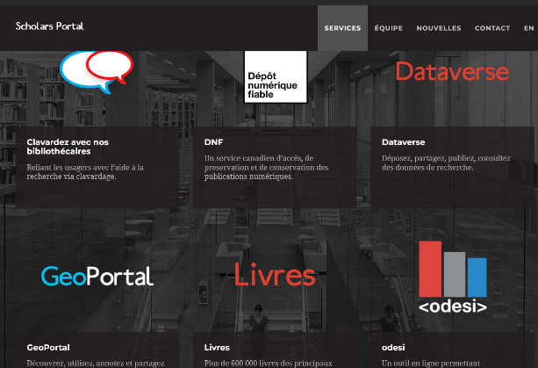
Documentation et communications
Traduction du site web
Traduction des guides d’utilisateur
Améliorer le soutien des utilisateurs francophones
Communications bilingues
Notes:
Comme nous avons déjà discuté, nous sommes, a SP, un organisme anglophone. Le CBUO a des membres bilingues, mais, jusqu’à ce point, pas de membres entièrement francophones. Nos efforts vers le bilinguisme, vers le soutien en français, visent vraiment les plateformes, les interfaces, qui seront utilisés par les “end user” (utilisateur final), c’est à dire les étudiants, professeurs, chercheurs, dans vos institutions. Et la documentation, la formation, les interfaces back-end, qui sont visibles seulement pour le personnel de la bibliothèque ou les bibliothécaires, ainsi que la communication de SP à votre bibliothèque, c’est généralement en anglais.
Site web disponible en francais
Nous avons aussi commencé la préparation pour traduire nos guides d’utilisateur. Il y a quelques ans, nous avons déménagé nos guides de LibGuides à un site de Wordpress. Ce site, learn.scholarsportal.info, est beaucoup plus flexible, et on peut basculer entre l’anglais et le français. En ce moment, seulement quelques-uns de nos guides ont été traduits en français -- Dataverse, Livres, et le guide sur la collection de sondages d’opinion publique sur ODESI. Mais la traduction des autres guides est quelque chose que nous prévoyons faire éventuellement.
Nous avons aussi maintenant plusieurs personnes à SP qui parlent francais (en incluant moi-même et Guinsly) et qui peuvent répondre à vos questions ou même faire une présentation comme celle-ci! SVP nous donner votre rétroaction.
Nouse essayons d’ameliorer nos communications bilingues – par exemple ce présentation aujourd’hui et aussi Nous publions un bulletin trois fois par an et nous espérons lancer une version bilingue en 2022.

Slide 90
Projets à l'échelle nationale
Scholars Portal Dataverse
Dépôt numérique fiable (DNF)
Presses universitaires sur Scholars Portal Livres
OLRC
Notes:
Nous tendons un peu dans cette direction
Dataverse - service nationale - nouveau nom – reunions bilingues
– ODESI – participants hors de l’Ontario
Nous sommes en train d’avoir des discussions avec le RCDR, le consortium national de bibliothèques universitaires, à propos de notre plateforme de périodiques. Scholars Portal périodiques est un Dépôt numérique fiable (DNF), ce qui signifie qu'il est certifié pour la préservation à long terme des articles scolaires. Le RCDR est en train de discuter si cette plateforme pourrait devenir un DNF national, c’est à dire, Scholars Portal Périodiques serait responsable pour la préservation numérique des revues scolaires pour toutes les universités canadiennes. Alors il faut considérer les implications pour nous, s’il faut servir des bibliothèques qui sont unilingues francophones.
En 2015, quelques collections canadiennes hébergées sur Scholars Portal Livres ont été ouvertes à des universités hors du CBUO grâce à un accord avec le RCDR, le consortium national des bibliothèques universitaires.

Slide 91
L’infonuagique : OLRC 2.0
15 clients partout au Canada
Nouveaux matériels
DuraCloud : une application qui permette de gérer la préservation des objets numériques dans votre stockage infonuagique
Nouveaux logiciels, particulièrement le tableau de bord Horizon
  Téléchargement de fichiers volumineux
  Protection pour vos fichiers contre le risque de suppression accidentelle
  Nouveaux statistiques d’usage
Les services de Scholars Portal qui utilisent l’OLRC pour leur stockage ont été migrés à l’OLRC 2.0 (Pergélisol, Dataverse)
Notes:
En 2021, l’OLRC, notre réseau de stockage infonuagique, a accepté des clients hors de l’Ontario.
Tous nos clients ont été migrés à la version 2.0 d’OLRC. Cette nouvelle version du réseau exploite de nouveaux matériels et logiciels pour améliorer les performances et la sécurité, et apporte plusieurs nouvelles fonctionnalités au service, notamment un nouveau tableau de bord Web et la possibilité de connecter davantage d'applications au stockage.

Slide 92
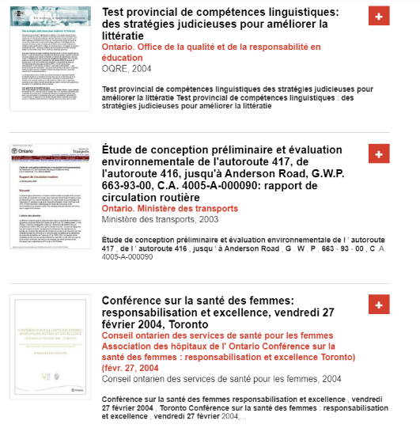
Publications
gouvernementales
Publications ontariennes
Collection pour les publications des groupes de réflexion canadiens (Canadian Think Tank Collection)
Notes:
Nous travaillons avec le la Government Information Community du CBUO et la bibliothèque de l'Assemblée législative pour la numérisation et la preservation de publications gouvernementales en Ontario.
Contributions de gens d’un grand nombre de nos bibliothèques pour les métadonnées pour notre Canadian Think Tank Collection. A peu pres 30 gens des membres CBUO ont cree des fichiers de métadonnées pour plus de 8000 documents. Nous allons envoyer ces métadonnées à Ex Libris pour inclusion dans le CDI / Alma (pour une meilleure découvrabilité)

Slide 93
ODESI et GeoPortal
Fin de vie pour les applications dorsales pour les dépôts de données ODESI et GeoPortal
Pour ODESI, une migration vers Dataverse est planifiée pour 2022-23
Pour le GeoPortal, un groupe de travail cherche encore des solutions pour le redéveloppement de la plateforme
Notes:
ODESI - le logiciel pour le dépôt, Nesstar, est en fin de vie. Un groupe de travail a recommandé qu’on le remplace avec Dataverse. Les ensembles de données vont migrer à Dataverse, en commençant avec les sondages d’opinion publique
GeoPortal : exigences fonctionnelles clés
Pour le GeoPortal, un group de travail pour le redéveloppement de la plateforme a soumis une proposition au CBUO pendant la rencontre des Directeurs la semaine dernière

Slide 94
Scholars Portal Days 2022
Questions?
Contactez-nous :
help@scholarsportal.info
sabina@scholarsportal.info (c’est moi!)

Slide 95
Scholars Portal Days 2022
See you tomorrow!
Content Services
Preservation Services
Data Services
And more!

