Slide 1

Scholars Portal Days 2022
Throwback Thursday
Remember these interfaces from the past?

Slide 2
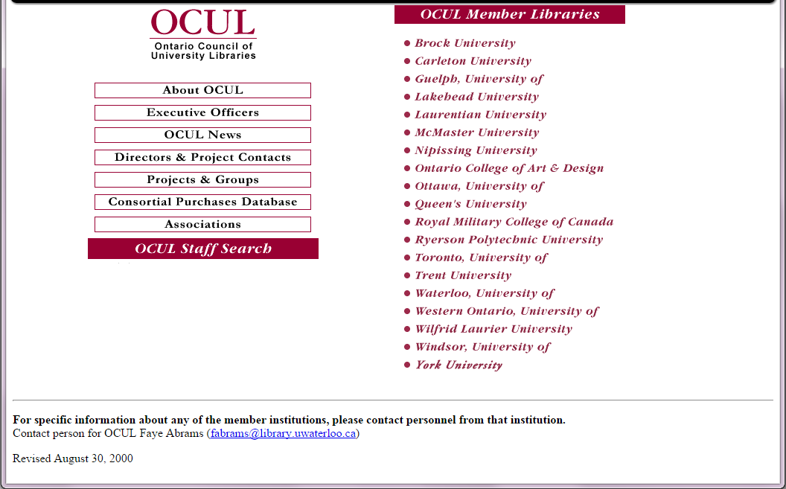
OCUL website,
2000
Notes:
Only 19 OCUL members! (no Ontario Tech or Algoma)

Slide 3
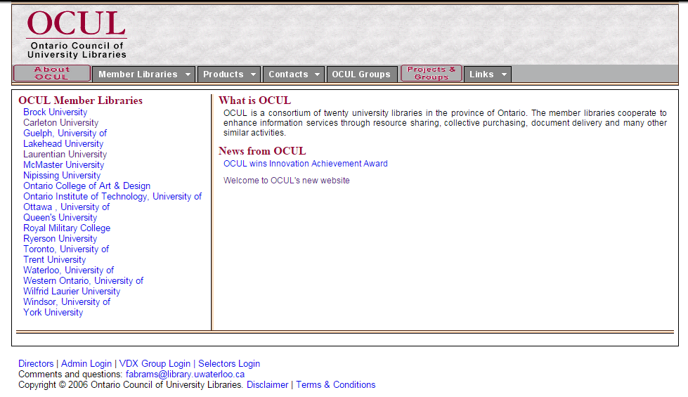
OCUL website,
2006
Notes:
20 members!

Slide 4
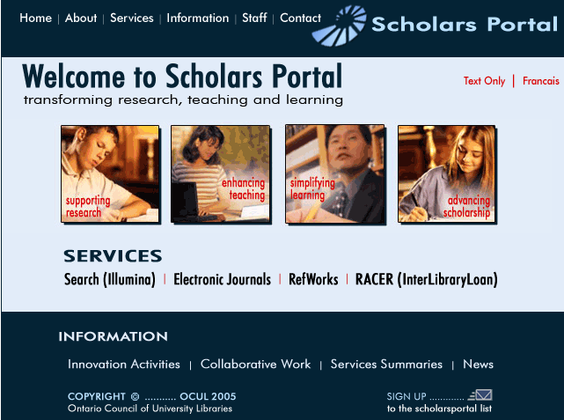
Scholars Portal homepage
2005
Notes:
Lovely stock images
2 services that no longer exist at SP!

Slide 5
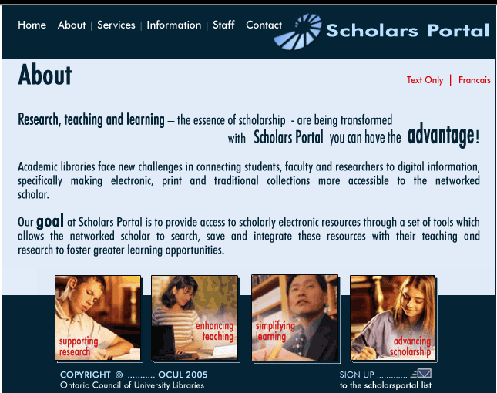
Scholars Portal
“About” page,
2006

Slide 6
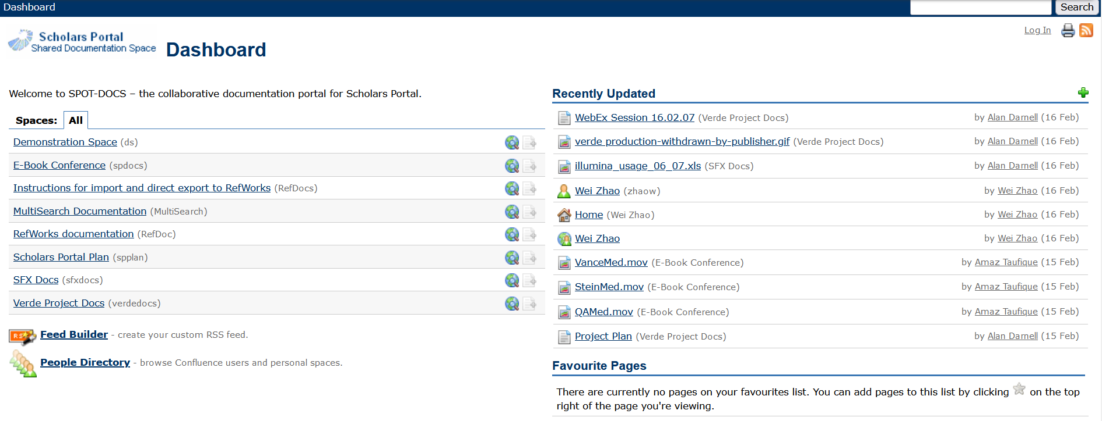
SpotDocs landing page, 2007

Slide 7
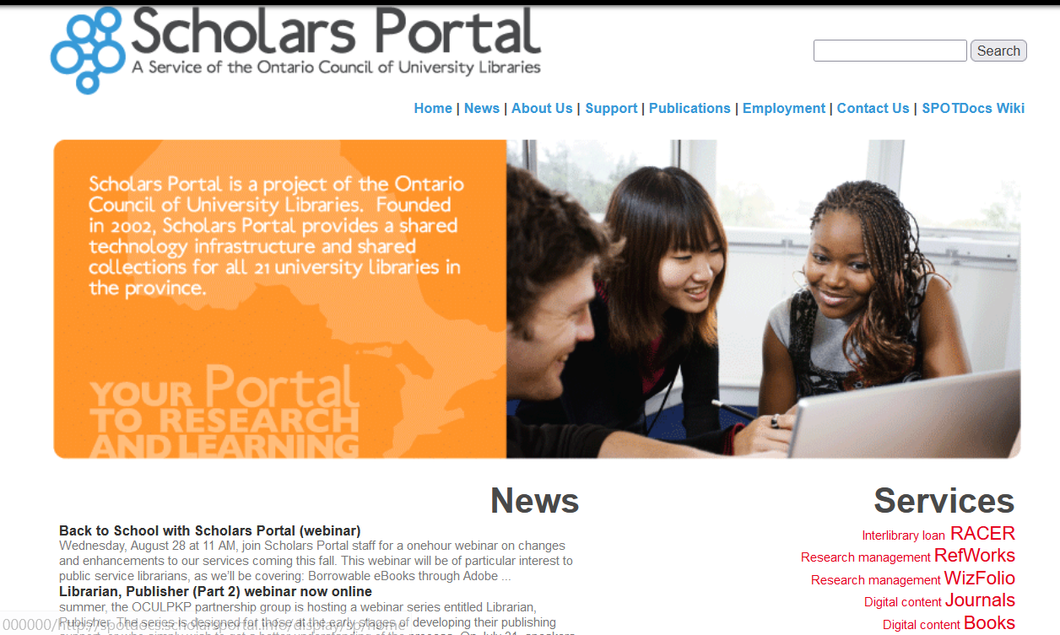
Scholars Portal homepage,
2013

Slide 8
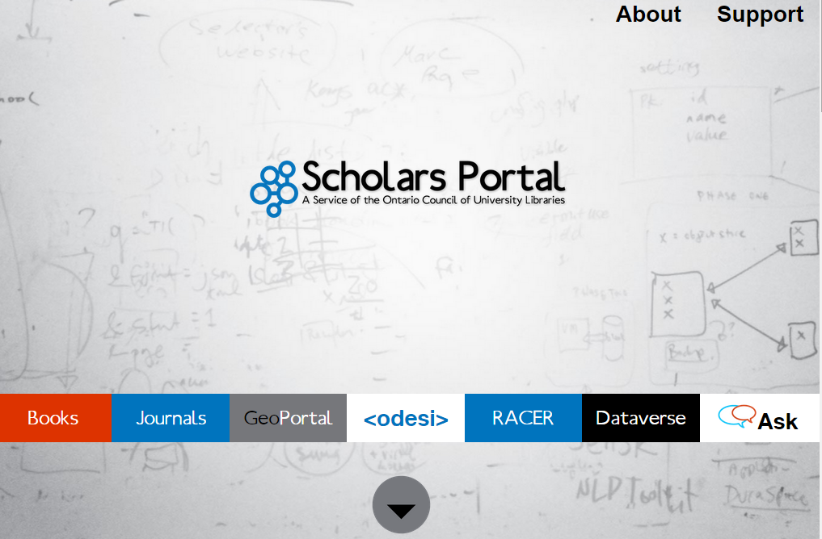
Scholars Portal homepage, 2014

Slide 9
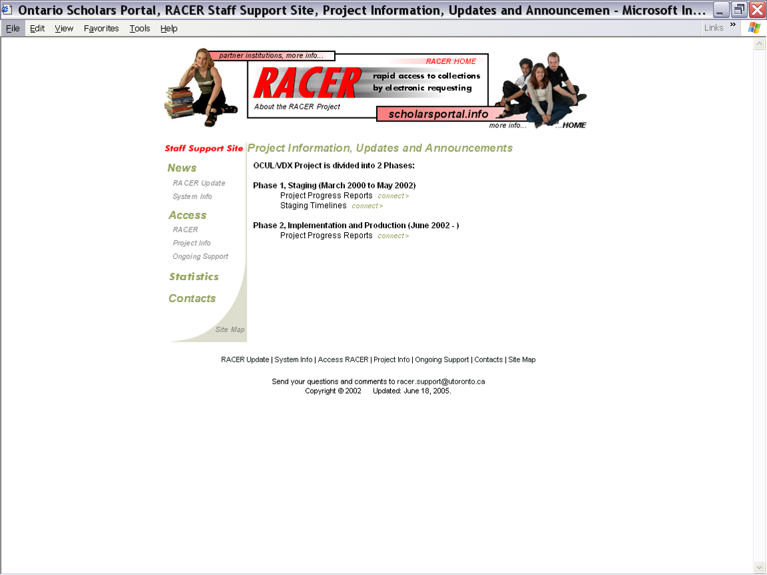
RACER project page,
2002

Slide 10
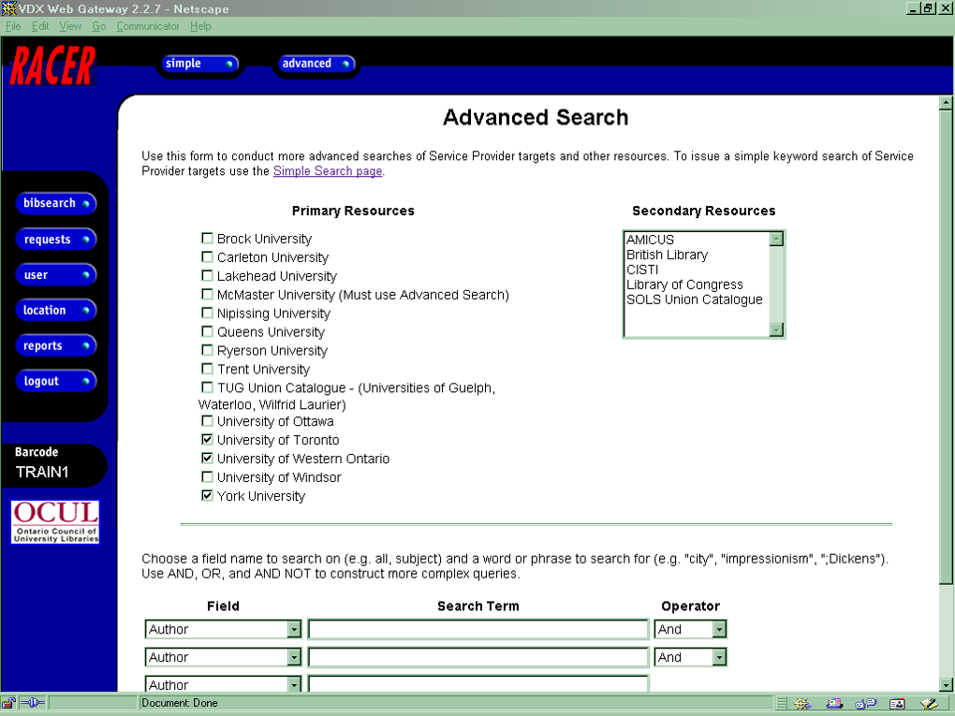
RACER advanced search,
2003

Slide 11
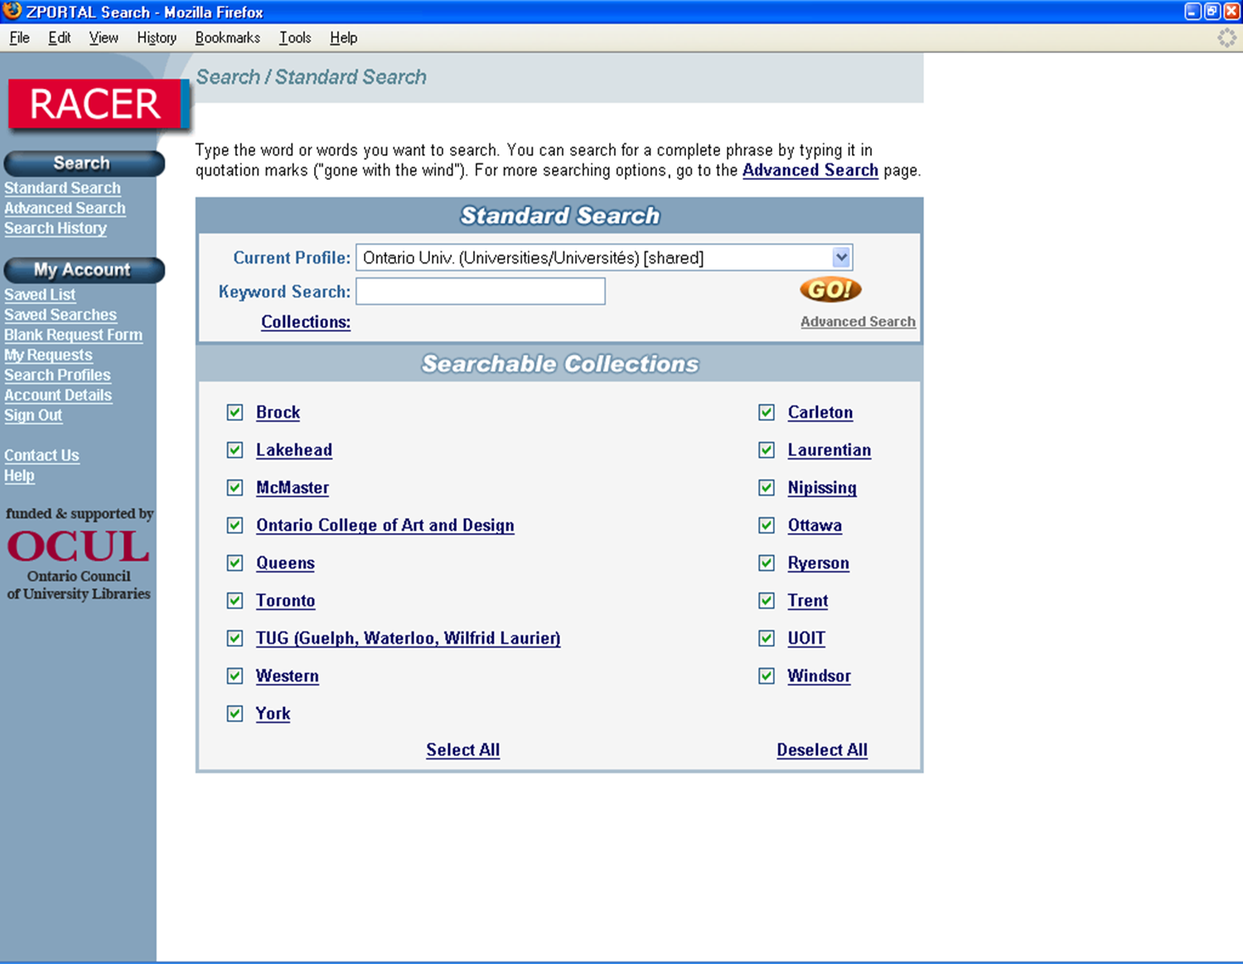
RACER patron interface,
2007

Slide 12
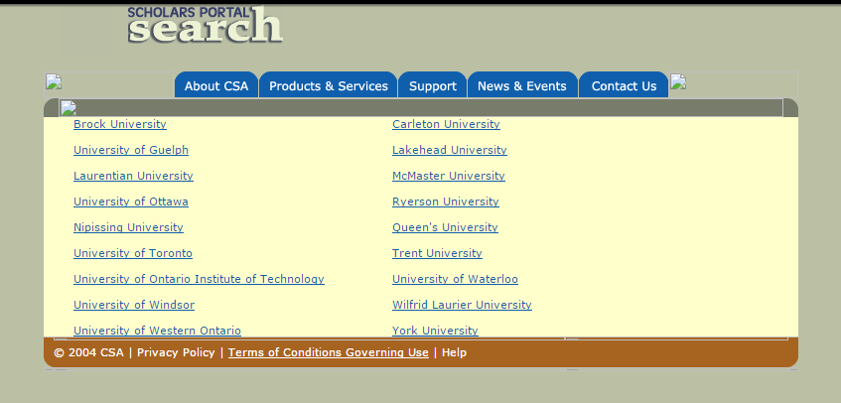
Scholars Portal Search 2007

Slide 13
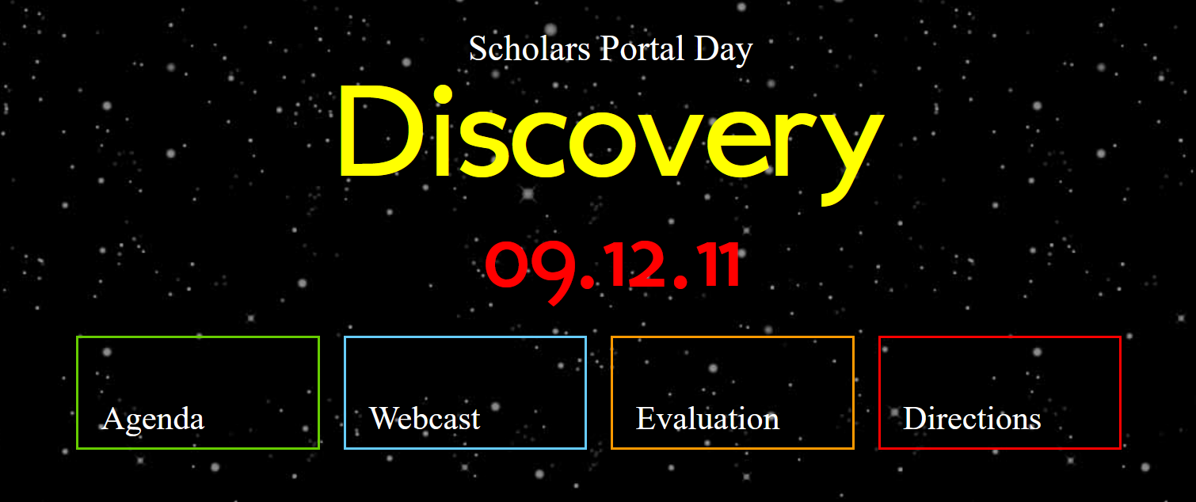
Scholars Portal Day 2011

Slide 14
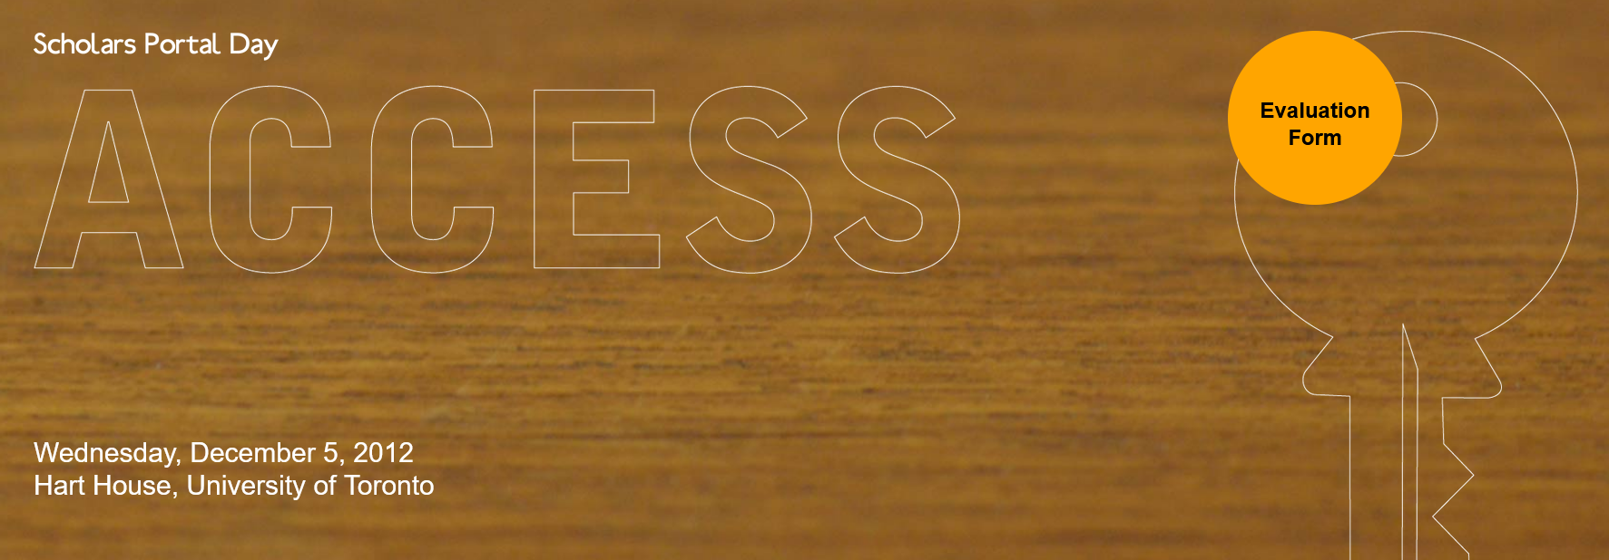
Scholars Portal Day 2012

Slide 15
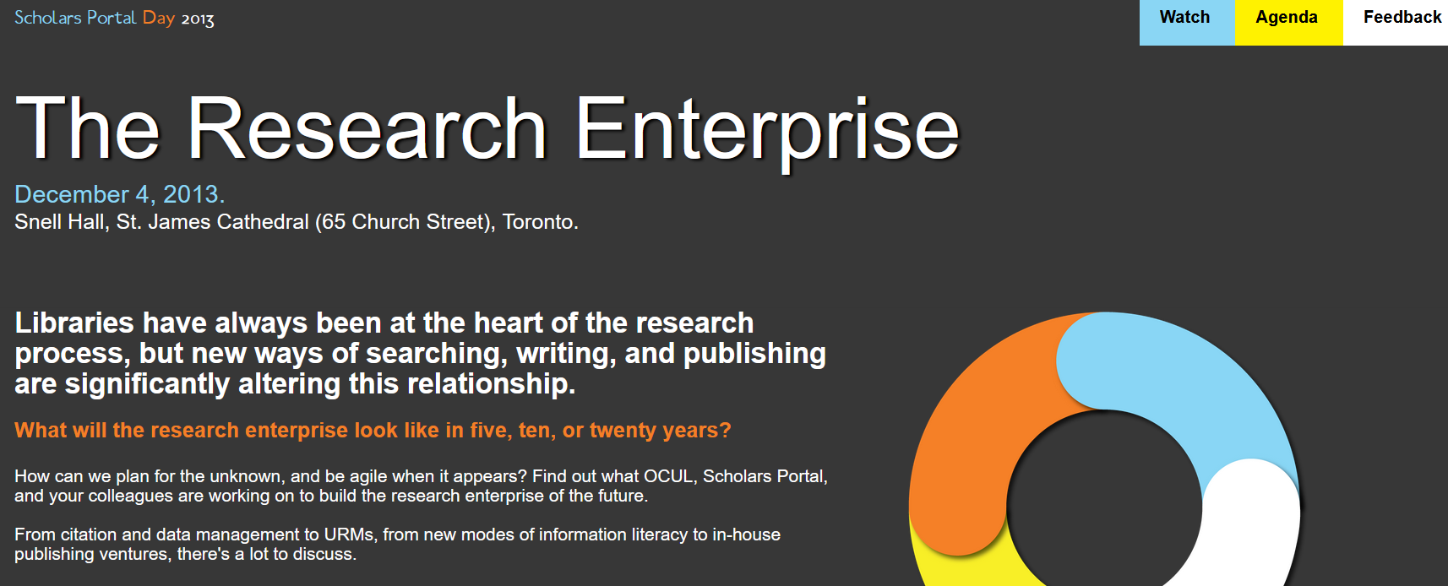
Scholars Portal Day 2013

Slide 16
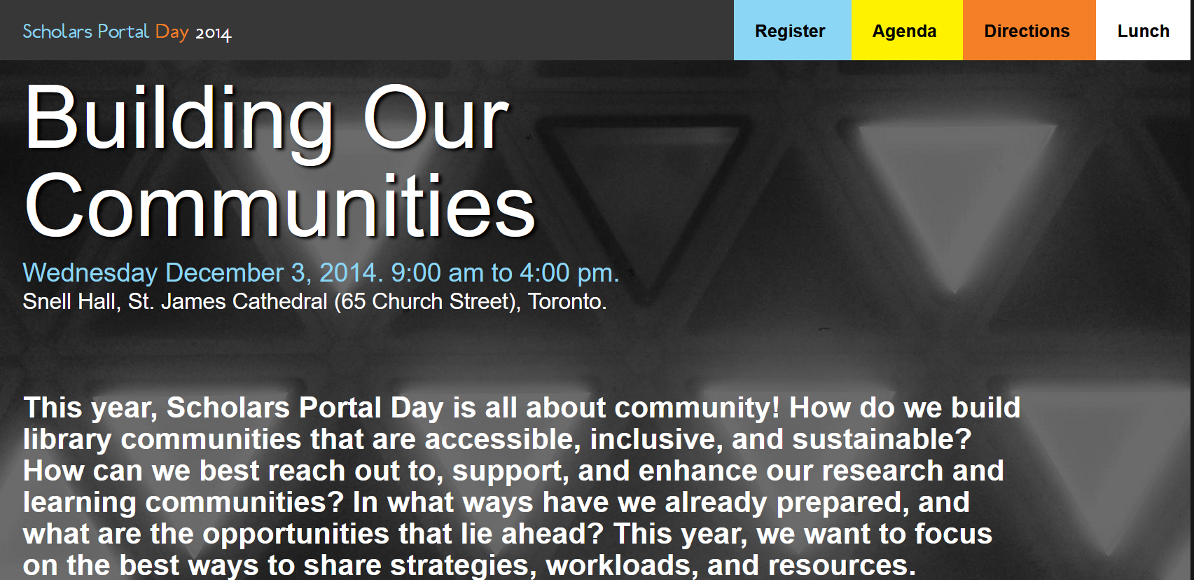
Scholars Portal Day 2014

Slide 17

Scholars Portal Day 2015

Slide 18
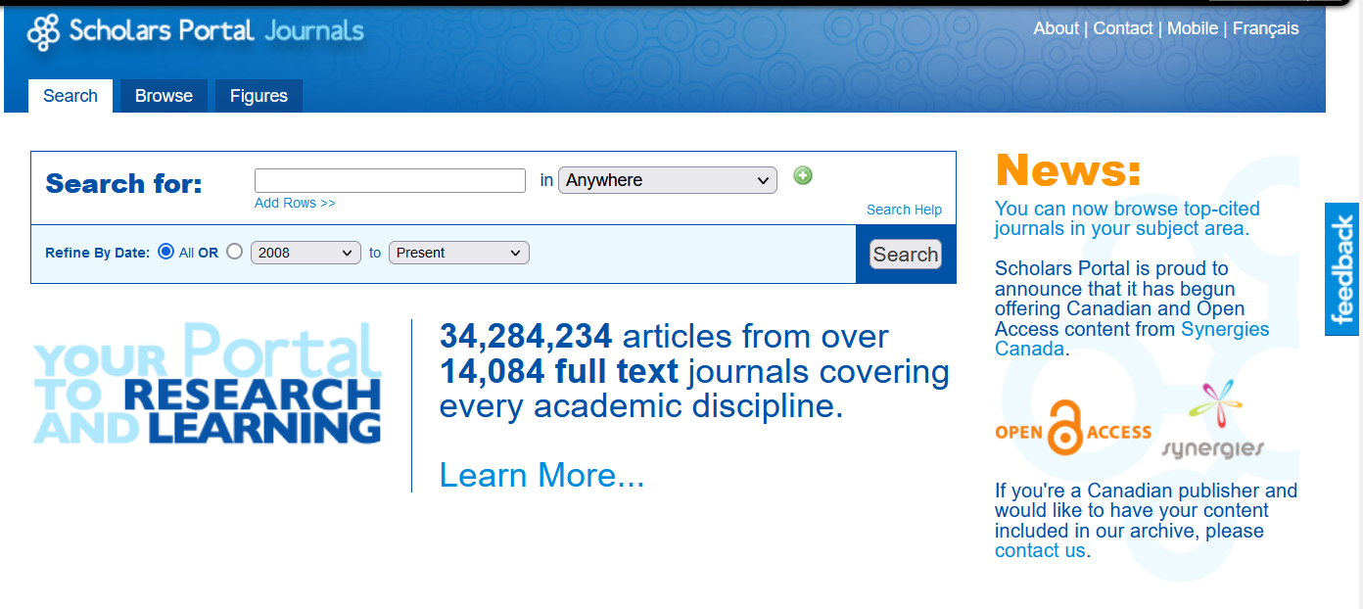
SP Journals, 2013

Slide 19
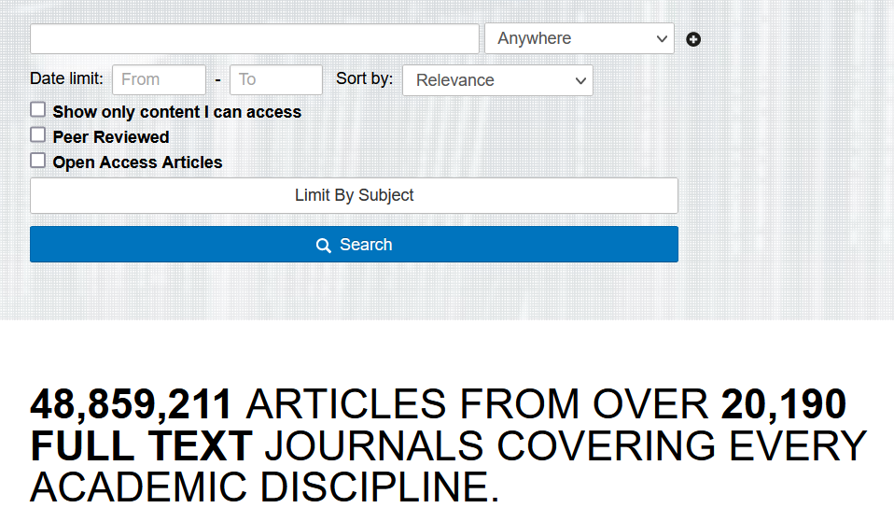
SP Journals,
2017

Slide 20
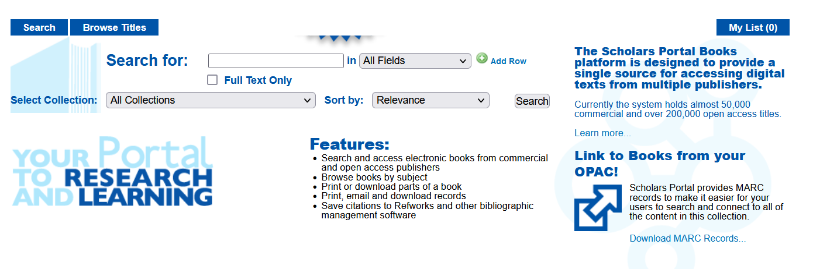
SP Books, 2010

Slide 21
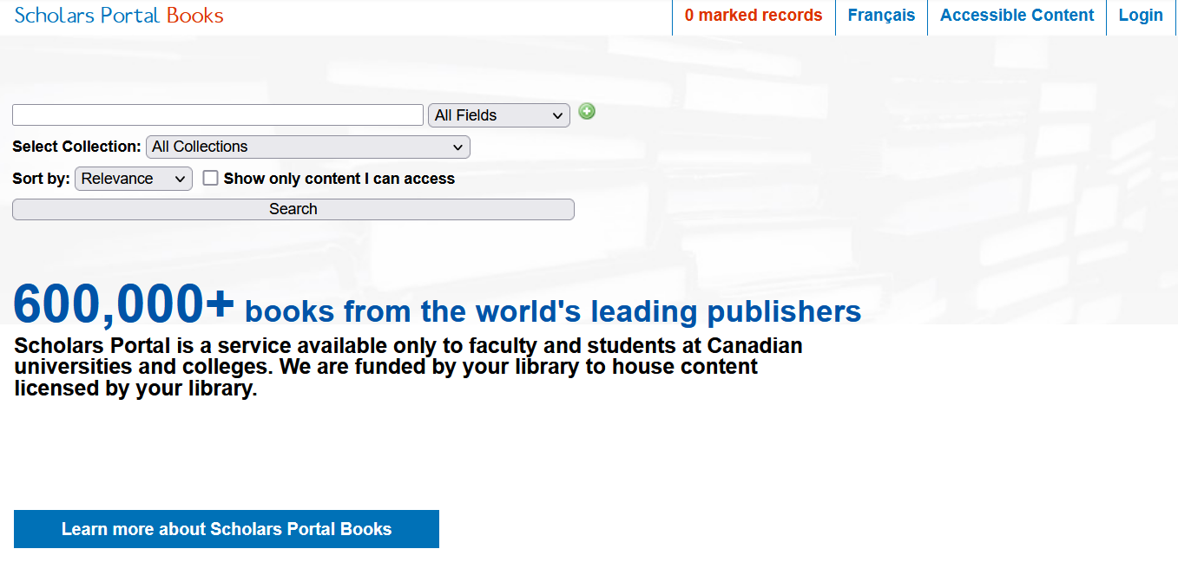
SP Books, 2017

