Slide 1



From Zero to Hero:
Carleton’s Texting Service: A Success Story
Aleksandra Blake
Sherri Sunstrum

Slide 2

Background information about Carleton University
•Carleton is a mid-sized comprehensive and research-intensive public university.
•Student population
•Undergraduate students Total 2020-2021 (fall and winter terms)
•Total: 27,829
•Graduate students Total 2020-2021 (fall and winter terms)
•Total: 4,287
•Carleton offers a diverse range of academic programs, and is organized into six faculties

Slide 3

MacOdrum Library
•The Library maintains a collection of approximately 1.8 million print items, 161,396 cartographic materials, and 872,396 ebooks. 82% of total collection budget is allocated to e-resources
•https://library.carleton.ca/ (general overview of where students and faculty can find help)

Slide 4

Research Support Services
What we do :
Liaison (faculty)
Research help (desk and virtual chat)
  Instruction (course related, workshops for graduate and undergraduate levels)
  Creating and maintaining subject guides, course guides and help guides
  Individual research assistance
  Support of faculty research

Slide 5


The Ask the Librarian Service rolled out with Carleton staff in the fall of 2017

Slide 6
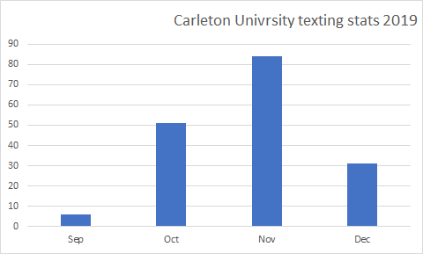
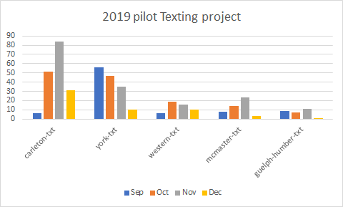
Off to a slow start
Texting Pilot began in September 2019
Five libraries participated

Slide 7

Promotion : bookmark

Slide 8
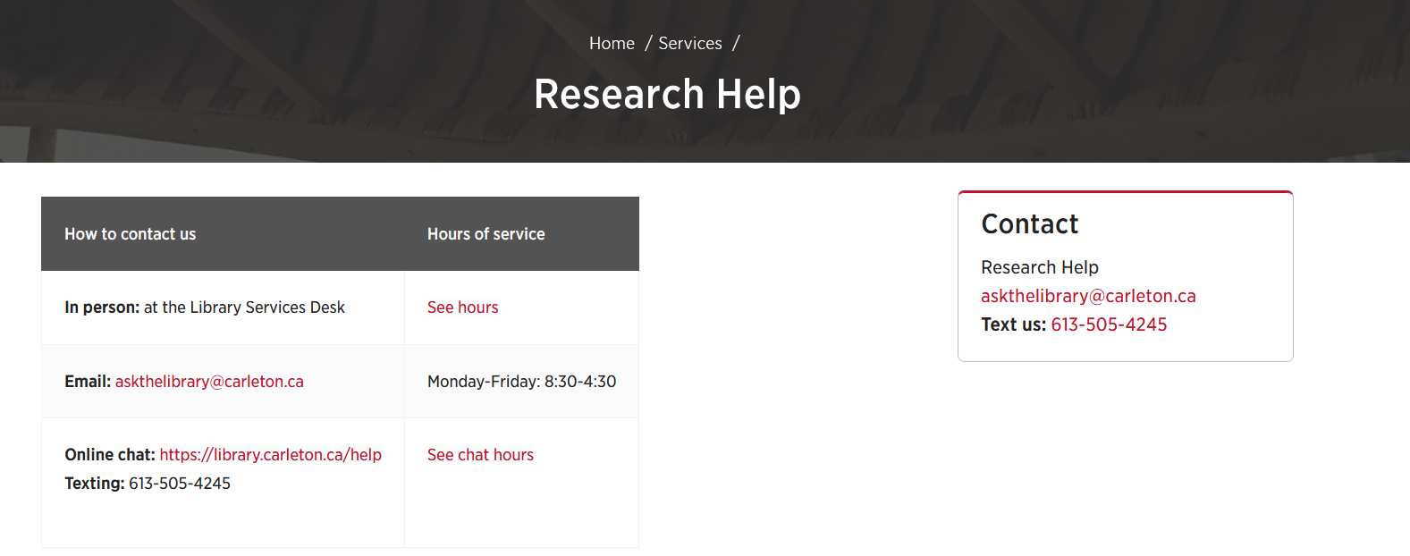
Promotion: library website

Slide 9
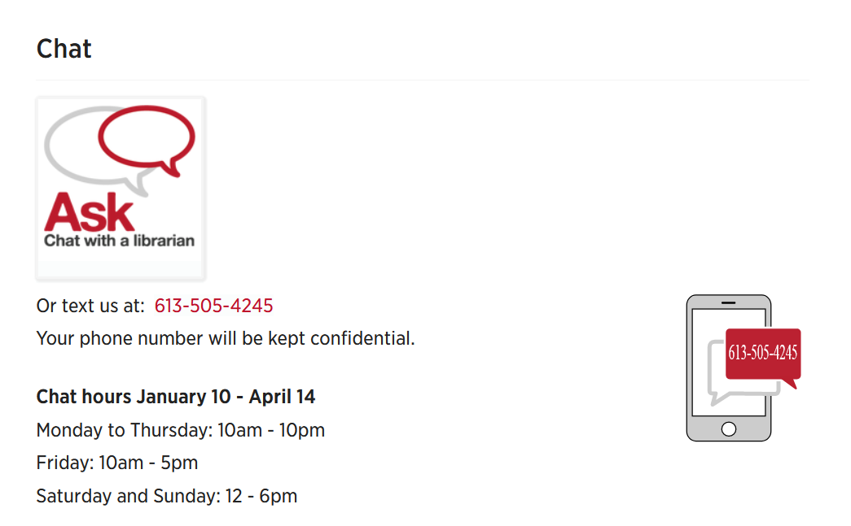
Library website

Slide 10

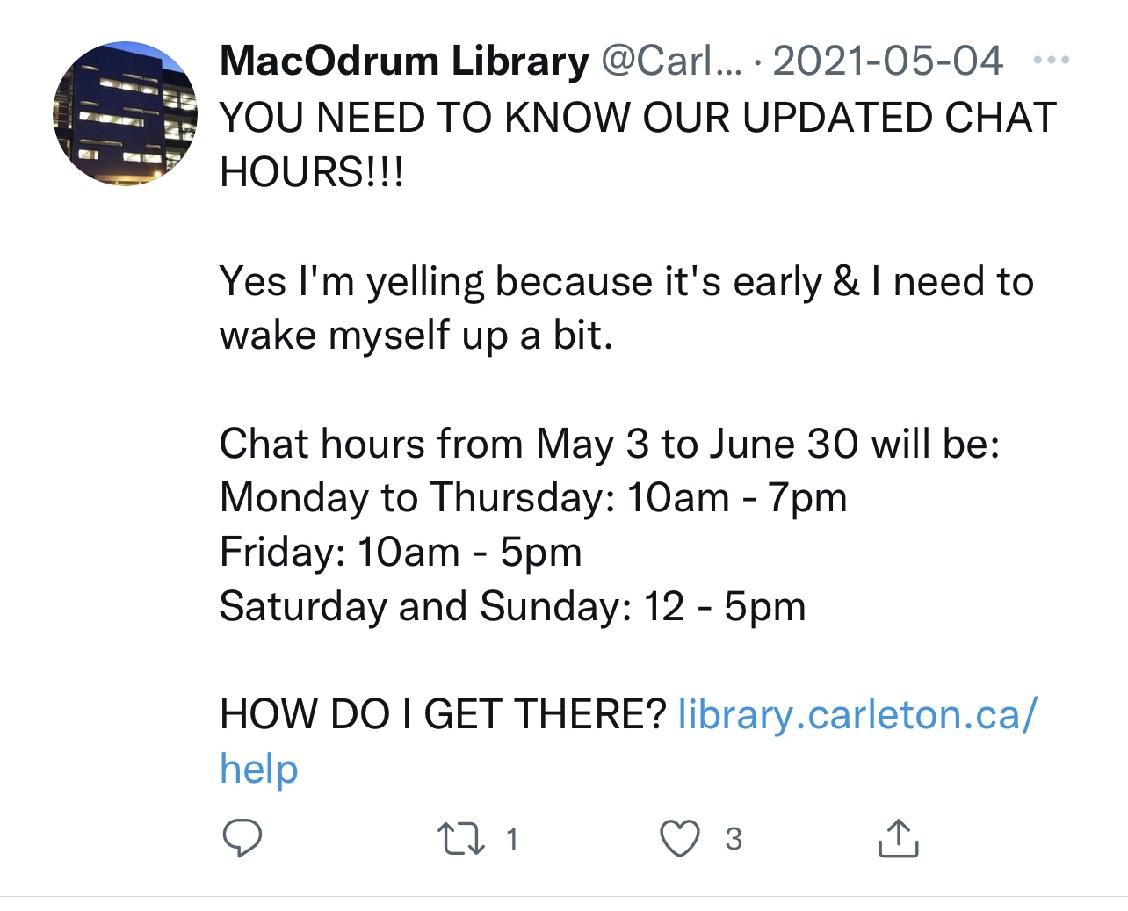
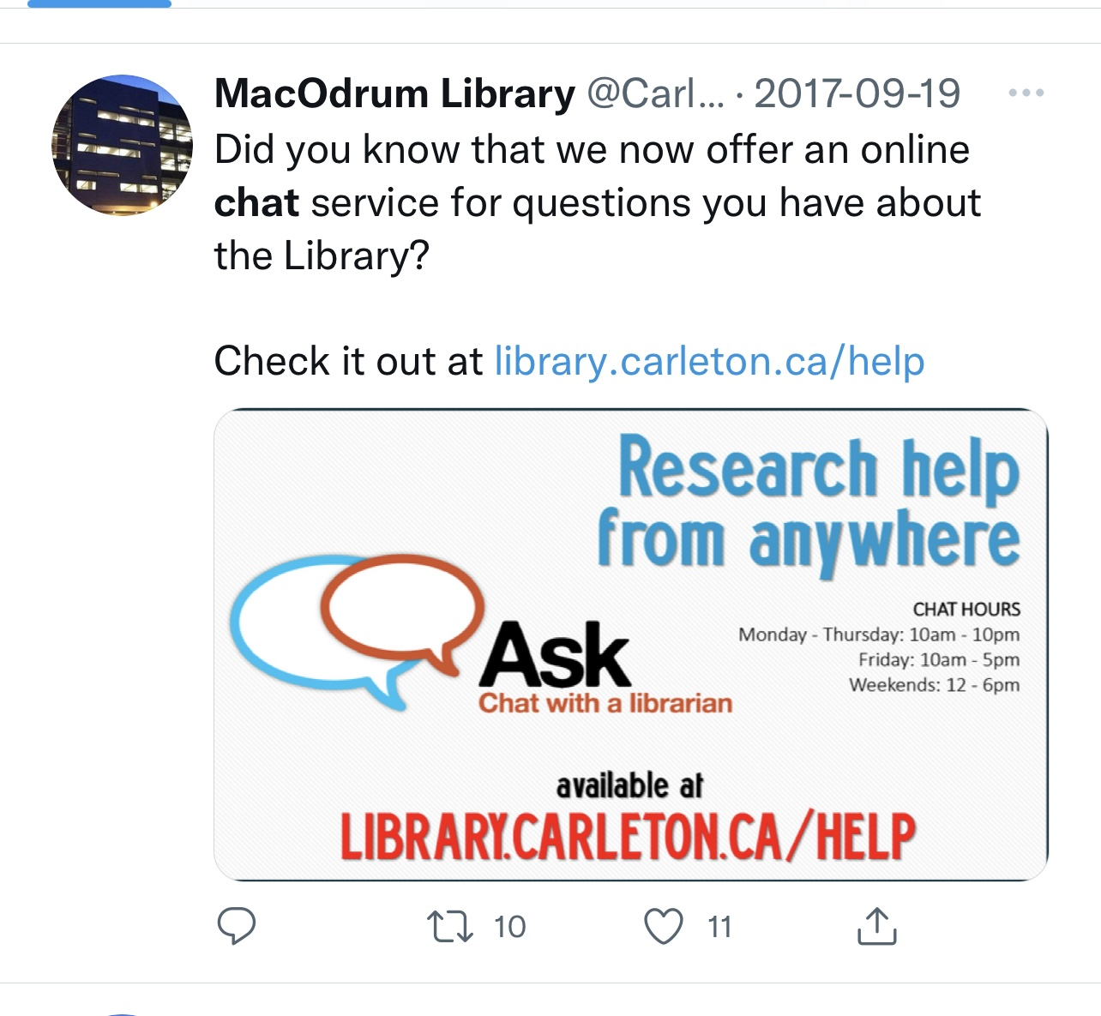
Promotion: social media

Slide 11
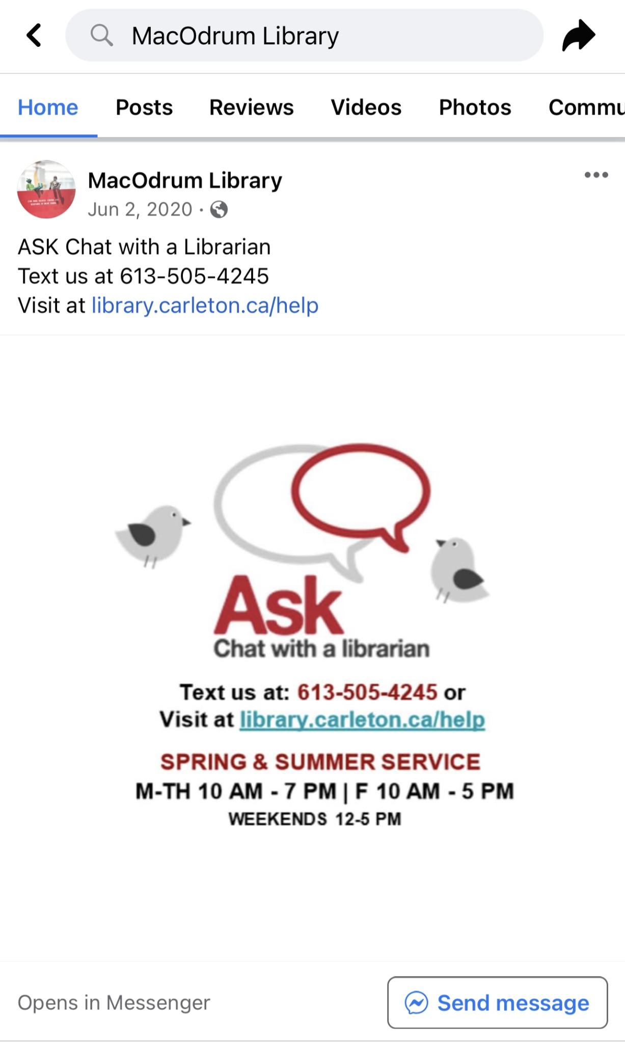

Promotion: Social media

Slide 12
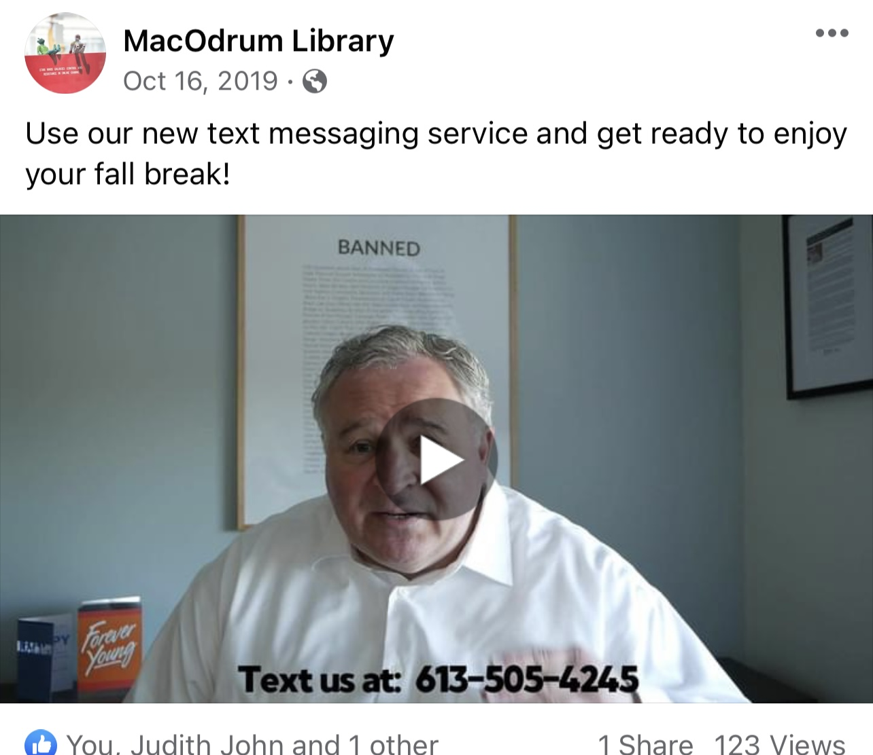
Promotion: videos

Slide 13
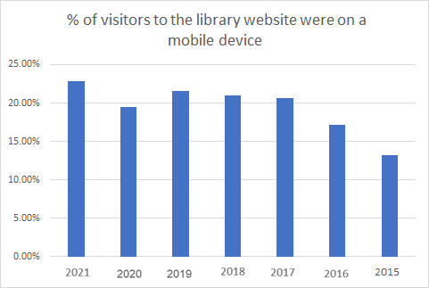
Use of mobile devices

Slide 14
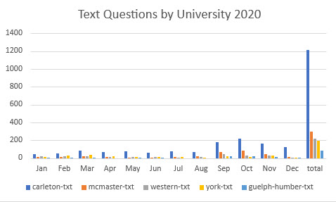
Text Usage in 2020 (I don’t like this title)
Successful campaign sees a huge increase in Ask a librarian users, accessing help via text and puts us at #1 among the 5 Universities

Slide 15
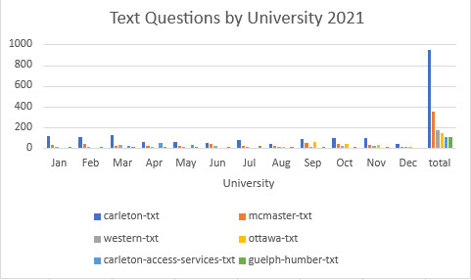
2021

Slide 16
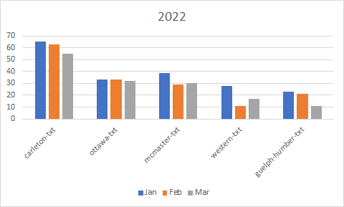
Off to a good start in 2022

Slide 17
Thank you
Aleksandra Blake aleksandra.blake@carleton.ca
Sherri Sunstrum
sherri.sunstrum@carleton.ca

