Slide 1

So, about all that text...
A lightning talk for Currents of Change
Art Rhyno, Leddy Library University of Windsor
Scholar Portal Days
May 12-13, 2022
Notes:
Hi there, I am going to talk about text.

Slide 2

2 Text Trajectories to Jupyter Notebooks
Notes:
And I am going to do that through what I am calling 2 text trajectories to jupyter notebooks. And I apologize at the outset for skipping through a lot of projects and initiatives that I am going to point to more than explain. I am hoping that you can go to the slides afterwards and follow the urls if you are interested.

Slide 3
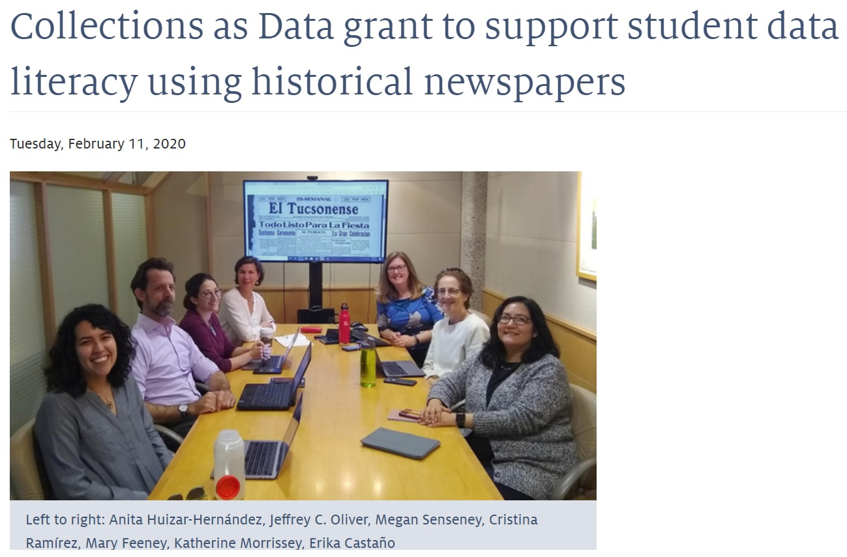
https://libguides.library.arizona.edu/newspapers-as-data
Notes:
The journey really begins just before the pandemic, with this story from the University of Arizona news. At Arizona, they have done an incredible job of leveraging their newspaper digitization work for supporting data literacy, and the libguide link nicely brings together the results of these efforts, which I m largely going to skip over.

Slide 4

https://collectionsasdata.github.io/
Notes:
The project has received funding as part of a broader initiative called "Collections As Data", which is also well worth exploring, basically the idea of using content, especially cultural heritage content, for text analysis and other forms of data processing. Arizona is somewhat unique, however, in embedding this work into the curriculum to the extent that they have done.

Slide 5
ENGL 696E | Archival Research Methods in Rhetoric and Composition
HIST 358 | Natural History of Disasters
HIST 495/595 | Archives, Museums, and Zoos: Introduction to Public History
JOUR 405/505 | Arizona Student Media Apprenticeship
SPAN 350 | Introduction to Literary Analysis
Notes:
I can't expound on this but I did want to show the success they have had in integrating their digitization efforts into courses, and this is a list of the courses where Jupyter notebooks are a conduit to text analysis.

Slide 6
“Avoid installation woes (and dependency hell) for students (this is hard enough in person)...”
Solution: Jupyter Notebooks
Notes:
I lifted this quote directly from one of Arizona's slides. It reads "Avoid installation woes (and dependency hell) for students (this is hard enough in person)..." and their solution has been Jupyter notebooks.

Slide 7
Demo
https://github.com/OurDigitalWorld/data_samples
Notes:
If you are not acquainted with Jupyter Notebooks, this example is following a script from Arizona. Jupyter is sort of a web-based computing environment. I am looking at occurances of the term influenza from mid-1917 to 1919, which is when the spanish flu was rampant in Canada. The newspaper content comes from a local title called the Amherstburg Echo which we digitized with the help of OurDigitalWorld. You can basically put your coding in these cells on the notebook page, and have them run interactively. And this char shows about what we would expect, the term influenza goes from nothing to appering a lot by mid-1918.

Slide 8
Jupyter Notebooks
Encourage a narrative
Foster sharing
Arguably convenient entry point to research computing
Notes:
I know not everyone is going to think coding statements in a cell, in this case, python, is a very intuitive rendering of logic, but at least the building blocks are there for explaining what is going on.
Notebooks also encourage sharing. Really, it is not so much notebooks, but the platform that they are on that can promote sharing, and some are better at this than others, but at least one promise of notebooks is that you can spin your own versions of what is available.
And, at least compared to most pathways to research computing, notebooks are an arguably smoother entry point to research calibre systems than many other options.

Slide 9

https://blog.allenai.org/sunsetting-cord-19-239fb2f9ff4a
Notes:
The second text trajectory that I want to highlight is the CORD-19 open research dataset, which first became available in March 2020. This received a lot of attention at the time, the White House and a coalition of leading research groups created a freely available dataset of over 1,000,000 scholarly articles to encourage data mining and other text-based approaches to help in the fight against Covid-19.

Slide 10
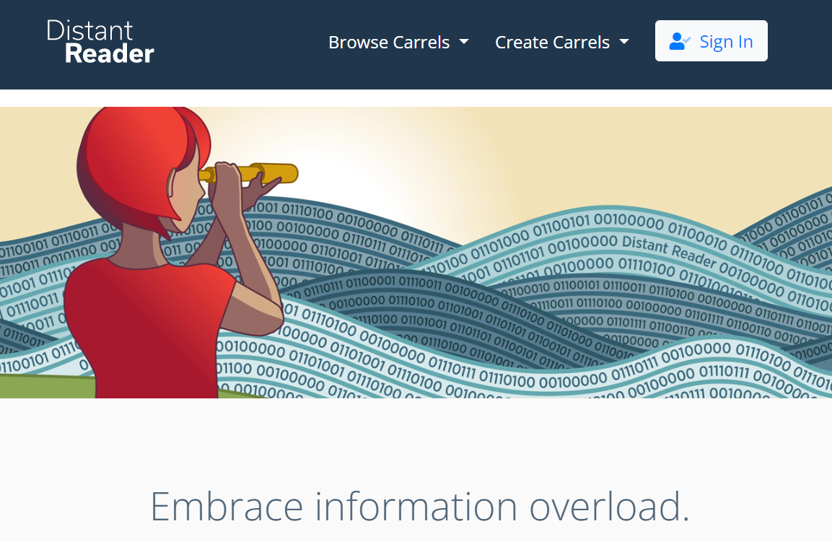
https://distantreader.org/
Notes:
I was fortunate to be able to work with Eric Lease Morgan on the CORD-19 Dataset as part of his ongoing efforts to leverage text tools to help manage information overload, a project he calls the Distant Reader. My role was mostly to help with indexing the CORD-19 dataset, for which I used solr and lucene, but I learned 3 important lessons from the process.

Slide 11
Lessons Learned
Scholars Portal data is awesome!
Research computing environments can be incredibly insular
Extracting useful data from full-text can be challenging
https://github.com/OurDigitalWorld/data_samples/blob/main/challenge.md
Notes:
One lesson, and probably the most important one for this event, is that Scholars Portal data is awesome. Bart has been working on a data view of Scholars Portal content that is world-class, and I think positions Scholars Portal well to leverage scholarly text for this kind of processing.
Eric had incredible luck in getting support from leading-edge research computing environments, and I was able to see and use some very impressive super computer systems in Indiana and Pittsburgh. I have seen a few others over the years as well, and they tend to be somewhat cryptic and insular. They have their own ways of exposing significant computing resources and there tends to be a one-off learning curve with each one of them.
So a promise of Jupyter for research computing, is that it might be the basis of a more consistent approach to research environments in general
And, finally, I don't want to oversell what is possible, the link here is a challenge that came from a consultation Eric's group had with a medical researcher at the Pittsburgh Supercomputer Center and if you are interested in the edges of text analysis, it is available for you to ponder.

Slide 12
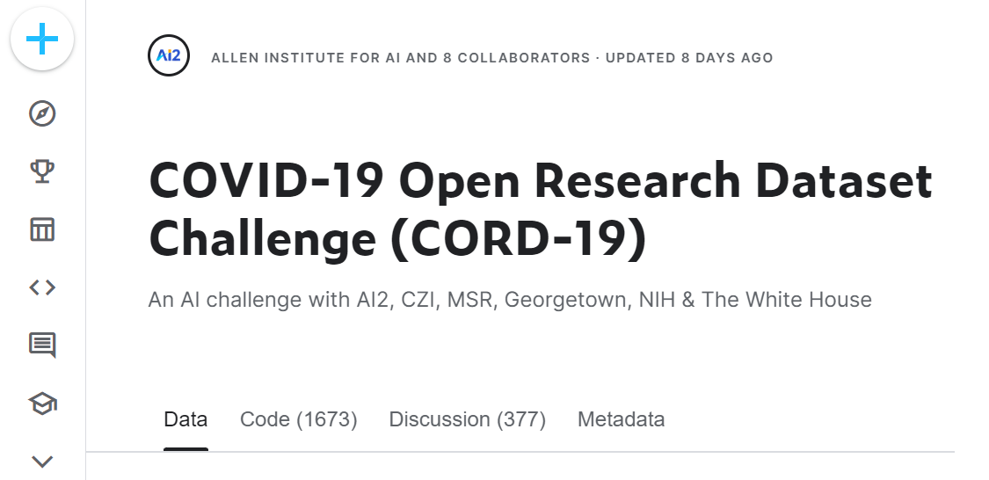
https://www.kaggle.com/datasets/allen-institute-for-ai/CORD-19-research-challenge
Notes:
But in terms of what is possible, I think it is worth considering the Kaggle competition that was held with the CORD-19 dataset. Kaggle has been called an AirBnB for data scientists, it is backed by Google, and it is a Jupyter Notebooks environment that I think really delivers on the idea of being able to share solutions. If you are interested in what Jupyter can offer for analysing scholarly text content, I would encourage you to look at this competition.

Slide 13
Demo
https://www.kaggle.com/code/yashvi/topic-modelling-using-gensim-lda/notebook
Notes:
So I am going to highlight a particular workbook from the Kaggle competition. This workbook attempts to provide a "more like this" solution when identifying an article that is of value for a researcher. You can go to the link and walk through every cell, and read the explanations, but I am going to cut to the chase and execute all the cells at once, and, given what I know about the underlying dataset, I think the results are promising.I should note, however, that it took 11 minutes in real time to execute this notebook.

Slide 14
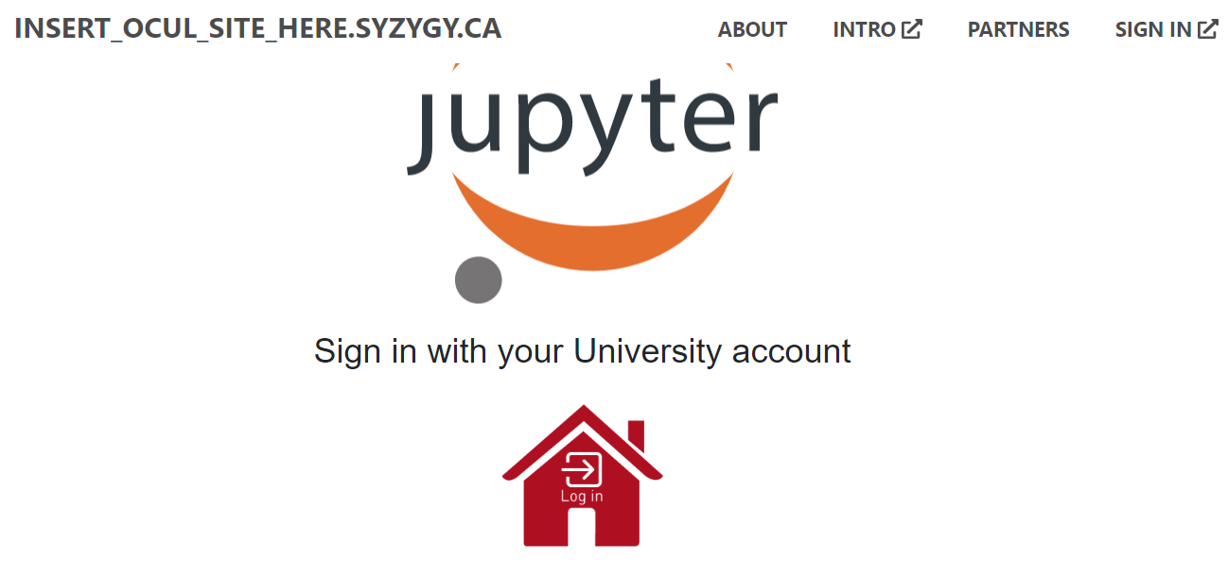
https://syzygy.ca/
Notes:
Some of you probably already know about this, but there is a project involving Compute Canada that offers a Kaggle-like environment for universities in Canada, and I believe all OCUL sites would have access to it, and it is call Syzygy, which is a clever name that means the alignment of three or more celestial objects.
And my understanding is that it is really just a matter of getting a form filled out by your computing centre. We are still in that process at Windsor but I am hopeful we will get there soon. Jupyter seems to be a common thread now for research computing in Canada, I understand that there's a project at the University of Toronto as part of the 2i2c initiative, which I believe started at Berkeley, and of course, the Digital Alliance of Canada, which is a big part of whatever Compute Canada is now, seems to see Jupyter as a common entry point for accessing computing resources.

Slide 15
Interested? Let us know.
artrhyno@uwindsor.ca
b.kawula@utoronto.ca
Notes:
So this has truly been a lightning talk. Bart and I have talked a bit about building a community of interest on text analysis vis-a-vis the amazing work being done at SP, and if you want to join in this process, Bart and I would be thrilled to hear from you. Thanks for listening.

