Slide 1
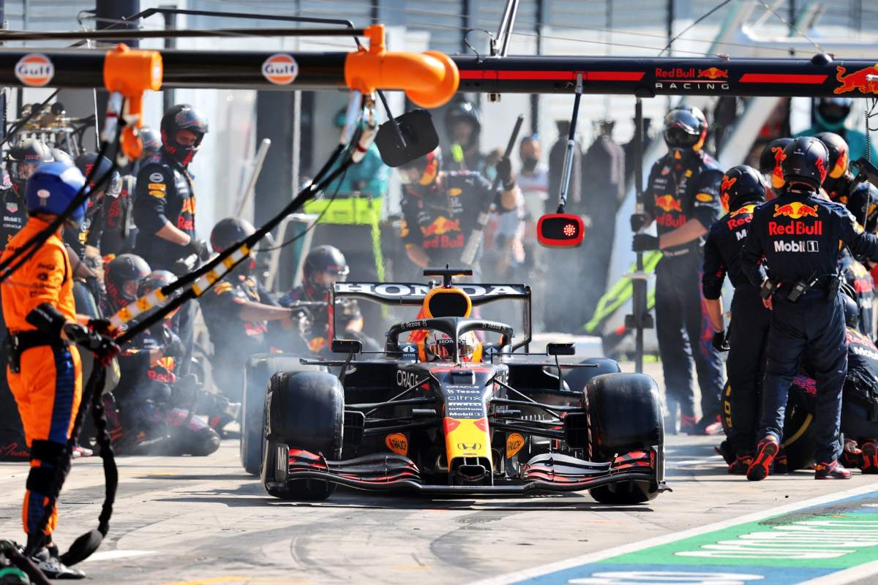

Marching Towards a PDF Pitstop:
Improving Scholars Portal Journals for Blind Users Across Ontario Along the Way
[Rivet guns firing]
[Car engine revs]
[Tires squeal]
Ashley Shaw, Mark Weiler, Matt Thomas, Bart Kawula, Aneta Kwak

Slide 2
Rationale
Only 2% of PDF scientific papers published between 2010-2019 were found to meet accessibility criteria (Wang et al., 2021)
31 out of 38 PDF’s I needed for my masters thesis literature review were untagged
For library users who are blind, the accessibility of full text materials is a major obstacle (Mulliken & Falloon, 2019)

Slide 3
When a PDF is inaccessible…
Inaccessible PDF’s feature
  Spelling errors
  missing spaces between words
  no clear reading order
  no descriptions for images
  No identifiable headings, links, tables, footnotes, references, and page numbers

Slide 4

CNIB partnership
Summer 2020: the Laurier library partnered with the Canadian National Institute for the Blind’s (CNIB) Score Summer Learning Academy
Blind and partially sighted high school students across Canada learned about using their assistive technologies to do library research

Slide 5
Call to action
It is difficult to remediate these accessibility issues in PDF’s (Jembu Rajkumar et al., 2020)
A strategy to address the prevalence of inaccessible PDF’s is needed (Post-Secondary Education Standards Development Committee, 2021, recommendations 87 and 88)

Slide 6
Design Goal: PDF Pitstop

Slide 7
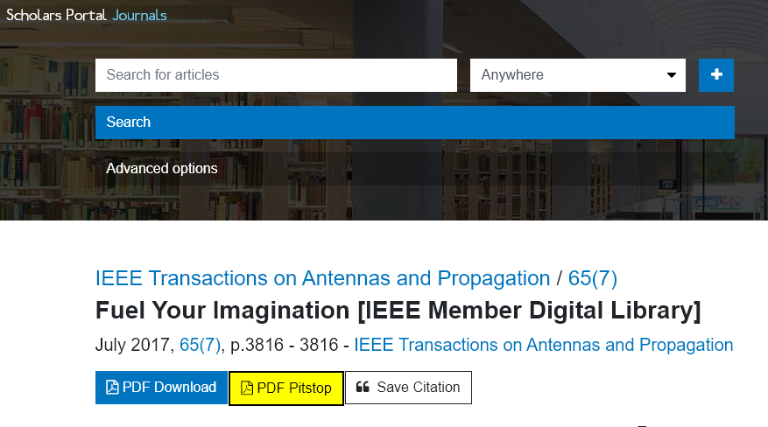
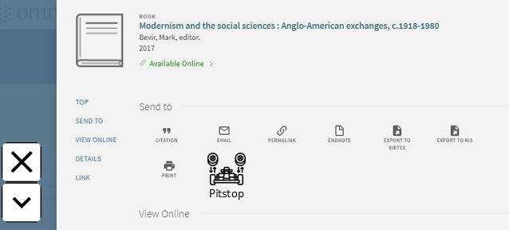
Integrating Document Remediation into Discovery
Notes:
There are two sounds on this slide. The first one announces what the interface sounds like to a screen reader user. This text is on the screen (e.g., “Fuel your imagination...”). The second sound plays when Mark says “[a PDF] pitstop tells stakeholders that a problem exists, so it doesn’t get swept under the rug anymore”. It is the sound of a pitstop. Rivet guns firing, car engine revving, and tire squealing. Your feet vibrate, soundwaves hit your chest, and your hair is thrown back by a burst of air as it the race car leaves.

Slide 8
Some characteristics of a PDF Pitstop
Verification with a screen reader;
Blind patrons should do no more work than your sighted patrons to get a usable resource; and
Report problems to stakeholders.

Slide 9
While Building Pitstop Workflows…
While building the PDF Pitstop workflows, we tried
  Tools and remediation providers
  Notifying publishers, authors, librarians
A discovery!!
  “Hidden” HTML versions were on Scholars Portal Journal

Slide 10
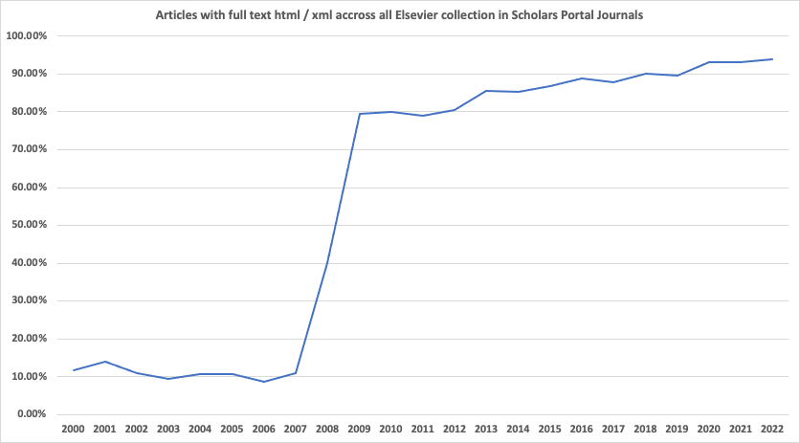
Growth of HTML Content
Articles with full text HTML across all Elsevier collections in Scholars Portal
Table data: https://nextcloud.scholarsportal.info/s/g7idKfR6rCEEoKe

Slide 11
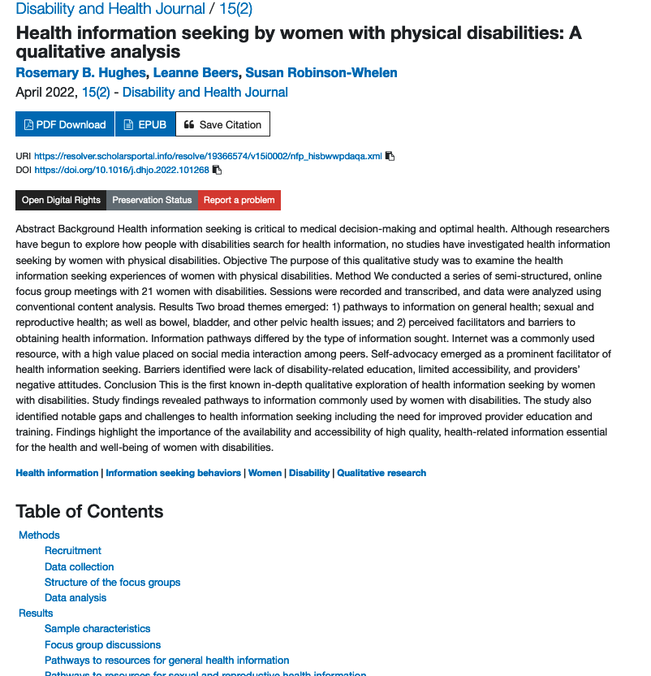
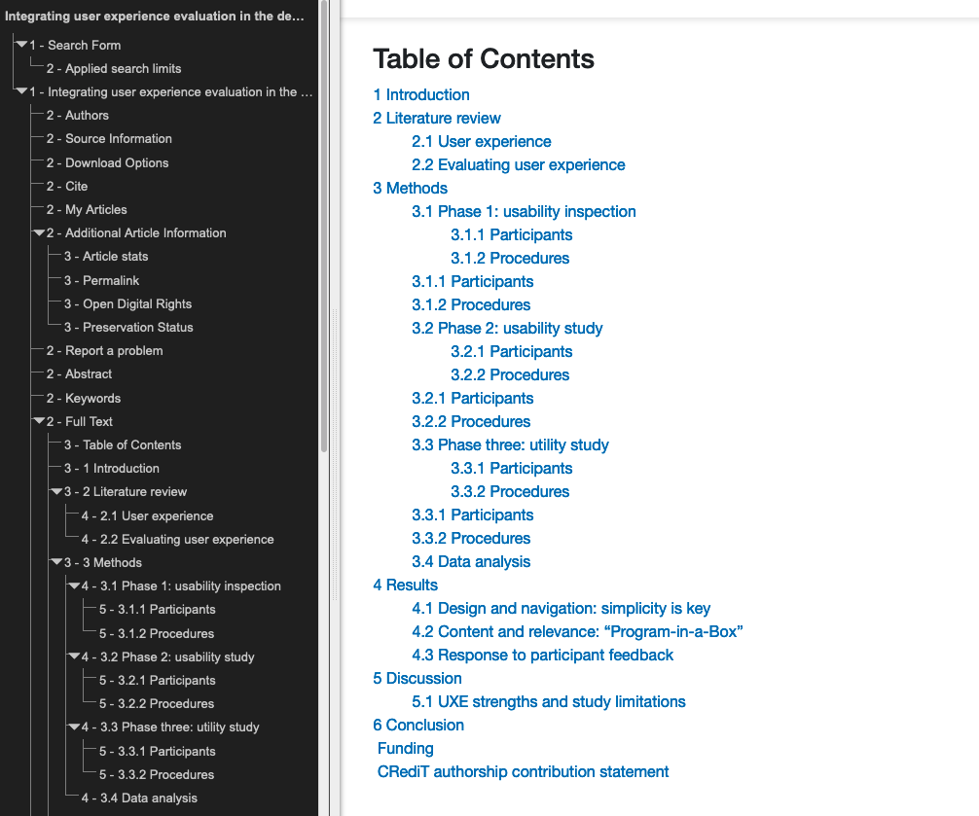
Bringing HTML to the Front

Slide 12
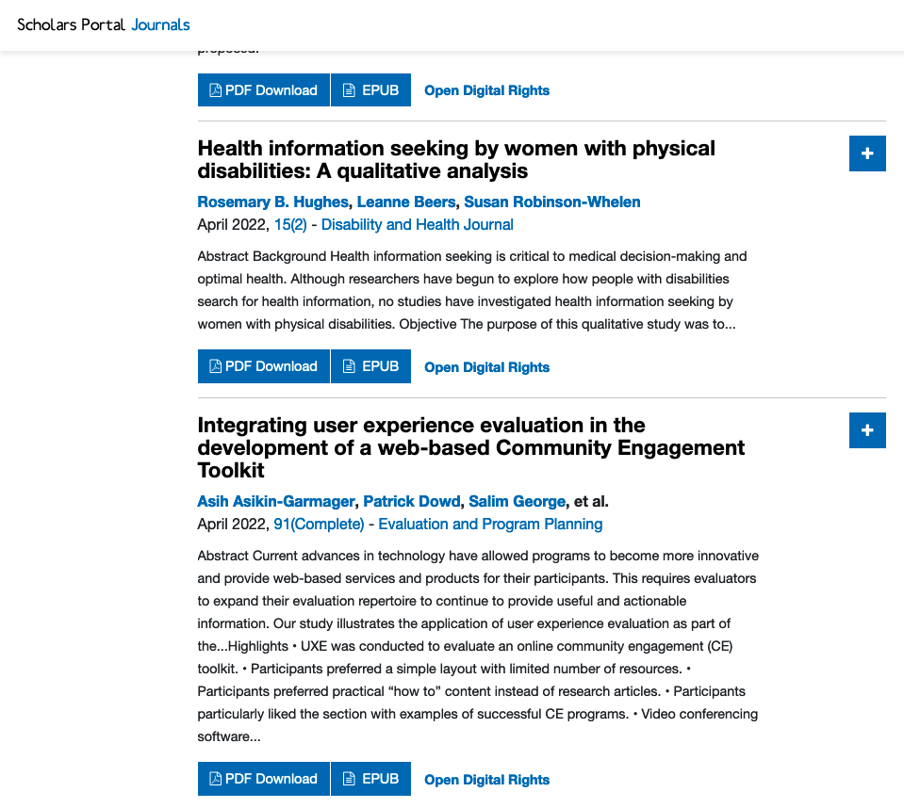
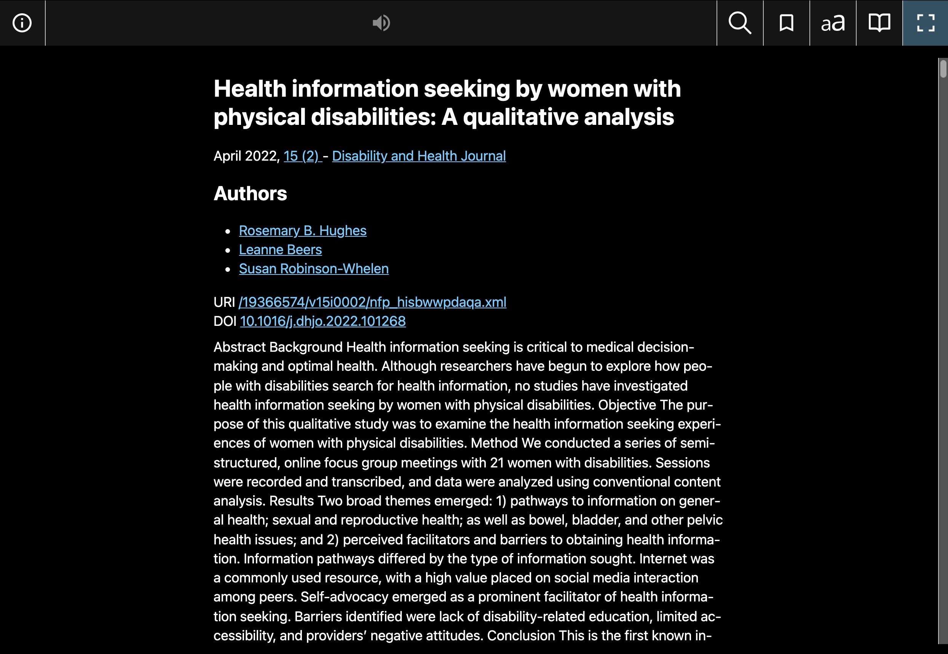
HTML to ePub

Slide 13
Nevertheless
Only 12.5 million articles in SPJ have full text HTML available. 20% of total collection of 63 million articles.
EPUB is still not perfect, but it's far easier to remediate.

Slide 14
Reflection & next steps
University libraries do not give sighted readers damaged journal articles
We should not give blind readers damaged journal articles and expect them to seek repairs.
According to the ACRL information literacy standards
  readers are expected to evaluate if the material is relevant to their study
  not spend their limited time finding readable copies of material, worrying if they are asking for too much, or learning to cope without.

Slide 15
Next steps
Do you know someone we can talk with?
Experts in automation tools, such as SharePoint’s Power Automate
Experts in collaborative editing tools for HTML

Slide 16
What can you do?
We continue to respond
Can you recommend
  Experts in automation tools, such as SharePoint’s Power Automate
  Experts in collaborative editing tools for HTML

Slide 17
Speak Out! Speak Up!
As long as we have collections that have not been verified, then we need pitstops in our library platforms
Ontario library employees make history and say:
“OCUL! We want support for PDF pitstops”

