Slide 1




Looking to the past for future directions of <odesi>
Alexandra Cooper, Queen’s University
Amber Leahey, Scholars Portal
Scholars Portal Day, 2022

Slide 2
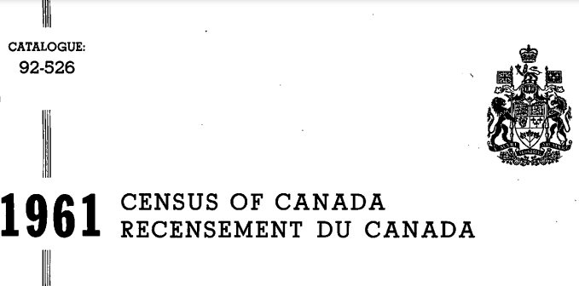


Data services beginnings
1961 Census:
First census data to be released in machine-readable format.
Data Library established at University of Toronto
1972
1961
First library-based data service created by the merger of UBC’s Computing Centre’s Data Service with the UBC’s Library
1980s

Slide 3




1986 Census
Statistics Canada creates new cost-recovery model for census publications
Canadian Association of Research Libraries (CARL) organizes a consortium of its members to purchase a copy of the census data for dissemination to participating members (pre-cursor to DLI)

Slide 4

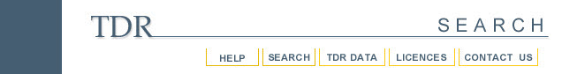

Early data portals
Internet Data Library System (IDLS) – Western
Queen’s web interface for SPSS (QWIFS) – Queen’s
~1996
1996
1999
1995
1998/99
Tri-University Data Resources (TDR) –
UofG, WLU, UofW
Integrated System for the manipuLation and
Analysis of Numeric Data (ISLAND) – UBC
Local Access to Networked Data Retrieval Utility (LANDRU) – Calgary
Data Liberation Initiative (DLI) established
Sherlock – CREPEQ (now BCI)
Consortium of Quebec universities

Slide 5

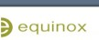

New platforms and collaborations
Equinox – partnership of WesternU and CREPEQ
Abacus Data Network (Nesstar) supporting UBC, SFU, UNBC, and UVic
QWIFS retires
Queen’s and CORA* start using Nesstar
TDR starts using Nesstar
2003
2008
2001
2006
2009
UofT starts using SDA*
University of California, Berkley platform
Scholars Portal (SP) introduces <odesi>, using the Nesstar platform
*CORA – Canadian Opinion Research Archive *SDA – Survey Documentation and Analysis

Slide 6


Collaborating with Scholars Portal
<odesi> Open Data Datverse released (Statistics Canada aggregate data)
<odesi> is opened to non-OCUL schools
2012
2015 - 2016
Scholars Portal launches Scholars Geoportal (geospatial component to data)
Scholars Portal launches Dataverse
2013
CORA moves to <odesi> Nesstar
Abacus Data Network launches their Dataverse
2017
SP Dataverse introduces institutional dataverses and opens to non-OCUL schools
Equinox retires

Slide 7
Migrating to the future
<odesi> Dataverse Collection goes live
<odesi> Nesstar shut down
2021-2022
<odesi> Nesstar Migration Project Working Group plan and migrate <odesi> to Dataverse
CORA collection migrated as pilot (Spring/Summer 2022)
2023

Slide 8
Continued collaboration

Slide 9
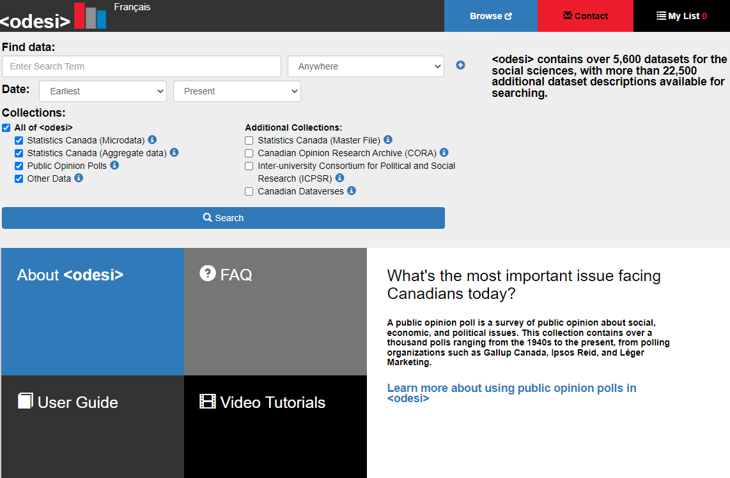
Background
Since 2008 <odesi> is a shared library infrastructure for access to social science survey data collections and public opinion polls
Online search, exploration, download in statistical formats
DDI variable-level metadata supports question and concept level discovery

Slide 10
Nesstar replacement
Nesstar - <odesi> back-end repository
Reaching end-of-life
  To be decommissioned in ~2023-2024
Nesstar Replacement Working Group (2020-2022)
  Evaluation of replacement solutions, models and workflows to be developed
  Report to OCUL SPOD in March 2022
Dataverse was selected as the replacement solution for Nesstar
<odesi> search (https://odesi.ca) will be maintained to help facilitate search and discovery

Slide 11
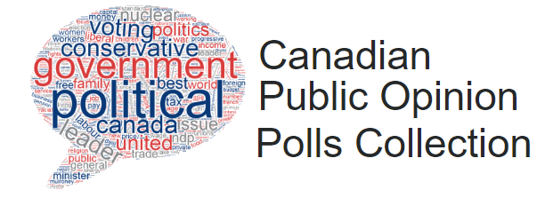
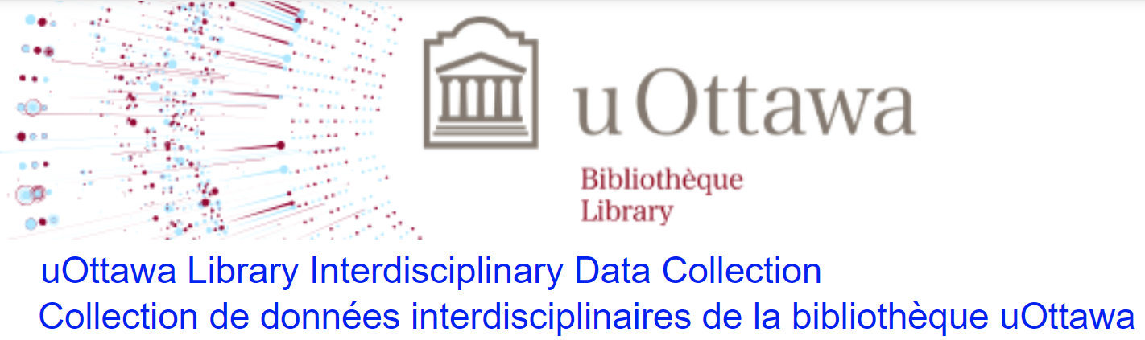
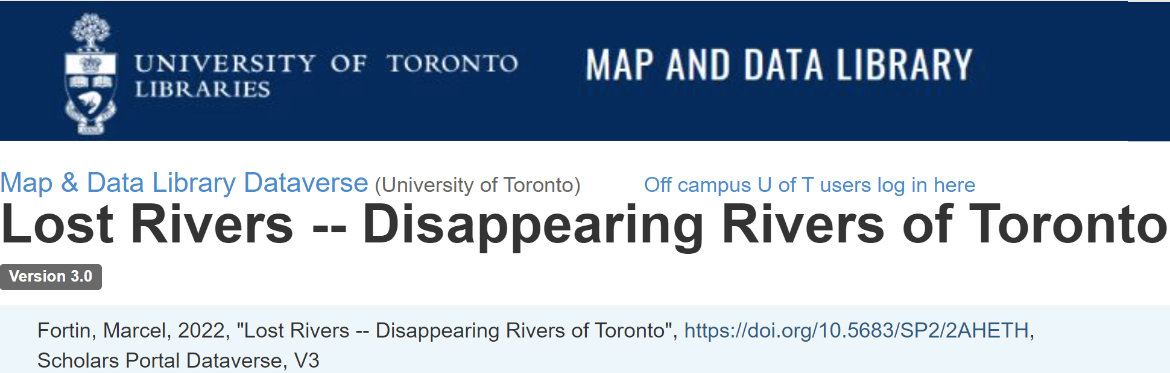
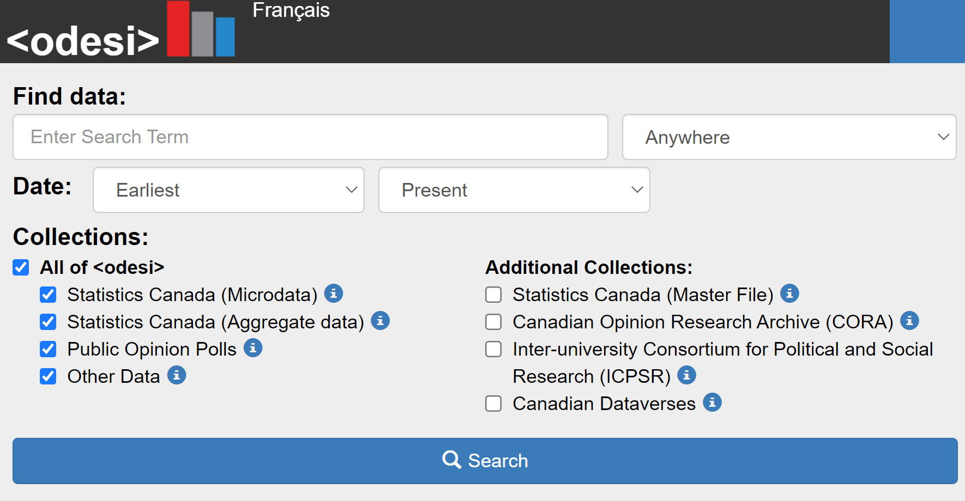

Coordination across collections

Slide 12
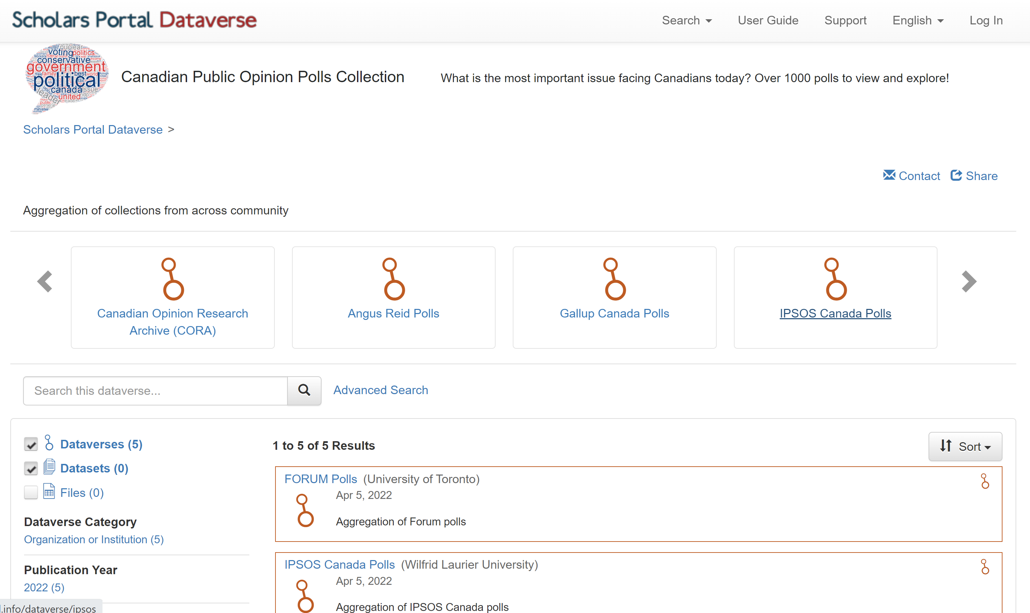
Public opinion polls
Aggregate across institutional POP archives:
FORUM (UofT)
IPSOS Canada (WLU)
IPSOS International (UofT)
Angus Reid (Queen’s)
CORA (Queen’s)
Gallup Canada (Carleton)
Leger (UOttawa)
…
https://demodv.scholarsportal.info/dataverse/canpop

Slide 13
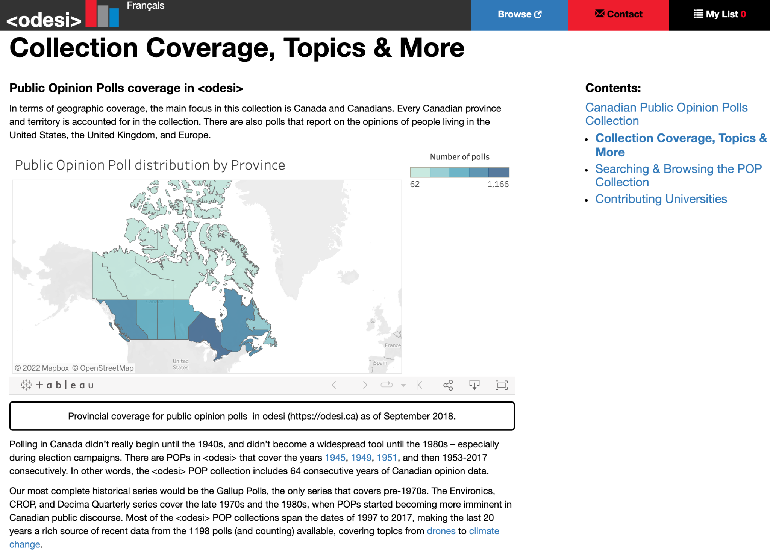
Fostering POP collaboration
Focus on topics, research impacts
Build cross-collection expertise
Teaching and learning modules
Shared infrastructure to support curation, long-term access & preservation of data collections
https://learn.scholarsportal.info/featured/pop/

Slide 14
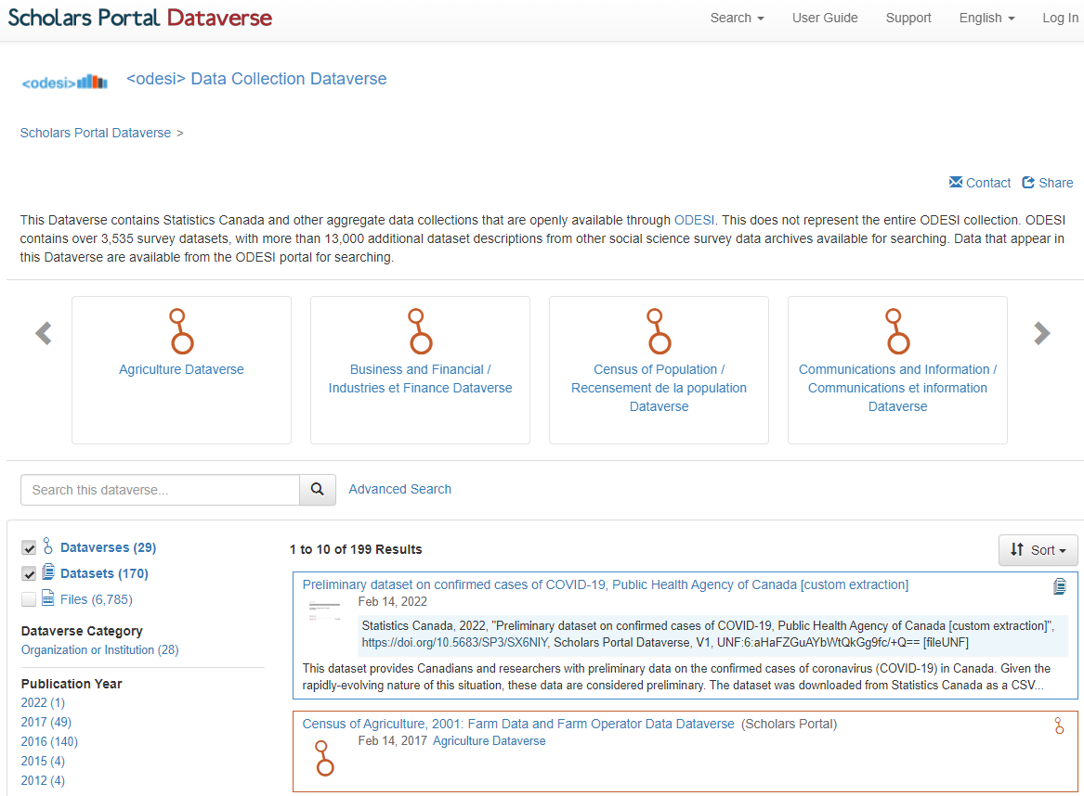
Statistics Canada (DLI)
Ongoing need for open discovery and access to DLI PUMF & aggregate data collections
Coordinate on digital preservation for historical / legacy data products (obsolete formats, inventories, etc.)
Provide library data infrastructure, to support reference, teaching and learning
https://dataverse.scholarsportal.info/dataverse/odesi

Slide 15
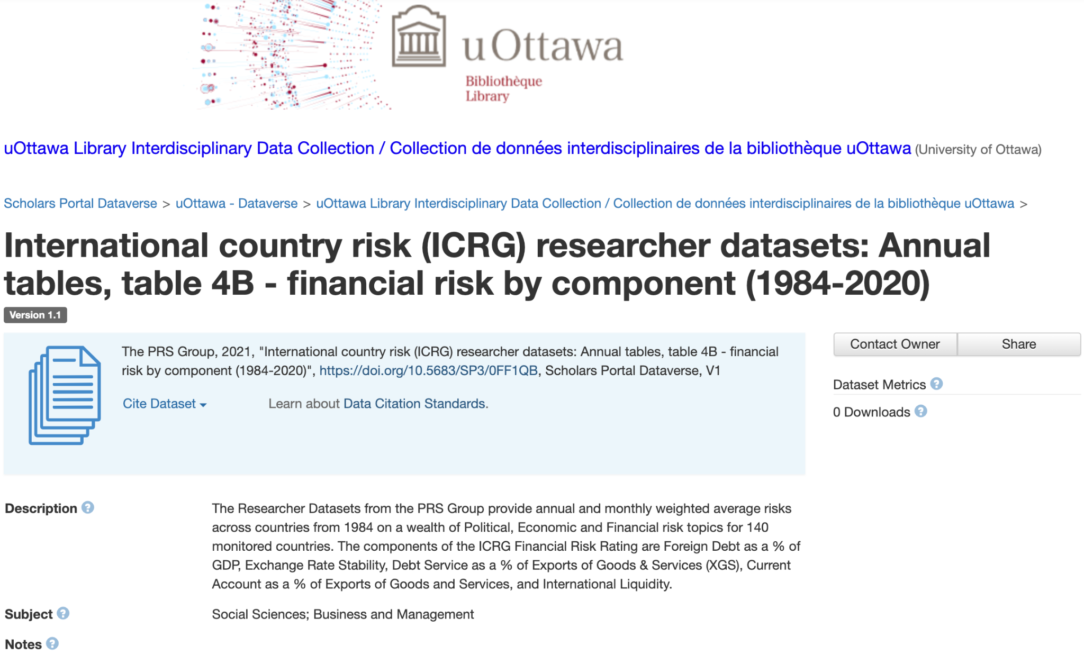
Licensed and restricted data
Institutional/library licensed data collections (e.g. commercial data, licenced government data, etc.)
Restricted access data
Restricted metadata collections (RDC microdata)
https://dataverse.scholarsportal.info/dataset.xhtml?persistentId=doi:10.5683/SP3/0FF1QB

Slide 16
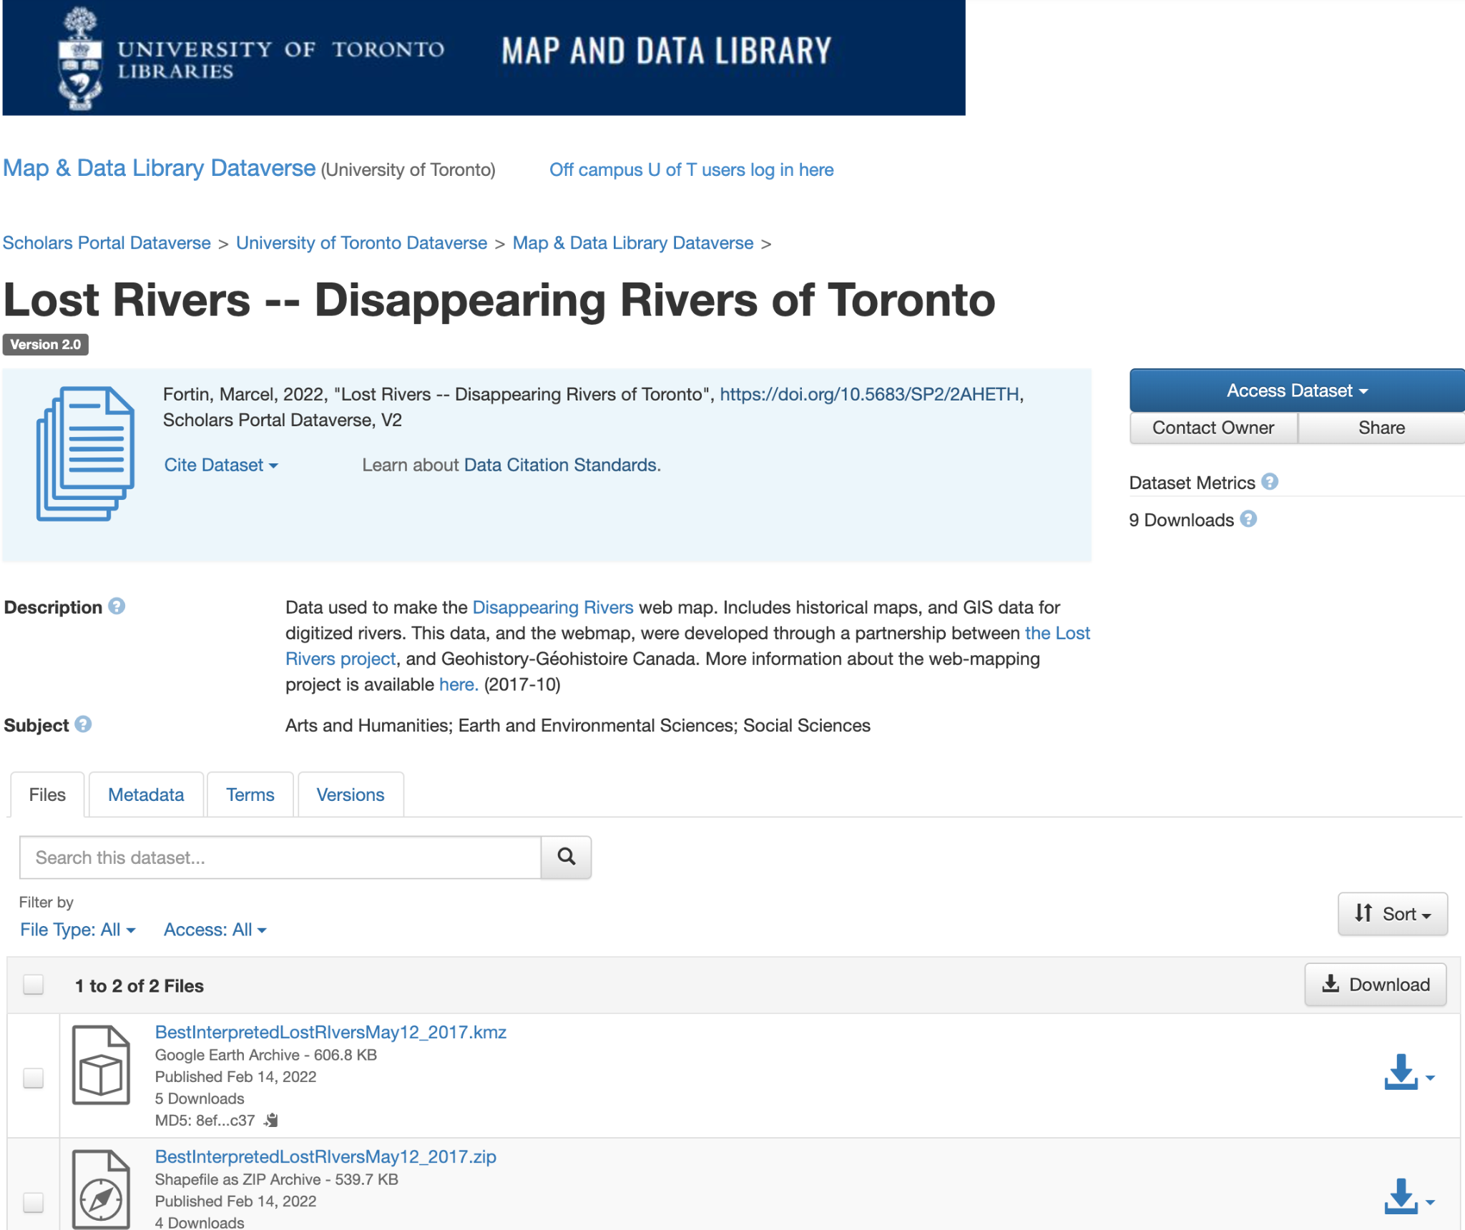
Library open data & disciplinary collections
Collections and archives of accessible data for use in research, teaching, and open learning
Emerging cross-disciplinary data collections:
  Social science surveys
  Census data
  Regional studies
  Historical GIS
  More
Academic libraries play a role in providing transformative access to high quality, curated data for use in research
https://dataverse.scholarsportal.info/dataset.xhtml?persistentId=doi:10.5683/SP2/2AHETH

Slide 17
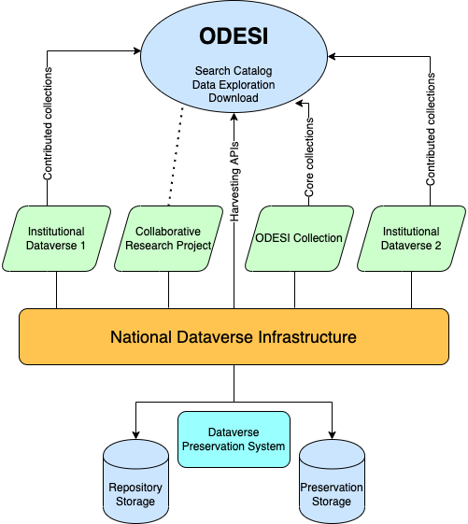
<odesi> - A way to discover curated research data

Slide 18
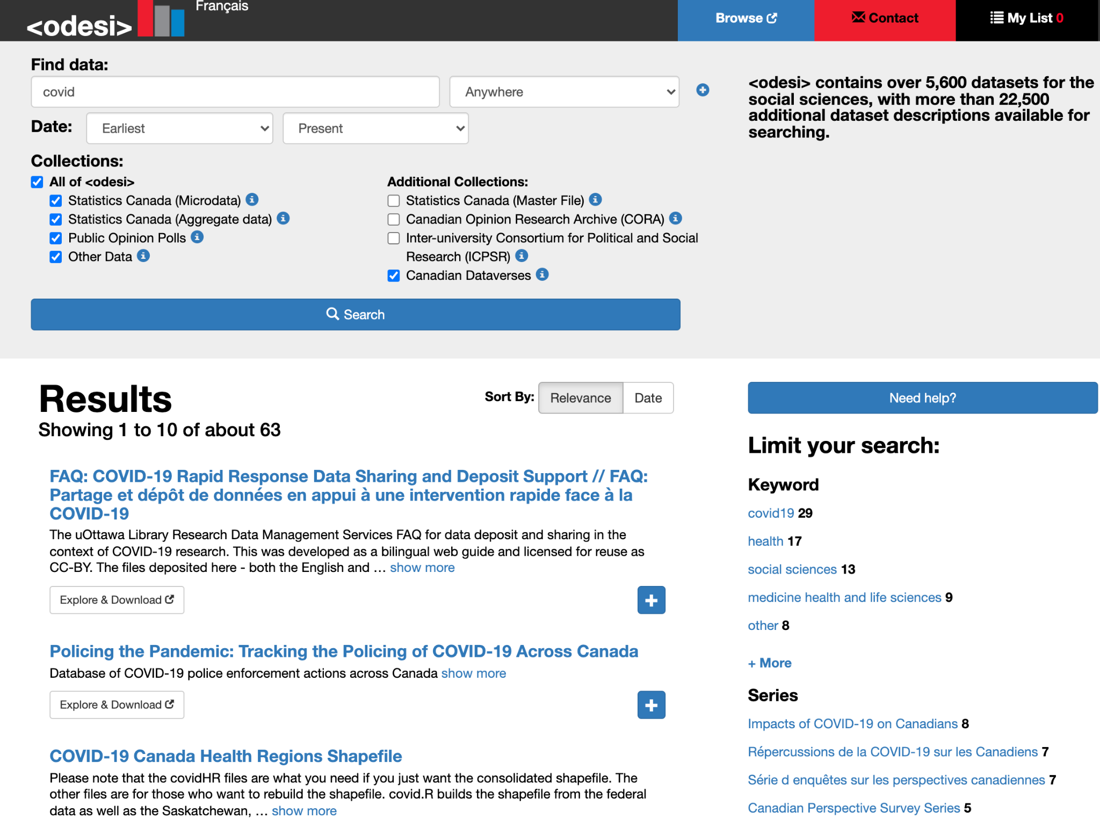
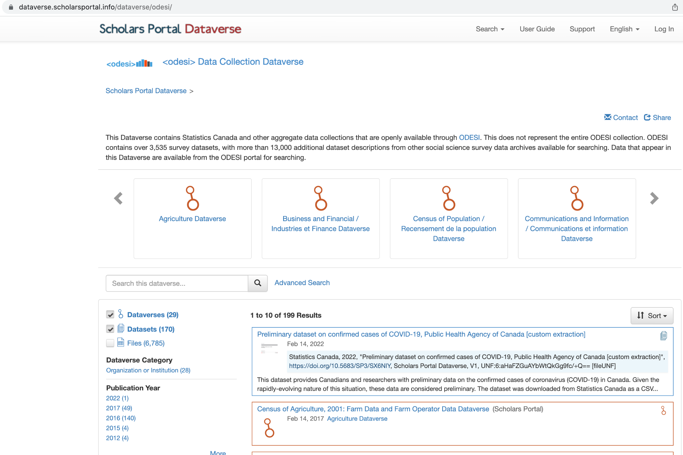

Slide 19
Next steps
Work with SP to automate workflows for migration and transfer
Adapt standard metadata and controlled vocabularies for use in Dataverse
Evaluate publishing and loading workflows for maintenance and new collections
Testing migration of the Canadian Opinion Research Archive (CORA)
Provide initial discovery integration with ODESI Search site
Continue consultation and communications with various stakeholders and communities about changes and migration timelines

Slide 20
<odesi> Migration Project Working Group
Amber Leahey, Scholars Portal
Guinsly Mondesir, Scholars Portal
Melissa Cheung, University of Ottawa
Alex Cooper, Queen's University
Jane Fry, Carleton University
Meghan Goodchild, Scholars Portal/Queen's University
Chantal Ripp, University of Ottawa
Michael Steeleworthy, Wilfrid Laurier University
Leanne Trimble, University of Toronto
Kate Davis, Scholars Portal
Kaitlin Newson, Scholars Portal
Alicia Urquidi Díaz, Scholars Portal
Victoria Lubitchv, Scholars Portal

Slide 21
Questions or comments
Amber Leahey, Scholars Portal amber.leahey@utoronto.ca
Alexandra Cooper, Queen’s University coopera@queensu.ca

