Slide 1
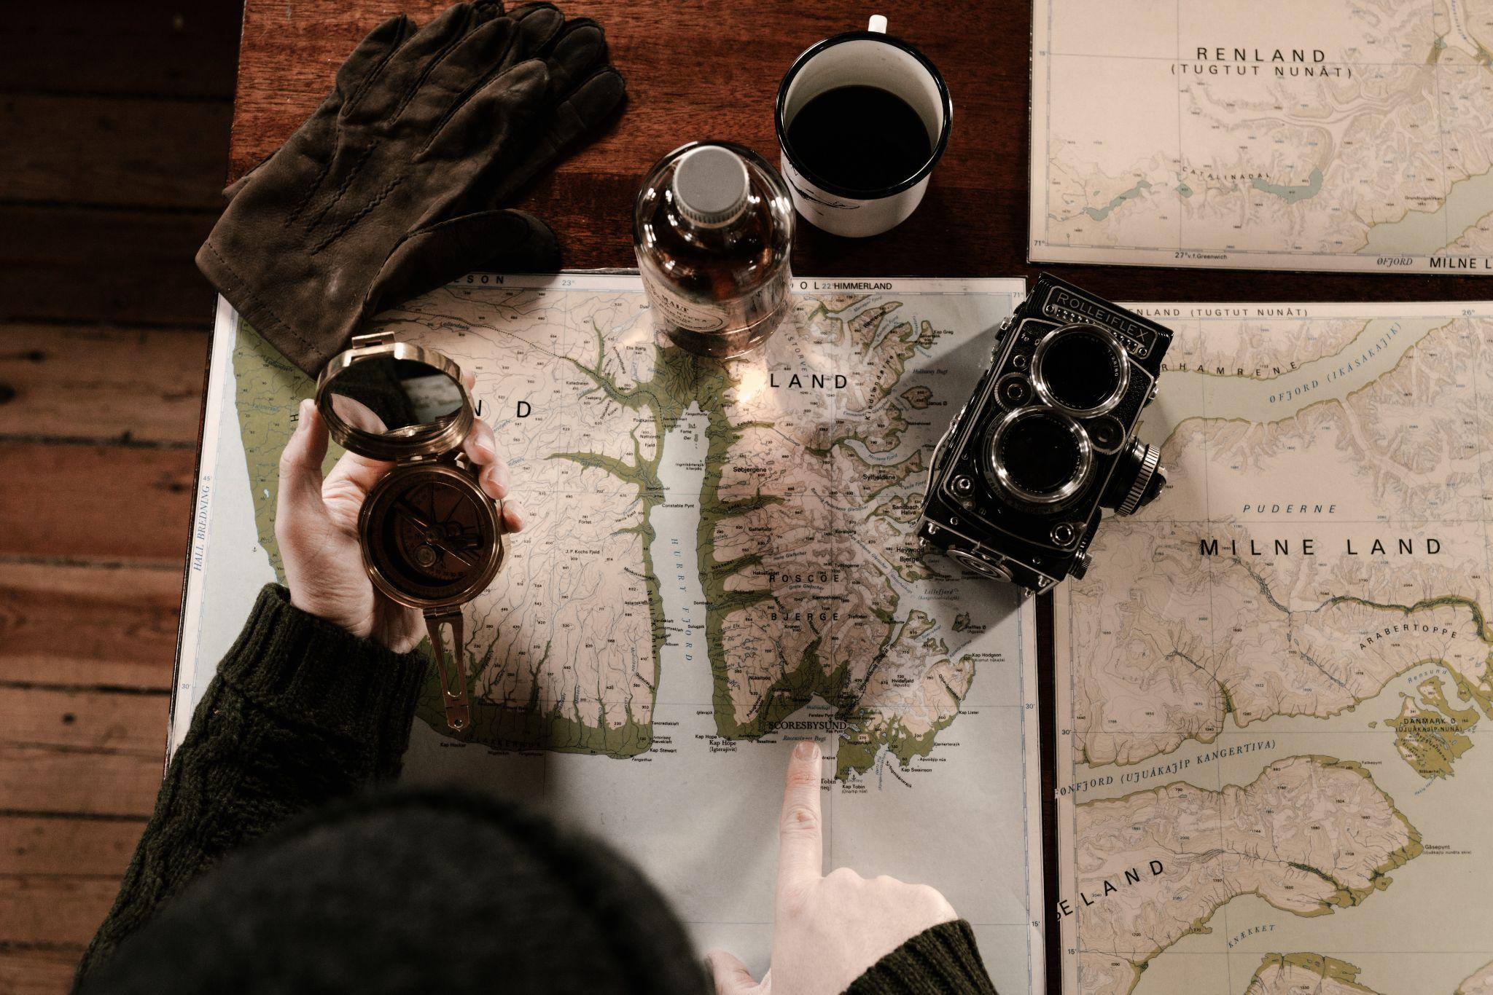
Reinvesting in the Scholars GeoPortal:
The future of GIS at OCUL
René Duplain, GIS Librarian, University of Ottawa
Kara Handren, Data Librarian, University of Toronto

Slide 2
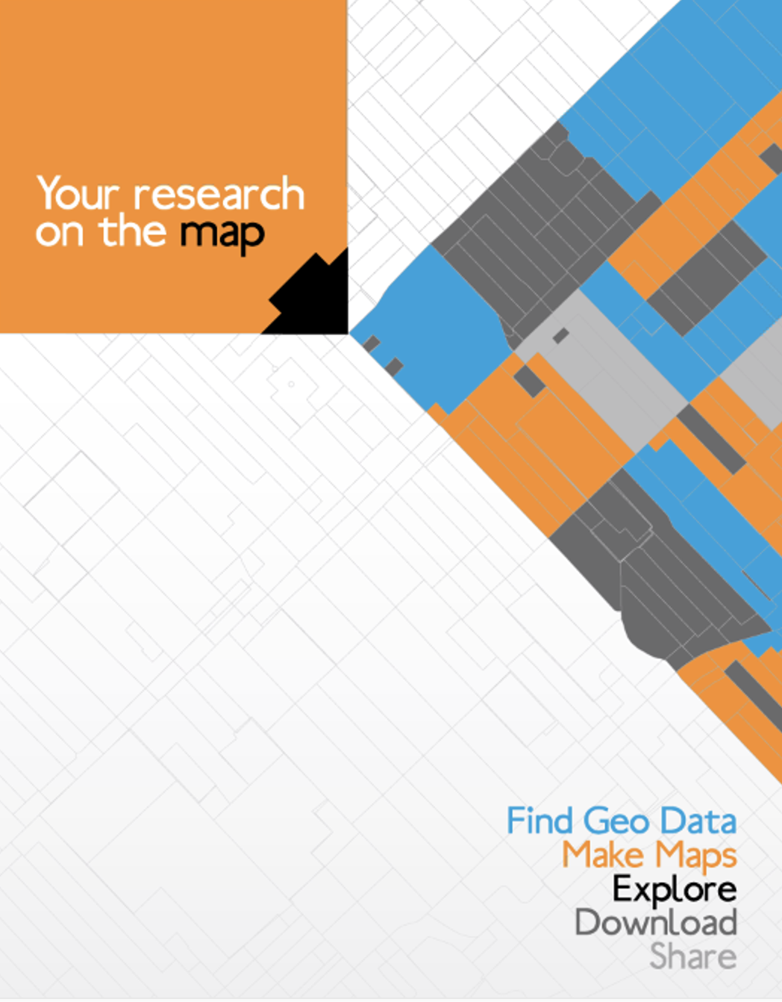
GIS at OCUL
The GeoPortal was Designed to:
Improve the research infrastructure in Ontario universities
Improve access to geospatial data through centralized repository
Leverage centralized staffing and consortial purchases of data and infrastructure
Create opportunities for integration of geospatial data into instruction

Slide 3
A Valuable Service
Hard to understate the value of having a “one-stop shop”:
  discover, visualize, compare, and download data - all in one place!
Can also make available robust datasets for researchers and provides equity of access for smaller institutions
Great to integrate into courses, and introduce new GIS users
Centralized staffing and hardware / technical resources result in a significant cost savings
Without the GeoPortal, each institution’s capacity to store and disseminate geospatial data would be greatly reduced

Slide 4
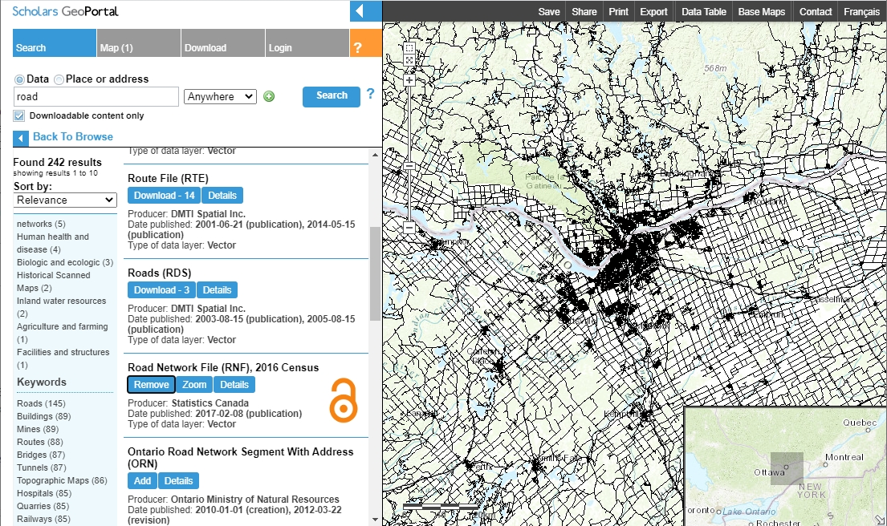
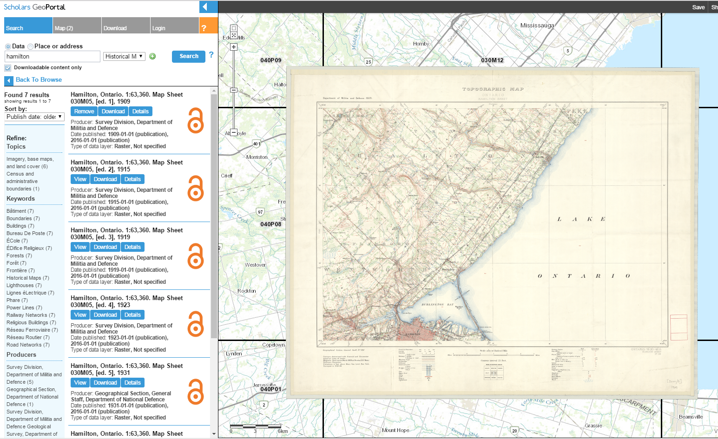
A Valuable Service

Slide 5
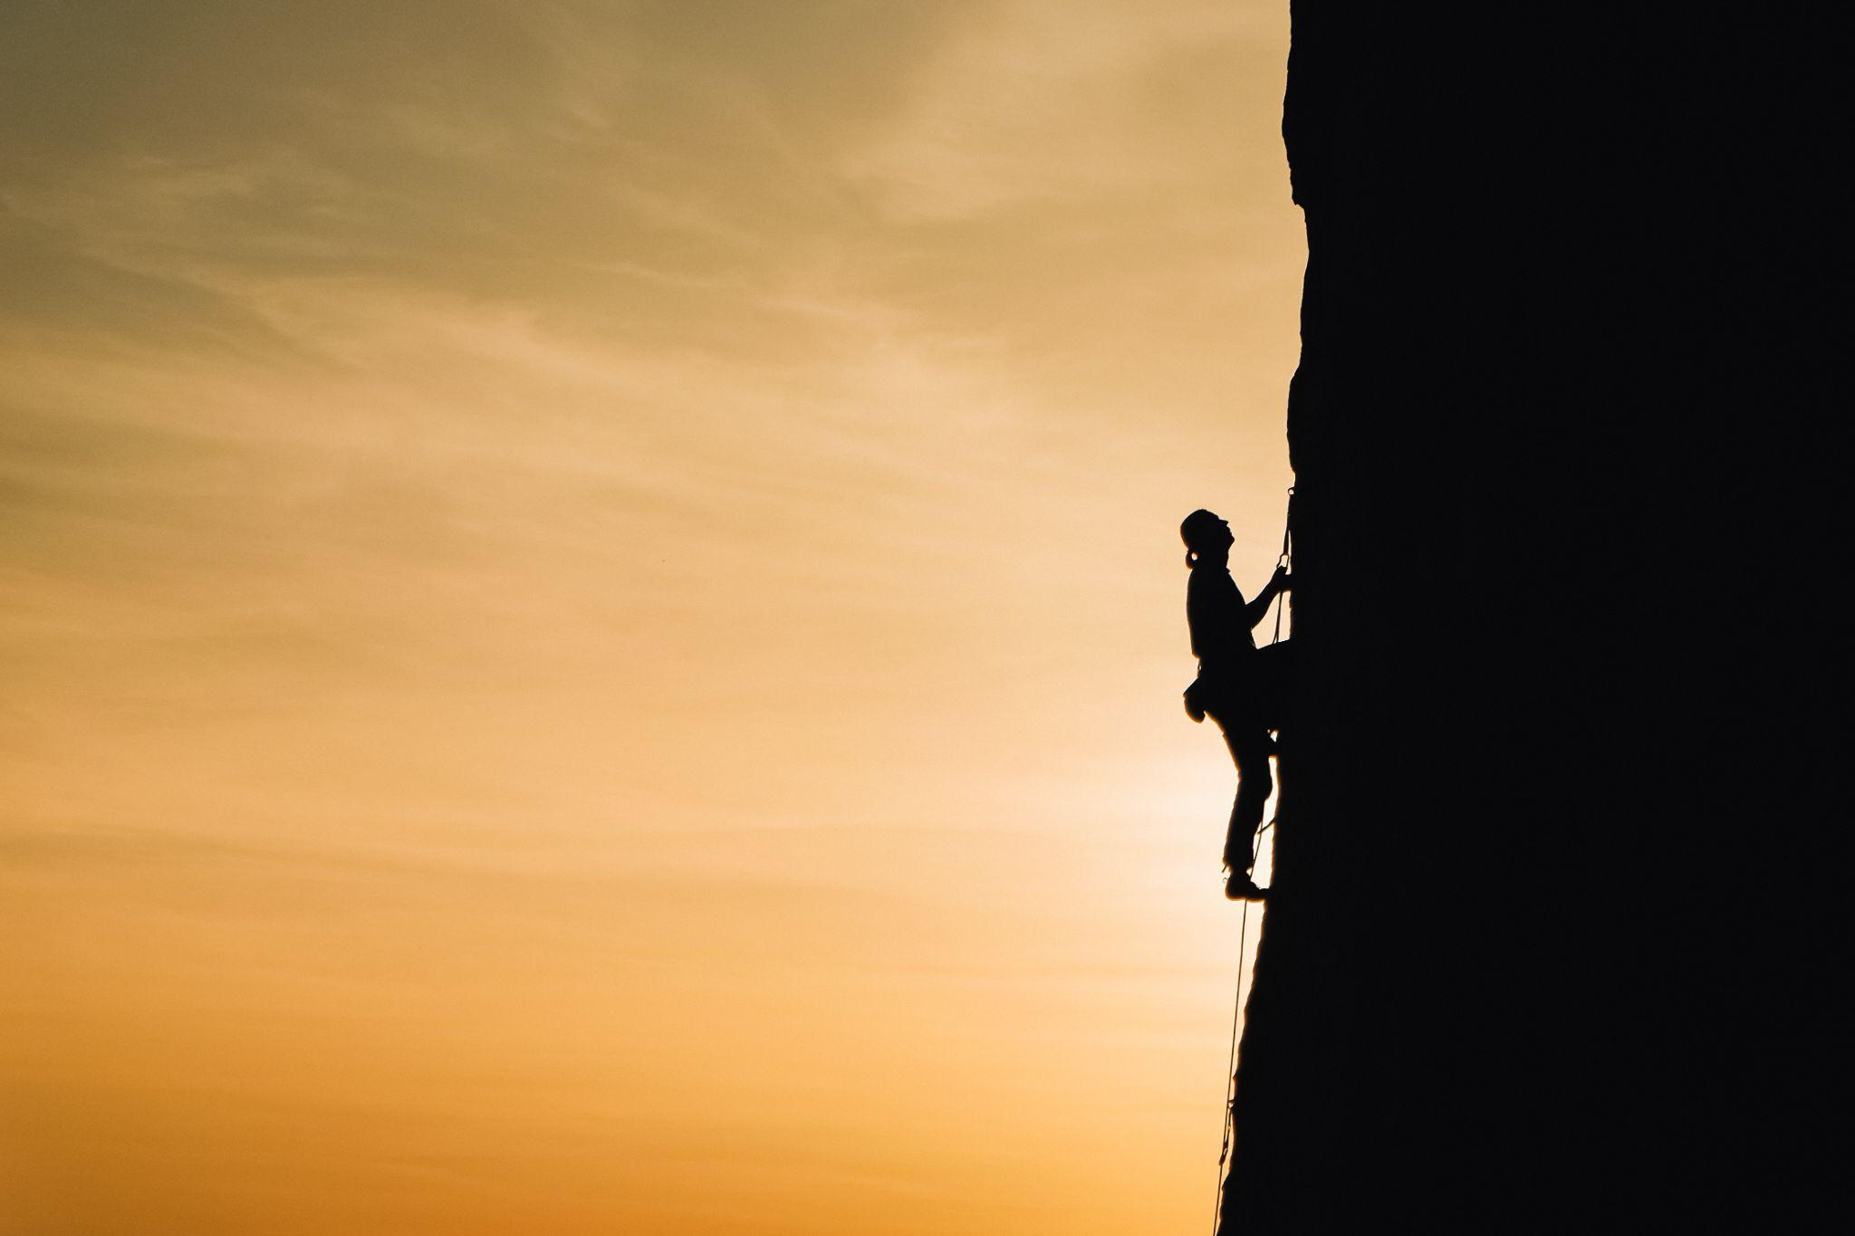
Reinvesting in the Scholars GeoPortal:
Challenges
Evolving Community and Community Needs
Changing Data Size, Types and Access
An Aging Infrastructure
The future of GIS at OCUL
René Duplain, Research Librarian, University of Ottawa
Kara Handren, Data Librarian, University of Toronto Libraries

Slide 6
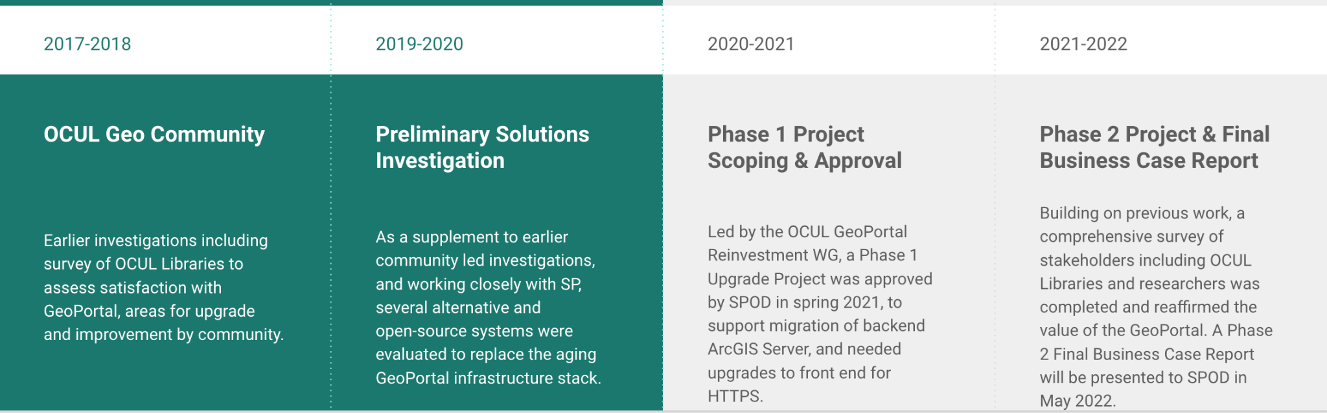
Towards a Reinvestment

Slide 7

Reinvesting in the Scholars GeoPortal:
Phase 2:
The Information Gathering Process
The future of GIS at OCUL
René Duplain, Research Librarian, University of Ottawa
Kara Handren, Data Librarian, University of Toronto Libraries

Slide 8
Towards a New Platform
A survey of OCUL Institutions
A survey of OCUL Researchers
SWOT Analysis of available vendor and Open Source out-of-the-box solutions
Meetings with ESRI
Drafting of Functional Requirements and Business Case Reports

Slide 9
A Survey of our Members
822
Average GIS data interactions by institution per year
94%
have an Esri Site License
1,047
average number of ArcGIS Online user accounts in each institution

Slide 10
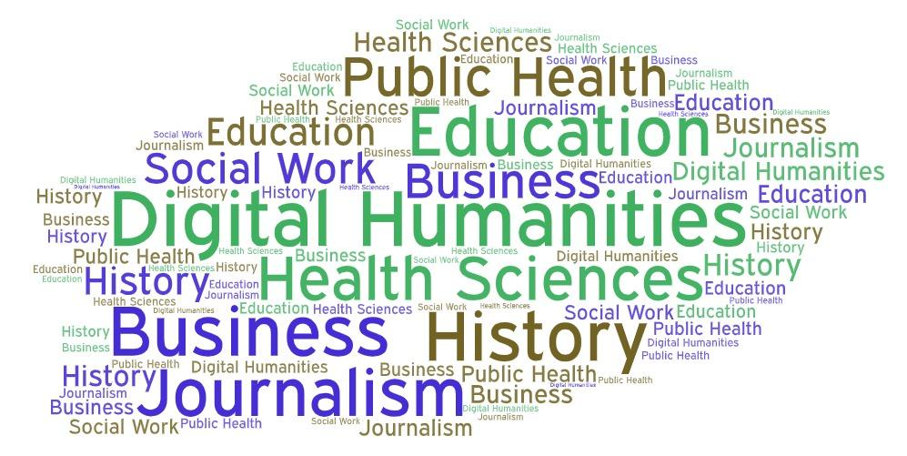
A Survey of our Members

Slide 11
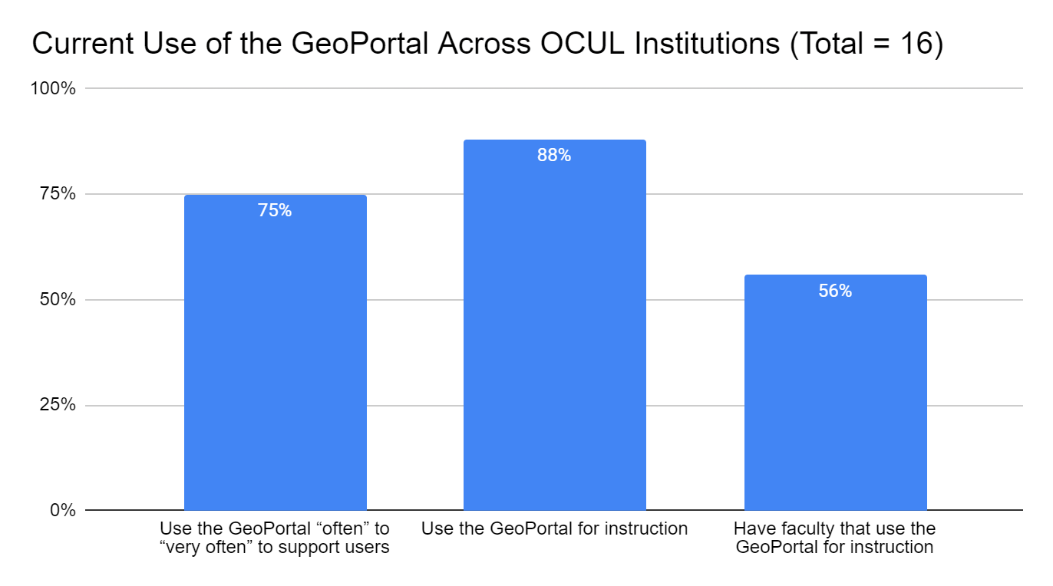
A Survey of our Members

Slide 12
A Survey of our Researchers
“Please keep its current functions! It took me years after moving to Canada to figure out where the hell data was kept, and if Geoportal went away, I'd have to re-learn this. Or just stop doing this kind of teaching and research.”
Faculty at Brock University
“I have used resources available from the GeoPortal for contextualizing newly collected data. In particular access to surficial geological data has been very useful for my environmental science research work.”
Faculty at York University
“Resource for Ontario based spatial data. I refer undergrad and graduate students to the Geoportal as a main source for authoritative data for the province.”
Faculty/Staff at Wilfrid Laurier University
“I have used data from GeoPortal for teaching my labs, and it has been very helpful!”
Faculty at the University of Toronto
o

Slide 13
Other Investigations
SWOT Analysis of available vendor and Open Source out-of-the-box solutions
  Completed by Scholars Portal, based on earlier recommendations by the 2019-2020 working group.
Meetings with ESRI
  Helped us to better understand possible out of the box solutions, and plan for a streamlined workflow from Phase 1 into Phase 2 work
Drafting of Functional Requirements and Business Case Reports

Slide 14
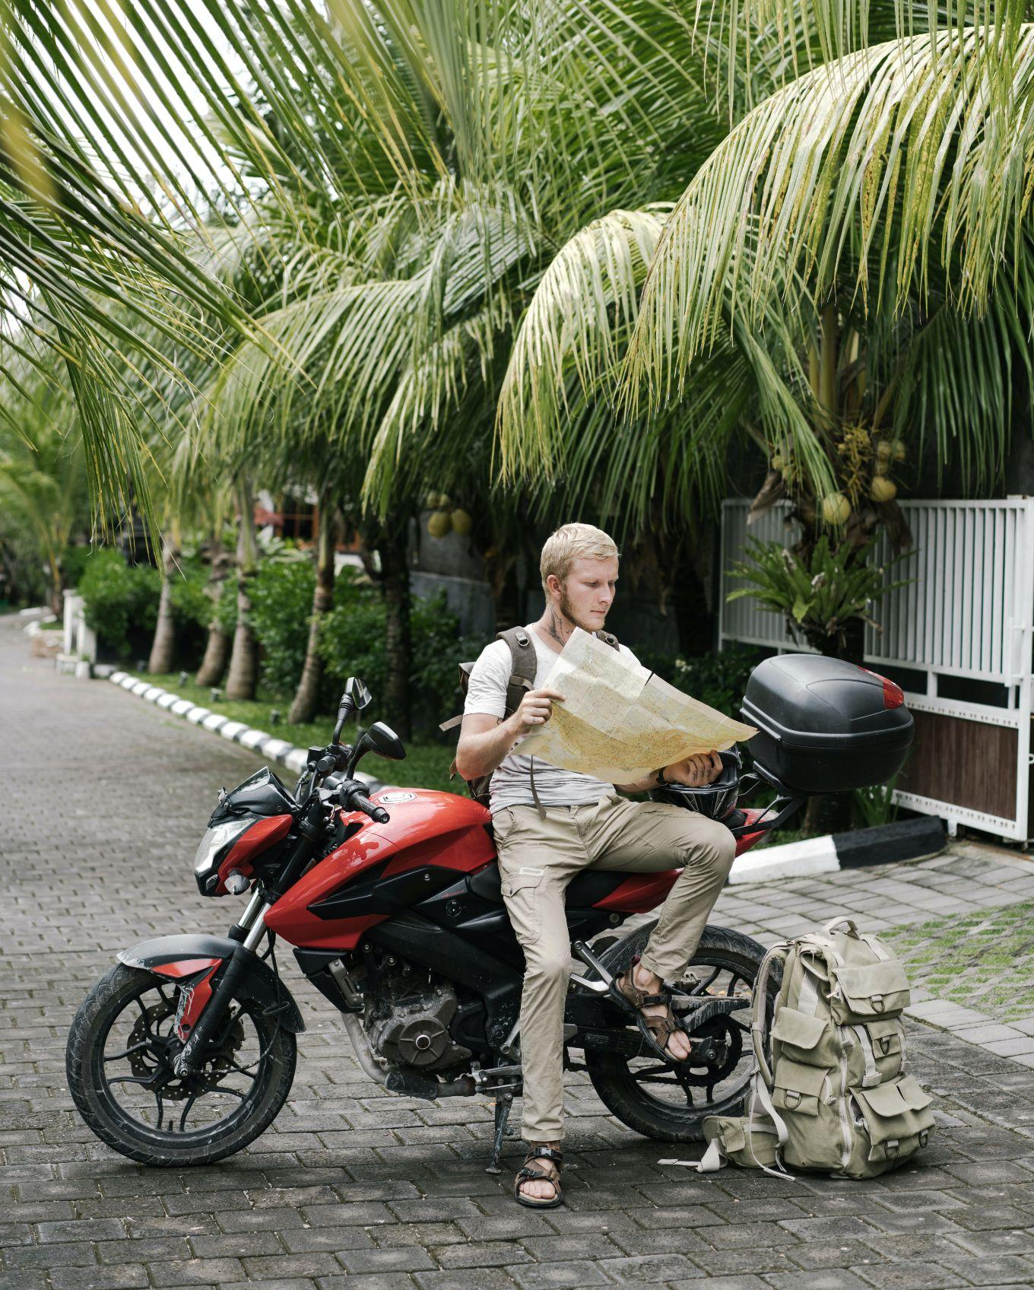
The Road Ahead
Cleaner and more user-friendly interface for data discovery, access and download
Leveraging open APIs for connecting and discovering data, and enabling integrations with research tools like ArcGIS Online
Custom download and access to large volumes and sizes of geospatial data
Support for historical maps and air photos, including index navigation and batch processing
More robust usage tracking and statistics gathering

Slide 15
Thank you!
The GeoPortal Business Case Working Group:
Kate Davis, Director (Scholars Portal)
René Duplain, GIS Librarian (University of Ottawa)
Marcel Fortin, Head, Map and Data Library (University of Toronto)
Kara Handren, Data Librarian (University of Toronto)
Dan Jakubek, Map & GIS Librarian (Ryerson University)
Amber Leahey, Data & GIS Librarian (Scholars Portal)
Leanne Trimble, Data Librarian (University of Toronto)
Markus Wieland, GIS Specialist (University of Waterloo)

Slide 16
Questions?
geo-reinvestment@scholarsportal.info

Slide 17
Image Credits
Slide 1: Black and Silver Camera Beside White Ceramic Mug by ArtHouse Studio
Slide 5: Person Rockclimbing by Анна Рыжкова
Slide 7: Blue Retractable Pen on Top of Notebook by Lukas
Slide 14: Focused man studying map leaning on motorbike by ArtHouse Studio

