Slide 1

CUrrents of Change
HUJMA CHOWDHURY
KARINA ESPINOSA

Slide 2
No one cared about copyright.
Interest in copyright law immersed with the expansion of the internet
" copyright industry’s hyperbolic claims about the damage that sharing online material causes, and its calls for absurdly serious punishments for infringing on copyright monopolies." (Moody, 2021)
Large collective societies (Access Copyright) exacerbating these fears
Notes:
Moody, G (2021). https://walledculture.org/widespread-copyright-anxiety-leading-to-copyright-chill-means-something-is-deeply-wrong/

Slide 3
How do our current realities stack up against the visions, or the fears, of the past?
What new and unexpected challenges or triumphs have arisen in our present?
How can we prepare ourselves for the future when the pace of change is too rapid for us to predict what the landscape will look like in another twenty years?
New copyright challenges following the pandemic
Immense pressure to make items accessible digitally as soon as possible
Roadblocks such as DRMs, not everything is available to purchase, especially textbooks
Books locked away in libraries
Copyright anxiety/copyright chill

Slide 4
New and Unexpected Challenges:
York U vs Access Copyright
Case in divided in two issues:
Is an interim tariff, and a tariff in general, mandatory?
  Are York’s Fair Dealing Guidelines sufficient to ensure that it is in compliance with the law?
Overturning the trial decision, the Federal Court of Appeal found that a tariff issued by the Copyright Board was not mandatory, and that users could choose to be copyright compliant in other ways
Like in the trial decision, the Federal Court of Appeal agreed that the Fair Dealing Guidelines were not sufficient
Neither side got what they wanted.
SSC hearing was in May 2021, concluded in July 2021 but continuous lobbying from author and publisher groups
Notes:
Moody, G (2021). https://walledculture.org/widespread-copyright-anxiety-leading-to-copyright-chill-means-something-is-deeply-wrong/

Slide 5
New and Unexpected Challenges:
Amendments to the (Copyright) Act in The Budget Implementation Act
proposed changes to the Copyright Act as announced in the Government of Canada’s Budget 2022 (p.328-330)
As part of the negotiation of the Canada-United States-Mexico Agreement (CUSMA) the Canadian federal government agreed to extend the general copyright term of life-plus-50 years by an additional 20 years
substantial shift in the balance between the rights of users and rights-holders
"Sustainable educational publishing industry"
Notes:
Shrink the public domain
https://www.ic.gc.ca/eic/site/693.nsf/eng/00305.html

Slide 6
Preparing for the future; the role of the librarian in Canada’s copyright system
“Librarians operate at the core of copyright's balance: they reward the creator through the purchase of works and other copyrighted subject matter and they disseminate knowledge and encourage learning, thus fulfilling the purpose of copyright law as set out by the Supreme Court of Canada in CCH.”
Owen, V. (2014). The librarian's role in the interpretation of copyright law: Acting in the public interest. Feliciter, 60(5), 8-12.

Slide 7
Preparing for the future.
Routinely revisiting fair dealing guidelines to affirm they match current environment and context
Ensuring the guidelines are prioritizing the students right (users) over the institution and continue to lobby for stronger user rights
Managing institutional risk
Copyright education across the board
Explore different avenues of resource sharing such as CDL

Slide 8
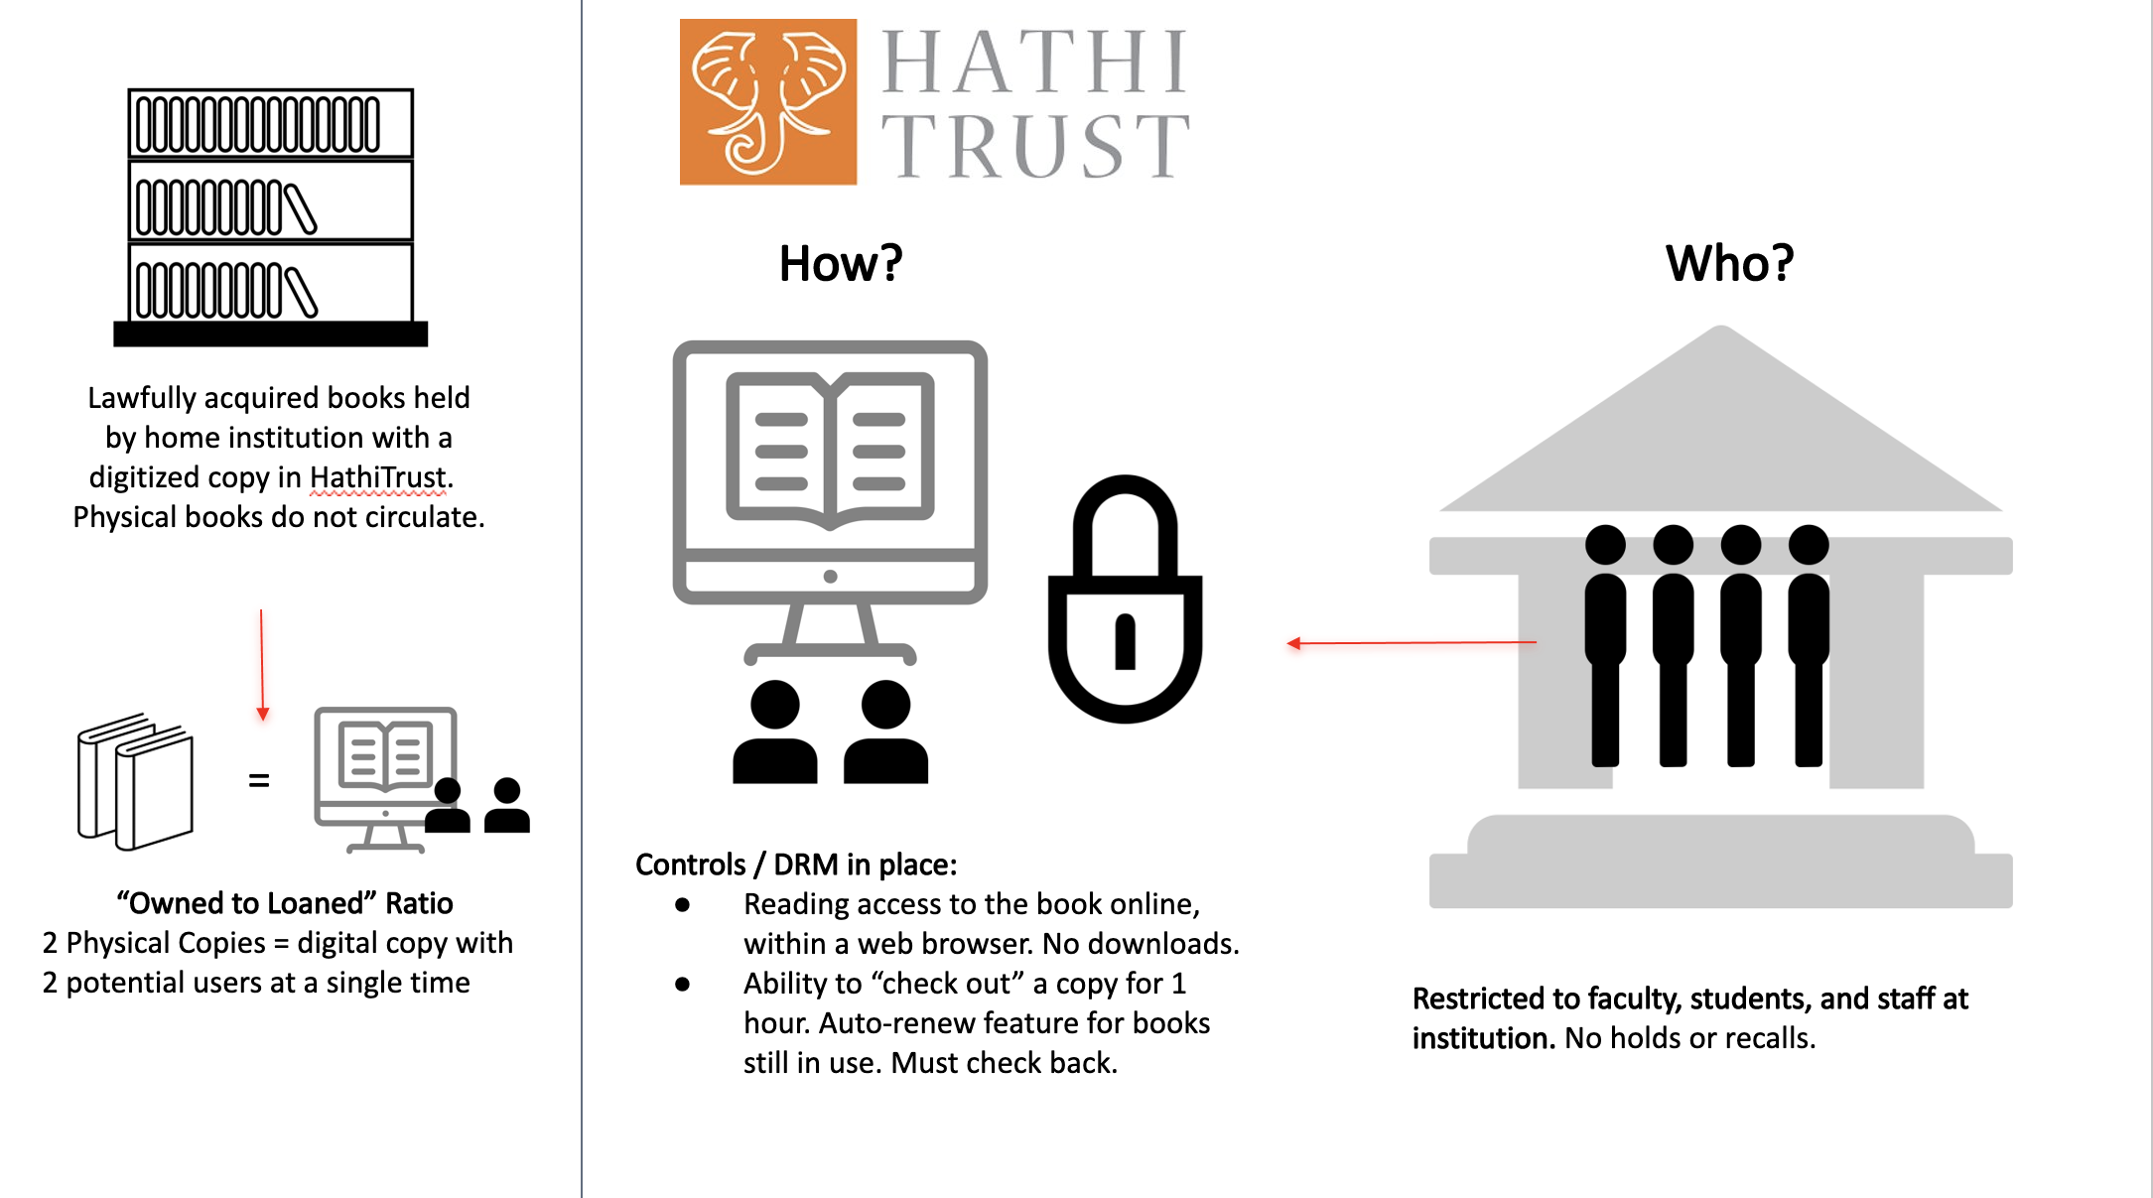
Controlled Digital Lending
Graphic created by Stephanie Orfano

Slide 9
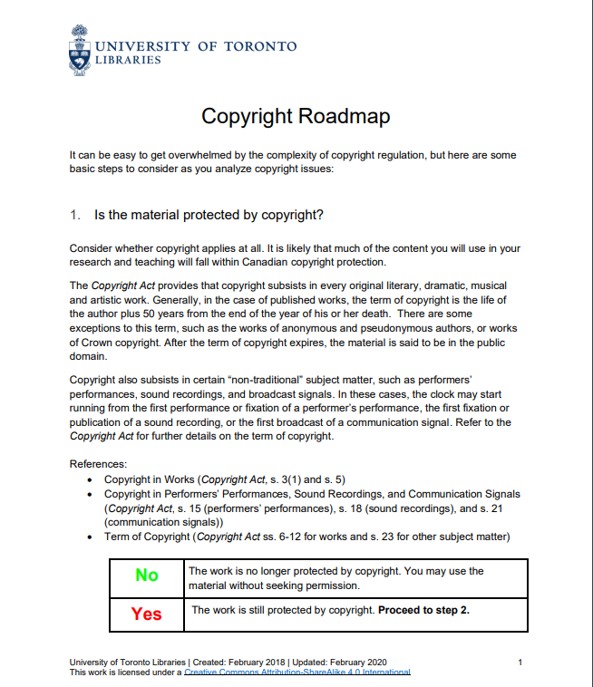
Currents of Change
Changes to the copyright roadmap
Notes:
The Copyright Roadmap is designed to assist in decision making when selecting resources and potentially copying material for use in teaching and research activities
Move away from traditional libguides something more interactive and engaging, really good uptake with the getting published challenge hosted on quercus created on articulate 360

Slide 10
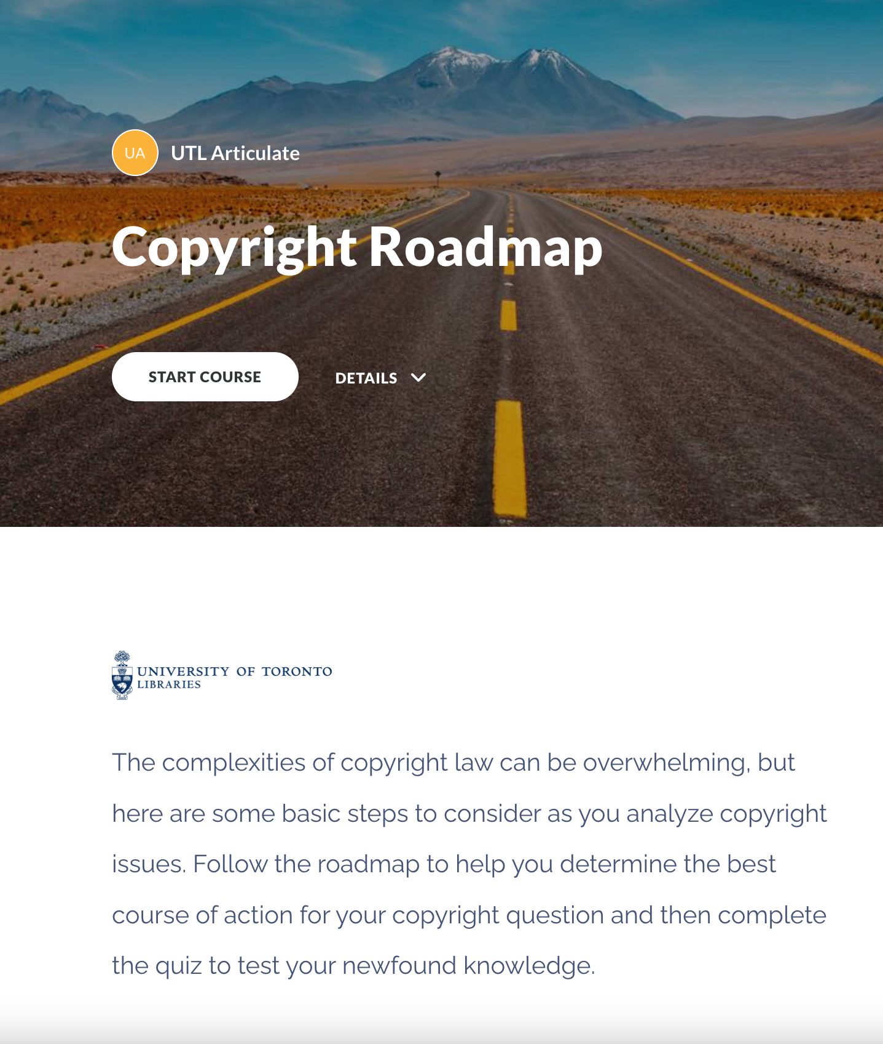
COPYRIGHT ROADMAP 2.0:
Interactive Learning Modules in Rise 360
Notes:
-

Slide 11
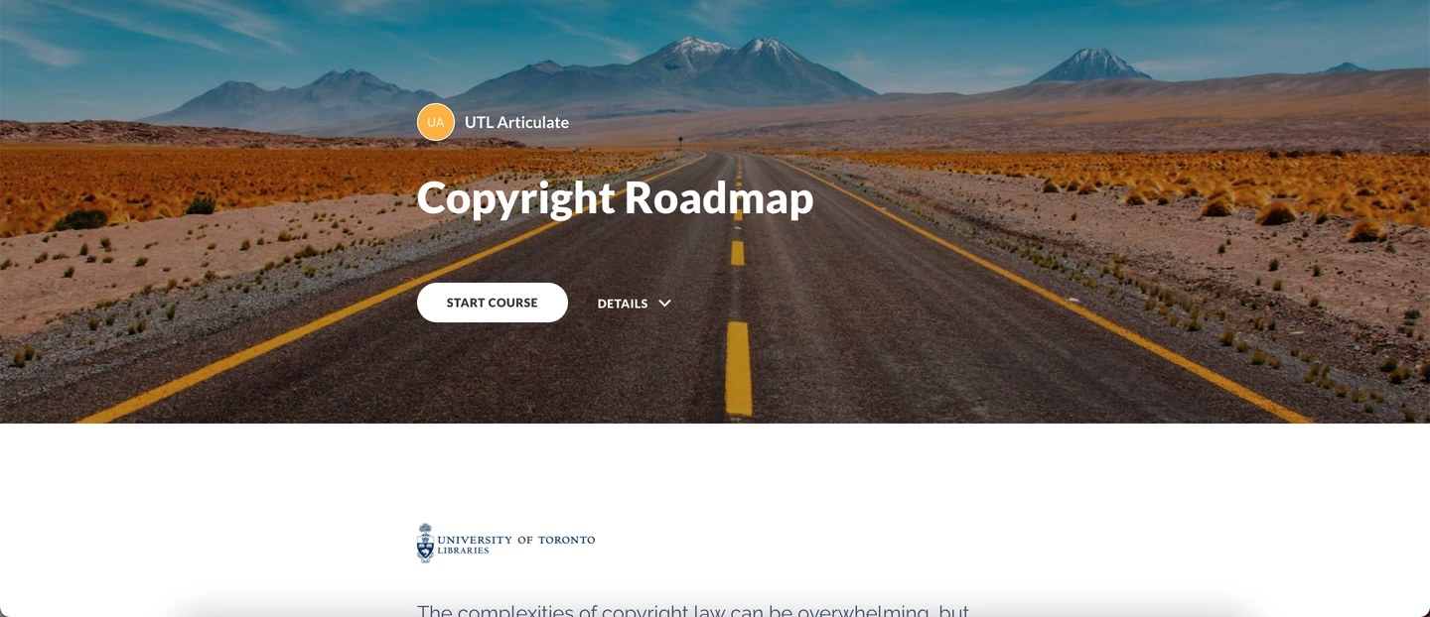
COPYRIGHT ROADMAP IN rise 360

