Slide 1
Content Services
Notes:
Delighted to be moderating our section on content services. We’re focused today on work happening for books and journals around improving the usage experience and improving the research process. We have three short presentations, and then I have a couple of quick updates.
I’m going to introduce each presenter as they come, and we’ll have a little time for questions at the end of each session, and hopefully a little more at the end.

Slide 2
Marching towards a PDF pitstop: Improving Scholar Portal Journals for blind users across Ontario along the way
Ashley Shaw, Matt Thomas, Mark Weiler, (Wilfrid Laurier)
Aneta Kwak (University of Toronto), Bart Kawula (Scholars Portal)
link
Notes:
https://nextcloud.scholarsportal.info/s/Nrn8P6sjmdNDNTP
First up
From Laurier
Ashley Shaw: MA Student, Community Psychology and former Library Web Accessibility Advisor
Mark Weiler: Web & User Experience Librarian,
Matt Thomas: eResources Librarian
From Scholars Portal
Bart Kawula: Web & Discovery Services Librarian,
From DG Ivey Library at New College, University of Toronto
Aneta Kwak: Information Services and Instruction Librarian
The library reading experiences for patrons who are blind in Ontario universities is far from okay. In response, we formed a tiger team that included the Laurier Library Web Accessibility Advisor, librarians from different universities and Scholars Portal. We conceptualized a PDF pitstop as a method to remediate - and verify - at blazing speeds the quality of library materials. While we marched towards this goal, we have found opportunities to make critical improvements to Scholars Portal Journals, which we share here with the wider OCUL family. We also pause here to call for further help to make a PDF pitstop a reality and continue to try to improve reading experiences for library patrons who are blind.
Thank you so much, that was really informative and engaging, there were numbers that surprised me there, so

Slide 3
About all that text….
Art Rhyno, University of Windsor
link
Notes:
Next up, we’ve got Art Rhyno, who is the Systems Libarian at the University of Windsor, and he’s going to talk today about using Jupyter Notebooks for text analysis of SP Journals content.. Art is a recent Chair of the ALTO Board, which maintains the ALTO standard for digitized text. ALTO is an XML schema for describing the physical layout and content of, for example, a newspaper or book. He was also the co-owner and publisher of the Essex Free Press for a decade.
I’m going to encourage you to turn up your speakers, this is a prerecorded session and it’s coming through a little quiet. But Art is here to answer questions at the end.
1. https://drive.google.com/file/d/1BAi2ZOTtOyopsfSnXW0Qi02qxipNfmsV/view?usp=sharing

Slide 4
Government Information &
Grey Literature on Scholars Portal
Ravit David, Scholars Portal
Notes:
Next up, Ravit David, who is the Distinctive Collections Librarian at Scholars Portal is going to give us an update on some of the government and grey literature loading at Scholars Portal Books. Many of you know that we’ve been expanding our government and related literature collecting over the past few years. This is a lot of content loading but also a lot metadata work and Ravit is going to walk you through some of what’s been happening there.

Slide 5
Updated Journals platform features
Notes:
I’m going to give you a quick update on some new and

Slide 6
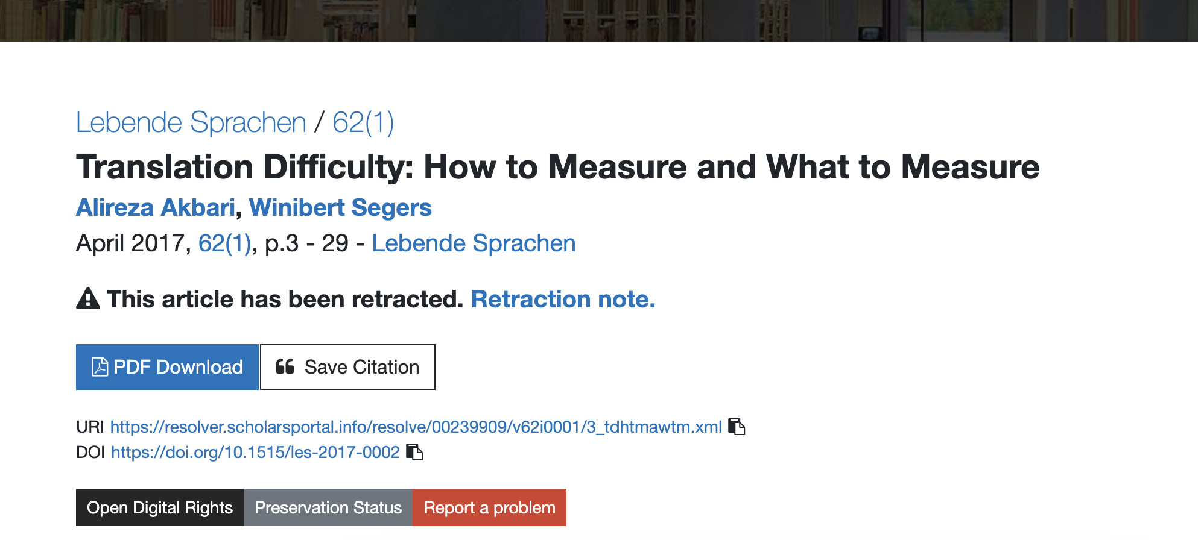
Enhanced retraction tracing

Slide 7
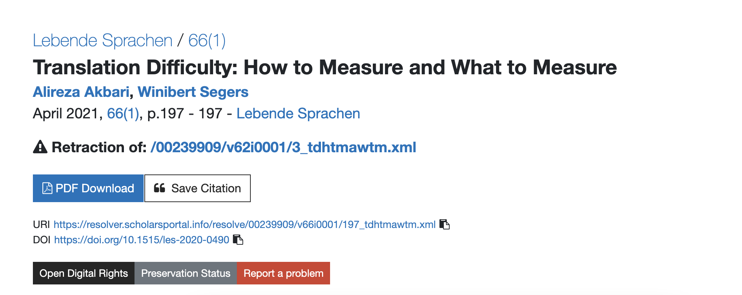
Enhanced retraction tracing

Slide 8
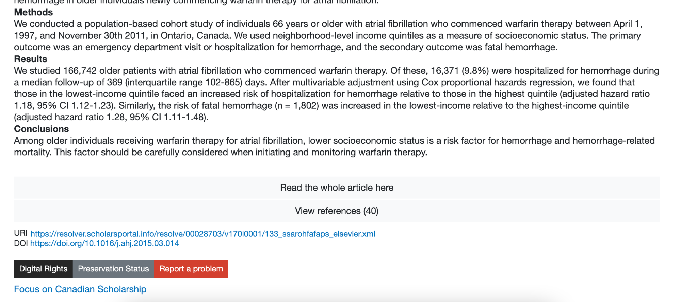
Focus on Canadian Scholarship

Slide 9
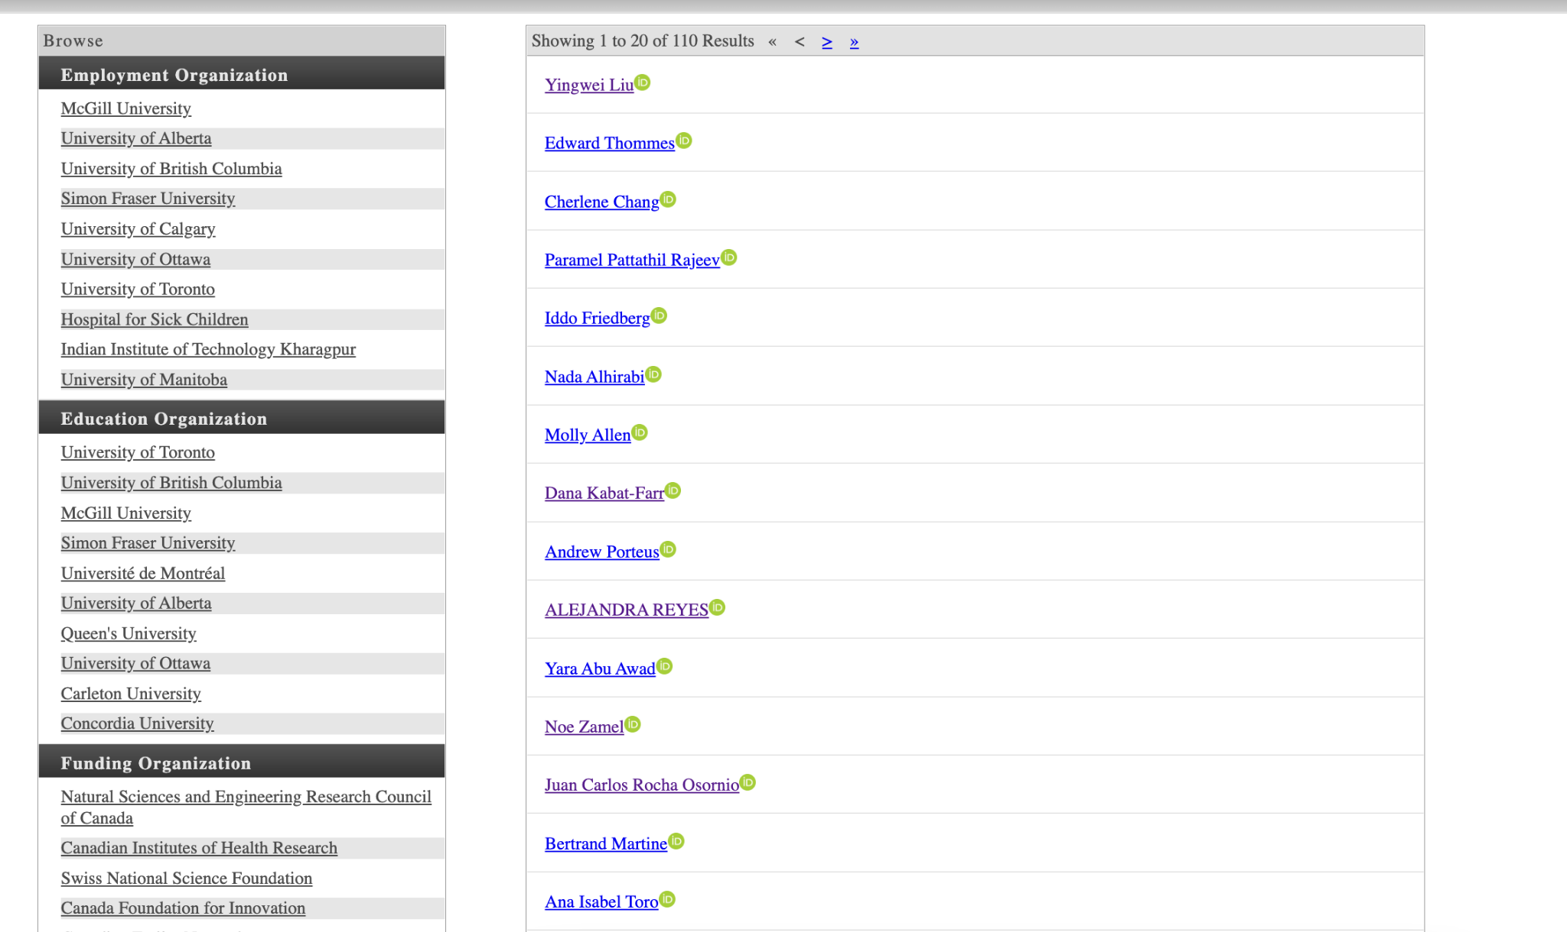
Focus on Canadian Scholarship

Slide 10
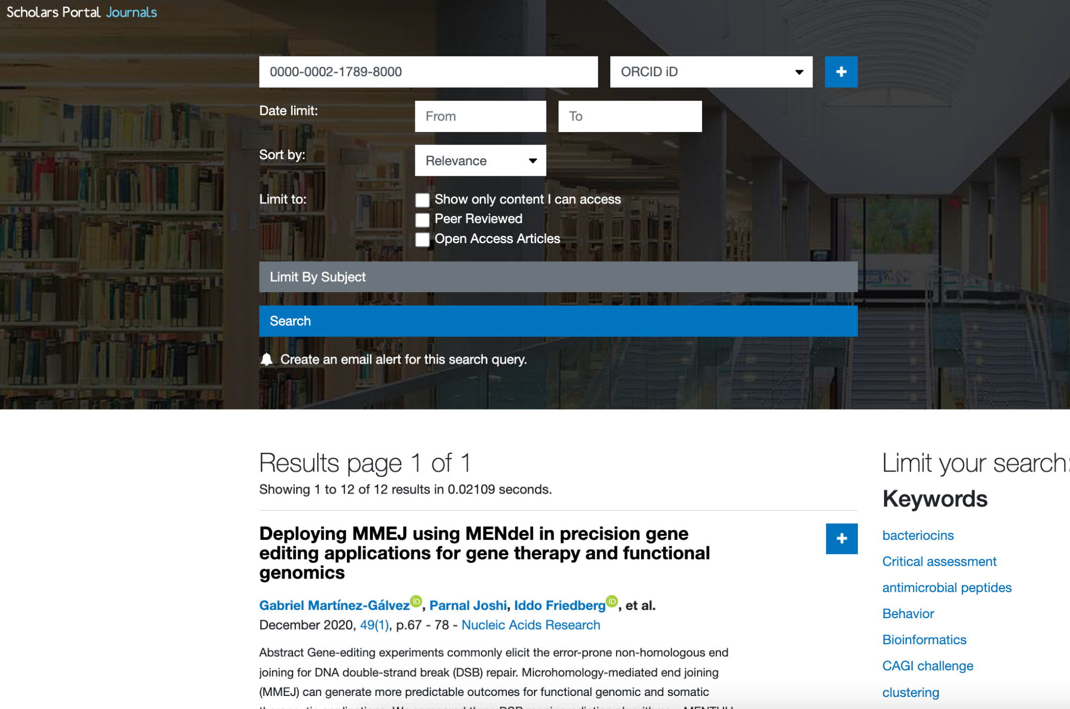

Slide 11
Questions?

