Slide 2
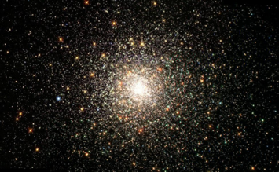
Unearthed Infrastructure & the Jagged Edges
Jutta Treviranus
Inclusive Design Research Centre
Attribution-NonCommercial 4.0 International License
Notes:
I’m Jutta Treviranus. I love the title of this conference and I want to talk about unearthed infrastructure and our human jagged edges

Slide 3
What is the opportunity in the midst of tragedy & disruption?
Notes:
I’ve been giving a great deal thought to what are the opportunities for deeper transformations during this disruption.

Slide 4
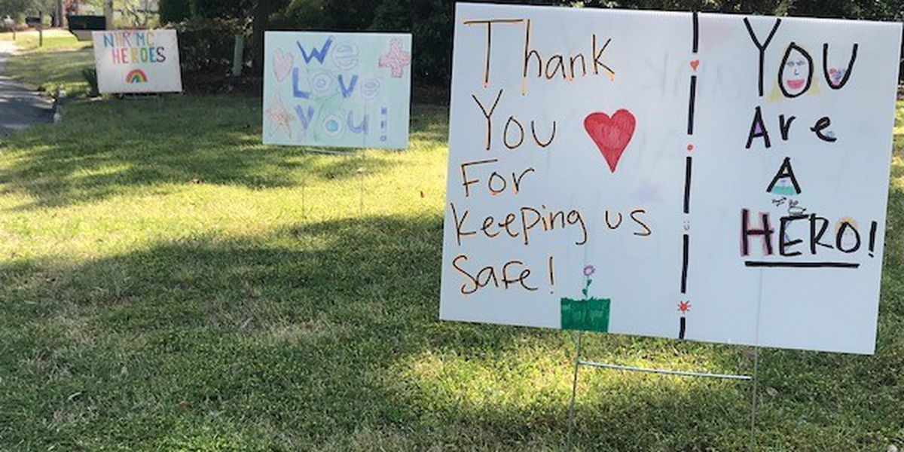

Put into question …
What has value?
How we know what is true?
Who participates in decisions?
Who we design things for?
Who benefits our society?
Notes:
The pandemic has put into question..

Slide 5
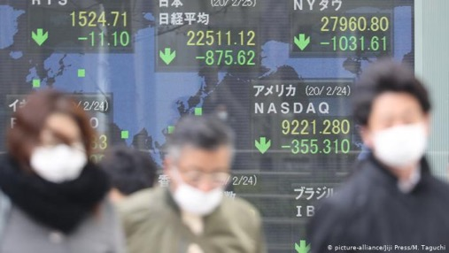
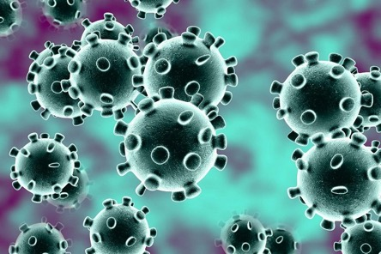
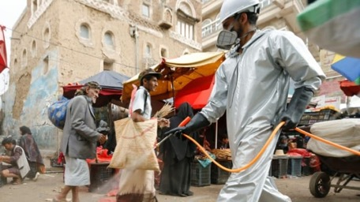
Crisis: crossroads or decisive point
Emergency: emergence or to emerge, arise and bring to light
Catastrophe:
Sudden overturning
Notes:
This has led me to examine the etymology of the many of the words being used at the moment

Slide 6
What emerges (aka Emergency)
What really matters
What is really possible
What is required of us
The value of life and what makes a life worth living

Slide 7
Overturning (aka Catastrophe)
What and who is valued
Conventions
Assumptions and presumptions

Slide 8
Turning point (aka Crisis)
Window of opportunity
Conflict between returning to the status quo and making profound changes
Pursue change in ways that seemed impossible
Best and worst possibilities

Slide 9
Tension between…
Awareness that we are all connected
Consider all the consequences of our decisions
Acts of kindness
“Freedom” as no limit to self-interest
Pick and choose values, facts and rules
Power grab

Slide 10
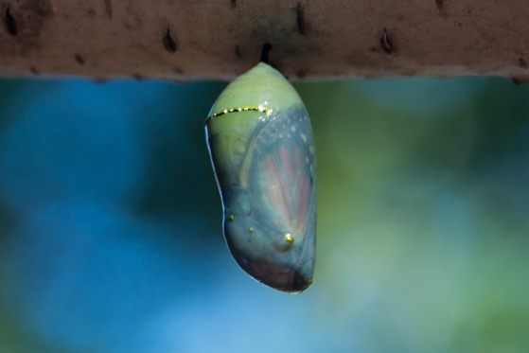
Dissolving the status quo
Leaving normal
In suspension
Lack of predictability
State of flux

Slide 11
The wrong turns during pandemic…
Notes:
In our desperation and panic we have taken some wrong turns

Slide 12

Notes:
Some have claimed that we must sacrifice the weak to promote the survival of the species, and in the process devalued and dismissed certain lives as not worth living.

Slide 13
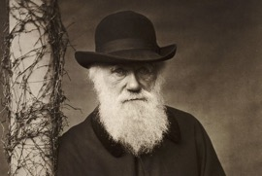
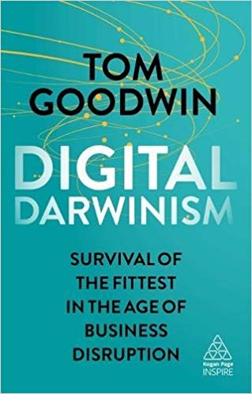
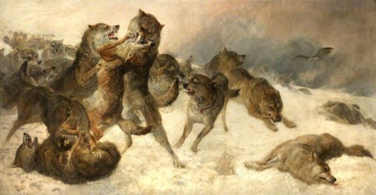
“Darwinism”
Survival of the fittest
Life is a winner-takes-all, zero sum game
Notes:
They have appealed to a form of social Darwinism that misrepresents Darwin that reduces Darwin's theory of evolution to ..

Slide 14
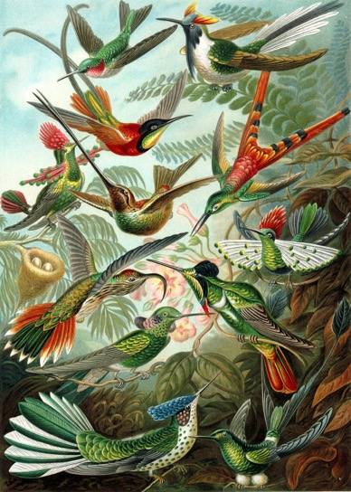
Diversification
Fuel of evolutionary advance
Expansion of evolutionary choices
Notes:
When in fact diversification is the fuel of evolutionary advance, as it offers an expansion of evolutionary choices

Slide 15
Darwinism reconsidered…
Relaxed selection offers greater genetic choice and leads to human advances (e.g., language)
We advance during collaboration across diversity
Predators are less adaptive
Notes:
Evolutionary theorist such as Terrence Deacon have shown that the human race advanced during periods of relaxed selection when diversity could thrive. If we did not have relaxed selection we would not have developed language.
We advance during collaboration across diversity
Predators are less adaptive and the first to be threatened by extinction

Slide 16
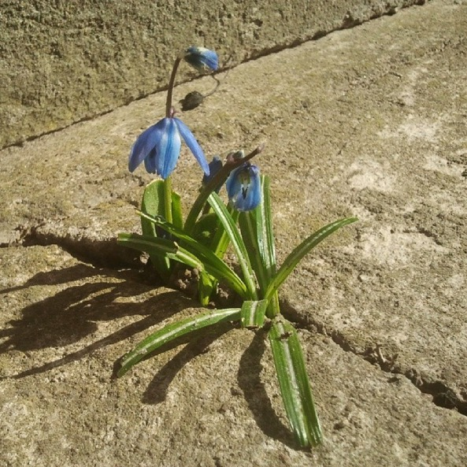
Who is the fittest?
Not the comfortable or complacent
Not those with wealth and power
Notes:
We know that fitness implies adaptability, not wealth or power. The comfortable and complacent have not practiced resourcefulness and don’t need to adapt.

Slide 17
Why do we need vulnerability and fragility to survive?
Compels us to create a system that will work for us when we are vulnerable
Helps us to survive the next storm
Perfect monocultures won’t survive
Social Darwinism will leave us without adaptive choices or safety nets
Notes:
I would argue that society needs vulnerability and fragility to survive. …

Slide 18
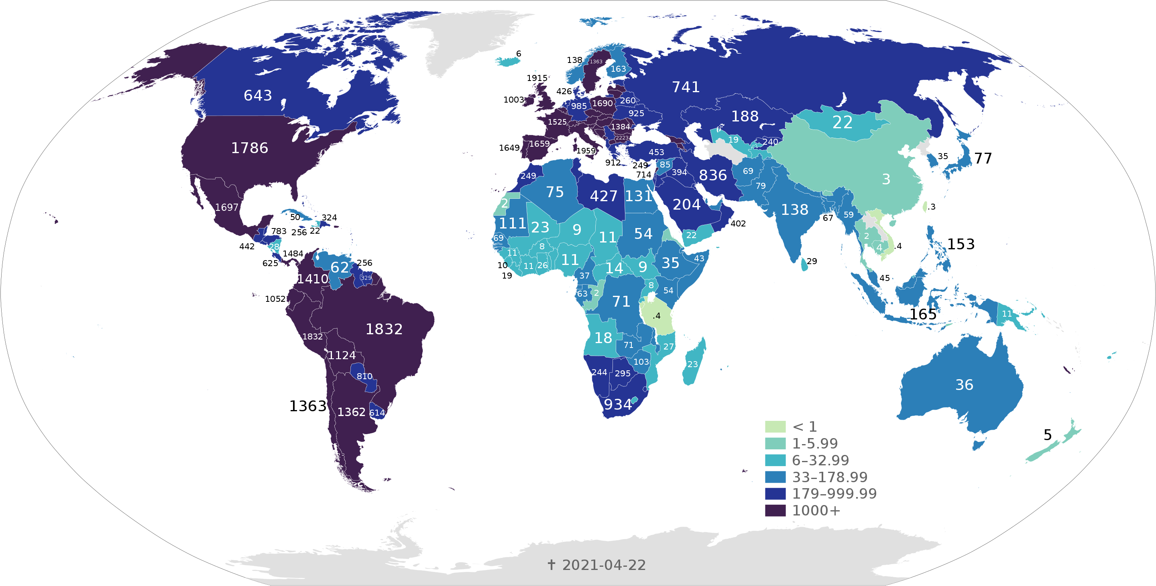
None of us are safe until all of us are safe
Notes:
We have been reminded during this pandemic that none of us are safe until all of us are safe.

Slide 19
This is not the last crisis..
Notes:
…and this is not the last crisis

Slide 20

Complex Adaptive system in accelerating flux…
Entangled and complexly connected
Rife with feedback loops
Viral
Not just complicated or amenable to engineering
Notes:
We’ve realized that we live in a complex adaptive system in accelerating flux
Everything is entangled and connected and cannot be isolated
It is rife to feedback loops
Growth and evolution is viral not engineered.

Slide 21
Stuck on Local Optima
Hill climbing
Optimizing the patterns of the past
Erosion on the slope
Notes:
Taking from complexity theory, we are navigating a complex mountainous terrain in flux. And we are currently stuck on a local optima, to find our way out of this and the next crisis we need to reach the global optima. But we keep optimizing the same things, eroding the slope, making it harder for people to ascend and intensifying disparity.

Slide 22
Finding Global Optima
People closest to bottom are more diverse
Less invested in the past
Notes:
To find the global optima rather than optimizing the patterns of the past, we actually need to do the opposite and climb down from our smaller hill and find the global optima. To do this we need to work with the people that are at the edge.. Who have a better view of the whole terrain are more diverse and are not invested in failing strategies. Not the people in the complacent middle.

Slide 23
Maladaptive responses to crisis..
Paralysis
Determined entrenchment
Make Faustian bargains with more powerful forces

Slide 24
Adaptive responses
Social cohesion
Prioritize the most vulnerable
Include the greatest diversity of perspectives
Listen to people who understand survival and resourcefulness
Stop repeating old patterns
Take only what is essential and move
Notes:
To respond adaptively we should…

Slide 25
Technology & human adaptability
Notes:
There is an often references graph from Thomas Friedman that shows that technology is adapting exponentially and humans are adapting linearly.

Slide 26
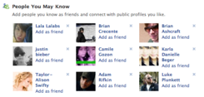

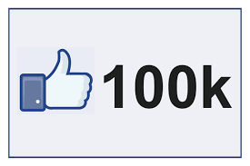

Impeding human adaptability?
Cushioning from dissonance and diversity
Recommender systems – “people like you”
Search engine optimization
Popularity bubble
UX conventions and technical lock-in
“Smart Compose”
Evidence-based decisions

Slide 27
One experience of deep rooted problems
Notes:
To illustrate some of these deep rooted problems I want to relay a recent experience I've had.

Slide 28
Bill C-7 and MAID
Reasonably foreseeable death requirement removed from medical assistance in dying legislation
MAID as an alternative not only to a painful death but a painful life – “disabling medical conditions”
Notes:
In Canada, we have recently passed Bill C-7 which governs medical assistance in dying. or MAID
Bill- C7 removes the requirement that the person requesting assistance in dying is facing a reasonably foreseeable death. This means that MAID is an alternative not only to a painful death but to a painful life, defined as disabling medical conditions.

Slide 29
Vulnerable Persons Secretariat
Offer to end a life that has been made unlivable – promoted as self-determination and dignity
Reduces the impetus to provide supports to make a life worth living – dignity in life, not just in death
Devalue certain lives
Notes:
We were approached by the Vulnerable Persons
secretariat to help gather data regarding the risks of Bill C-7
They argued that it could be abused to ...

Slide 30
“Show us the data, bring us the evidence”

Slide 31
What qualifies as truth and evidence?
Survey of 300,000 Canadians
Perspective of the stigmatized minority that feels the greatest impact
Quantified data vs. anecdotal stories

Slide 32
We equate evidence with majority, repeatability and statistical probability, …
If you are not like the average, probability is wrong

Slide 33
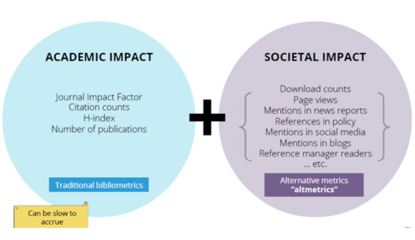
We equate impact with a single measure for a large homogeneous number
What about heterogeneous groups that need different measures?

Slide 34
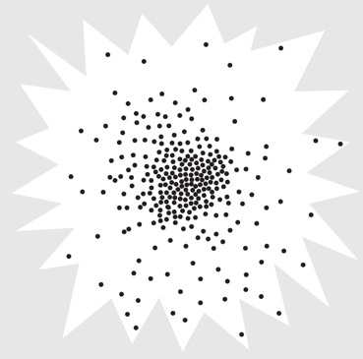
Our human starburst…

Slide 35
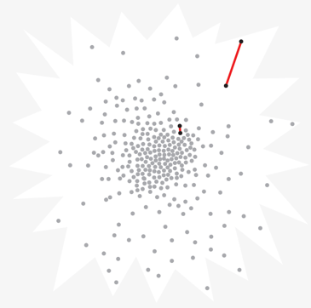
Difference…

Slide 36
The only common characteristic of disability is sufficient difference from the norm that things are not designed for you

Slide 39
Who Counts?

Slide 40
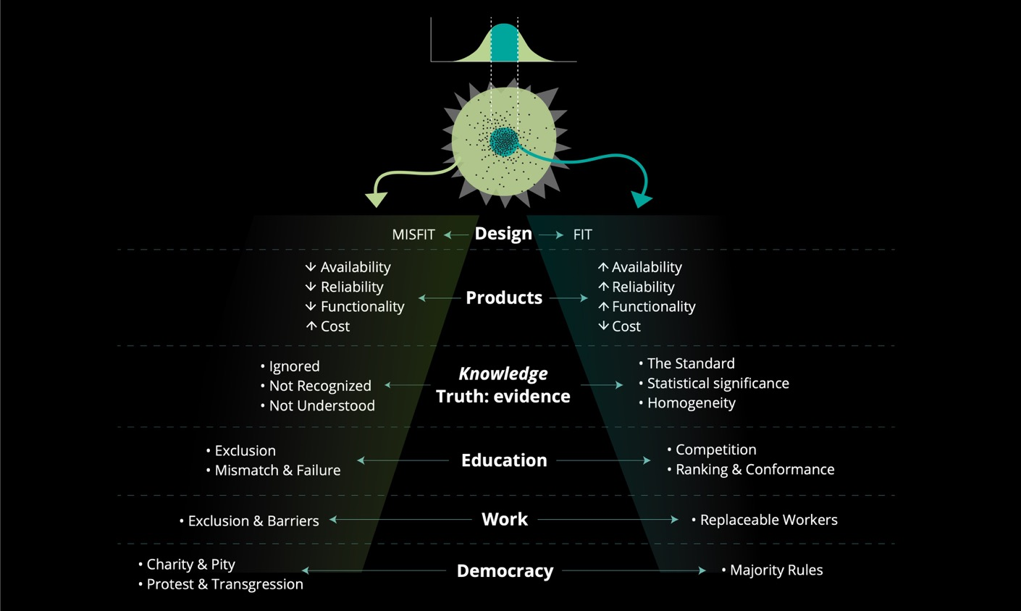

Slide 41
The trivial needs of the majority vs. the critical needs of the few

Slide 42
Academia & Minority Research
Publishing in high impact journals, peer review
Citation rates and the popularity echo-chamber
Researcher Impact factor
Tenure, Promotion
Research funding & peer review

Slide 43
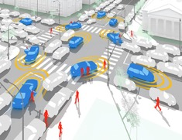
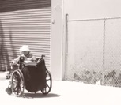
Alice and the unexpected…
Notes:
I came to this realization in 2015 when I was asked to assess a number of machine learning based decision systems used to guide automated vehicles through intersections. I tested them with a capture of a friend who unlike the norm, pushes her wheelchair backwards with her feet. All learning models chose to run her over.

Slide 44

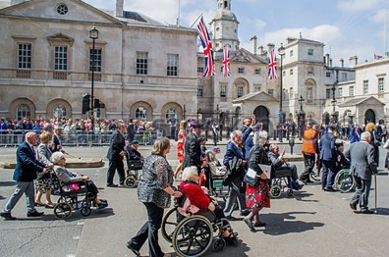
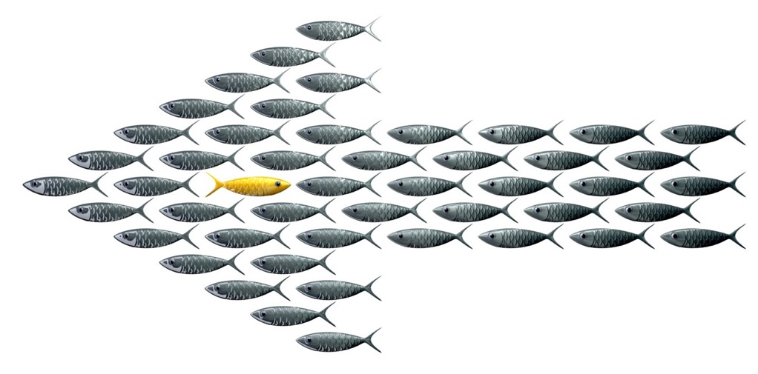
Smarter is not always better…
Notes:
I was assured that the learning models were immature and simply needed more relevant data. When I retested the models trained on more data about wheelchairs in intersections they chose to run my friend over with greater confidence.

Slide 45
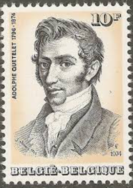
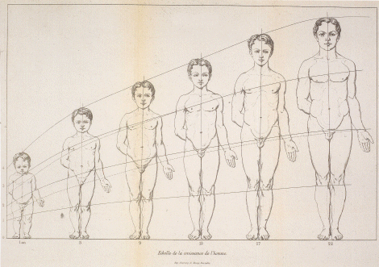
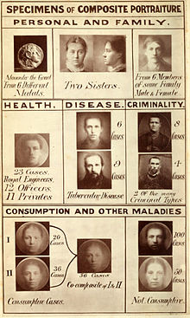
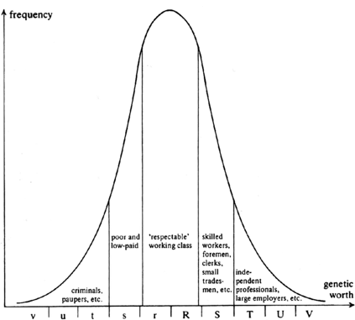
Problem predates artificial intelligence
AI only amplifies and automates existing patterns
Probabilistic reasoning & statistical analysis
Linear logic models
Reducing diversity, complexity, and variability
Notes:
Recently AI bias has received a great deal of attention. And there are many efforts to address bias in AI. However, the problem predates AI as far as Quetelet and the invention of the average man. AI only amplifies and automates a problem with probabilistic reasoning, statistical analysis, and linear logic models which reduce diversity, complexity and variability.

Slide 48
The view from the edge

Slide 50
Upend hierarchy of compromise
“Be happy with…”
Disability constrains adaptability, the compromise costs are greater
Notes:
We need to upend the existing hierarchy of compromise where we tell people at the margins to be happy with the pittance of change we provide. People at the margins, such as people with disabilities have less room to compromise because they feel greater constraints. It is the people with the most power, attention and resources that are most able to compromise.

Slide 51
Upend hierarchy of justification
Excluded have the largest burden of justification for change
Included can rely on “that’s just the way we do things, this is our standard procedure”
Progress during disruption & leapfrogging
Notes:
We should also upend the hierarchy of justification.
The burden of justification should be on the status quo and stasis. This is how we make progress and leapfrog

Slide 52
Watch out for
Cobra Effects
unintended consequences of over-simplistic “solutions” to complex problems
linear thinking
the rut of mono-causality
Not considering the complex adaptive system we live in
Notes:
But we should watch out for cobra effects, or the …
Falling into the rut of mono-causality when the causes are complex and entangled

Slide 53
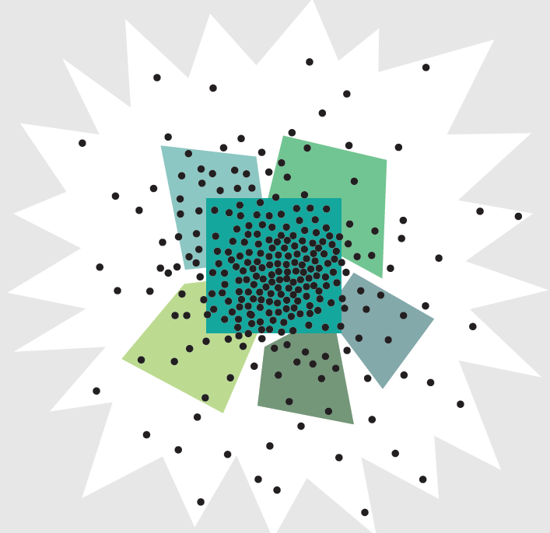
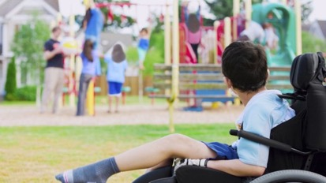
The divisiveness of labels, categories, and hierarchies.

Slide 54
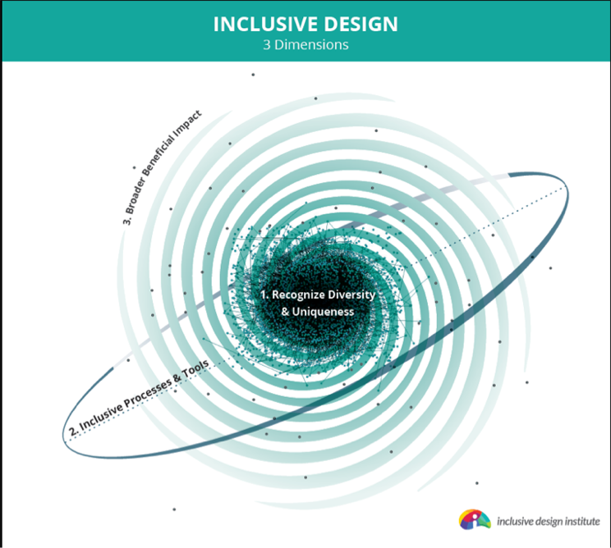
Inclusive Design..
One-size-fits-one - recognizing diversity, integrated, self-knowledge
Inclusive process – co-design – diverse team- “who is missing?”
Benefit-for-all - intervention in complex adaptive system

Slide 55
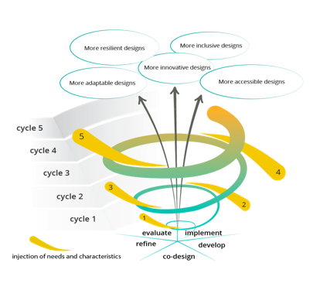
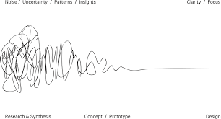
The Virtuous Tornado and the Design Squiggle
Notes:
I think we need to abandon the idea that there is one winning solution, fix or best practice. We like to use the virtuous tornado planning process whereby we iteratively stretch to reach the outer boundaries of our human starburst.

Slide 56
What about cost?..
Notes:
Before you voice the objection of cost….proactively planning with the edge from the start means we create a system that can weather the contextual changes, does not need to be retrofitted to address excluded needs, and thereby costs less in the long term.

Slide 57
When we value the vulnerable edge of our human scatterplot..
Adapt to change & respond to the unexpected
Detect risk
Respond to inevitable change and transfer of context
Results in greater dynamic resilience & longevity
Will reduce disparity
May hold the key to our survival

Slide 58
Implications for
Scholars Portal

Slide 59
Designed to be Change Resistant
Strongholds against parochialism and superstition
Built to resist transitory political forces and whims of popular ideologies
Protected silos of expertise
Defend accepted values and proven knowledge from upstarts and peerless notions
Notes:
Our institutions of learning grew up as strongholds against parochialism and superstition. They are built to resist the transitory political forces of the day. They have evolved to uphold the principles of science. In the process they have bestowed sanctity to armaments such as statistical power and quantitative evidence, to guard against the whims of popular ideologies and vigilantly arbitrate our understanding of truth. Institutions of higher learning create protected and self-perpetuating silos of expertise, or disciplines, with challenging and strongly fortified gates. Our peer-review processes uphold accepted values and proven knowledge and defend these from upstarts and peerless notions.

Slide 60
Scholars Portal
Sharing across institutions
Supporting open access
Attending to accessibility
What’s next?

Slide 61
Continuing the conversation:
https://idrc.ocadu.ca
https://inclusivedesign.ca
@juttatrevira
https://medium.com/@jutta.trevira

