Slide 1

Andy Foster & Kaitlin Newson
ONTARIO LIBRARY RESEARCH CLOUD

Slide 2
What is the OLRC?
“
A geographically distributed, highly scalable, highly redundant, highly available object storage cluster.
”
Notes:
Read the slide.
Quite the mouthful, so let’s break that down.

Slide 3
What is object storage?
Filesystem storage
  Data accessed via OS
    “C:\Program Files”
    “/home/andy/docs”
  Must setup backup strategy
    Often costly, complex, and time-consuming
    Is the backed-up data sound?
  It doesn’t scale very well (if at all)
Notes:
What is object storage?
It might be helpful to talk about more traditional storage first.
We’ve all seen filesystem storage, where the data is accessed via the OS.
And this probably isn’t going away any time soon, and has served us well for decades.
But what about when we start talking about large amounts of really, really important data? The data that you as librarians curate, and know that if we were to lose that data, there’s no way it could ever be re-generated?
Well, we could use filesystem storage still, sure. As long as…
You have a very good backup strategy in place. And to set that up is often costly, complex, and time consuming. Not just in the setup, but also in the maintenance.
Needs constant monitoring. Did the backup last night succeed? Who is looking at the backup logs? Did we even set it up right?
And then there’s the delay in getting copies of that data off-site, so we know it’s truly safe. It can take hours, days or even weeks before that data is written and secured off-site.
And it doesn’t scale very well.
What if a researcher turns up on your doorstep with a box of hard drives, and suddenly needs 50TB of data stored? Can we handle that? Where would it go? Can the backup system handle that? Not just in terms of capacity, but also in terms of the time it takes to copy that data from one place to another?

Slide 4
What is object storage?
Files (objects) have URLs
  https://olrc2.scholarsportal.info/account/container/object
HTTP PUT/POST/GET/DELETE
Objects accessible from anywhere
  No need to mount a filesystem
Redundancy is built-in
Build applications against the API
Notes:
So this is where object storage comes in.
Unlike a traditional filesystem, files have URLs, not filesystem paths, and the actual storage of the data is abstracted away from the user.
Files (which I will now start calling “objects”) are stored with HTTP PUT/POST requests, retrieved with HTTP GET requests, and deleted with HTTP DELETE requests.
And this means that the data is accessible from anywhere. No need to mount a filesystem, or plug in a drive to gain access.
Redundancy is built-in. We don’t have to think about storing multiple copies of the data, because it writes multiple copies the moment an object is created.
And it means you can build applications via the API, using standard HTTP, and run the application anywhere (on your laptop, in a data centre, in the cloud)
Amazon S3 is a great example of an object storage system. But the object storage system that the OLRC uses is called “Swift”.

Slide 5
What is Swift?
“Software to reliably store billions of objects distributed across standard hardware”
Originally a Rackspace project
Open-source
6 month release cycle
Notes:
So as I said, the OLRC is an object storage cluster, but more specifically, it is an OpenStack Swift cluster. So what is Swift?
Swift is software to reliably store billions of objects distributed across standard hardware. There’s nothing special about the hardware. We run the OLRC on standard Dell servers and hard-drives.
It was originally a Rackspace project, that was open sourced in 2010
And they have a new release every 6 months.

Slide 6
Highly scalable
Shared-nothing infrastructure
No central database
Need more space? Just add more disks!
Notes:
It is very VERY scalable. Can scale to multiple PBs of data, billions of objects
It has a shared-nothing infrastructure
So there’s no central database
If we need more space, all we have to do is add more disks, make Swift aware of the new disks, and it handles all of the re-shuffling of the data in the background.

Slide 7
Highly redundant
3 proxy nodes
5 storage nodes
No single point-of-failure
Notes:
If you want Swift to be highly redundant, it can be, and our implementation of it certainly is.
We have 3 proxy nodes, which is where all requests come in and 5 storage nodes placed throughout Ontario, so there is no single point-of-failure.

Slide 8
Highly durable
3 encrypted copies
Lifetime integrity
Failover
Notes:
And it’s highly durable. 3 copies of an object are written immediately. There is no delay between when the object is written, and when there are 3 copies at 3 different locations.
The integrity of those objects are then checked continuously for the entire lifetime of the object (until the object is deleted)
We can lose a disk, or even an entire node, without affecting access to the data. And if that disk or that node is unavailable for long enough, it will begin re-creating the copy that was lost to a different disk or a different node.

Slide 9
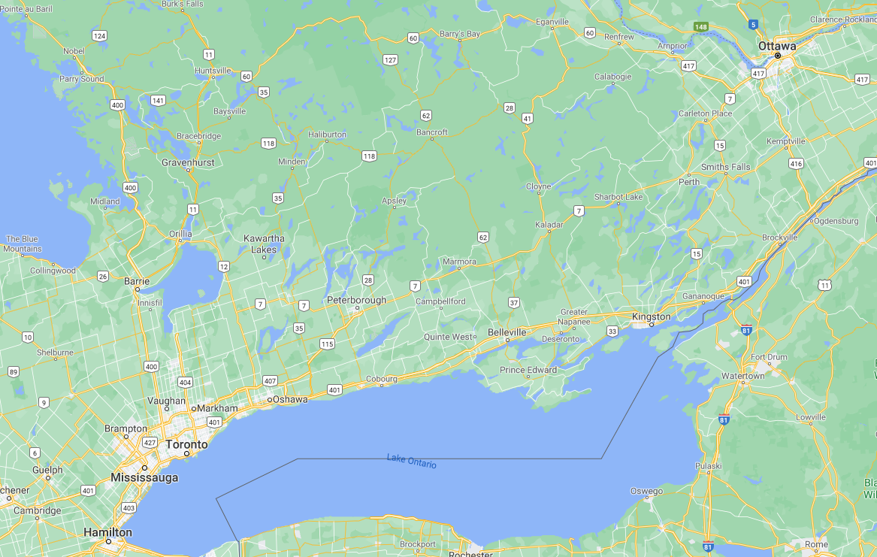
Notes:
And finally, what do we mean by geographically distributed?
Well, the storage nodes, where the data actually resides, are located in Toronto, York, Guelph Kingston and Ottawa.

Slide 10
How objects are written
HTTP PUT
Proxy
Encryption
Handoff to storage
Integrity
Notes:
An HTTP PUT request is made
The request hits one of the 3 proxy servers
The object is encrypted, then handed off to 3 of the 5 nodes simultaneously
The chosen 3 nodes store the object
The integrity of the 3 copies are continuously checked for the rest of the object’s life

Slide 11
OLRC to date
In operation for 6 years
Hardware is ageing
Swift version Kilo (April 2015)
260TB of 320TB used
Notes:
So why are we talking about this today?
Well, we’ve been running the OLRC now for 6 years
And the hardware is starting to age, soon it will be out-of-warranty and we will be unable to renew the warranty
And it’s running Swift version Kilo, which is also 6 years old now.
We’re running out of space!

Slide 12
OLRC 2
OLRC “2.0” now in production
Complete hardware refresh
  320 TB to 840 TB storage
  More CPUs and RAM
Software upgrade from version “Kilo” to “Wallaby”
We will upgrade in-situ
Notes:
We have now fully deployed and configured the next iteration of the OLRC, which we are dubbing “OLRC 2.0” and we have begun the very long process of migrating data from one to the other and reaching out to subscribing schools.
We have new everything, better storage, better performance.
More CPUs and more RAM means more throughput.
We have upgraded to the latest version of the OpenStack suite, Wallaby.
This allows us to take advantage of some of the great new features of OpenStack, which we’ll highlight in the coming slides.
And we’re pleased to say that we now have testing and tooling in place to ensure that we no longer fall behind in the OpenStack version we’re running.

Slide 13
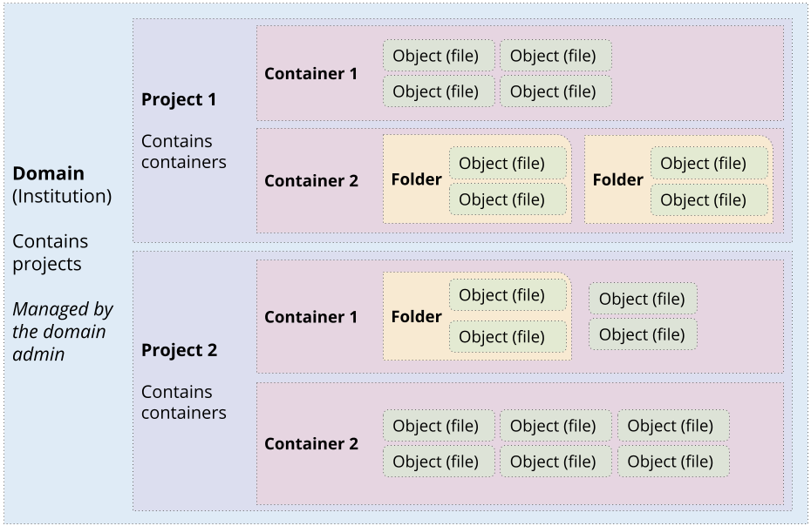
Notes:
This image outlines the structure of the content in OLRC2. Each subscriber has its own domain that is managed by the domain administrator. Within that domain, you can have multiple projects, which can have different users assigned to them. Projects can have multiple containers within them, and the containers can have files and folders. Permissions, projects and containers can all be managed in the new Horizon dashboard.

Slide 14
Horizon
Web dashboard for user and content management
Replacement for SwiftBrowser, which is being gradually sunset due to end of maintenance
Notes:
Horizon is the new web dashboard for the OLRC, which is a part of the OpenStack suite of tools. In Horizon, users can manage their user accounts, their projects, and can upload content. Horizon will be the replacement for the SwiftBrowser tool, which is gradually being sunset since it’s no longer maintained by the original developers. The SP team is working on adding features to the Horizon dashboard so it will do everything that users could originally do in SwiftBrowser.

Slide 15
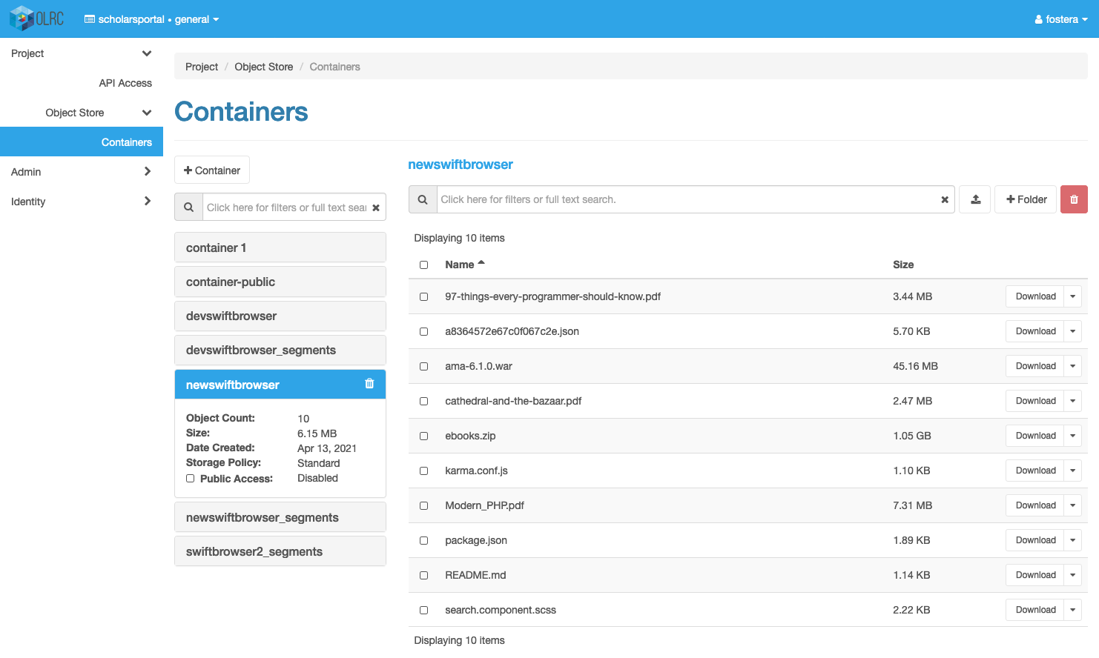
Notes:
This is a screenshot of the Horizon interface which shows a user’s different containers. On the left menu there are options for managing the project and user accounts. In the middle column we can see a list of the user’s available containers, and more details about the selected container like the number of objects and their total size. On the right, we can see a list of the objects in the container, as well as their sizes and different download options.

Slide 16
Duracloud
Preservation storage management system that sits on top of the OLRC
Audit, integrity, usage reports
Duplication to other storage providers
Content transfer tools
Notes:
In OLRC 2, users now also have the option to use DuraCloud to manage their content. DuraCloud is a preservation storage management software that sits on top of the OLRC.
It provides additional features for managing storage, including:
Audit reports, which detail all interactions with objects;
Integrity reports to ensure data has not suffered from bit rot;
Storage and usage reports;
Duplication to other object storage providers, such as Amazon’s S3, for users that want to back up their content in a secondary location;
And additional content transfer tools like the DuraCloud sync tool which can synchronize files from your machine directly to duracloud.
The Duracloud integration was completed as part of a Canarie-funded grant project throughout 2019 and 2020. The project team worked to remove Duracloud’s dependencies on Amazon S3 storage and connect it to the OLRC.

Slide 17

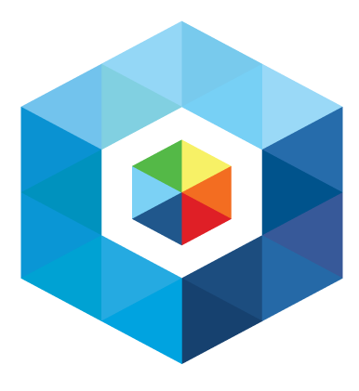

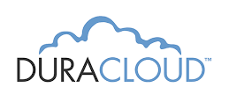
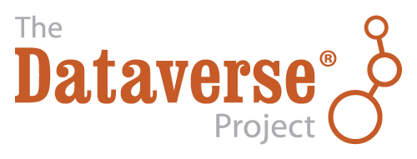
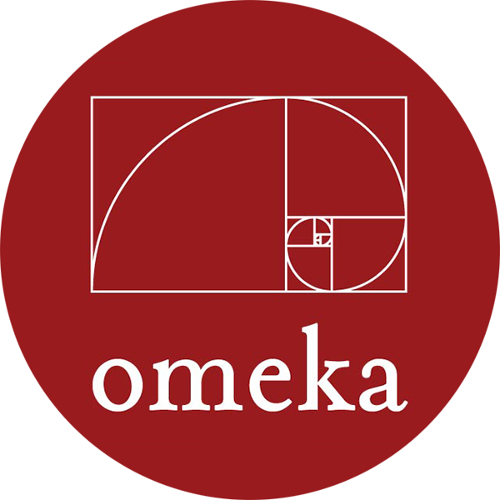
Feature Highlights: S3 Emulation
+
Notes:
One of the most exciting new features of the OLRC is its ability to emulate the popular S3 protocol. This is what Amazon’s object storage solution uses, and because it is so widely used, it is also widely supported by third-party applications.This means that you can potentially connect the OLRC to systems that are able to connect to S3 storage, which includes platforms like Archivematica, Islandora, Dataverse, and Omeka.
At SP, we’re in the process of moving Dataverse over to using OLRC storage, and have successfully connected the two systems in a testing environment. We’re also testing Archivematica’s integration with the OLRC’s S3 protocol.

Slide 18
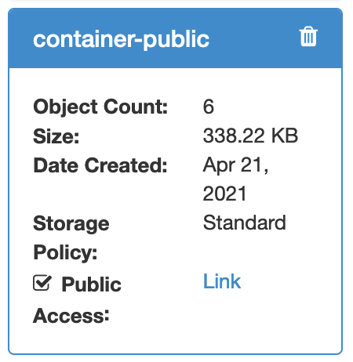
Feature Highlights: Public Objects
Upload files to an OLRC container
Set the container as public
Retrieve public web links
Notes:
Another interesting way that you can use the OLRC is to host static objects. This means that users can upload their files to the OLRC, and then make that container public. After some additional configuration by the SP team, users will have stable links that can be shared or used within other systems.

Slide 19
How can you use the OLRC?
Notes:
Next we’d like to share a few ways that schools are making use of the OLRC. We’d also like to thank Wayne Johnston at the University of Guelph, and Kevin Bowrin at Carleton University for sharing some of their use cases with us.

Slide 20
Use Cases: Backup & Archival Storage
Encrypted server backups
Backup purchased materials (e.g. videos)
Web archiving
Notes:
Perhaps one of the most common use cases for the OLRC is as a backup storage location. At Carleton, they’ve used the OLRC for encrypted file system archives and database backups. At Guelph, they’ve used the OLRC to store archival copies of videos they’ve purchased. They also use the OLRC to store files for archiving faculty website projects, including WARC files, code, and discrete digital content like PDFs and images.

Slide 21
Use Cases: Storage for External Partners
Dark storage for research projects
No need to manage local server with central IT group
Improved workflow in OLRC 2
Notes:
Another use case for the OLRC is as a storage space for external partners. At Carleton, they provided dark storage for research projects. This means they didn’t need to manage their own local servers, which would have required working with their central IT group - providing access through the OLRC saved a lot of admin work for their library.
In OLRC 1, this required contact SP to set up these projects. With OLRC 2, this workflow will be even easier because administrators can create their own projects and user accounts that can be directly shared with third-parties.

Slide 22
Use Cases: Streaming
Video streaming for classroom use
Supplementing local streaming options
Notes:
The OLRC can also be used to host and stream multimedia files like images, audio, or videos. At Guelph, they uploaded video files to the OLRC, and then provided direct video streaming from the OLRC that was restricted to a single class over the course of a semester. This was a use case that their local streaming service was not able to support.

Slide 23
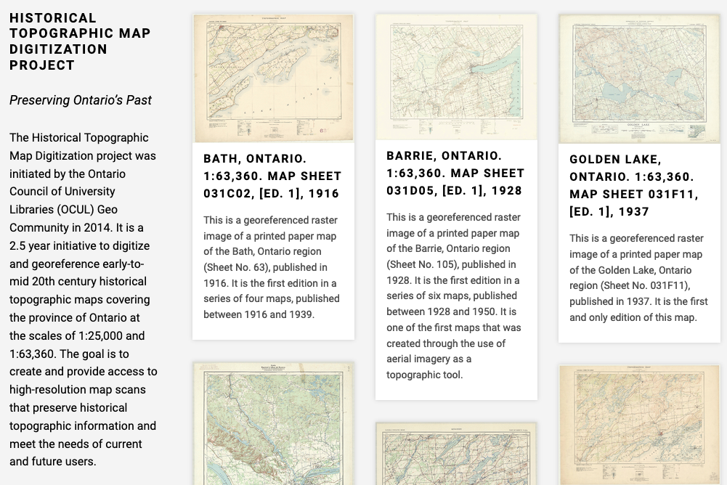
Use Cases: Historical Topos
Static websites (HTML, CSS, JS)
Map image tiles in Scholars GeoPortal
Notes:
At SP, we use the OLRC to host several different websites. This includes websites for several of our services, including Dataverse, Permafrost, and Ask a Librarian. This is also where we host the website for the Historical Topographic Map Digitization project that was started by the OCUL Geo community in 2014.
These websites are built with the Hugo static website generator, and are made up primarily of HTML, CSS, JavaScript and image files. The website files are uploaded to a public OLRC container, and a URL is configured to work with the container. To update the site, files are uploaded to that same container.
In addition to the website being hosted on the OLRC, the Topographic Maps project also has tiled map images hosted in the OLRC. These images are displayed in Scholars GeoPortal whenever a user adds the map to the map viewer.

Slide 24
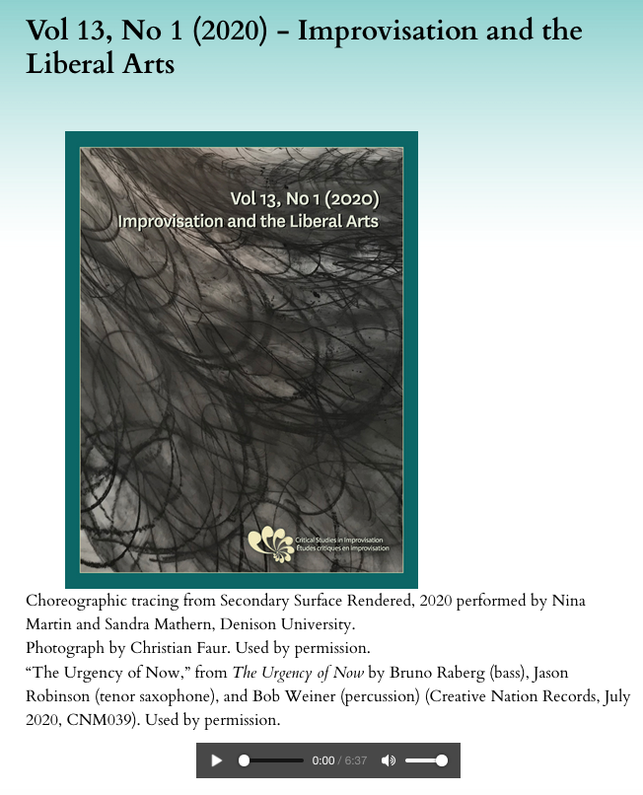
Use Cases: OJS Files
“Critical Studies in Improvisation” OJS journal at Guelph
Supplementary audio files hosted in the OLRC
Notes:
At the University of Guelph, they provide library publishing services to journals which are hosted in Open Journal Systems. One of the journals that they host is Critical Studies in Improvisation, an open-access electronic journal on improvisation, community, and social practice. Each published issue is accompanied by a piece of music, which is uploaded to the OLRC and linked to in the issue on OJS.

Slide 25
Why use the OLRC?
By OCUL, for OCUL
We are the stewards of the data
Data does not leave Canada
Cost
Notes:
So why use the OLRC for your object storage needs, instead of something like Amazon S3?
By supporting the OLRC, you’re supporting community owned and developed infrastructure. Within OCUL, we have complete stewardship and ownership of the data. All of the data lives in Canada, and is transmitted over private Canadian networks. OLRC data never leaves those networks unless you want it to.
Another key benefit of using the OLRC is the cost.

Slide 26
Updated Pricing
Pricing for OCUL Subscribers | Previous Pricing | 2021 Pricing
Base Subscription (includes 5TB) | $1,600 | $1,381
Additional Storage
Per 1 TB | $320 | $276
Per 10 TB | $3,100 | $2,604
Per 50 TB | $15,500 | $12,272
Notes:
This is the latest pricing for the OLRC, which was approved this week by the OCUL directors. The base subscription rate is now down from $1600 to $1380. The rate of additional storage for 1TB has been reduced to $275, and there will be similar reductions at the 10 and 50 TB rates.
These rates will also apply to other services that are using the OLRC storage, and will be updated on the OLRC website soon.

Slide 27
Price comparison
 | Total Cost Per TB With Increased Use
 | 500TB | 600TB | 700TB | 800TB | 840TB | 10TB data retrieval
OLRC | $276 | $246 | $225 | $209 | $204 | $0
AWS | $460 | $458 | $455 | $454 | $453 | $980
All prices in Canadian Dollars
Notes:
To give you a sense of how the OLRC pricing compares to a service like Amazon AWS, this table shows the annual cost per TB for different amounts of data. In the OLRC the price per TB goes down the more you use it.
AWS is also priced in US Dollars, so the prices can fluctuate significantly.
Additionally, subscribers aren’t charged for data retrieval in the OLRC, but if you wanted to retrieve 10TB of data through AWS, you would be charged another $1000.
The OLRC serves over 100TB every month, so you can see how the cost of other cloud providers can quickly spiral out of control.

Slide 28
Questions?
https://cloud.scholarsportal.info
cloud@scholarsportal.info
Notes:
That brings us to the end of our OLRC update - thanks for your attention! If you’d like to find out more about the OLRC, you can check out the service website at cloud.scholarsportal.info. If you’d like to contact the team, you can reach us at cloud@scholarsportal.info.

