Slide 1

Preserving Books at
📕 📘 📗
Grant Hurley
Digital Preservation Librarian
SP Day 2021
May 7, 2021

Slide 2
The Goal
Preservation processing for all eligible* books available via books.scholarsportal.info
~600,000 books will join the ~40 million journal articles in the Scholars Portal Trustworthy Digital Repository
* Titles for which SP has been granted rights to store and give access to the book title and its complete contents

Slide 3
What is Preservation Processing?
Checksums for file integrity: Is the file complete and unaltered?
File format identification: What is the file format (e.g., “PDF”) and version (e.g., “1.7”)
Well-formedness and validity: Is the file correctly structured and does it meet the minimum quality standards for its format?
Preservation metadata record:
  Descriptive metadata: Which books are in the TDR?
  Rights metadata: What preservation-related rights do we have?
  Technical metadata: When did preservation processing happen? Which tools were used and what was the result? Where are the files stored?

Slide 4
Development Project
6-month project, Nov – April 2021
Brought together members of the Books and Journals teams to share knowledge and approaches

Slide 5
Design Phase
Processing workflow
Replacement workflow
TDR metadata record

Slide 6
Testing Phase
Association of Canadian University Presses (ACUP) collection as pilot
  11,689 books
  272 of these with EPUBs
  Full preservation rights

Slide 7
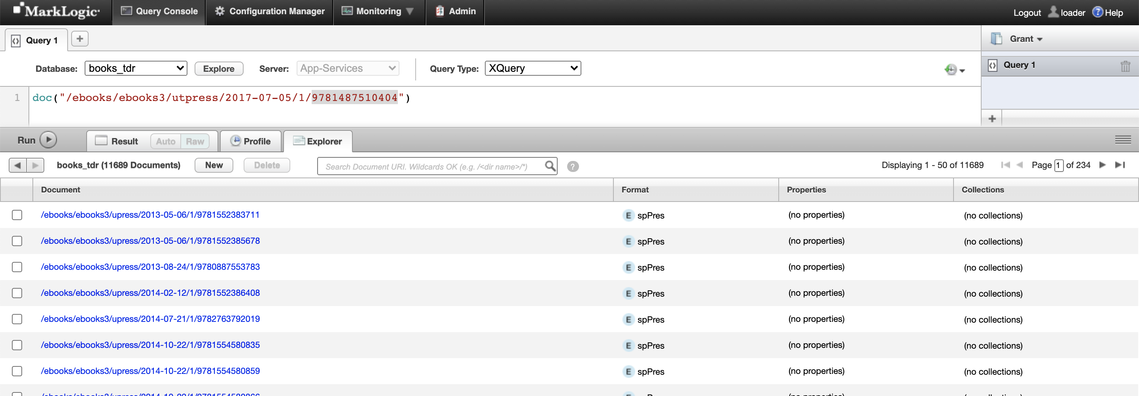
Results
11,689 processed books + TDR metadata records

Slide 8
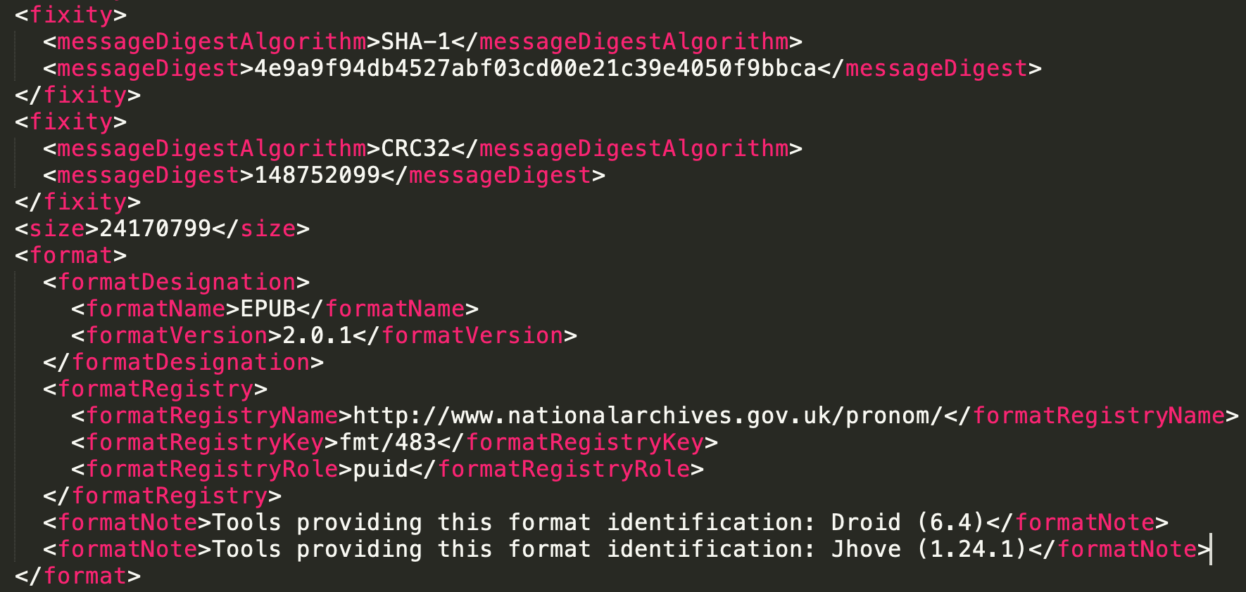
Preservation Metadata: XML Format

Slide 9
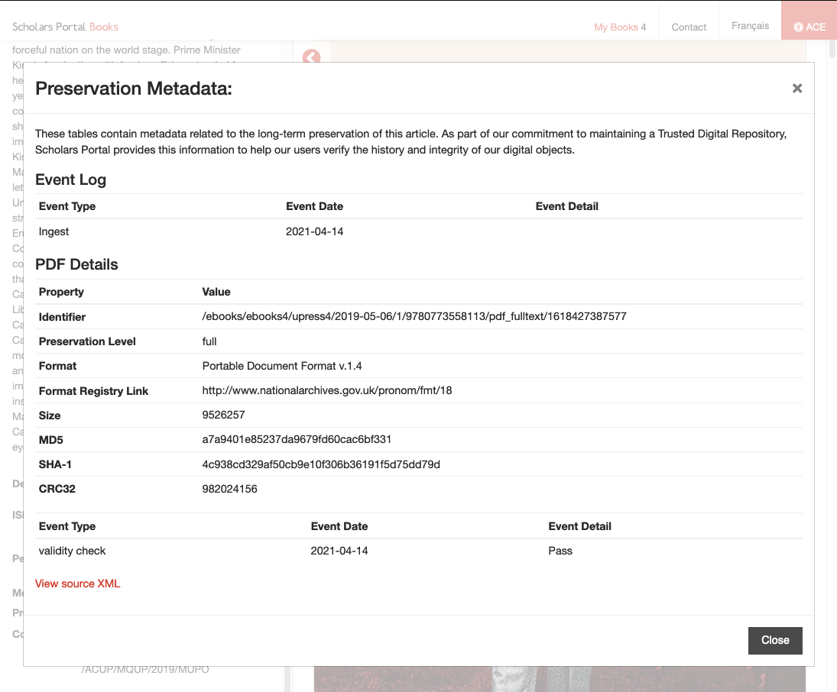
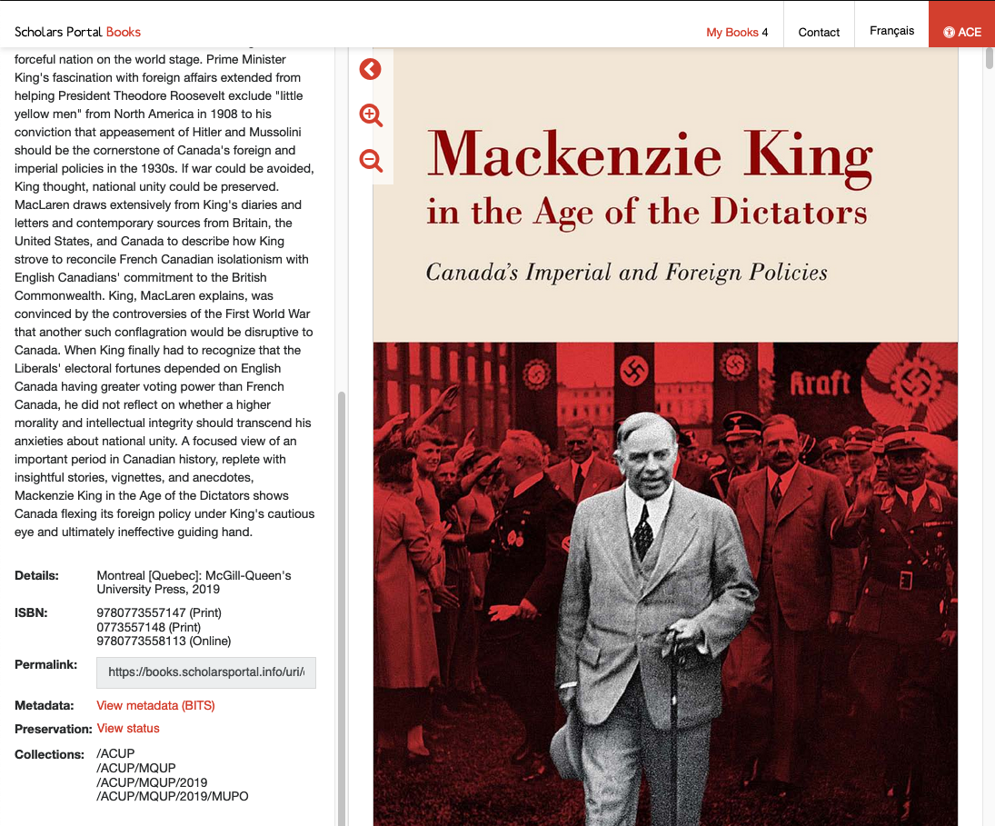
Preservation Metadata: User-Facing (Example)

Slide 10
Up Next
TDR metadata in the Books platform
Testing with additional collection formats
  Books with chapter-level PDFs
  XML books
Production processing for all books
Documentation updates

Slide 11
Thank you!
Questions? Reach out to grant@scholarsportal.info

