Slide 1
PETS OF OCUL
Pets belonging to, or beloved by, members of the OCUL Community.

Slide 2
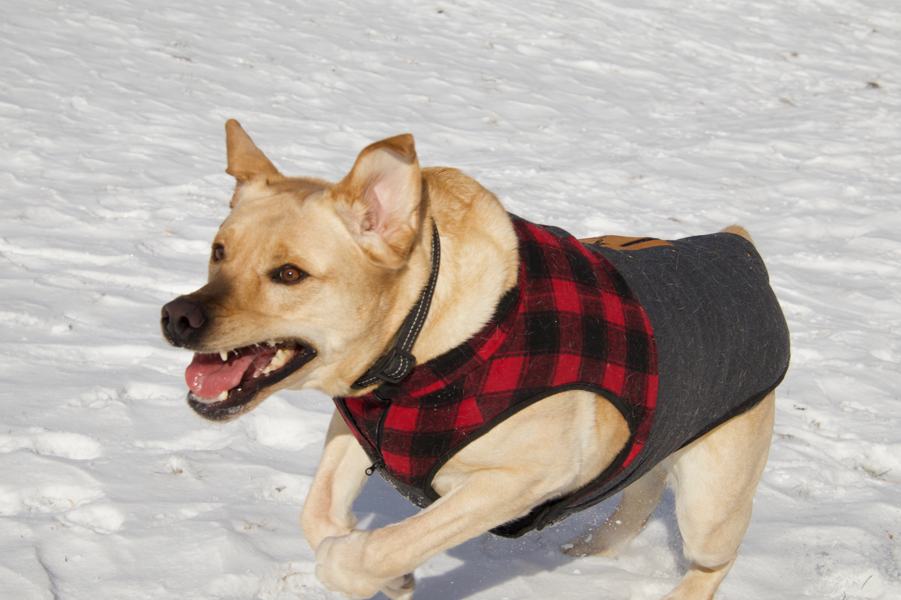
BEN
Submitted by:
Alan Darnell, Scholars Portal

Slide 3
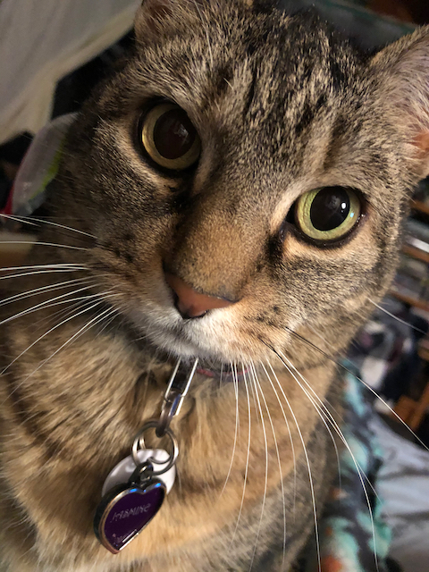
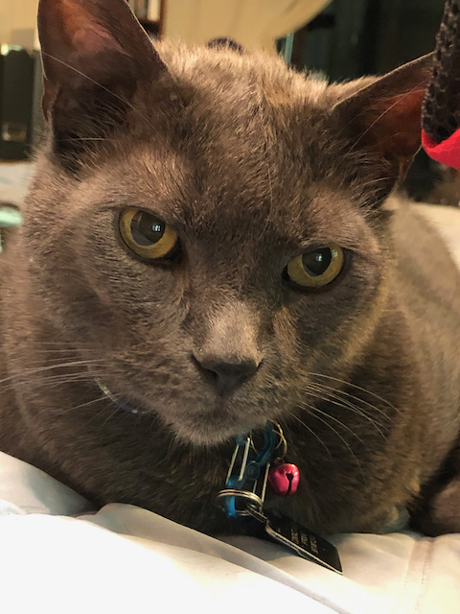
JASMINE (left)
RILEY (right)
Submitted by:
Alicia Cappello, Scholars Portal

Slide 4
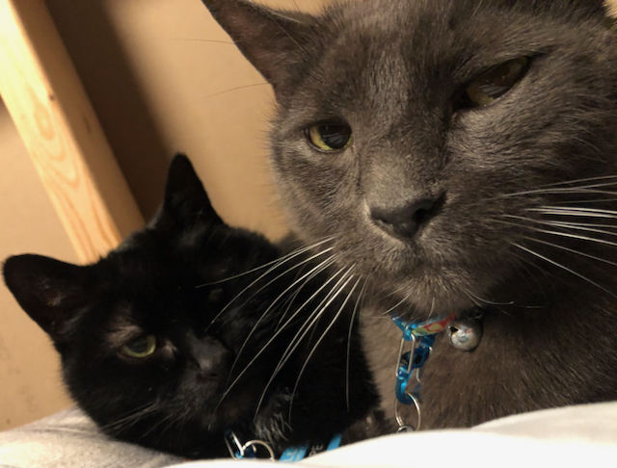
BEN and JASPER
Submitted by:
Alicia Cappello, Scholars Portal

Slide 5
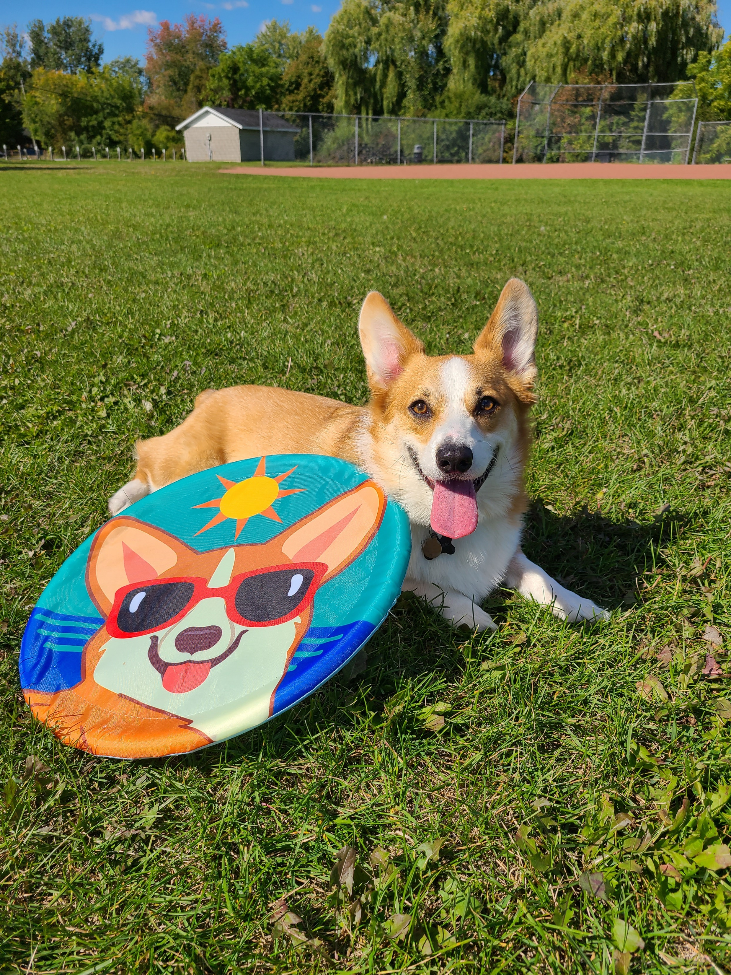
ZIGGY
Submitted by:
Carling Spinney, Queen’s

Slide 6
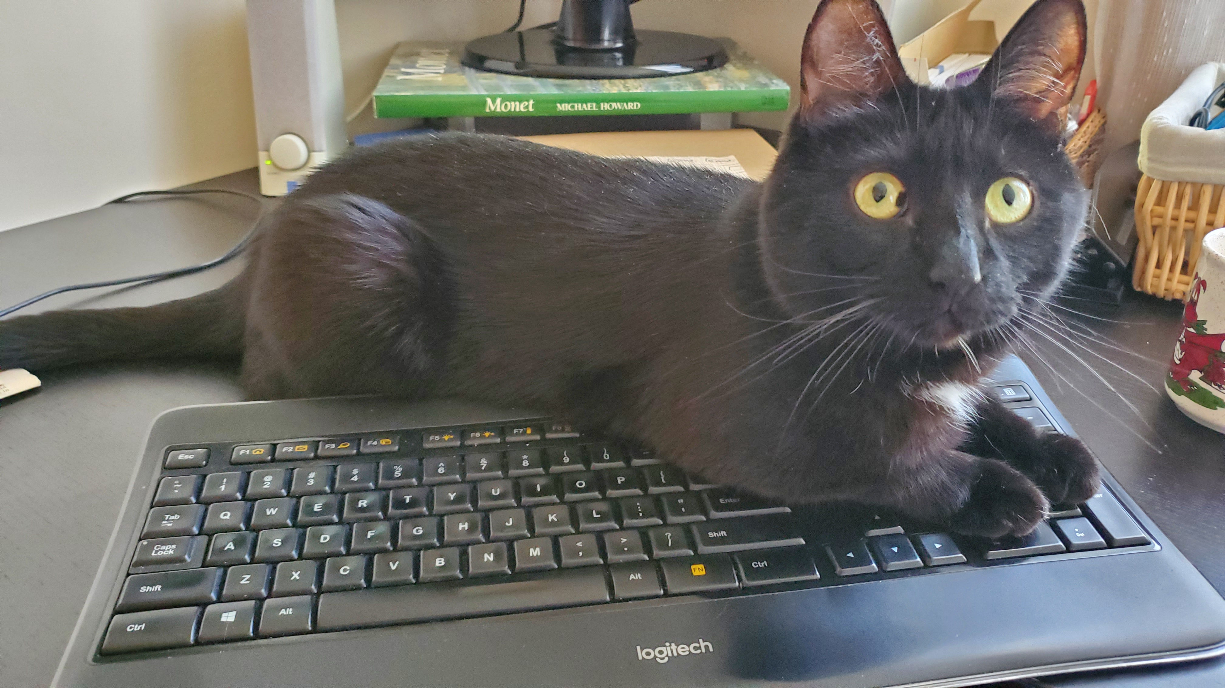
KERMIT
Submitted by:
Alison Hitchens, Waterloo

Slide 7
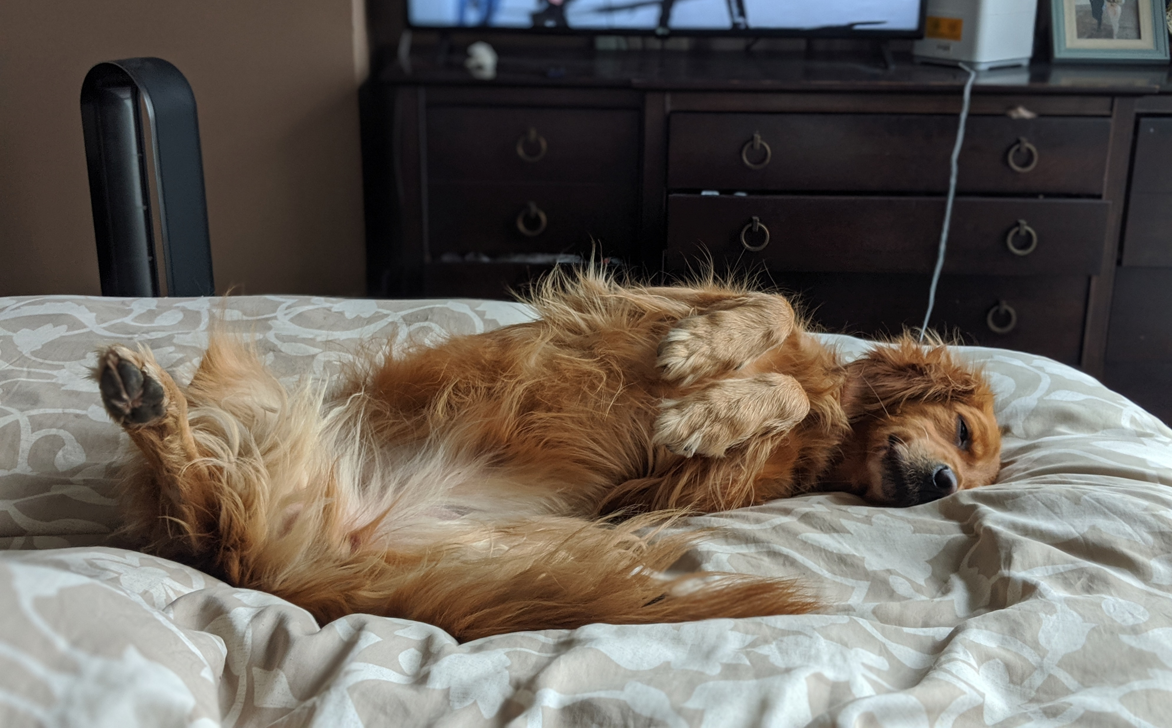
GERTIE
Submitted by:
Kara Handren, Scholars Portal

Slide 8
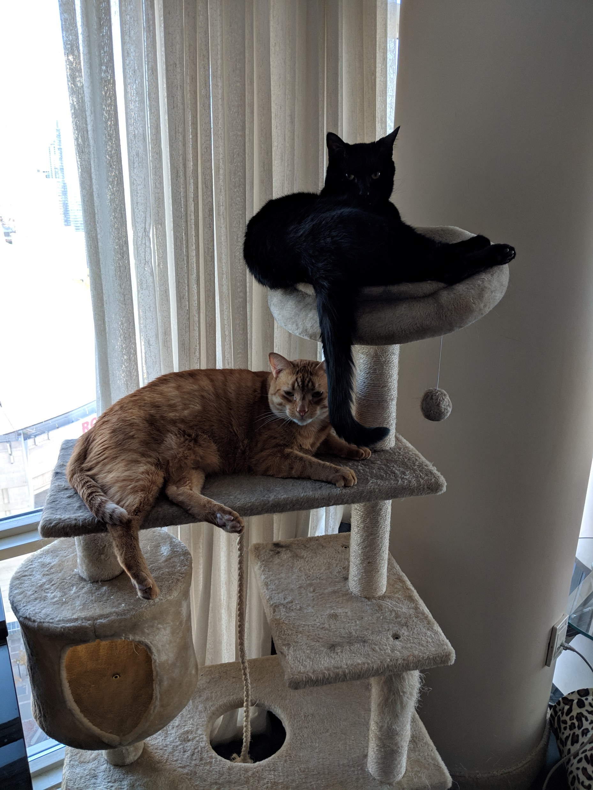
INDIGO and ARTI
Submitted by:
Kara Handren, Scholars Portal

Slide 9
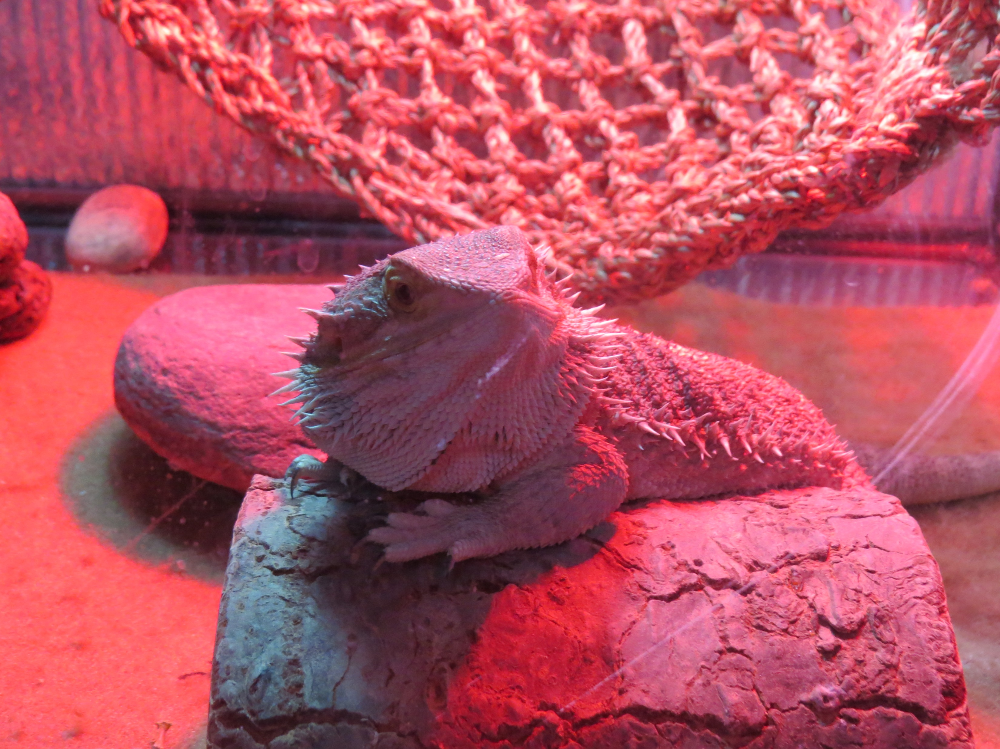
REX
Submitted by:
Mindy Thuna, UofT

Slide 10
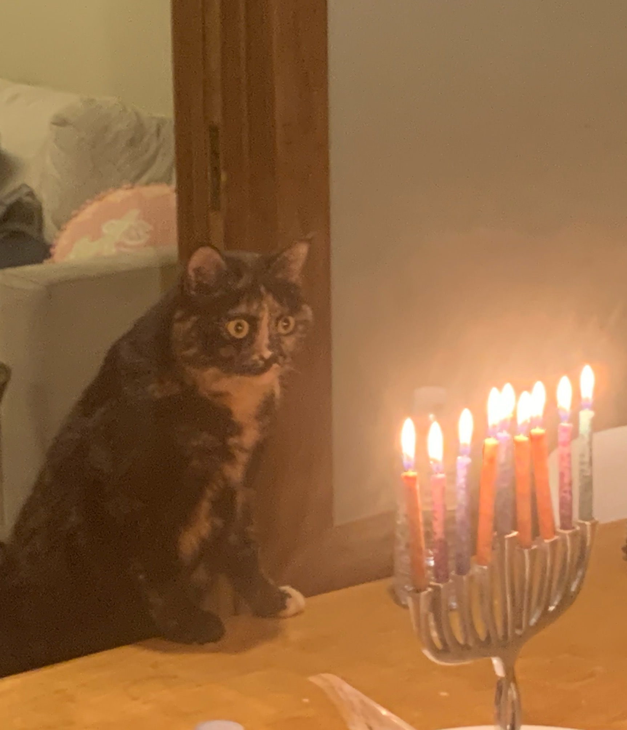
TANYA
Submitted by:
Ravit David, Scholars Portal

Slide 11
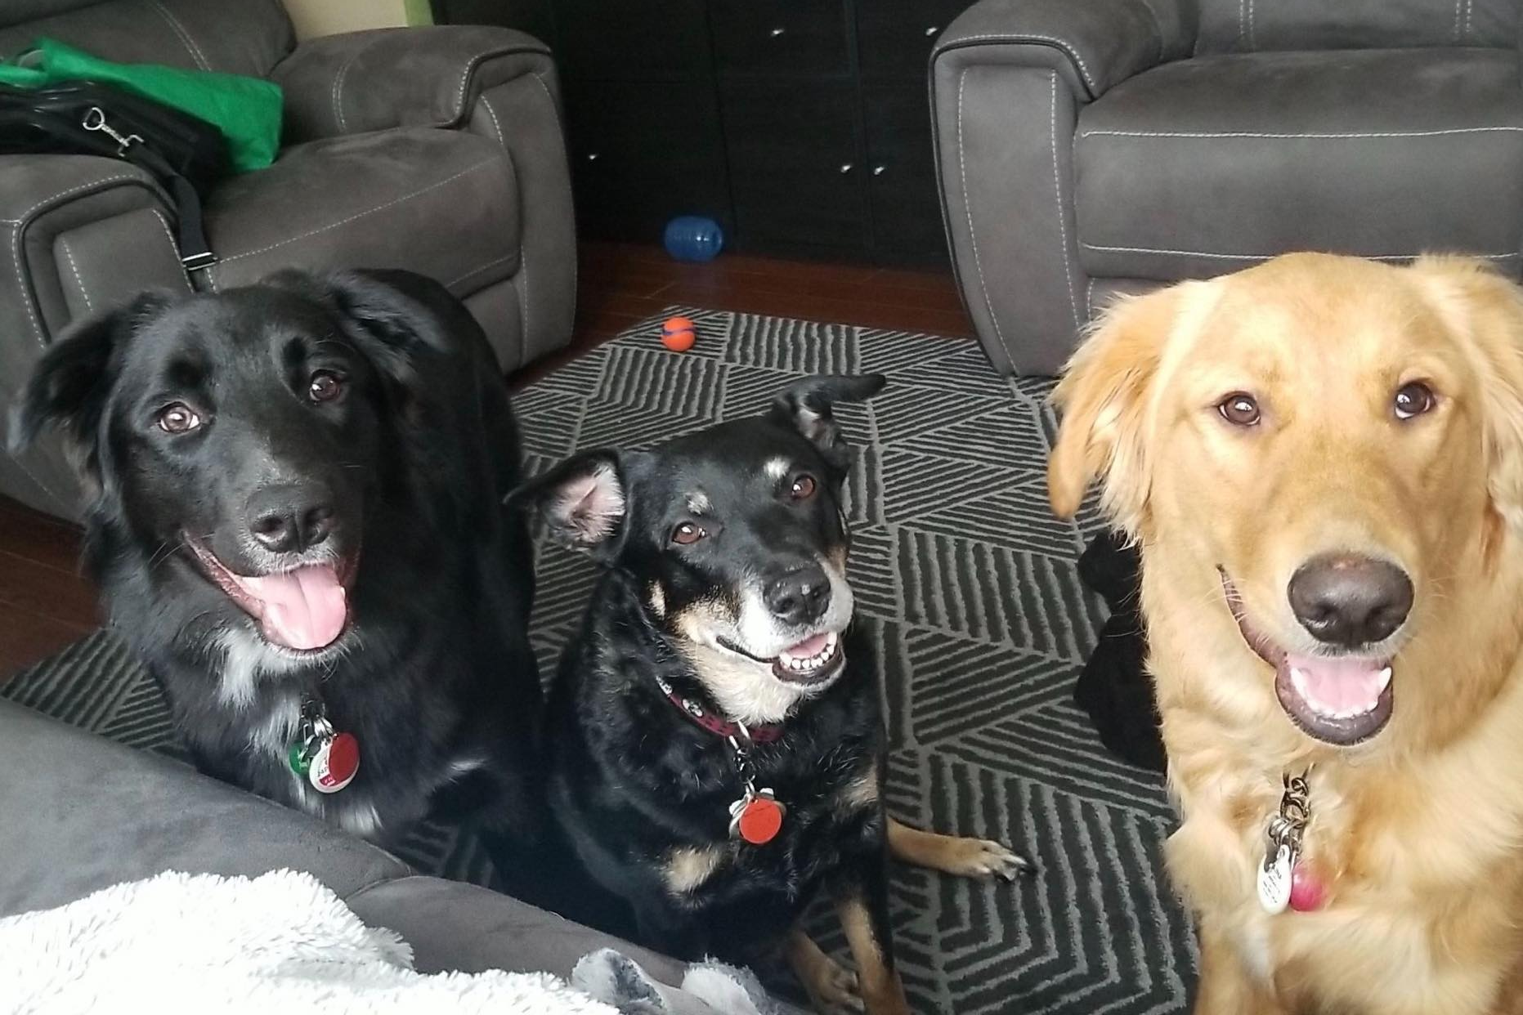
JACEN, SHELBY and JAINA
Submitted by: Nancy Waite, McMaster

Slide 12
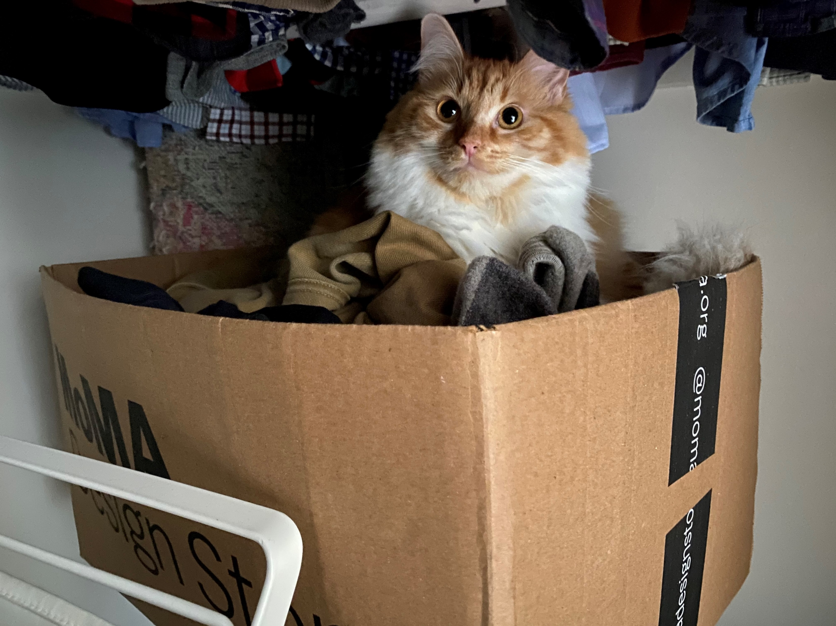
KORGEIGH
Submitted by:
Meghan Burke, Queen’s

Slide 13
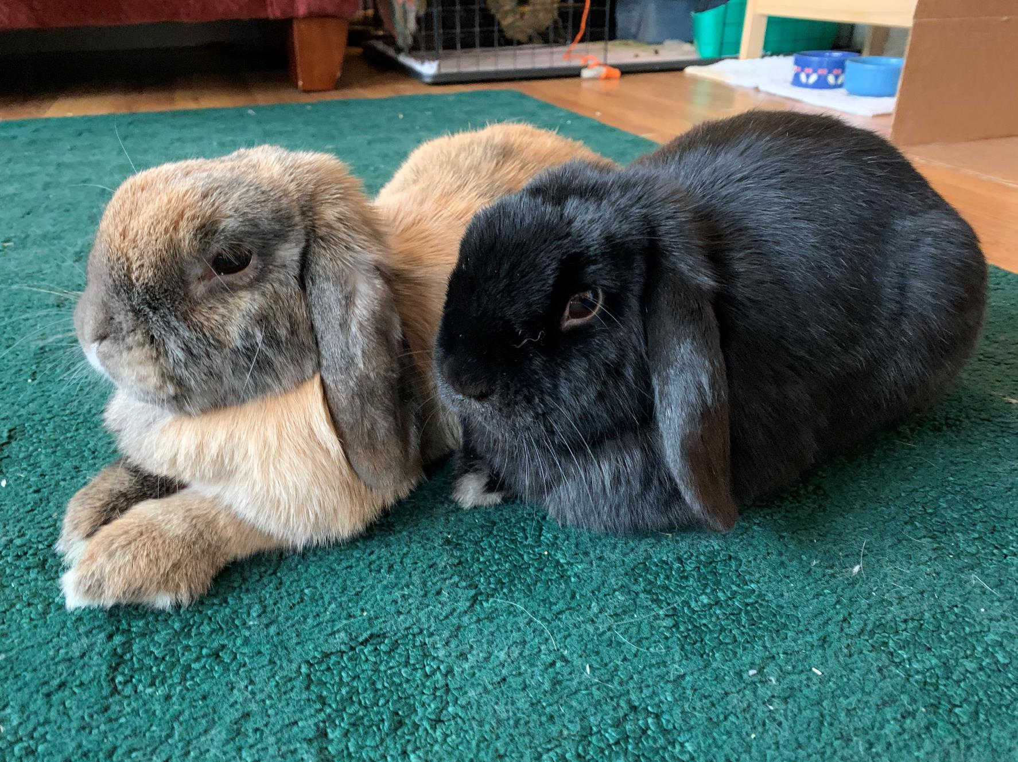
TIGGERS and HUCKELBERRY FINN
Submitted by:
Lisl Schoner-Saunders, Algoma

Slide 14
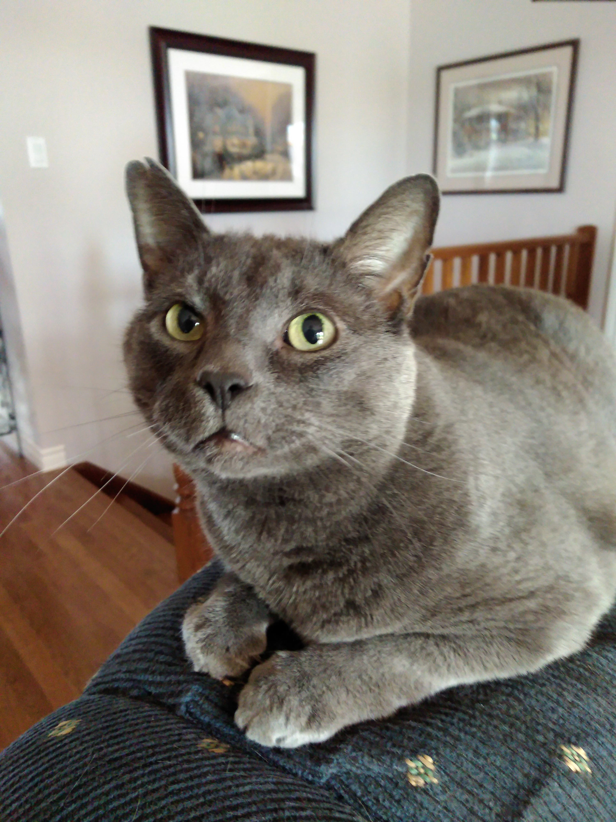
KING TUT
Submitted by:
Matt Tales, Laurier

Slide 15
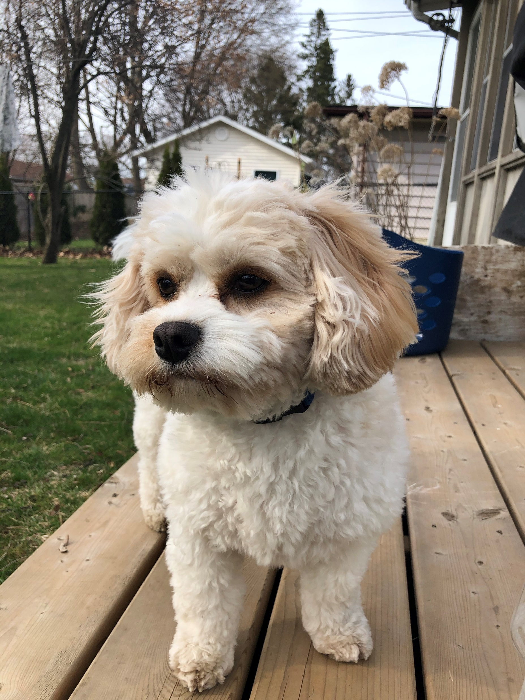
TAIKA
Submitted by:
Nathalie Soini, Queen’s

Slide 16
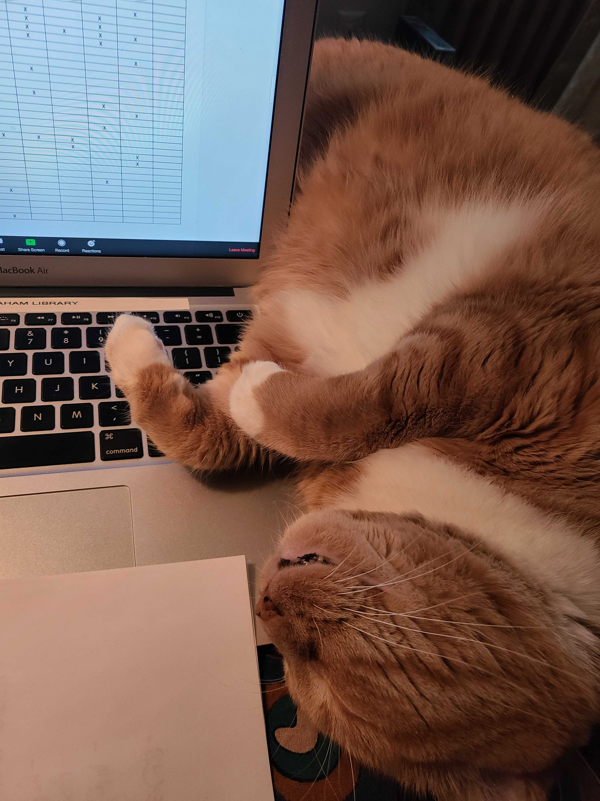
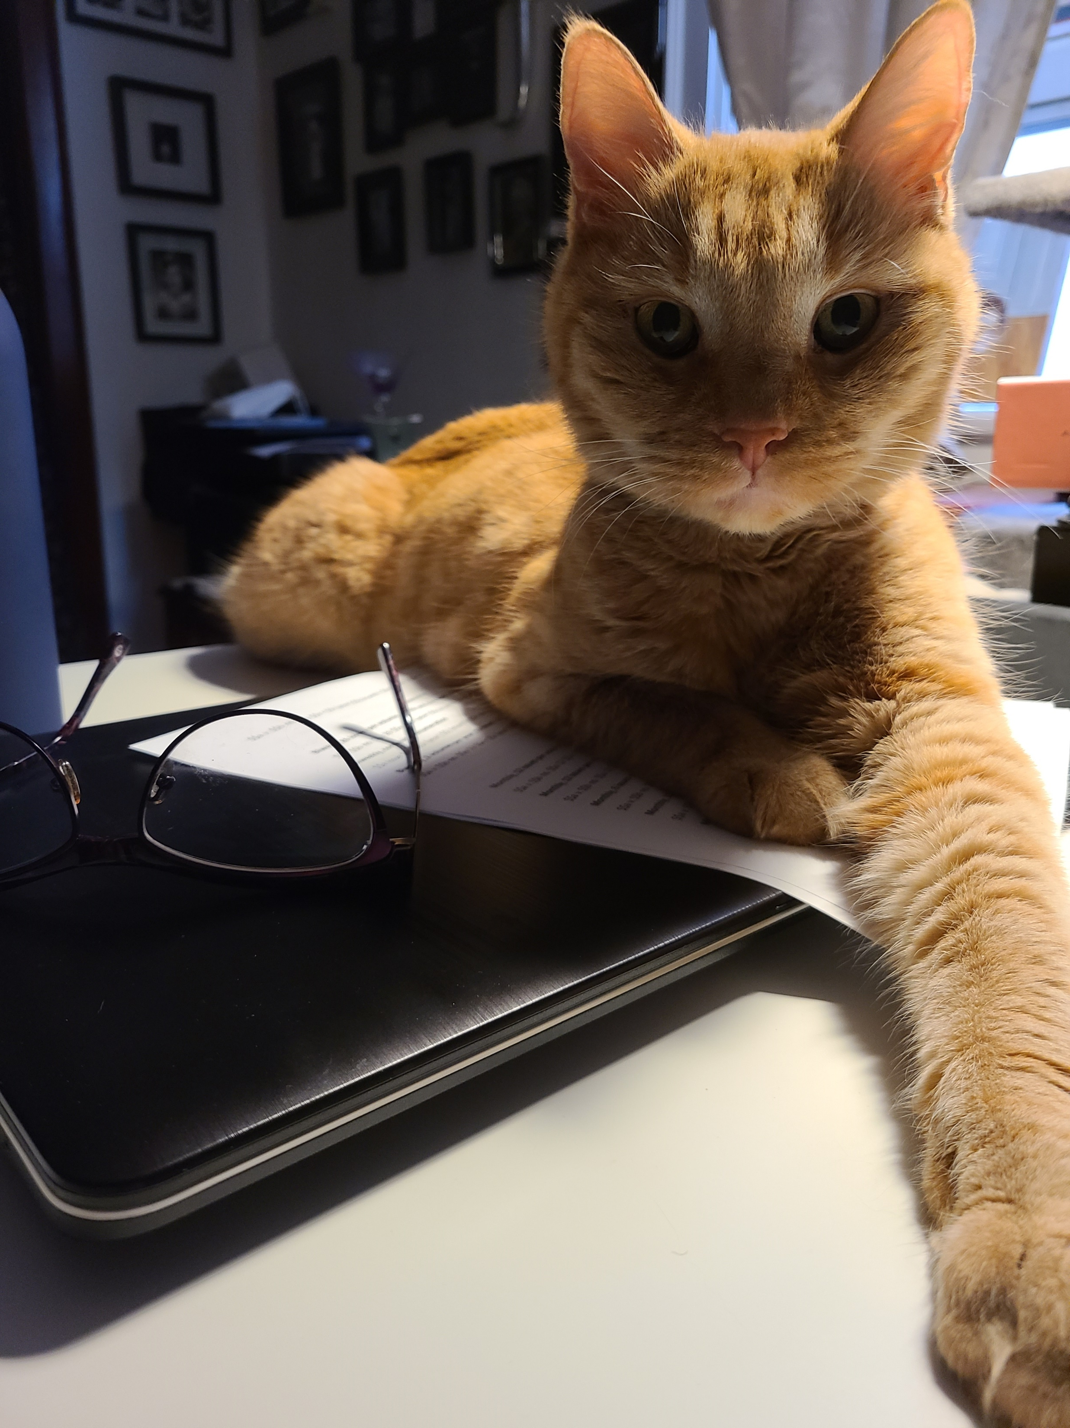
HAWKEYE (left) RADAR (right)
Submitted by:
Adrienne Findley-Jones, UofT

Slide 17
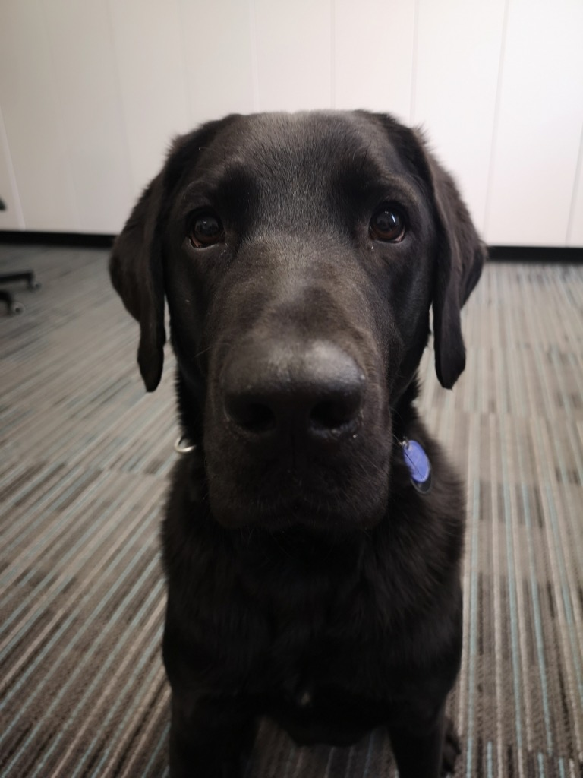
JUAN
Submitted by:
Ashley Shaw, Laurier

Slide 18
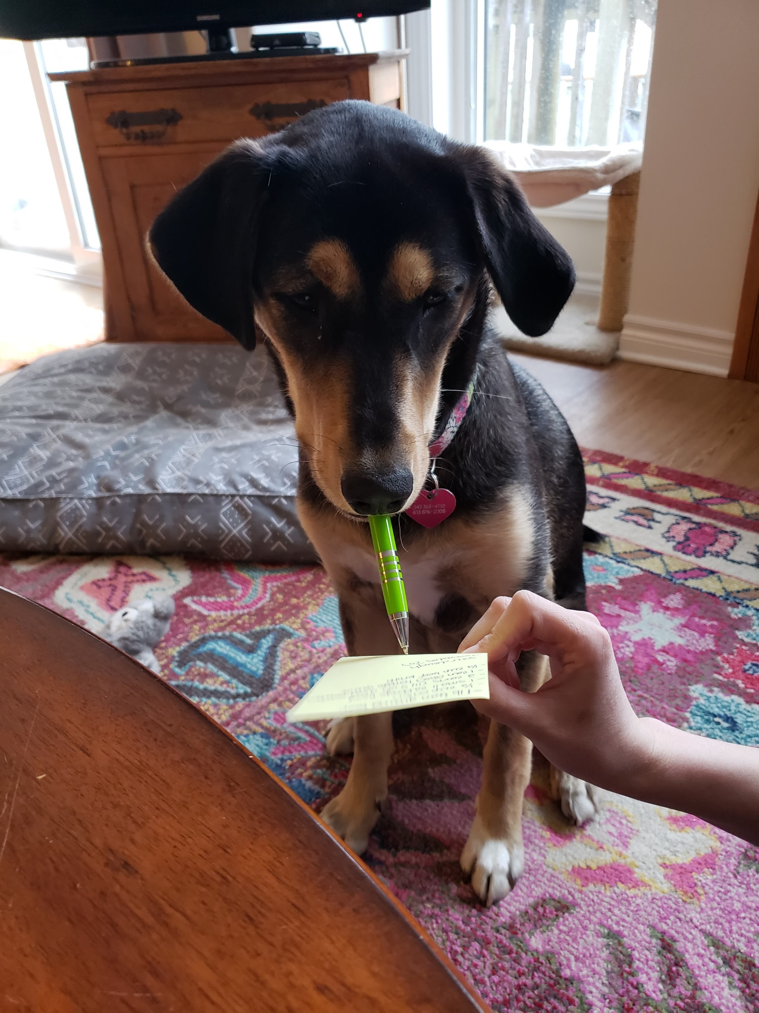
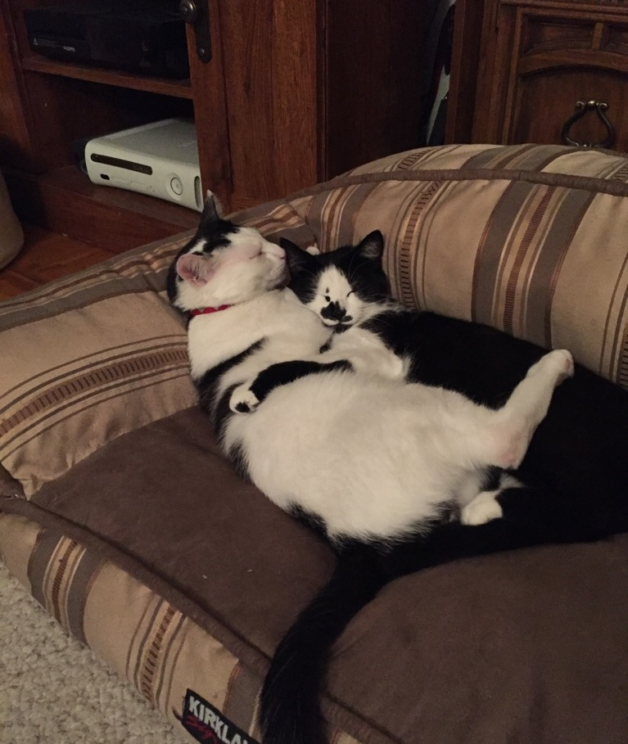
RIVER (left), MULDER and NOMI (right)
Submitted by:
Catherine DeNoble, Queen’s

Slide 19
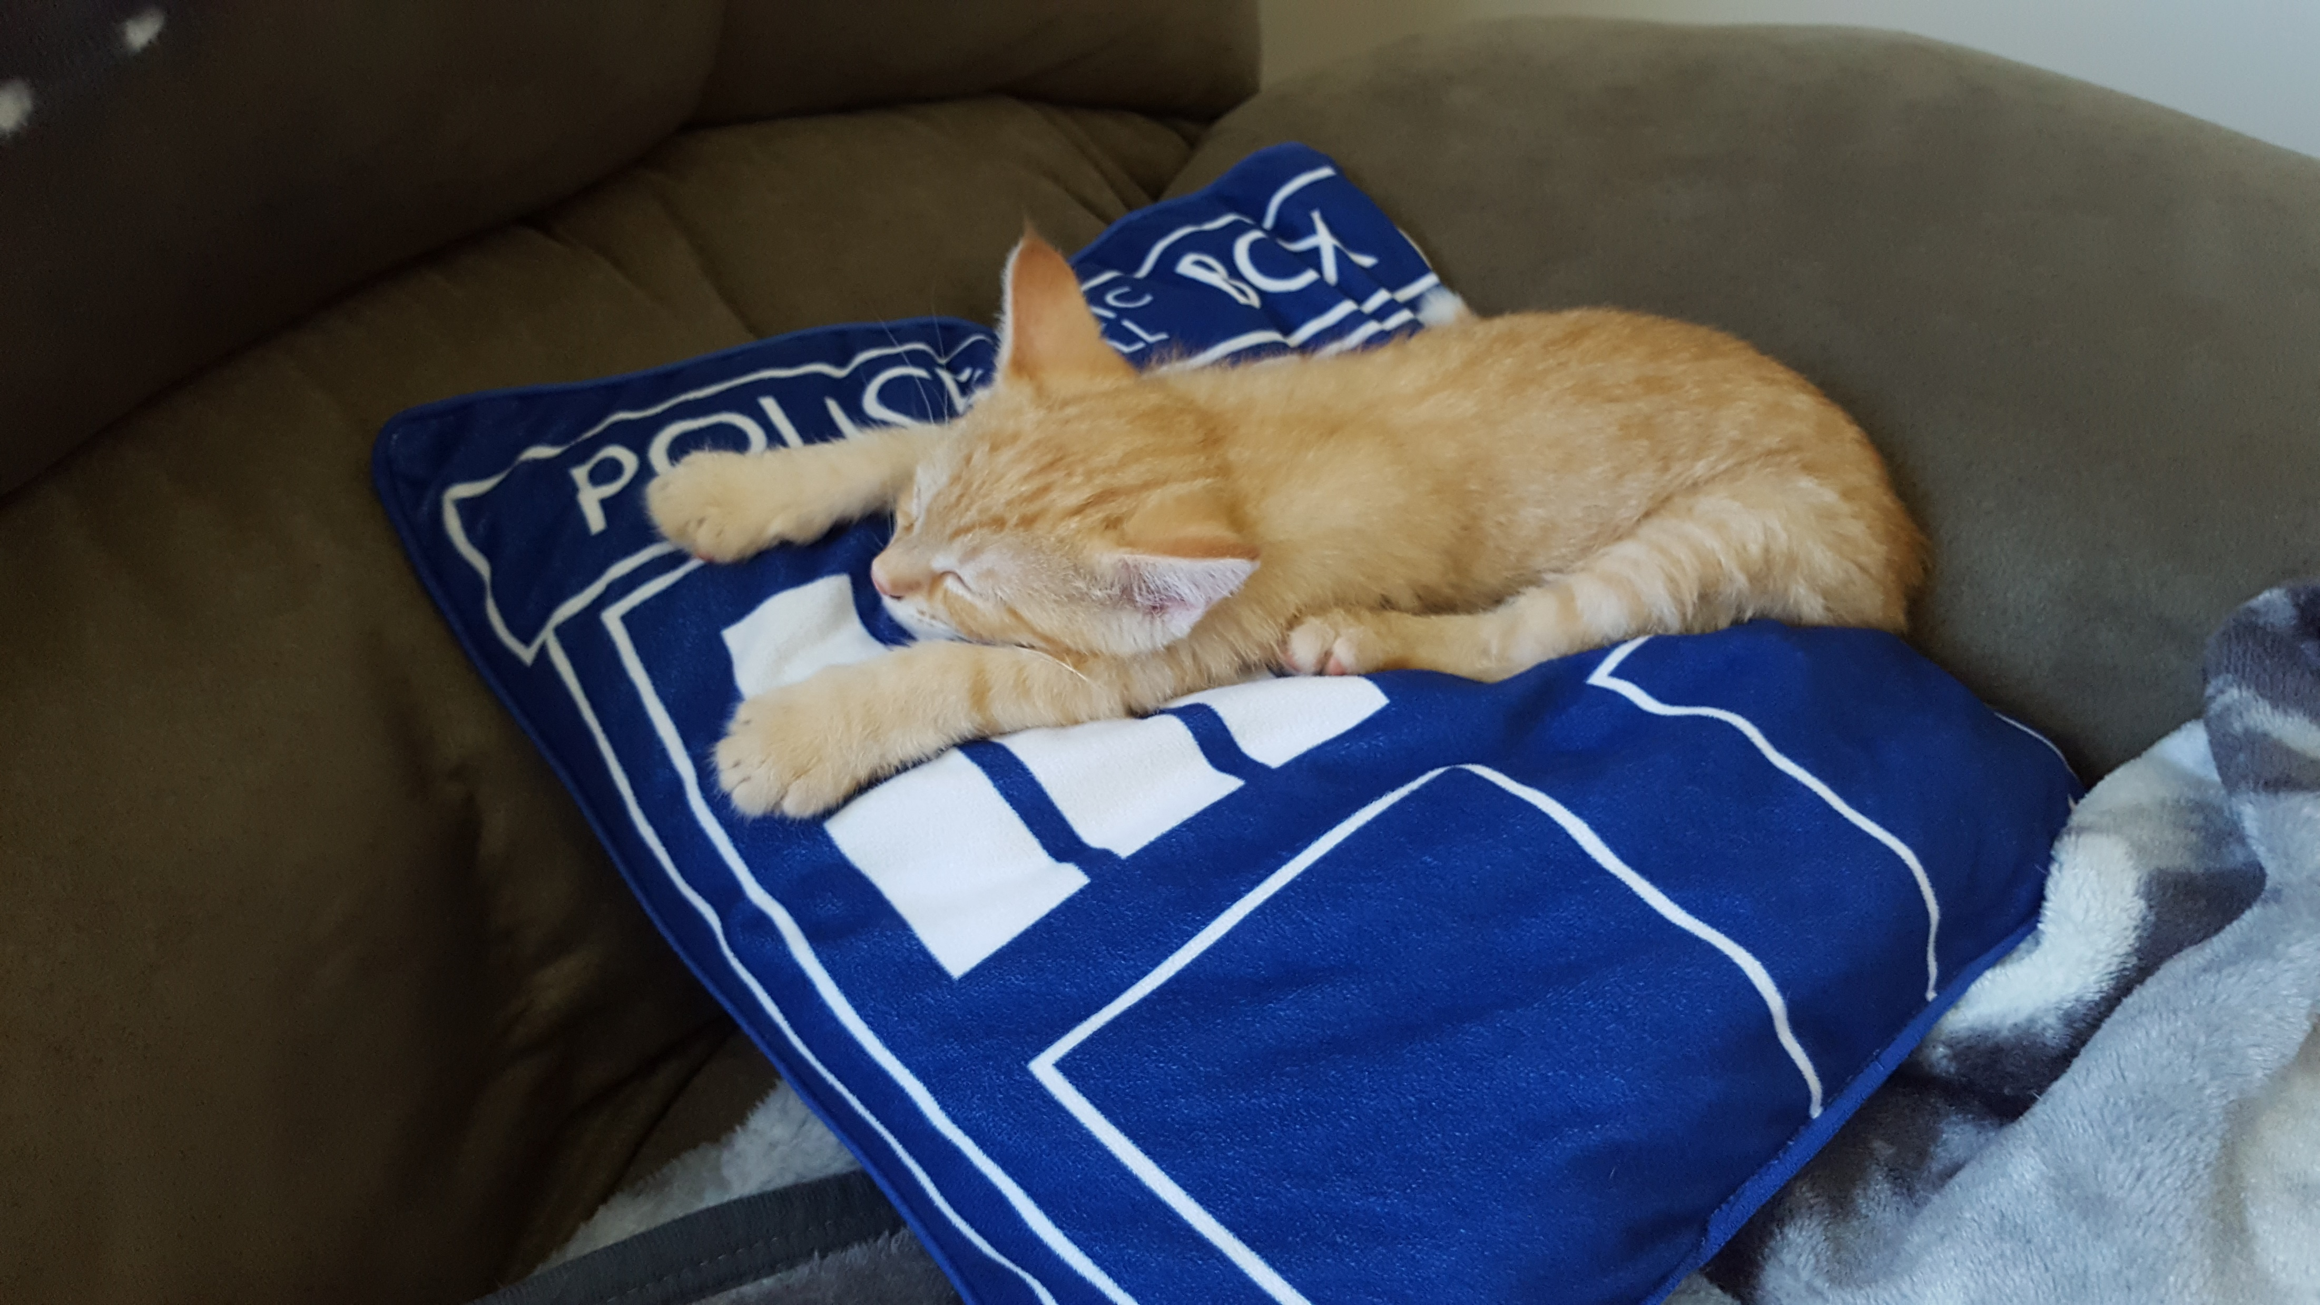
FURLEY MOWAT
Submitted by:
Catherine DeNoble, Queen’s

Slide 20
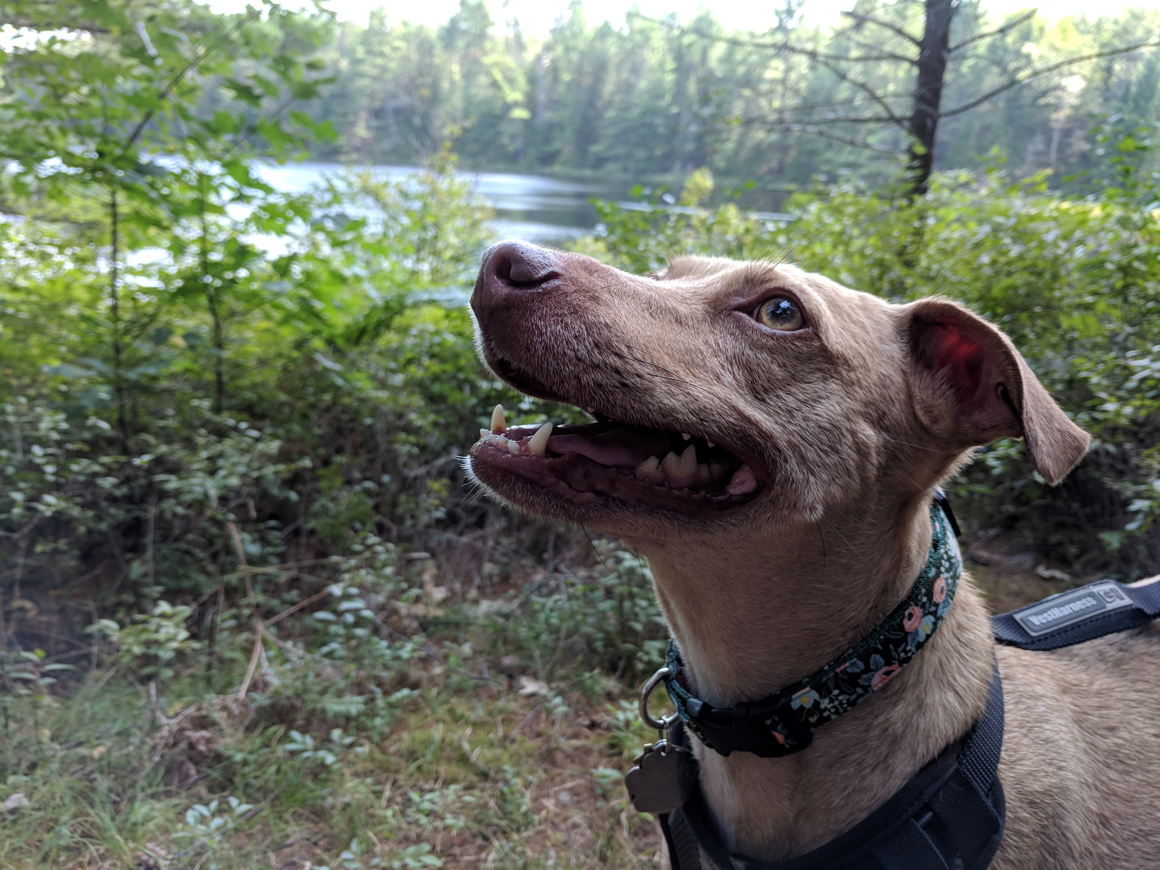
WILLOW
Submitted by:
Kaitlin Newson, Scholars Portal

Slide 21
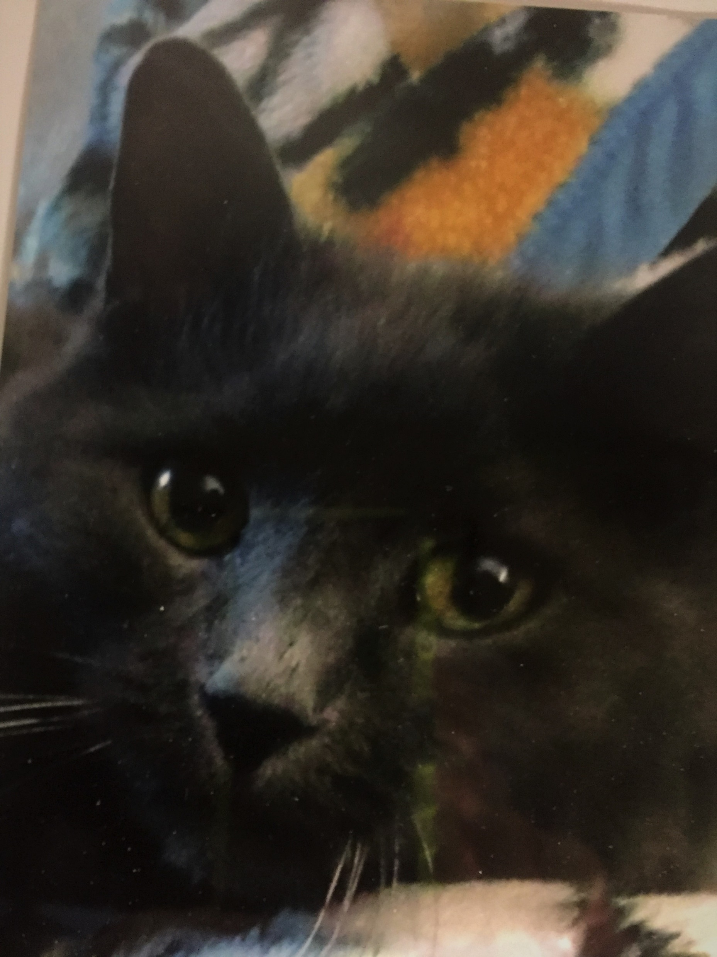
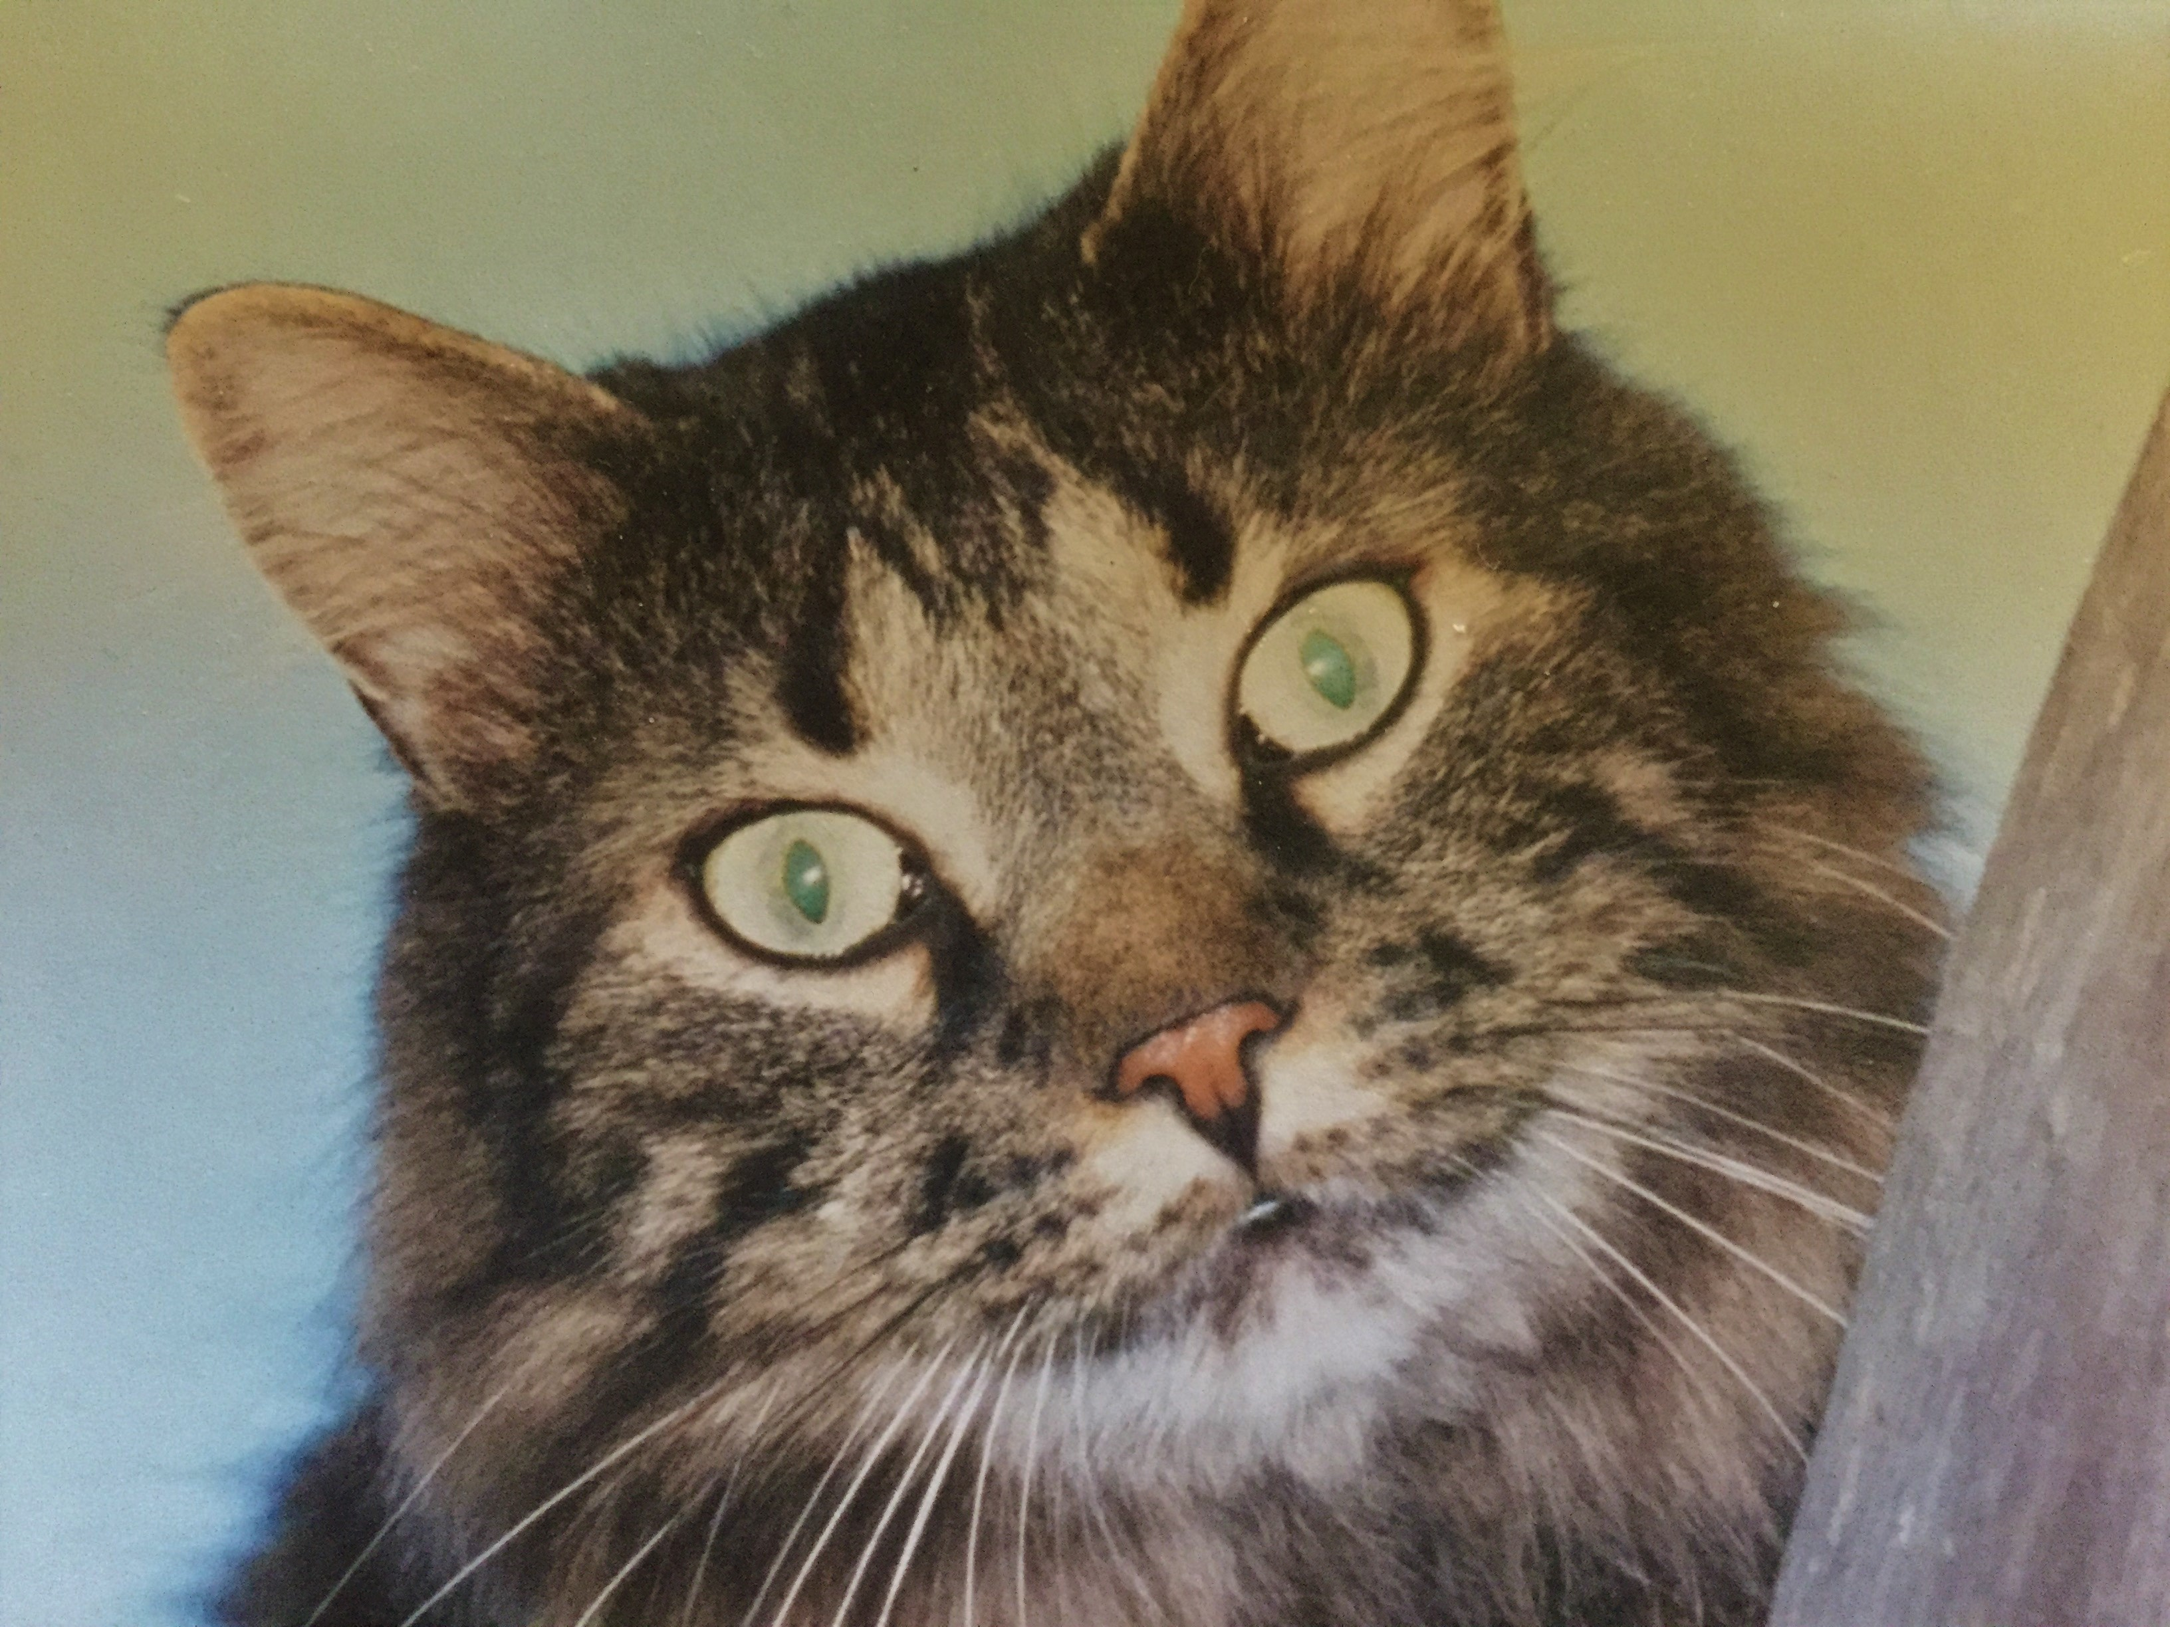
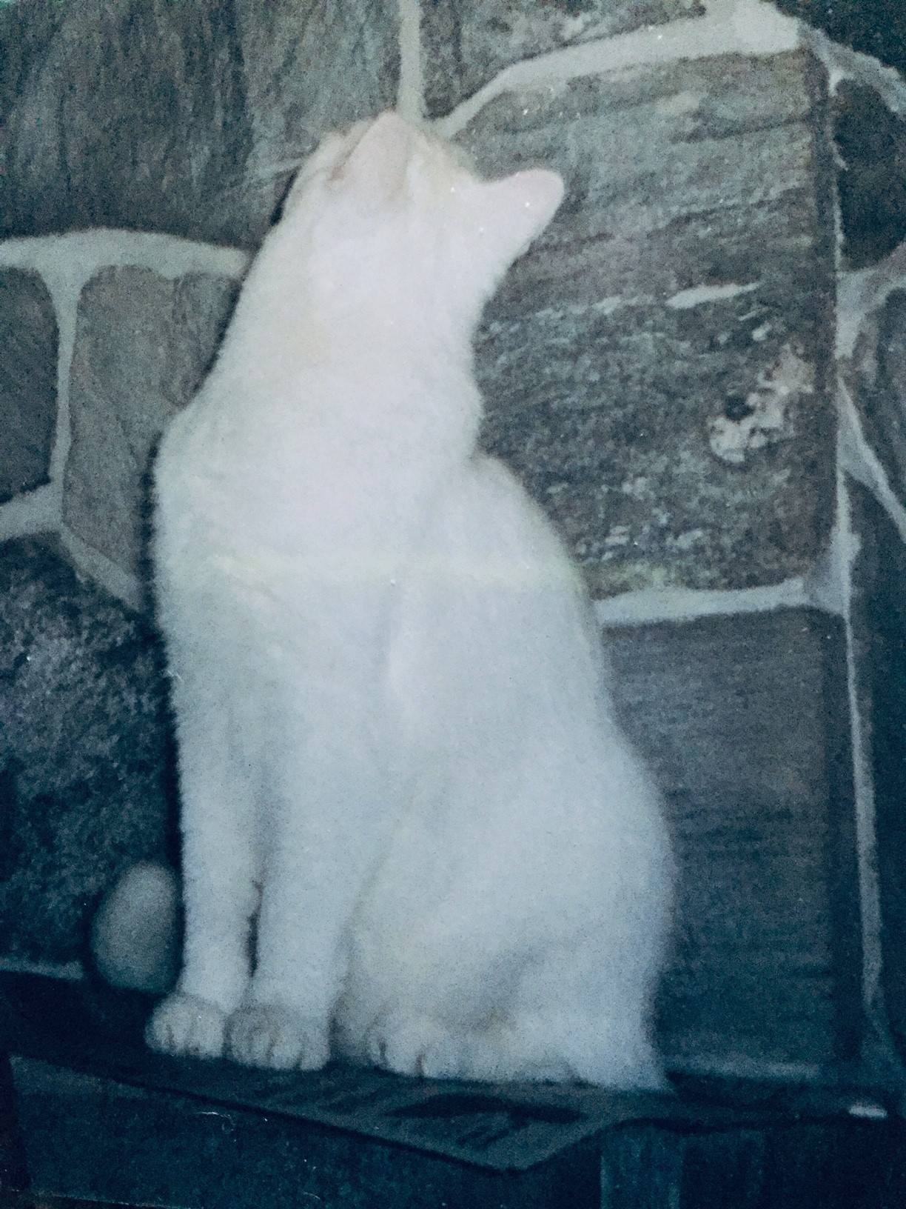
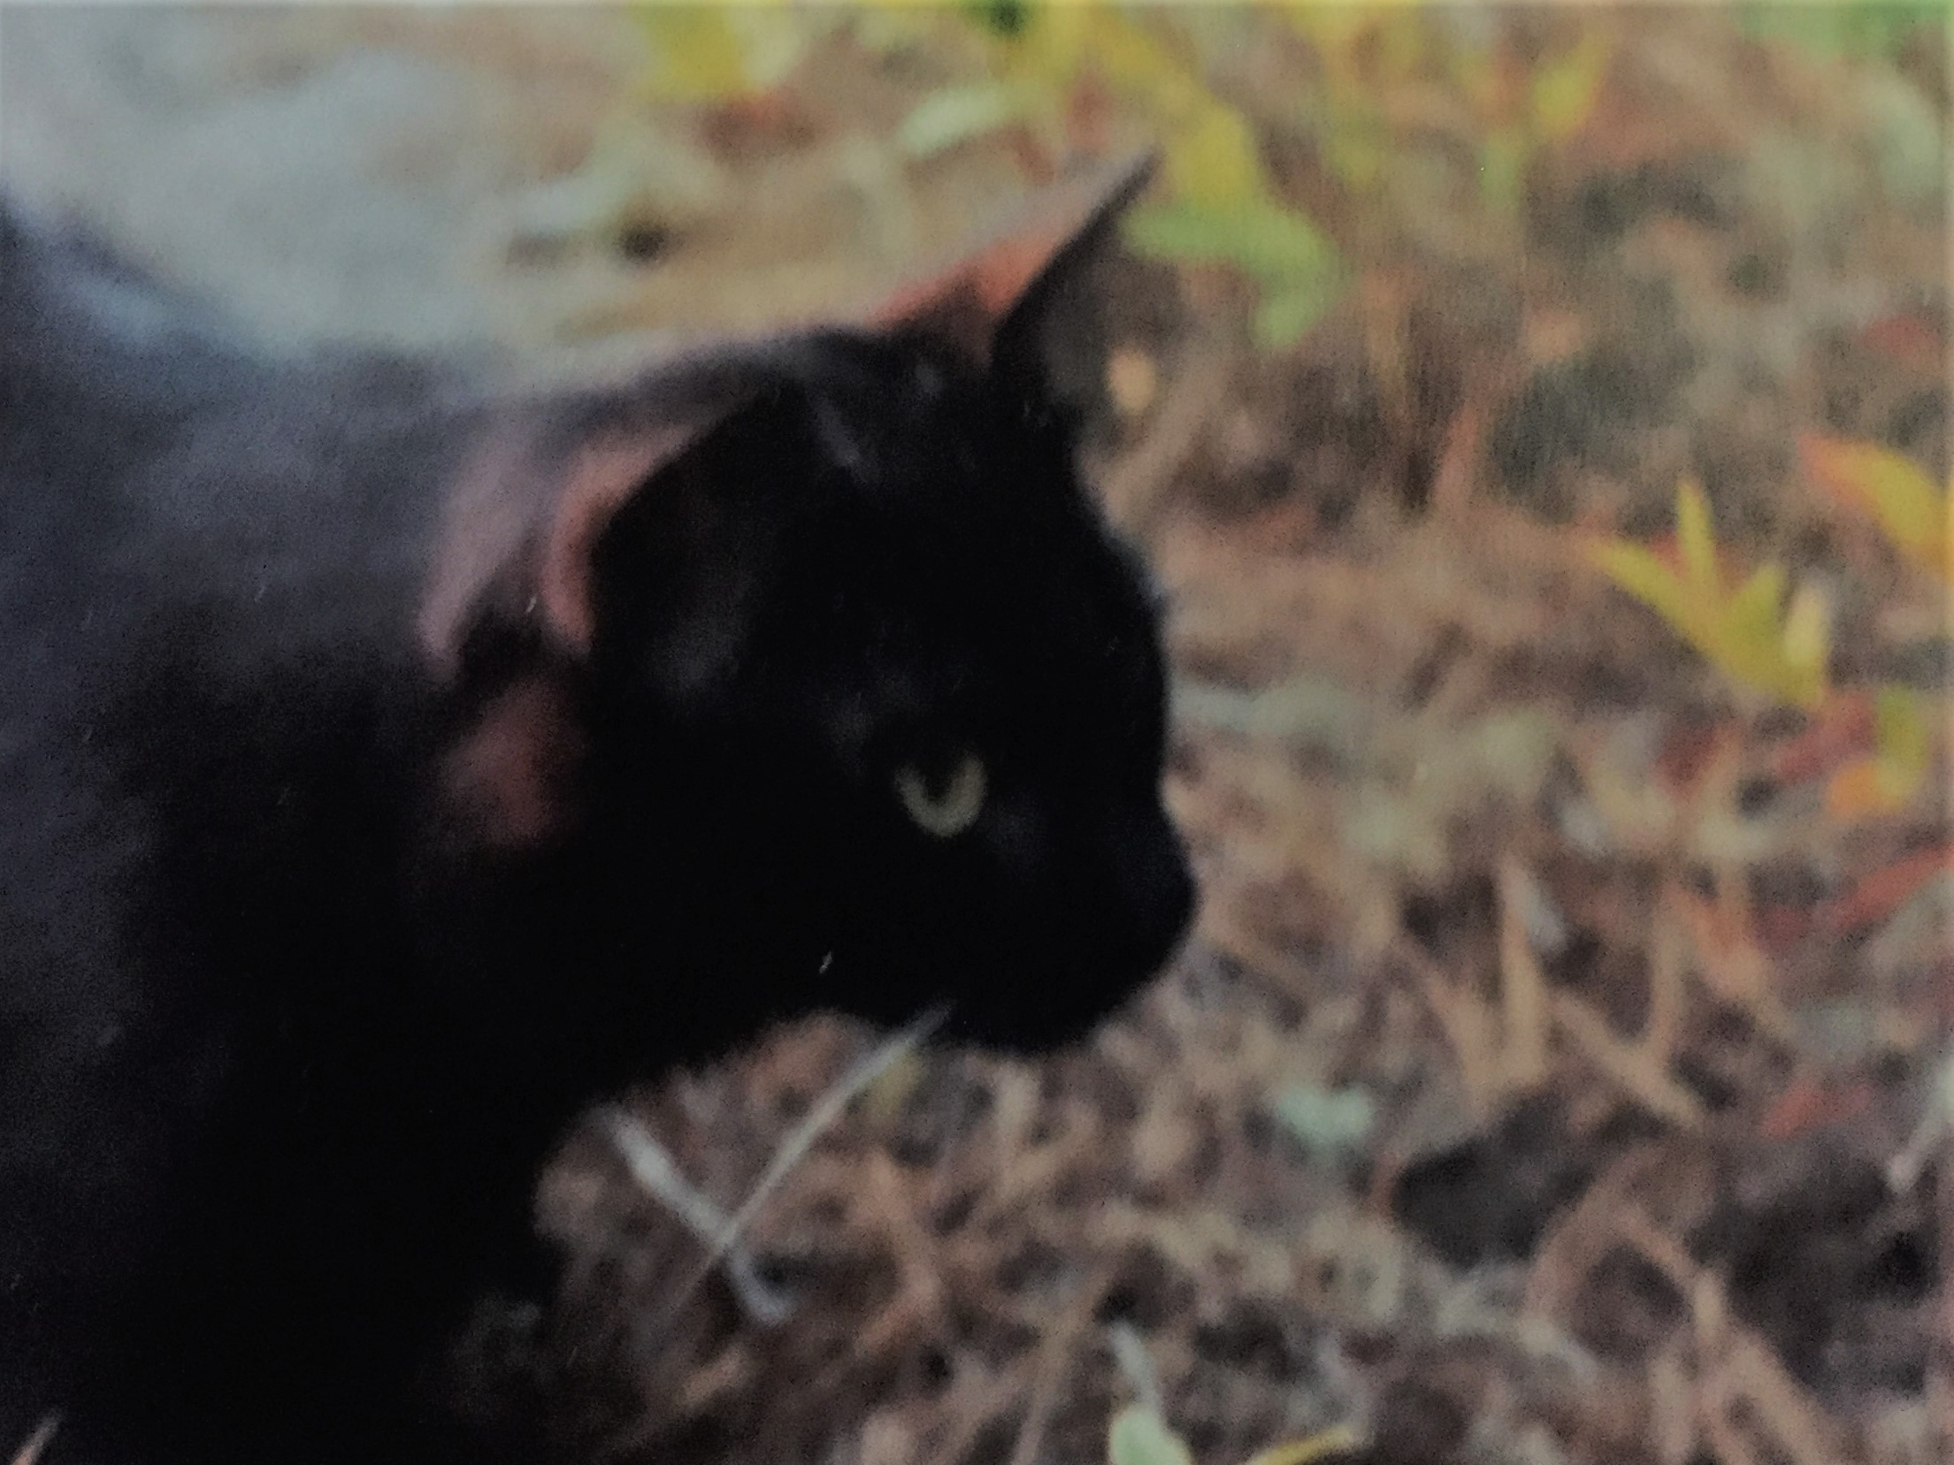
WOLF, JAKE
MISS T and TYCHO
Submitted by:
Arlene Jackson, Nipissing

Slide 22
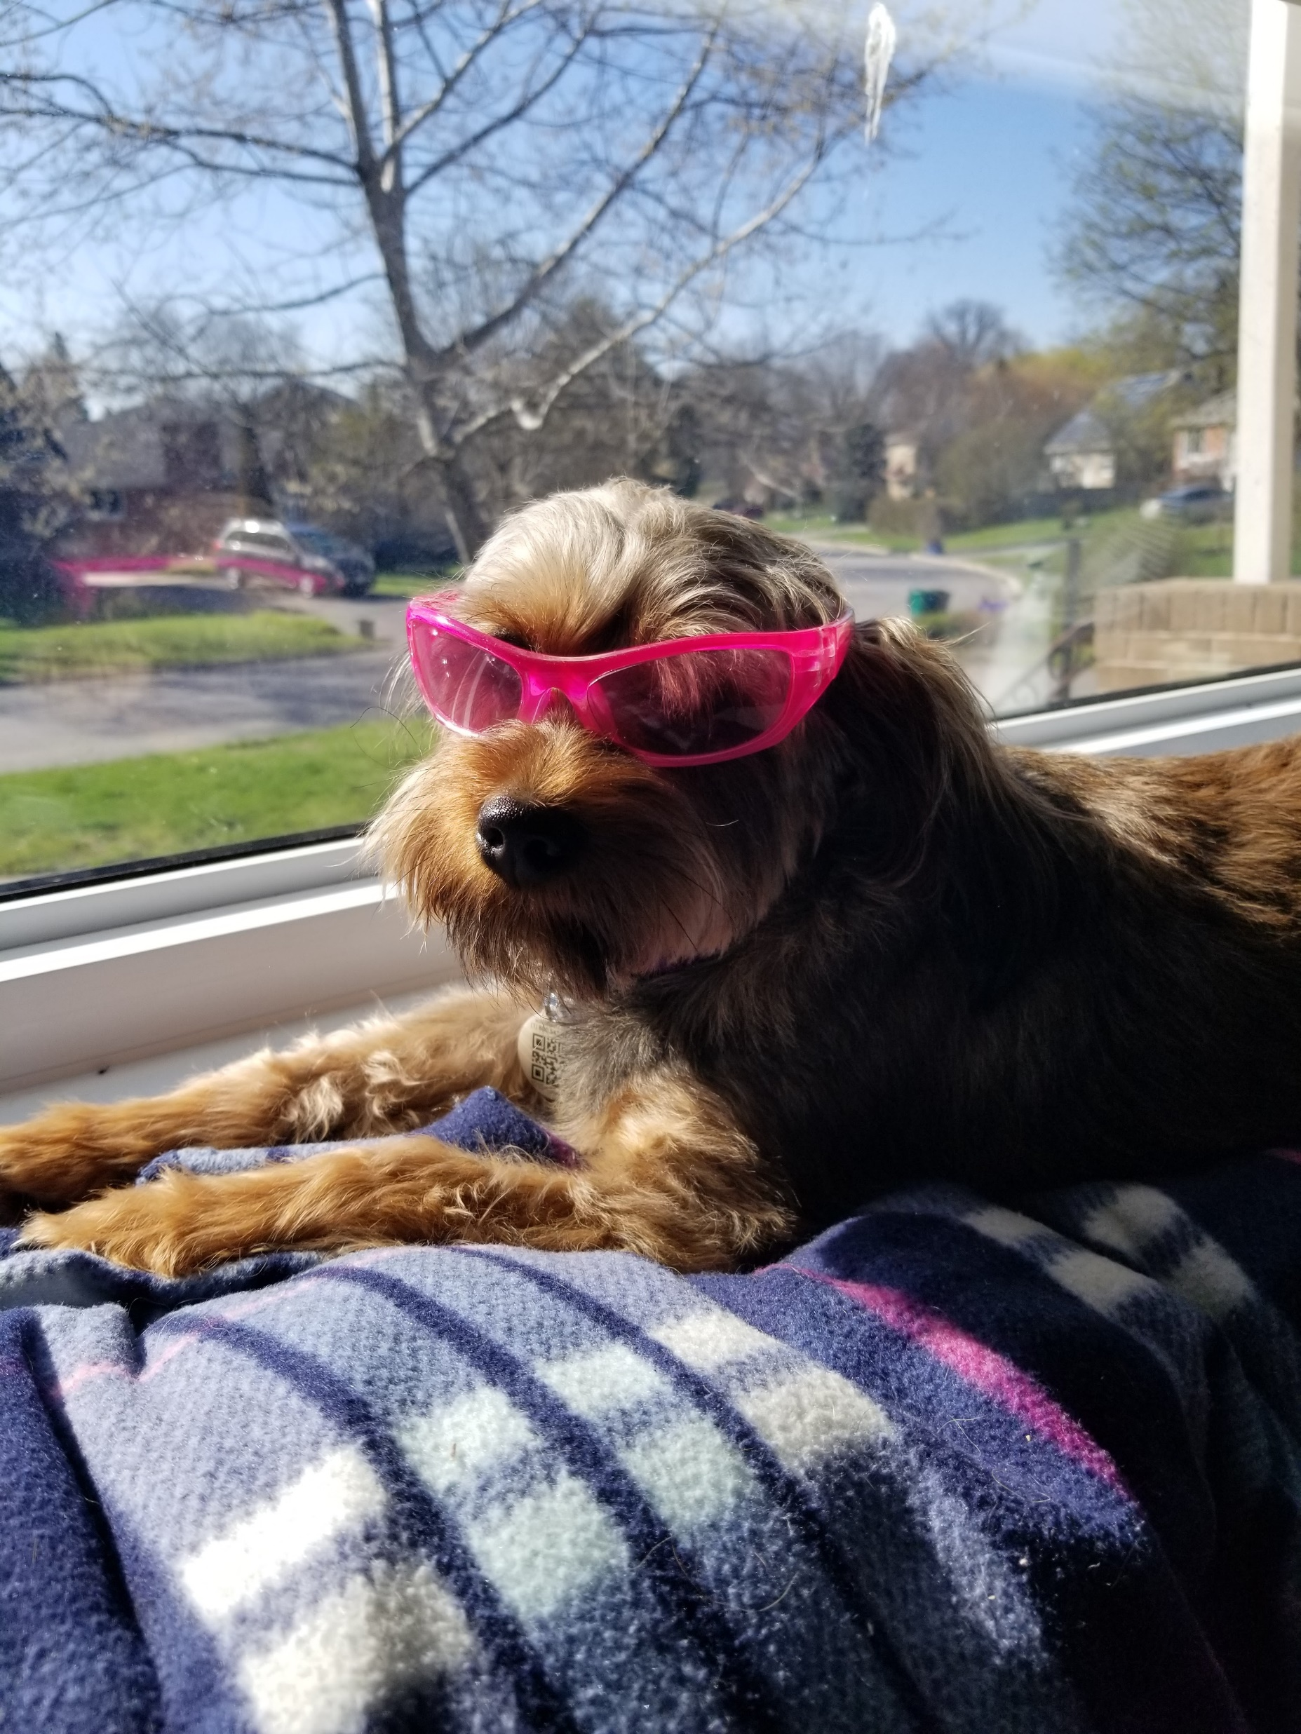
EBONY
Submitted by:
Amy Rutherford, Queen’s

Slide 23
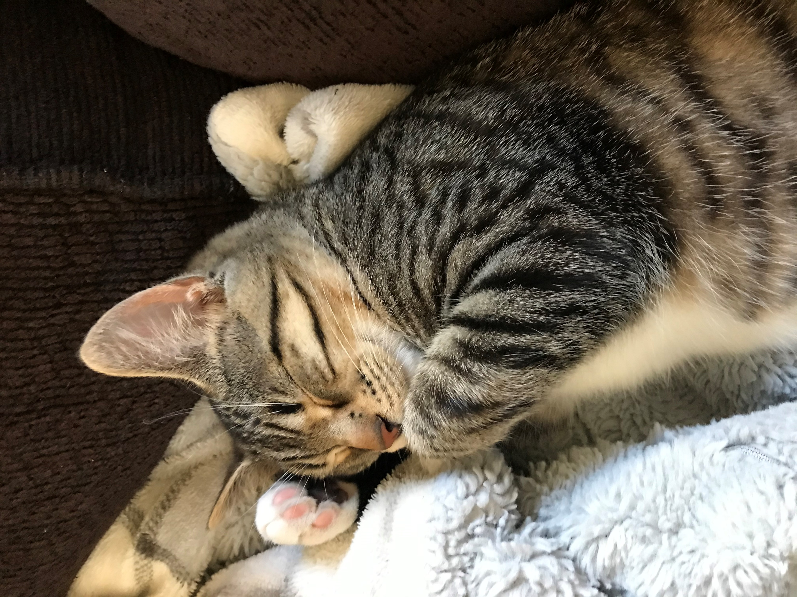
EUGENEELF
Submitted by:
Tamara Monster, McMaster

Slide 24
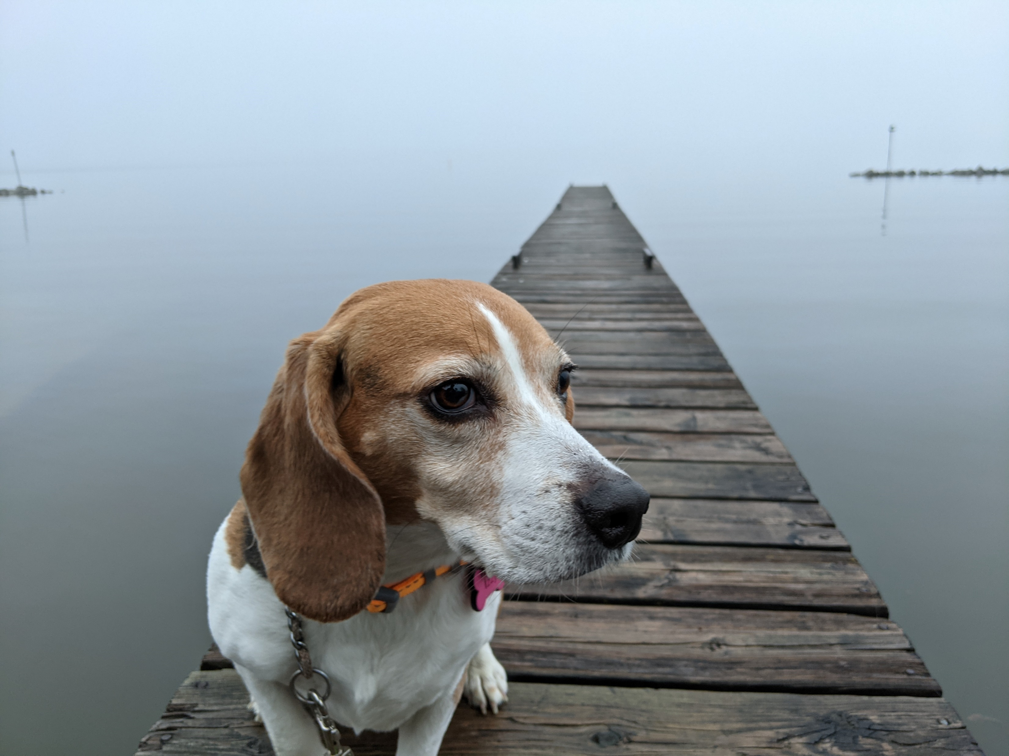
IZZY
Submitted by:
Geoff Andrews, Trent

Slide 25
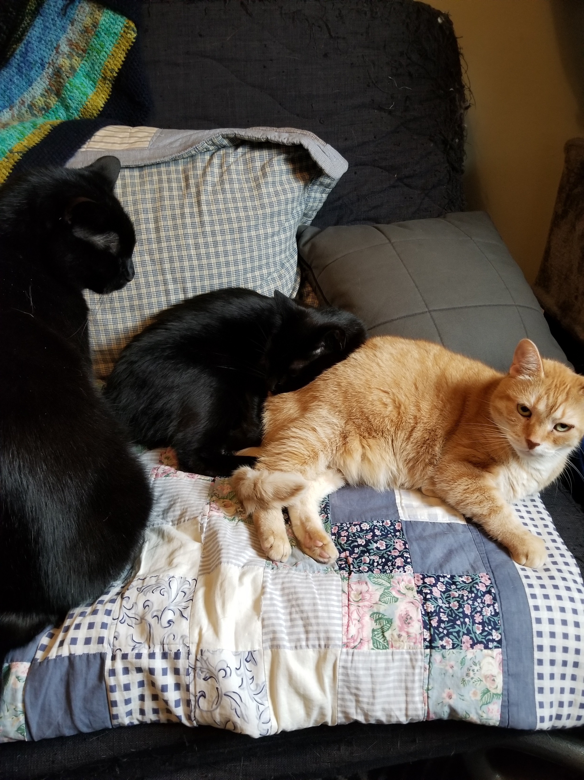
NORO-LIM, NIXIJUJU, and NIMUE
Submitted by:
Jackie Cato, OCUL

Slide 26
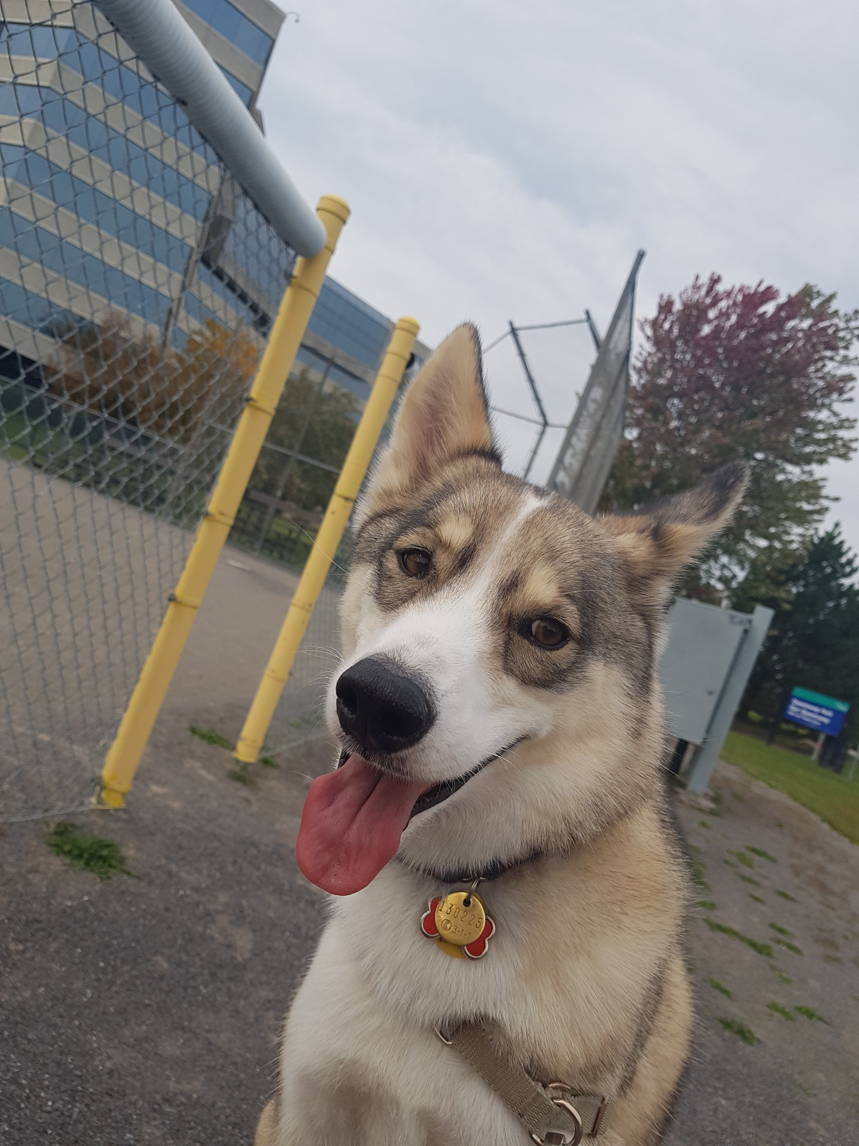
NANOUK
Submitted by:
Julie Cormier, uOttawa

Slide 27
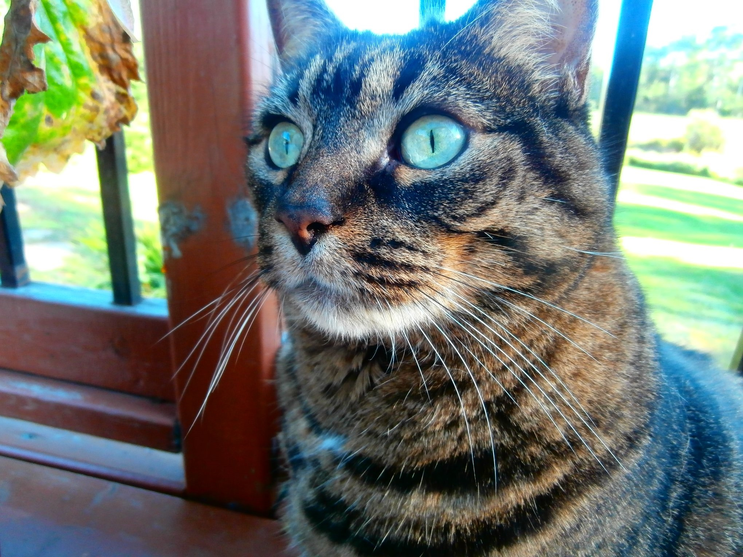
MATT THE CAT
Submitted by:
Ed Driedger, Nipissing

Slide 28
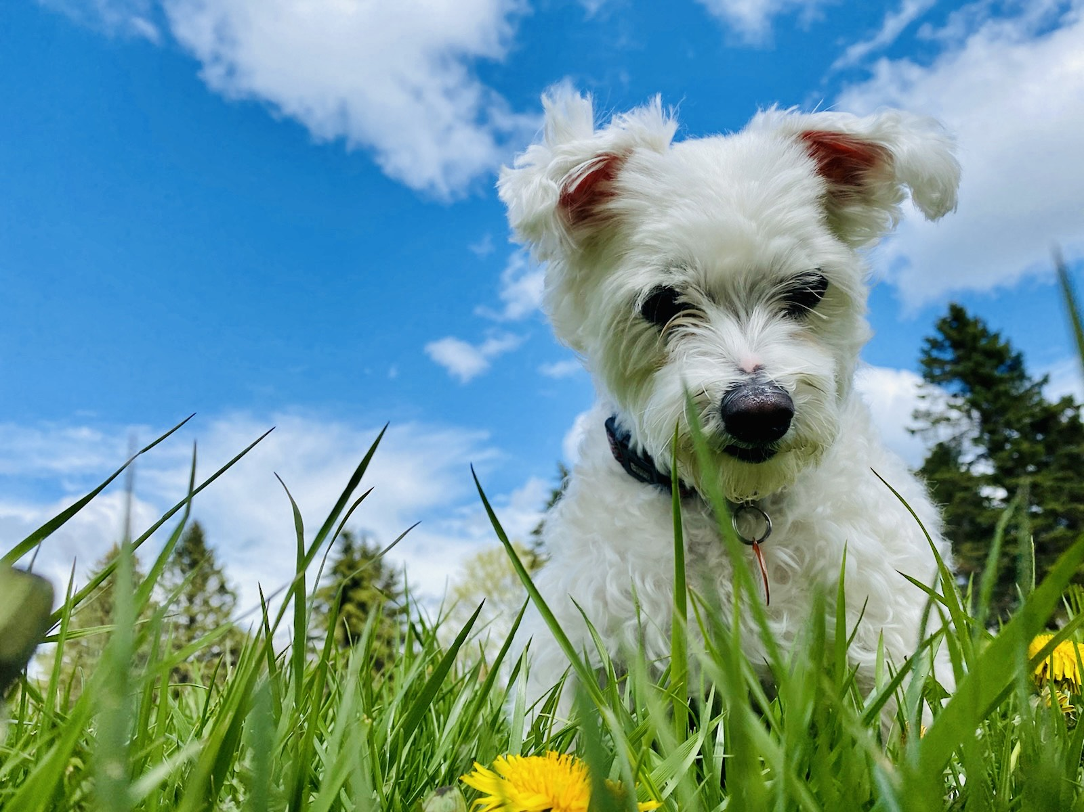
COOKIE
Submitted by:
Kelly Kimberley, Ryerson

Slide 29
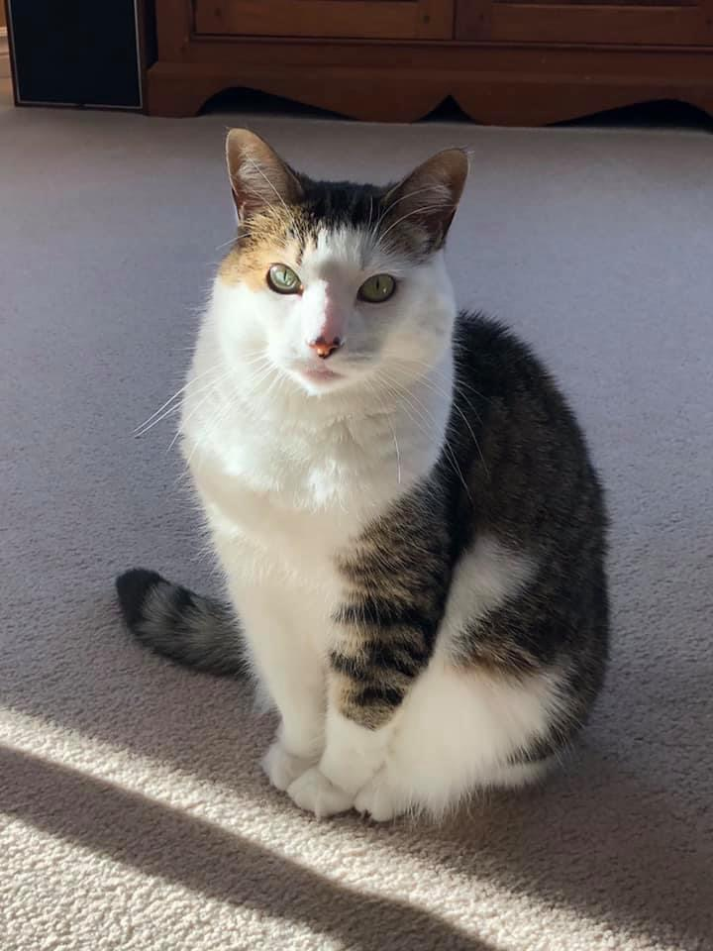
CALI
Submitted by:
Angela Hayward, Carleton

Slide 30
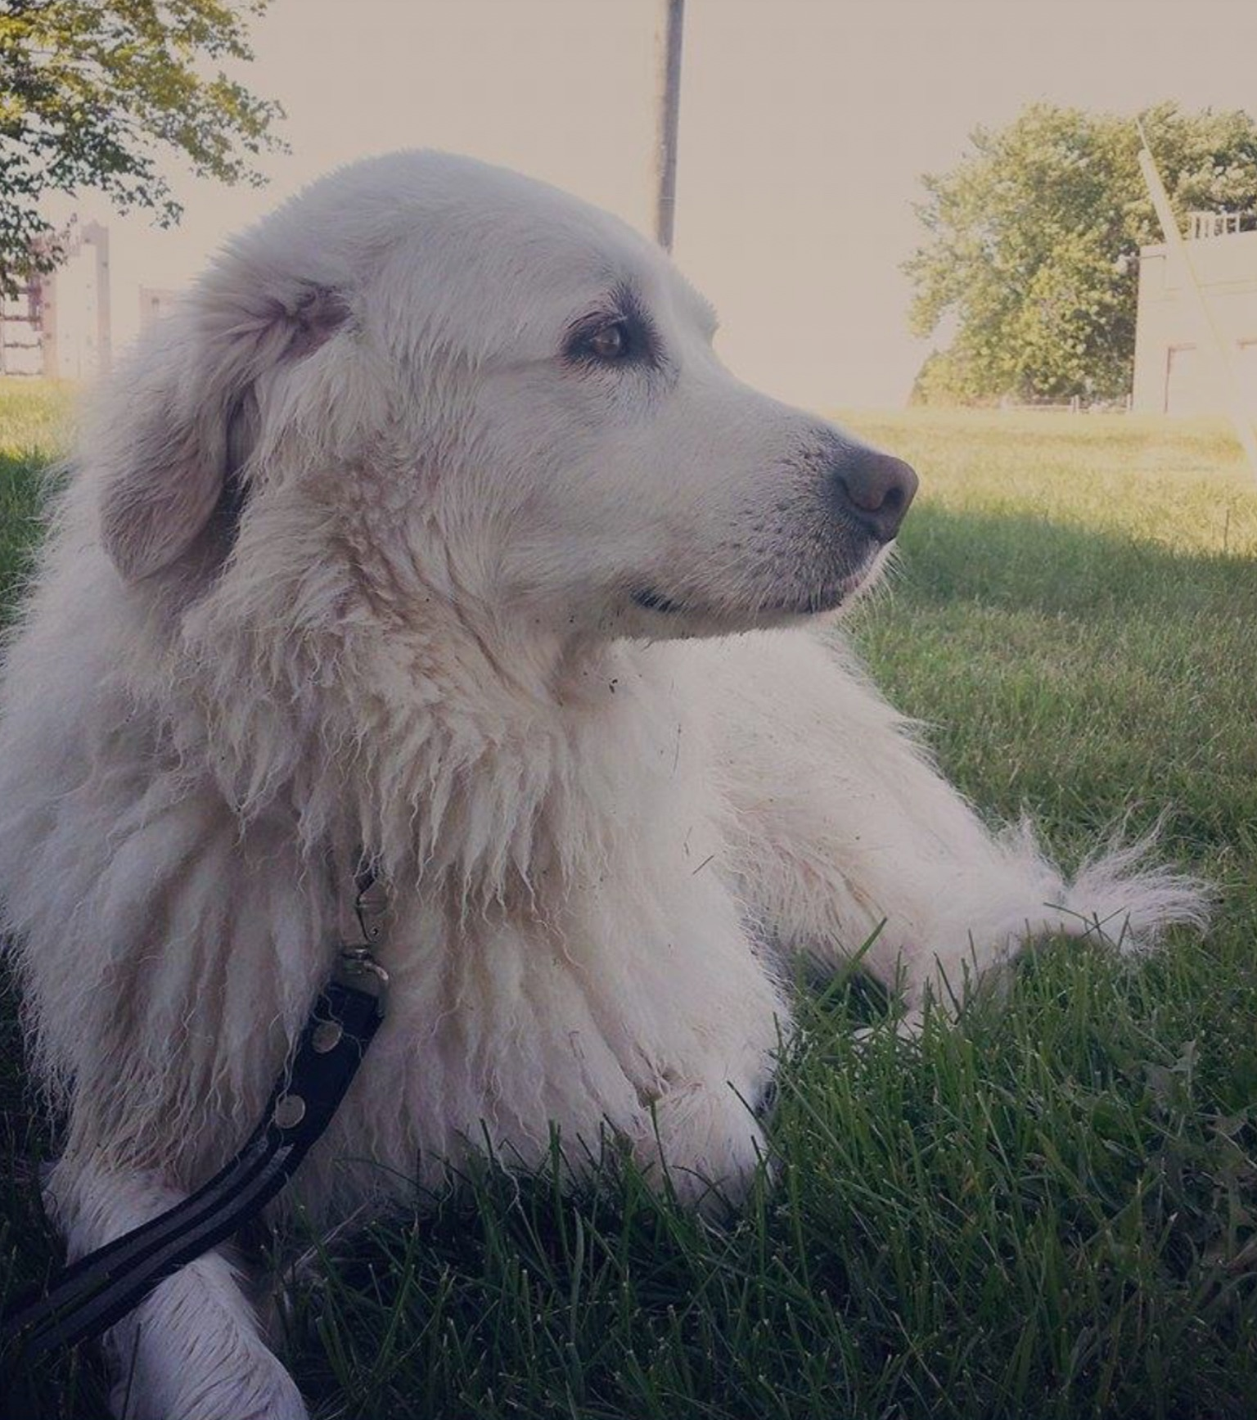
MINA
Submitted by:
Elizabeth Lonbro, Queen’s

Slide 31
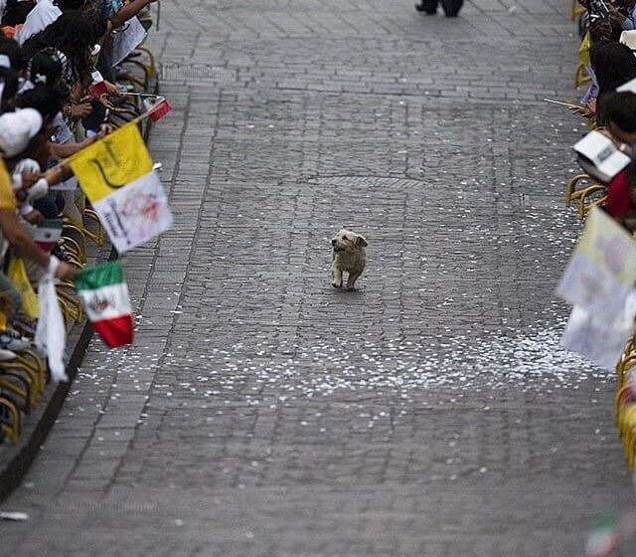
Submitted by:
Mark Weiler, Laurier

Slide 32
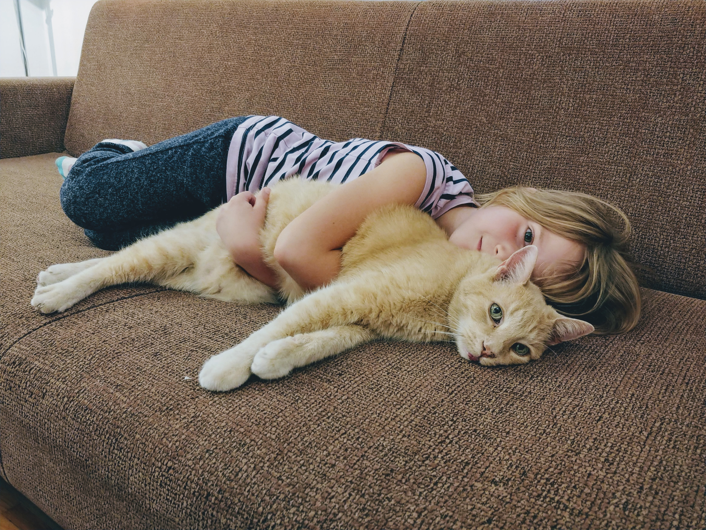
MR. GUNTHER
(RIP)
Submitted by:
Bart Kawula, Scholars Portal

Slide 33
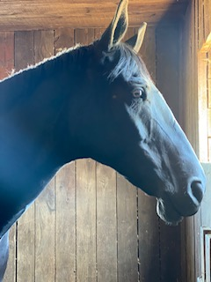
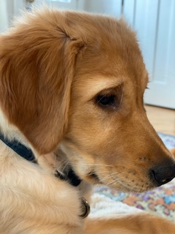
DUKE (left) HARLEY (right)
Submitted by:
Gillian Akenson, Queen’s

Slide 34
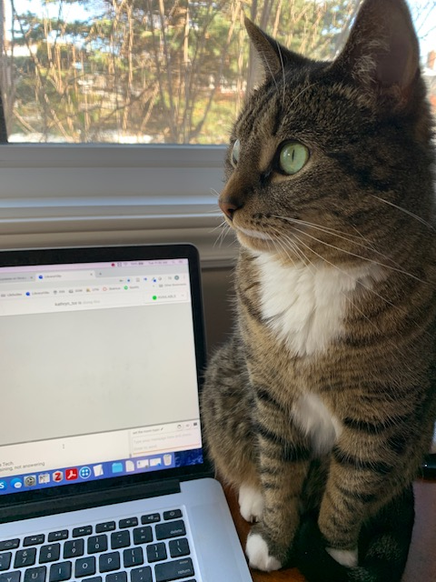
SHADOW
Submitted by:
Kathryn Barrett, UTSC

Slide 35
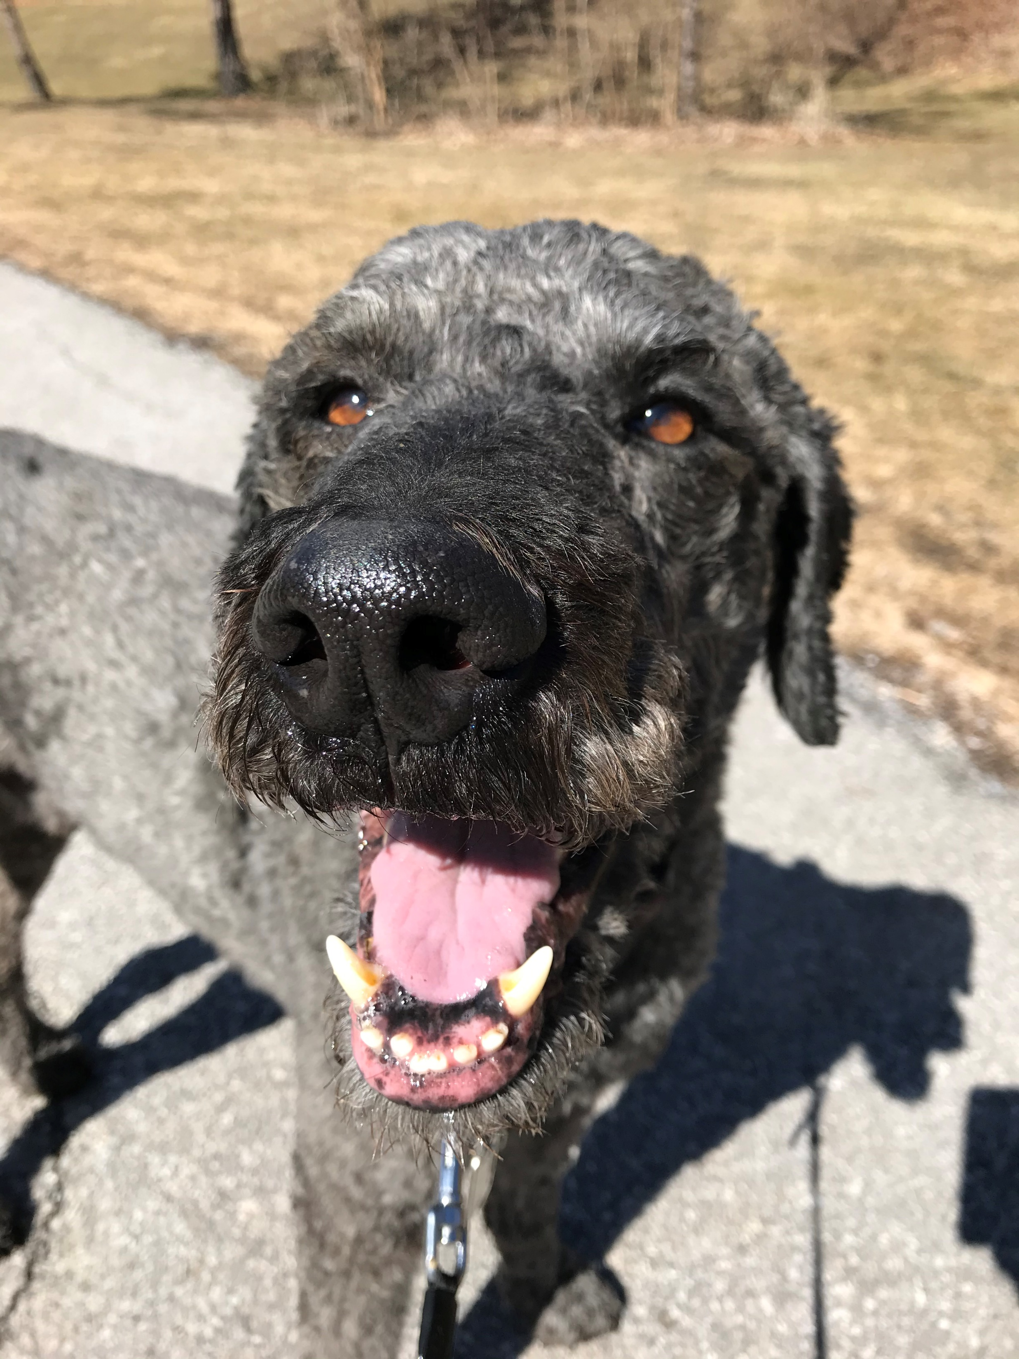
LOUIE
Submitted by:
Jo Ashley, Scholars Portal

Slide 36
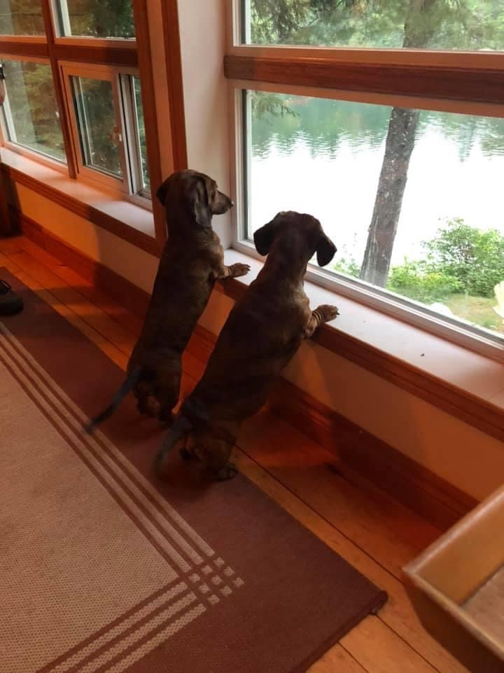
BEAR and RUBY
Submitted by:
Teresa Lewitzky, Guelph

Slide 37
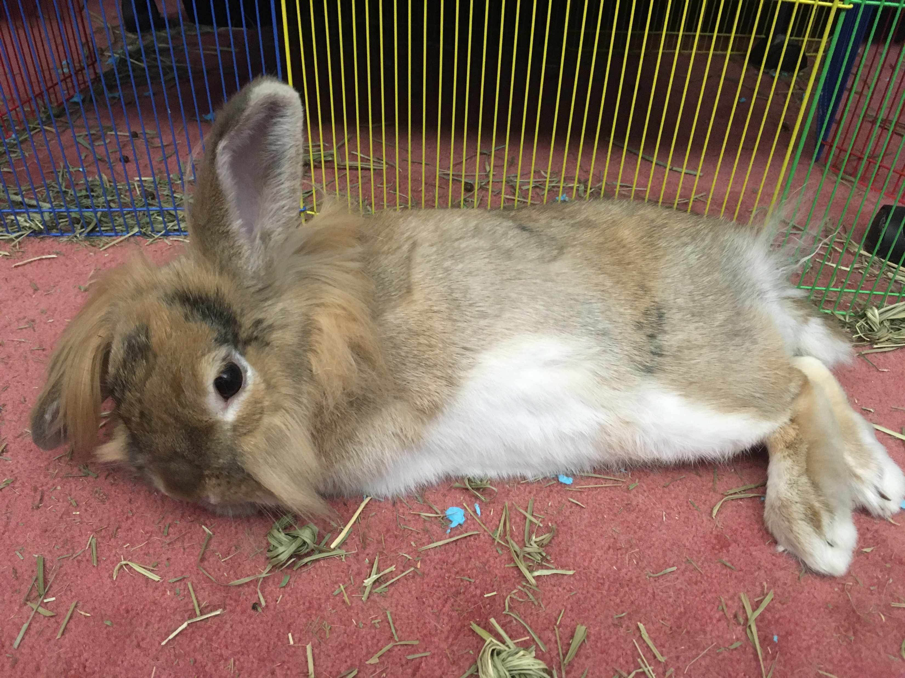
BUTTERSCOTCH
Submitted by: Dwayne Collins, Trent

Slide 38
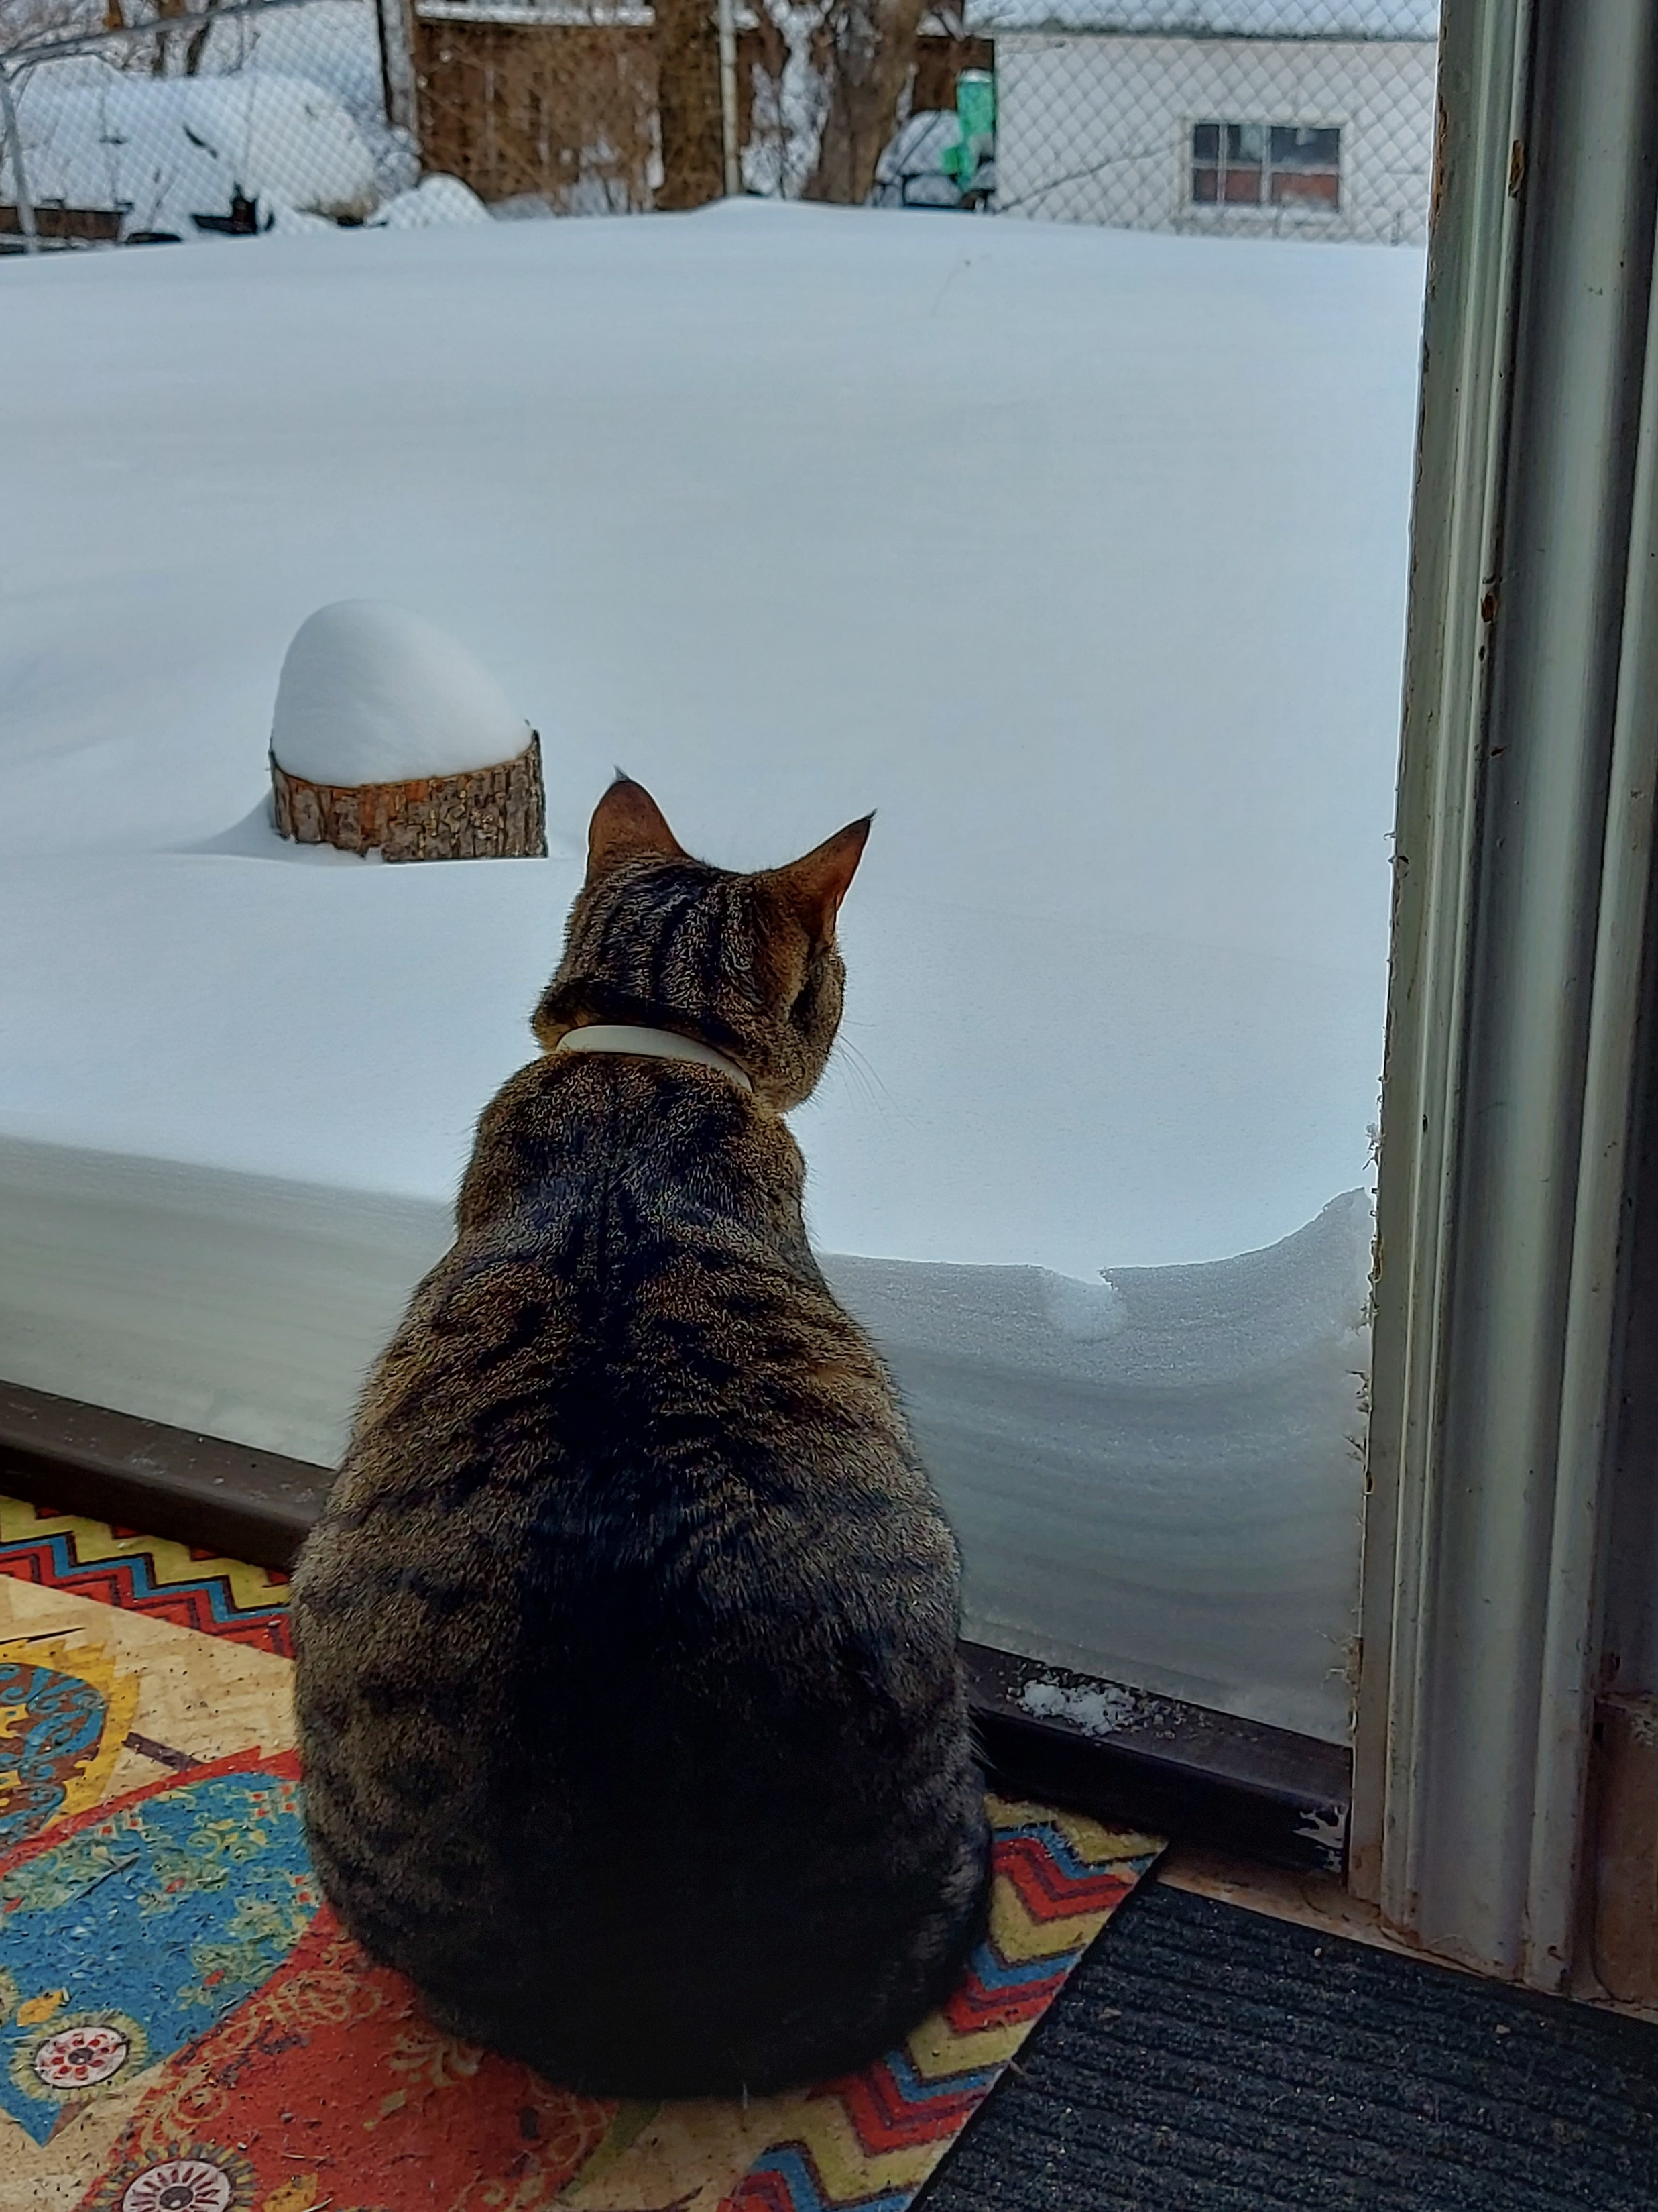
LEXIE
Submitted by:
Leïla Saadaoui, Laurentian

Slide 39
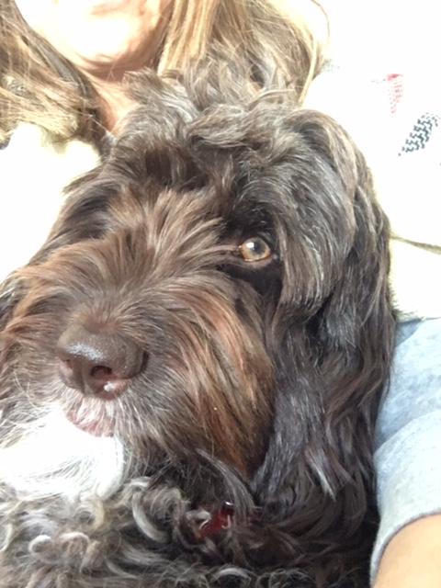
JUDY
Submitted by:
Lynne Serviss, McMaster

Slide 40
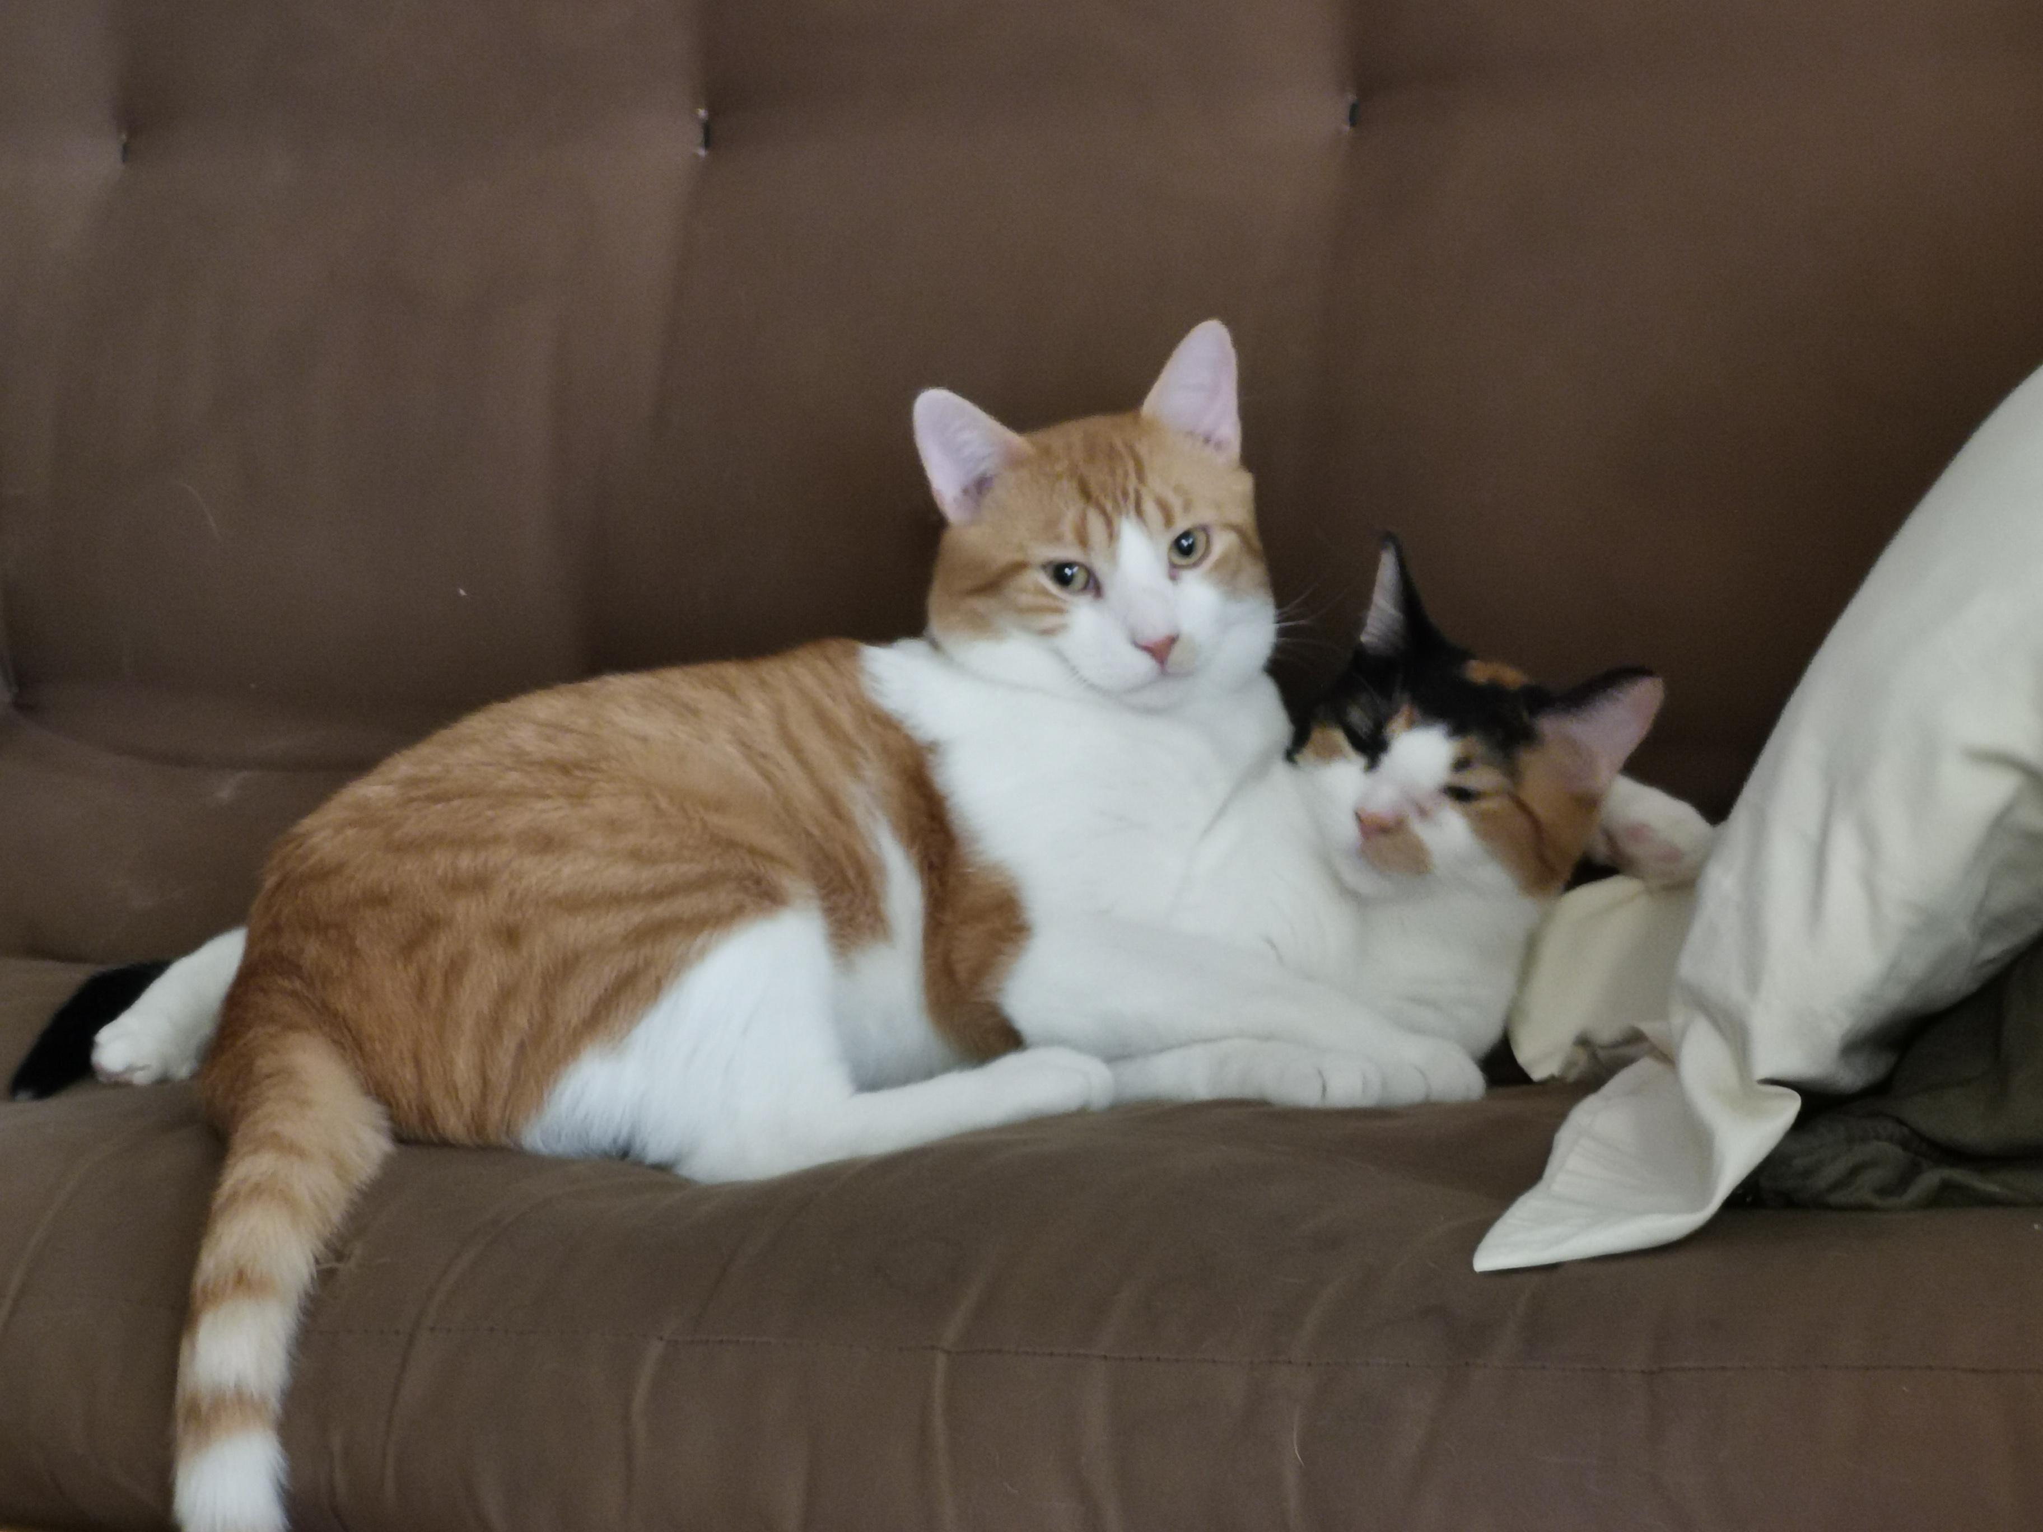
PAEGE and TURNER
Submitted by:
Margit Wessner, McMaster

Slide 41
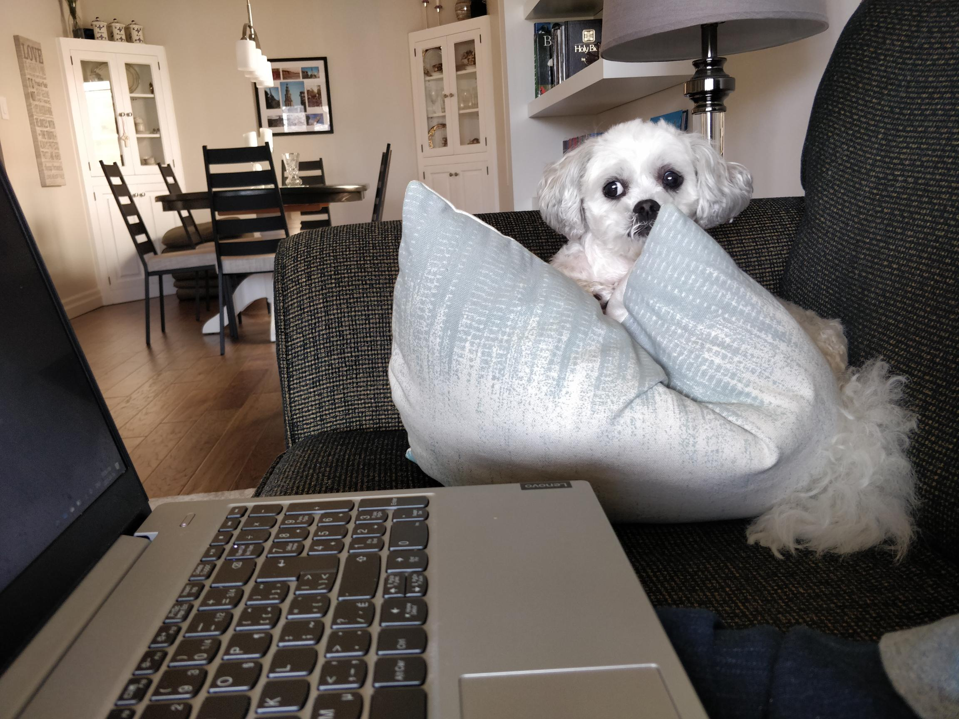
OSCAR
Submitted by:
Greg Sennema, Laurier

Slide 42
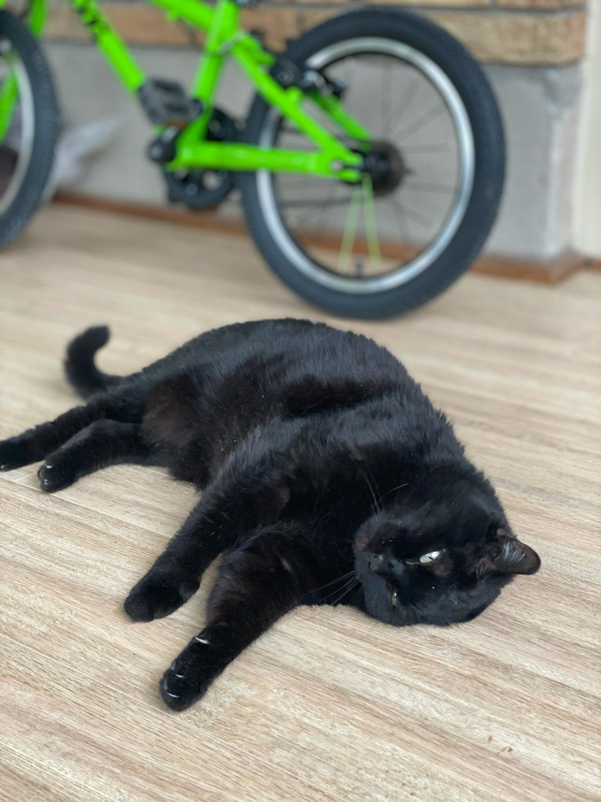
RAY
Submitted by:
Katya Pereyaslavska, Scholars Portal

