Slide 1

Evolving with Chat
Strengthening our Service During a Pandemic
Amy Rutherford & Carling Spinney
Notes:
[CS]
Hi everyone, my name is Carling Spinney, I'm the Ask Us Reference Assistant at Stauffer Library in Information Services.
[AR] Hello, my name is Amy Rutherford, I’m a reference assistant for Health Sciences and Information Services.
We are presenting to you from Queen’s University, which is situated on traditional Anishinaabe and Haudenosaunee territory. We ask you to join us in acknowledging and uplifting these communities, their elders both past and present, as well as future generations, and the lands in which you are tuning in from.
Amy and I are both chat operators for the Scholars Portal Ask-a-Librarian consortia and we’re also part of the chat assessment subgroup at Queen's. Today we have a few minutes to share the ways in which the pandemic's disruption of services like chat, has actually strengthened it for both users and chat operators in ways that will remain permanent moving forward. So let's jump in!

Slide 2
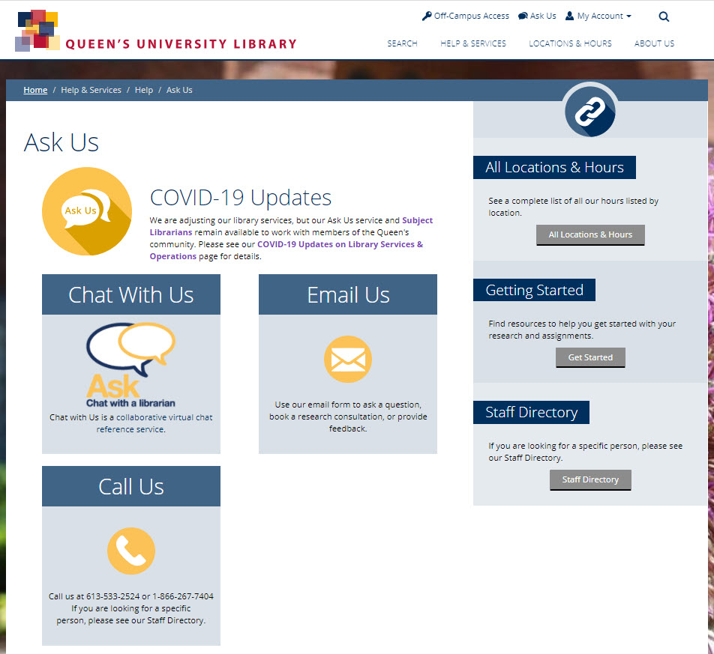
Background
Notes:
[CS]
Queen's adopted Ask-a-Librarian chat in mid-April, 2019 initially as a one-year pilot project. Chat is a highly popular addition to our existing Ask Us suite of services, which currently includes email and phone as well. When the pandemic first began to unfold and caused widespread shutdowns, we were just approaching one full year of having chat. At the time, as part of the pilot project, we had created a Chat Assessment Group and had submitted our report, this analysis and recommendations in combination with the sudden and drastic need for virtual online support, resulted in the Library's decision to continue with chat.

Slide 3
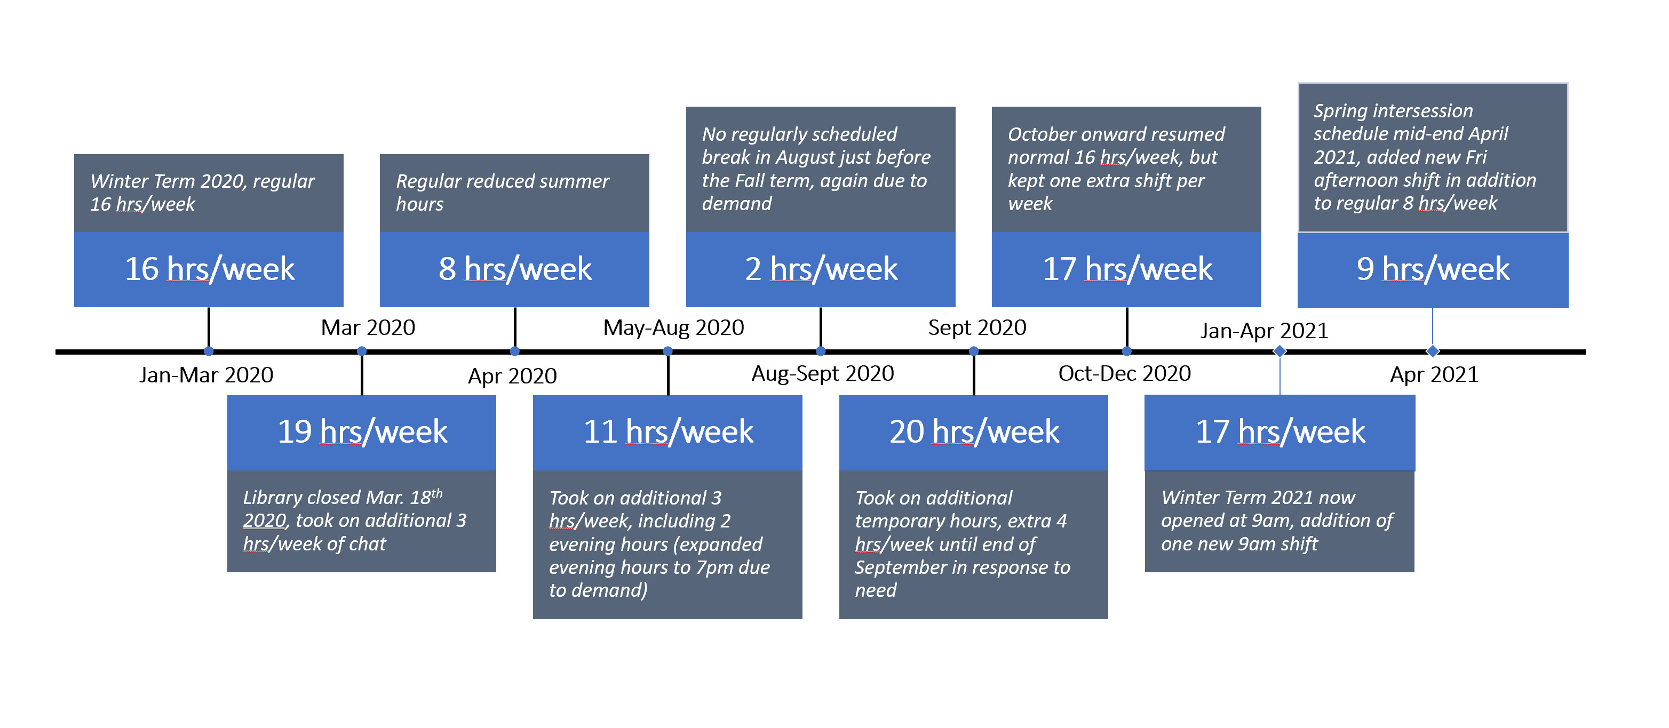
How we staffed chat during a pandemic
Notes:
[AR]
At Queen's, we have 12 chat operators. This team consists of both reference assistants and librarians. We are responsible for a varying number of shifts that generally ranges from 9-17 hours per week, depending on the time of year and outlined here.
This timeline illustrates the ongoing changes made to our staffed chat hours at Queen's. Many of these changes were service-wide decisions as Scholars Portal responded to a surge in demand and record-high chat numbers.
Being part of a wider collaborative chat service has allowed us to offer not only another channel of service to our users, but also provides far more hours of service than would otherwise be possible.

Slide 4
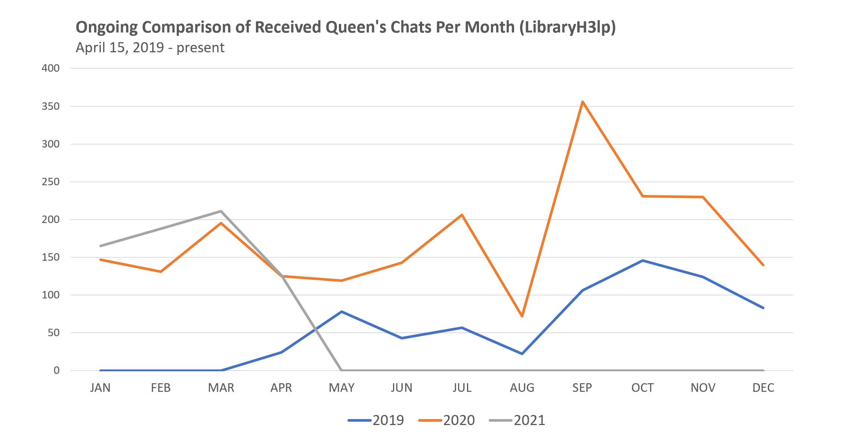
Queen’s Queue Chats Yearly Comparison
Notes:
[CS]
To provide a little more context, let's take a quick look at Queen's user statistics. In this line graph we are looking specifically at chats received via the Queen's queue (that is, questions from Queen's users only). We compare 2019 (beginning mid-April when we adopted the service), 2020, and most recently the past few months of 2021. As the graph illustrates, Queen’s chat use has steadily increased year after year.

Slide 5
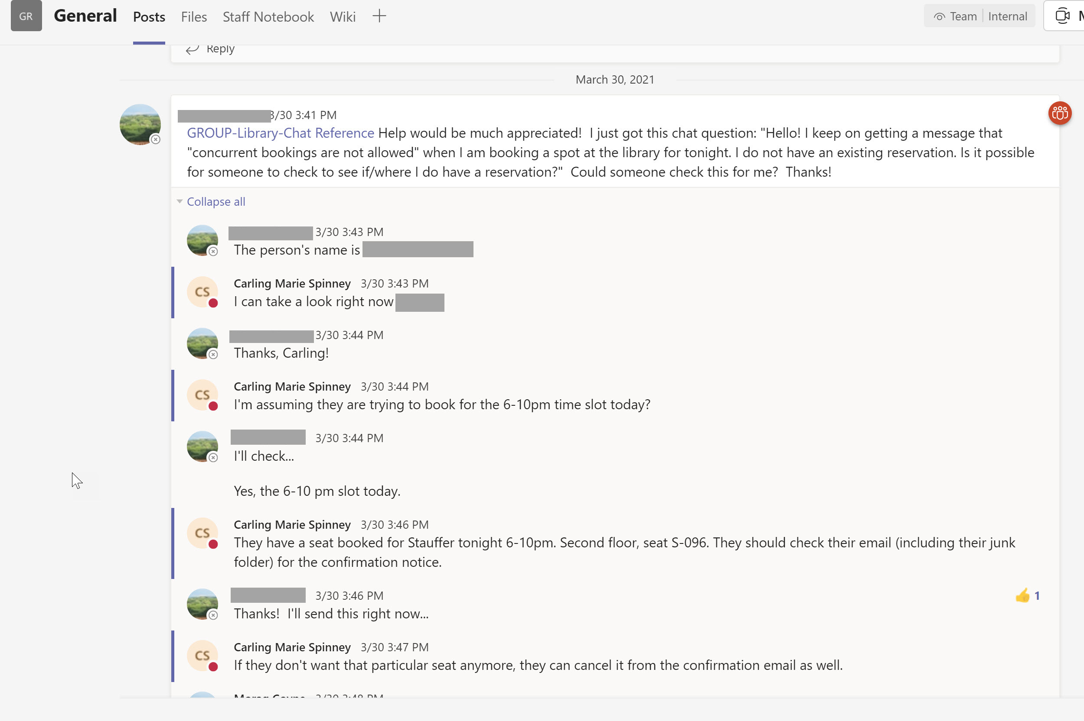

Communication & Team Building
Notes:
[AR]
One local change we've implemented here at Queen's is improved communication behind the scenes.
When we joined Ask-a-Librarian, we implemented a Microsoft Teams group for chat operators, which we used increasingly as the pandemic continued. Operators were (and are) working both on site and remotely so the Teams space became a place to share key updates, and problem solve real-time chat questions such as the seat booking issue pictured here. This resulted in quicker chat responses, and a streamlined experience. It also has helped build on connections between Reference Assistants and Librarian operators, which is key in strengthening our referral process.
We also increased our local chat operator meetings from 1 per term to 1 per month. Standing items include: reviewing usage statistics, and reserved time to discuss chat experiences, which often leads to knowledge sharing and solutions for common issues.
Being part of the consortial service enables us to think about how information is conveyed on our webpages. Frequent chat questions led to website changes such as more visible curbside hours, and adding a Hathi Trust ETAS instruction guide.

Slide 6



Strategic Staffing Hours
Overall Tuesday busiest day of the week
Mondays busiest at 10am, 2pm
Tuesdays busiest at 11am, 2pm
Wednesdays busiest at 3pm
Thursdays busiest at 1-2pm
Fridays busiest at noon-1pm
Sept – Dec 2020
Overall Tuesday busiest day of the week
Mondays busiest at 2pm
Tuesdays busiest at 2pm
Wednesdays busiest at noon
Thursdays busiest at 10am, 2pm
Fridays busiest at 1-3pm
May – Aug 2020
Fall Term
Winter Term
Summer Term
Jan – Apr 2020
Overall Tuesday busiest day of the week
Mondays busiest at noon, 2pm
Tuesdays busiest at 11am, 3pm
Wednesdays busiest at 11am
Thursdays busiest at noon
Fridays busiest at 2pm
Notes:
[CS]
Queen's participates in the home-team-first model, meaning when Queen's operators are on, Queen's chats are routed to them first. With the pandemic causing almost constant service changes specific to individual institutions, it can be difficult to know about some changes if you're not located there. Scholars Portal created a very helpful document (Sept 2020) in SpotDocs to help address this issue, so that all operators can refer to it when responding to chats from any school. Sometimes, though, local operators may know about impending changes not yet made public, or perhaps they can respond to detailed curbside questions, other times questions may require access to accounts or seat booking software that only local operators would have. It was within this context that we aimed to staff Queen's operators at known high-traffic times for Queen's users.
We analyzed the 2020 academic year by term to discover the most popular days and times that Queen’s users were chatting; summary findings are on this slide. In general, we found that we were already covering the majority of Queen's user high traffic times! And, thanks to the flexibility at Scholar’s Portal, we were able to make a couple small adjustments to our staffed hours and cover times that we currently weren't.
In this way, we have struck a balance, both benefiting the user while still being a team player within the consortia and contributing other needed hours, including regular evening hours.

Slide 7
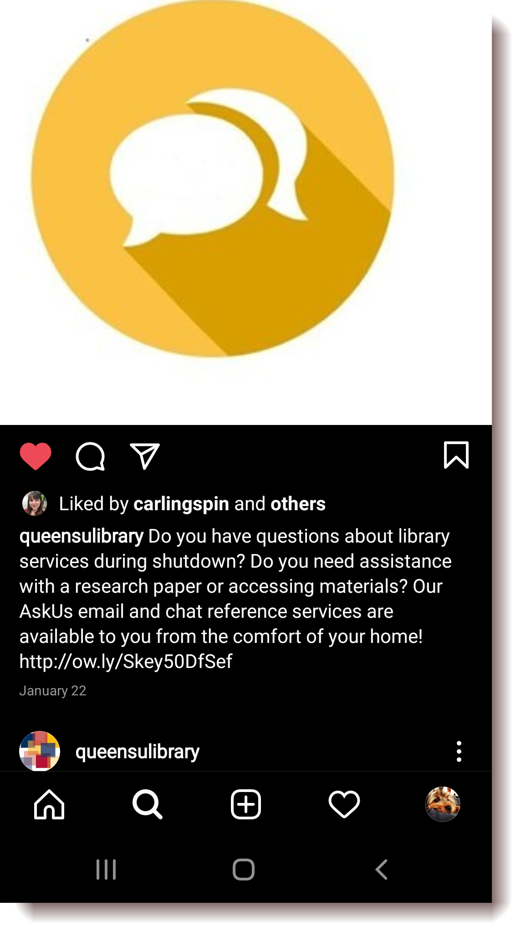
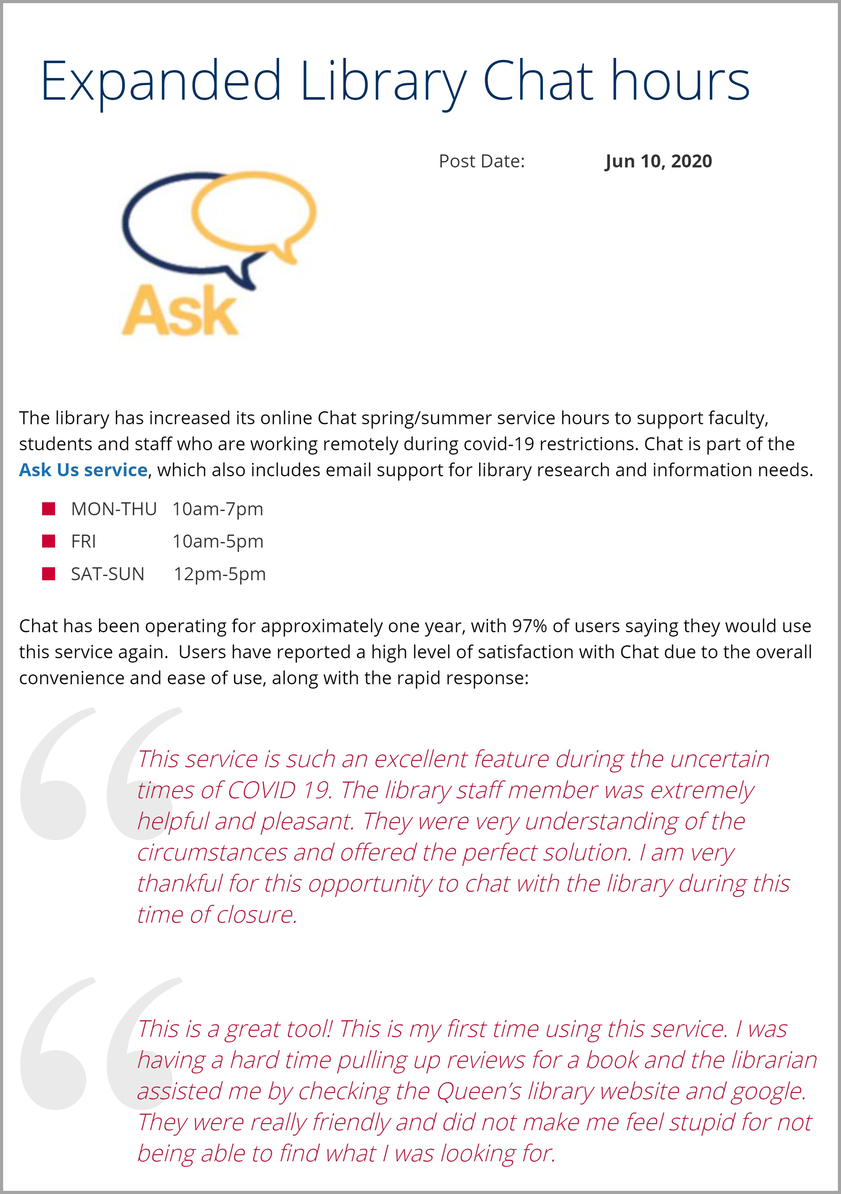
Outreach & Chat Promotion
Notes:
[AR]
In the summer of 2020, we formed a chat promotion subgroup to generate ideas for increasing the visibility of the Chat service. With physical spaces closed it was important to ensure our users knew all the options to contact us whether through chat, email, or phone.
Working with the Queen’s Library Communications Coordinator and with Discovery and Technology Services we accomplished the following.
Provided promotional information for Faculty Departmental newsletters and other campus publications
Posted on the library homepage and on Social media (as shown in this slide)
Implemented a persistent chat tab on the Omni search pages (both basic and advanced) This is our first step towards investigating proactive chat

Slide 8
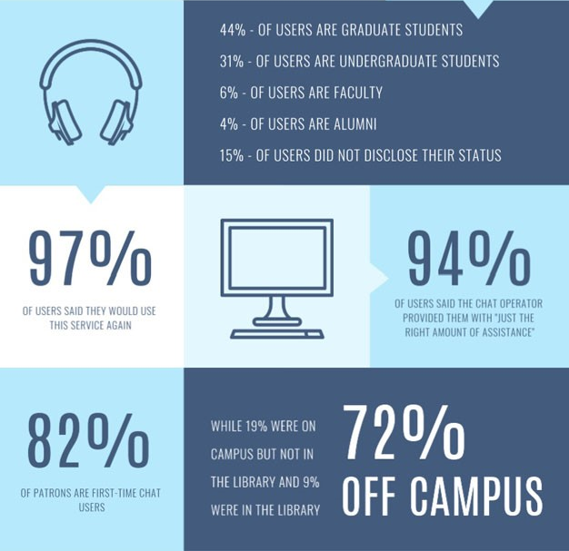
Chat Analysis
From previous Chat Assessment Report data. Based on 142 received satisfaction surveys from Queen’s patrons, Sept. 9, 2019 – Apr. 9, 2020
Notes:
[CS]
As mentioned earlier, Queen's began conducting chat assessment reports internally originally due to the chat pilot. We continue with these assessment reports as they have proven incredibly insightful. Currently, work is underway for our third report, which covers April 2020 – April 2021 where we will follow up on previous recommendations, and update graphs & analytics (like the one pictured here) based on the LibraryH3lp dashboard data and our internal statistics.
Now that we are past the 2-year mark of having chat, we want to take a closer look at what Queen's users are asking. Our chat assessment project group is analyzing Queen's queue questions in terms of question type (basic, facilitative, complex, referral) as well as question topics (research or informational). This project involves using Access database and in-house coding. It's in its early days, but potential uses may result in changes to our webpages, libguides, or we may uncover unforeseen needs/gaps and address those.

Slide 9
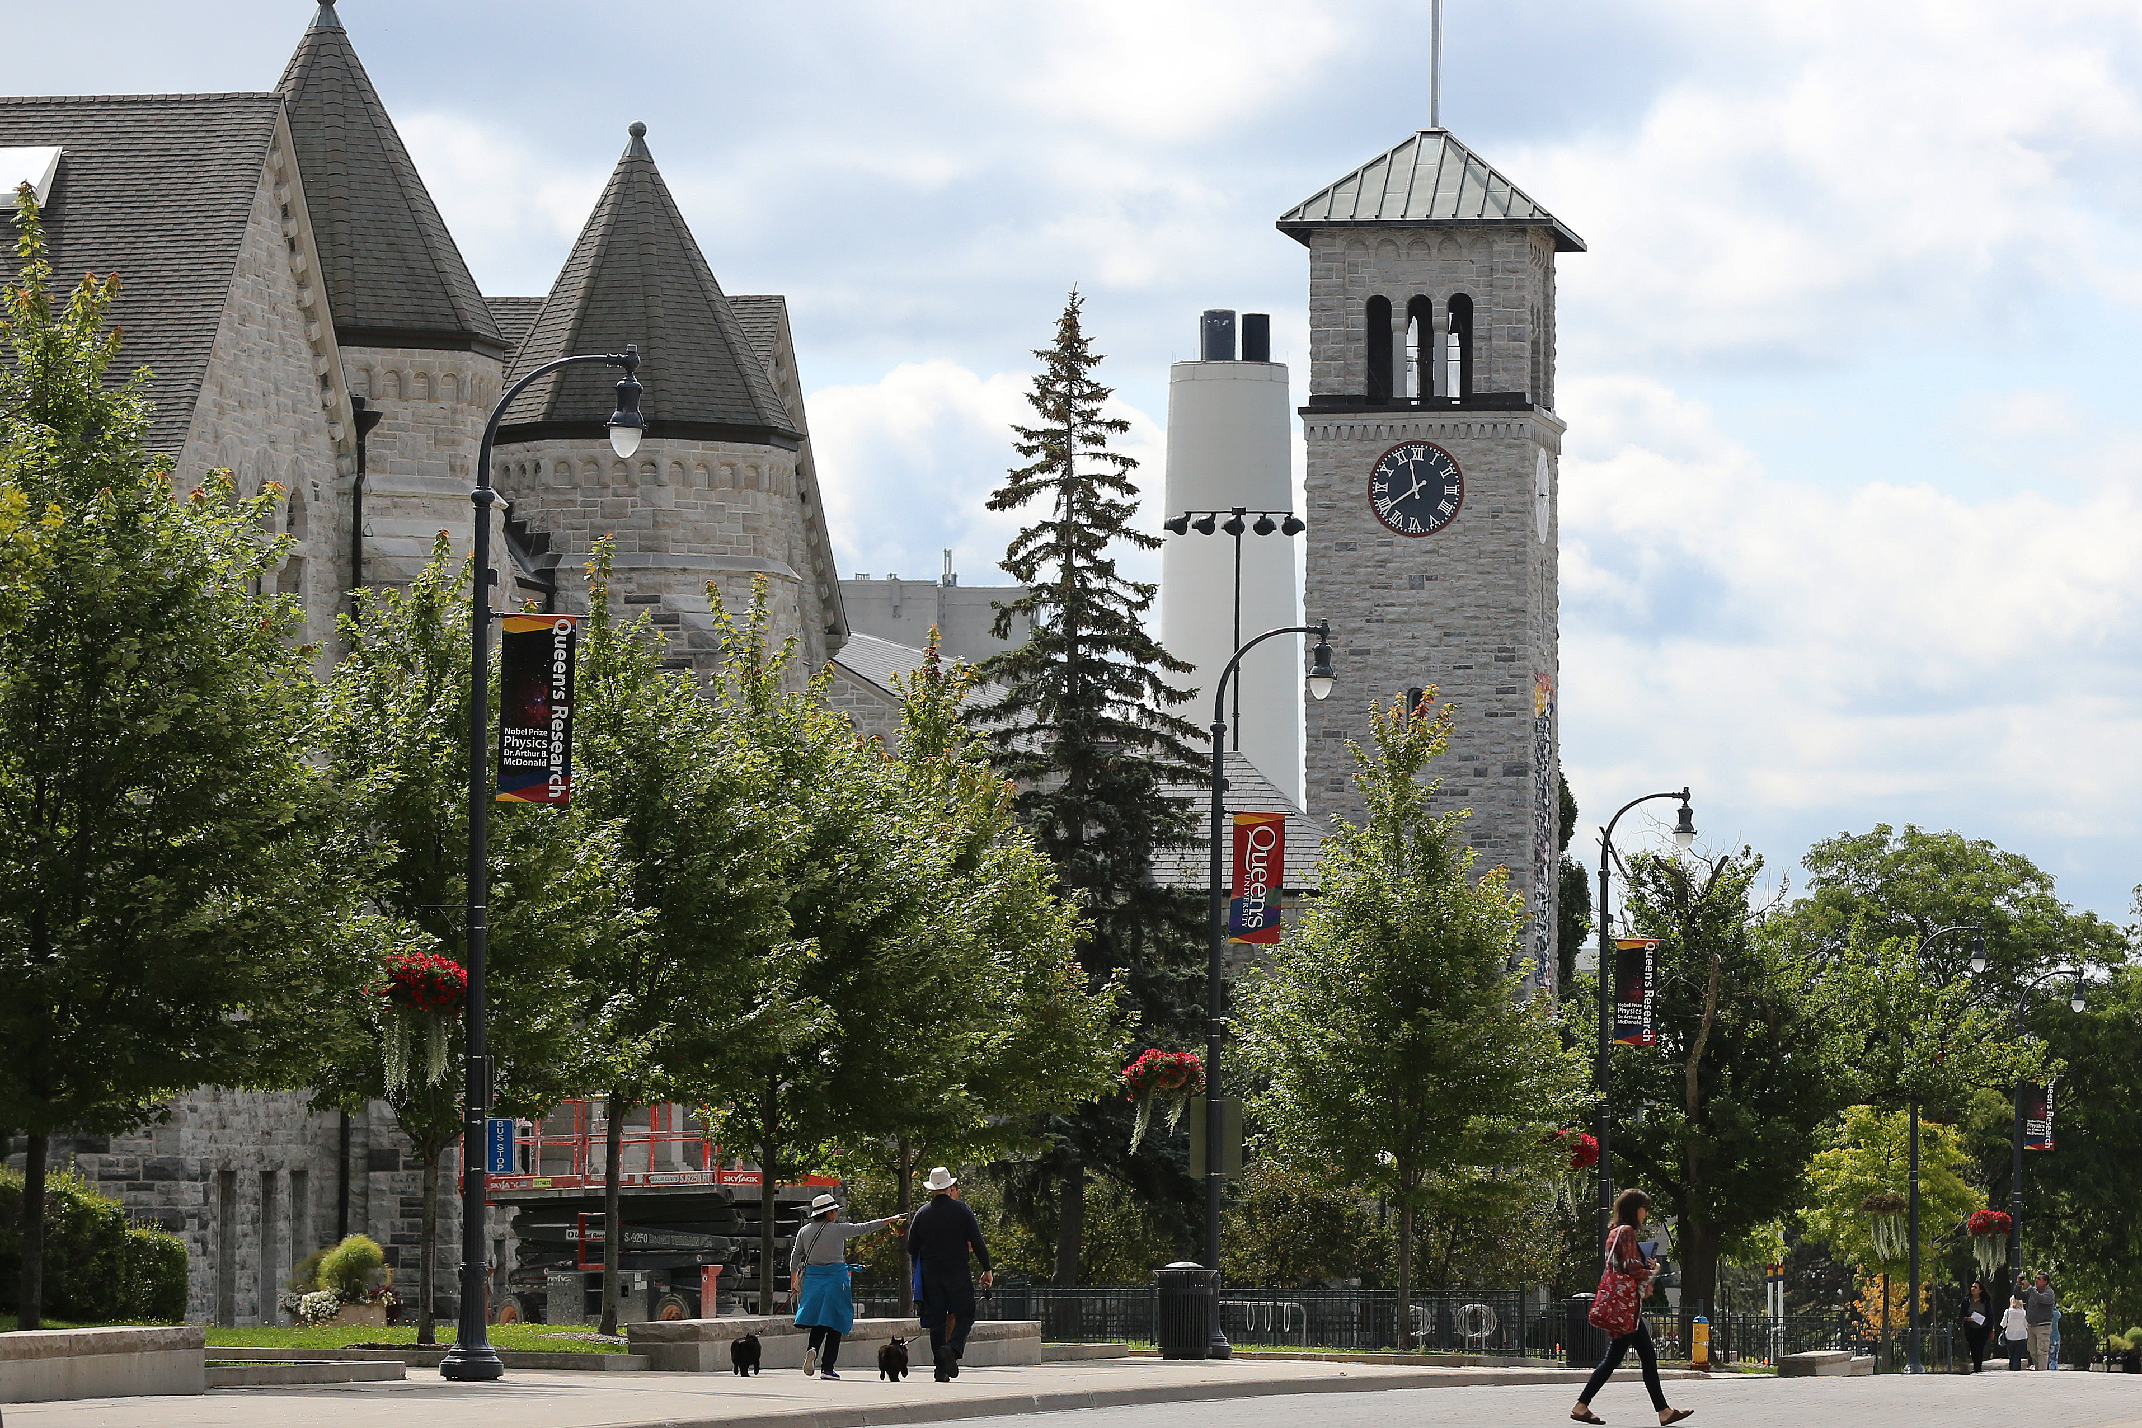
Thank you for tuning in!
Notes:
[AR]
Due to the pandemic, we have had to quickly respond to challenges and adapt our chat service to meet the needs of our users. Our communication, team building, staffing hours, outreach, and promotion have permanently strengthened how we offer the Ask-a-Librarian chat service both for operators and for users. Of course, this is an evolving process, in which we are continually learning and improving.
We would like to conclude by thanking Michele Chittenden, the Virtual Reference Coordinator at Queen's who oversees our chat operators’ team. We also want to thank Scholars Portal for their responsiveness to users and their flexibility with partner institutions. And thank YOU for tuning in to our presentation! We would be happy to take any questions you may have.

