Slide 1
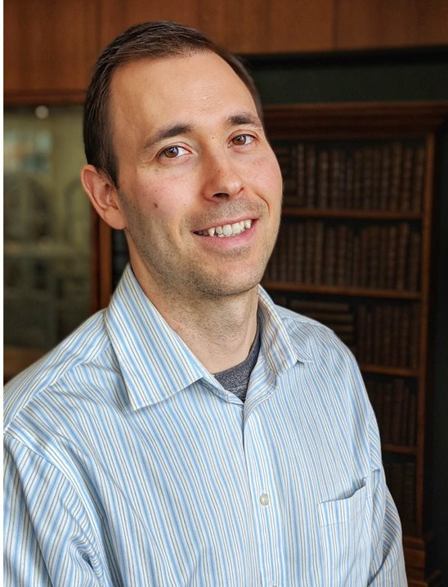
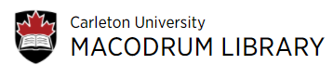
Meeting our users where they are: Learning, adopting and utilizing virtual tools
by Joël Rivard
Subject Area Coordinator
Arts, Social Sciences & Humanities Teams
Research Support Services (RSS)

Slide 2
Agenda
Who we are?
Virtual Tools
Learning & Adopting virtual tools
Moving Forward

Slide 3
Research Support Services
Provides teaching, learning & research support services
3 subject-based teams & functional specialists
Major tasks that we do for our users:
  Instructional Sessions
  Research Consultations

Slide 4










Reference / Consultations
Synchronus
Asynchronous

Slide 5
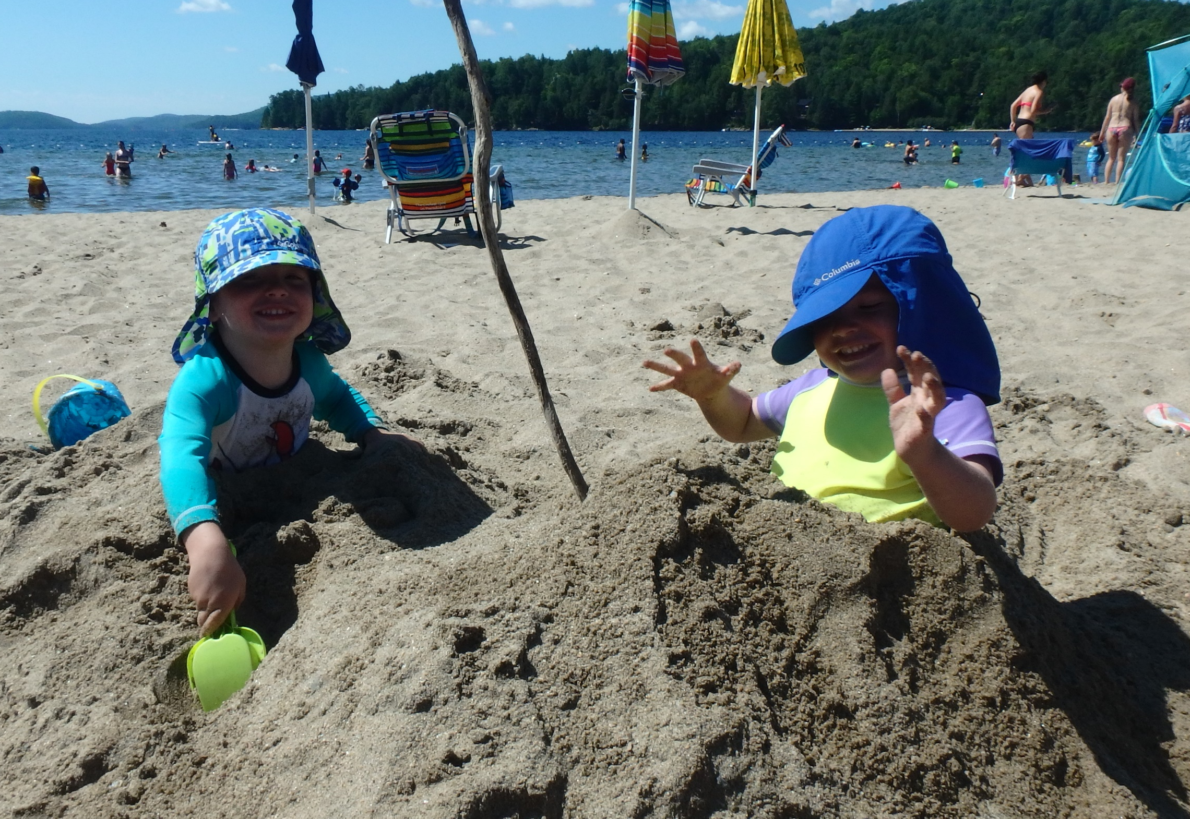
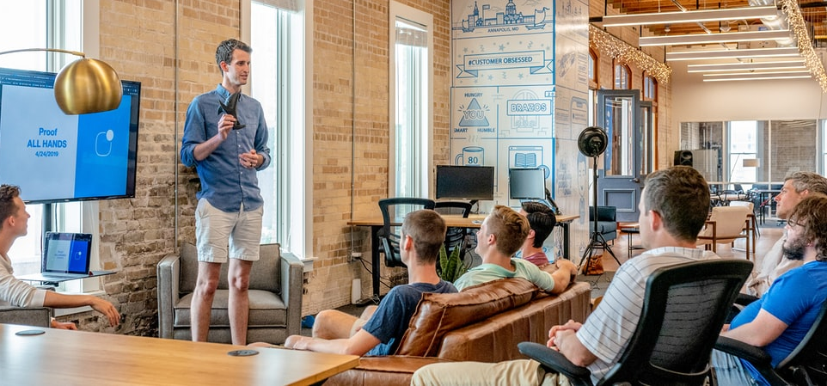

Learning Virtual Tools
Peer-to-peer
Library Team
Teaching & Learning Services

Slide 6


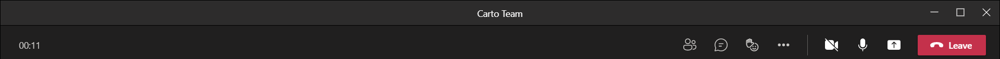

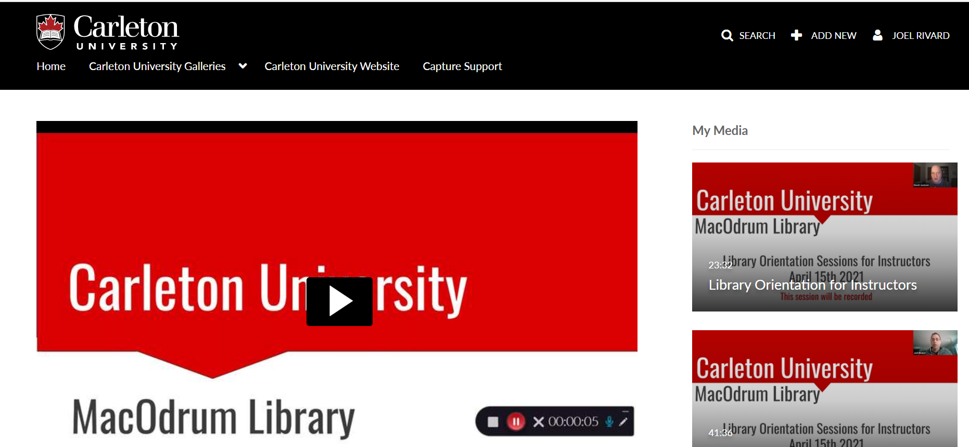
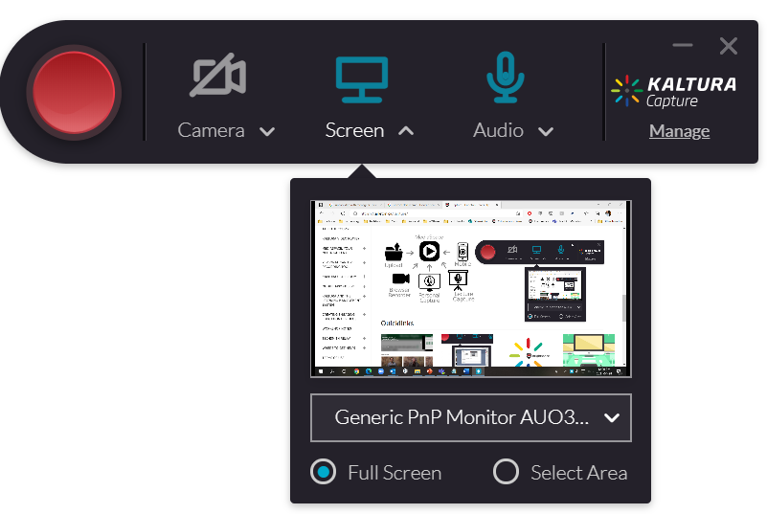
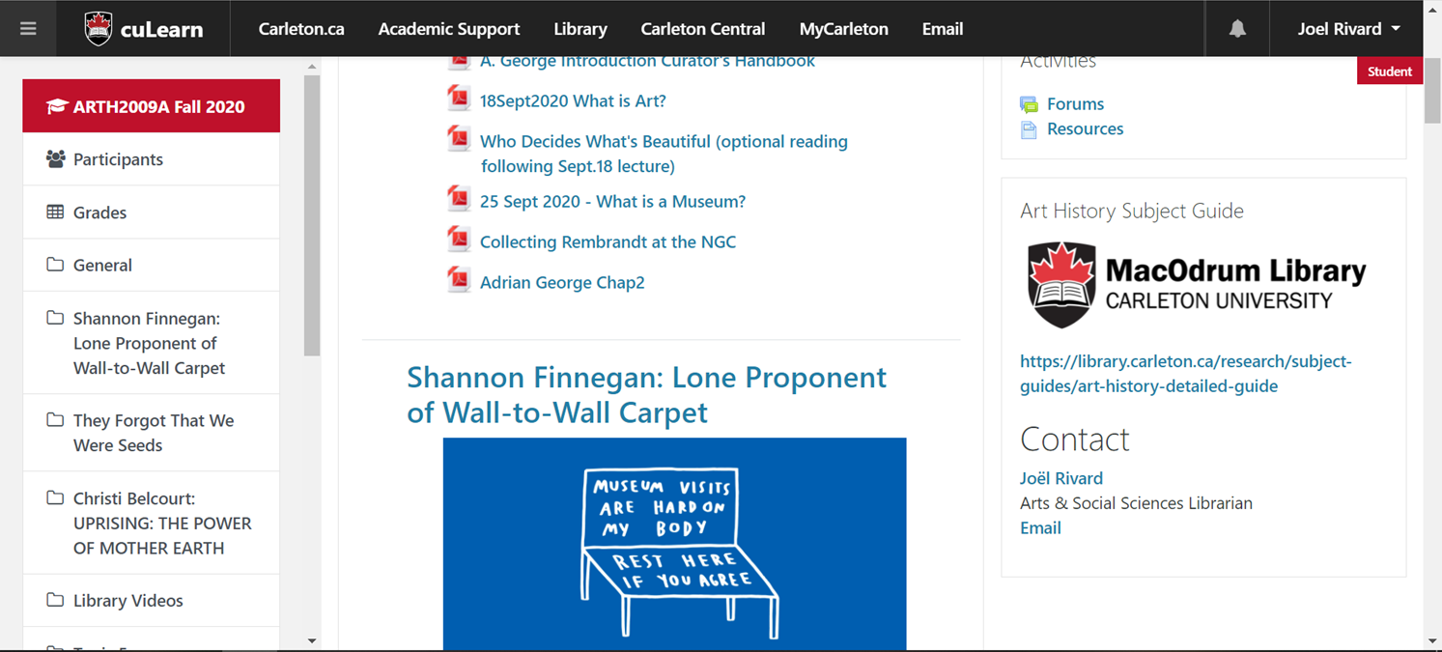
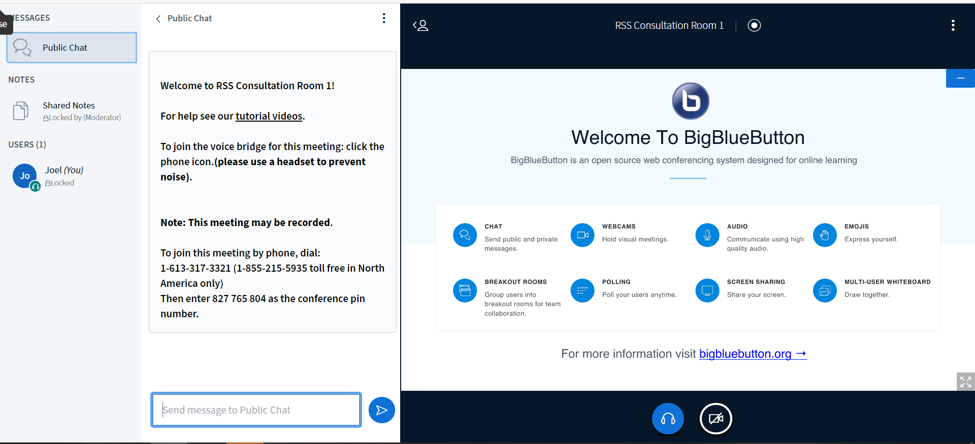
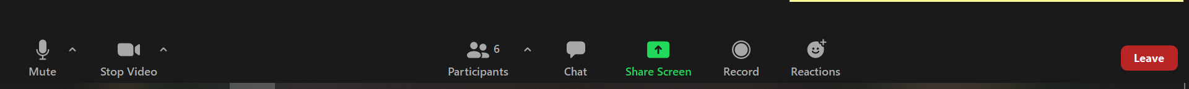
Adopt & Utilize
Meet our users where they are
Adopting virtual tools for live courses
Adopting virtual tools for asynchronous courses

Slide 7

Moving Forward
Embedded into courses
Creating instructional videos
Continue to learn virtual tools
Continue virtual consultations
Virtual Live Reference

Slide 8
Question?

