Slide 1
Collaborating to Improve the Accessibility of Scholars Portal Journals
Mark Weiler, Wilfrid Laurier University
Bartek Kawula, Scholars Portal

Slide 2
Barriers in Library and Environment
An incoming student drew my attention to barriers in the library web environment
Ontario Human Rights Commission:
  "Education providers operating in Ontario have a duty to take steps to prevent and respond to breaches of the Code."
I reached out to Bart
We met at OLA 2020
He was in!
Notes:
This talks begins with an incoming Laurier student drawing my attention to barriers in the library web environment

Slide 3
Feature 1: Report a Problem

Slide 4
The Need: Users Can Report Problems
We want to recognize urgency of issues
We want to recognize we are subject to WCAG 2.0's 4th conformance requirement
  Web content needs to be compatible with user's assistive technology and browser

Slide 5
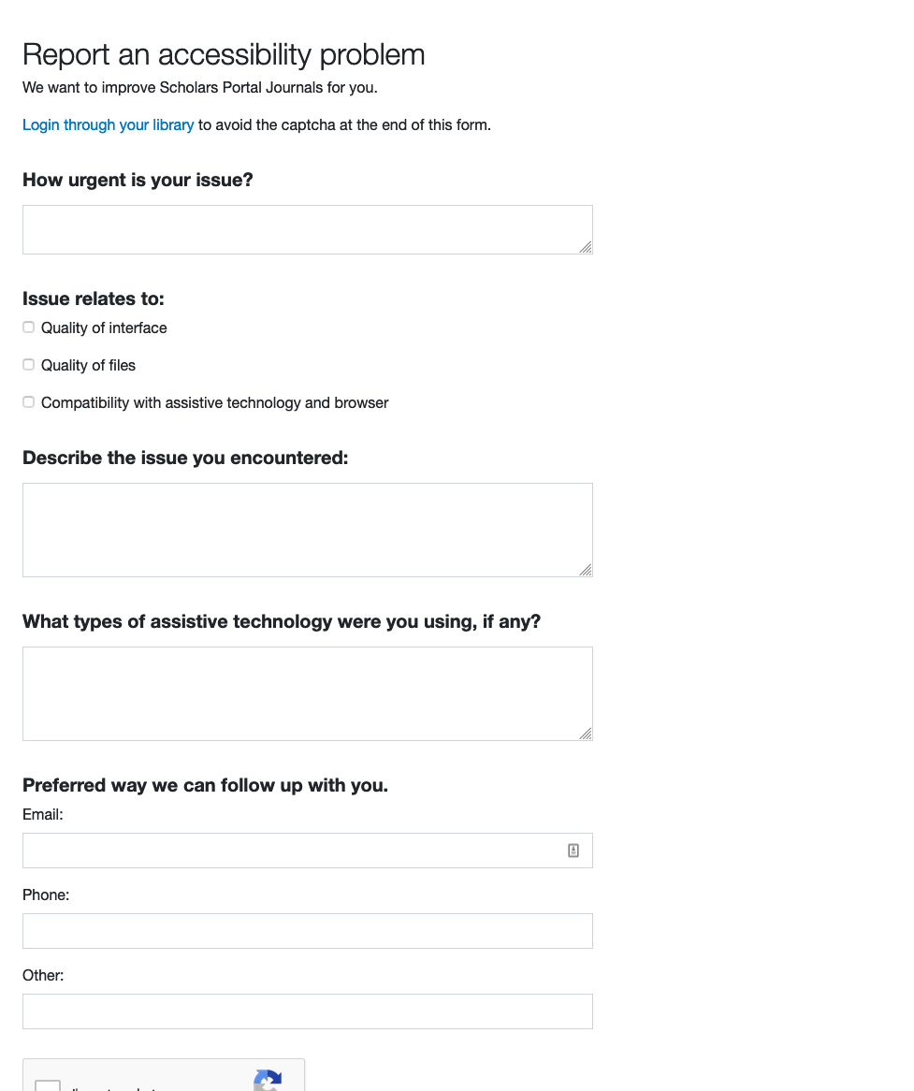
Report An Accessibility Problem
Form

Slide 6
Feature 2: Help Guide for Screen Readers Users

Slide 7
Responding to needs not in WCAG
Problem: Learning a platform can be time consuming for text to speech/Braille users
Visual style and layout can communicate function
For example...
Notes:
While efficiency of learning a platform, isn’t a formal requirement of WCAG 2.0, the actual criteria is undue hardship. The problem of time-to-learn rises to the level of a major obstacle that disadvantages users who are blind. We welcome the opportunity to push ourselves to our limits to respond. This is a work in progress.

Slide 8
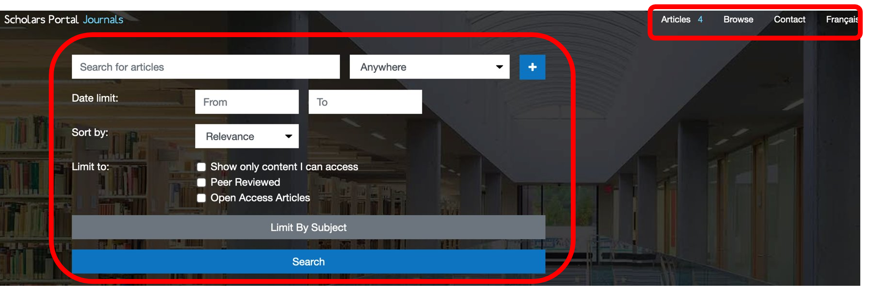
For example...
Visual layout conveys affordances differently than a screen reader
Notes:
Visually the main navigation region is 1 square inch, smaller, tucked in the corner, while the search region is 17 times larger, above the fold, centred.
But from a JAWS perspective, the main navigation region is 11 steps, while the search region is 22 steps.
The point: visual layout and format conveys meaning and implies tasks
A screen shot of the search region on Scholars Portal Journal. I&#39;ve overlaid red rectangles around the parts of the interface that correspond to the Main navigation region and the search region. We can clearly see that the main navigation region is quite small compared to the larger search region, which is also positioned centrally on the screen.

Slide 9
Responding to a need not in WCAG
Web Content Accessibility Guidelines is not a stopping point
Human rights legislation calls us to respond to situations that disadvantage members of protected groups
“How can we save screen reader users time?”
Notes:
While efficiency of learning a platform, isn’t a formal requirement of WCAG 2.0, the actual criteria is undue hardship. The problem of time-to-learn rises to the level of a major obstacle that disadvantages users who are blind. We welcome the opportunity to push ourselves to our limits to respond. This is a work in progress.

Slide 10
Accessibility Help: The Design

Slide 11
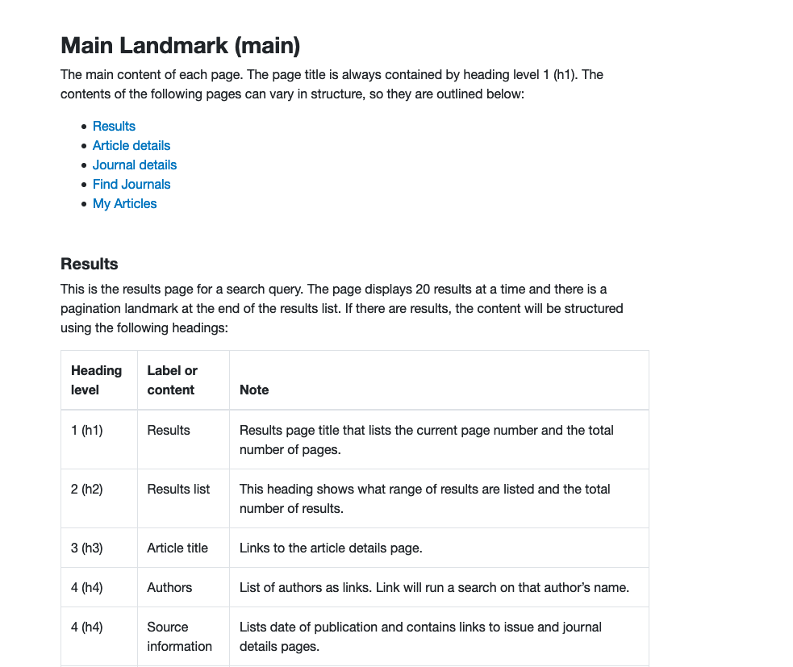
Contextual help

Slide 12
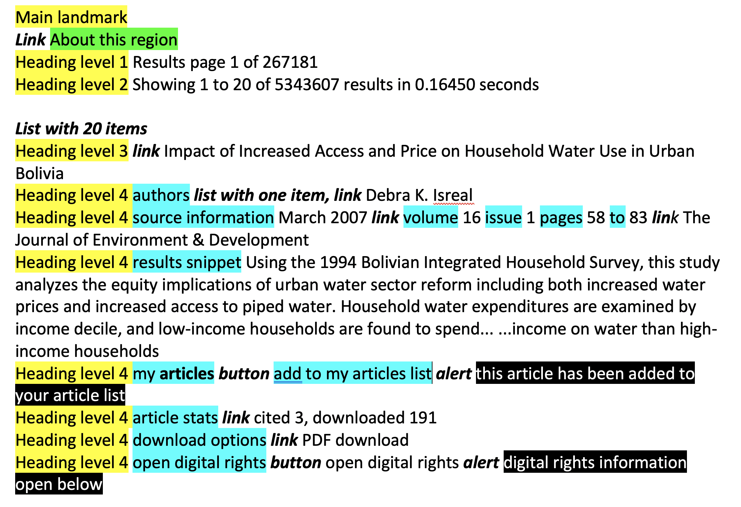
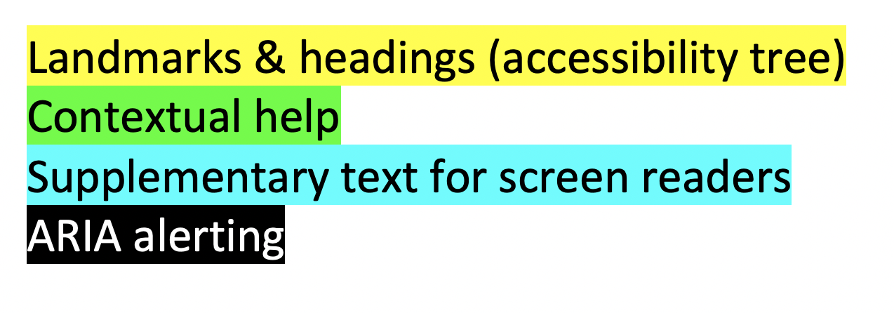
Contextual Help
Notes:
While efficiency of learning a platform, isn’t a formal requirement of WCAG 2.0, the actual criteria is undue hardship. The problem of time-to-learn rises to the level of a major obstacle that disadvantages users who are blind. We welcome the opportunity to push ourselves to our limits to respond. This is a work in progress.

Slide 13
Next Steps

Slide 14
Next Steps
Ontario Human Rights Commission's Policy on accessible education for students" with disabilities states
"education institutions should consult with students with disabilities to gain a greater understanding of students’ diverse needs, and how to most effectively meet them."

Slide 15
Next Steps: Guidelines
Laurier Library has hired a Library Web Accessibility Student Advisor (Ashley Shaw) to co-develop guidelines with us about saving time
Goal: Guidelines applicable to multiple websites
Bart apply them to the SPJ accessibility help page
Rallying call to Ontario university libraries:
  Hire Library Accessibility Student Advisors!
  Develop and share accessibility guidelines
  How many barriers can we prevent and remove in 1 year?

