Slide 1

Scholars Portal Updates
#spday2018

Slide 2
Scholars Portal Dataverse
Platform and Service Development Update
Meghan Goodchild, Research Data Management Systems Librarian

Slide 3
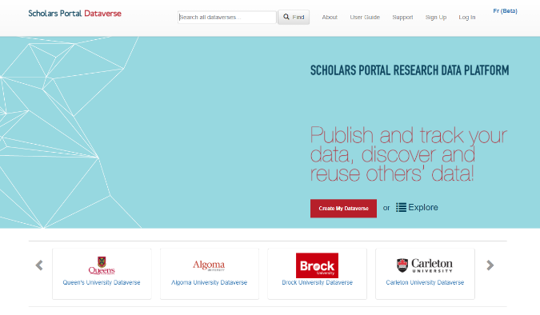
Scholars Portal Dataverse - Highlights 2018
Upgraded to 4.8.6
Performance enhancements
Usage report
Data Explorer
Ongoing projects and development
Internationalization
CANARIE RDM grant
Portage’s Dataverse North
Dataverse-Archivematica Integration
Notes:
[Introduce myself]
-Scholars Portal Dataverse is a research data repository provided as a shared service of OCUL and participating institutions since 2012.
-We’ve seen an ongoing growth in the service, particularly in the past year.
-As an overview, here are some highlights for 2018
-In May, we upgraded to version 4.8.6, which resulted in a number of performance enhancements and a few bug fixes
-The Scholars Portal team also developed two new tools, including the usage report feature and the data explorer, which I’ll touch on in a moment.
We’re also involved in a number of projects developing the platform and service
I’ll go into more detail today about the internationalization project, the CANARIE RDM grant, our involvement with Portage’s Dataverse North, and
Grant and I will conclude with Dataverse-Archivematica Integration.

Slide 4
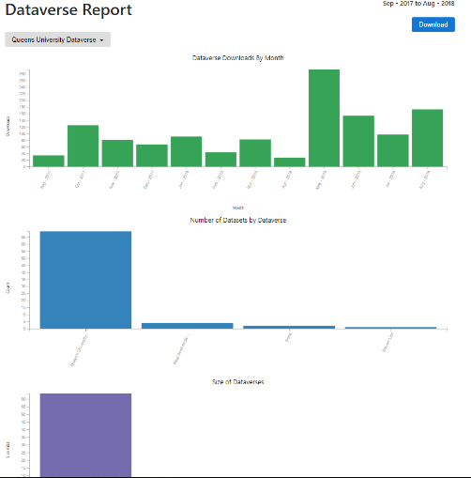
Scholars Portal Dataverse Highlights
Dataverse Usage Report
Online, interactive charts
Downloadable spreadsheet
Updated monthly
dataverse.scholarsportal.info/metrics
Notes:
We’ve had a lot of interest in Dataverse usage statistics.
Scholars Portal developed the usage report, which consists of online, interactive charts.
Charts include the number of downloads by month, number of datasets by dataverse, size of dataverses, file types, and subject coverage.
The report can be refined by institution or by Dataverse in the root directory.
Also a downloadable spreadsheet, which is updated monthly, where you can investigate these usage statistics in more detail.
This online report is accessible from the “metrics” link on the main Dataverse root page or from this link: datavesre.scholarsportal.info/metrics

Slide 5
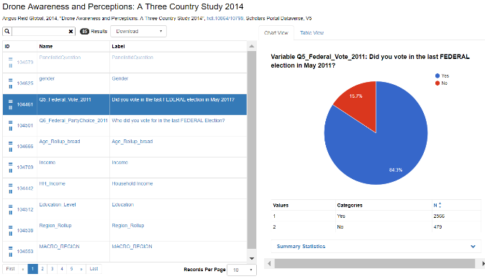
Scholars Portal Dataverse Highlights
Data Explorer
Online tool to explore tabular data files
Chart view and table view
Developed at Scholars Portal, now part of core code
Notes:
SP developed the Data Explorer tool and it is now part of the core DV code
-Tool to explore tabular data files, allowing users to chart variables *all within in the browser.
-This screen shot shows the the chart view
-Here you can click on a particular variable, which automatically creates bar or pie graphs.
You can also see summary statistics below
-If a user selects two or more variables, a cross tabulation is conducted under the table view
-This simple-to-use tool for data exploration is generating a lot of interest in the Dataverse community, used by a number of instances around the world including Harvard.

Slide 6
New Dataverse resources
3 new Dataverse videos (youtube.com/user/ScholarsPortal)
  Dataverse Overview: Finding and Exploring Data
  Creating, Editing, and Publishing a Dataverse
  Publishing Datasets in Dataverse
Updated user guide with new sections and updated FAQ
  learn.scholarsportal.info/all-guides/dataverse/
Portage’s Dataverse North Training Group materials (coming soon)
Notes:
-actively building Dataverse resources and we wanted to draw your attention a few new items
-3 new Dataverse videos for new users to dataverse on finding and exploring data, creating, editing and publishing a dataverse and publishing datasets
-plans for videos for more technical details for librarians and advanced users.
Updated SP user guide with new sections on customizing institutional dataverse, which is linked to from DV under “About” or at the link shown here.” In particular, the new FAQ contains more details and specifications related to file upload/download, data citation, and data sharing.
-We are collaborating with Portage’s Dataverse North Training Group to develop materials for Canadian researchers and libraries
So stay tuned for more updates!

Slide 7



Dataverse Internationalization Project
Collaboration with BCI, OCUL, UTL/SP, and IQSS at Harvard
Developing an open, internationalized Dataverse for use in multiple languages
Requires major changes to core code framework
4.9 release (early 2019) will include internationalization features
Notes:
Moving into some updates about development work around Dataverse at Scholars Portal
-The Dataverse Internationalization Project involves a collaboration with the Quebec consortium BCI and OCUL, with support from the Institute for Quantitative Social Science at Harvard.
-The aim is to produce an open, and fully internationalized Dataverse platform, which could be used in multiple languages, including English and French.
-The Scholars Portal team has been working with the Université de Montréal to internationalize the code as well as translate the user interface text and documentation into French.
-As you may know, the current French/English toggle is in beta.
-We are planning for a fully bilingual service as part of the next release in January 2019, which will incorporate many internationalization features, including the new language toggle in the UI
-Crucial development that will better support French language users across Canada.

Slide 8

CANARIE RDM program grant
Dataverse for the Canadian Research Community: Developing reusable and scalable tools for data deposit, curation, and sharing
Led by Scholars Portal and UTL with support from CARL and Portage
18-months (October 2018 - March 2020)
3 main areas of development
Notes:
We have an exciting announcement to share.
With support from CARL and Portage, Scholars Portal recently submitted a grant proposal to the CANARIE RDM program - and it was successful!
The project entitled, “Dataverse for the Canadian Research Community: Developing reusable and scalable tools for data deposit, curation, and sharing”
Led by Scholars Protal, with support from CARL and Portage. Will also be working with IQSS at Harvard to ensure developments can be shared more broadly with community
Funds 18-month development, beginning in October until end of March 2020
3 main areas of development, which I’ll walk you through now
Able to hire new developers and work is already underway

Slide 9


CANARIE grant - 1) Scalability
Optimize system architecture for scalable use
Improve ability to handle high volume traffic
Support large files in upload/download contexts
Notes:
The first piece aims to improve system scalability
-optimizing system architecture to
-improve the ability to handle large files in upload/download contexts
Deliverables include connecting to SWIFT object storage (connect to the OLRC)
-supporting globus endpoints, for better interoperability with other Canadian infrastructure platforms like FRDR (discover a globus endpoint through the DV interface.)
-new interface to support new workflow
[also more connections?]
Optimize DV setup for simultaneous users / uses
Host DV files in Ontario Library Research Cloud (OLRC)
Cloud storage can be scaled more easily
File access can be mediated outside of the DV app (links)

Slide 10



CANARIE grant - 2) Authentication
Integrate Dataverse with CAF Shibboleth Login
Support ORCID (ORCID Canada)
Streamline login workflows
Notes:
Single sign-on
Identity management across multiple systems/tools
No need to store IP locally in app
Data maintained by local school/CAF
Eventually this will help support linking of research outputs, discovery use cases

Slide 11
CANARIE grant - 3) Data Curation
Data Curation Tool
Improve data curation workflows
Enhance variable metadata using DDI standard
Adopt standards and best practices
Notes:
Data that lacks structure, organization and/or meaningful documentation is useless
Data curation involves preparing data so as to make it reproducible, reusable, discoverable, and accessible to others
The Data Curation tool will improve data curation workflows and be integrated within Dataverse
-Allow users to add/enhance DDI metadata at variable metadata
Labels, concepts, question text, universe statements etc. (using the DDI metadata standard)
Create a DDI XML file and generate detailed dataset Codebooks for reuse in DV

Slide 12
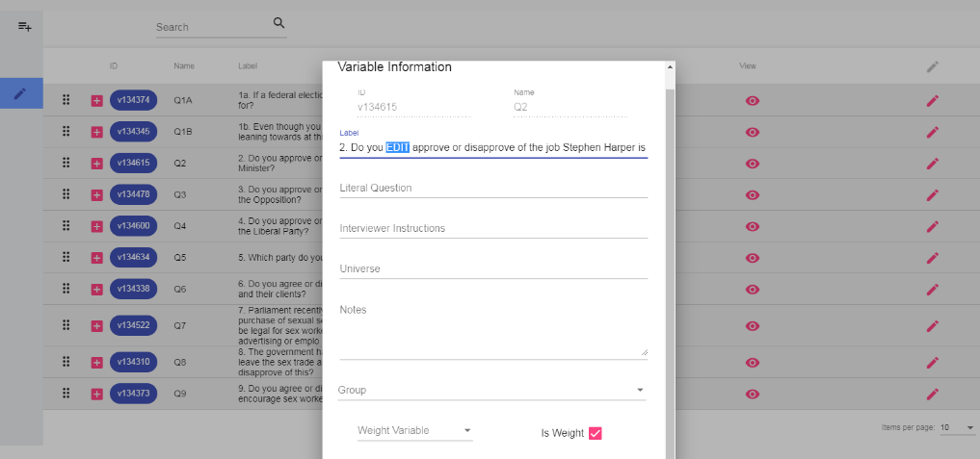
CANARIE grant - Data Curation Tool prototype
Notes:
-Towards this goal, SP has already developed a data curation tool prototype to edit and enhance metadata
-The online tool works with tabular datasets uploaded to Dataverse, allowing users to create and edit metadata at the variable-level.
-The tool would be able to interoperate with other components of Dataverse, including the Data Explorer tool.
Data curation includes adding contextual metadata to variables
Assist end-users with understanding data for
reuse

Slide 13

Portage Network’s Dataverse North (DVN)
Business Models Working Group key recommendations:
Establish National Dataverse Service
  Hosted by SP/UTL
  Sustainable library service
Coordinate governance through Portage Network DVN
Guiding benefits/principles:
Realizing true economies of scale
Pooling resources
Strengthen technical capacity
Improve funding opportunities
Support local and regional efforts
Notes:
Partnerships
Working with regional and national partners (BCI, Portage & DV North)
Develop SLA for use of SP Dataverse
Identify needs for Canadian researchers
Develop DV as a national repository option
OCUL level of service will not change; expect to increase and expand capacity in 2019-2020:
National funding opportunities (grants, federal funding possibilities)
Increased buy-in and support from local schools and regions across Canada
Collaborate at the national level (DV North as an example)

Slide 14
Partnerships
Working with regional and national partners (BCI, Portage, Dataverse North)
Developed draft Service Level Agreement by OCUL, UTL & BCI
  Outlines responsibilities
  Currently being reviewed by BCI
Respond to needs of Canadian researchers
Working towards developing Dataverse as a national repository option
Notes:
Partnerships
Working with regional and national partners (BCI, Portage & DV North)
Develop SLA for use of SP Dataverse
Identify needs for Canadian researchers
Develop DV as a national repository option
Through these partnerships, the projects mentioned before, we’re really working towards developing Dataverse as a national repository option. Many steps to go!

Slide 15
Scholars Portal Dataverse Roadmap
Q1-Q2 2019
Q3-Q4 2019
Q1-Q2 2020
Q3-Q4 2020
Fully bilingual Dataverse release
BCI schools onboarding
CANARIE project first deliverables
Governance model / business plan development
SP/UTL/OCUL extends SLA to others
CANARIE project continues
Governance model / business plan in place
CANARIE project ends
Launch Dataverse as national service
Notes:
Here a road map for the next two years
-In early 2019, we will upgrading to the latest version of Dataverse with internationalization, for a fully bilingual release
-After this time, we will begin onboarding the schools in Quebec to the service
-In March, we plan on releasing the first deliverables for the Canarie project
For the second half of 2019, we begin developing an appropriate governance model and business plan for Dataverse in consultation with partners
-We will extend the SLA to other interested institutions/consortia
-Continue work on the CANARIE project
For the first half of 2020
-We would aim to have the governance model and business plan in place
-The CANARIE project development would come to an end, and announcements would be made about the new features for the community
In the second half of 2020, we would aim to launch Dataverse as a national service option, with national governance model with institutional and/or consortial representatives
-Exciting developments afoot! Along with the infrastructure developments, we will continue to work with local, regional and national partners within and outside the library to ensure sustainable platform option for Canadian researchers

Slide 16
Research Data Preservation at Scholars Portal
Archivematica-Dataverse Integration
Project Update
Grant Hurley, Digital Preservation Librarian
Meghan Goodchild, Research Data Management Systems Librarian
Notes:
[Grant preamble]
I’m happy to join Meghan to report briefly on the progress made on the Archivematica-Dataverse integration project that Scholars Portal has sponsored. This project introduces the capacity to begin preserving datasets that have been uploaded to Dataverse for the long term, and it takes advantage of many of the basic preservation actions that Dataverse already includes as part of its functionality.

Slide 17
Archivematica-Dataverse Integration Overview
Growing interest in preserving research data
OCUL sponsored work with Artefactual Systems Inc.
  Phase 1 - Proof of Concept (2015)
  Phase 2 - Public release in v. 1.8 (November 2018)
Select & transfer dataset
Process
Long- term
storage
Notes:
[Meghan]
-project responds to a growing interest from OCUL schools to preserve research data using trusted standards and formats as recommended by the archival and digital preservation community.
-In 2015, OCUL sponsored a proof-of-concept project with Artefactual to develop an integration between Dataverse and Archivematica
[open-source digital preservation workflow tool that follows digital preservation standards and best practices]
-enable users of Archivematica to select and transfer datasets from Dataverse instances and process for long-term access and digital preservation
-The second phase began this summer to bring the proof of concept into public release of Archivematica.
-Very happy to announce that the integration is included in the latest release v. 1.8
-The Scholars Portal team has been involved with testing during this development work and contributed to the documentation (which will be provided at the end) that outlines some of the known issues and future enhancements
-Brings an important piece of infrastructure to assist with digital preservation of research data to the OCUL community and beyond.

Slide 18


Preservation Pathways for Dataverse
Curation & Configuration
Processing with Archivematica
Storage & Maintenance
Archivematica configured to ingest Dataverse datasets
Preserver selects datasets desired for preservation
Processing choices determined by institutional policies
Permafrost instance
(hosted Archivematica service)
or locally hosted Archivematica instance
AIPs stored on OLRC (or other connected storage) for long-term preservation
Policies and costs managed by local library/archive
Notes:
[Grant]
The approach taken during development has been intentionally modular. The workflow begins with a preserver who has datasets in a dataverse instance they want to preserve, as well as access to an Archivematica instance. It is assumed that the preserver has stewardship oversight over the datasets. They then make a decision that they wish to preserve some or all of the datasets as standalone archival packages. The advantage of doing so is that the files are removed from their native system - in this case dataverse - metadata is gathered about the files (not only the content, but information like their file format), and they are stored with good backups to enable long-term management with an eye toward managing any risks inherent in the materials, such as file format obsolescence. The preserver is also following archival principles - assessing what they wish to preserve based on their mandate and agreements with the data providers, as well as what long-term value the materials may have. Alternatively, a preserver may decide that everything in a dataverse is in scope, and process this accordingly, though the integration as current designed does not yet support this option, though it very easily could.
Secondly, the preserver has the option to configure preservation processing choices, such as whether they will create normalized copies of the files for preservation. For example, they may wish to normalize all jpegs to tif files, which is generally considered more preservation-friendly, but takes up more space. Therefore, they may also choose to hedge their bets and wait to see if jpgs ever fall out of favour, at which point they could normalize the files then.
They then would process the files using Archivematica. For those unfamiliar with it, Archivematica is a workflow system for taking data and performing a series of actions on that data in order to prepare a package of the files and associated metadata for long-term storage and management. Preservers could do so using a hosted service like Scholars Portal’s Permafrost service, which I will talk about in a minute, or a locally installed instance of Archivematica.
Finally, the preserver would store the result - the archival information package or AIP - on a reliable storage method like the OLRC and keep an eye on it, again based on institutional policies.

Slide 19
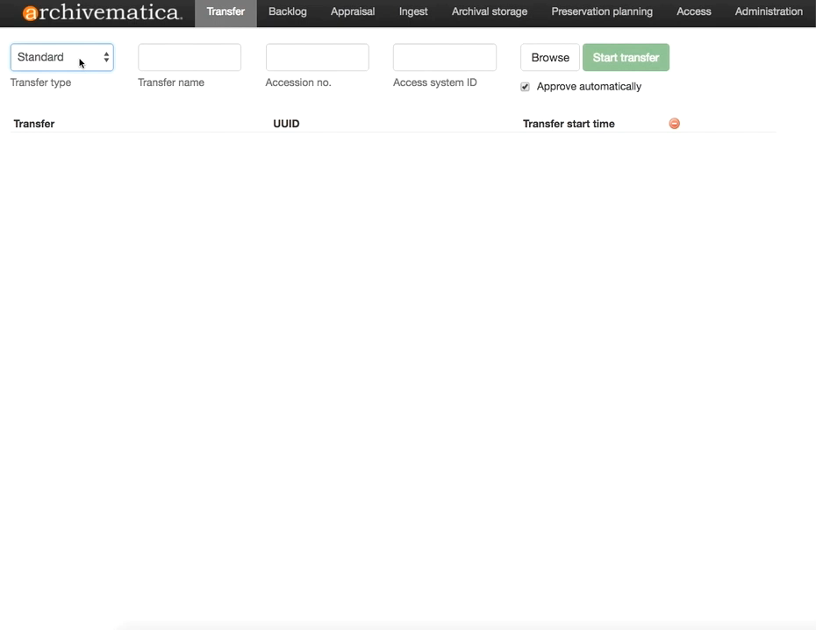
Notes:
[Grant]
User selects dataverse as the transfer type and then hits browse to see the datasets available
The integration can be set up to search across a whole dataverse, or restrict its view to a specific sub-dataverse or search query.
The user then scrolls and selects the dataset they would like to process and titles the transfer.
They add the dataset, and then hit “start transfer” to begin processing.
It may take anywhere from a few seconds to a few minutes to transfer the files from dataverse. This video has been edited to prevent you from looking at a blank screen for what feels like forever, but is really about 10 seconds.
Archivematica then begins processing the files. As part of this process, descriptive metadata from Dataverse is parsed, and any checksums provided by Dataverse are validated, which enables you to be sure that the files were uncorrupted during their travels.
Other functions like a virus scan is performed. Archivematica also ingests any derivative files that Dataverse created from tabular data.
From then on, the user can choose to continue the preservation process, including the option to normalize files, and then send the resulting archival information package to storage.

Slide 20
Archivematica Integration - Next steps
Public Archivematica sandbox hosted by Scholars Portal beginning January 2019
Connected to test datasets at Scholars Portal Demo Dataverse (demodv.scholarsportal.info)
Invite feedback at dataverse@scholarsportal.info
White paper on integration including feedback
Documentation:
  Archivematica 1.8 Release Notes
  Archivematica – Dataverse Documentation
  Archivematica – Dataverse Project Wiki
Notes:
[Meghan]
-Scholars Portal plans to host a public Archivematica sandbox beginning in January 2019 for a limited time
-It will be connected to test datasets in our Demo Dataverse
-We will invite the community to try out the integration and provide any feedback
-This will be incorporated into a white paper progress report, which would integrate feedback and our findings through testing
-At this point, we invite you to review the documentation, listed here, for a more detailed description of the integration, known limitations and future improvements

Slide 21

A Brief Update on Permafrost
Grant Hurley, Digital Preservation Librarian

Slide 22
What is Permafrost?
Permafrost provisions a suite of tools, training and resources to enable members of OCUL to begin actively processing digital objects for long-term preservation and access
  It is operated by Scholars Portal on a cost-recovery basis
Tools include:
  Archivematica for preservation processing
  The Ontario Library Research Cloud (OLRC) for storage
Training includes webinars, consultation and optional on-site sessions
Resources include ongoing technical support, documentation, guides and reporting

Slide 23

What’s happening with Permafrost?
5-member pilot completed Summer 2018
Transitioned to production and accepting subscribers as of September 2018
Currently has 5 subscribers; 2 are new to the service

Slide 24
Want to learn more?
Visit our website! permafrost.scholarsportal.info
Look at our guide!
Handling Digital Archives Before Ingest @ learn.scholarsportal.info
E-mail Grant at grant@scholarsportal.info!

Slide 25

An update on a new grant-funded project:
DuraCloud Canada: Linking Data Repositories to Preservation Storage
Grant Hurley, Digital Preservation Librarian

Slide 26
What is DuraCloud?
DuraCloud is a set of software components that allow for more effective oversight/management of preservation copies stored in cloud environments
Users can choose to store data across a set of connected cloud storage options to:
  Manage risks (higher value content might go to more storage services)
  Understand the scope/quantity of their content better

Slide 27
Why DuraCloud Canada?
The OLRC project provided much-needed storage capacity. Now users need better tools to use and interact with the OLRC:
  Easier integrations with data repositories, Archive-IT, etc.
  Integrates with Archivematica
  Usable upload/download tools
  Stronger management and reporting tools

Slide 28
OLRC Now vs. DuraCloud Out of the Box
Feature | OLRC | DuraCloud
Archivematica | ✔ | ✔
Institutional Repositories | Planned | ✔
Archive-It | Planned | ✔
Upload/download tool | In development | ✔
Preservation metadata in GUI | Planned | ✔

Slide 29
What does the project involve?
Collaboration between DuraSpace, the University of Toronto Libraries, Scholars Portal, and COPPUL
18 month grant from CANARIE Research Data Management Program for:
  1 FTE programmer (covered)
  1 FTE system support (covered)
  $18,000 infrastructure costs
  $18,000 consultation services

Slide 30
CANARIE Grant Goals - to April 2020
  Remove DuraCloud’s dependencies on Amazon Web Services
  Integrate with OLRC
  Integrate with WestVault (COPPUL’s LOCKSS-based storage method)
  Host open source version on SP servers at UTL data centre
  Test and verify connectors to other cloud-based storage services
  Test and verify connectivity with Archivematica, DSpace, Archive-It

Slide 31
Thank you!
Meghan Goodchild - meghan@scholarsportal.info
Grant Hurley - grant@scholarsportal.info

Slide 32
Implementing Linked Data in
OCUL Scholars Portal
Wei Zhao, Senior Metadata Librarian, Scholars Portal
Jayanthy Chengan, Senior Software Developer, Scholars Portal

Slide 33
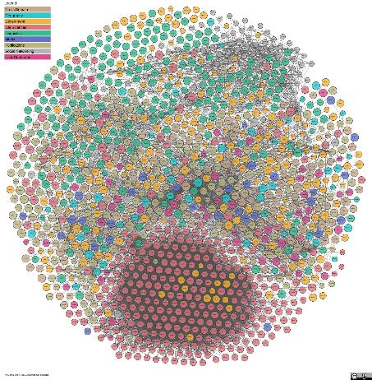
The Linked Open Data Cloud
https://lod-cloud.net/

Slide 34
Scholars Portal Linked Data Activities
Participating Canadian Linked Data Initiative (CLDI)
Attending Linked Data conferences—LODLAM, LD4P, SEMANTiCS
Purchasing MarkLogic Semantics license
Conducting pilot projects

Slide 35
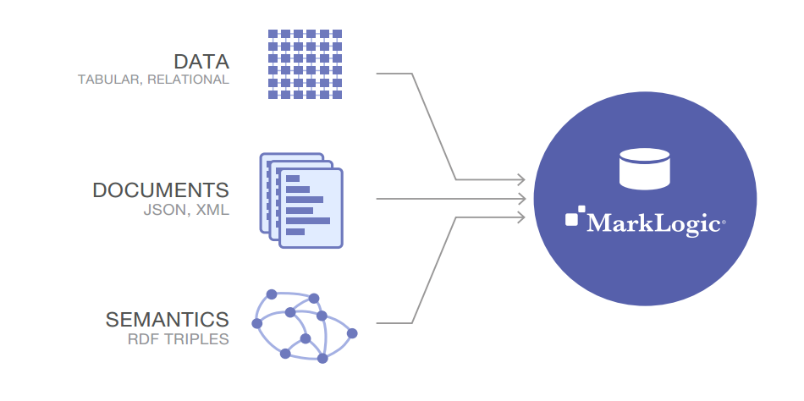
MarkLogic Semantics
https://www.sagesoftcloud.com/products-and-services/mark-logic/

Slide 36
MarkLogic Semantics
Triple store
Triple index
Native SPARQL query and SPARQL update
JavaScript, XQuery, and REST
Ontology Driven Entity Extraction

Slide 37
Modeling Journals Entitlement as Linked Data
Objectives
Manage entitlement better.
Track the perpetual access information.
Track the history of the entitlement changes.
Track the title transfers.
Generate the report as needed.
Export the entitlement data to member institutions’ ERM or ILS systems.

Slide 38
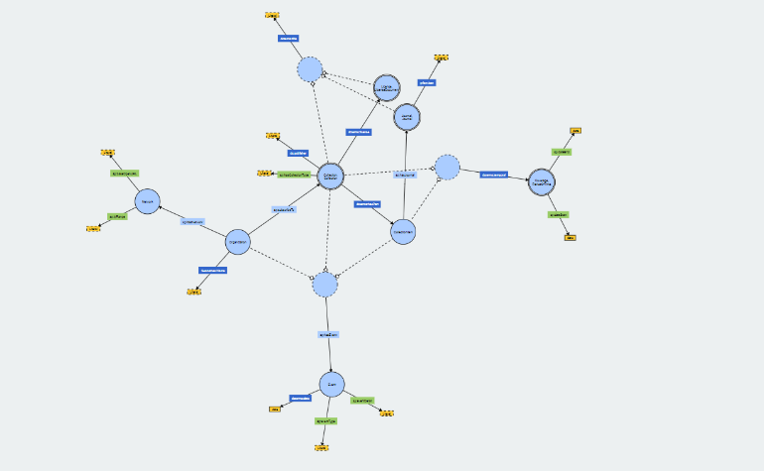
Modeling Journals Entitlement as Linked Data
Data Model

Slide 39
Modeling Journals Entitlement as Linked Data
Entitlement data loaded in MarkLogic
SPARQL query tested for use cases
Next steps
  --Continue testing
  --Revise the data model
  --Build the entitlement admin tool based on linked data model

Slide 40
Building linkages between SP collections
Books
Journals
GeoPortal
<odesi>
Dataverse

Slide 41
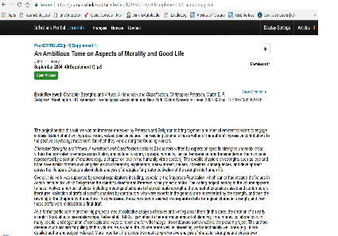
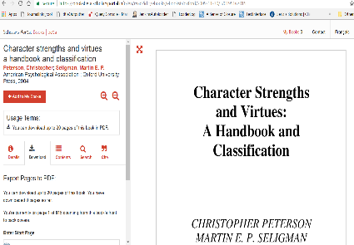
Building linkages between SP collections
SP Journals Platform
SP Books Platform

Slide 42
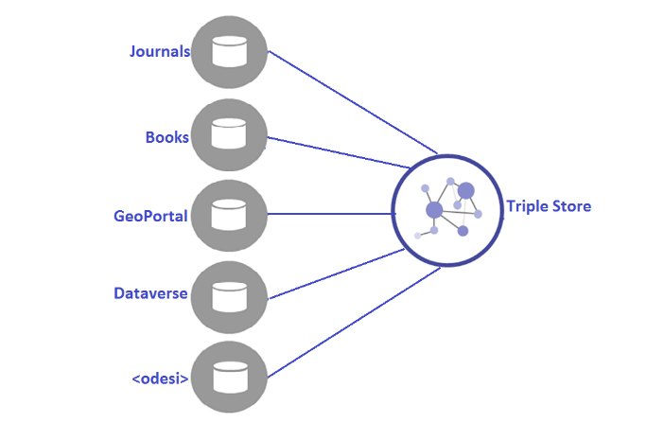
Building linkages between SP collections

Slide 43
Building linkages between SP collections
Book and its book review article is linked.
Working on building other linkages.
Working on interacting with external resources.
The data model and ontologies are under review and finalization

Slide 44
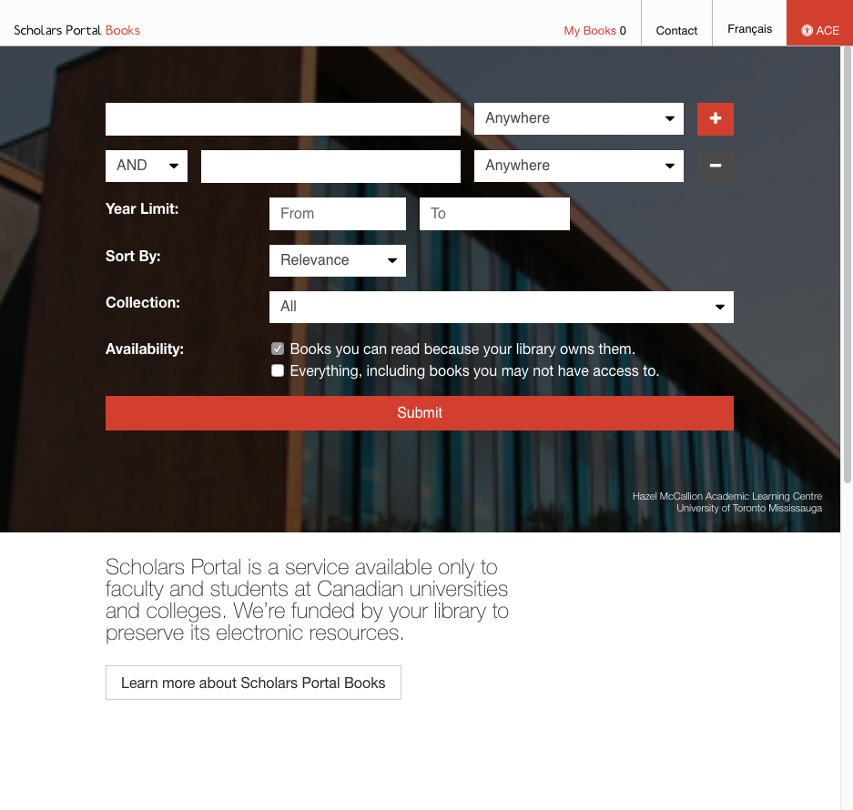
Books Update

Slide 45
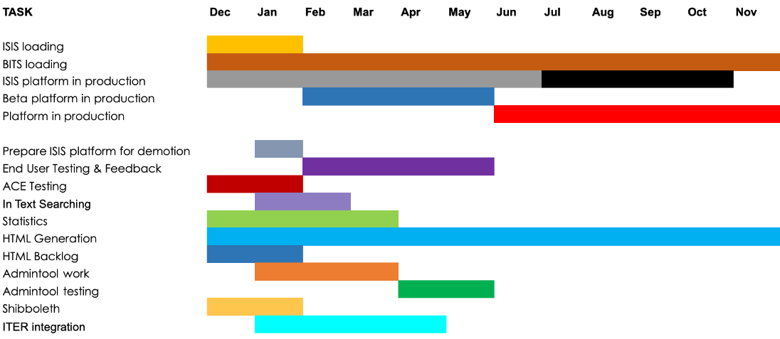
Books Redevelopment Phase 1

Slide 46
Books Redevelopment Phase 1
DONE!

Slide 47
121,234+
titles loaded in 2018!

Slide 48
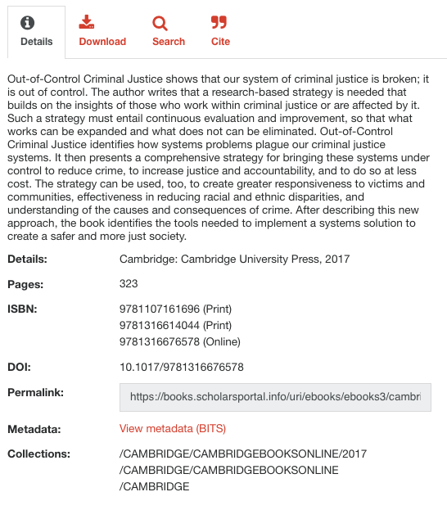
Better
Metadata

Slide 49
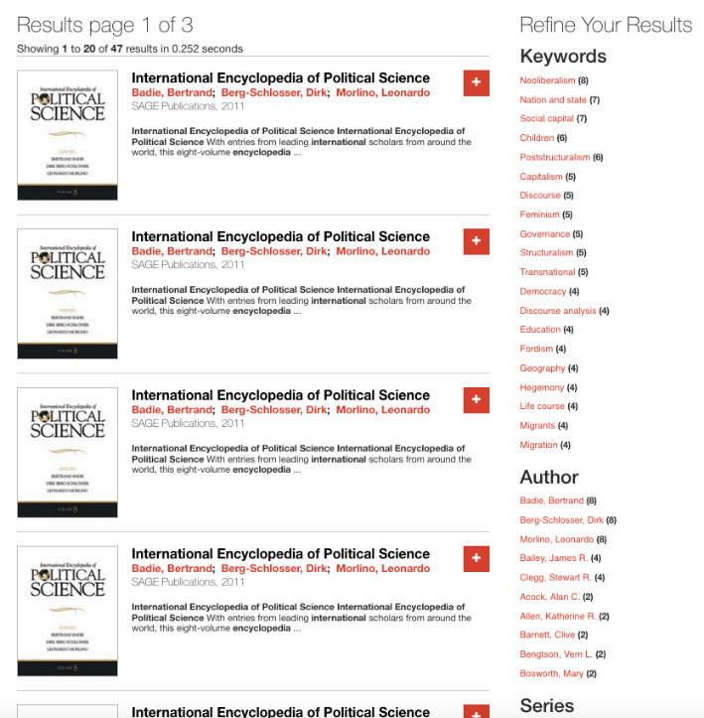
Metadata
Cleanup

Slide 50
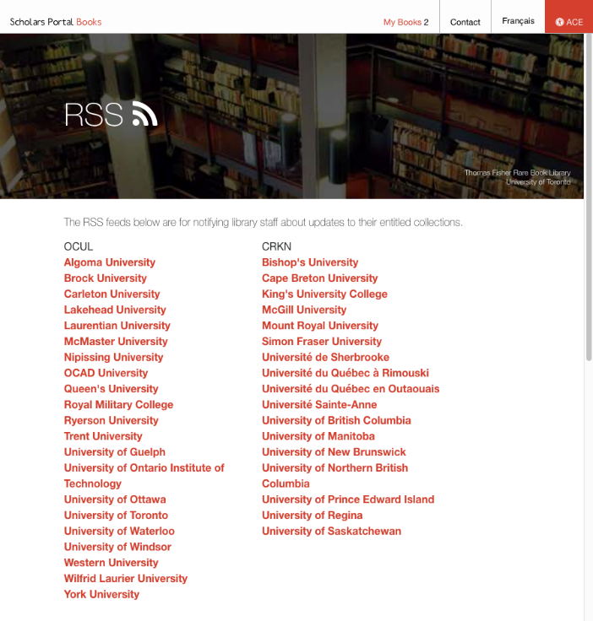
Loading Updates

Slide 51
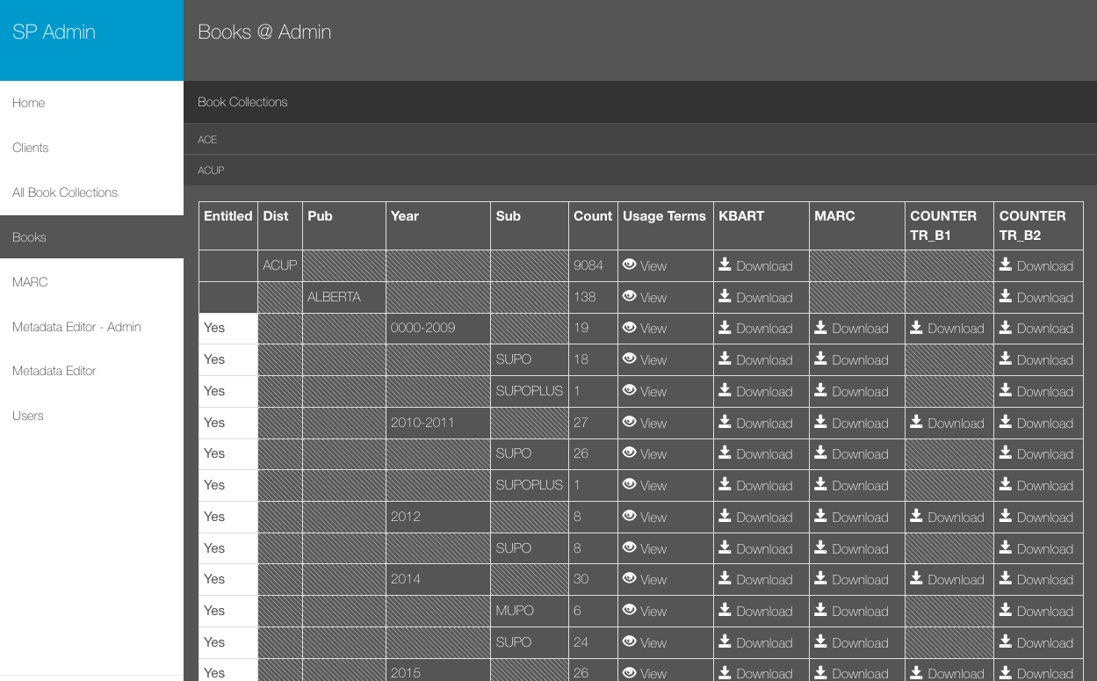

Slide 52
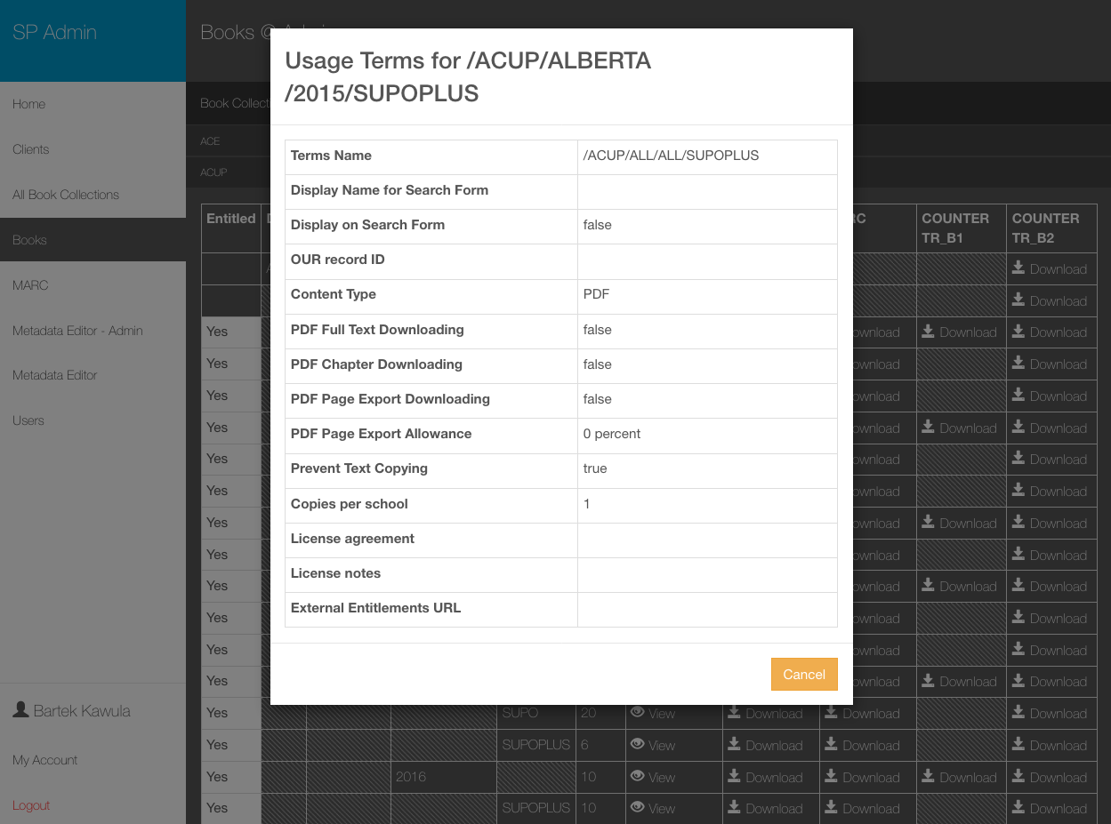

Slide 53
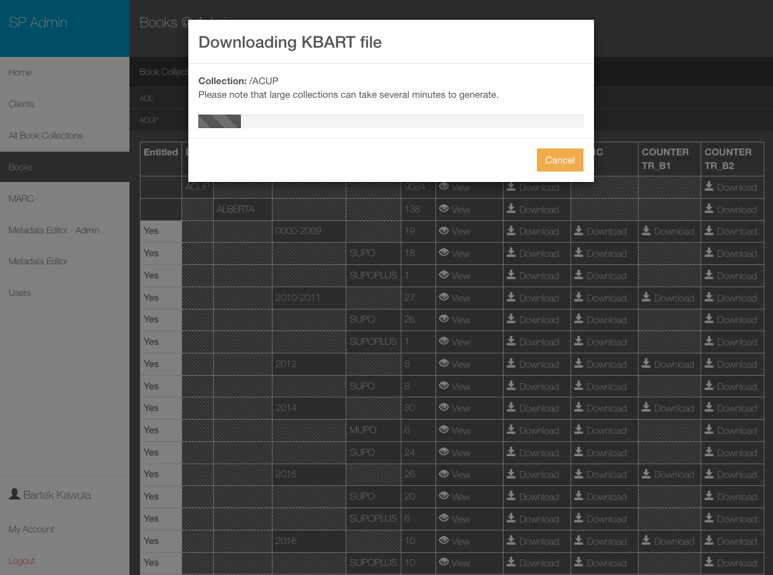

Slide 54
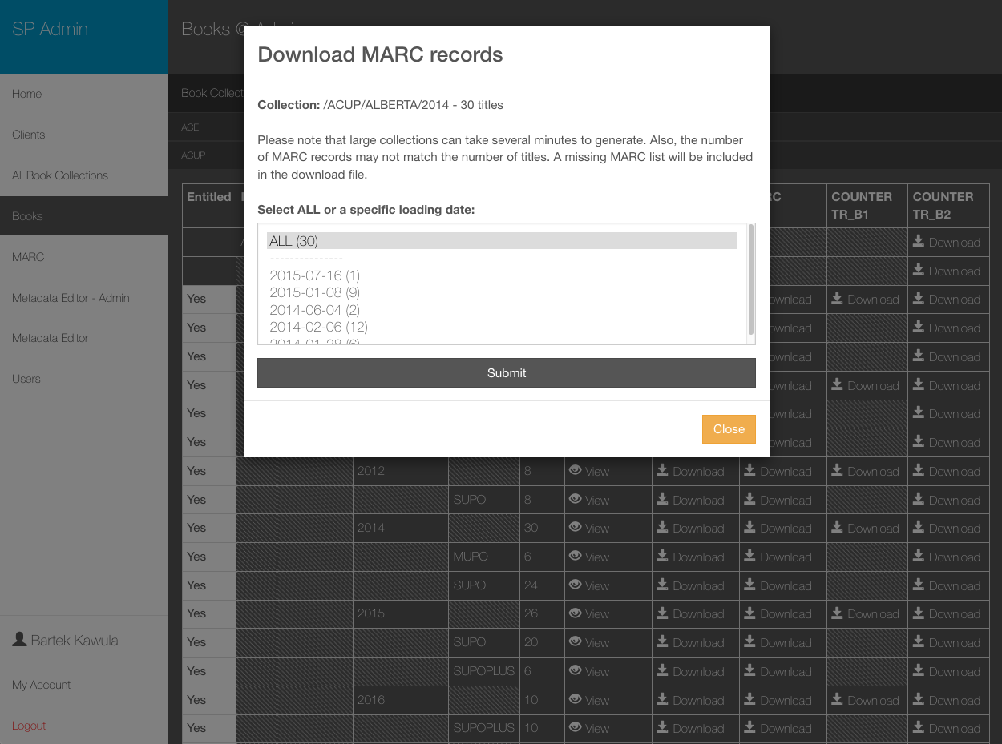

Slide 55
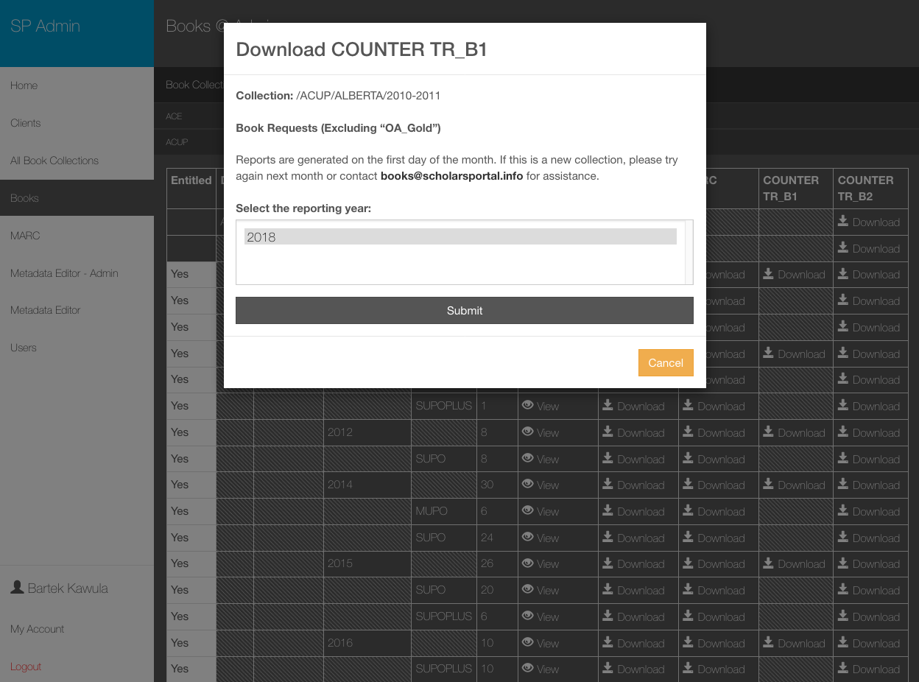

Slide 56
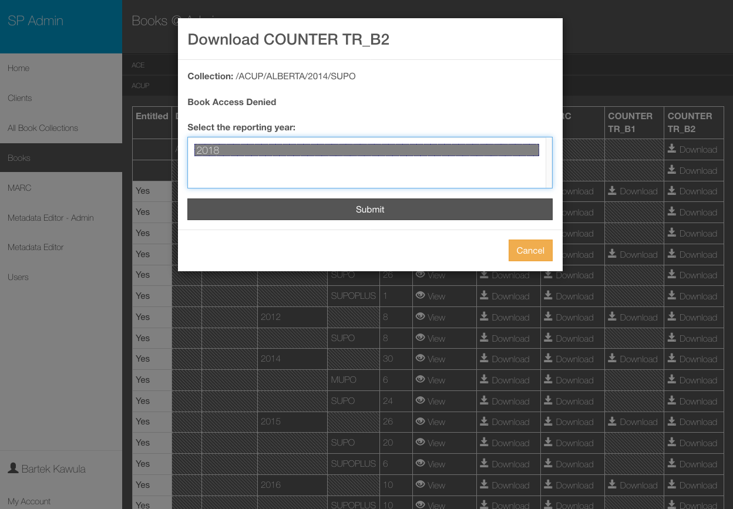

Slide 57
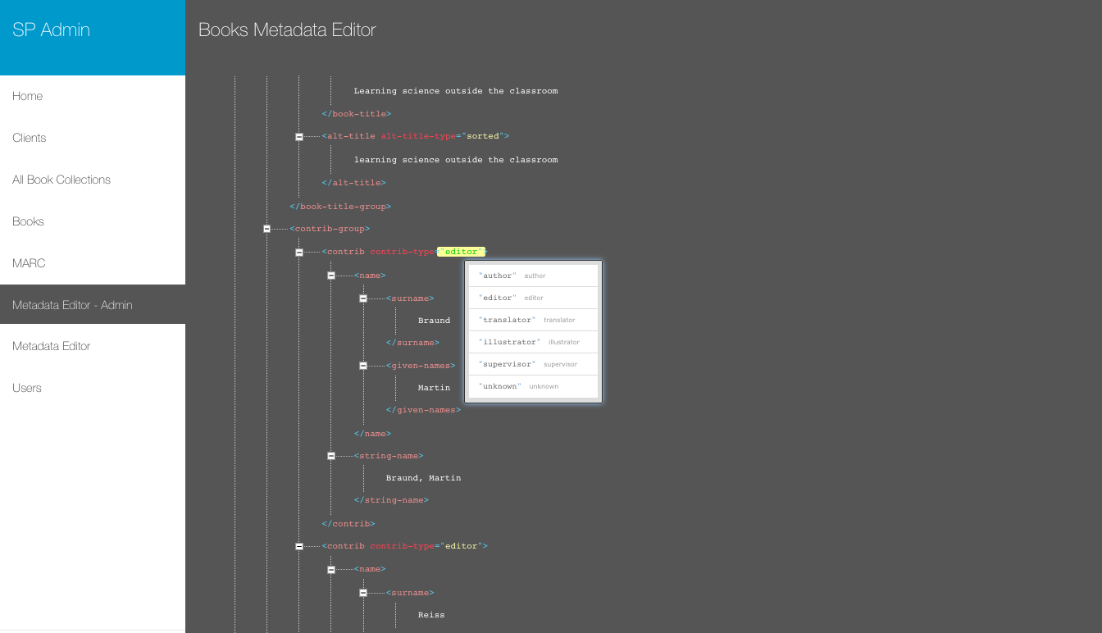

Slide 58
What’s next?
New loading workflows
Reload Internet Archive data
Preservation
Recommendation services
Data analytics fun

Slide 59
Total Reads & Downloads since July 1st

Slide 60












Top 12 books across all libraries in November
Marijuana and the Cannabinoids
Humana Press
444 reads
Feminisms matter
debates, theories, activism
University of Toronto Press
414 reads
The logic of care
health and the problem of patient choice
Routledge
382 reads
Land's end
capitalist relations on an indigenous frontier
Duke University Press
347 reads
Martindale
the complete drug reference
Pharmaceutical Press
345 reads
Inside capitalism
an introduction to political economy
Fernwood
343 reads
The Blacks in Canada
McGill-Queen's University Press
329 reads
A history of science in society
University of Toronto Press
296 reads
Whose national security?
Between the Lines
287 reads
Clearing the Plains
University of Regina Press
284 reads
Modern Mathematical Statistics with Applications
Springer
277 reads
Trans/forming
feminisms
Sumach Press
274 reads

Slide 61
Top 100 (November)
Marijuana and the Cannabinoids
Feminisms matter
The logic of care
Land's end
Martindale
Inside capitalism
The Blacks in Canada
A history of science in society
Whose national security?
Clearing the Plains
Modern Mathematical Statistics with Applications
Trans/forming feminisms
Theories of race and racism
Gender and development
Severing the ties that bind
Mohawk interruptus
Encyclopedia of Adolescence
A companion to philosophy of religion
A brief history of neoliberalism
The colonial problem
Productive Remembering and Social Agency
Give a man a fish
The rites of men
A knock on the door
Should we change how we vote?
Canadian critical race theory
Sexual assault in Canada
Stedman’s Medical Dictionary
Gender, race, and nation
Dark threats and white knights
After Morgentaler
Color of violence
Critical lessons
Politics, society, and the media
Never going back
Disrupting queer inclusion
Understanding Analysis
Philosophy of law
At the centre of government
Scratching the surface
The dark side of the nation
A recognition of being
Violence against indigenous women
Animal rights
Multicultural odysseys
Sexual violence at Canadian universities
Dark matters
Social capital in action
The Canadian student financial survival guide
Policing the risk society
Crimes of colour
Fairness at work
Media and cultural studies
Ms. Prime Minister
Treaty elders of Saskatchewan
Ideological perspectives on Canada
Breaking the bargain
A Readable Introduction to Real Mathematics
Travesti
Learn, teach, challenge
Racial profiling in Canada
Here is hell
Never saw it coming
Fraud Analytics
Sur le bout de la langue
Computer‐Aided Fraud Prevention and Detection
Critical disability theory
The Canadian war on queers
Surviving incarceration
Culture of prejudice
Colonialism-postcolonialism
Read, listen, tell
Poems, emblems, and The unfortunate Florinda
The Routledge companion to race and ethnicity
Keeping promises
Group politics and social movements in Canada
Canada's residential schools
Invisible women
Canadian politics
Black feminist thought
Canada's odyssey
Judicial power and Canadian democracy
Folk devils and moral panics
Citizenship, diversity, and pluralism
A history of French language through texts
City form and everyday life
Introduction to Biomedical Imaging
Conservatism in Canada
Sisters or strangers?
Pompeii
Employment equity in Canada
The post-colonial studies reader
Spartan women
Abortion
Cities from scratch
Power through testimony
Reconstructing value
A brief history of neoliberalism
The Beatles as musicians
Reconciling Canada

Slide 62
Thanks!
Questions & Suggestions: books@scholarsportal.info

Slide 63
Scholars Portal – Brief Updates
Amy Greenberg, Acting Co-Director

Slide 64
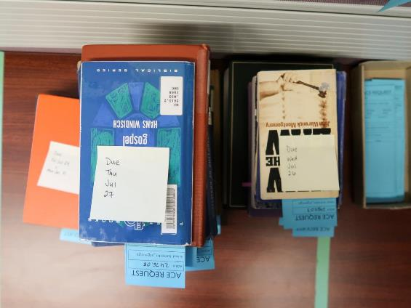
Accessible Content ePortal (ACE)
The Accessible Content ePortal hit a major milestone in summer 2018: 15,000 accessible titles in our collection.
The launch of the new Books platform means a new look and feel for ACE, and better accessibility of ebooks their school has purchased.
Notes:
In keeping with our theme…start off with ACE

Slide 65
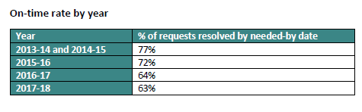
ACE Turnaround Times
The Problem:
Increase in turnaround time for ACE digitization requests over the last couple of years, and especially this past summer.
Notes:
Unfortunately this coincided with a not-so exciting milestone in the summer

Slide 66
ACE Turnaround Times
Contributing factors:
Unpredictable request volume
Marginalia - erasing needed!
Staffing model
Technical changes at Internet Archive and SP Books
Notes:
Partial list!
ACE is still a young service and we are finding that so far, past request volume trends do not necessarily predict future volume
Tricky to decide on appropriate student staffing

Slide 67
ACE Turnaround Times
Mitigation strategies:
Check for marginalia first
Investigate alternate options (e.g., purchasing)
Flexible student staffing model
Improved record keeping
Social media campaign
Notes:
Partial list!
Working with the University of Toronto Libraries communications team, we planned a social media campaign encouraging students not to write in library books. While this may not have an immediate impact, we hope it may help in the long term.
Preliminary results from the campaign indicate it was one of UTL’s most popular Instagram stories ever!

Slide 68
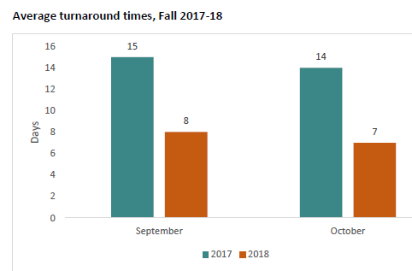
Notes:
New procedures implemented Sept. 2018
2 months later these are the stats - reduced turnaround time cf last year
Possibly other factors at play but this is encouraging

Slide 69
Open Journals Systems (OJS)
Scholars Portal’s hosted OJS instances now contain:
  over 31,000 published articles
  in 125 journals
  at 10 OCUL institutions
Notes:
Growing service as more libraries become involved in scholarly publishing

Slide 70
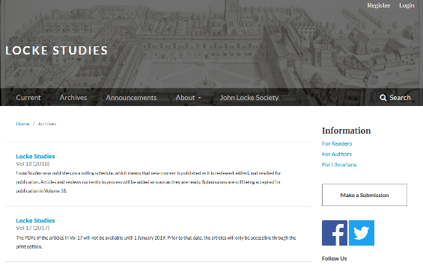
OJS 3.0
This year, we migrated all of our OJS instances to version 3. OJS 3 includes an improved user interface, improved publisher workflows, a mobile-friendly design, and enhanced theming options.

Slide 71
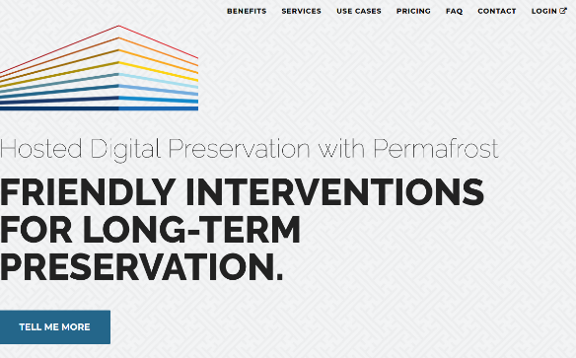
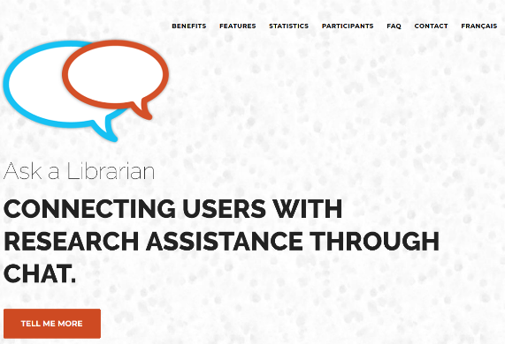
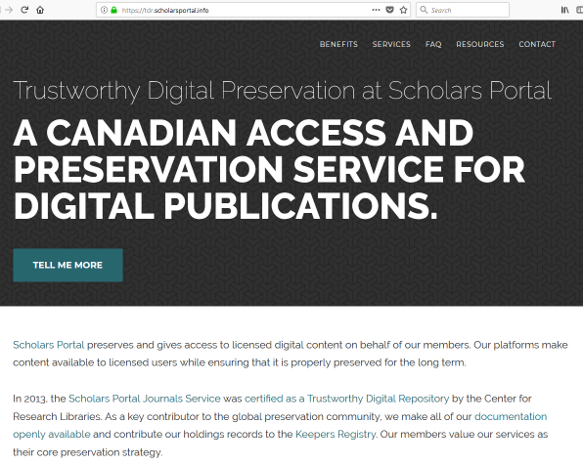
New Websites

Slide 72
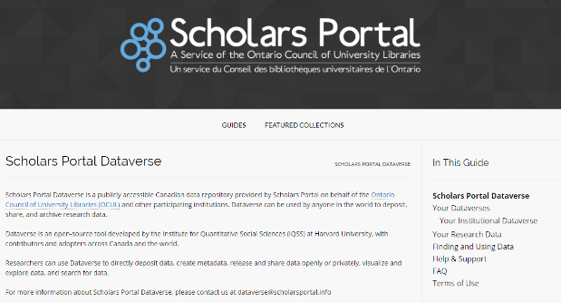
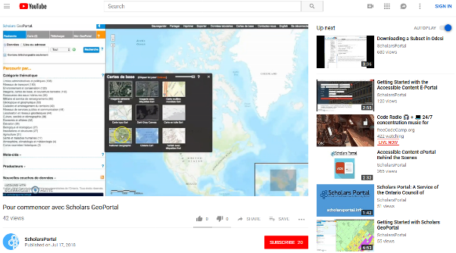
User guides and featured collections
Notes:
Learn.scholarsportal.info new site

Slide 73
Collaborating with Collaborative Futures
Considerations:
SFX hosting
Ensuring that SP collections are discoverable in the new platform
OUR licensing information
New ways of sharing resources
Notes:
Meetings with CF project team esp Mandy & Gord, and with Ex Libris reps
Consortial ILL – perhaps re-think how this happens
Discussions well underway!

Slide 74


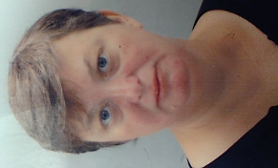
New faces
Sohaib Anwar
Systems Support Specialist
Victoria Lubitch
Data & GIS Programmer/Analyst
Carlos McGregor
Systems Support Specialist
Notes:
Thanks in part to our CANARIE grant funding, this year we welcomed 3 new people to the team

Slide 75
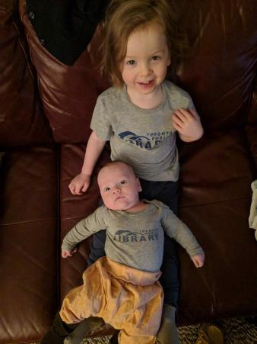
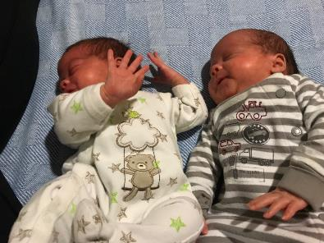
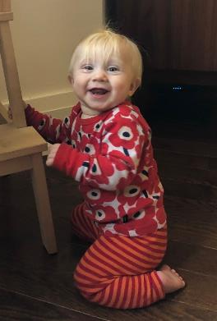
Newer faces
Notes:
On Leave: Amaz, Jacqueline, Katya (thank you, Sabina!) and Alan

Slide 76
Contact us!
General Help
help@scholarsportal.info
Member Services
chat@scholarsportal.info
racer-support@scholarsportal.info
ace@scholarsportal.info
ojs@scholarsportal.info
Content Services
journals@scholarsportal.info
books@scholarsportal.info
odesi-help@scholarsportal.info
geoportal@scholarsportal.info
dataverse@scholarsportal.info
Systems
admin@scholarsportal.info
Notes:
Get everyone to stand up for acknowledgement!!

Slide 77
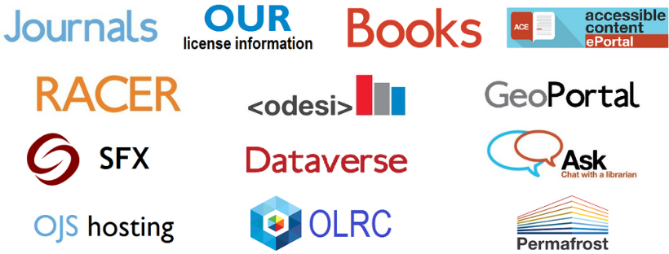
Q&A
Notes:
Thank you!
Questions?

