Slide 1

Welcoming the whole academic community into the library
#spday2018

Slide 2
Supporting French-Language Speakers
Nadia Caidi

Slide 3
Supporting French-language speakers’ needs in the GTA
Prof. Nadia Caidi, Faculty of Information, Univ. of Toronto
With INF2300 students: Elizabeth Carbone, Joanna Grodecki,
Lubnaa Jaumdally, and Ciara O’Kelly
Scholars Portal Day, Dec 7, 2019

Slide 4
Why SUPPORTING French language services?
French has a special status in Canada
  One of Canada’s two official languages
  Relates to the history, heritage, culture, and identity of our nation
  Special status of French in a minority context:
    Loi sur les Services en Langue Francaise,1986, guarantees an individual’s right to receive services in French from the ON gvt.
    Commissariat aux Services en Langue Francaise de l’Ontario
There is a demand for French language services
  A rich and diverse francophone community in the GTA
  Diversity in terms of age, background, language competence, etc.
  Bilingual education (French immersion, French public schools)
  Employment opportunities (public sector, education, business, etc.)
French language services and/in Libraries
  Libraries serve the needs of everyone: youth, newcomers.
  Community-building; partneships with community organizationss;
  Working toward a sustainable and accessible strategy for Ontario’s francophone communities

Slide 5
Who are FRANCOPHONES IN ON?
French presence in ON dates back over 400 years.
1986: French Language Services Act passed.
Francophone population equal 622,415, which represents 4.7% of the pop in ON
  The absolute number of Francophones has steadily increased over the past two decades.
There are1.5M Ontarians who speak both French and English (about 11% of the pop in ON).
2009: Adoption by ON of the IDF: the Inclusive Definition of Francophone
  IDF includes not only people whose mother tongue is French but also individuals whose mother tongue is neither English nor French (allophones), who have a particular knowledge of French and who use it at home.
  Example: A Senegalese family that speaks Wolof and French at home is considered Francophone.
  Source: Office of the French Language Services, Commissioner of ON, 2018.

Slide 6
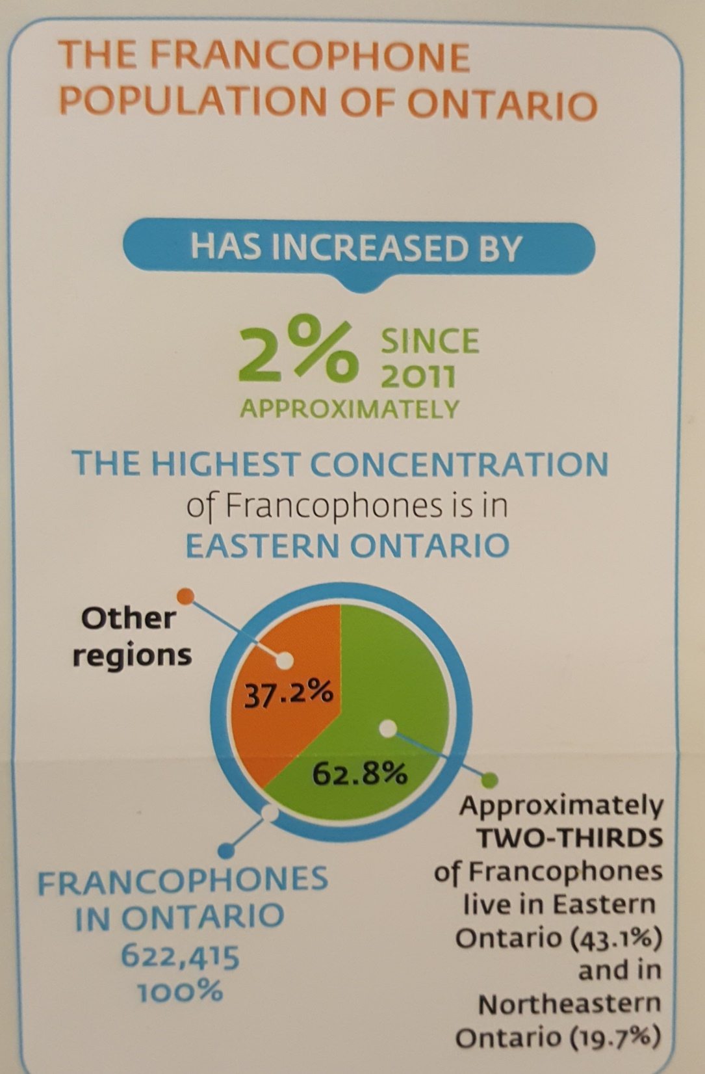
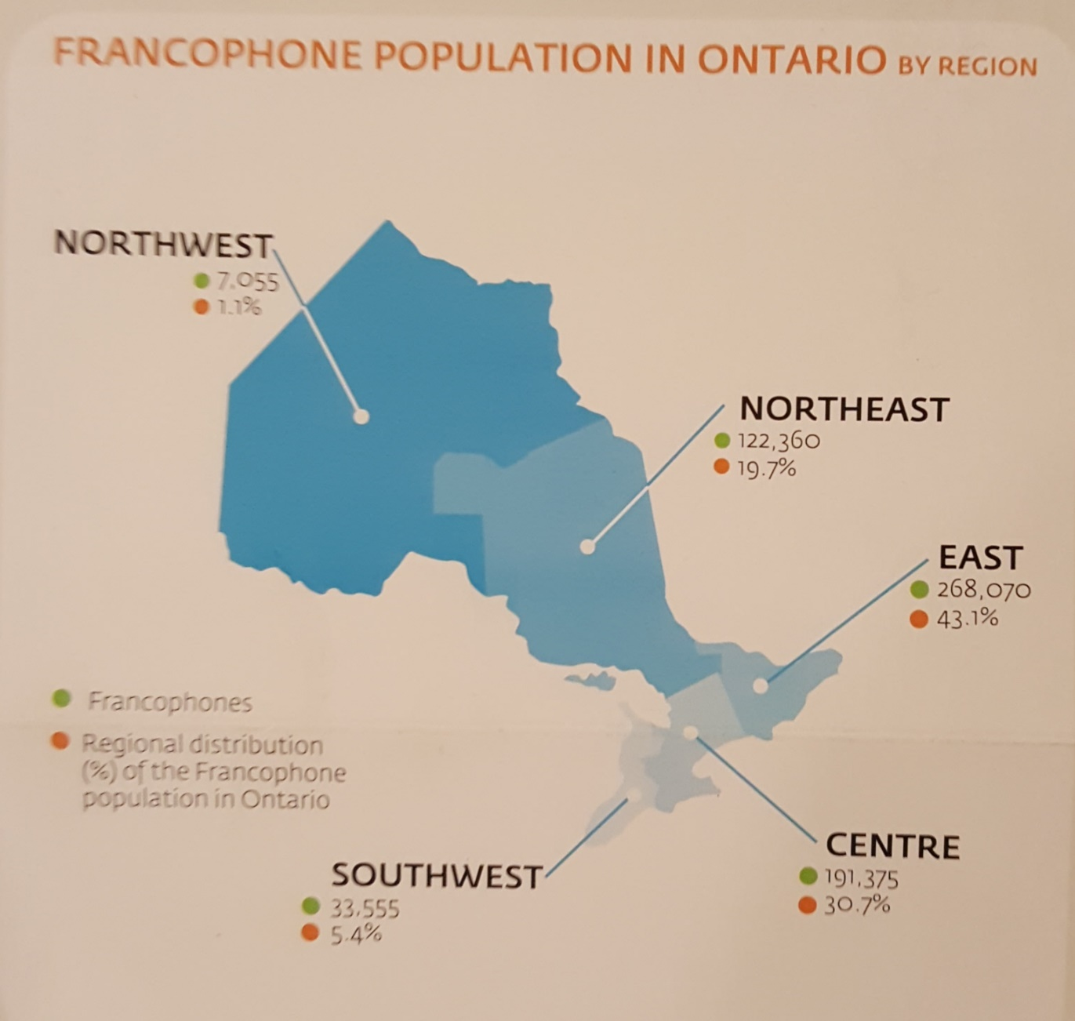
  Source: Office of the French Language Services, Commissioner of ON, 2018.

Slide 7
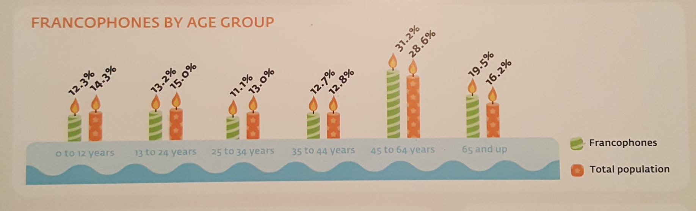
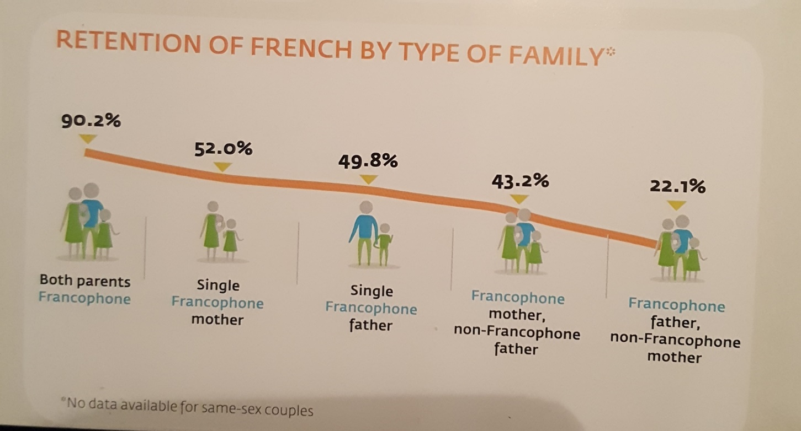
  Source: Office of the French Language Services, Commissioner of ON, 2018.

Slide 8
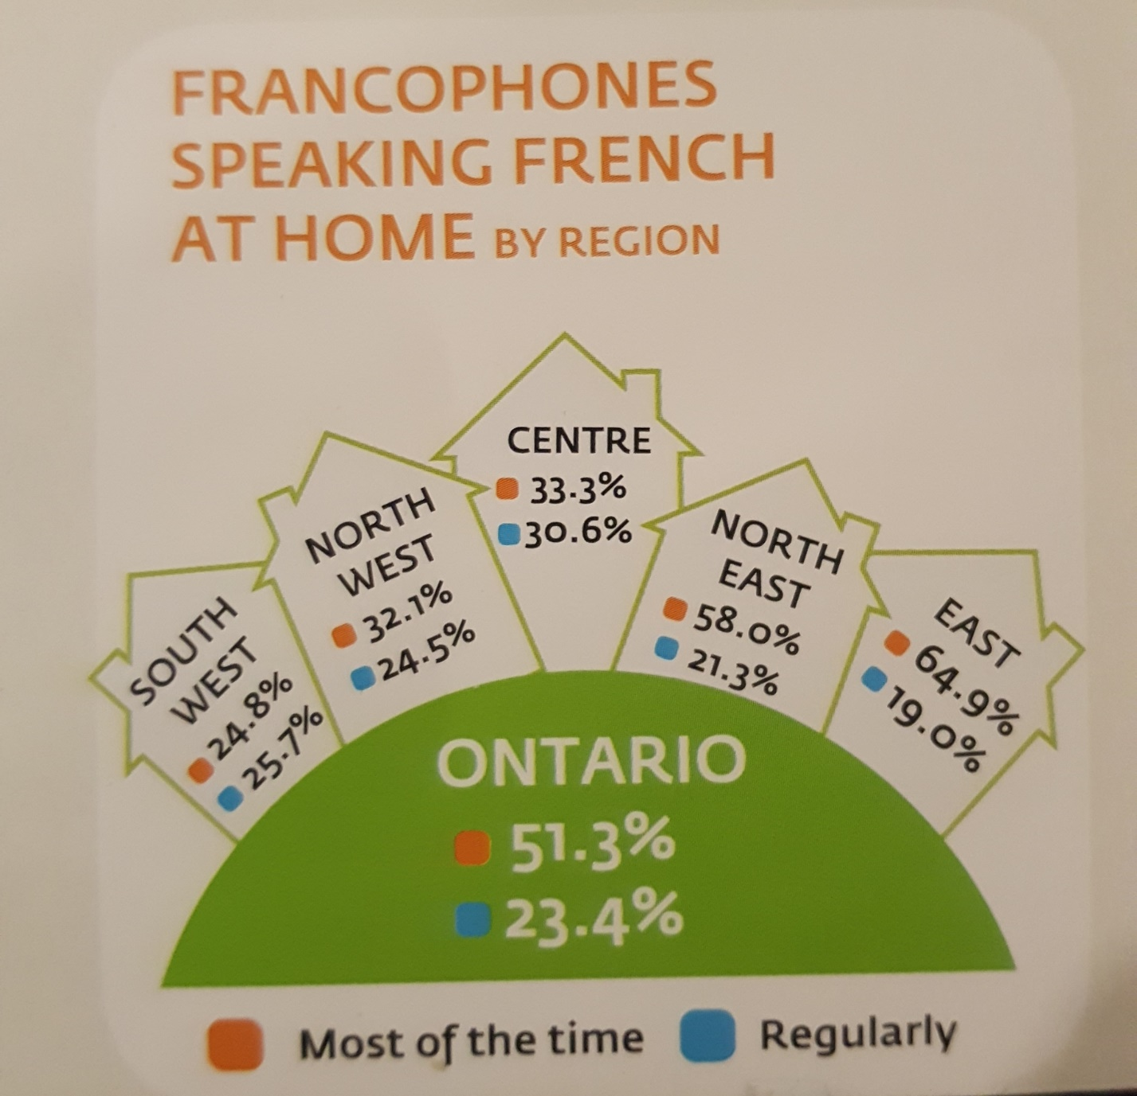
  Source: Office of the French Language Services, Commissioner of ON, 2018.

Slide 9
How are libraries faring when it comes to the needs of francophone communities in the gtA?

Slide 10
A work in progress
(at best)
Hard to get hard data or (oh mon Dieu!) budget information
Providing services in French should be made a priority in libraries (not just an after-thought)
Libraries should contribute more to the valorisation of the French language
  More visibility
  Better accessibility (e.g., websites, signs, services, French-speaking librarians)
Supporting all French speakers through partnerships with community organizations
Libraries as spaces for experimentation (e.g., content production in French; original programming, etc.)
Educating a new generation of francophone librarians
  Recruitment
  Retention
  Hiring, professional development
Information professionals need to assume the fact that Canada is a bilingual country

Slide 11
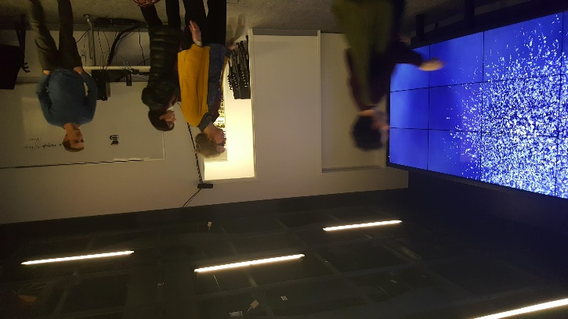
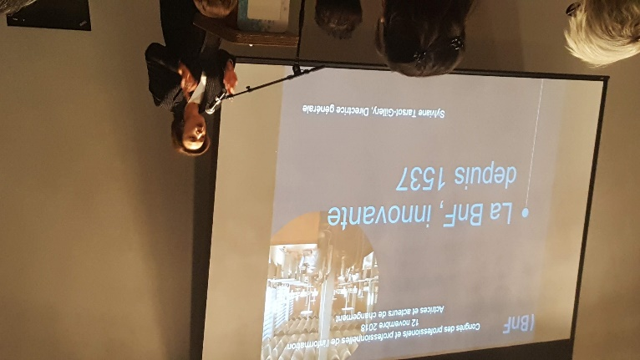
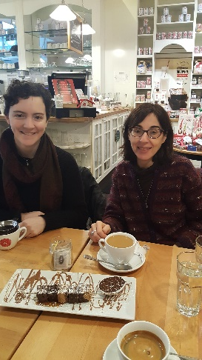
INF2300: Les bibliotheques et leurs publics en milieu francophone
First course taught exclusively in French at the iSchool
  Readings; In-class discussions
  Interventions by guest speakers (en francais)
Study trip to Montreal
  Attended the Congress for Francophone Information Professionals
  Visited various types of libraries while there
Awareness of the needs for French language services
  Brown bag lunch at the iSchool, (Dec. 4, 2018)
  Scholars’ Portal Day (Dec 7, 2018)
  Follow up Reading Course in Winter 2019
  Plans for co-authoring and publishing an article on the experience and the lessons learnt
  Various knowledge dissemination mechanisms

Slide 12
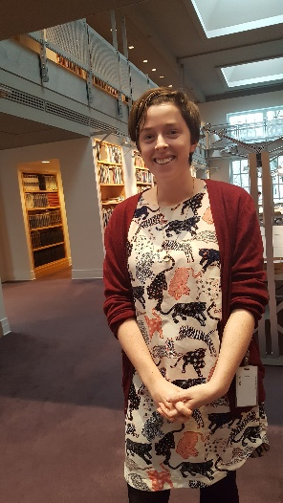
To be continued…
Keep ourselves informed about recent developments:
  The fate of the Universite de l’Ontario Francais
  The fate of the Commissariat aux services en langue francaise de l’Ontario
  Learning more about the francophone communities in ON (through data collection; original research, etc.)
  Ever evolving needs of francophones in ON (healthcare, educational and entertainment needs)
  Relationships between government and francophone citizens (esp. in the digital era)
  French language content creation: trends and challenges
  What are our responsibilities as a university in one of the world’s most diverse cities? As an iSchool? As a profession?

Slide 13
Diversity and Leadership in Libraries
Maha Kumaran

Slide 14
Diversity and Leadership Interests
Maha Kumaran
Maha.kumaran@usask.ca
Associate Librarian
University of Saskatchewan
Samson Wakibi
was016@mail.usask.ca
Masters in Nursing
University of Saskatchewan
Dr. Keith Walker
Professor, Educational Administration
College of Education
University of Saskatchewan

Slide 15
Participants who aim or do not aim for leadership roles

Slide 16
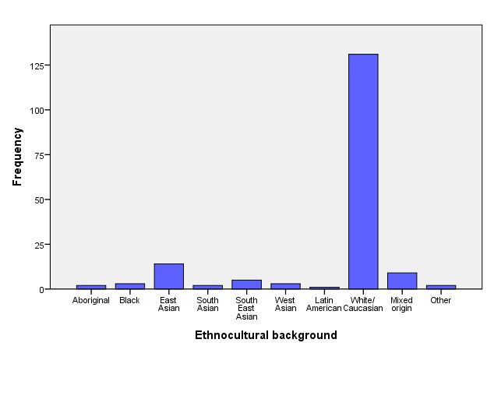
Ethnocultural backgrounds
76%
8%
5%
1%
2%
1%
3%
2%
1%
1%

Slide 17
Ethnocultural backgrounds in two categories

Slide 18
Statistical analysis
To investigate whether the Caucasians and non-Caucasians differ on whether they aim or do not aim for leadership role in future, a chi-square statistic was conducted. All assumptions were checked and met. The chi-square results indicate that the Caucasians and non-Caucasians are not significantly different on whether or not they aim for leadership in the future (χ2= 2.03, df= 1, N=167, p= .154). Therefore, Caucasians are not more likely than the non-Caucasians to aim more or less for leadership roles.

Slide 19
Gender distribution of participants who aim for leadership

Slide 20
Age distribution of participants who aim for leadership

Slide 21
Sexual orientation of participants who aim for leadership

Slide 22
Self-identified visible minority participants who aim for leadership

Slide 23
Residency status of participants who aim for leadership

Slide 24
Education status of participants who aim for leadership

Slide 25
Participants who aim for leadership against whether they are still at their first, second or third jobs

Slide 26
Participants who aim for leadership against supervisory roles

Slide 27
Categories of employees supervised by the Non-Caucasian participants
Students (7)
Staff (5)
Librarians (4)
Library technicians (3)
Managers and supervisors (1)

Slide 28
Categories of employees supervised by the Caucasian participants
Support staff (IT, steel workers, professional, managerial) (18)
Students (17)
Librarians, librarian practicums, library assistants, library clerks (14)
Library technicians (3)
Archivist, Assistant archivist (2)
All employees (2)
Contractual employees (1)
Office assistants (1)

Slide 29
Participants who aim for leadership in future against and leadership role outside library

Slide 30
Participants who aim for leadership in future against whether they are encouraged or not to learn about leadership roles and possibilities in the library

Slide 31
Desired leadership roles (Non-Caucasian) and reasons for being in them
Just a bit different from current one: I love working with people and helping them.
Director: have skills needed, to represent diversity in leadership
My current one is good: I love it, and can help people
Department head: will increase my employability; was acting head for a year and enjoyed the experience; I have abilities for change and planning
Manager or Supervisor: to support doing research as librarians; to emulate my past great managers
Vice president research: to develop and interpret policy and procedures related to research

Slide 32
Desired leadership roles (Non-Caucasian) and reasons for being in them
Better than current: for more information and independence; to lead strategic planning initiatives in library
Manager or coordinator: to advance library services through digital technologies; to influence change, coach, and develop staff
University librarian: to set strategic direction; to contribute to profession
Supportive role: to support my colleague librarians and young librarians
Senior management role: to bring diversity in librarianship
Lead of team project: to provide leadership in specific direction

Slide 33
Desired leadership roles (Caucasian) and reasons for being in them
Better role: to be in a position to work on big picture policies, programs, principles, etc. of the whole university library system; to build relationships in without limitation of confines/barriers of the library; make a difference, be promoted and to expand my duties; one that helps drive the course/set the values of library; but not administrative .
Senior leadership position: I have experience, ideas, and like managing people and projects; have learned a lot and would like to share it
Working on special projects: greater diversity of tasks and ability to close off projects
Current role: its ideal and congruent with my education; I use my skills, aptitudes and background; I enjoy what I do; I have opportunities to set or influence directions; I am good at what I do; I am used to and experienced in it; I am frustrated by my lack of awareness of our library mission and goals; great colleagues and strong faculty community; I have autonomy .
University librarian in large library: to experience new challenges; stronger operational supports than in a smaller organization

Slide 34
Desired leadership roles (Caucasian) and reasons for being in them
Unit (Librarian) head/middle manager: I really enjoy administrative work and working with teams; it’s the only way to effect real change; to implement knowledge acquired; make money, teach, and opportunities to change library; It is what I was trained to do; it is a natural forward progression; to support my colleagues; working with people and helping to coordinate projects; A middle-management position would allow me to use my leadership skills while maintaining a focus on my children.
University librarian: to make a difference in the future; only option for upward progression; play more of a role in how we choose technologies and build tech-enabled spaces; its my goal and money is a big factor; to challenge myself, I also like administrative roles; I am very much a big picture person; I feel that I can make the change that I want to see in the library.
Specialized role: I enjoy specialization

Slide 35
Desired leadership roles (Caucasian) and reasons for being in them
Dean/Director/Executive director: I like strategic planning and the 'bigger picture' focus; to make positive impacts to research and teaching; to influence the path of the institution, was acting head of department recently and enjoyed it; forward progression; I work well with people and want to help them succeed.
Manager/management: work with people, and opportunities for growth and development; to challenge myself and be more involved in decision making; to have additional responsibilities.
Department head: To affect future planning and decision making; Promote digital librarianship to the greater academic community; I care about how things are done; to challenge my self
Administrator: We have a significant deficit of leadership in research, education, and institutional analysis.

Slide 36
Understanding of leadership in librarianship (Non-Caucasian)
Transforming the current state of librarianship (4)
Matching right people and skills to right projects
Focuses on serving community and the organization
Cares about library resources
Thinks ahead to for professional growth (2)
Passionate about profession and practice
Inspiring (4)
Has vision (3)

Slide 37
Understanding of leadership in librarianship (Non-Caucasian)
Expert in the library field
Working hard
Shaping an ambitious future
Approachable, open-minded, decisive when needed
Compassionate
Aware of invisible systems in librarianship
Promoting best of self and others
Knowledgeable and flexible
Coping with uncertainty and helping others cope with uncertainty.

Slide 38
Understanding of leadership in librarianship (Caucasian)
Making clear and precise judgement among different issues
Have the good qualities of a leader (4)
Understand core values of librarianship
Inspiring (2)
Having vision for librarianship (9)
Willingness to engage staff in library activities
Strives for future of libraries; change and improvement (5)
Having knowledge and information about profession (3)
Enabling community access best information; serving excellently (5)
Caring

Slide 39
Understanding of leadership in librarianship (Caucasian)
Represent his/her library on campus
Creativity and innovativeness (2)
Challenging barriers in libraries (2)
Setting a good example
Encouraging professional development
Committed to employees and every one
Encourages others to contribute to goal/mission of library (2)
Influence and guide
Comfortable with issues on all levels; locally, nationally, internationally (2)
Trust in staff and can delegate work appropriately

Slide 40
Putting Marrakesh into Practice
Victoria Owen

Slide 41

Welcoming everyone into the Academic library
Putting Marrakesh Into Practice
Victoria Owen
Information Policy Scholar-Practitioner
Faculty of Information - University of Toronto
OCUL Scholars Portal Day
December 7, 2018

Slide 42
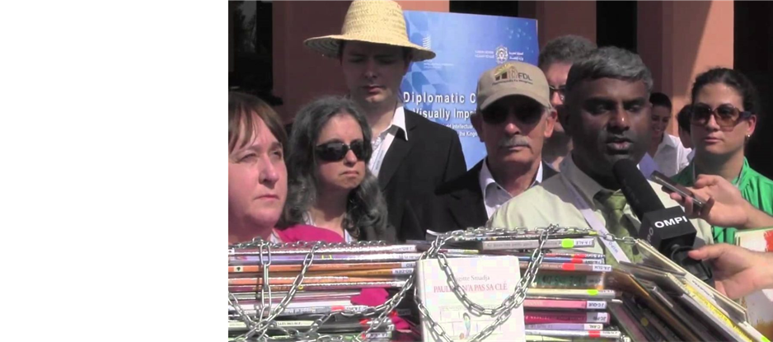
Marrakesh Treaty 2013 to Facilitate Access to Published Works for Persons Who Are Blind, Visually Impaired or Otherwise Print Disabled
First users’ rights IP treaty
Process of negotiating an international treaty involved, WIPO member states, diplomats, legislators, NGOs, driven by The World Blind Union, IFLA, EIFL, LCA,…
After the MT, legislators, beneficiaries, and librarians need to ensure wide adoption of the MT to live up to its promise of access to works across borders WBU Legislation enables the implementation of the MT provisions
47 countries ratified or acceded to the MT as of December 5, 2018¹

Slide 43

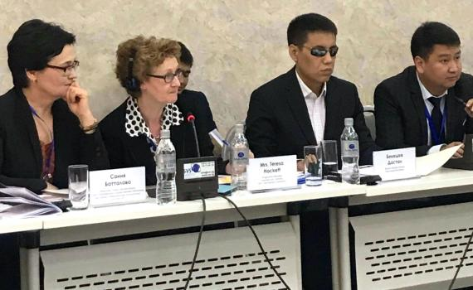
Putting Marrakesh into practice : libraries are essential
For libraries and librarians:
What happens now?
  How does the treaty get implemented on the ground level?
  What are the first steps?
  As librarians, how do our users benefit from the treaty?
Test Case – April 2018 in Kyrgyzstan
The first international transfer of accessible books in Kyrgyzstan under the Marrakesh Treaty took place during the seminar.
Books were from the UofT library system
SP’s ACE service
Timeline – 2 weeks – and high level intervention

Slide 44
The process and timeline
The Role for Libraries
Two MT countries
Locate the texts
Digitize
Upload / process – depending on where the accessible format copies are made
In the Kyrgyzstan example - DAISY and Braille formats
SP Leadership
Already have a successful international exchange
Confirm standard procedures
Actively seek partners and agree on protocols

Slide 45






Getting started
Getting Started for Canadians – a hands-on, practical guide for library staff
Sets out the basics of MT in plain language
  How library staff go about providing access
  Sharing mechanisms
  Record keeping
  Accessible book services that exist
  Digital locks

Slide 46
Authentic Indigenous Voices in Academic Libraries
Jamie Lee Morin

Slide 47
Welcoming the whole academic community into the library
#spday2018

