Slide 1

Lightning Talks
#spday2018

Slide 2
Lightning Talks
Starting the conversation: an initiative to highlight a wealth of resources by Indigenous authors
Kim Vallee, Lakehead University
Picking a needle out of the haystack: where to start when you have 20,000 videos to caption
Nancy Waite, McMaster University
RDM in court: creating a repository for the Robinson Treaties Annuities Case
Tomasz Mrozewski, Laurentian University

Slide 3
Picking a needle out of the haystack
Where to start with captioning compliance
Notes:
Good Afternoon! My name is Nancy Waite, I am the TD Coordinator for Library Accessibility Services at McMaster University. I am not here to talk to you about Picking a needle out of the haystack or where to get started with captioning compliance.

Slide 4
Our first step – Getting our Ducks in a Row
Making our legacy video collection captioned or captionable by January 1, 2020.
Ensure catalogue record is up to date
  Captioned videos are not always identified in the catalogue record
  A note on the case does not guarantee a note in the catalogue record
Notes:
A few years ago, we started working on our captioning strategy. Our goal was to make our legacy video collection captioned or captionable by 2020. The first place we started was by getting our ducks in a row and identifying which videos in our collection were captioned and which were not. A couple things that we found out; first, captioned videos are not always identified in the catalogue record or on the DVD case, and second a note on the DVD case does not guarantee a note in the catalogue record.

Slide 5
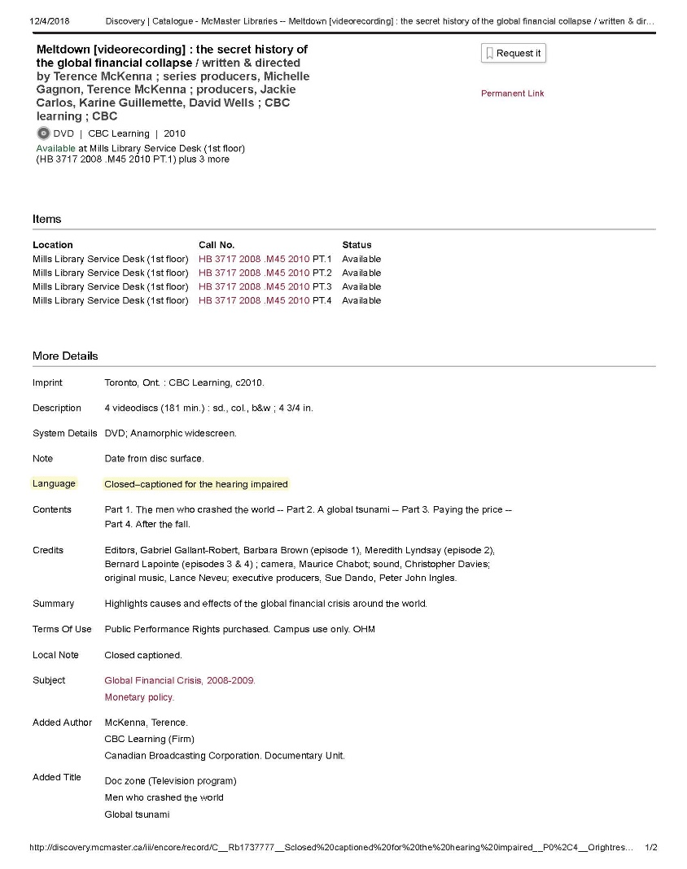
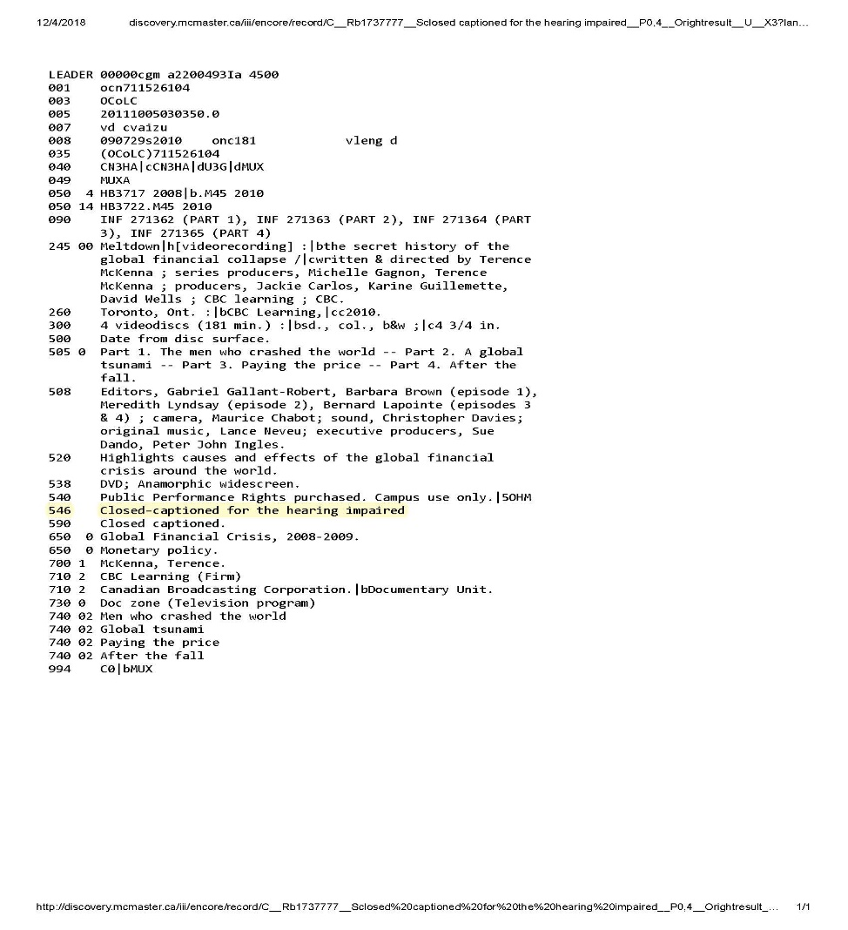
A Picture is Worth a Thousand Words
Notes:
I am not sure how easy it is to see this, on the left is a screen shot of a patron view of a video record and on the right is the Marc record. In our collection clean up we ensured that all of our video files that are captioned contain Closed-captioned for the Hearing Impaired in the 546 field. Previously we found the captioned note would appear in a variety of places. We wanted to ensure standardized language and placement in the catalogue going forward.
Part of the reason for completing this work, specifically relating to standardized language, is that we hope to use “Closed-captioned for the hearing impaired” as a search filter for our catalogue so instructors can run a subject search for all of the captioned films.

Slide 6
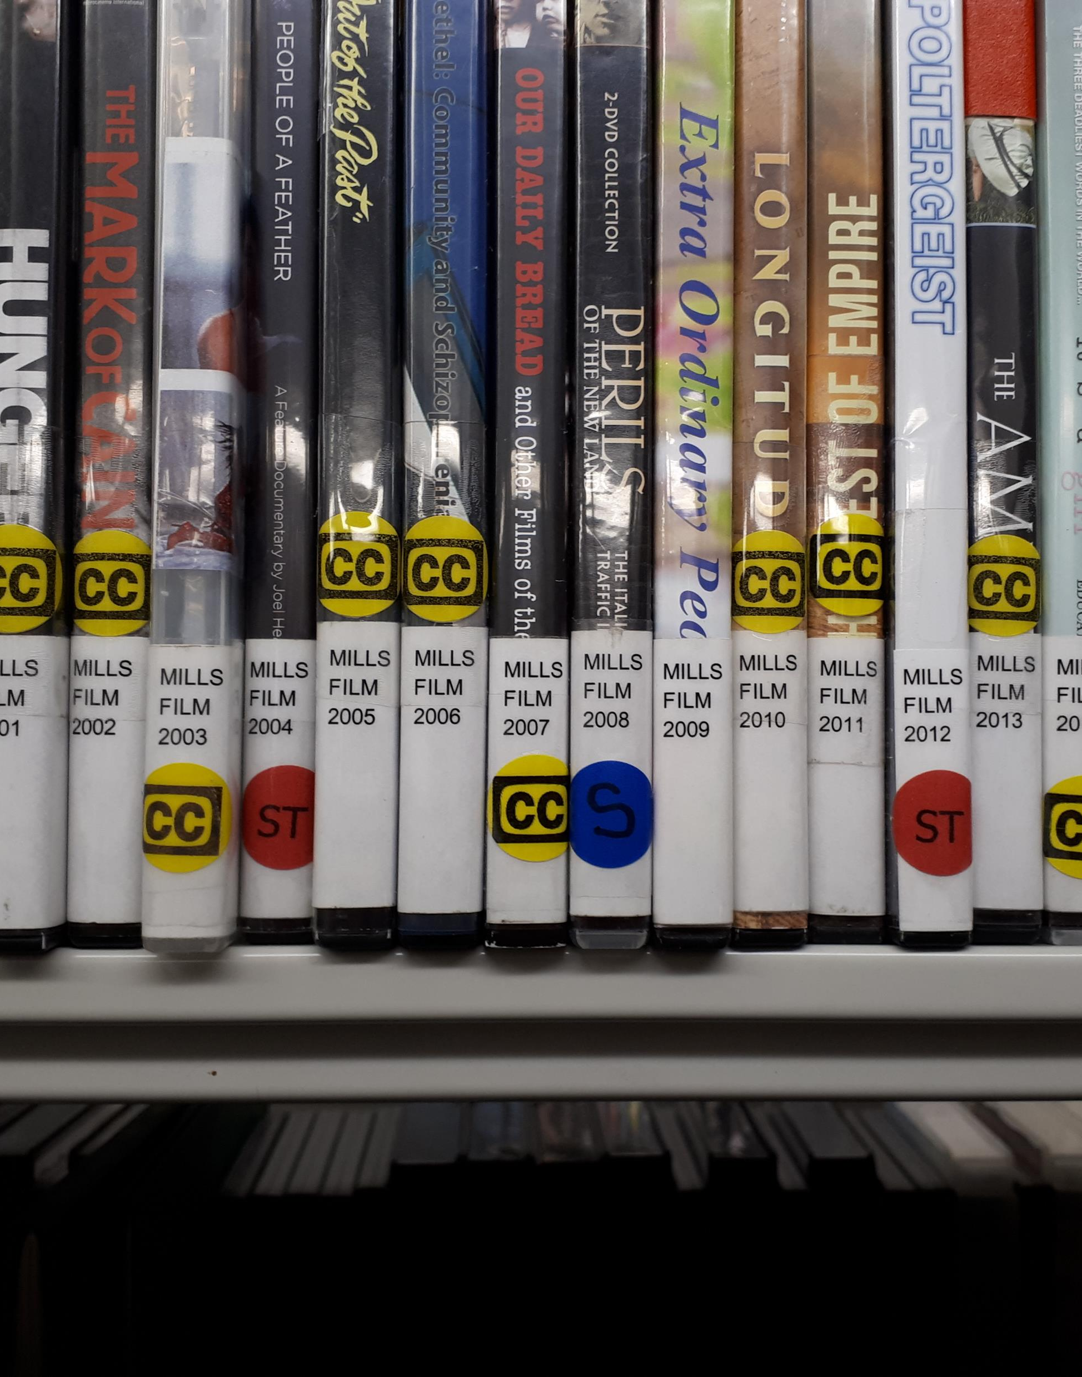
Seeing clearly
Once we had figured out which titles had captions, subtitles or were silent films we ensured all of the cases were clearly labelled for quick identification
Notes:
Once we figured out which titles had captions, subtitles or were silent we clearly labelled each case for easy identification. In this photo we have a number of DVD cases with three different coloured stickers. The yellow stickers are applied to DVDs with closed captions, the blue stickers are applied to DVDs that are silent and the red stickers are applied to the DVDs that have subtitles. Cases without a label would have Film Lacks Captions in the 590 filed and permission to caption, or at least an attempt at securing permission to caption.

Slide 7
Working Hand in Hand
Worked with the library’s Video Booking Department
  Videos booked for a class were proactively captioned
Offered Instructors an online caption request tool
  For their own material screened in class
Notes:
During the fall of 2016 we started working with the library’s Video Booking Department to identify which videos were being booked for classroom viewing and caption them proactively.
Going back to our labels for a minute; these labels allow the staff working in video booking to glance at a DVD and know if the title needs to be sent to LAS for captions, or if it can be booked right away.
At the same time that we started our proactive captioning project we also offered instructors an online captioning tool to request captions for videos that were screened in class that were not available through the library.

Slide 8
One Step at a Time
Contact the producer – to secure permission
Upload to rev.com
Receive files back
Burn in open captions with DVDFab
Share files to instructors
Notes:
Just a side note on our process, in order to caption a video we contact the producer to secure permission to caption, which we must do under current copyright law. After that permission has been secured we send our videos out to rev.com. Once we have the captions back they are burned in using DVDFab, as open captions to make things easier for the instructors.
Then we share the video with the instructor.

Slide 9
The Results
Films captioned as part of Video Booking have decreased greatly
  37 titles the first year, 56 last year and only 2 this year
Film captioning requests from instructors have steadily increased
  8 requests the first year, 72 last year and 133 since September
Notes:
The first two years were busy, however, this term we have only captioned two films thus far. This was expected as we have captioned the videos that are routinely used for courses.
Requests from instructors for non-library material has jumped from 8 requests the first year to 133 requests from the beginning of September as instructors become aware of our service and the responsibility to caption.

Slide 10
Challenges Ahead
Lecture captures
Described Video
Notes:
We have already started working in a small scale on lecture captures and described video, but it will be interesting to see what the future has in store. Its exciting to see all of the ways the playing field is staring to be levelled, but there is so much more work to be done.
Thank you for your time!

Slide 11
Questions??
Nancy Waite
TD Coordinator for Library Accessibility Services
McMaster University
waitenm@mcmaster.ca
905-525-9140 x26058
Notes:
Please feel free to contact me with any questions you may have!

Slide 12

Starting the conversation
An initiative to highlight a wealth of resources by Indigenous authors
Kim Vallee
Scholars Portal Day 2018

Slide 13
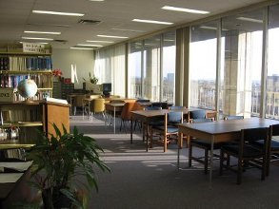
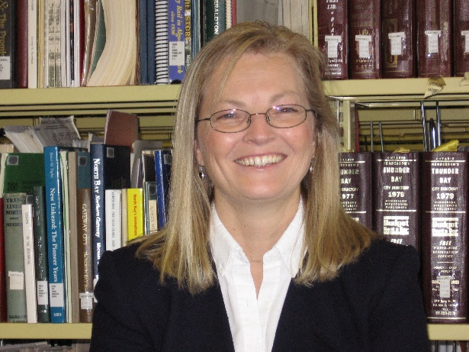
Northern Studies Resource Centre
Trudy Russo

Slide 14
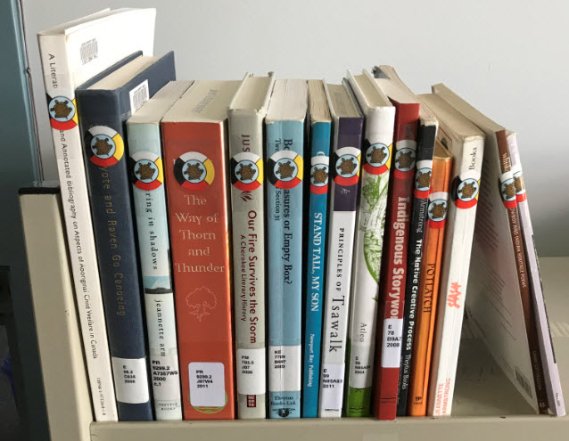

Slide 15
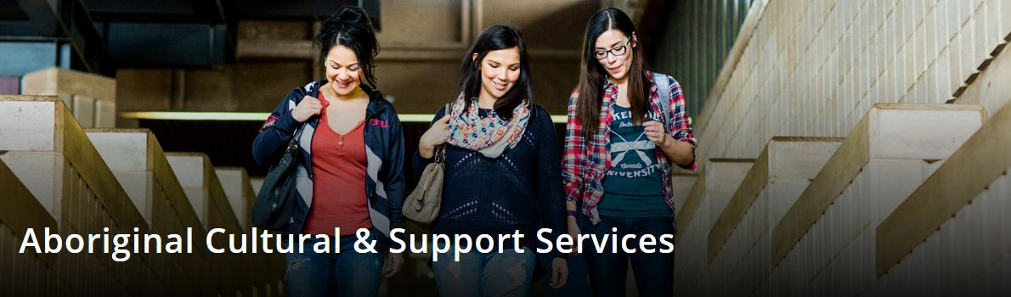
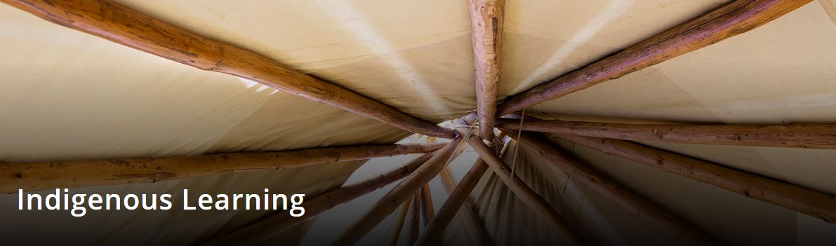

Slide 16
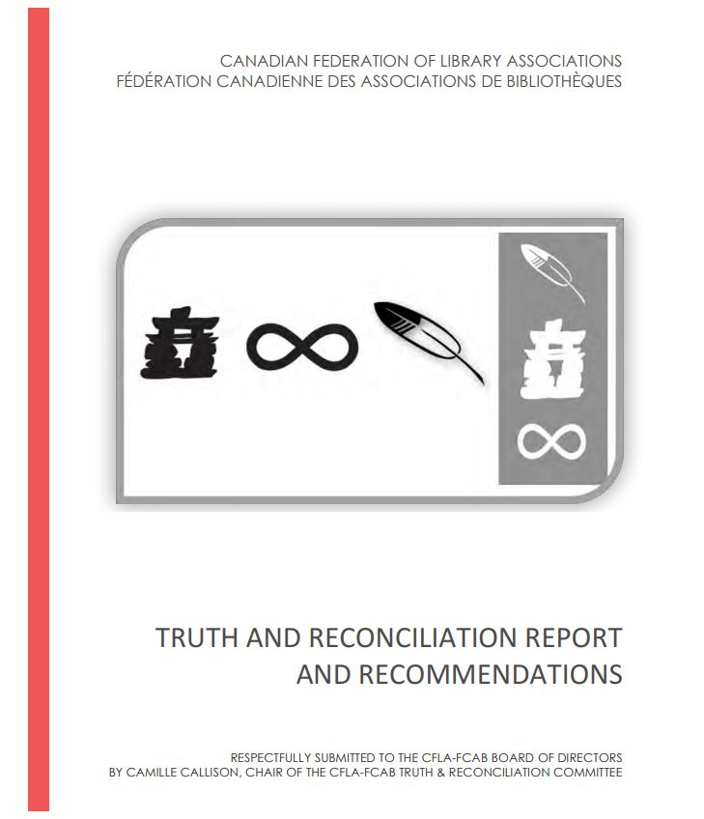

Slide 17
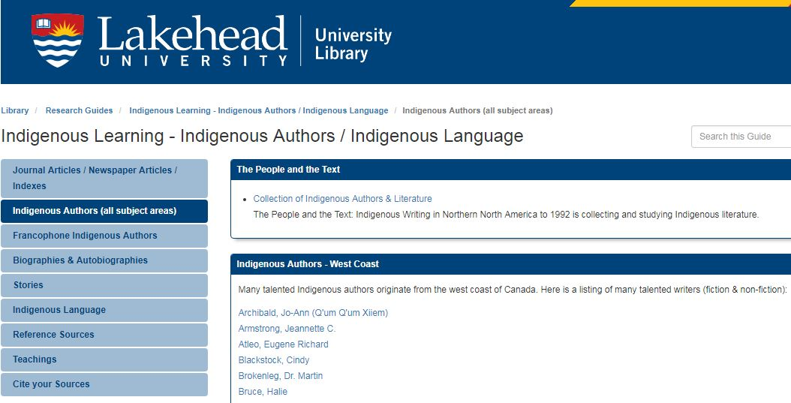
Notes:
https://libguides.lakeheadu.ca/IndigenousAuthors/Language

Slide 18
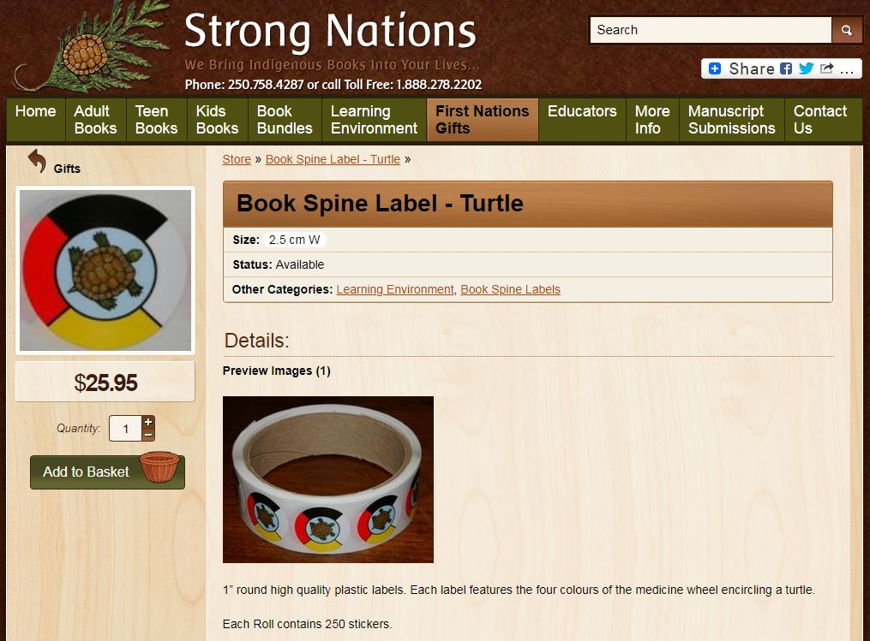
Notes:
www.strongnations.com

Slide 19


Slide 20
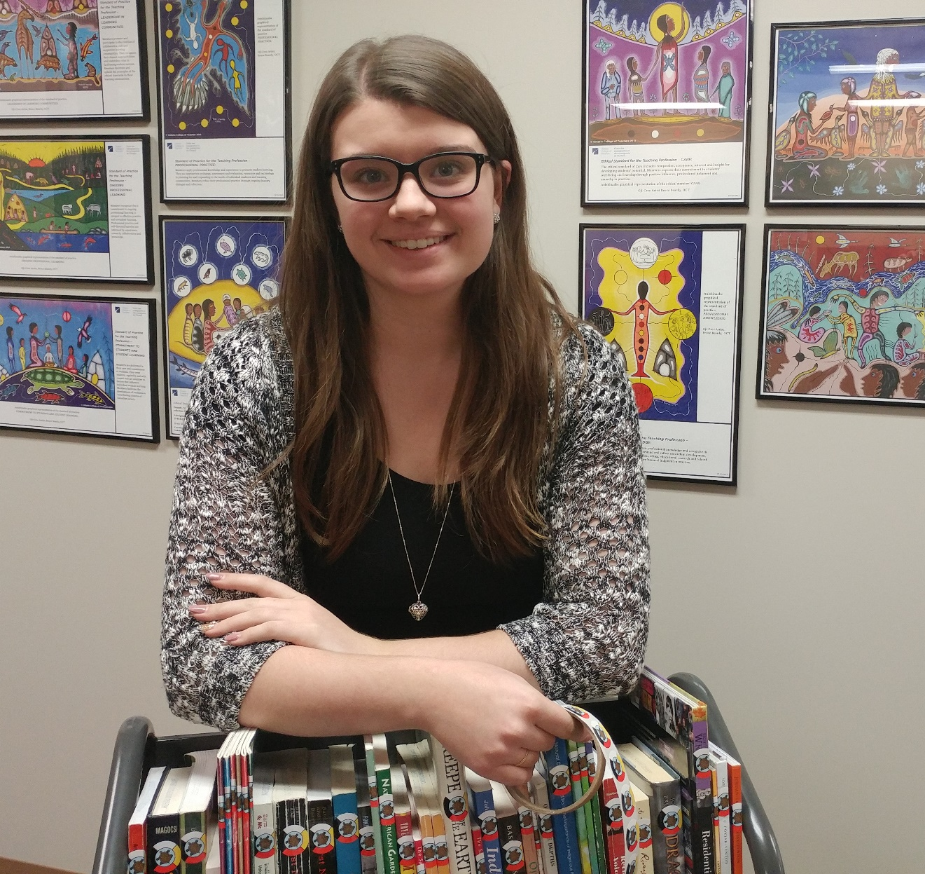

Slide 21
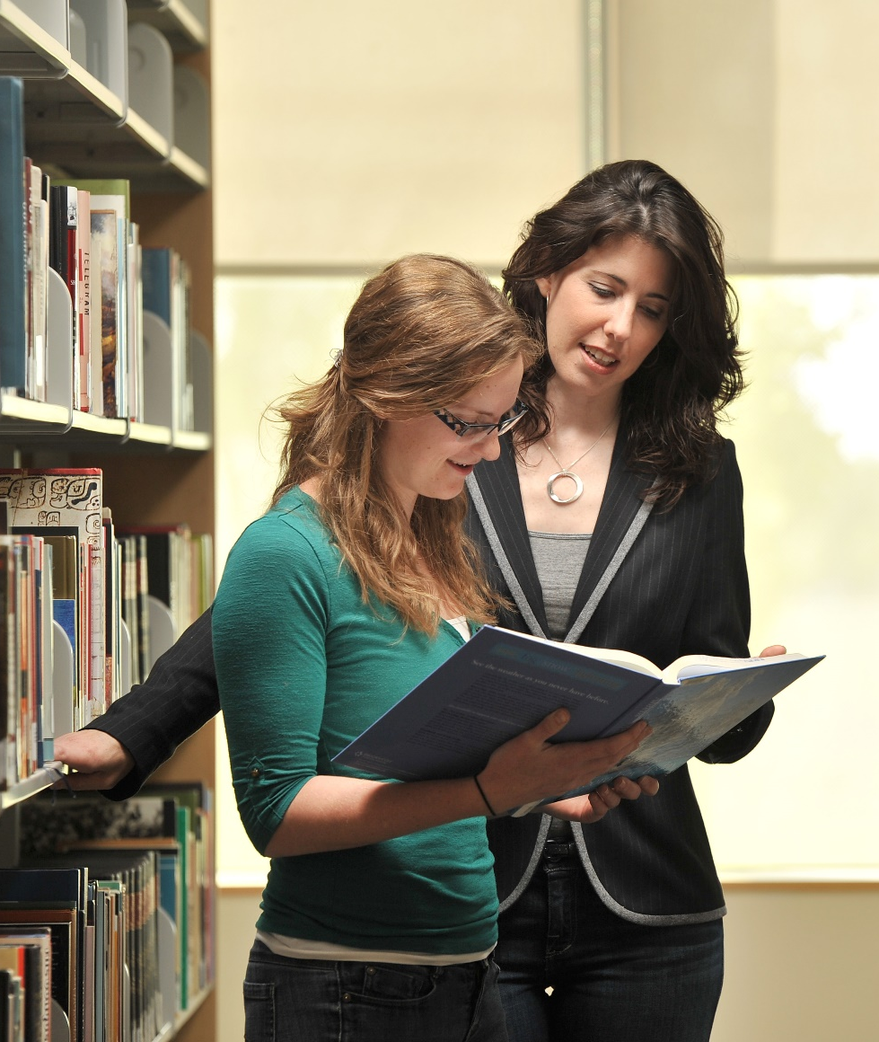
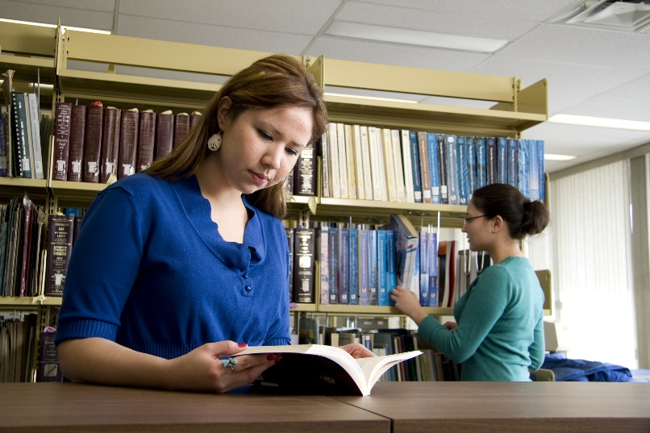


Slide 22
Thank you
kim.vallee@lakeheadu.ca

Slide 23
RDM in Court:
Creating a repository for the
Robinson Treaties Annuities Case
Tomasz Mrozewski
Laurentian University

Slide 24
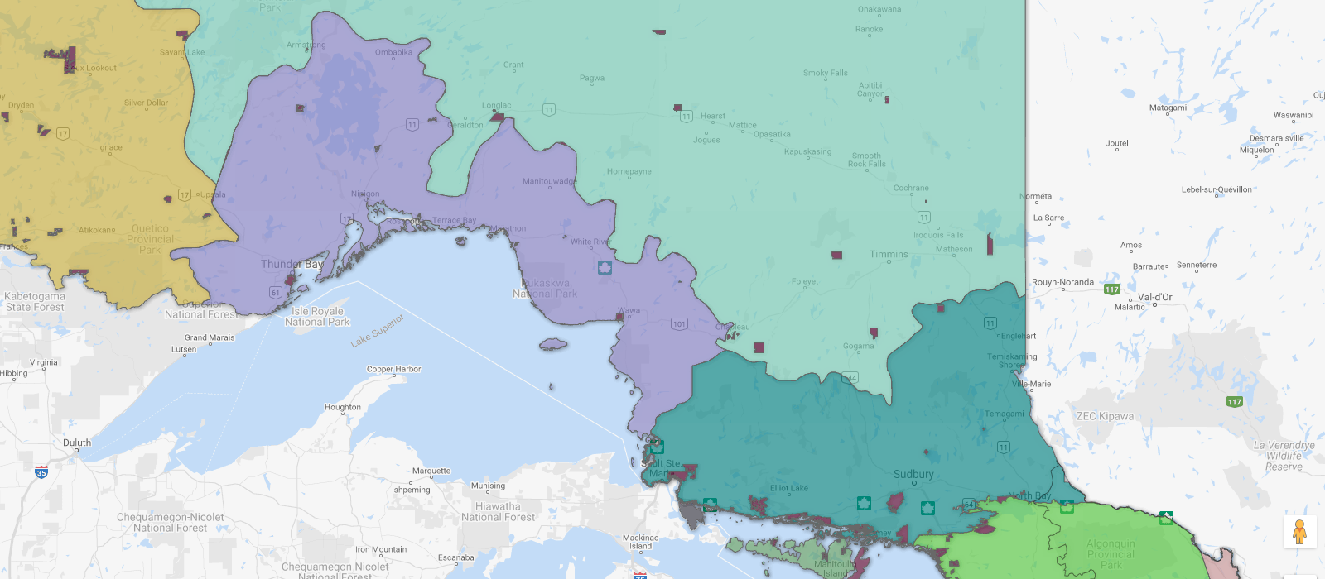
Robinson Huron and Robinson Superior Treaties
Robinson Huron Treaty
(September 9, 1850)
Robinson Superior Treaty
(September 7, 1850)
Source: Ontario Ministry of Indigenous Affairs, Map of Ontario Treaties and Reserves

Slide 25
The claim
"[I]n this case the plaintiffs seek a declaration that since 1850 the Crown has and remains legally obligated, under the Robinson Huron Treaties of 1850, to increase the annuities from time-to-time if the territory produces an amount which would enable it to do so without incurring loss, and the size of the annuity is not limited to an amount based on 1 pound per person, or otherwise expressed 4 dollars per person.“
The Honourable Justice Patricia C. Hennessy, September 25, 2017

Slide 26
The project
To create a open, digital repository of testimony, exhibits, statements and other materials submitted to and created by the Court in the case.
26 expert witness reports, reply reports, and affidavits
11,884 pages of transcripts (Phase I only)
224.8 GB of video (Phase I only)
Opening and closing statements; chronologies; exhibit lists; etc.
Indices of approx. 2,500 primary and secondary historical documents referenced (plus digital images?)

Slide 27
Technical solution
Collection subject to a Court order (currently being drafted); follows the Court’s Decision on Broadcasting (2018 ONSC 114, http://canlii.ca/t/hpx5c)
Use Scholars Portal Dataverse and (probably) OLRC to host the document collection
Create documentation and pathfinders to help navigate collection and contextualize items in civil proceedings
Working with two advisory groups: one legal (reps from all parties), one Indigenous

Slide 28
Being an “accomplice”
Working closely with Office of the Associate Vice President, Academic & Indigenous Programs (AVPAI)
Working with Laurentian University Native Education Council (LUNEC) to form an advisory group of Indigenous faculty and community members from Treaty territories and across Ontario
Ensuring that the work is done “in a good way”

Slide 29
Lightning Talks Questions?
Starting the conversation: an initiative to highlight a wealth of resources by Indigenous authors
Kim Vallee, Lakehead University
Picking a needle out of the haystack: where to start when you have 20,000 videos to caption
Nancy Waite, McMaster University
RDM in court: creating a repository for the Robinson Treaties Annuities Case
Tomasz Mrozewski, Laurentian University

