Slide 1

Lightning Talks
#spday2018

Slide 2
Lightning Talks
Summer Web Content Accessibility Guidelines 2.0 reading camp
Mark Weiler, Wilfrid Laurier University
Inclusive leadership: ARL’s Year Long Career Development Program (LCDP)
Sonny Banerjee, Ryerson University & Jack Leong, University of Toronto
Assessing the accessible content provider landscape in North America: a brief on what we have learned
Meredith Hatton, York University

Slide 3

WCAG 2.0 Summer Reading Group
Scholars Portal Day, 2018
Mark Weiler
Web & User Experience Librarian
Wilfrid Laurier University
mweiler@wlu.ca
www.stripes.com

Slide 4
WCAG 2.0 summer reading group
www.stripes.com

Slide 5

Summer reading group

Slide 6

My profile
Web & User Experience Librarian
Certified Web Accessibility Specialist

Slide 7
An important thing to know…
WCAG 2.0 is not a technical document
It is a conceptual document
  focuses on abstract properties of technologies
It is not just for the IT department

Slide 8
Goal of reading group
Build
CONFIDENCE
in talking about
WCAG 2.0

Slide 9
About the reading group
OCUL provided support: help from an intern
Meet 3 times, every two weeks, from July to August
Each session was 1 hour

Slide 10
About the reading group
Assigned readings in advance
Guided discussions during the session

Slide 11
Participants?
9 participants from 6 OCUL universities

Slide 12
What did we read?
We read official WCAG 2.0 documents
Very selective in what we read

Slide 13
Making it easier to read
Redacted sections to reduce complexity

Slide 14
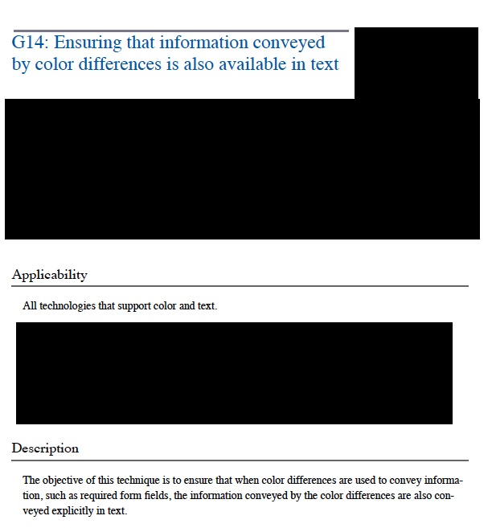
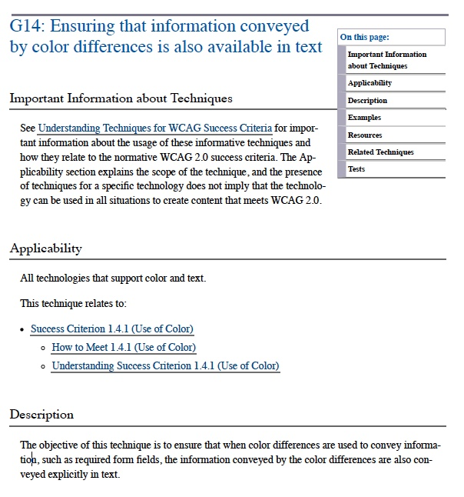

Slide 15
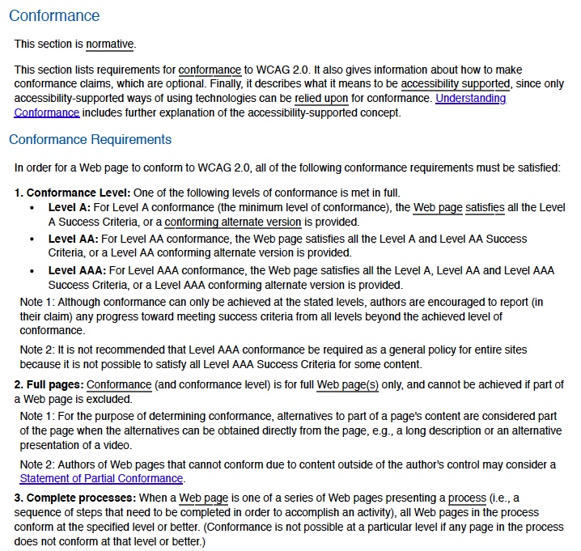
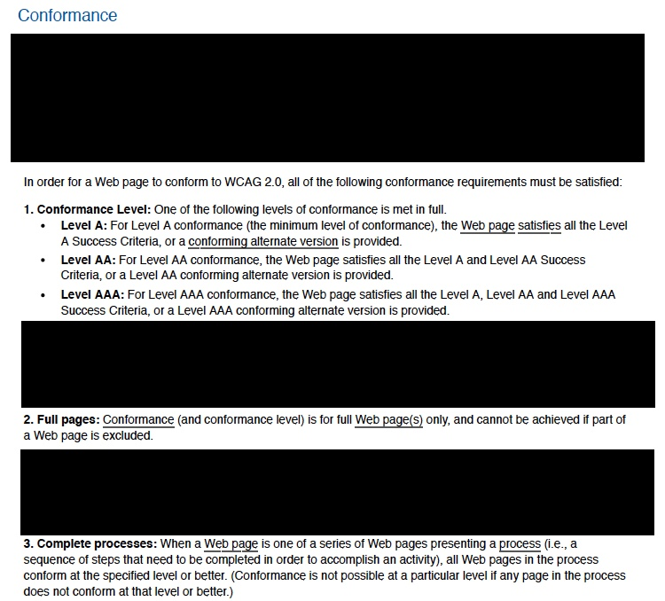

Slide 17
The discussion sessions

Slide 18
First session, we covered…
Purpose of WCAG
Concepts:
  “Normative”
  “Informative”
  “WCAG’s Principles of usability”
  “Guidelines”
3.5 pages of reading

Slide 19
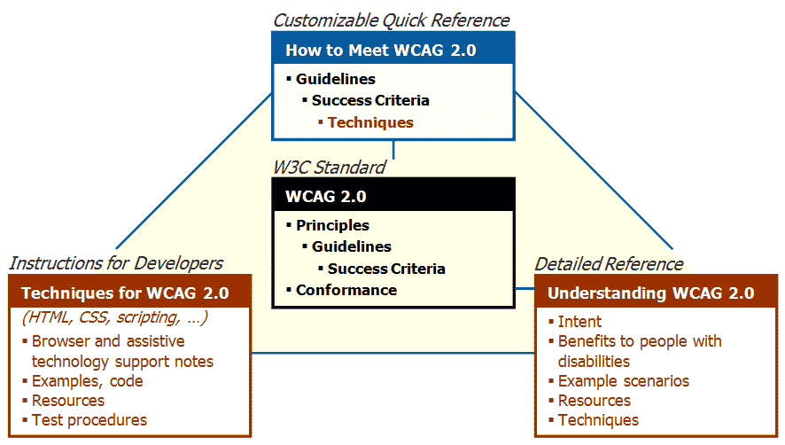
First session, we covered…
Reviewed relationship between the 4 official WCAG documents
4
1
3
2

Slide 20
Second session, we covered…
5-part definition of conformance
Concepts
  “Assistive technology”
  “Accessibility supported”
  “Non-interference”
  “Success criteria”
Detail study of examples of “Success criteria”

Slide 21
Third session, we covered…
Focus: WCAG’s conceptualization of technological implications
Not specific technologies: HTML, CSS, JavaScript, etc.
Concepts:
  “Sufficient techniques”
  “Common problems”
Implications:
  “Non-normativity” for evaluation
  Interpreting outcomes of testing procedures (automatic/manual)

Slide 22
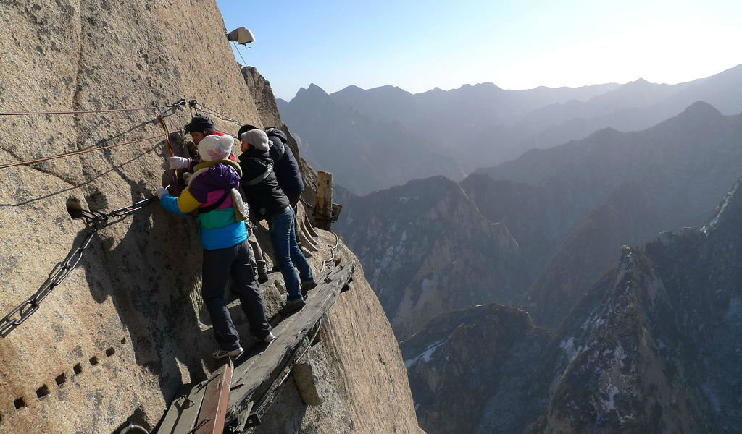
Third session, we covered…
Threshold concepts
  E.g., “Accessibility supported”
Thebeautyoftravel.com

Slide 23
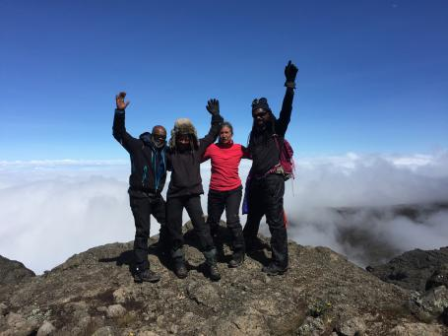
Done!
www.voice-online.co.uk

Slide 24
Positives: Confidence levels increase?
“Yes, most definitely, but still have a ways to go…”
“I went in knowing nothing of WCAG and its documents. I feel like I could carry on a conversation.”

Slide 25
Areas for improvements
Delivery format and materials had some barriers
Compress from 6 to 2 weeks
Have sessions to discuss specialized WCAG topics

Slide 26
Why is this important?
Academic libraries have a mission to pursue infrastructures that support people with all sorts of disabilities and abilities to access and create the academic record as fully as possible.

Slide 27
Why is this important?
Knowledge of WCAG helps in:
  Planning projects
  Making purchasing decisions
  Delivering services

Slide 28
Why is this important?
Collaborating with others
  Provincially
  Nationally
  Internationally

Slide 29
Next steps?

Slide 30
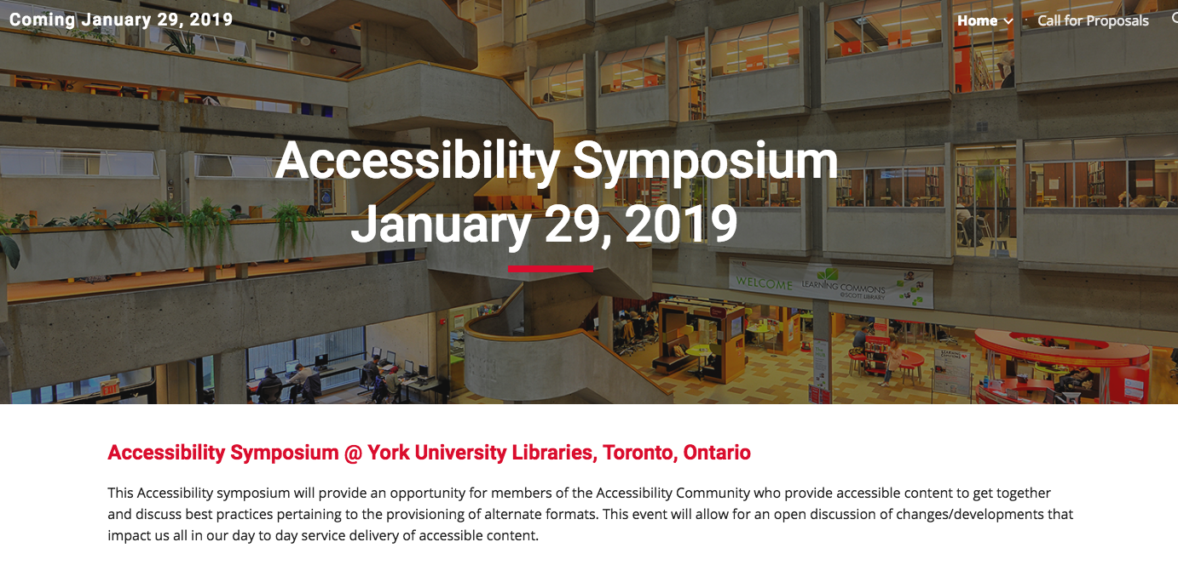

Slide 31
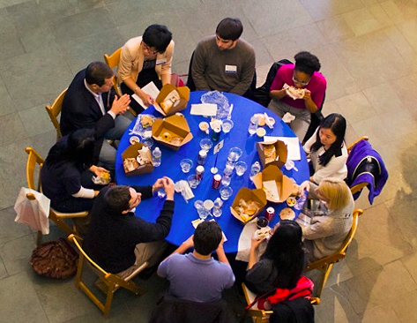
WCAG: Building on successes
lunch discussion
Contact me to reserve a spot
duke.edu

Slide 32


Inclusive Leadership: ARL’s Year Long Career Development Program (LCDP)
Jack Leong, University of Toronto & Sonny Banerjee, Ryerson University

Slide 33
Leadership & Career Development Program
The ARL Leadership & Career Development Program (LCDP) is a yearlong program to prepare mid-career librarians from historically underrepresented racial and ethnic groups to take on leadership roles in their careers and in the profession at large.
The program addresses the need for research libraries and archives to develop a more diverse professional workforce that can contribute to library success in serving the research, teaching, and learning of increasingly diverse scholarly and learning communities.

Slide 34
Design of the LCDP Includes:
A two-day orientation & two multi-day institutes
Career-coaching relationship with an ARL library director or senior staff member
Training on identifying, developing, and conducting a research project during the fellowship
Online discussions and webinars related to the ARL Strategic Framework
A closing event to commemorate the completion of the program

Slide 35
Eligibility for the LCDP:
Identify as being from an underrepresented racial or ethnic group, based on the categories outlined by the US Census Bureau or Statistics Canada as well as First Nations, Métis, and Inuit people classifications
Be a citizen or permanent resident of the United States or Canada
Be employed as a library, archive, or information professional in any setting
Demonstrate a strong interest in pursuing leadership roles within the library or archives profession

Slide 36
Application Requirements:
Complete the LCDP Application Form online
A current résumé or CV
A 500-word essay describing your interest in the program
A letter from your immediate supervisor describing your leadership aspirations and potential
A letter from your library director confirming your readiness for the program, and confirming that the library will support your participation in a rigorous, one-year fellowship

Slide 37
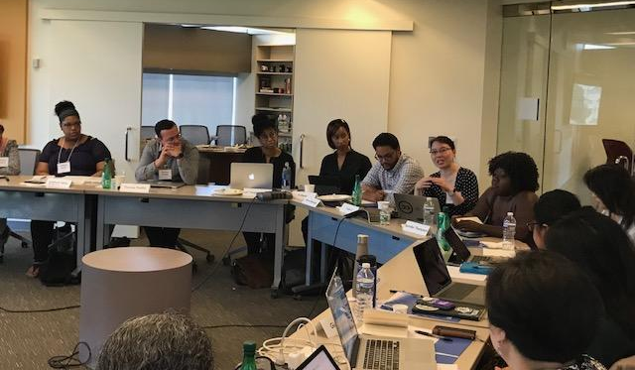

Slide 38
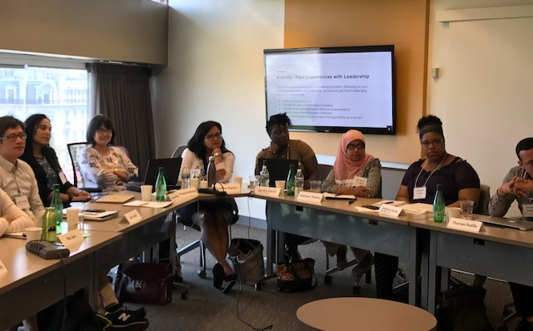

Slide 39
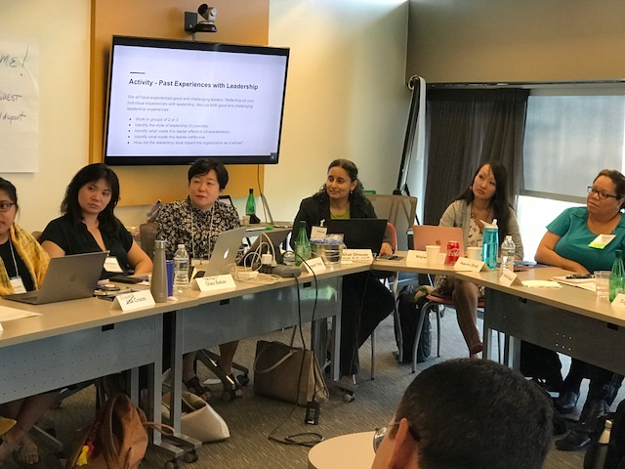

Slide 40
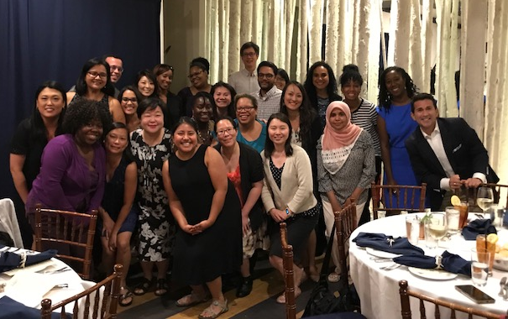

Slide 41

Inclusive Leadership: ARL’s Year Long Career Development Program (LCDP)
Jack Leong, University of Toronto & Sonny Banerjee, Ryerson University

Slide 42
Assessing the Accessible Content Provider Landscape for Higher Education in North America
Meredith Hatton, Manager Access Services and Library Accessibility Services York University Libraries

Slide 43
The Whys ?
We wanted to a have better informed approach of creating best practices in regards to accessible content deliver.
By having it go through research ethics process allows up us to share and use this information for other purposes.

Slide 44
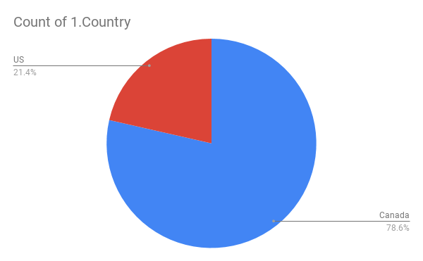
Responses
Notes:
25 separate institutions

Slide 45
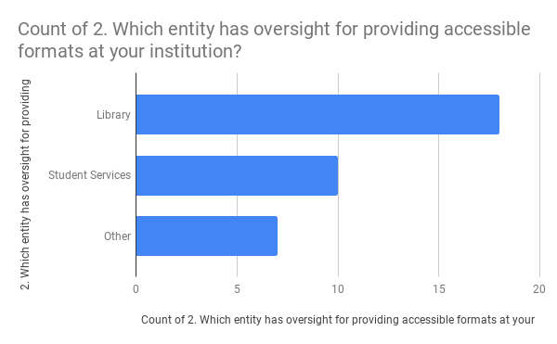
What Did We learn ?
Notes:
Libraries are major players in providing accessible content

Slide 46
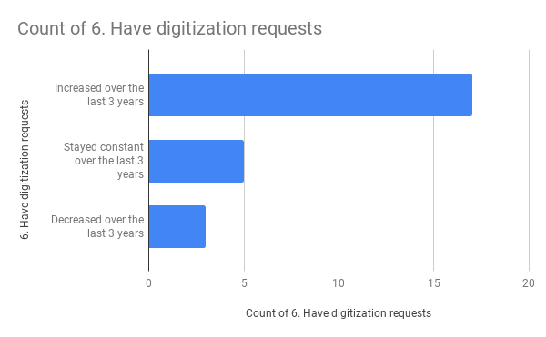
Accessible Content Needs Are Growing

Slide 47
Learn More
Join us January 29th, 2019 for the
Accessibility Symposium @ York University
Accessibility is cross cutting and is an essential part of all of everything we do.

Slide 48
Special Shout Outs & Thank Yous
Andrea Kosavic, Associate Dean, York University Libraries who made this research happen !
Tom Scott, Associate Dean, York University Libraries who has provided endless support !
Accessibility Symposium Planning Committee !
Meredith Hatton York University
Aneta Kwak University of Toronto
Kelly Dermody Ryerson University
Mark Weiler Wilfrid Laurier University
Nancy Waite McMaster University

Slide 49
Lightning Talks Questions?
Summer Web Content Accessibility Guidelines 2.0 reading camp
Mark Weiler, Wilfrid Laurier University
Inclusive leadership: ARL’s Year Long Career Development Program (LCDP)
Sonny Banerjee, Ryerson University & Jack Leong, University of Toronto
Assessing the accessible content provider landscape in North America: a brief on what we have learned
Meredith Hatton, York University

