Slide 1

Lightning Talks
#spday2018

Slide 2
Lightning Talks
Open + Affordable = Inclusivity at UofG
Ali Versluis & Heather Martin, University of Guelph
What is RDM? Why should I care?
Jane Fry, Carleton University
The Robarts Library Family Study Space: creating equitable library access for students with children
Kyla Everall & Jesse Carliner, University of Toronto

Slide 3
Open + Affordable =
Inclusivity at UofG
Ali Versluis (versluis@uoguelph.ca / @aliversluis)
Heather Martin (martin@uoguelph.ca / @heat13her)
University of Guelph

Slide 4
UofG Student Textbook Surveys
Are students buying textbooks?
If not, why not?
How are they managing without them?
What are the negative impacts?
Partnered with student association to survey all undergrads
Overwhelming response rate/ thousands of written comments
Led to formation of Open and Affordable Course Content Task Force
Survey run in Fall 2016, repeated in Winter 2018 - similar results

Slide 5
What we learned

Slide 6
Winter 2018
Fall 2016
54%
56%
37%
69%
spent more than $250 on textbooks
did NOT buy all required textbooks
used library’s copy instead of purchasing
were somewhat or very concerned about decision not to purchase
67%
57%
28%
88%
49% dropped a course or didn’t register in a course due to textbook cost
83% reported at least one negative impact of not purchasing textbooks

Slide 7
Reasons for not buying textbooks
Negative impacts of not having text
“...did not have enough money to buy all textbooks - I had to pick and choose”
“If I use the library copy, I only have a few hours. This means that I am unable to truly absorb the content”
“Very expensive and profs don’t make much use of it”
“I feel bad borrowing it from someone”
“Astronomical fees for continually ‘updated’ editions”
“Constant stress and anxiety. It's either buying a textbook or buying groceries”
“As a student living with a chronic medical condition, all my extra funds go towards my health care.”
“...often find I do not end up needing the books I do buy”
“Feeling lost in the course material. Losing marks on exams”
“I am paying for tuition, housing, food and other school expenses myself ….and I have run out of money.”
“Not being able to complete assignments …. [not having] online access codes for quizzes so you'd get an automatic 0 on 20% of your grade”

Slide 8
What we did about it

Slide 9
Course Reserve Changes
Launched textbook purchasing project for course reserves​
preemptively place required textbooks for most undergrad courses on reserve
Implementing reserve policy changes
longer loan periods
loans outside the library
overnight loans
Self-service reserves model further improves student access

Slide 10
Started Open Conversations
Deliberately reached out to high-impact courses
tag-teamed conversations with Educational Technologist
Facilitated opportunity for first major adaptation in Microbiology
course buy-out
replaced $258 textbook for 300 students
updated to reflect Canadian content, improve accessibility, and integrate interactive content
Open resources increase student access and success

Slide 11
Supported Open Pedagogy
Integrated teaching approach for Human Physiology I/II
no suitable textbook exists
Opportunity to make teaching and learning a visible, public process
cohort of students (16) enrolled in independent study
work in pairs to locate and evaluate learning objects for inclusion in an open textbook
3 year project that will involve research, writing, and creation of OER
Open practices increase inclusivity and diversity of course content

Slide 12

What is RDM?
Why should I care?
Scholars Portal Day
Jane Fry
December 7, 2018
Notes:
Currently, one of the greatest challenges I face as a Data Services Librarian is explaining different concepts to our researchers at all levels.
At this point in time, I am facing this challenge in regards to Research data mgmt or RDM. The Portage Expert Training Grp, of which I am the Chair, has come up with a number of innovative bilingual training aids that will help us to build our RDM services. This is of great benefit to all of us because it not only levels the playing field for those of us providing data services, it also levels the playing field for researchers.

Slide 13
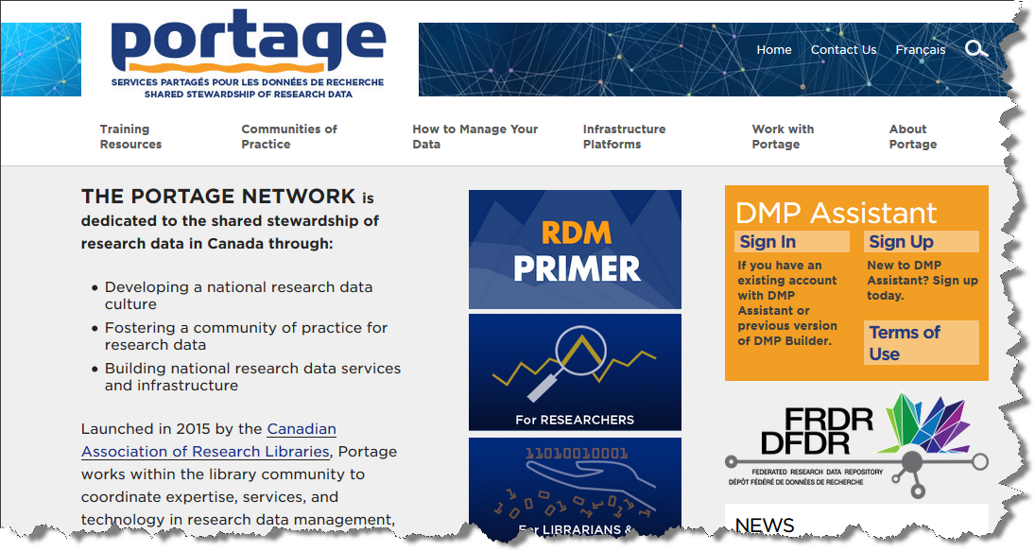
Reference: https://portagenetwork.ca/
Notes:
Materials accessible to the world
Anything produced by P is bilingual – making rdm information and training materials accessible to more res-ers
Can switch to Fr easily

Slide 14
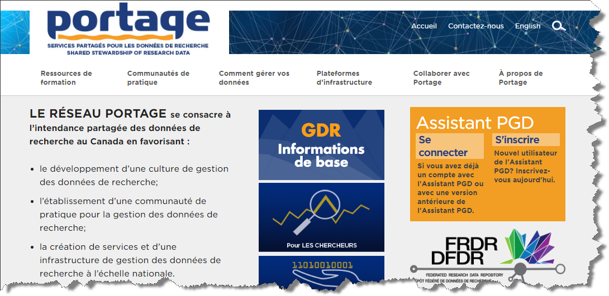

Slide 15
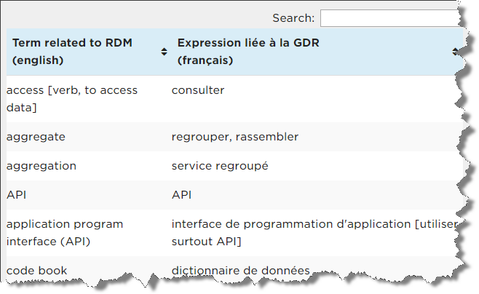
Definitions
https://portagenetwork.ca/training-resources/rdm-equivalents-french-english/
Notes:
Also a data thesaurus from the Ntl Network of Libraries of Medicine (E/F and several other languages)
And a Research Data Dictionary from CASRAI (E/F terms)
These resources are easy to find from the front page of P, thus making it easy for anyone to find terms for which they are looking quickly and in their language of choice

Slide 16
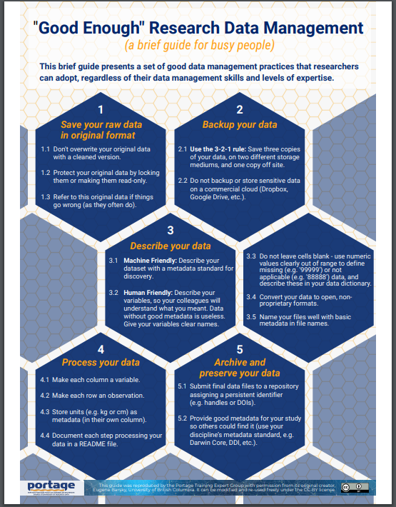
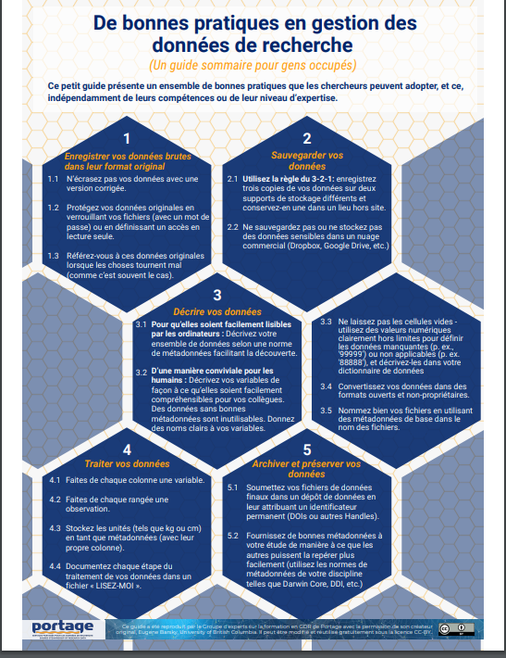
What is RDM?
Notes:
Busy Bee series
Point form
Short and to the point
1 pager pdf
Can print up a bilingual one
Available under Training resources
More coming in the series – DV, FRDR, Curation

Slide 17
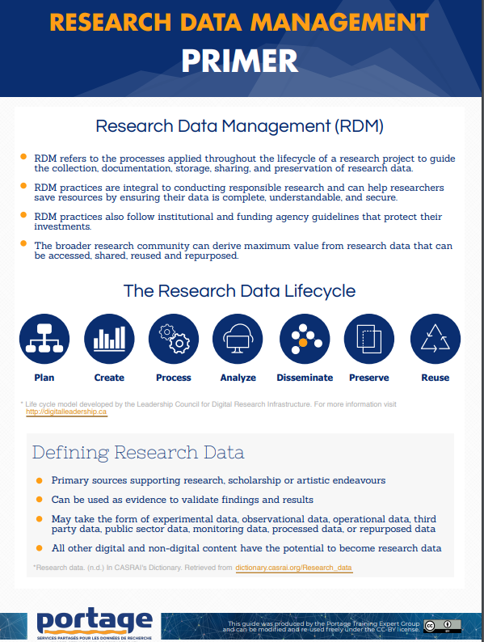
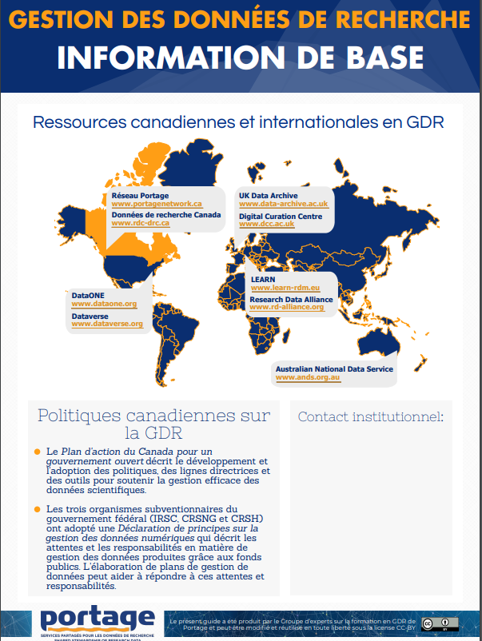
More info, please!
Notes:
More detailed than the BB
Shows that RDM is being conducted world wide
1 page double-sided - pdf
With space to put in your contact info on the back page
Once again, downloadable from the P website

Slide 18


Training Modules
http://www.cihr-irsc.gc.ca/lms/e/app-rdm-mod1/
http://www.cihr-irsc.gc.ca/lms/f/app-rdm-mod1/
Notes:
These ones put together by folks from Portage
Portage will soon be coming out with RDM 101
Next year will have DMP 101

Slide 19
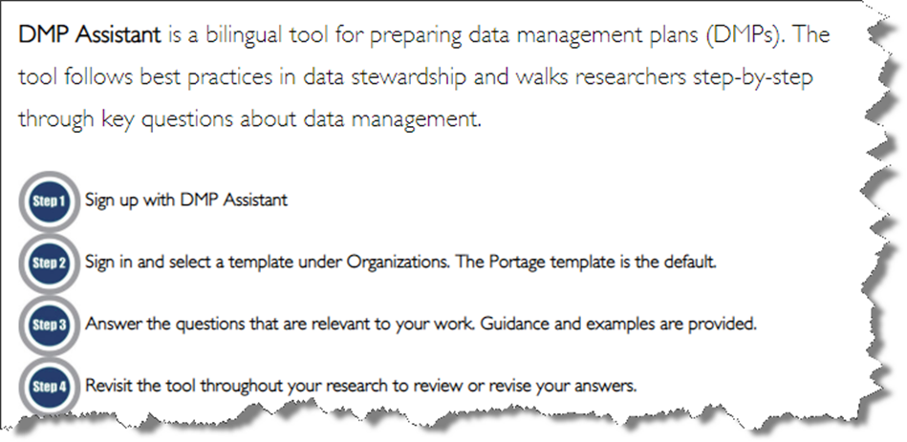
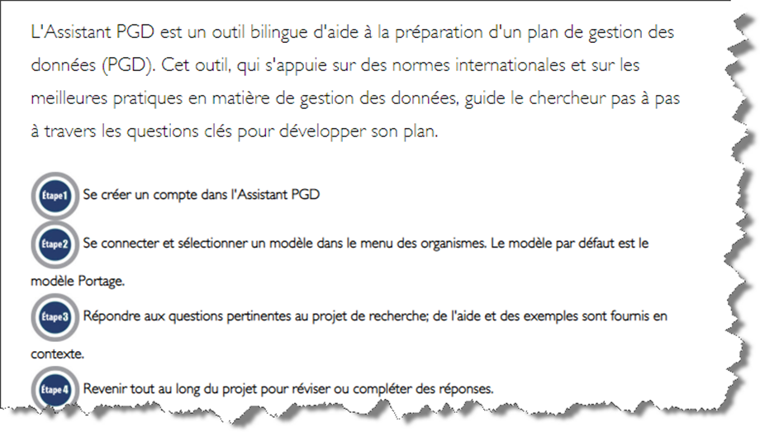

DMP Assistant

Slide 20
Why should I care?
Libraries are the hub of the campus
We level the playing field for researchers
Tri-Agency RDM Policy
  Coming next year
  Be prepared!
Notes:
People from most disciplines and faculties come to see us
They come when they need help and consultations on different stages of the research life cycle
We give them all the same info so they all have the same potential to be equally prepared
Contacts at your organization – page at P – make sure you are listed there if you do RDM

Slide 21
Thank you!
Contact information:
Jane Fry
Data Services Librarian
MacOdrum Library
613.520.2600 x1121
jane.fry@Carleton.ca
https://library.carleton.ca/find/data

Slide 22
The Robarts Library Family Study Space
Creating equitable library access for students with children
Jesse Carliner & Kyla Everall
University of Toronto

Slide 23
Lack of library support for students with children is an equity issue.

Slide 24
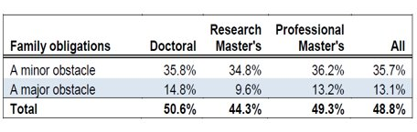
Family obligations are an obstacle for student success
Statistics from the 2016 Canadian Graduate and Professional Student Survey (CGPSS)

Slide 25
"UofT libraries should provide special study spaces for students with children.
I have seen this in multiple European university libraries and for a world class university as UofT this should be a
manageable task."
Doctoral student, LibQUAL+ 2016

Slide 26
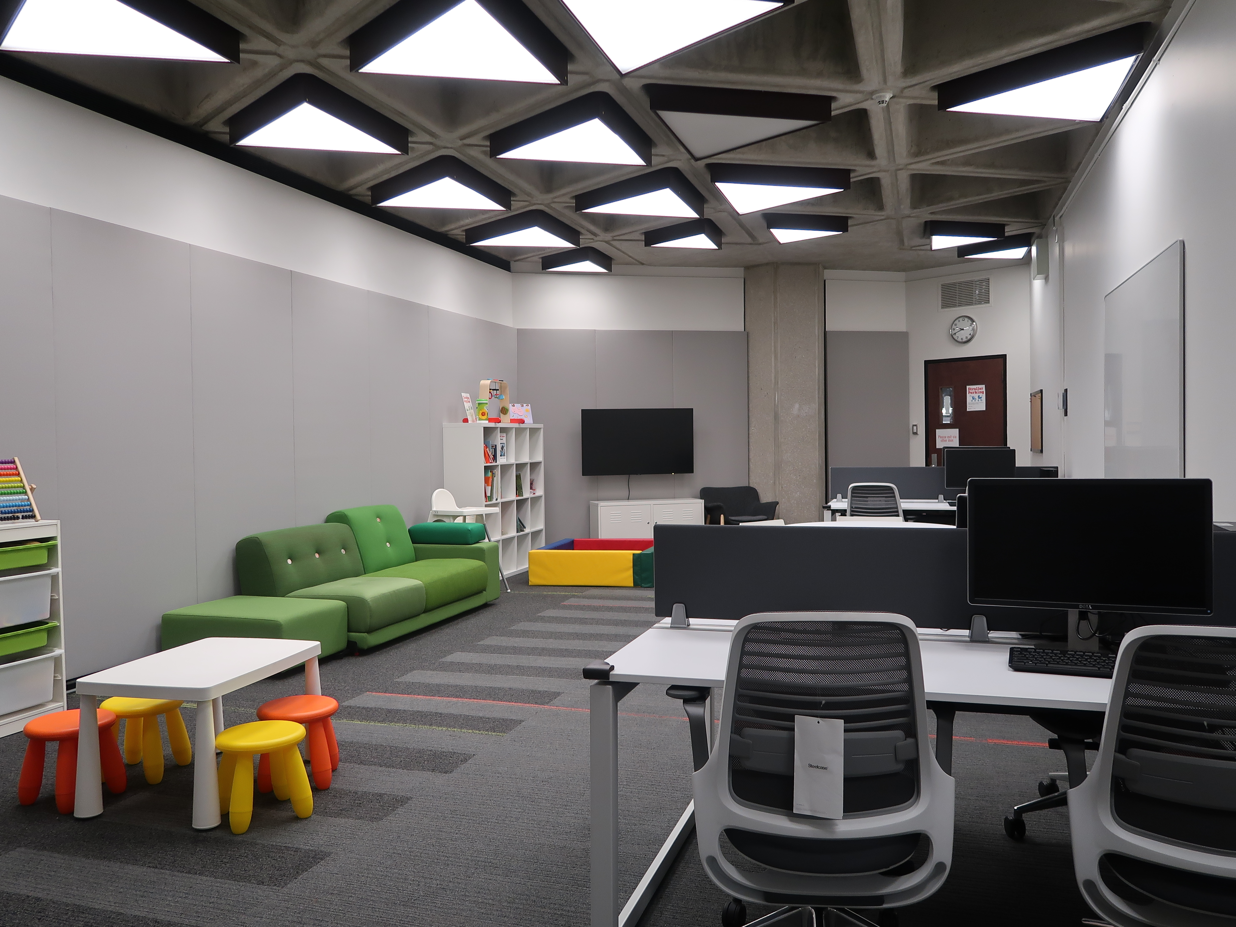
Robarts Library Family Study Space

Slide 27
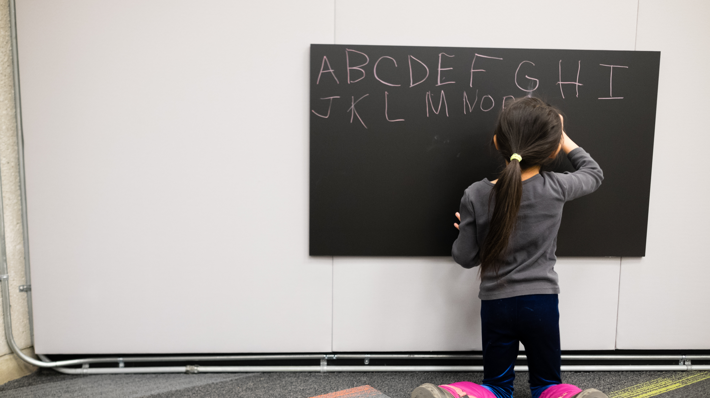
What you can do
Consider policy
Create space
Find partners on campus
Advocate

Slide 28
Lightning Talks Questions?
Open + Affordable = Inclusivity at UofG
Ali Versluis & Heather Martin, University of Guelph
What is RDM? Why should I care?
Jane Fry, Carleton University
The Robarts Library Family Study Space: creating equitable library access for students with children
Kyla Everall & Jesse Carliner, University of Toronto

