Slide 1


Lightning Talks

Slide 2
Lightning Talks: Group 3
The Impact of Change Management on Organizational Renewal
Liz Hayden, University of Ottawa
Transforming an Academic Library to Meet the Needs of the Users: Services, Spaces, Structures & Staff
Heather Cunningham, University of Toronto, on behalf of the Gerstein Library Management Committee
Resource Evaluation Inventory: A Comprehensive Serials Assessment Tool
Shawn Hendrikx & Kristin Hoffmann, Western University

Slide 3

Liz Hayden
University of Ottawa
December 8, 2017

Slide 4

Individual change
Image: Dreamstime (2017) https://www.dreamstime.com/royalty-free-stock-photo-love-fear-change-embrace-different-things-image19459775

Slide 5
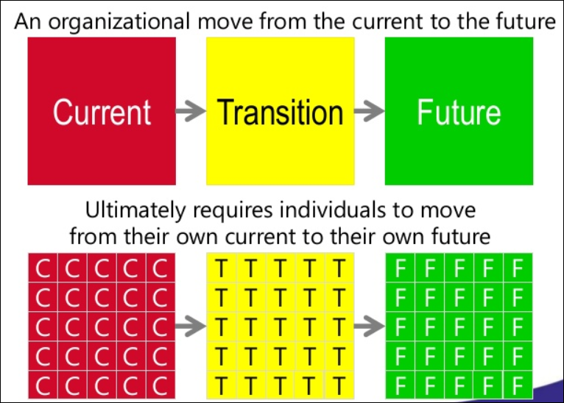
Image: Prosci (2011) https://www.slideshare.net/TimCreasey/change-management-value-proposition

Slide 6
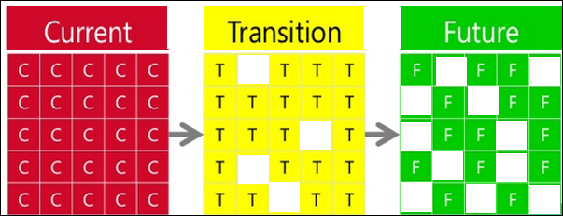
Image: Prosci (2011) https://www.slideshare.net/TimCreasey/change-management-value-proposition

Slide 7
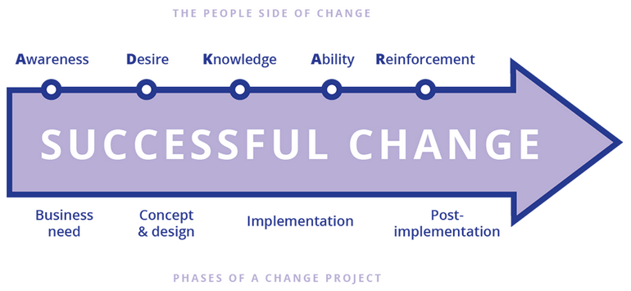
ADKAR
Image: ProSci (2017) https://www.prosci.com/adkar/adkar-model

Slide 8

Is it working?
Image: Cosmic BookNews (2017) https://www.cosmicbooknews.com

Slide 9
The numbers
 | 1 | 2 | 3 | 4&5
Awareness | 0 | 1 | 15 | 73
Desire | 0 | 3 | 14 | 72
Knowledge | 0 | 2 | 34 | 53
Ability | 0 | 6 | 21 | 62
Reinforcement | 0 | 4 | 15 | 70

Slide 10
Transforming an academic library to meet the needs of users: services, spaces, structures and staff
Heather Cunningham on behalf of the Gerstein Management Committee
University of Toronto Libraries

Slide 11
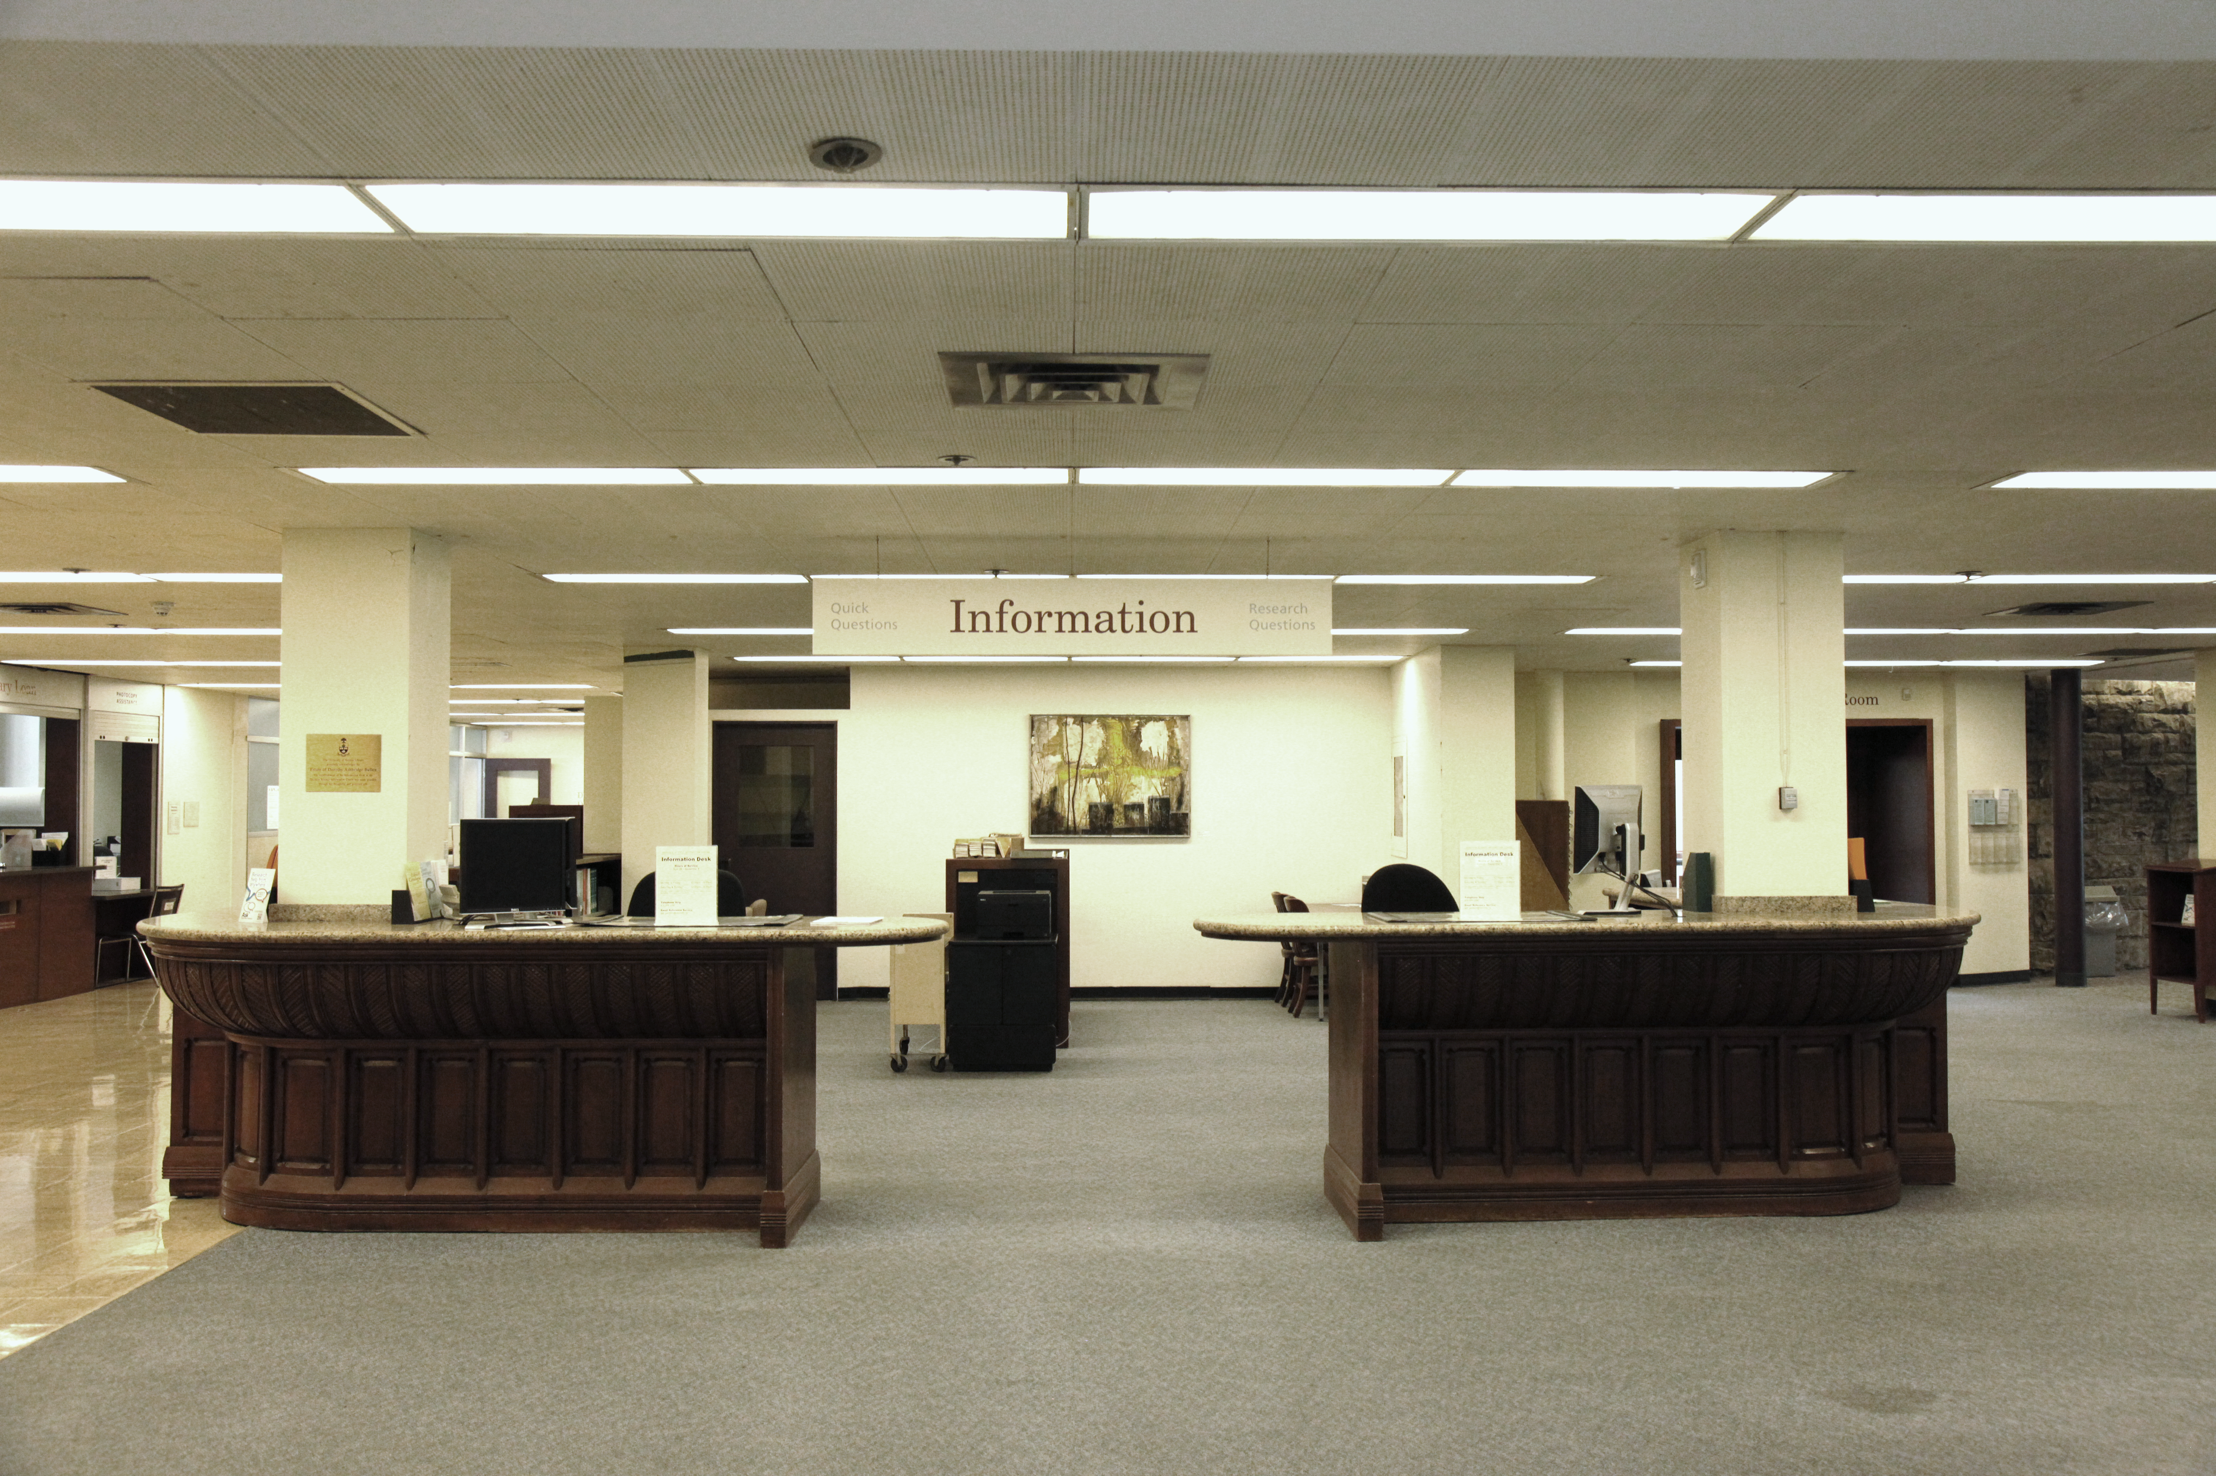

Slide 12
Reference desk based service model
Librarians
Library staff
patron
patron
patron

Slide 13
User based service model
Structure
Reference & Research Unit
Students
Faculty
Researchers
Staff

Slide 14
User based service model
Structure
Research & Innovation Services
Education & Information Services
Students
Faculty
Researchers
Staff

Slide 15
User based service model
Structure
Research & Innovation Services
Education & Information Services
Services
Embedded IL
Systematic & Scoping Review Service
Consultations
Students
Faculty
Researchers
Staff

Slide 16
User based service model
Structure
Research & Innovation Services
Education & Information Services
Services
Embedded IL
Systematic & Scoping Review Service
Consultations
Students
Faculty
Researchers
Staff
Staffing
Entrepreneurship Librarian
Research Services Librarian

Slide 17
User based service model
Structure
Research & Innovation Services
Education & Information Services
Services
Embedded IL
Systematic & Scoping Review Service
Consultations
3D Printing
VR tech
Spaces
MAD Lab
SVPSC
Elder consultation room
Students
Faculty
Researchers
Staff
Staffing
Entrepreneurship Librarian
Research Services Librarian

Slide 18

Thank-you & Questions

Slide 19
Resource Evaluation Inventory:
A Comprehensive Serials Assessment Tool
Shawn Hendrikx
Kristin Hoffmann
Western Libraries

Slide 20
Background
What titles do we have access to for a given subject area?
What titles are must-haves for a given subject area?

Slide 21
Two tools to answer those questions
Journal Inventory
Priority Title List

Slide 22
Journal Inventory
Print & Electronic
JR1 Reports
Breakdown by Subject Code
To learn more:
OLA Super Conference Session, Thursday 2:50pm:
Making Usage Stats Usable: Evaluating Usage Stat Tools and Maximizing Excel/Pivot Tables

Slide 23
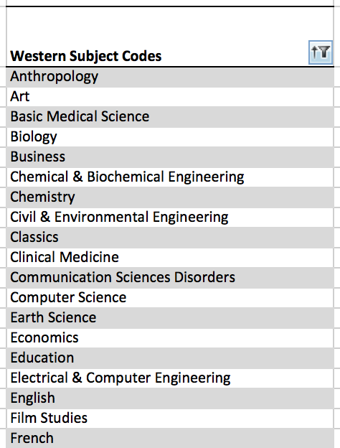
List of Controlled Western Subject Codes

Slide 24
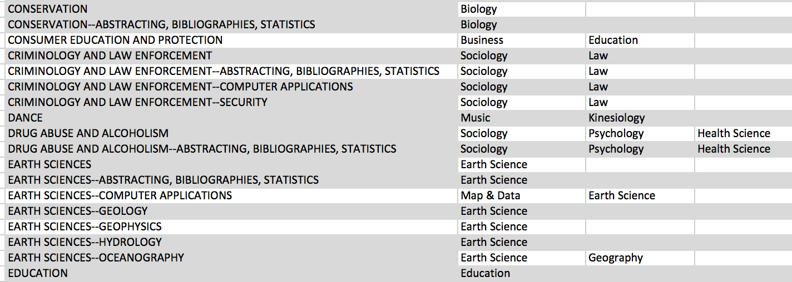
Ulrich’s Headings Matched to Our Codes

Slide 25
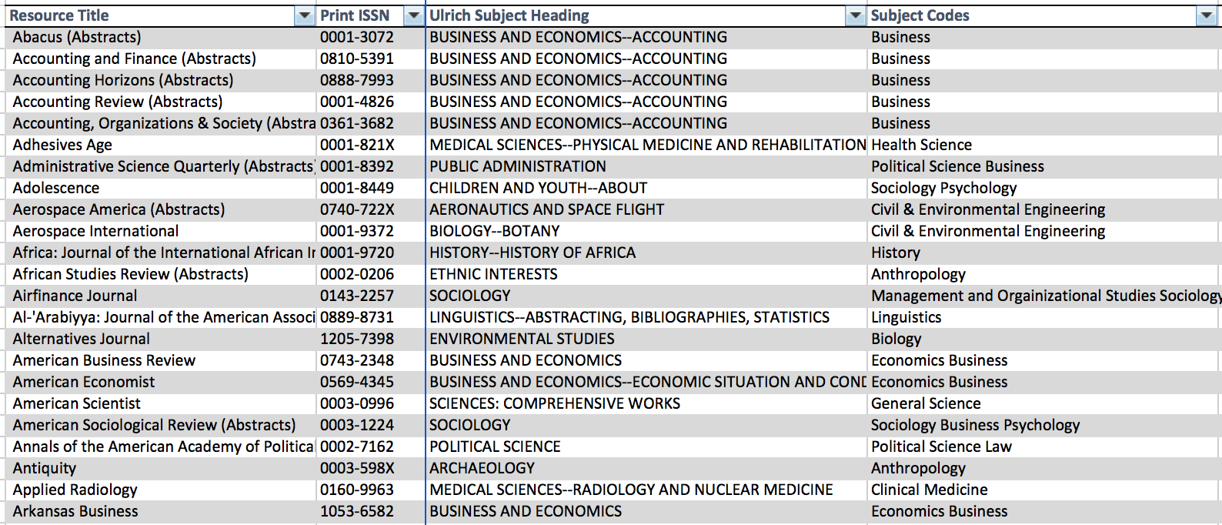
Each Title Matched to Ulrich’s

Slide 26
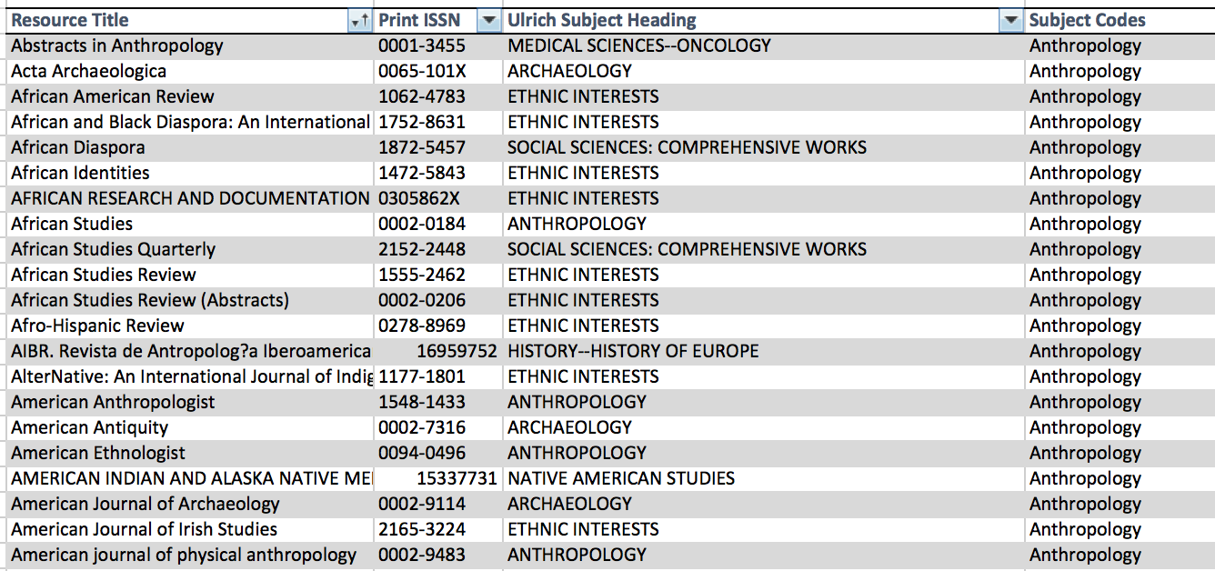
Journals Filtered by Subject Code

Slide 27
Background
What titles do we have access to for a given subject area?
What titles are must-haves for a given subject area?

Slide 28
Priority Title List
CRKN Journal Usage Project
  Survey responses from faculty, PhD students, post-docs
  Citations
  Usage
80/20 rule: most of the mentions/citations/usage will come from relatively few titles

Slide 29
Priority Title List
80% thresholds for mentions, citations, downloads
In 4 broad subject areas:
  Arts & Humanities
  Biomedical
  Natural Sciences & Engineering
  Social Sciences

Slide 30
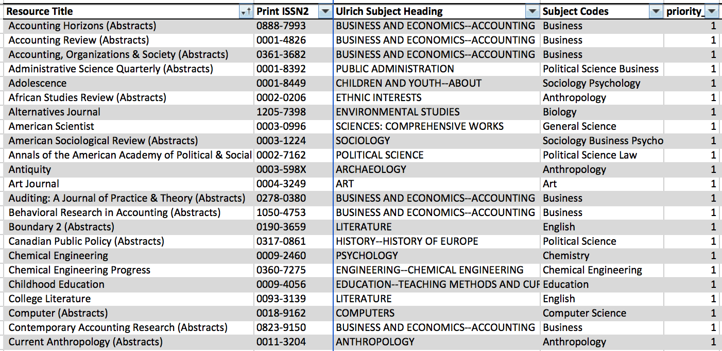
Priority Titles

Slide 31
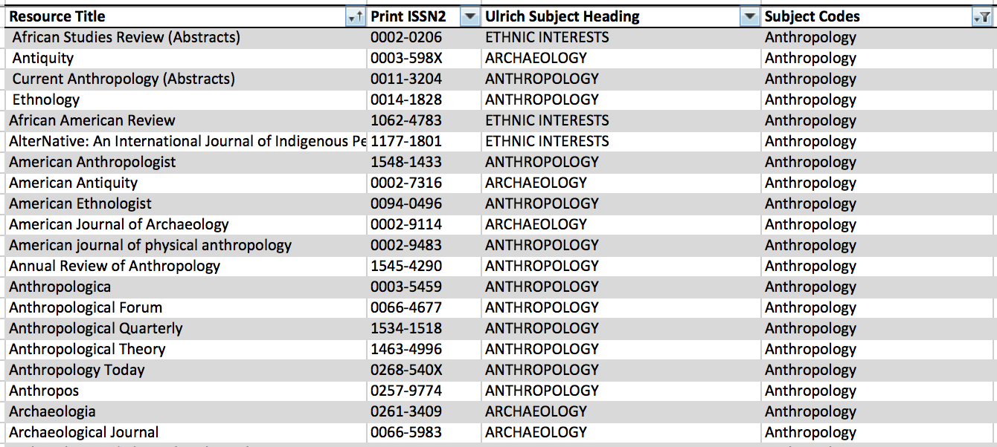
Priority Titles Filtered by Subject

Slide 32
Journal Inventory
>23,000 titles
Priority Titles With Access
Priority Title List
~5,600 titles

Slide 33
Next Steps
Consult with faculty about Priority Title List
Finalize the Priority Title List
Use the inventory and priority title list when considering:
  cancellations
  unbundling “big deals”
  new purchases

Slide 34
Questions?
slido.com
#spday17
The Impact of Change Management on Organizational Renewal
Liz Hayden, University of Ottawa
Transforming an Academic Library to Meet the Needs of the Users: Services, Spaces, Structures & Staff
Heather Cunningham, University of Toronto, on behalf of the Gerstein Library Management Committee
Resource Evaluation Inventory: A Comprehensive Serials Assessment Tool
Shawn Hendrikx & Kristin Hoffmann, Western University

