Slide 1


Lightning Talks

Slide 2
Lightning Talks: Group 2
Accessible Online Course Reader Service: A Proactive Approach to Providing Accessible Texts
Aneta Kwak, University of Toronto
Creating an OER Publishing Infrastructure for Ontario
Sally Wilson & Ann Ludbrook, Ryerson University
Transforming Training Opportunities for Research Data Management (RDM) in Canada
Laure Perrier, University of Toronto, on behalf of the Portage Training Expert Group

Slide 3
Accessible Online Course Reader Service:
A proactive approach to providing accessible texts
Aneta Kwak, Accessibility and Public Services Librarian
D.G. Ivey Library, New College, University of Toronto
aneta.kwak@utoronto.ca

Slide 4
D.G. Ivey Library
Small library at New College, University of Toronto
2 librarians, 10 student staff
Collection and services tailored to New College programs and courses
  African Studies
  Buddhism
  Psychology and Mental Health
  Human Biology
  Caribbean Studies
  Women and Gender Studies
  Equity Studies
  Disability Studies

Slide 5
Online Course Reader Service
Work with instructors to identify readings for upcoming semester
Source readings as appropriate, adhering to Canadian copyright provisions and existing licenses,
  Ebook
  Ejournals
  Web content
  PDF
  Place books on Course Reserve for short term loan

Slide 6
Accessibility for Ontarians with Disabilities Act
Libraries of educational and training institutions
18. (1) Subject to subsection (2) and where available, the libraries of educational or training institutions that are obligated organizations shall provide, procure or acquire by other means an accessible or conversion ready format of print, digital or multimedia resources or materials for a person with a disability, upon request. O. Reg. 191/11, s. 18 (1). ….
(3) Obligated organizations to which this section applies shall meet the requirements under this section in accordance with the following schedule:
1. In respect of print-based resources or materials, January 1, 2015.
2. In respect of digital or multimedia resources or materials, January 1, 2020. O. Reg. 191/11, s. 18 (3).

Slide 7
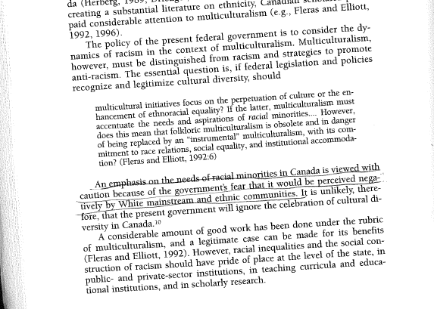
Example of a Scanned Reading

Slide 8
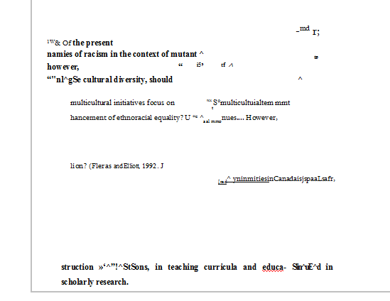
Example of the OCR

Slide 9
Making Our Readings Accessible
Updated scanning procedures and created new scans
  ACE Guidelines on Erasing Marginalia
  Identified the most effective scan settings on our scanner
Identified steps for making WCAG 2.0 compliant PDF scans
  Applying Alt text to images
  Fully tagging the PDF
Next Steps…
Identifying appropriate technologies to use
Formatting readings to meet WCAG 2.0 criteria

Slide 10
Thank you
Aneta Kwak, Accessibility and Public Services Librarian
D.G. Ivey Library, New College, University of Toronto
aneta.kwak@utoronto.ca

Slide 11
Prototyping an OER Publishing Infrastructure for Ontario
Ann Ludbrook and Sally Wilson
Ryerson University Library and Archives
Scholars Portal Day
December 8, 2017
Notes:
Introductions

Slide 12
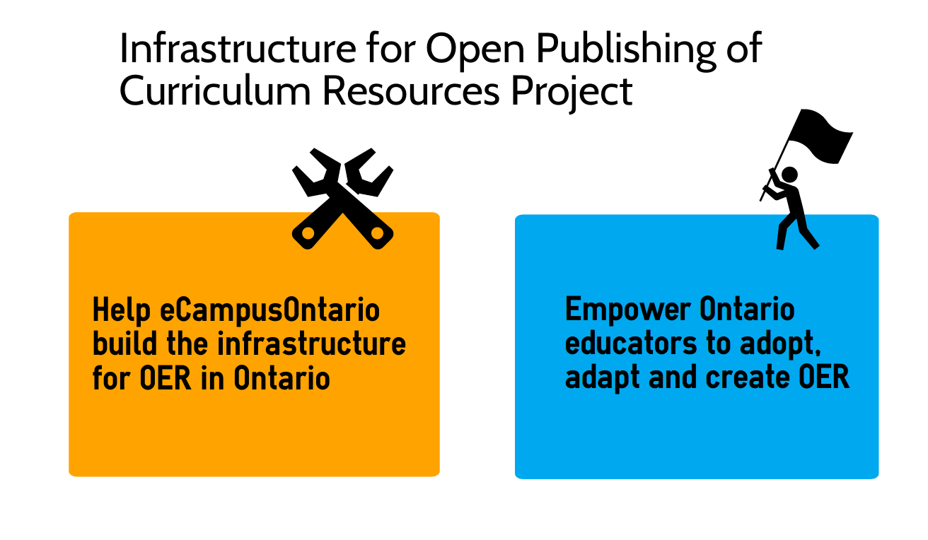
Notes:
AL - Dual Focus - Pedagogy; infrastructure - The WHY of the Project

Slide 13
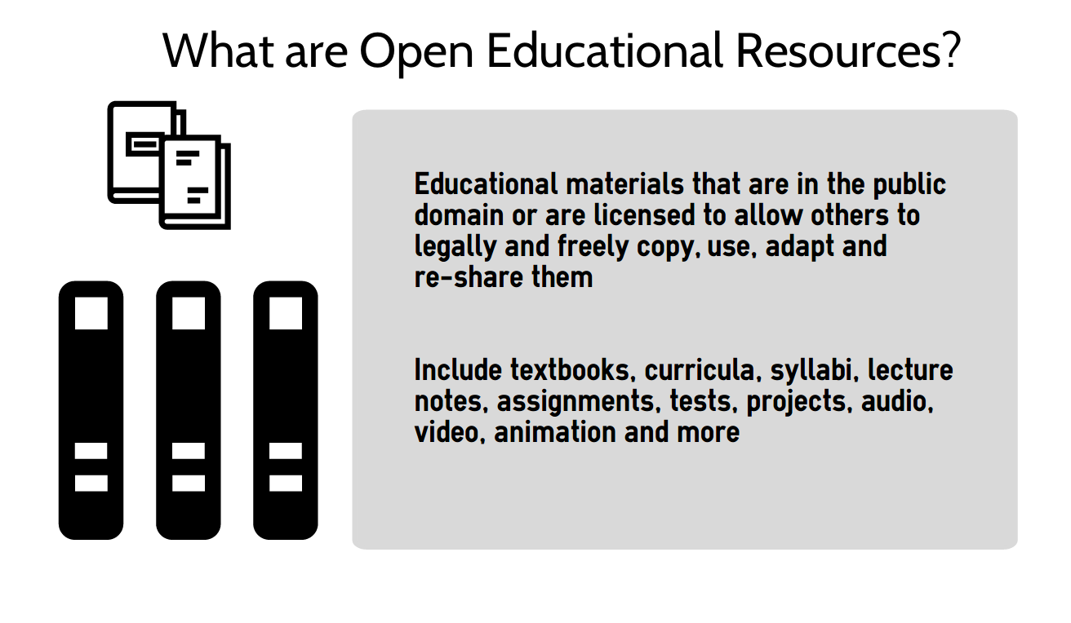
Notes:
AL

Slide 14
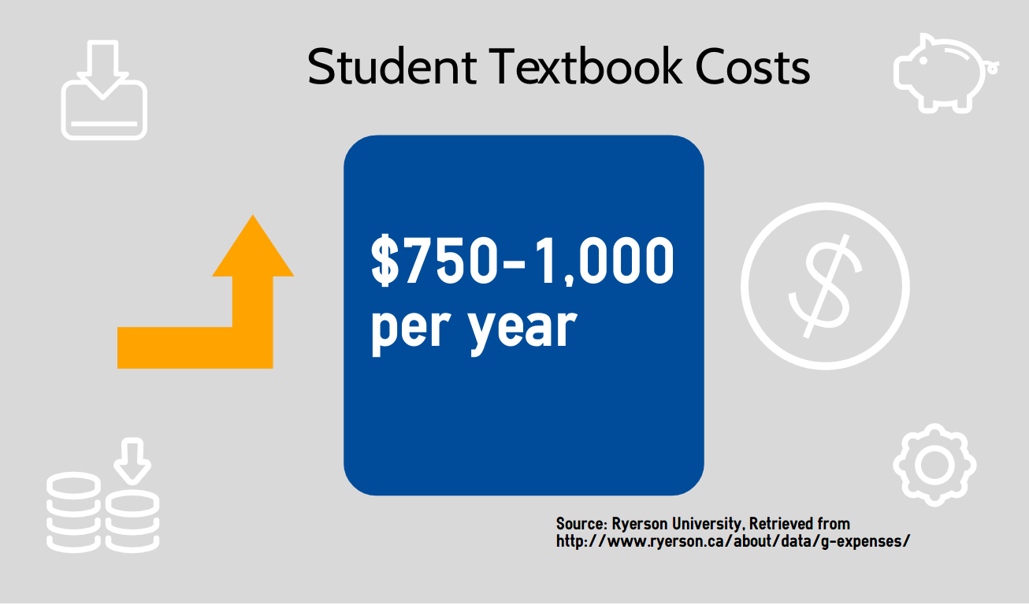
Notes:
AL
building the infrastructure for Open in Ontario
it’s out there, but in bits and pieces
in other geographic places
in US - by state and by institution
in europe
what about learning objects, not just textbooks

Slide 15
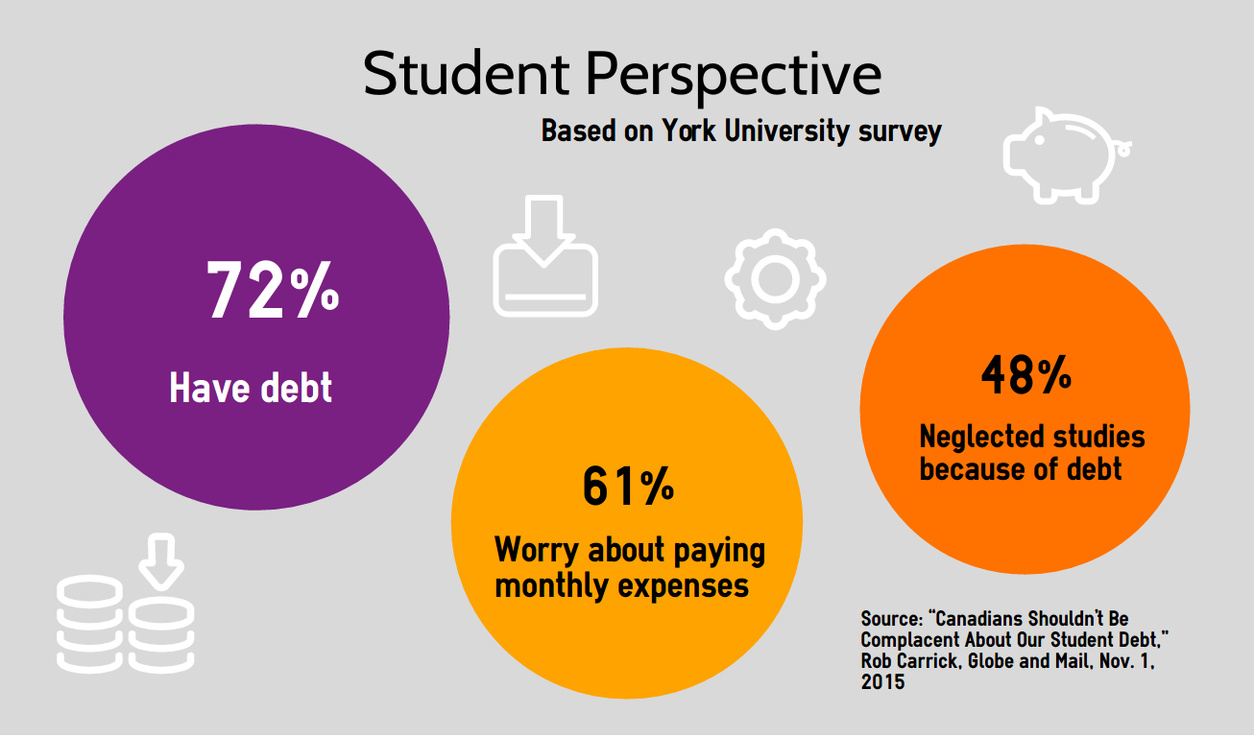
Notes:
AL
In an article titled “Canadians shouldn’t be complacent about our student debt” in the Nov 1, 2015 edition of the Globe and Mail, by Rob Carrick, the author cites a recent study that looks at student’s feelings and concerns about debt out of Ohio State University. 52 American Colleges and universities were polled. These results were compared to students at Toronto’s York University. It’s interesting to note that although tuition is considerably higher in the U.S., the concern amongst York students is higher. One explanation is that Canadian students are as well prepared for student debt as American students. And there is more access to funding through federal and state assistance programs, as well as grants and scholarships.

Slide 16
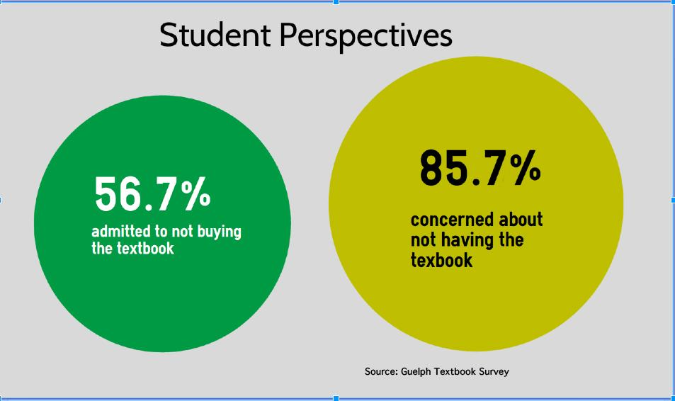
Notes:
AL
2 in 3 admit to not buying the textbook because costs are too high.
These figures are from Guelph - https://www.lib.uoguelph.ca/sites/default/files/uofg_student_textbooksurvey_report.pdf
Money saving
Better marks
Fast completion of degree
Flexibility in choice of courses

Slide 17
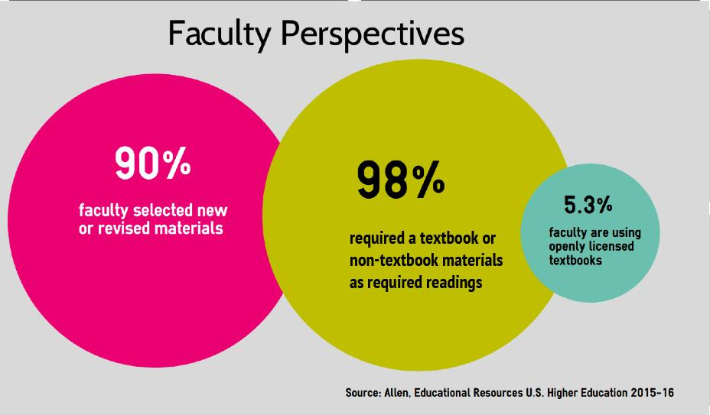

Notes:
AL

Slide 18
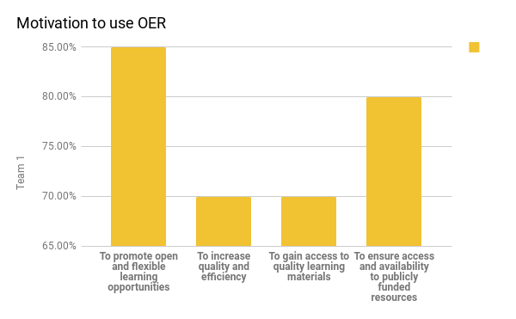
Source: Commonwealth of Learning OER Global Report 2017
Notes:
AL
Pedagogy

Slide 19
Prototype Project Objective
Build a prototype open publishing infrastructure for Ontario
Project start date: April 2017
Project completion date: August 31, 2017
Notes:
SW eCampus Ontario issues an Expression of Interest - March 2017
Grant awarded later that month March 2017
Project Goal

Slide 20
Key Deliverable Workstreams
The four core activity streams were:
Authoring prototype with enhanced features (Pressbooks)
eCampusOntario Infrastructure Project
Build an open source repository that will support the open textbook platform and other content
Community building and knowledge mobilization
Learning module authoring and distribution prototyping
Notes:
SW - Four Work Streams

Slide 21









Project Team
Ryerson
External Advisory Partners
Office of E-Learning
Library and
Archives (RULA)
Computing and Communications
Services
Digital Educational Strategies,
Chang School of Continuing Education
Learning and Teaching Office
Technology Partners
Notes:
SW - Project Team

Slide 22





Prototype Publishing Infrastructure
Authors
Authoring Tools
Repository
User Interface
Learners/Educators
Drupal
Scalar
Notes:
Authors - Authoring Platform - Repo - User Interface- Users
Image Credits
Publishers By Aneeque Ahmed from the Noun Project
people by asianson.design from the Noun Project
Web Portal by Pieter J. Smits from the Noun Project

Slide 23
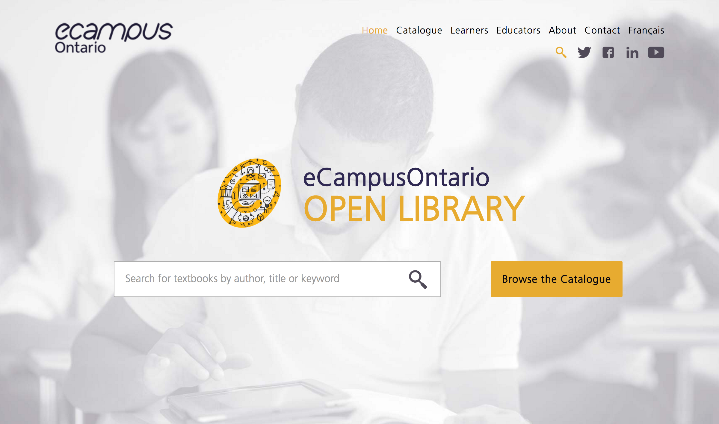
eCampus Ontario Prototype
Notes:
SW - eCampusOntario Open Library website
Front page of the re-designed Open Textbook Library
improving discoverability, browsing
New comprehensive discovery platform
Uses eCampusOntario new brand assets
Clean and modern user interface
Feature-rich HTML5 discovery process with responsive design for mobile users
Discoverability - ontario-based repository, ontario names, local/regional authors, find resources

Slide 24

Individual Book Description
Notes:
Individual Book Description
Graphic Design and Print Production Fundamentals

Slide 25
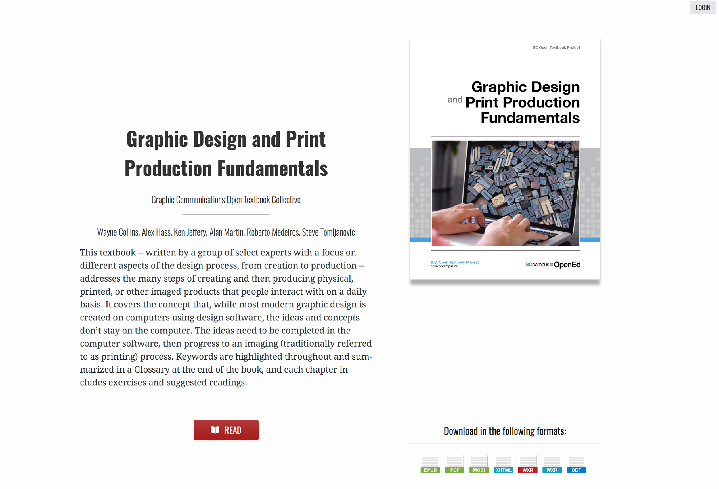
Read Online (Web book)
Notes:
Read Online - Currently links to web books using Pressbooks
Complete overhaul of the front-end for Pressbooks
Standardized, web-friendly metadata format
Any openly licensed, publicly available book can be easily cloned
Full repository integration
AODA accessibility

Slide 26
Phase II - Beyond the Prototype
Make Prototype Operational (March 31, 2018)
Build Ontario Repository
Migrate BCcampus Collection to Ontario
Local Authoring Platform for eCO grant recipients
Integrated Print on Demand Service/Reviews
Look at hosting options/phase III opportunities
Notes:
Moving beyond the prototype - Our Ideas for phase 2
Second stage - make the technical infrastructure a reality, simplify process, the easier to move forward to support faculty and expand faculty use

Slide 27

Thank you
For updates: library.ryerson.ca/open/
@RyersonOER
aludbrook@ryerson.ca
swilson@ryerson.ca

Slide 28
Transforming Training Opportunities for Research Data Management (RDM) in Canada
Laure Perrier
Research Data Management Librarian
University of Toronto Libraries
March 13, 2018

Slide 29
Goals of the Portage Network
Foster a community of practice for research data management (RDM)
Facilitate and provide leadership in the development of RDM infrastructure
Engage and advocate for research data management with stakeholder communities

Slide 30
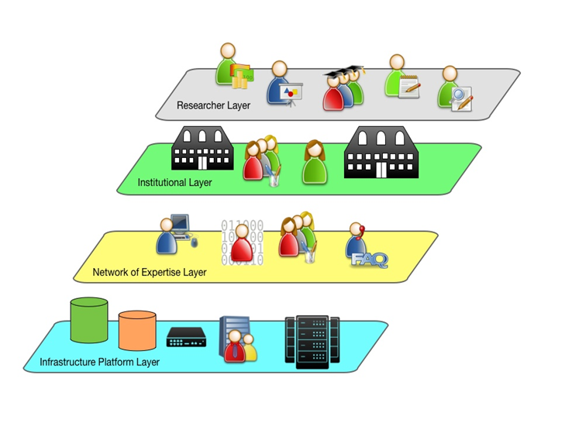
Building a Community of Practice

Slide 31
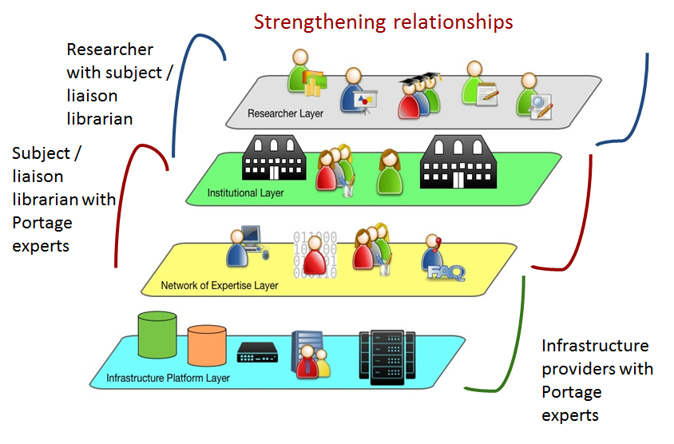
Building a Community of Practice

Slide 32
Portage Network of Experts
6 Expert Groups
Data Management Planning
Curation
Data Discovery
Preservation
Training
Research Intelligence
3 Working Groups
Dataverse North
FRDR Service Model
Institutional Strategies

Slide 33
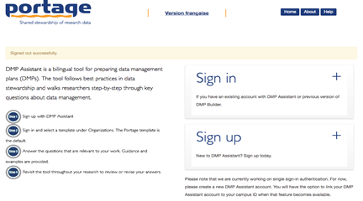
Portage Platforms
DMP Assistant
assistant.portagenetwork.ca/en

Slide 34
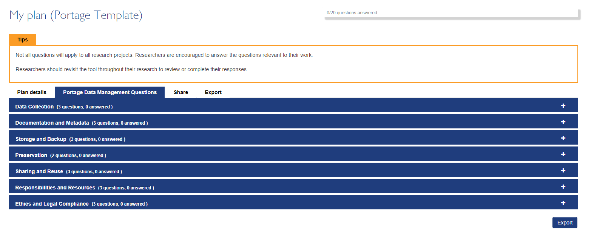
DMP Assistant
The DMP Assistant is an online, bilingual, data management planning tool that will help you create your own data management plan.

Slide 35
Portage Guidance and Training
RDM Training Expert Group
Two main areas of focus:
To develop and maintain a high-level training roadmap for RDM in Canada
To organize and oversee working groups to prepare and support training materials on RDM
Notes:
Bilingual
Downloadable

Slide 36
Portage Guidance and Training
RDM Training Expert Group Members
Jane Fry, Carleton University (Chair)
James Doiron, University of Alberta
Danny Létourneau, Université de Montréal
Laure Perrier, University of Toronto
Carol Perry, University of Guelph
Wendy Watkins, Carleton University, Emerita
Notes:
Bilingual
Downloadable

Slide 37
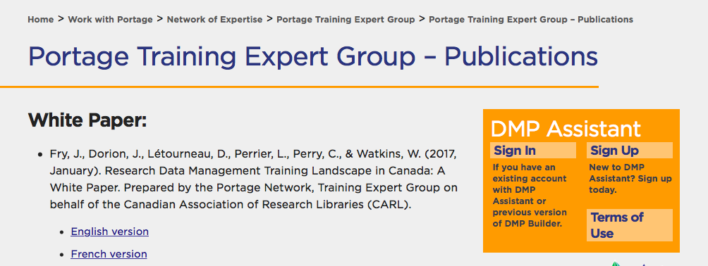
Portage Guidance and Training
White Paper: RDM Training Landscape
in Canada
Notes:
Bilingual
Downloadable

Slide 38
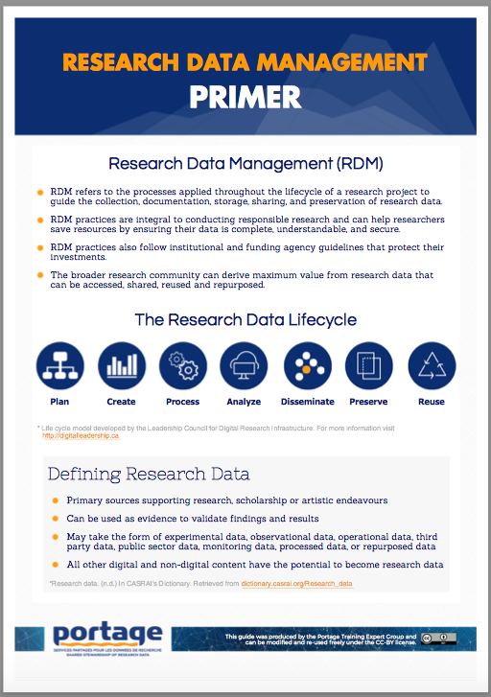
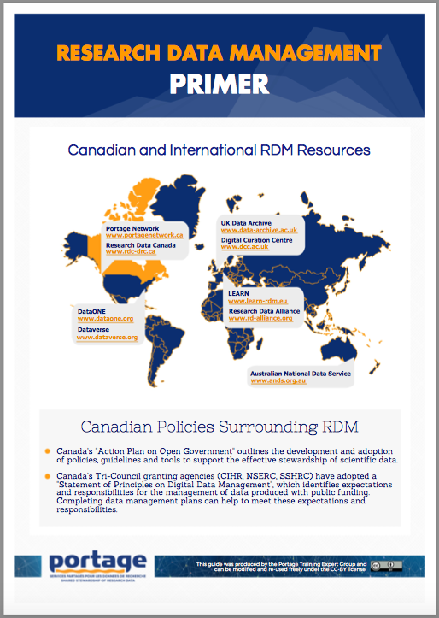
Portage Guidance and Training
RDM Primer
https://portagenetwork.ca/wp-content/uploads/2017/06/Portage-RDM-Primer.pdf
Notes:
Bilingual
Downloadable

Slide 39
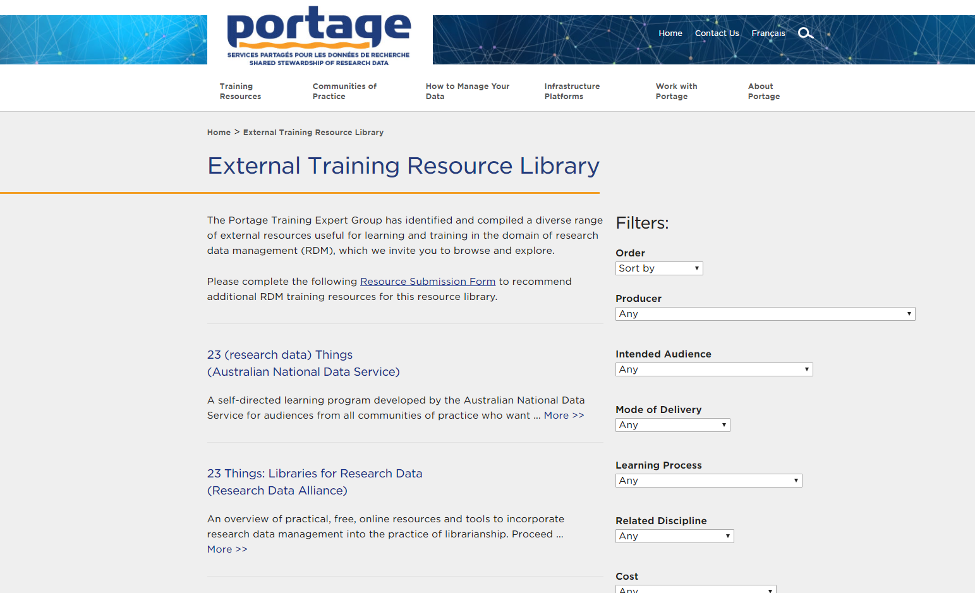
Portage Guidance and Training

Slide 40
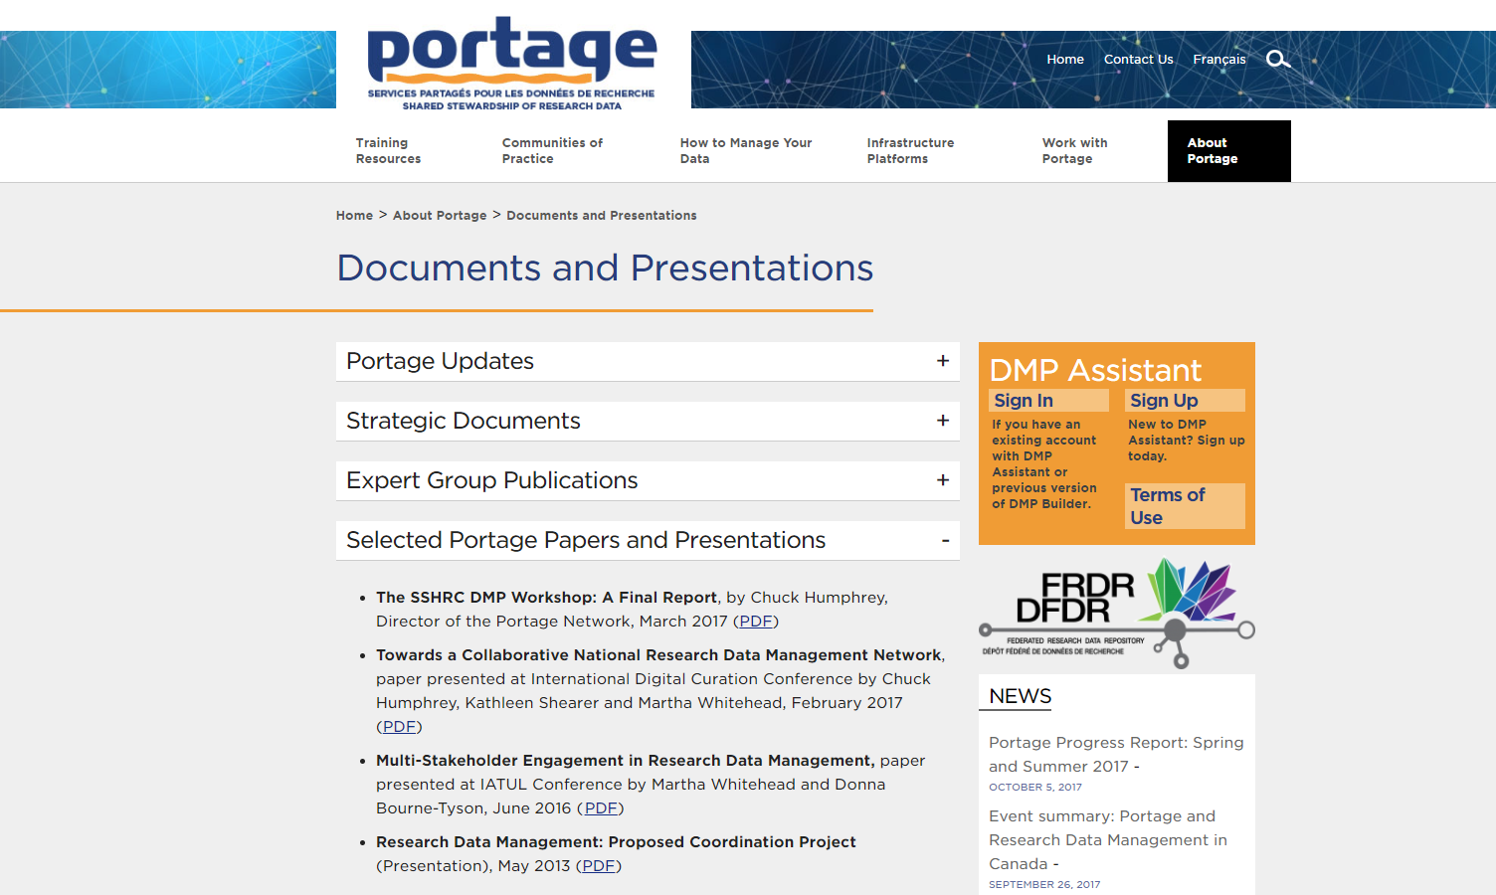
Portage Guidance and Training
Notes:
Past presentations online

Slide 41
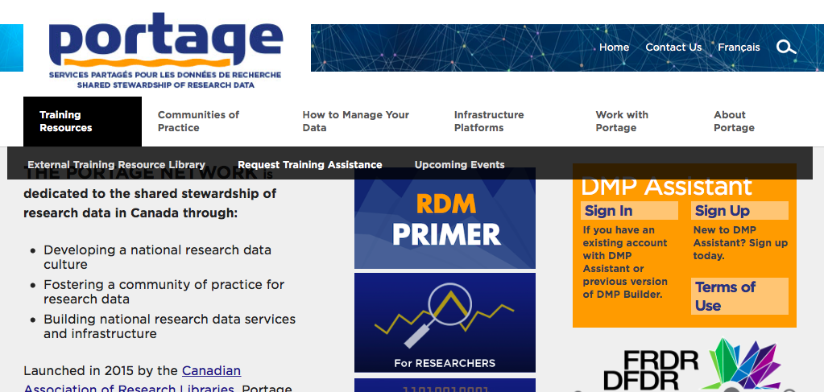
Portage Guidance and Training
Request for RDM Training

Slide 42
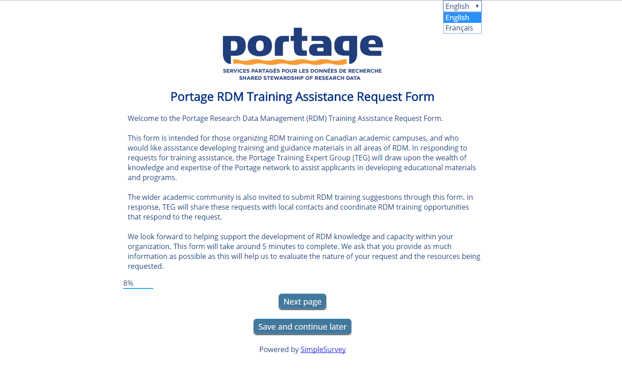
Portage Guidance and Training

Slide 43
Portage Guidance and Training
RDM Training
Stakeholders: All types
Focus: General or specific training
Delivery: In-person or web-based
Style: Collaborative or fully delivered
Language: English; French
Price: Cost friendly (free if possible!)

Slide 44
Portage Guidance and Training
Coming Soon … Online Training Modules
RDM 101
(Lead: Carol Perry)
Data Management Plans
(Lead: James Dorion)
Content will be finalized by December 2017

Slide 45
Portage Guidance and Training
Portage and
Research Data Management in Canada
What: 1-Day Educational Event
When: Tuesday January 30, 2018
Where: Ryerson University, Toronto, ON
Price: No Charge

Slide 46
Portage Guidance and Training
Portage and
Research Data Management in Canada
Morning: Plenary and Panel
Afternoon: Choose a workshop:
1) DMP (Data Management Plans)
2) Dataverse/FRDR
(Federated Research Data Repository)
Lunch and breaks provided

Slide 47
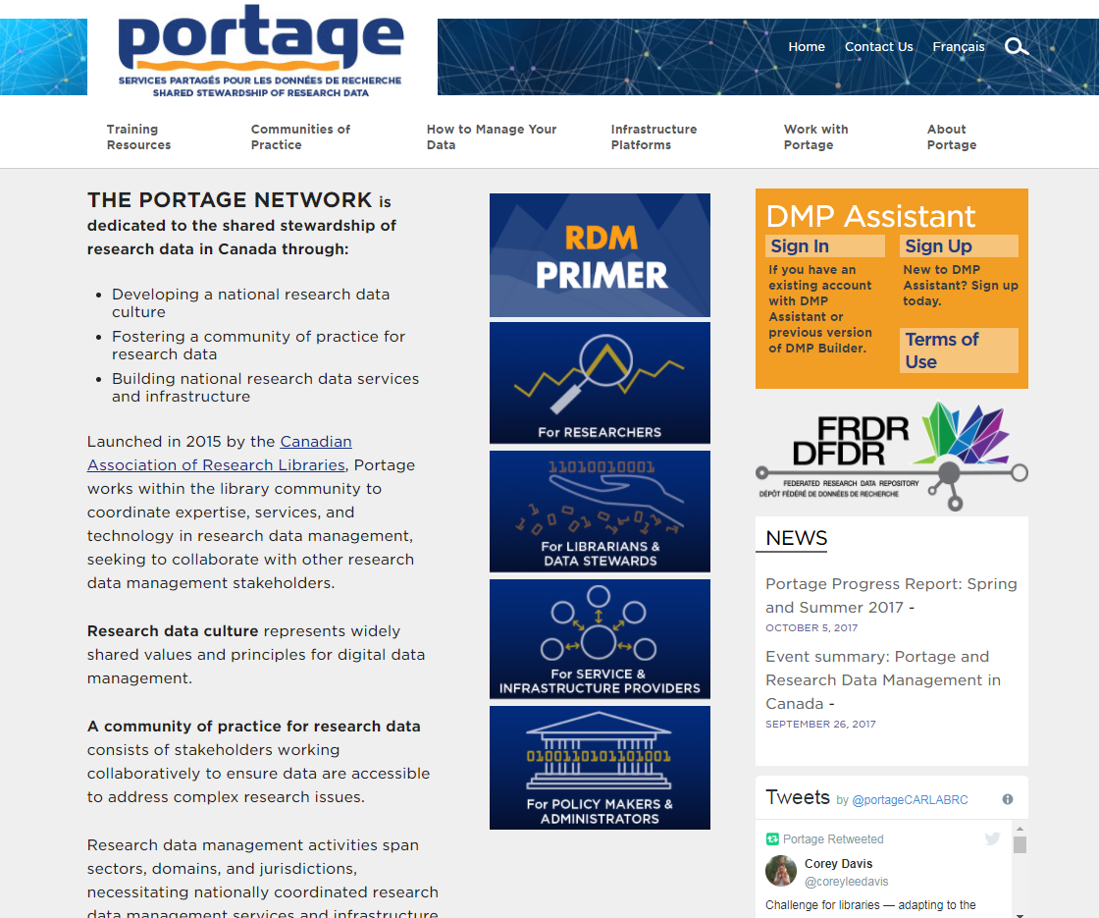
Portage Website
portagenetwork.ca

Slide 48
Questions
Contact Info
portage@carl-abrc.ca

Slide 49
Questions?
slido.com
#spday17
Accessible Online Course Reader Service: A Proactive Approach to Providing Accessible Texts
Aneta Kwak, University of Toronto
Creating an OER Publishing Infrastructure for Ontario
Sally Wilson & Ann Ludbrook, Ryerson University
Transforming Training Opportunities for Research Data Management (RDM) in Canada
Laure Perrier, University of Toronto, on behalf of the Portage Training Expert Group

