Slide 1


Lightning Talks

Slide 2
Lightning Talks: Group 1
Community Content in the Cloud
Art Rhyno, University of Windsor
Migrating the Canadian Opinion Research Archive (CORA) to <odesi>
Alexandra Cooper, Queen’s University
UTransfer: An Owncloud Success Story
Steve Marks, University of Toronto
From Historical Map to Geospatial Information: The OCUL Topo Map Digitization Project
Jay Brodeur, McMaster University, on behalf of the OCUL Geo Community

Slide 3
Community Content in the Cloud
Art Rhyno, University of Windsor
Scholars Portal Day - Dec. 8, 2017
OCUL Digital Curation Summit - Oct. 27, 2016

Slide 4

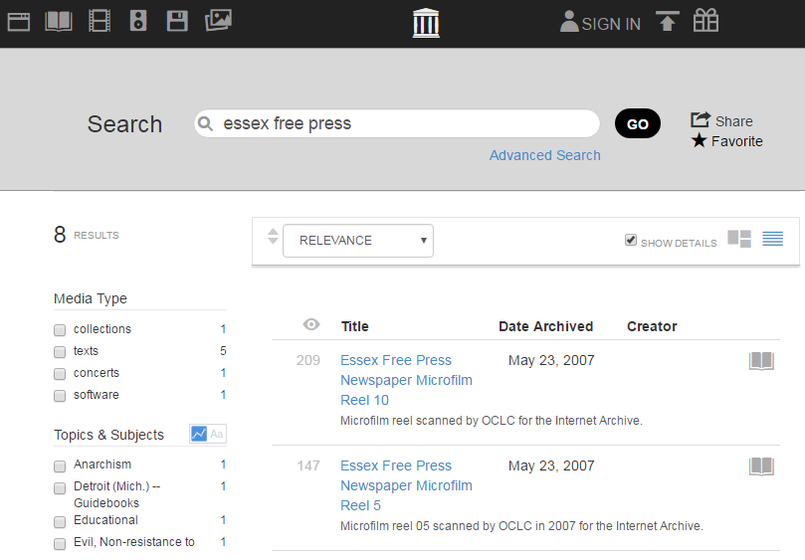
Thanks to a suggestion from Aaron Swartz & help from the Internet Archive, OurOntario/ODW began to grapple with large-scale newspaper digitization in 2007

Slide 5
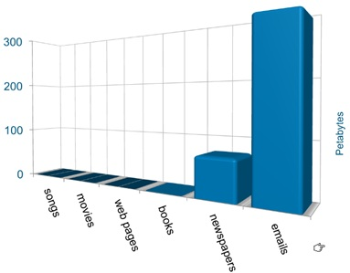

BOOKS
NEWSPAPERS
The Essex Free Press (weekly) - 70,335 pages for 1895 - 2011
Microfilm: 41,073
Microfiche: 22,982
PDF: 6,280

Slide 6

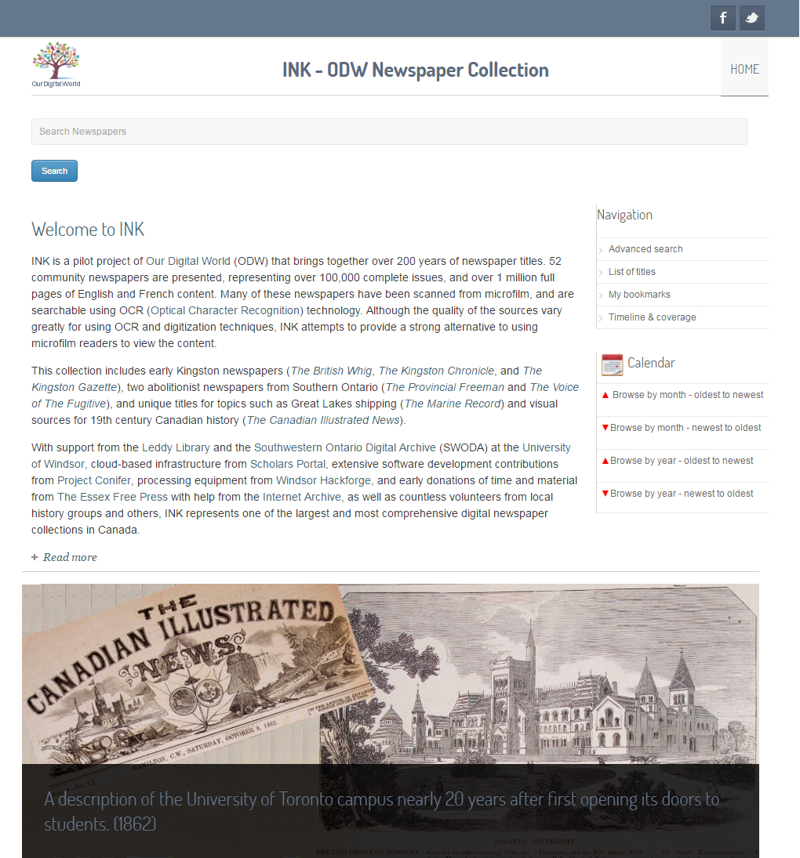
ink.ourdigitalworld.org
It has been estimated that newspaper digitization can cost an organization $3 US per page *
* “Amateur Beats Gov't at Digitizing Newspapers: Tom Tryniski’s Weird, Wonderful Website” - http://reason.com/archives/2013/03/05/amateur-beats-gov-at-digitizing-newspape/1

Slide 7
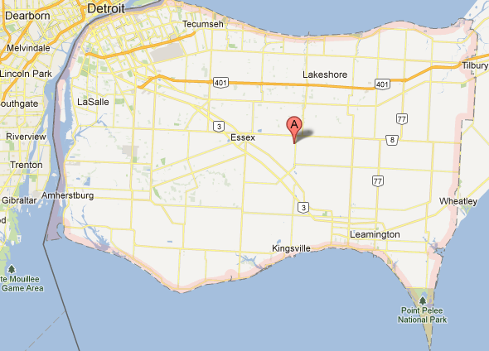
Title | Coverage | Pages
The Amherstburg Courier | 1849-1850 | 183
The Amherstburg Echo | 1874-1982 | 46,024
The Border Cities Star (Windsor) | 1918-1935 | 144,965
Canadian Emigrant And Western District Advertiser (Windsor) | 1831-1836 | 365
Le Canadien (Windsor) | 1891 | 3
The Comber Herald | 1892-1917 | 5,768
Commonwealth (Windsor) | 1857 | 8
Le Courrier and Le Courrier De L'Ouest (Windsor) | 1883 - 1909 | 34
Courrier D'Essex | 1884-1885 | 11
La Defense (Windsor) | 1918 | 5
The Essex Free Press | 1895-2011 | 70,335
The Essex Record | 1871-1882 | 1,987
The Harrow News | 1950-2011 | 31,495
L'Independent Du Canada (Windsor) | 1892 | 4
The Kingsville Reporter | 1893 - 2001 | 78,237
LaSalle Silhouette | 1990-2011 | 46,982
The Leamington Post | 1907 - 1995 | 104,165
The Provincial Freeman | 1853 - 1857 | 278
The Tecumseh Maple Leaf | 1931-1958 | 10,685
The Tecumseh Tribune | 1959-2010 | 11,127
True Royalist (Windsor) | 1860 - 1861 | 25
The Voice of the Fugitive | 1851 - 1852 | 131
The Walkerville Mercury | 1890 - 1891 | 206
The Walkerville News | 1934 - 1936 | 477
The Walkerville Times | 1999-2016 | 1,613
The Western Herald (Windsor) | 1838 - 1842 | 755
The Windsor Evening Record | 1893 -1918 | 71,789
The Windsor Herald | 1855 - 1856 | 420
 |  | 628,077
Small Sources of Big Data

Slide 8
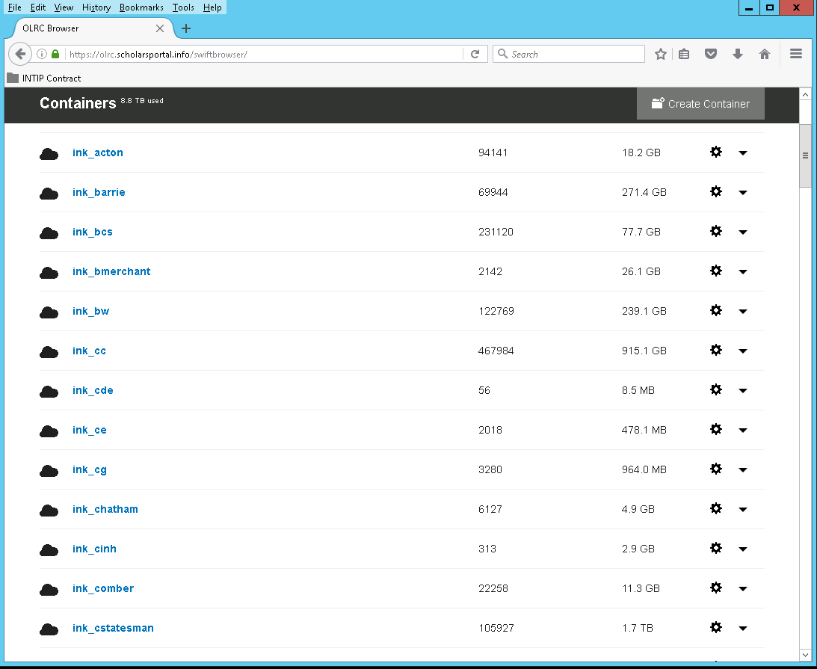
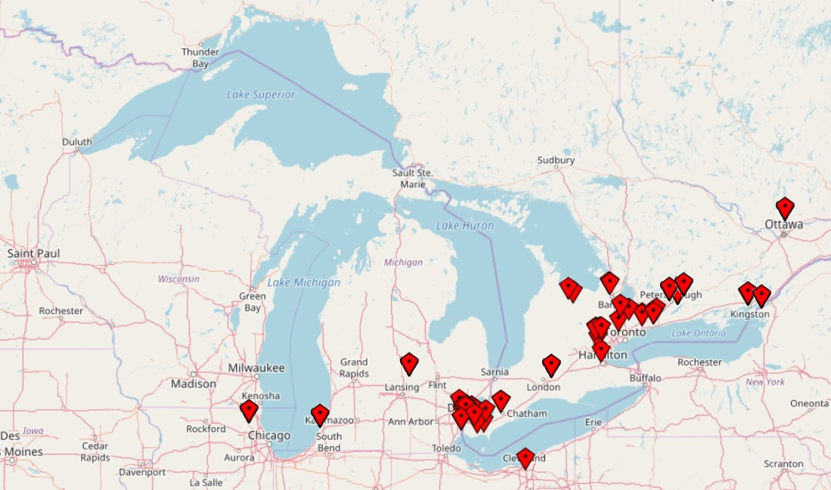
...
No. | Title | Coverage | Pages
1. | The Acton Free Press | 1875-1984 | 33,643
2. | The Acton Tanner | 1992-2001 | 3,154
95. | The Weekly Post (Lindsay) | 1900-1907 | 4,780
96. | Weekly Sun (Toronto) | 1895-1896 | 5,472
97. | The Welland Canal | 1835 | 12
98. | Western Dispatches (Michigan) | 1817-1854 | 4,823
99. | The Western Herald (Windsor) | 1838 - 1842 | 755
100. | Western planet (Chatham) | 1853-1856 | 1,240
101. | The Western Sentinel (Chatham) | 1847 | 320
102. | The Whitby Free Press | 1971-1996 | 34,422
103. | The Whitby Gazette and Chronicle | 1912-1941 | 2,795
104. | Wilmette Life | 1923-1966 | 45,831
105. | The Windsor Evening Record | 1893 -1918 | 71,789
106. | The Windsor Herald | 1855 - 1856 | 420
107. | The York Commonwealth | 1858-1963 | 997
108. | The York Herald | 1859-1890 | 946
 |  |  | 1,716,934
Ready to load...

Slide 9



real 24m41.785s
user 9m17.944s
sys 1m8.796s
2M * 25 minutes = 50M Minutes
833,333.33333…
Hours
34,722.22222…
Days
95+ Years
ink_efp/efp/1895_01/odw/00012/tiles/512/00012_x512_y5632.jpg
real 1m4.501s
user 0m9.028s
sys 0m1.164s
2M * 1 minute = 2M Minutes
33,333.3333…
Hours
138.88888…
Days
3.8+ Years
PUT /v1/AUTH_myaccount/my_backups/?extract-archive=tar.gz

Slide 10
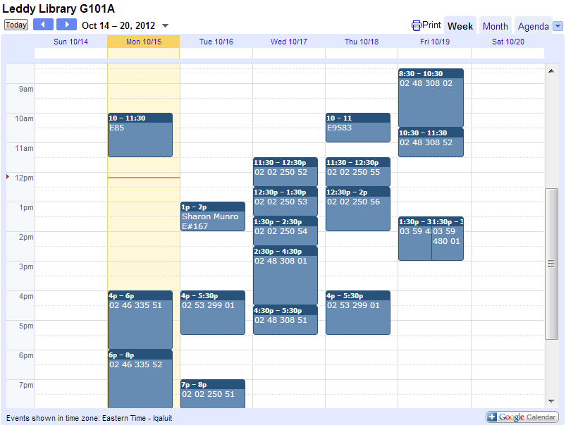
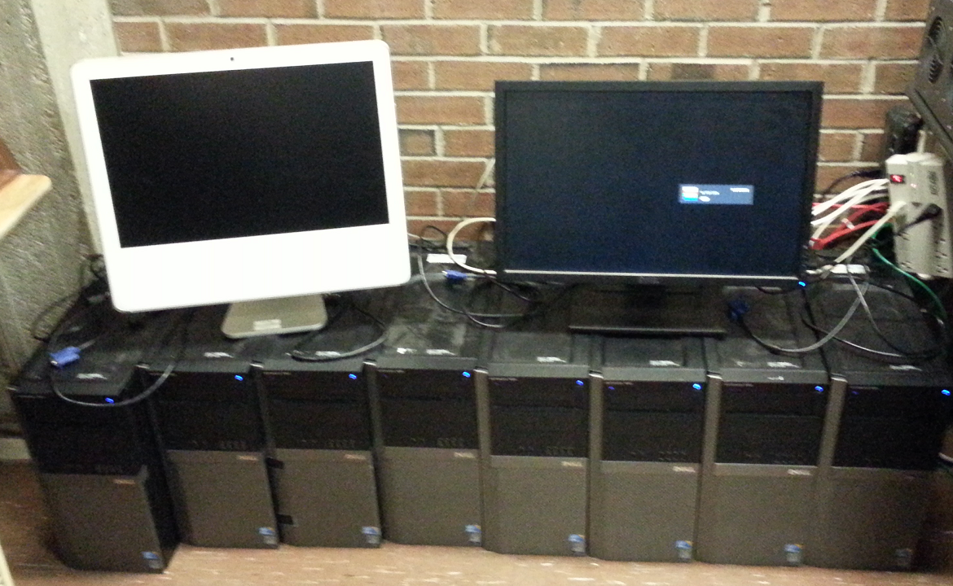
Concurrency saves the day!

Slide 11
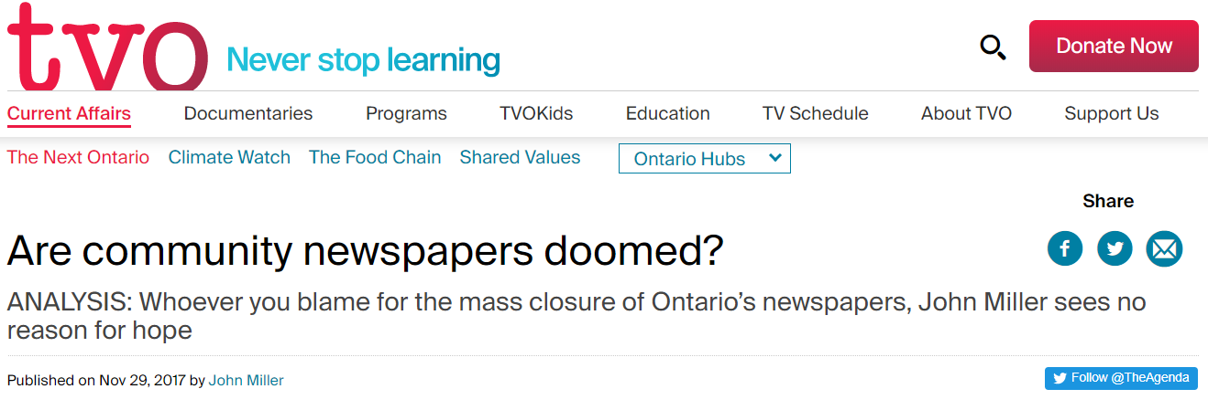
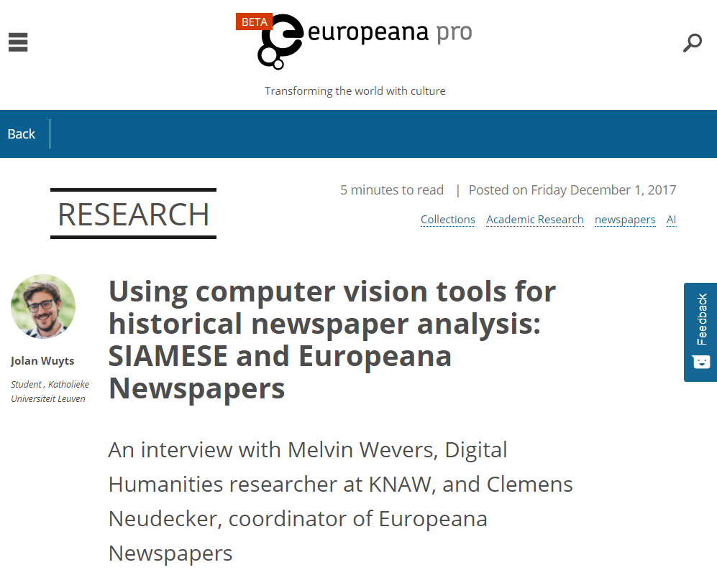
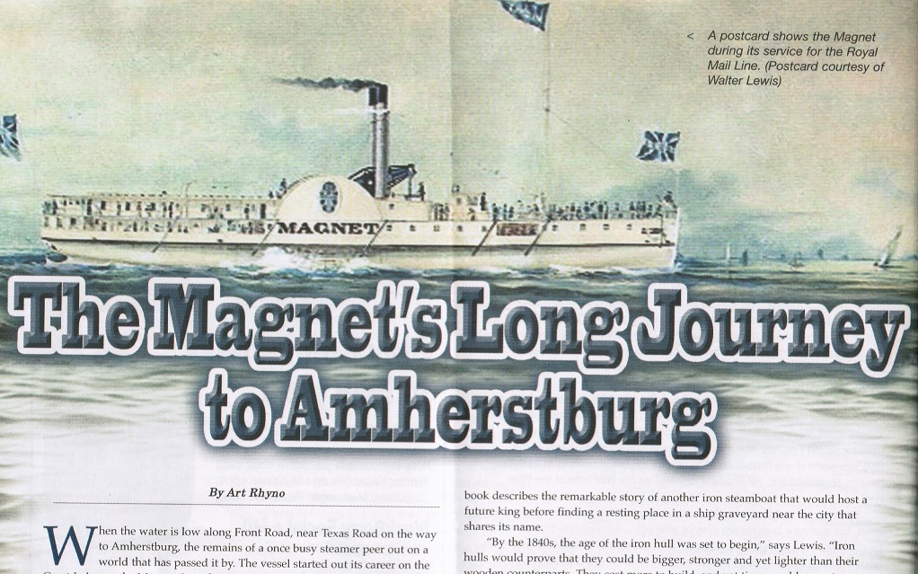
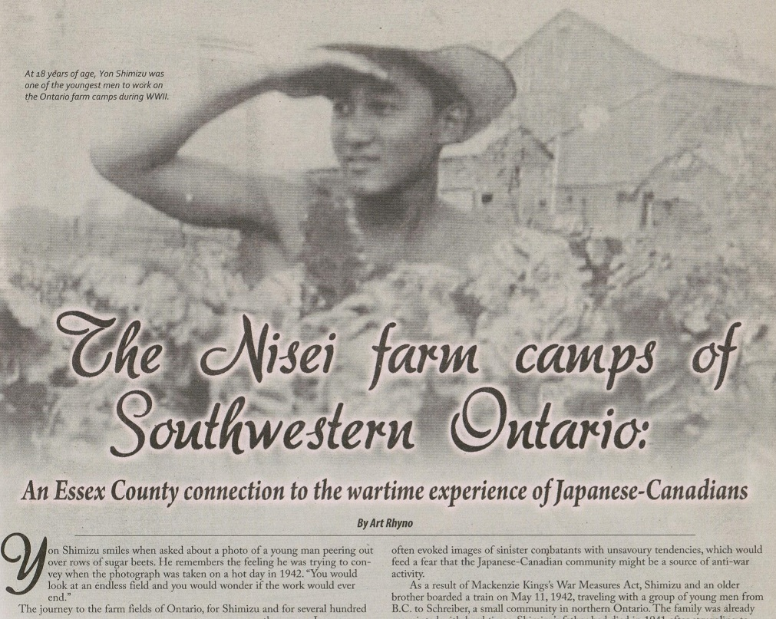
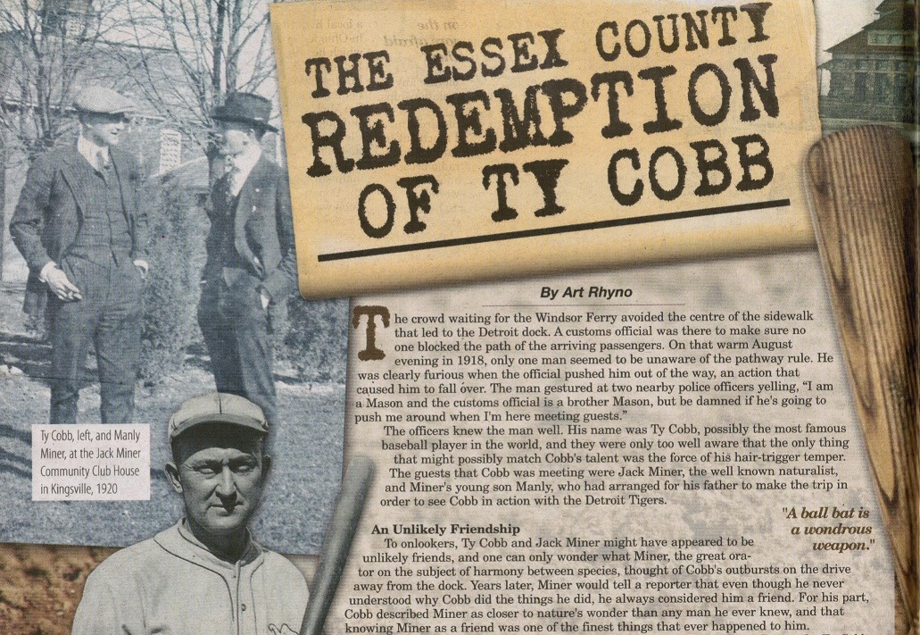

Slide 12
Thank you!

Slide 13
Migrating the
Canadian Opinion Research Archive (CORA) to <odesi>
Scholars Portal Day
December 8, 2017
Alexandra Cooper
Data Services Coordinator
Queen’s University Library

Slide 14
Provides access to commercial and independent surveys to academics, researchers and journalists
Data from CROP, Decima, Environics, Canadian Election Studies
Notes:
CORA provides access to commercial and independent surveys to academics, researchers and journalists. The archive includes data from as far back as the 1970s, from polling companies such as:
CROP – Political Surveys and Socio-Cultural Surveys
Decima Quarterly
Environics
Environmental Monitor, Focus Ontario, Focus Canada, Environics International
Canadian Election Studies
And a few Government surveys from
Environment Canada, Health Canada, Industry Canada, and Public Works and Government Services Canada

Slide 15
1992 - Established at School of Policy Studies, Queen’s University
2007 – CORA data made available through Nesstar webview
2010 – CORA metadata made discoverable in <odesi>
2017 – CORA data migrated to <odesi>
Notes:
It was established in 1992 at School of Policy Studies, Queen’s University, with support from the Library.
2007 – QUL began hosting a Nesstar server. CORA data was added to Nesstar and QUL provided technical support for the server and for marking up files. Users were able to view metadata but unable to download data; they would have to contact CORA directly to be given access to data files. Also, there was no way to efficiently search for CORA data.
2010 – CORA metadata made discoverable in <odesi> - XML files (metadata records) sent to <odesi> and added to the odesi search interface. Users were able to efficiently search for CORA data and from the results page were pointed back to the CORA site to view the records.
June 2017 – Elizabeth Goodyear-Grant, Director of CORA, agrees to open CORA data files and to have them migrated to <odesi>, allowing for better search ability of and access to the CORA data. This would also allow for the CORA data to be searched along with the Public Opinion Polls collection.

Slide 16


Data repository for social science and polling data
Public Opinion Poll Collections
Centre for Research and Information on Canada (CRIC) Gallop Canada Ipsos Reid | Angus Reid Institute Listening to Canadians Voice of the People
Notes:
<odesi> is the digital repository for social science and polling data. It has a large public opinion poll collection including CRIC, Gallop, Ipsos Reid, Angus Reid Institute, Listening to Canadians, and Voice of the People.

Slide 17

Migration
547 data files in CORA
Each reviewed to determine work needed to match <odesi> best practices
Scholars Portal – search and replace in XML files (metadata files)
Queen’s MarkIt Student – created new Nesstar files and published each one to <odesi>
Notes:
Planning started in summer of 2017 – inventory of what was in CORA, and what work would need to be done to move them into odesi
547 data files in CORA with accompanying documentation – a few – Centre for Research and Information on Canada (CRIC), Listening to Canadians, Canadian Election Surveys – already in odesi. CORA had some additional documentation that odesi did not and also some additional years of data that odesi did not.
Meeting with Scholars Portal about how migration; Kevin Worthington, programmer at SP, looked at automating the migration using Nesstar API – didn’t work out; switched to a more manual process in September.
Some basic cleanup of the metadata files were made before migrating including changing documentation links from CORA server to odesi server; SP provided these new XML files to QUL.
QUL – MarkIt Student – merged new xml files with data files creating a new Nesstar file and published files to odesi one by one
Once the files were published to odesi, SP then assigned the CORA files to ‘Public Opinion Poll’ group and ‘CORA’ group and made the data files open to world

Slide 18
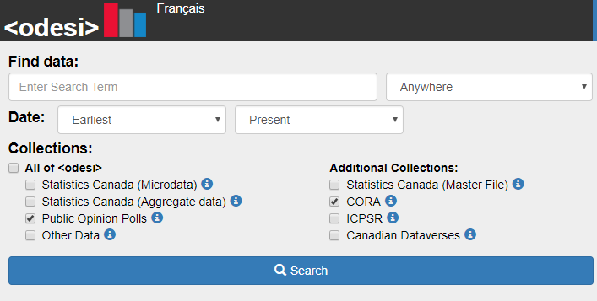
Notes:
Search for CORA files as part of:
All of odesi
Public opinion polls collection
CORA
Access – made open to the world for teaching and research purposes but not for any profit making purpose; all users can download datasets.
CORA data is now more accessible to the various communities it serves including students, faculty, government and think tank researchers, and journalists.

Slide 19
Next Steps
Improving metadata records for better search results
Paper documentation
French records
More data
Ontario Data Community – Public Opinion Polls Working Group
  Highlight and promote collection
Notes:
Some of the CORA records don’t have question text included so can’t search at variable/category level and some are missing keywords – adding this will improve searching
Paper documentation – extract information from paper documentation – using questionnaires and codebooks to add question text; additional metadata to records
Discovered on the CORA computer that there are French versions of some of the datasets. Inventory these to see what is available and if there is enough documentation to add to the French collection.
Work with CORA to get current datasets that they have.
ODC Public Opinion Polls Working Group – sub-group of the ODC will look at how to highlight and promote the Public Opinion Polls Collection in <odesi>

Slide 20
Questions?
Alexandra Cooper
Queen’s University
coopera@queensu.ca
open.scholarship.services@queensu.ca

Slide 21
We Did a Thing!
UTransfer: An OwnCloud Success Story
Steve Marks
University of Toronto Libraries
Scholars Portal Day 2017

Slide 22
The Problem
Transfer of electronic archival records in a way that is:
  (Relatively) secure
  Easy-to-use
  Allows for back-and-forth between the department and the records archivists
  Easy to implement

Slide 23
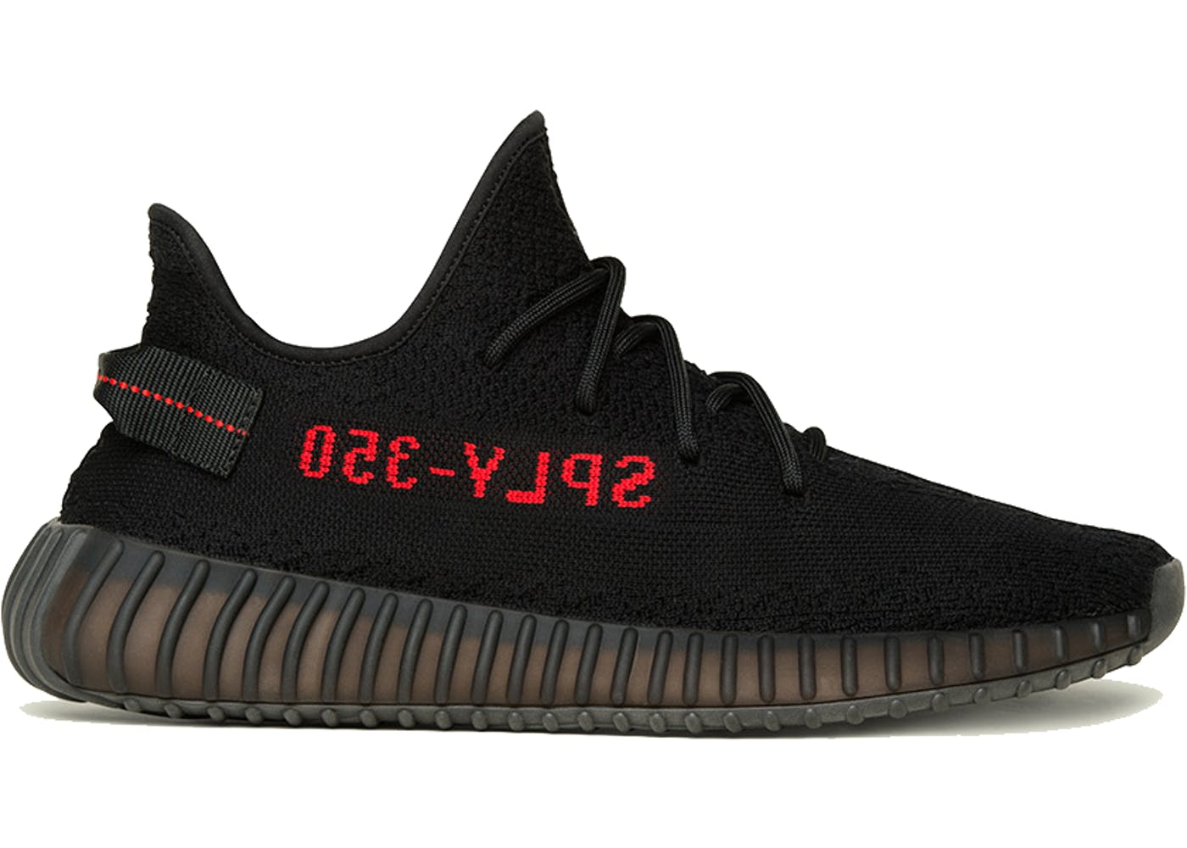
The AS-IS Implementation

Slide 24

Enter: OwnCloud

Slide 25
The Project
Define workflows
Set up accounts
Pilot departments
Operationalize

Slide 26
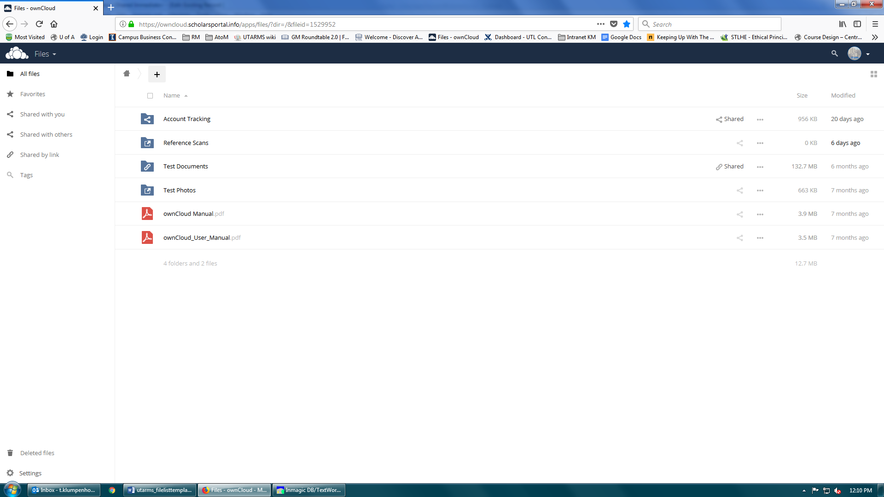

Slide 27
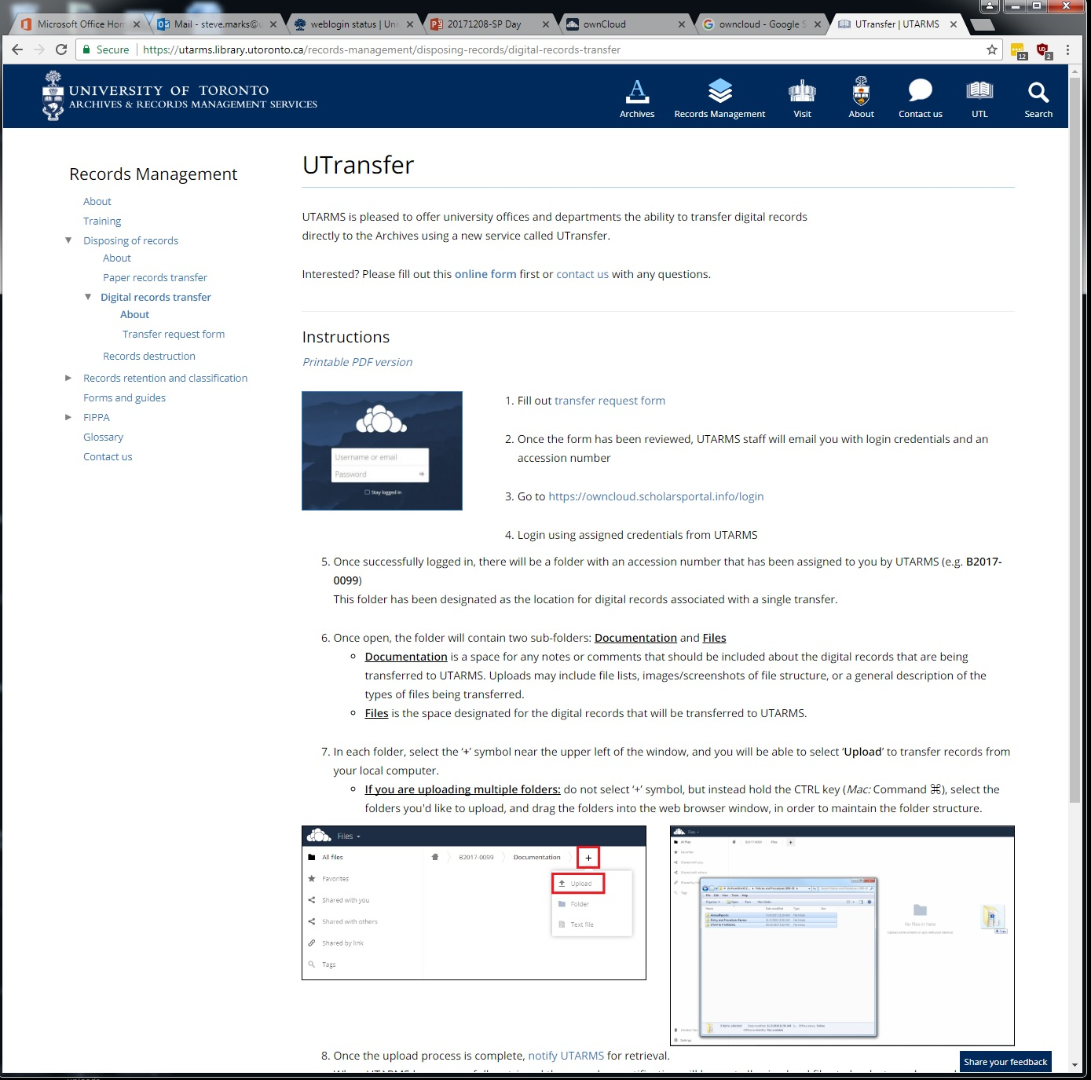

Slide 28
The Future
Individual user logins via Shibboleth
Other uses – research data?

Slide 29

Thanks!
https://utarms.library.utoronto.ca/records-management/disposing-records/digital-records-transfer
steve.marks@utoronto.ca (that's me)
utarms@list.library.utoronto.ca

Slide 30
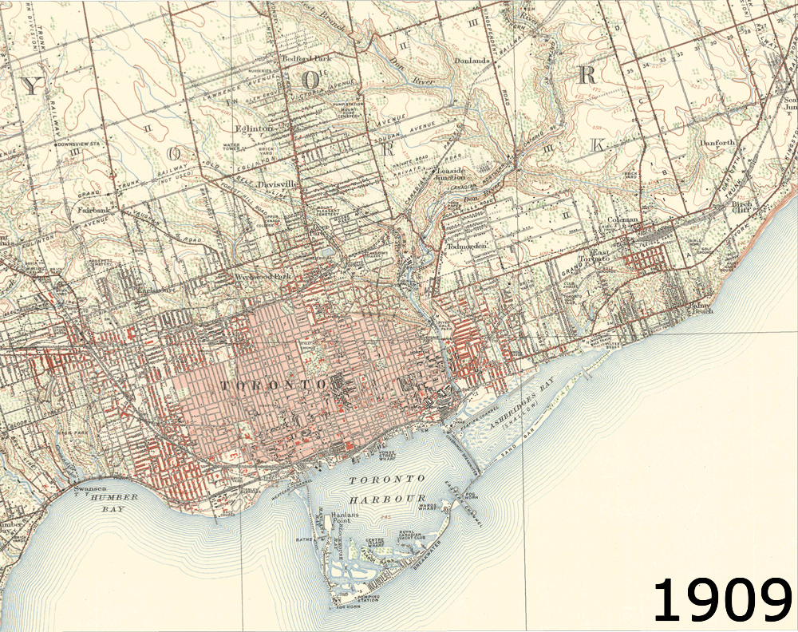


From Historical Maps...
...to Geospatial Information
The OCUL Topo Map Digitization Project
Jay Brodeur, McMaster University Library
OCUL-Geo Community
SP Day Lightning Talk | December 8, 2017
Toronto, 1" = 1 mile, 1909-1949
Notes:
From Historical Map to Geospatial Information: The OCUL Topo Map Digitization Project

Slide 31
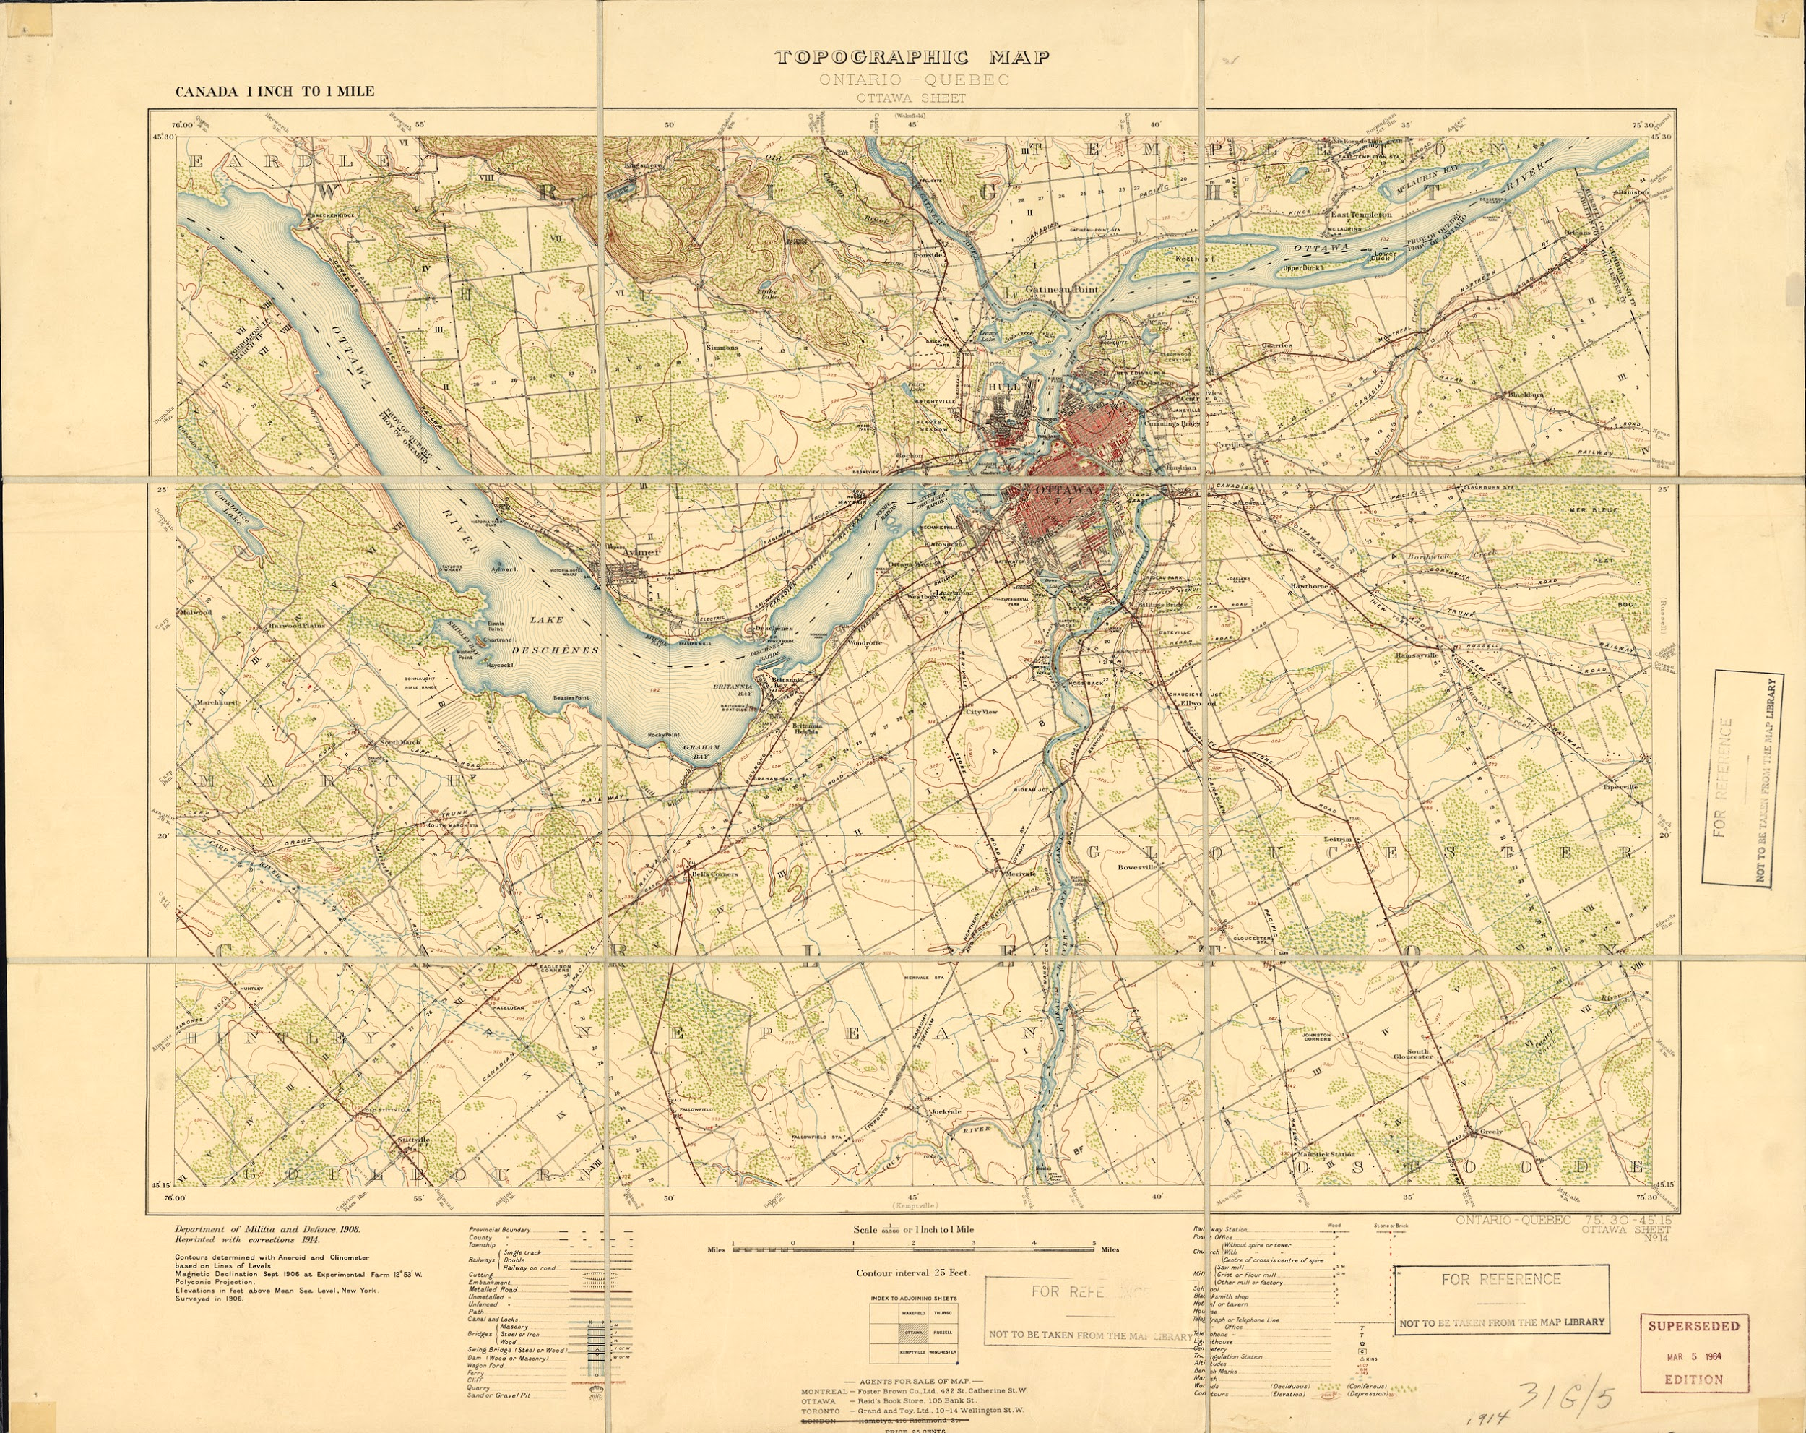
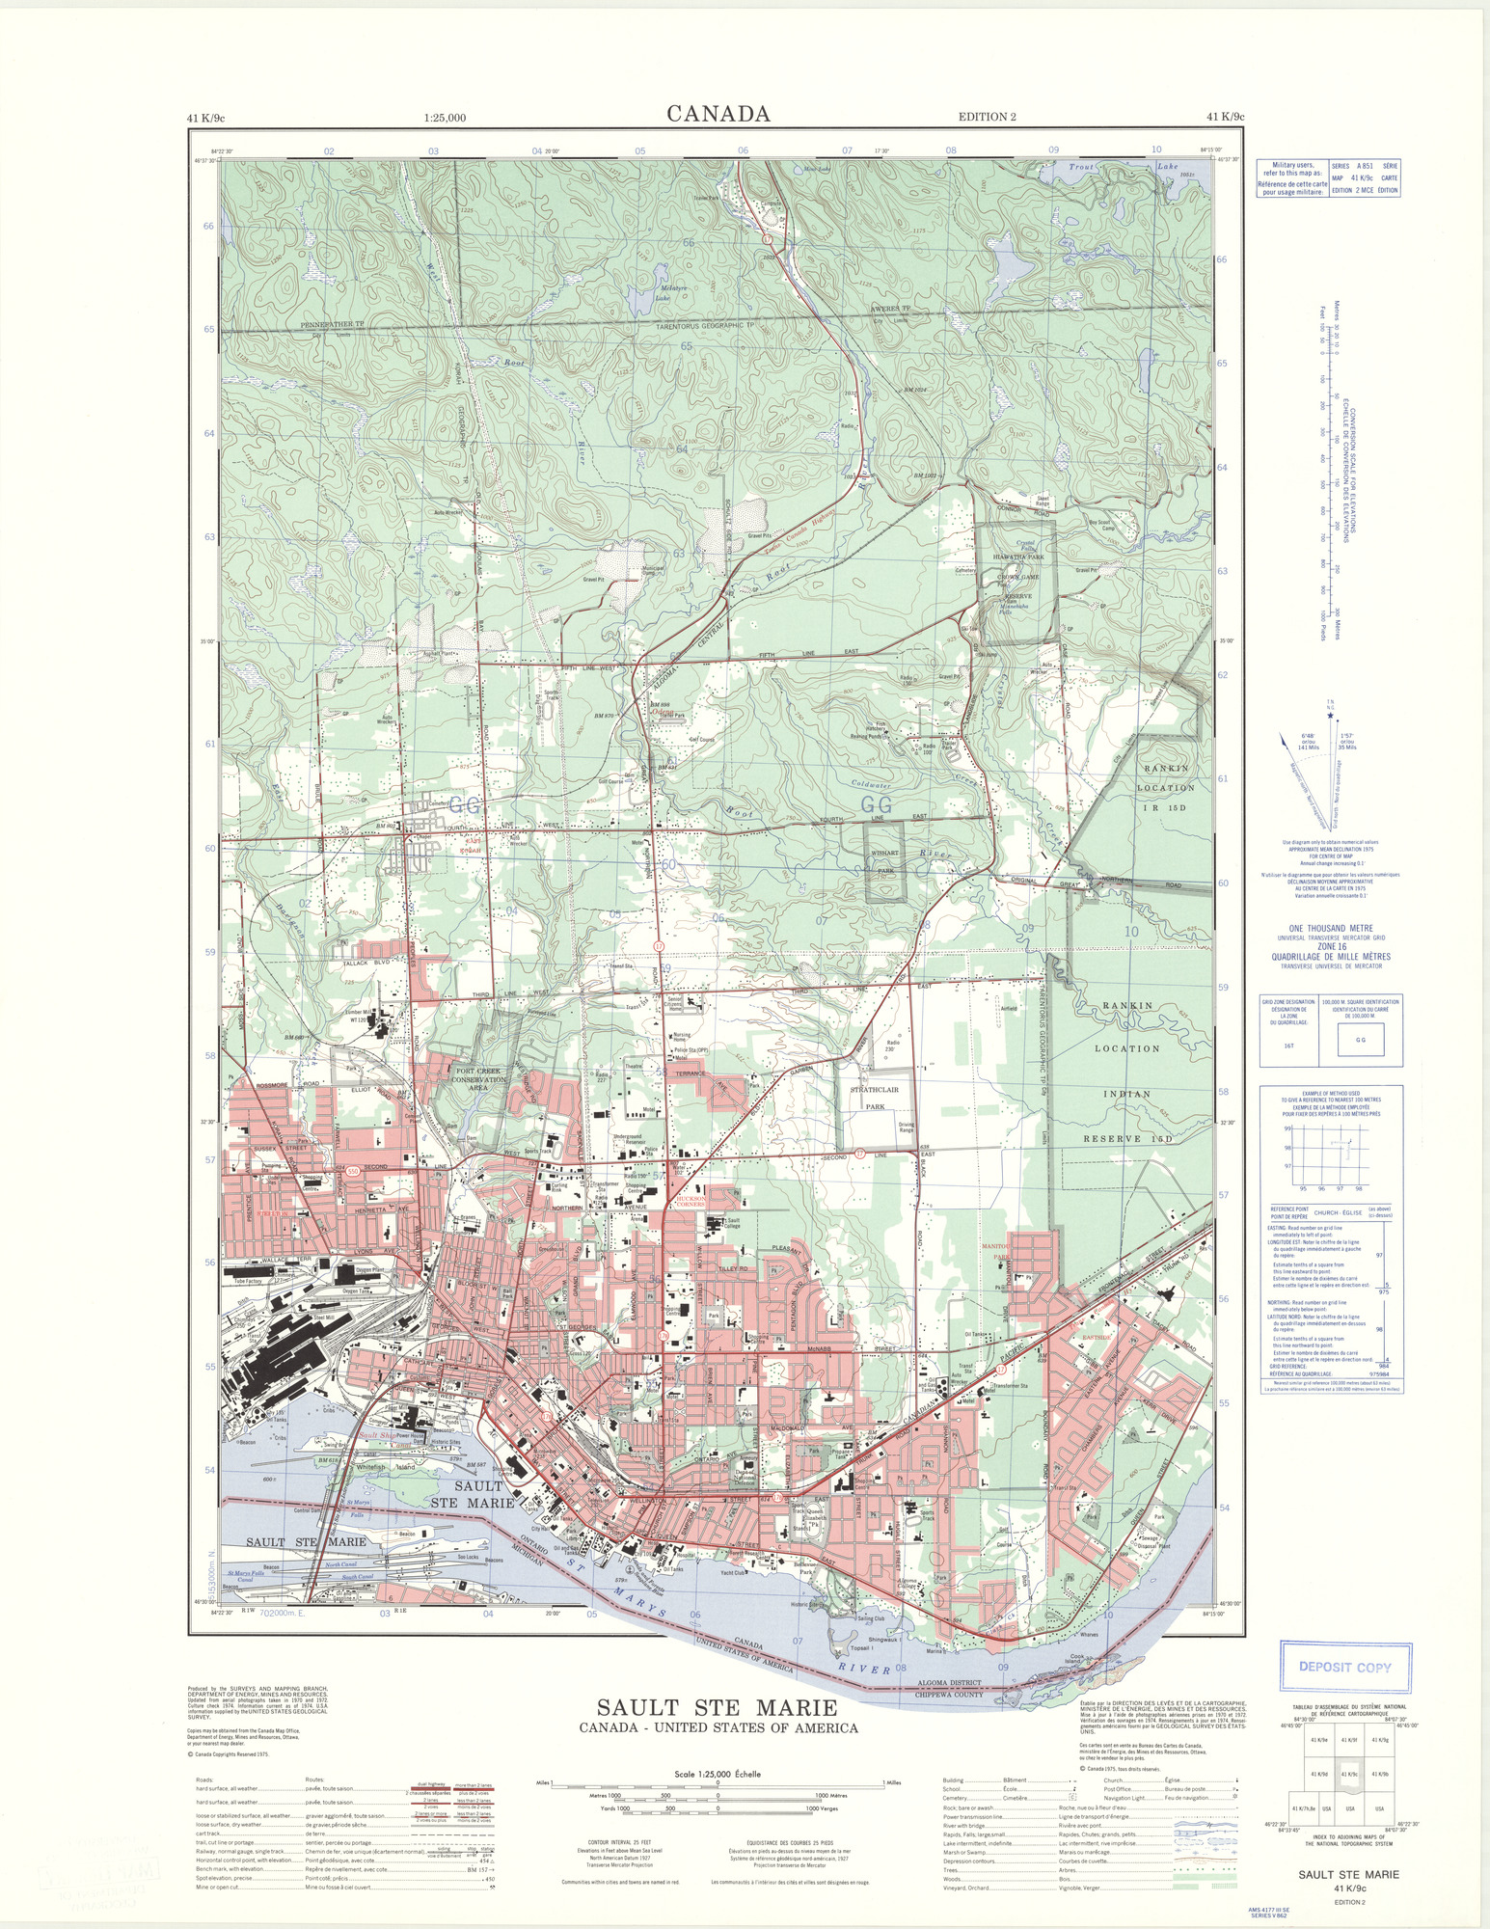
The Project
The OCUL Historical Topographic Map Digitization Project set out to inventory, digitize, georeference, and provide broad access to early topographic maps of Ontario.
Over 1000 maps spanning 1906 to 1977 in two series:
1:63,360 (1” = 1 mile)
1:25,000
Notes:
Public domain for 1” to 1 mile; permission from NRCan to publish all post-1967 1:25000 sheets

Slide 32
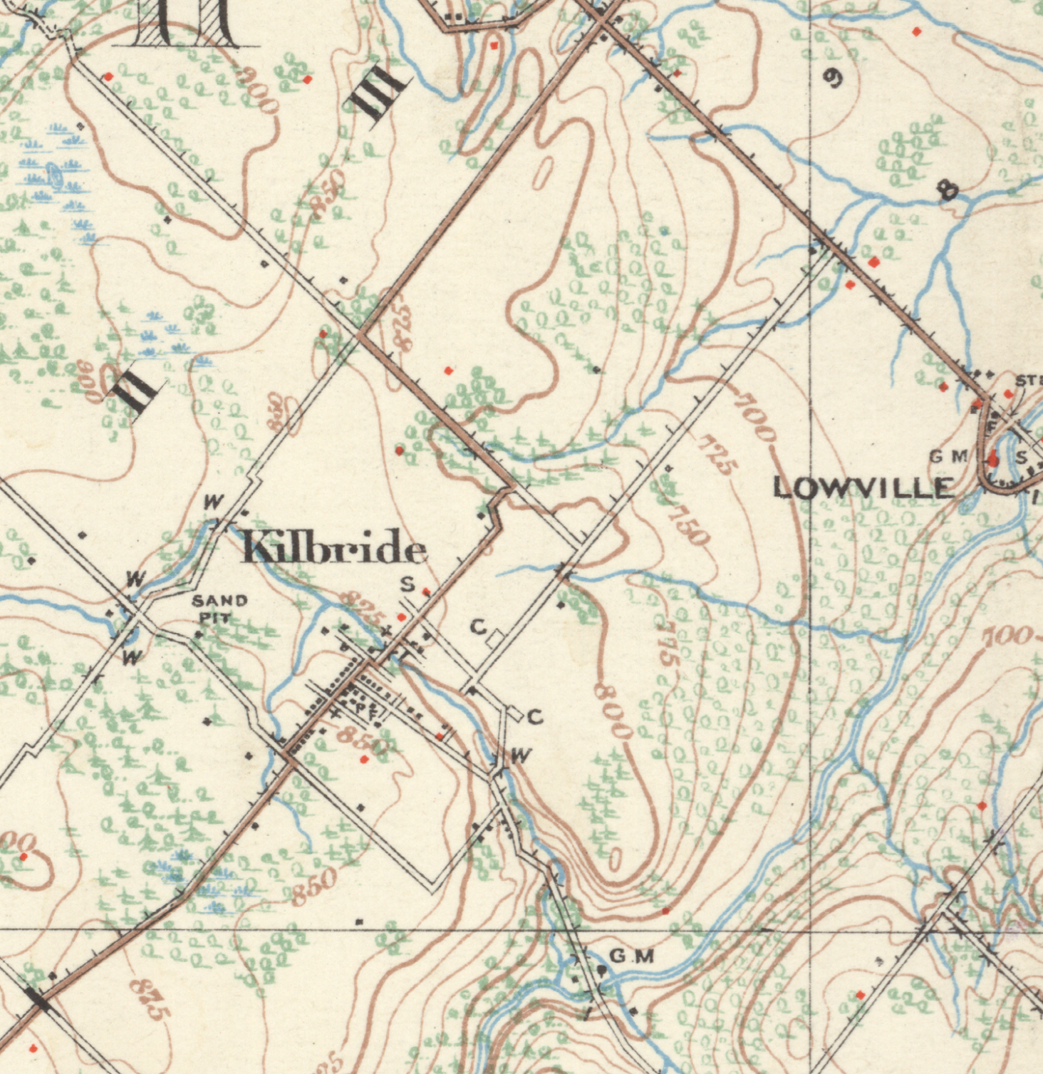
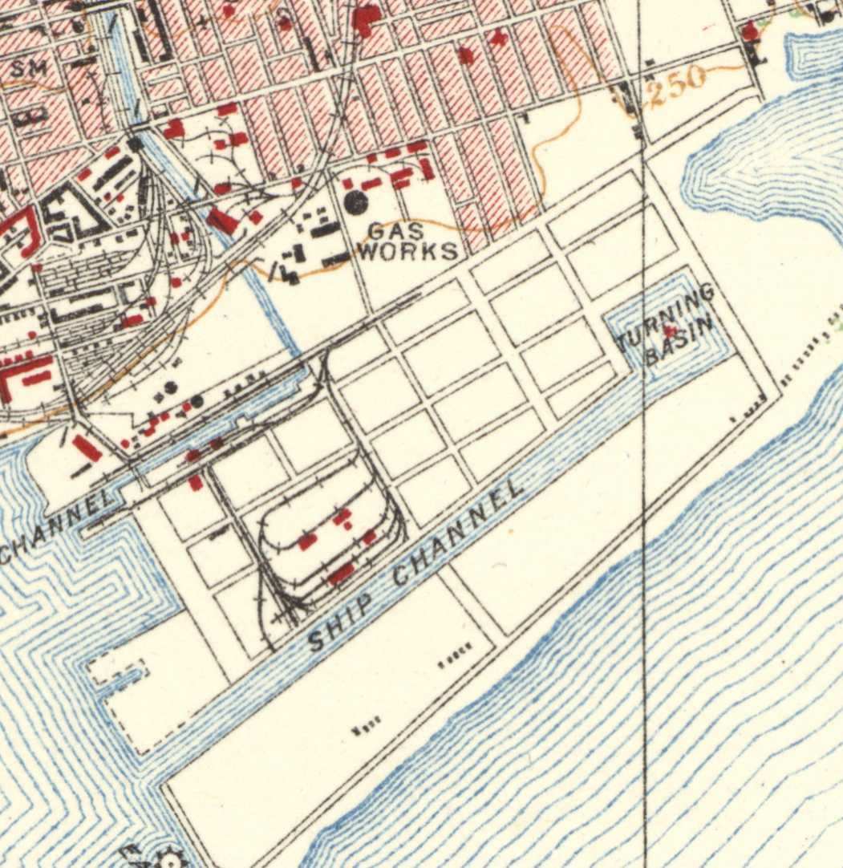
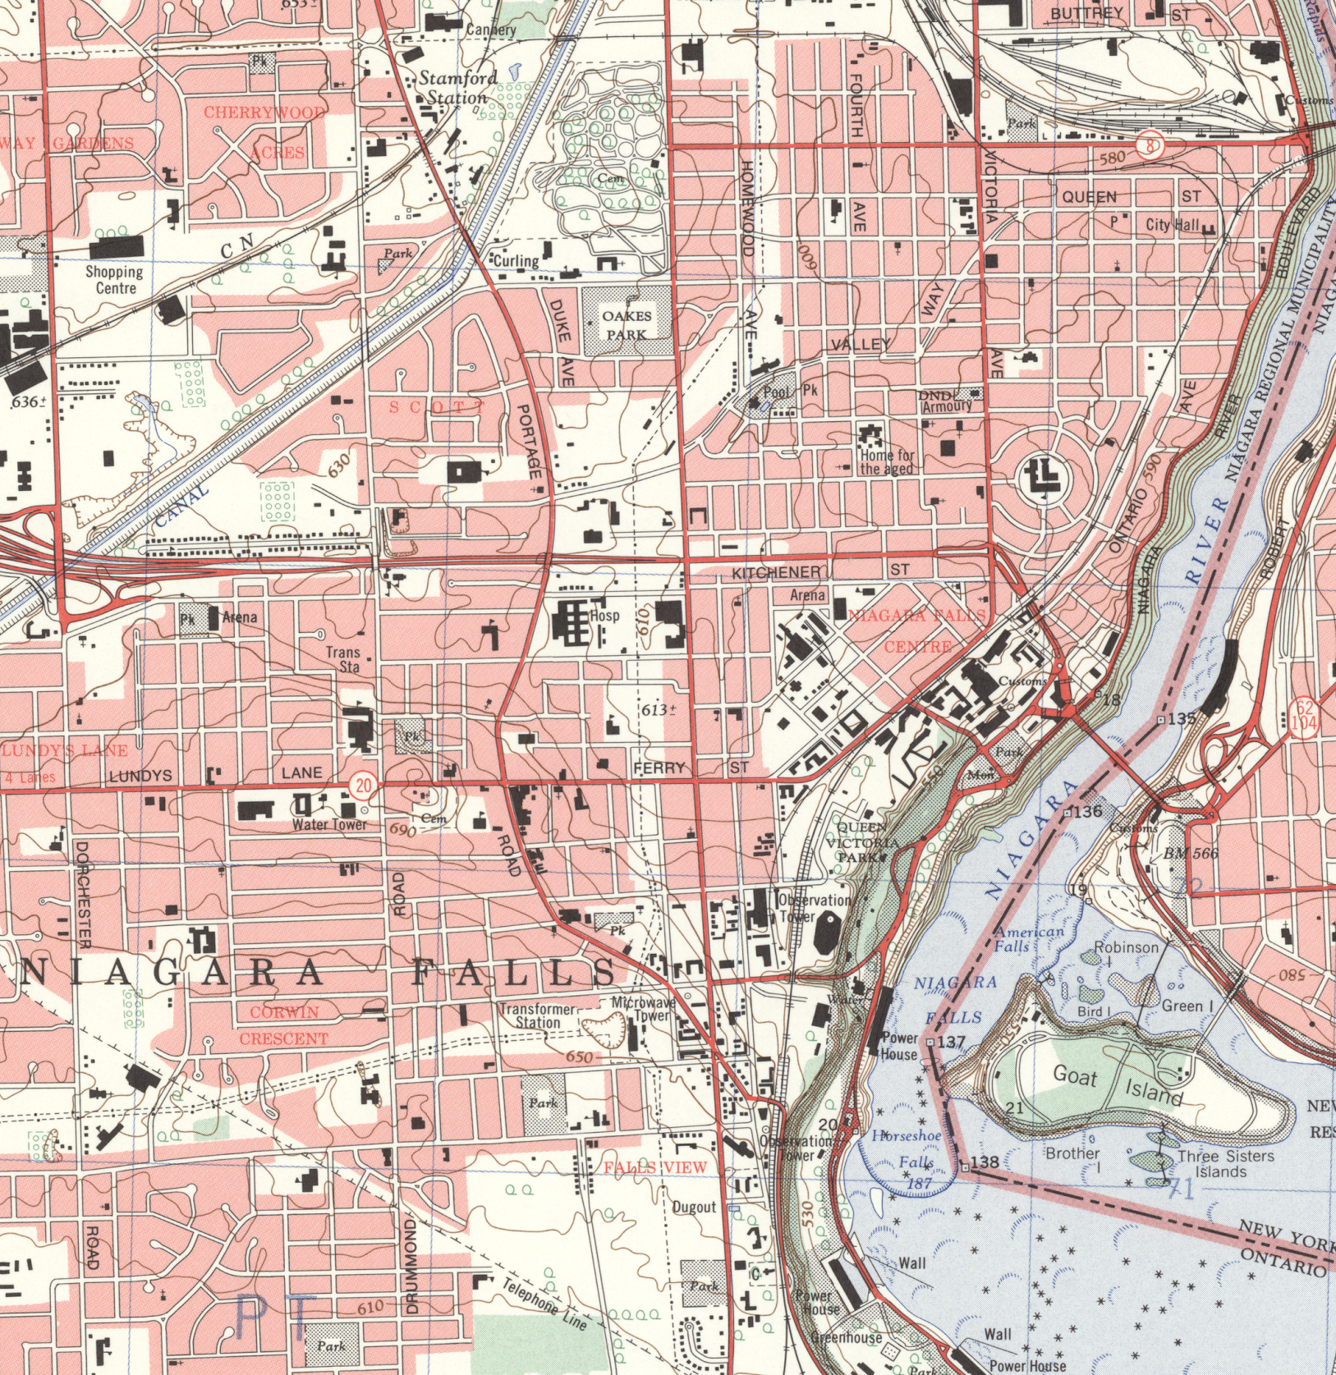
Why These Maps?
Value for academic, commercial, and public research
No organization/institution had access to a province-wide set of these series
  Opportunity to create an open, shared collection

Slide 33
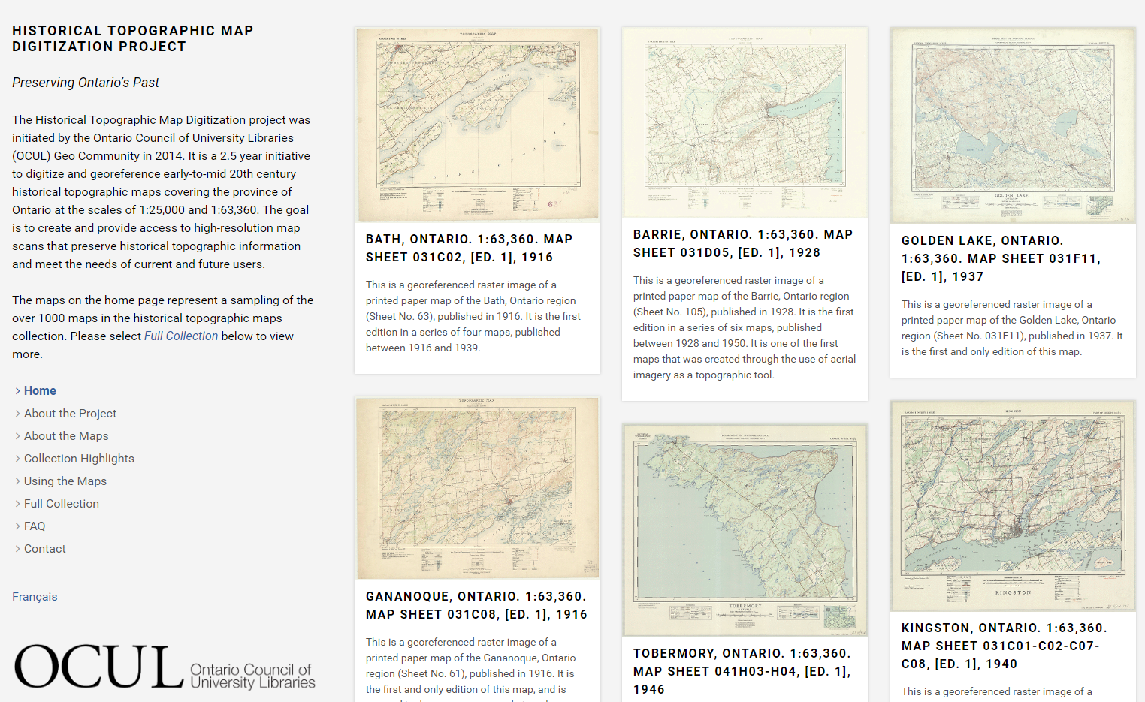
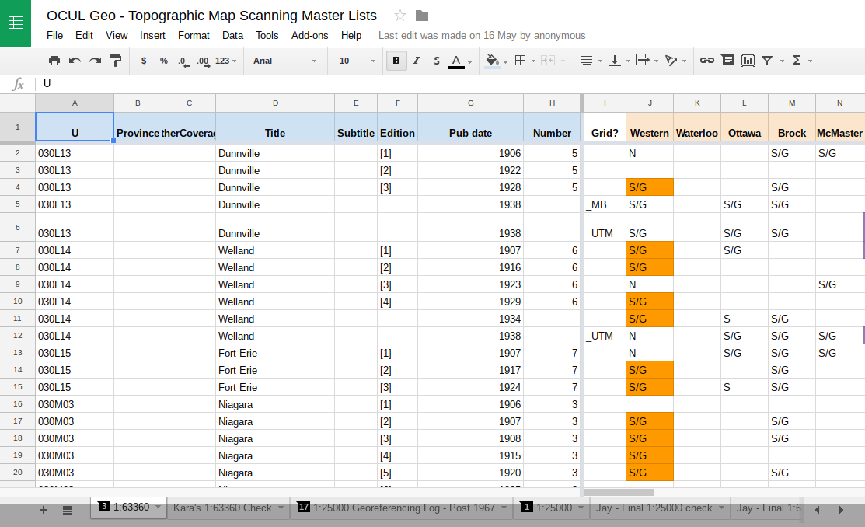
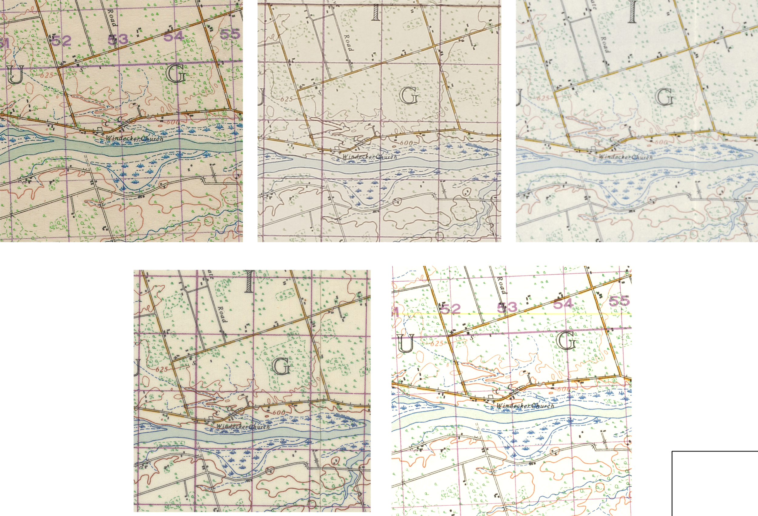
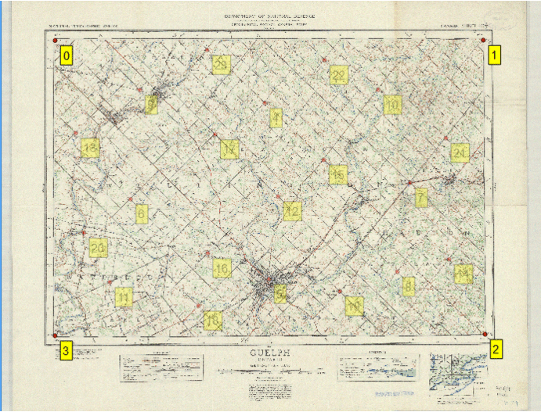
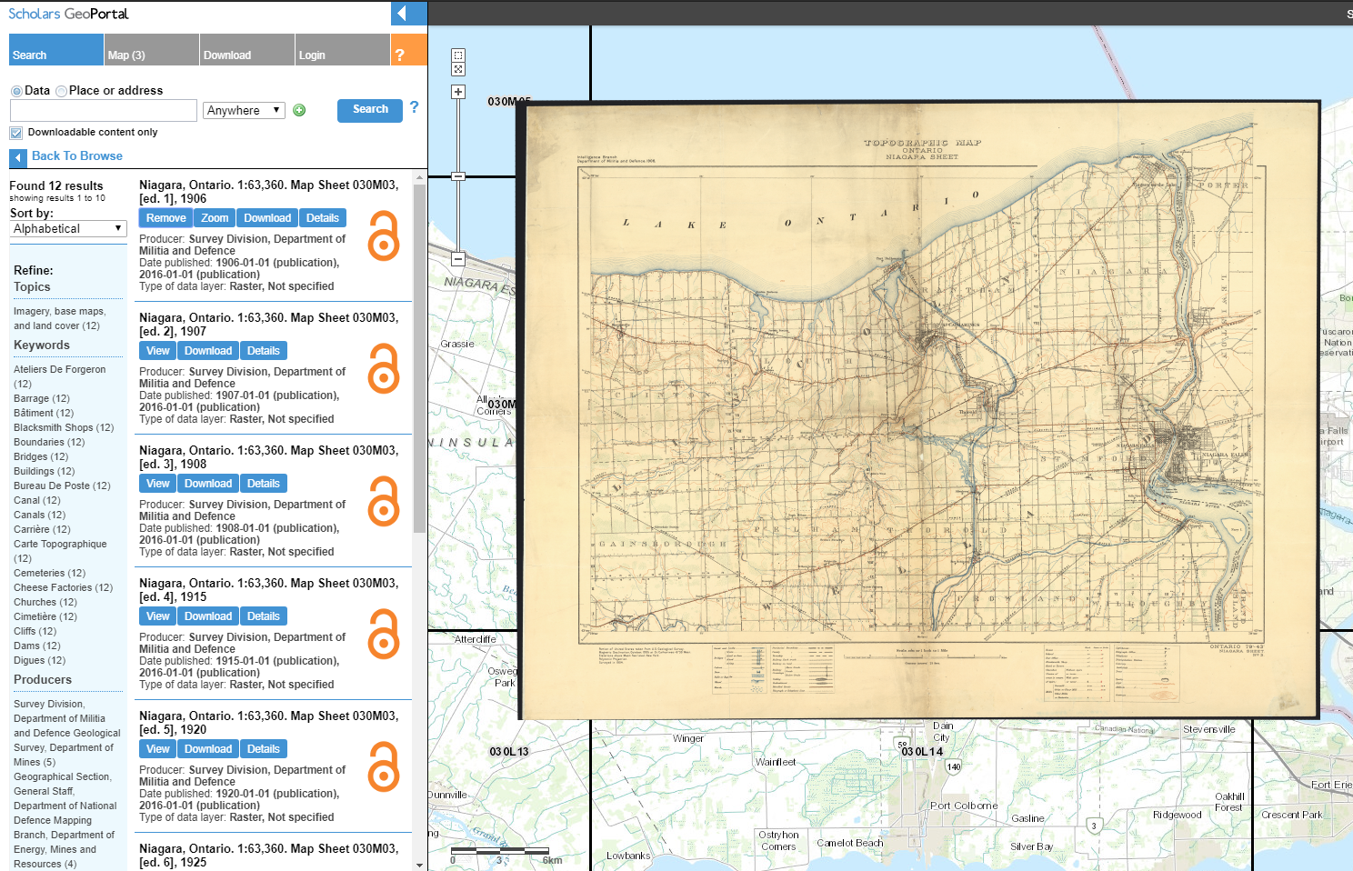
2011-2013: Preliminary work
2014-2017: The funded project
Inventory of OCUL institutions, LAC, OA, TRL
Standards created for scanning/georeferencing
Sheets digitized and georeferenced
Derivatives created (JPGs, GeoTIFFs)
Metadata and services created
GeoPortal customized
Project website created
Notes:
2011: Topographic maps identified as a strategic goal by the OCUL Map Group (now the OCUL Geo Group)
2012-2013: Preliminary steps
An inventory of Canadian federal government maps was created
A small digitization group began preliminary work
Funding application
2014:2017
Range of tools
Student assistant contributions

Slide 34
By the numbers
41 named contributors
18 contributing organizations
1091 digitized map sheets
804 GB of raw TIFF images
10087 manually registered GCPs

Slide 35

















Collaborators
Notes:
JAY

Slide 36
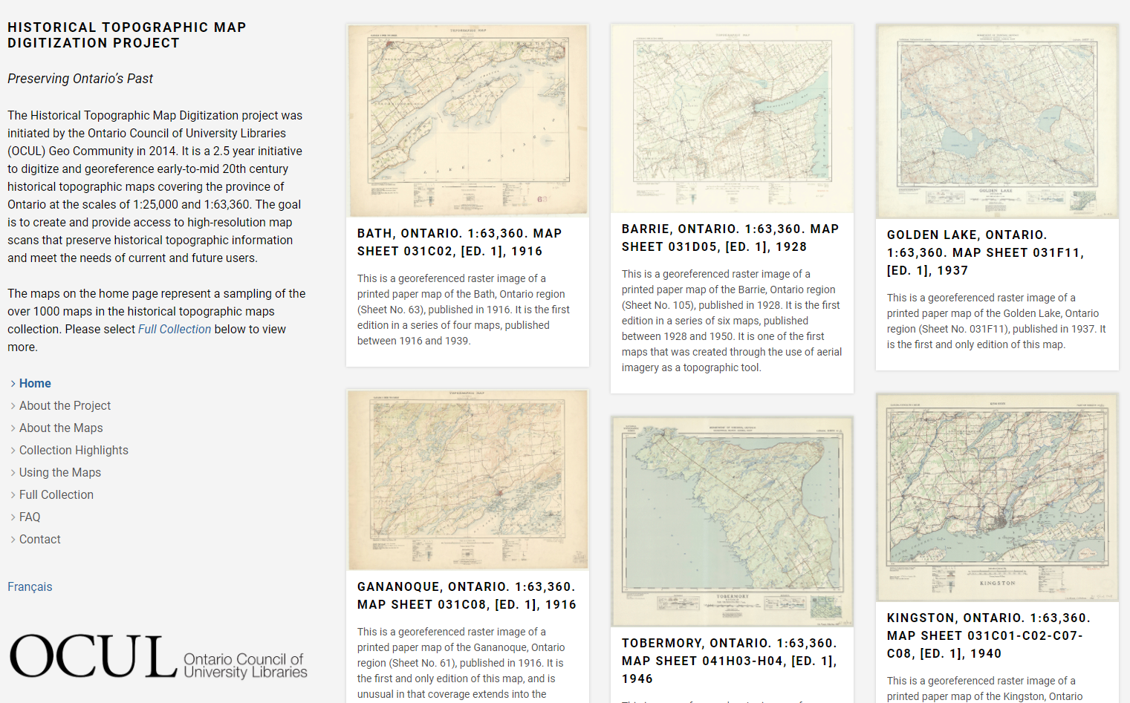
Project Website
ocul.on.ca/topomaps
Notes:
Talk briefly about each section: most time on how to search for maps in the ‘full collection’, what the different information available in ‘using the collection’ is, and quickly point out the collection highlights. Links well into the section on navigating in the GeoPortal.
http://geo.scholarsportal.info/#r/details/_uri@=HTDP63360K031G02_1909TIFF

Slide 37
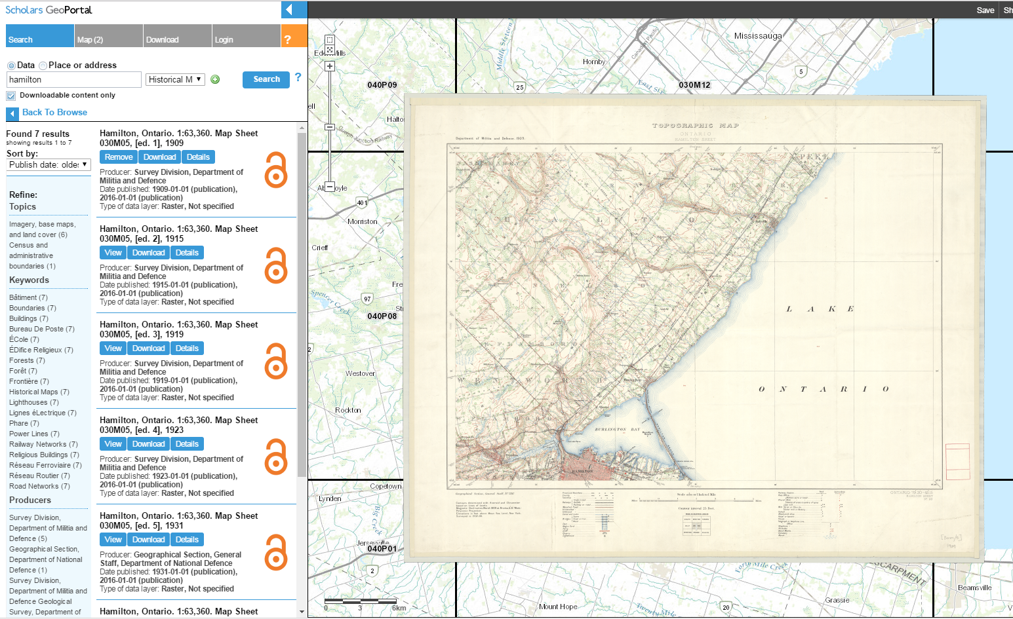
Scholars GeoPortal
geo.scholarsportal.info
Notes:
Introduce the GeoPortal — this is an excellent opportunity to talk about what it is, and show people how to use it (and discuss what data is available to them!)
Basic intro - how to navigate around in the GeoPortal
How to locate indexes - introduction to the indexes and why they’re so great. How to use them to explore the collection and locate maps
Download/details buttons after you’ve found a map
Download a map to the local computer.
How to load (and remove) a map in the portal, and explore it once it’s been loaded (adjust transparency, base maps, multiple maps,)
For example: use Niagara 030M08 - 1907 and 1930
Other ways to locate maps (may not cover all)
Search using the ‘historical maps’ dropdown (essentially the same as searching in the website)
Search by area

Slide 38
Next Steps
Identify and digitize additional Ontario series
OCUL Geo Working Group
Explore national topo map digitization project
National Working Group
Long-term preservation for digital products
Scholars Portal Permafrost (Archivematica) Pilot
Continue to solicit feedback
Tell us what you want & think!

Slide 39
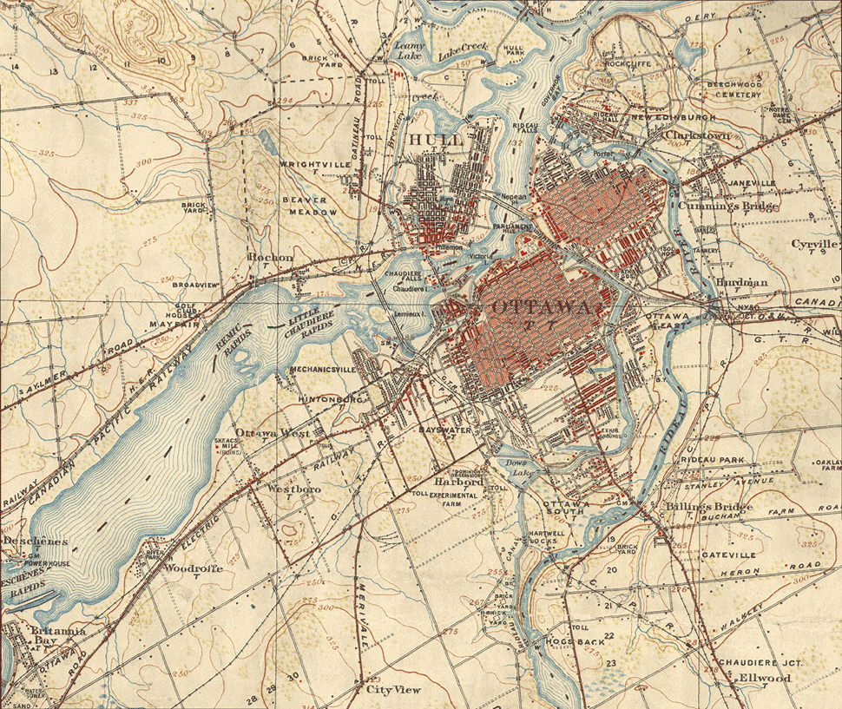
Thank
You
Explore more at:
ocul.on.ca/topomaps
E-mail us:
topomaps@scholarsportal.info
Use our stuff:
github.com/scholarsportal/historical-topos
github.com/jasonbrodeur/OCUL_HTDP
Ottawa, 1" = 1 mile, 1906-1948
Notes:
Github:

Slide 40
Questions?
slido.com
#spday17
Community Content in the Cloud
Art Rhyno, University of Windsor
Migrating the Canadian Opinion Research Archive (CORA) to <odesi>
Alexandra Cooper, Queen’s University
UTransfer: An Owncloud Success Story
Steve Marks, University of Toronto
From Historical Map to Geospatial Information: The OCUL Topo Map Digitization Project
Jay Brodeur, McMaster University, on behalf of the OCUL Geo Community

