Slide 1
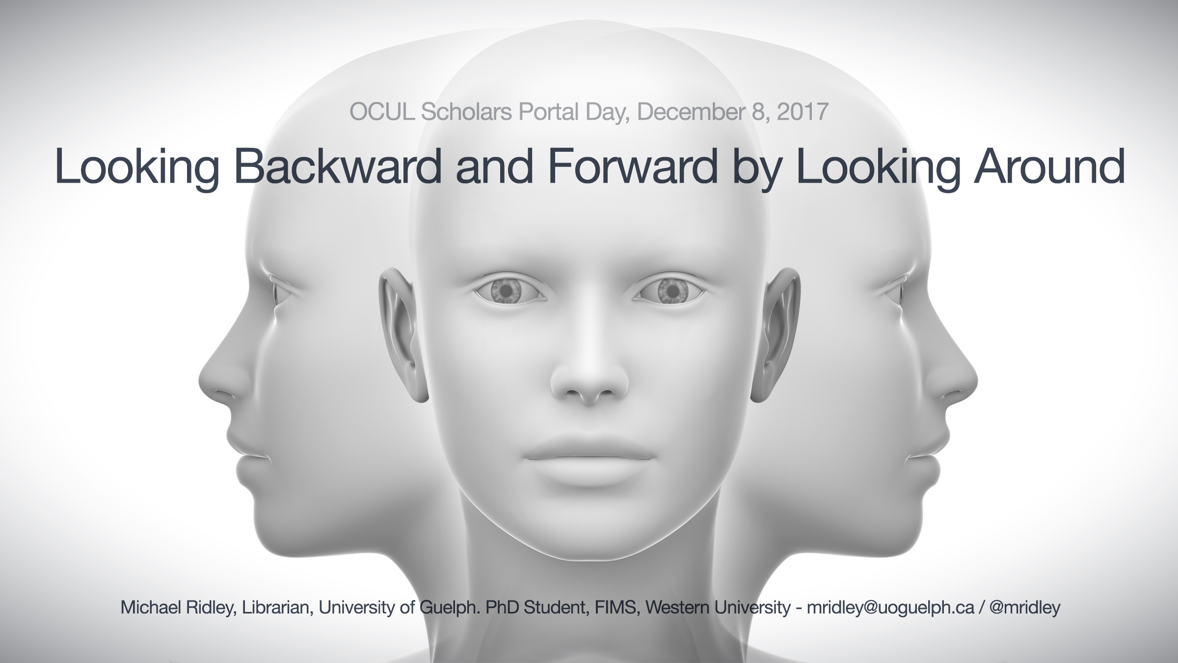

Slide 2
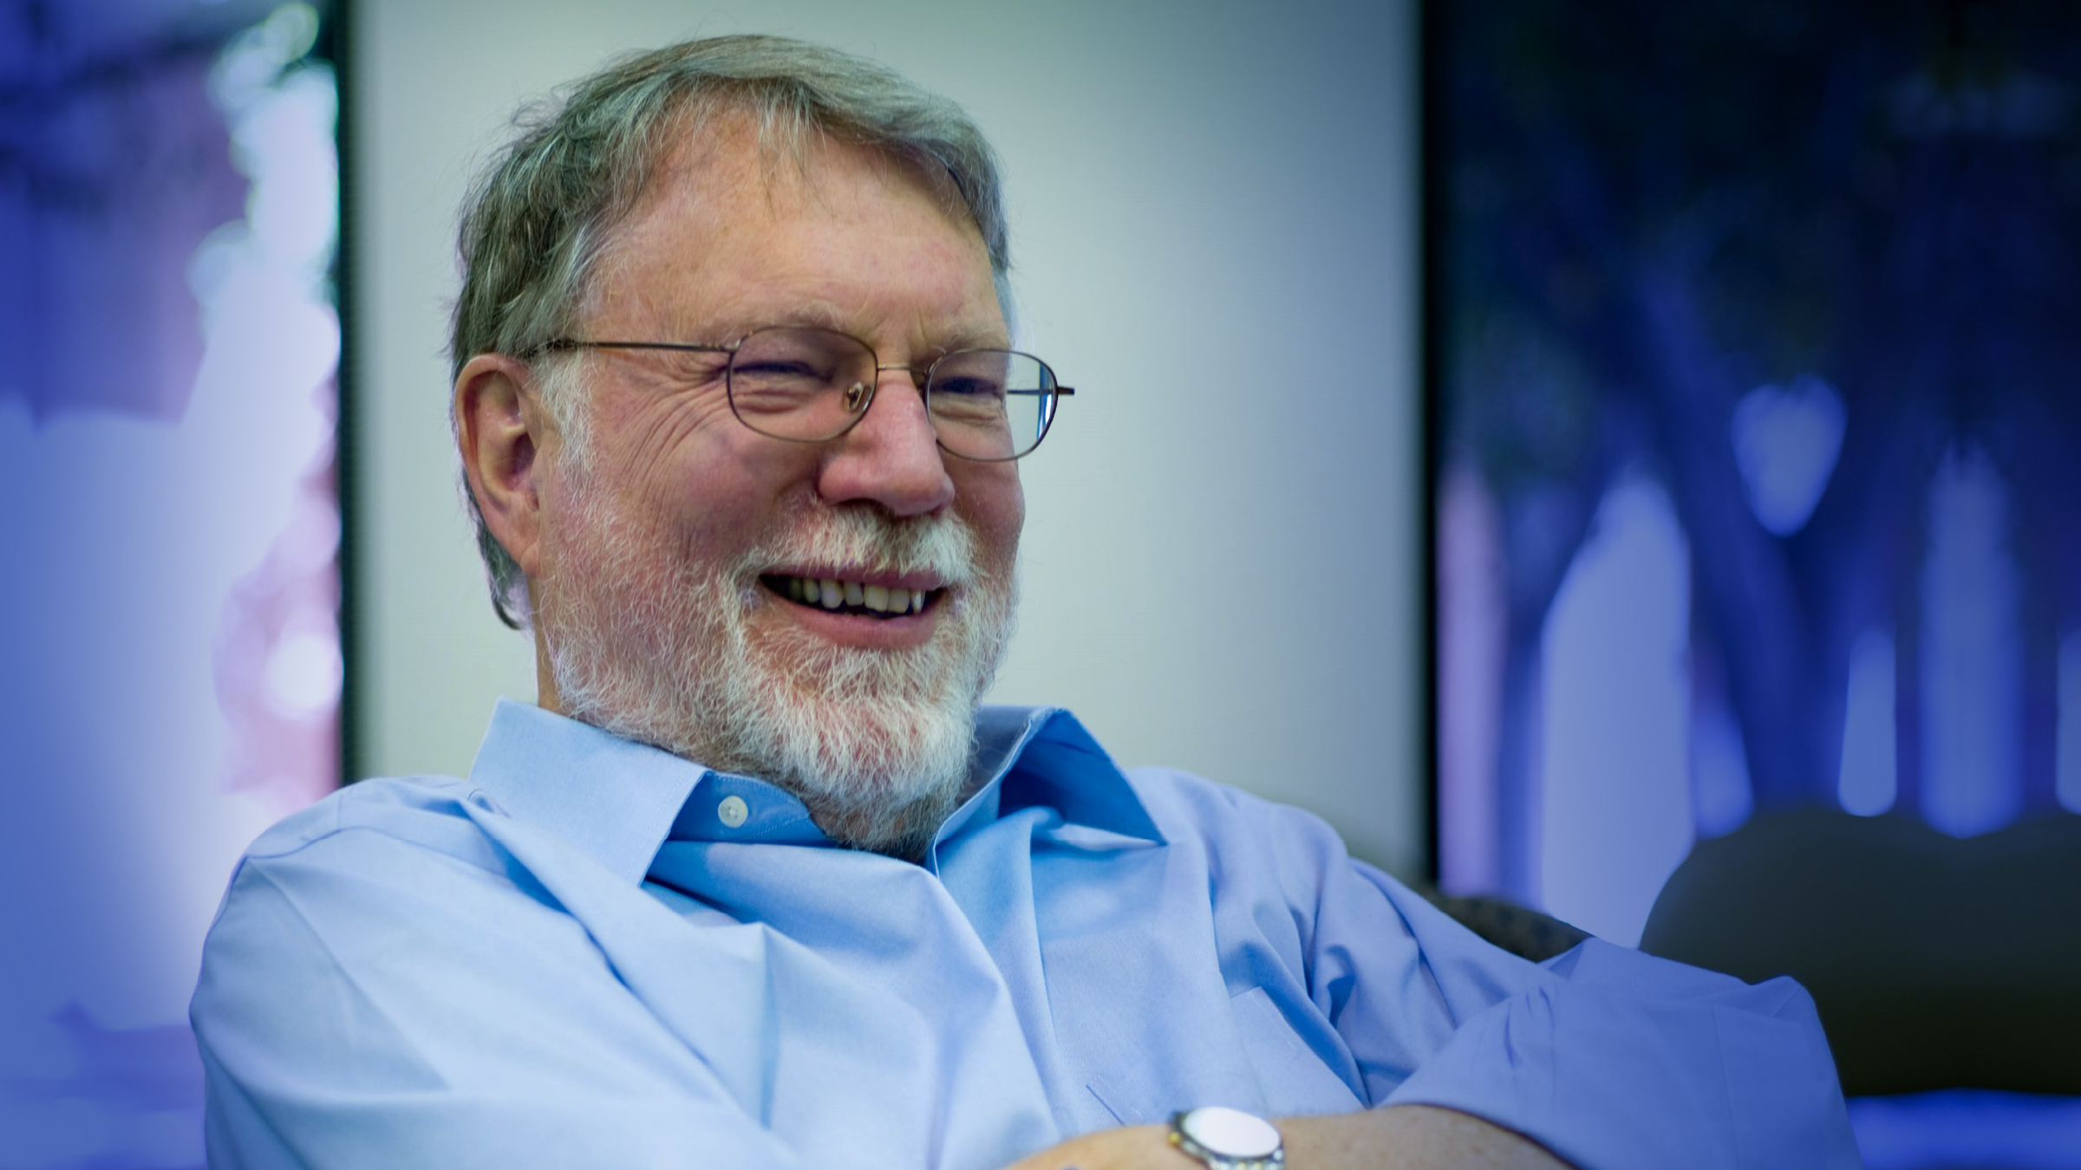
"If we're to move forward, we must not limit ourselves to merely looking ahead, but we must also learn to look around."
John Seely Brown
The Social Life of Information

Slide 3
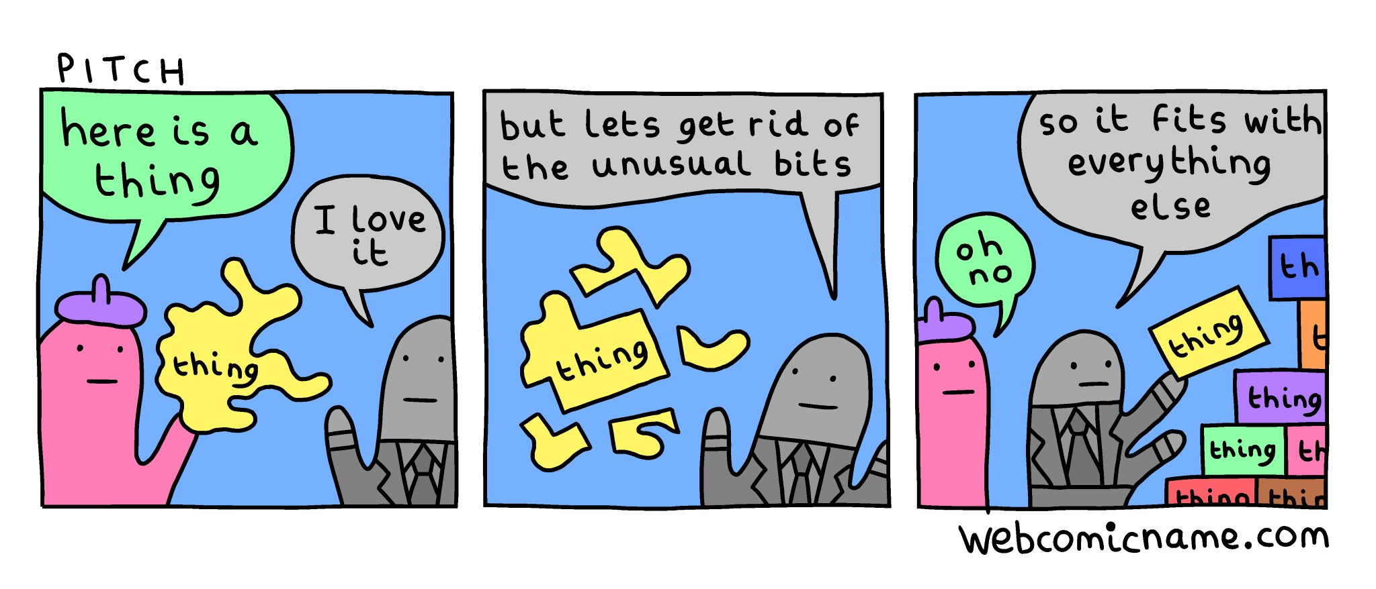

Slide 4


Slide 5


Slide 6
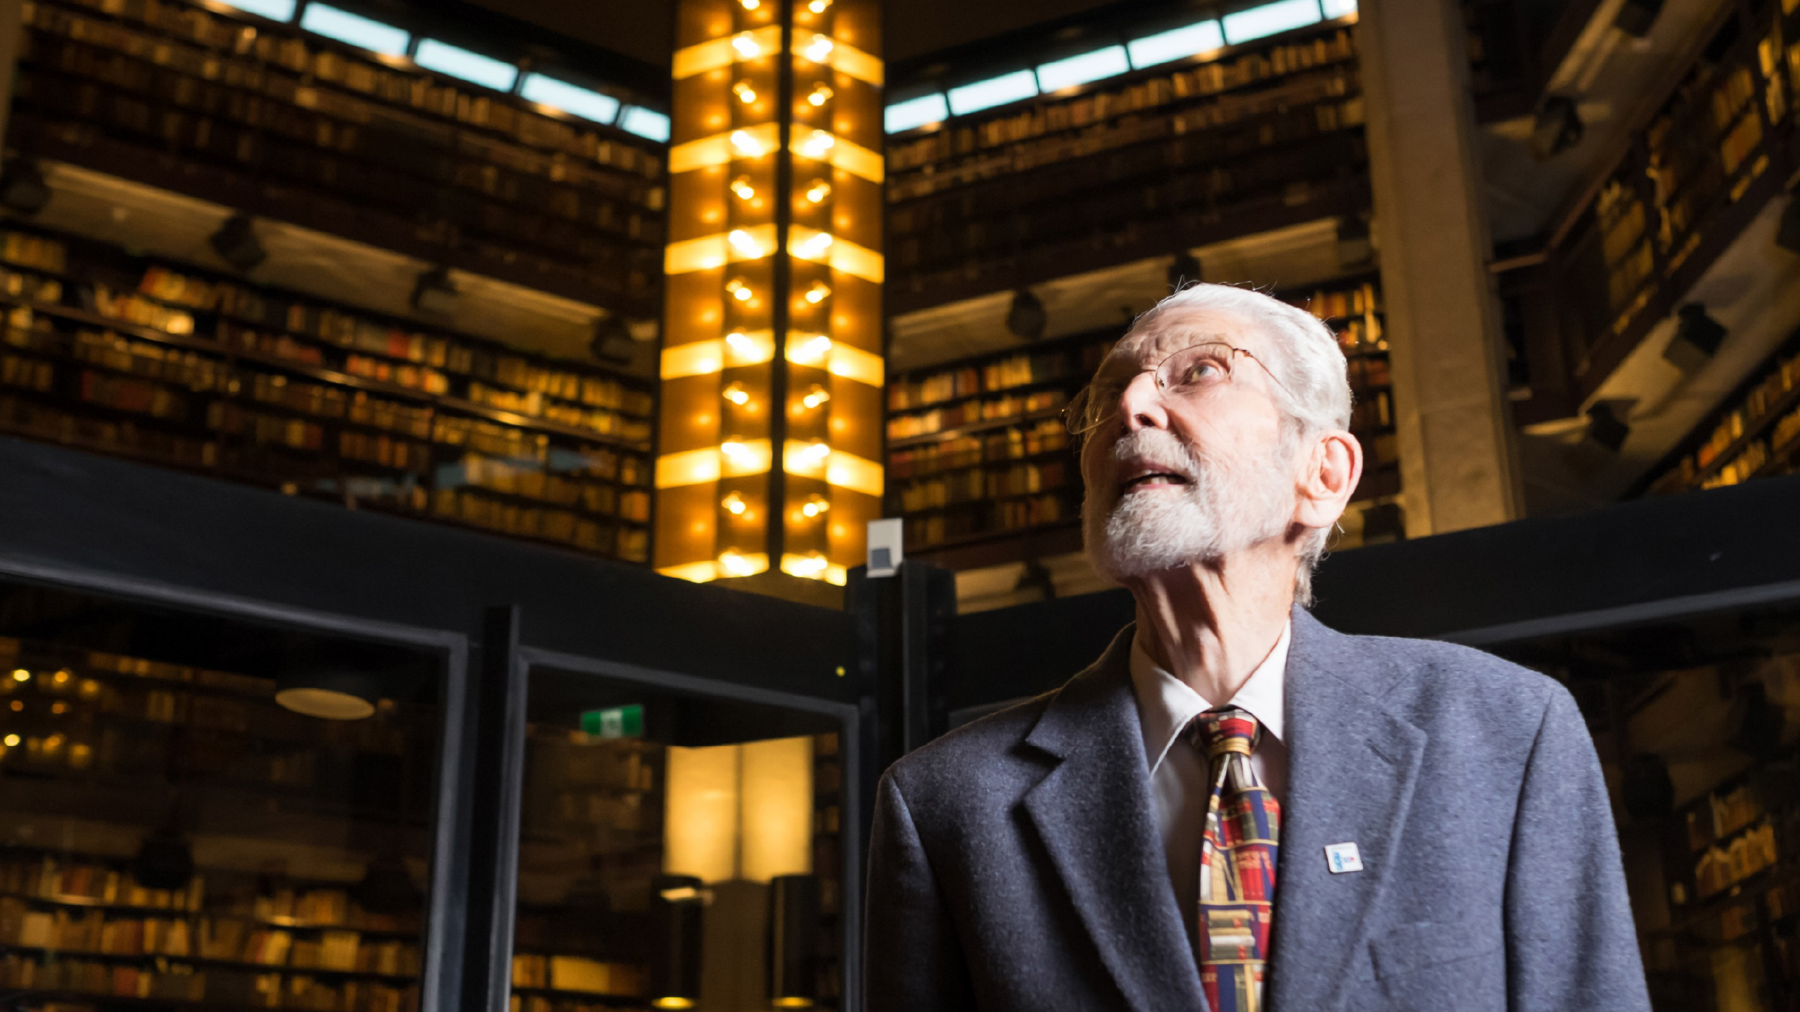
Robert Blackburn
Chief Librarian (1954-1982) University of Toronto
Notes:
Early days of OCUL; IUTS; Unicat/Telecat; MARC; ff

Slide 7


Slide 8
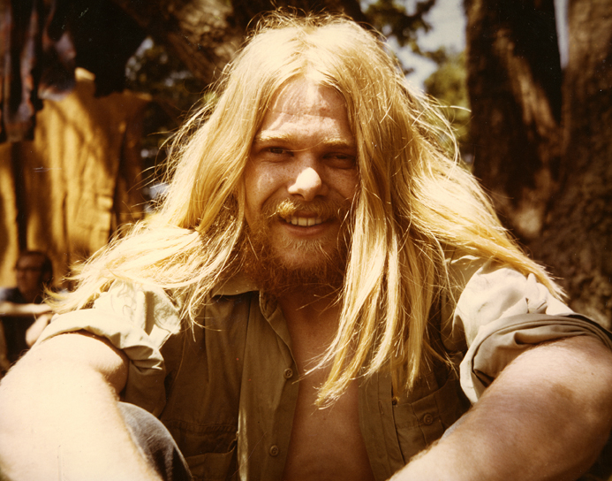

Slide 9
Notes:
Carol Moore, Peter Clinton, Kathy Scardellato, Graham Hill, Faye Abrams

Slide 10
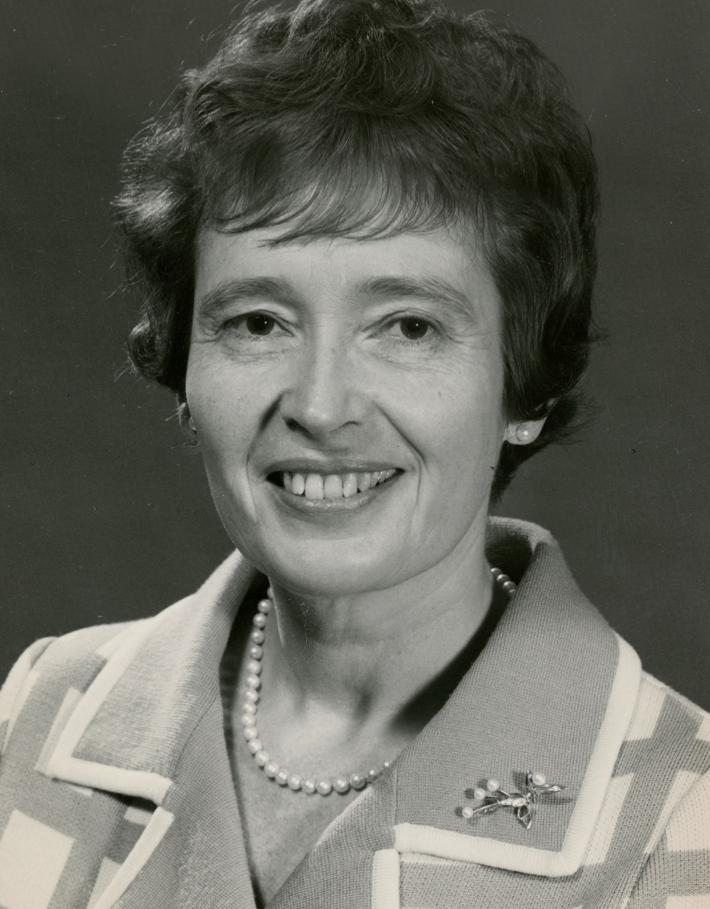
Margaret Beckman
Chief Librarian (1971-1984)
University of Guelph

Slide 11
Scholar Practitioner
Library Automation

Slide 12


Slide 13
Scholar Practitioner
Library Automation

Slide 14
Four Things

Slide 15
1. Digital
Transformation
2. Scholarly
Communications
3. Critical Librarianship
4. Cooperation to Collaboration to Partnership

Slide 16
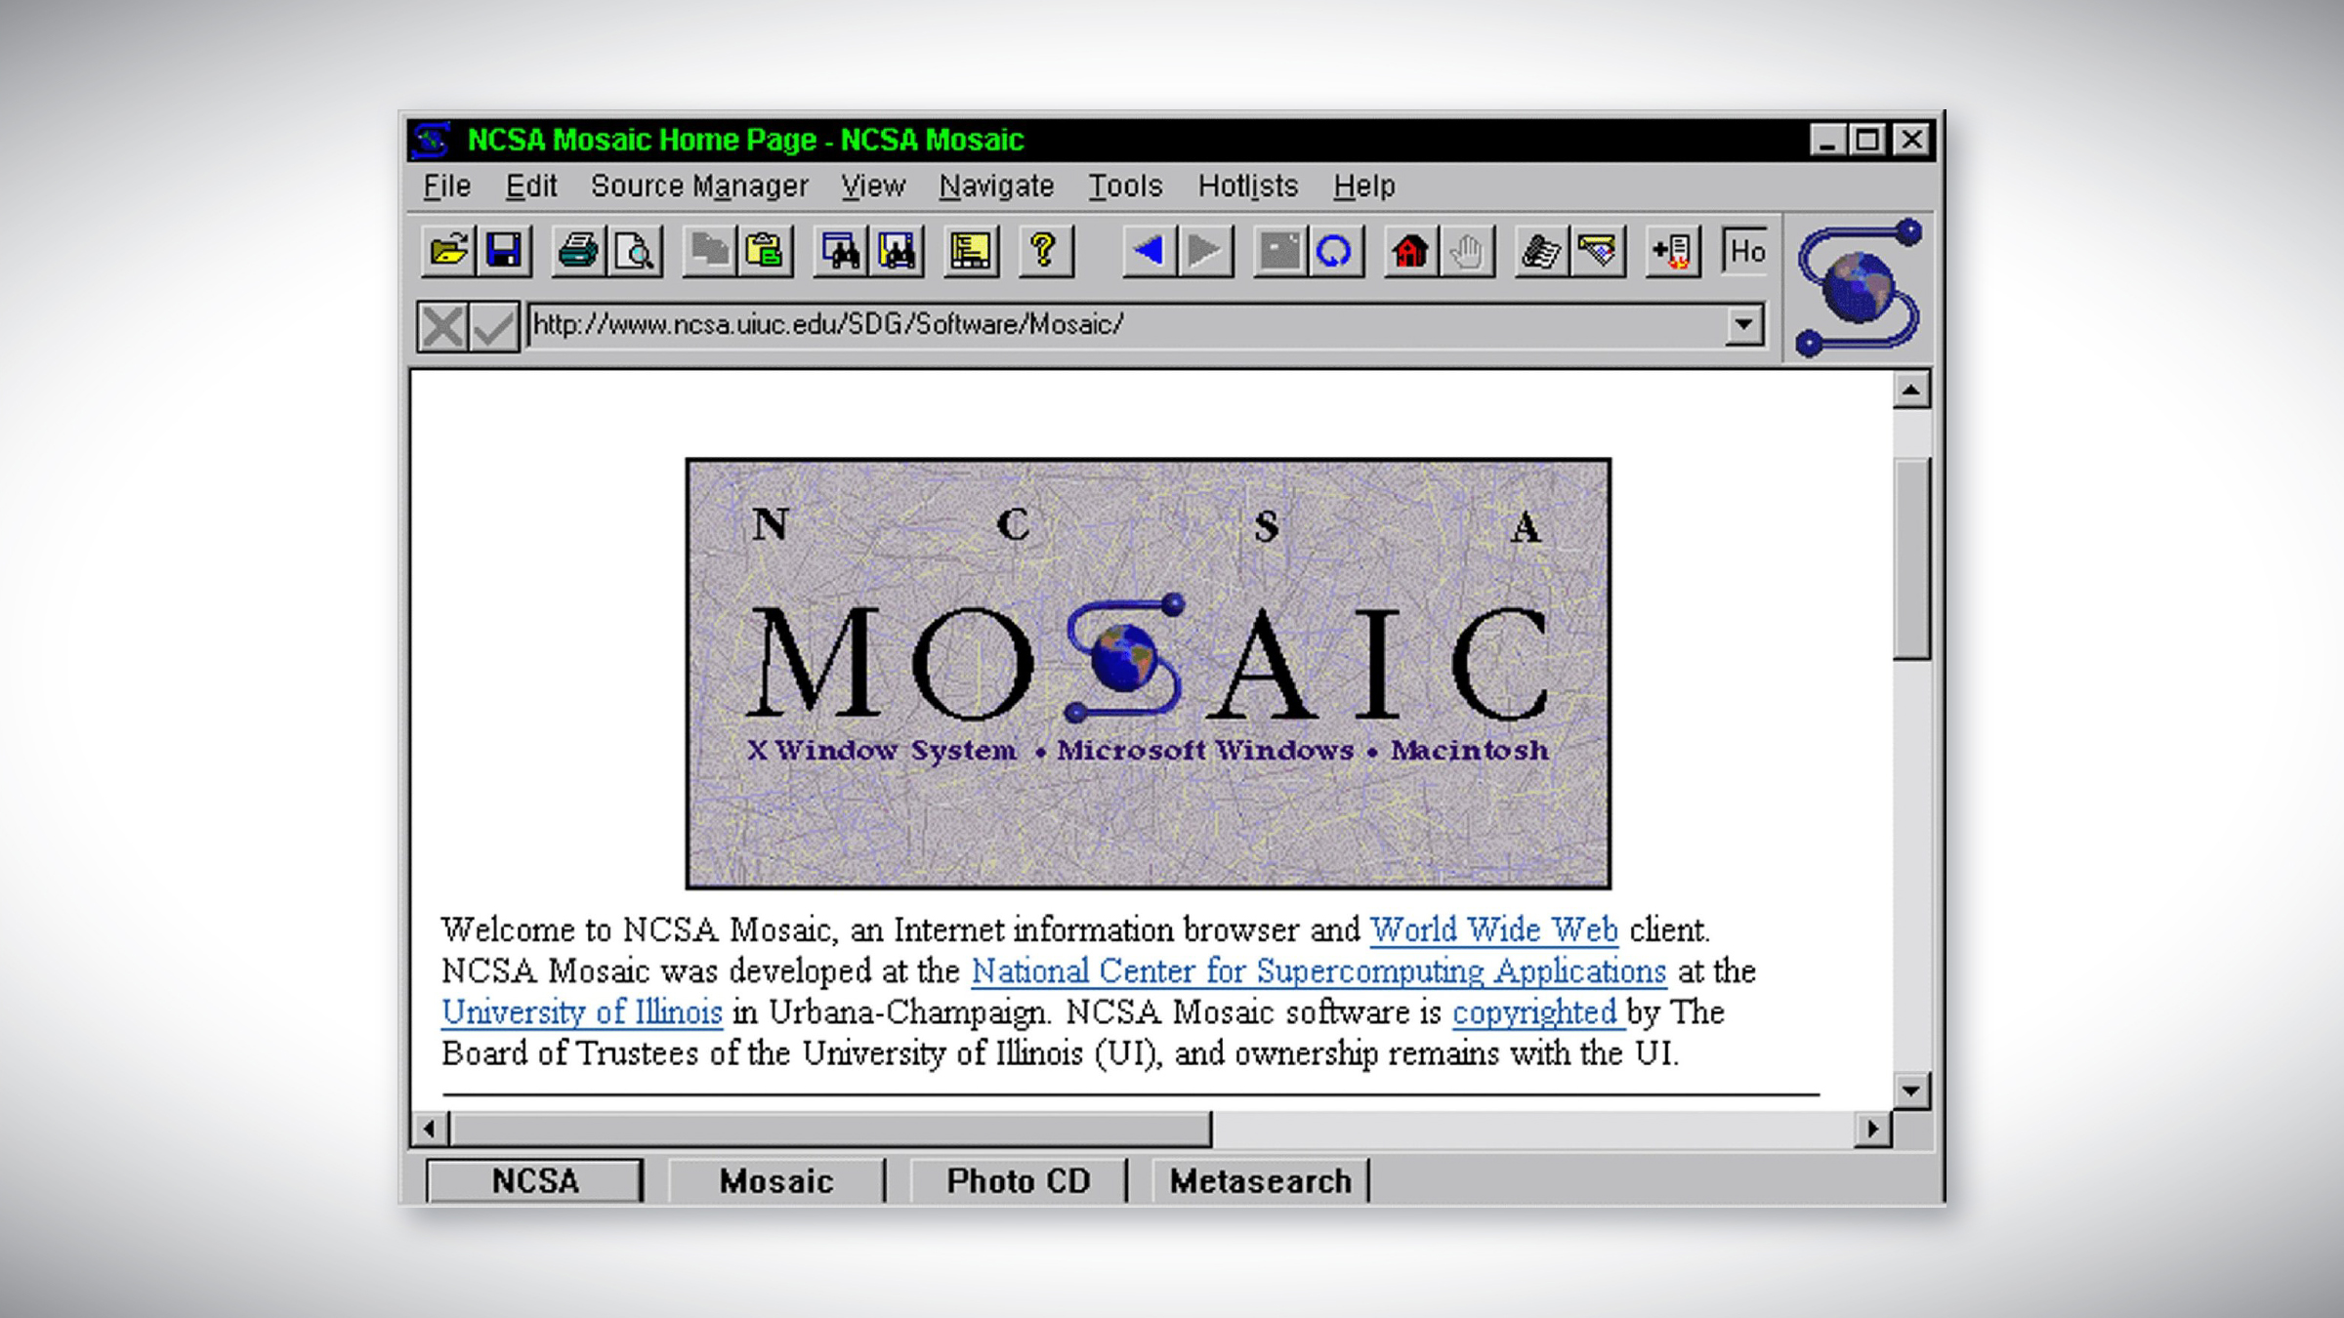
Notes:
1994 University of Illinois at Urbana Champaign National Centre for Supercomputing Applications (NCSA). Marc Andressen.

Slide 17
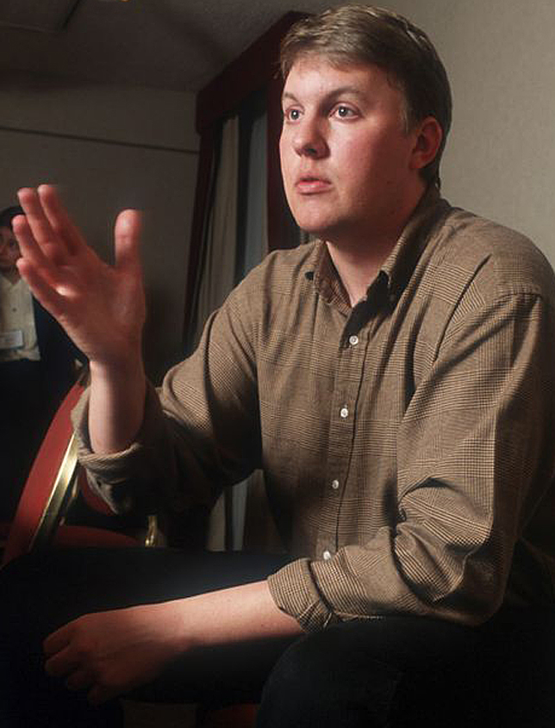
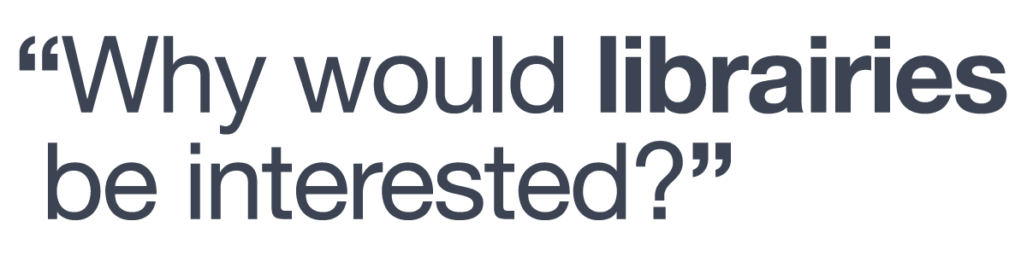
Marc Andreessen (c. 1995)

Slide 18
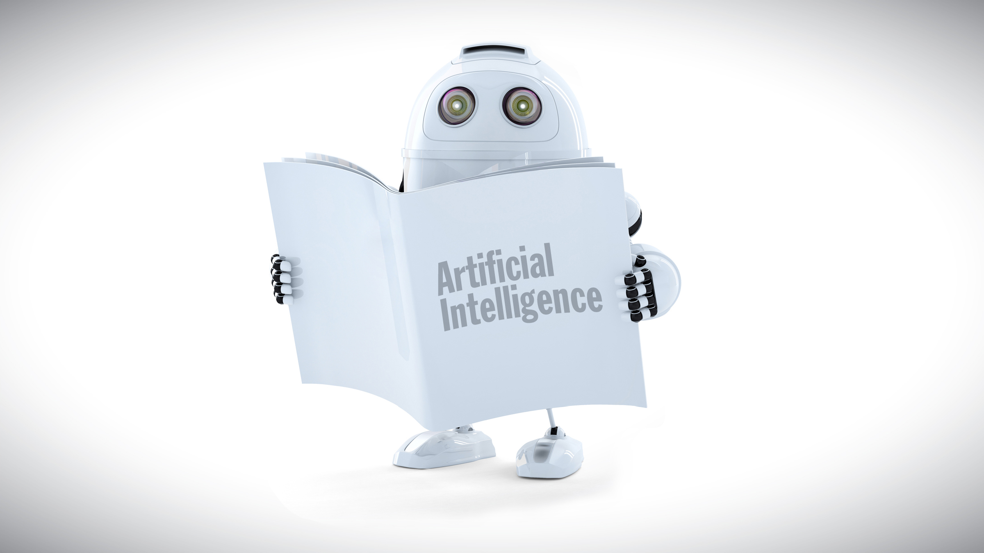

Slide 19
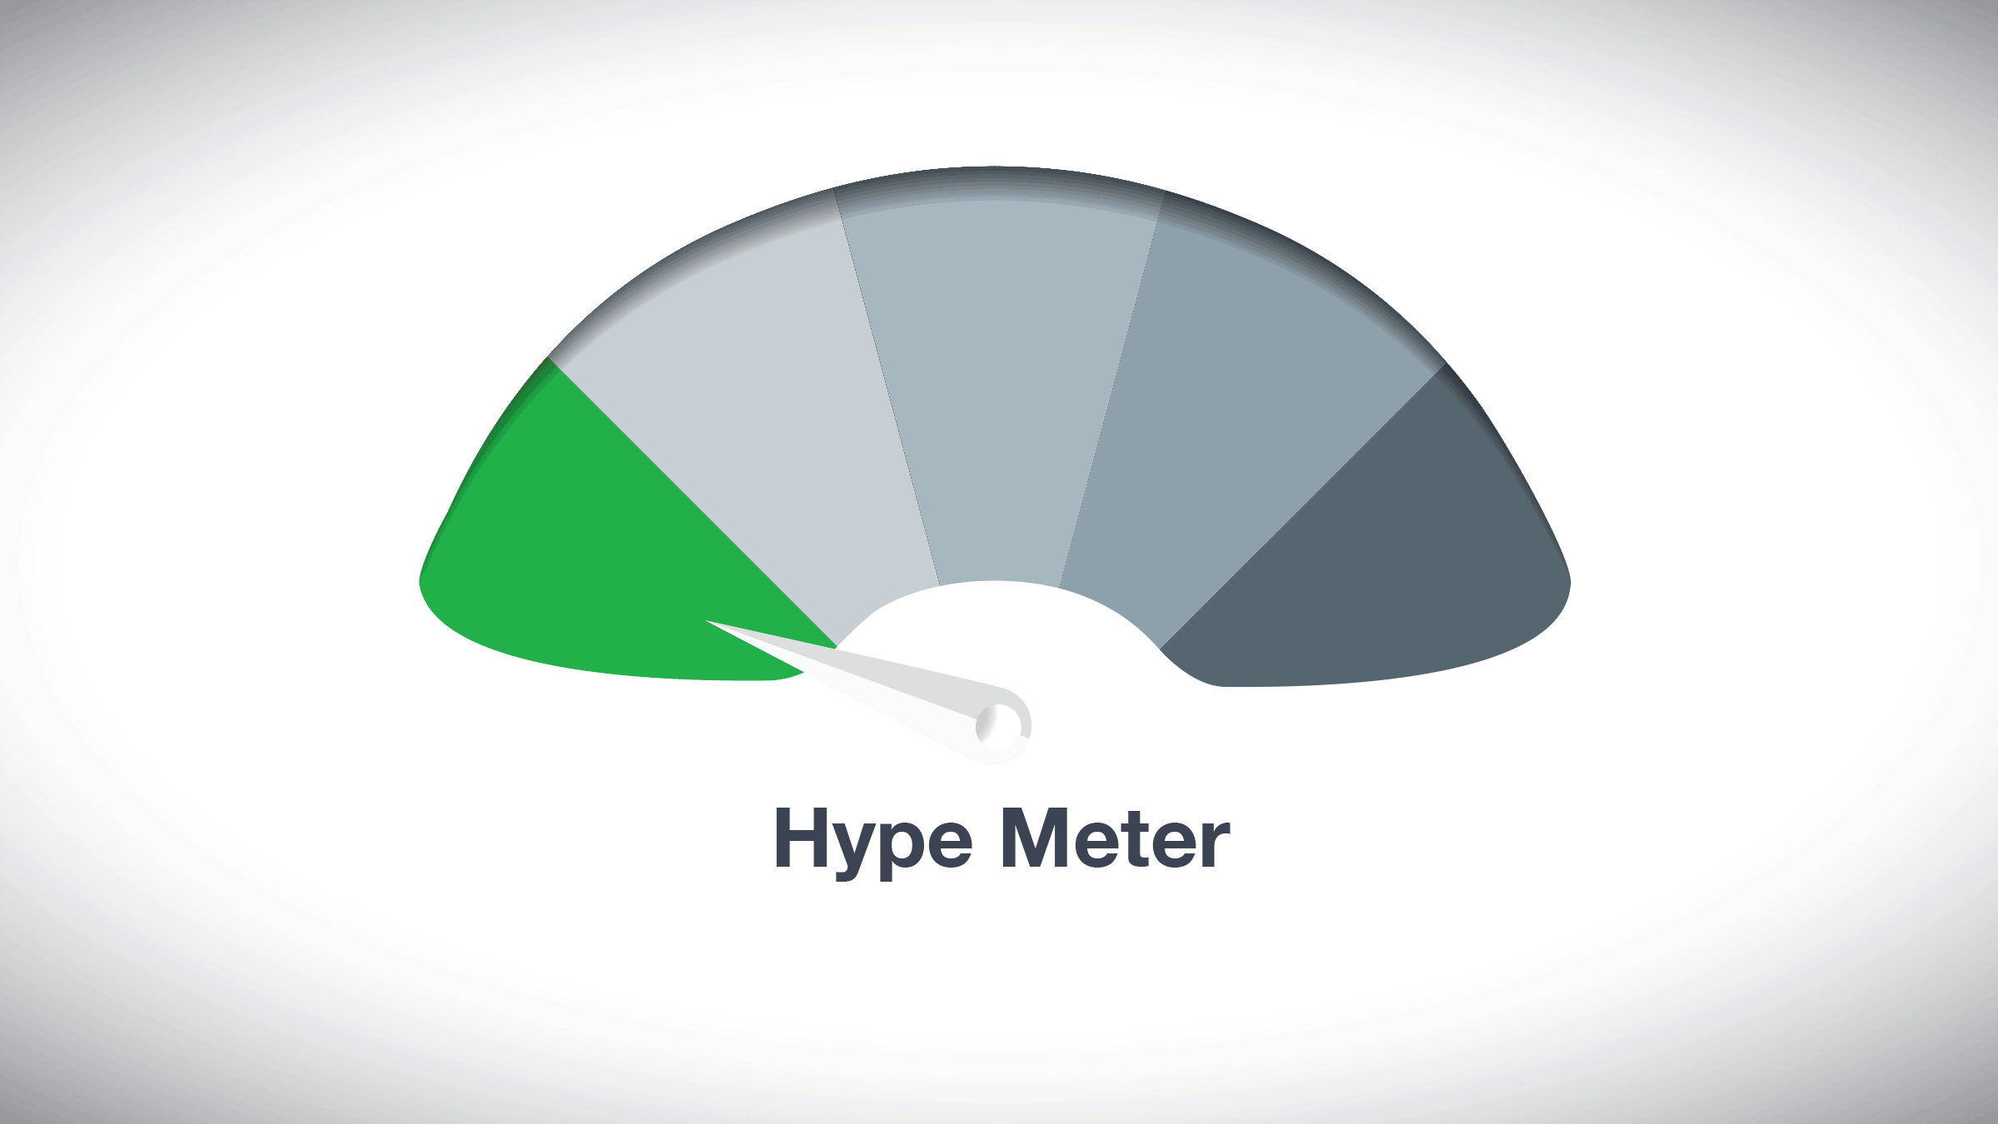

Slide 20
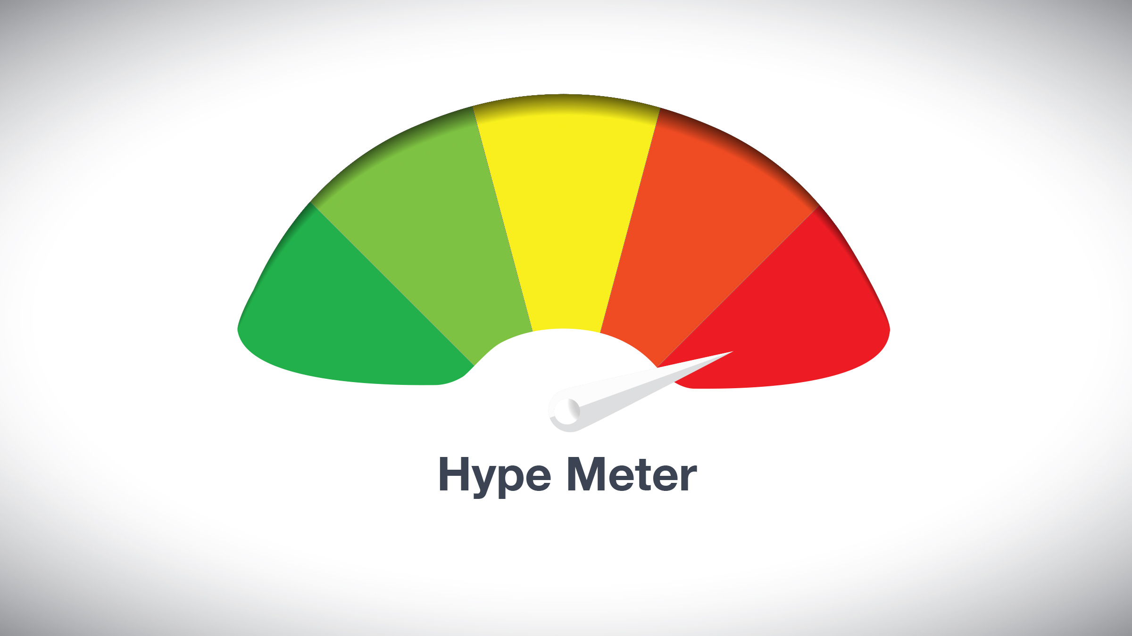

Slide 22
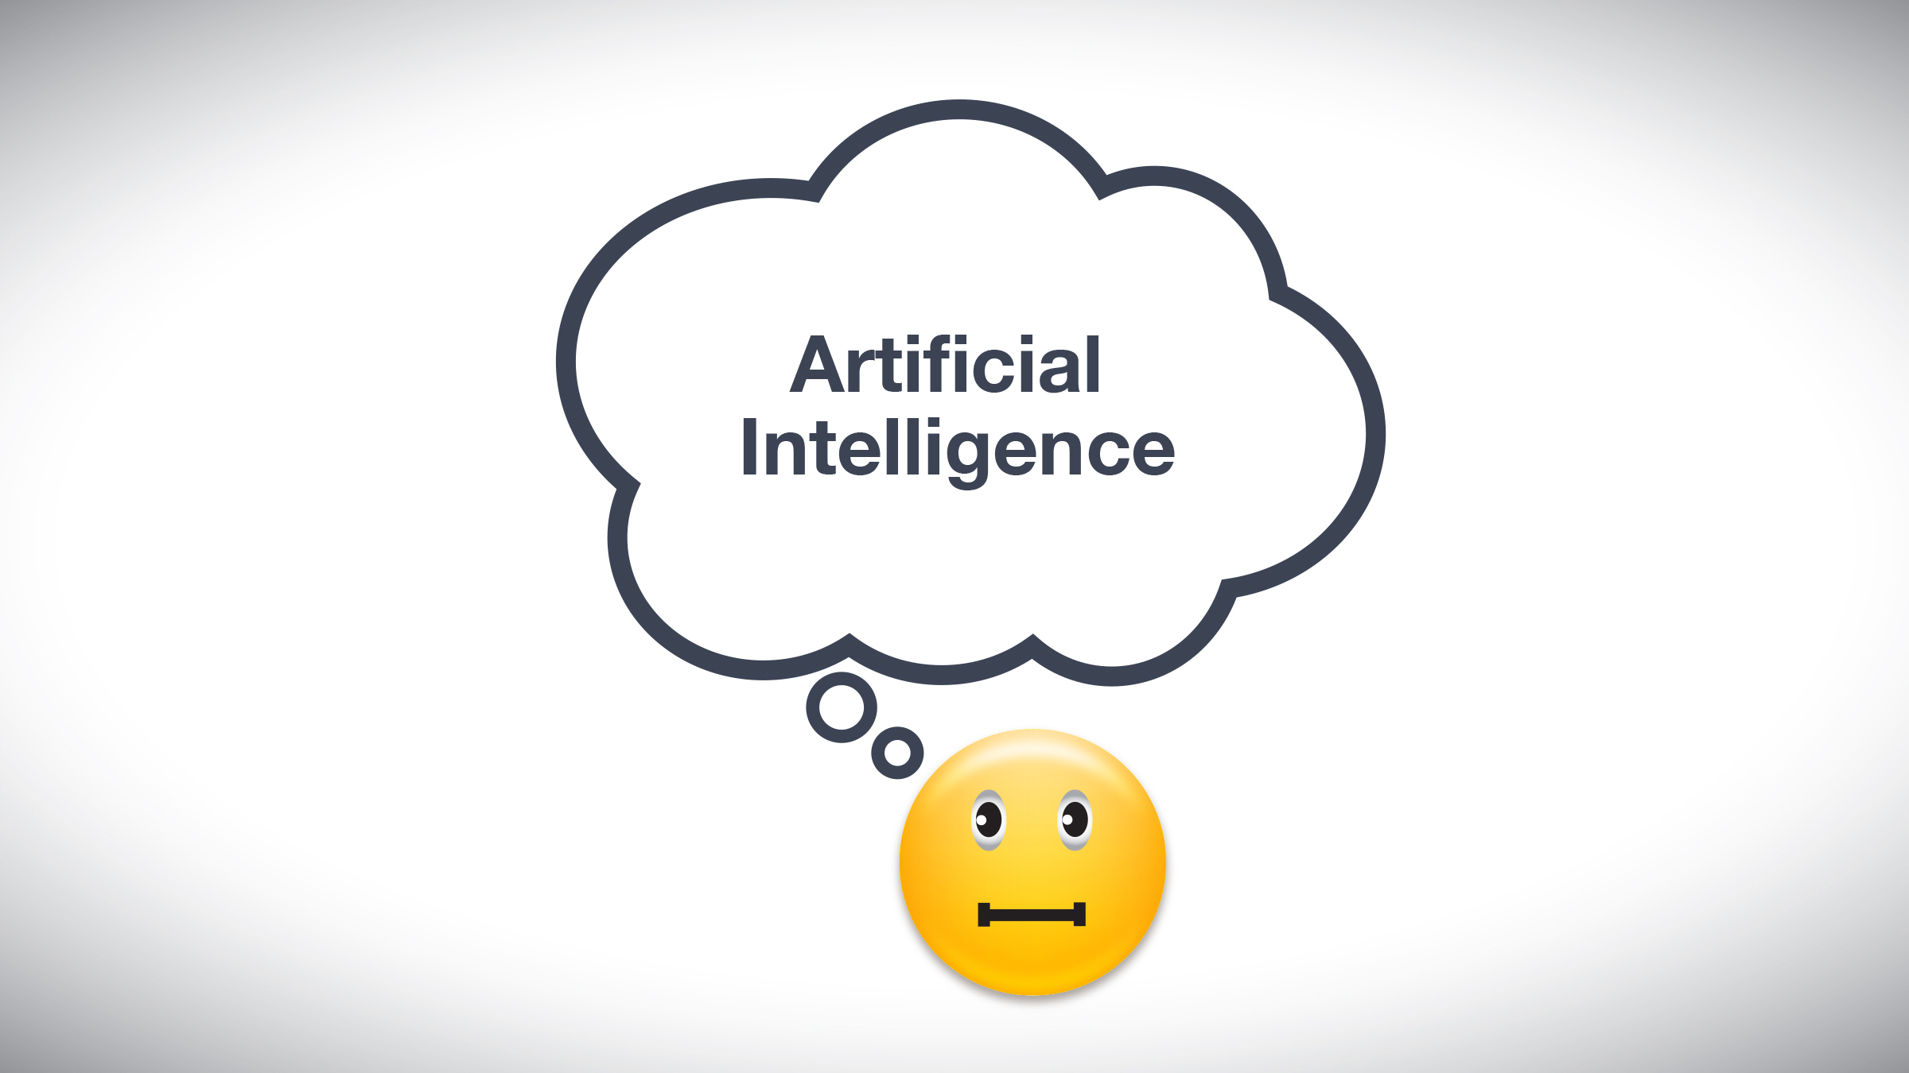

Slide 23
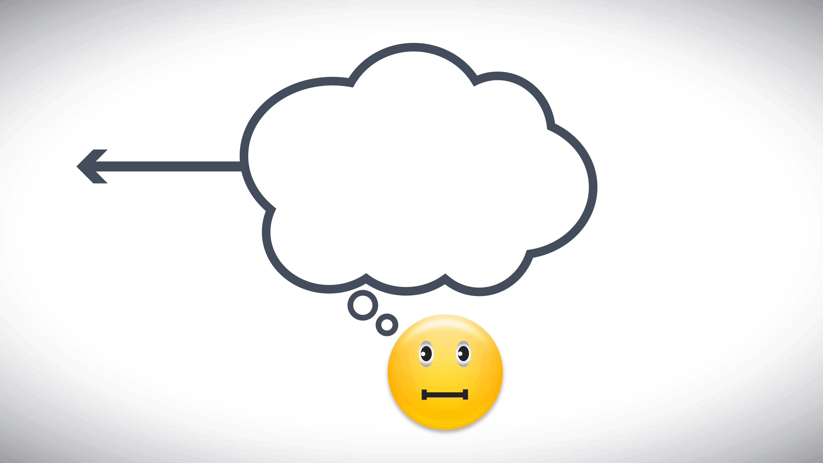

Slide 24

“right to explanation”

Slide 25
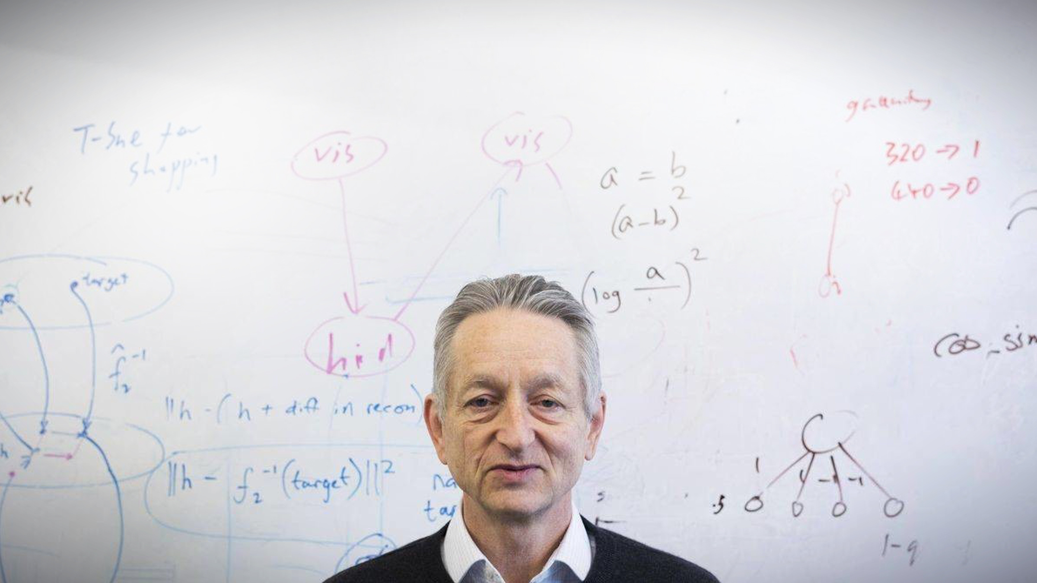
“A deep-learning system doesn’t have any explanatory power. The more powerful the deep-learning system becomes, the more opaque it can become.”
Geoffrey Hinton,
University of Toronto & Google

Slide 26


Slide 27
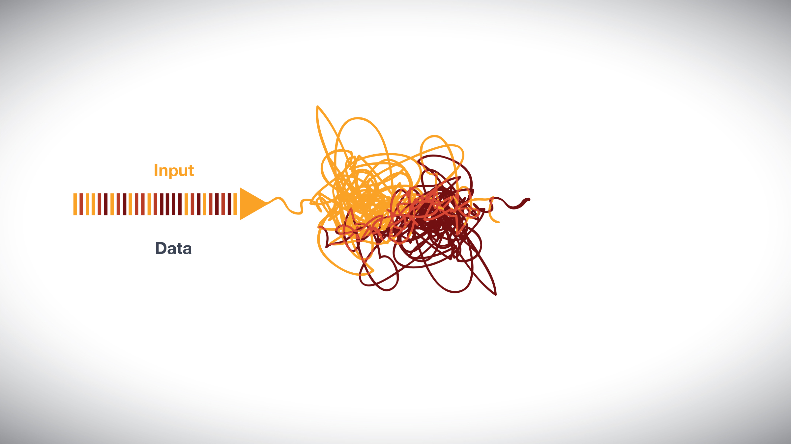

Slide 28
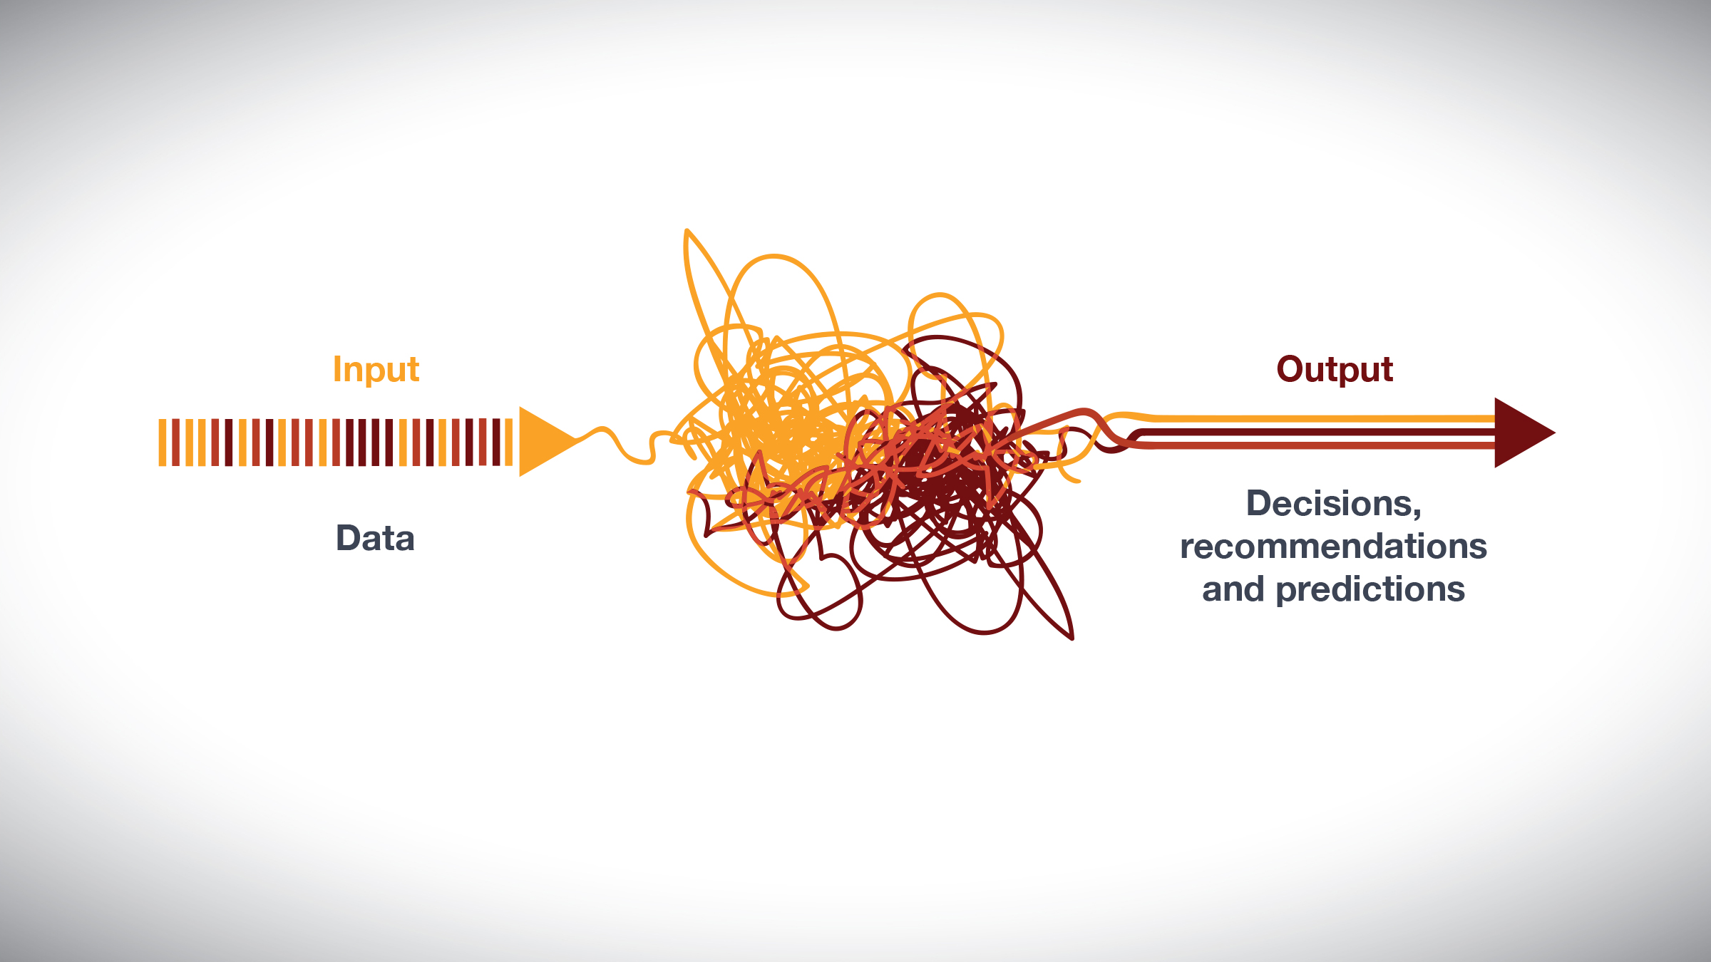

Slide 29
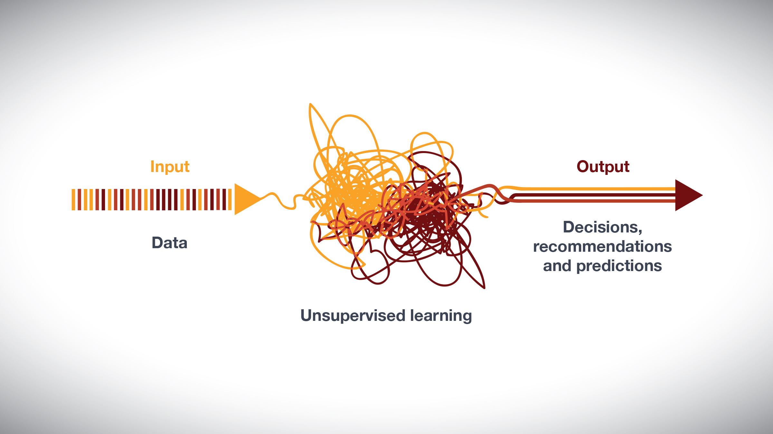

Slide 30
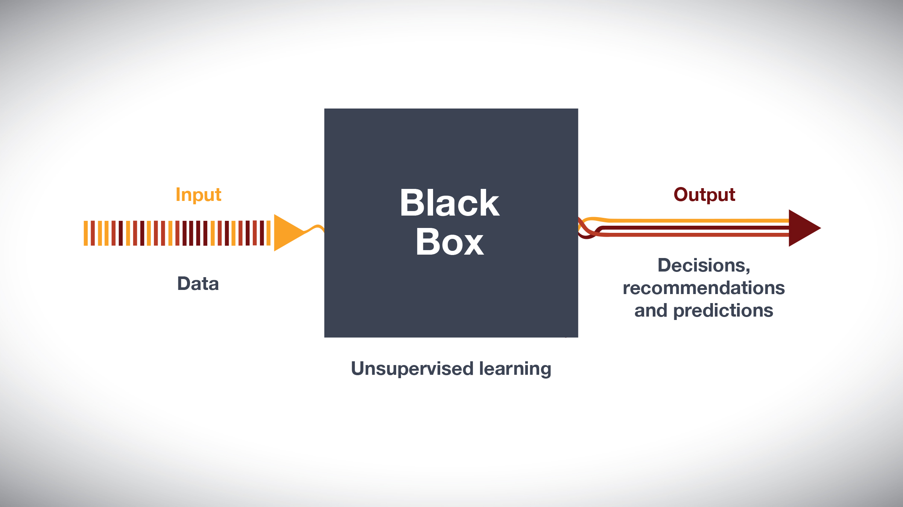

Slide 31
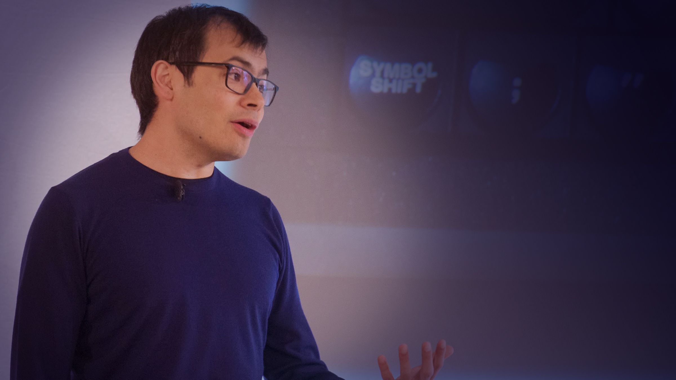
AlphaGo Zero had "genuine moments of creativity” and was "no longer constrained by the limits of human knowledge".
Demis Hassabis
DeepMind co-founder & CEO

Slide 32
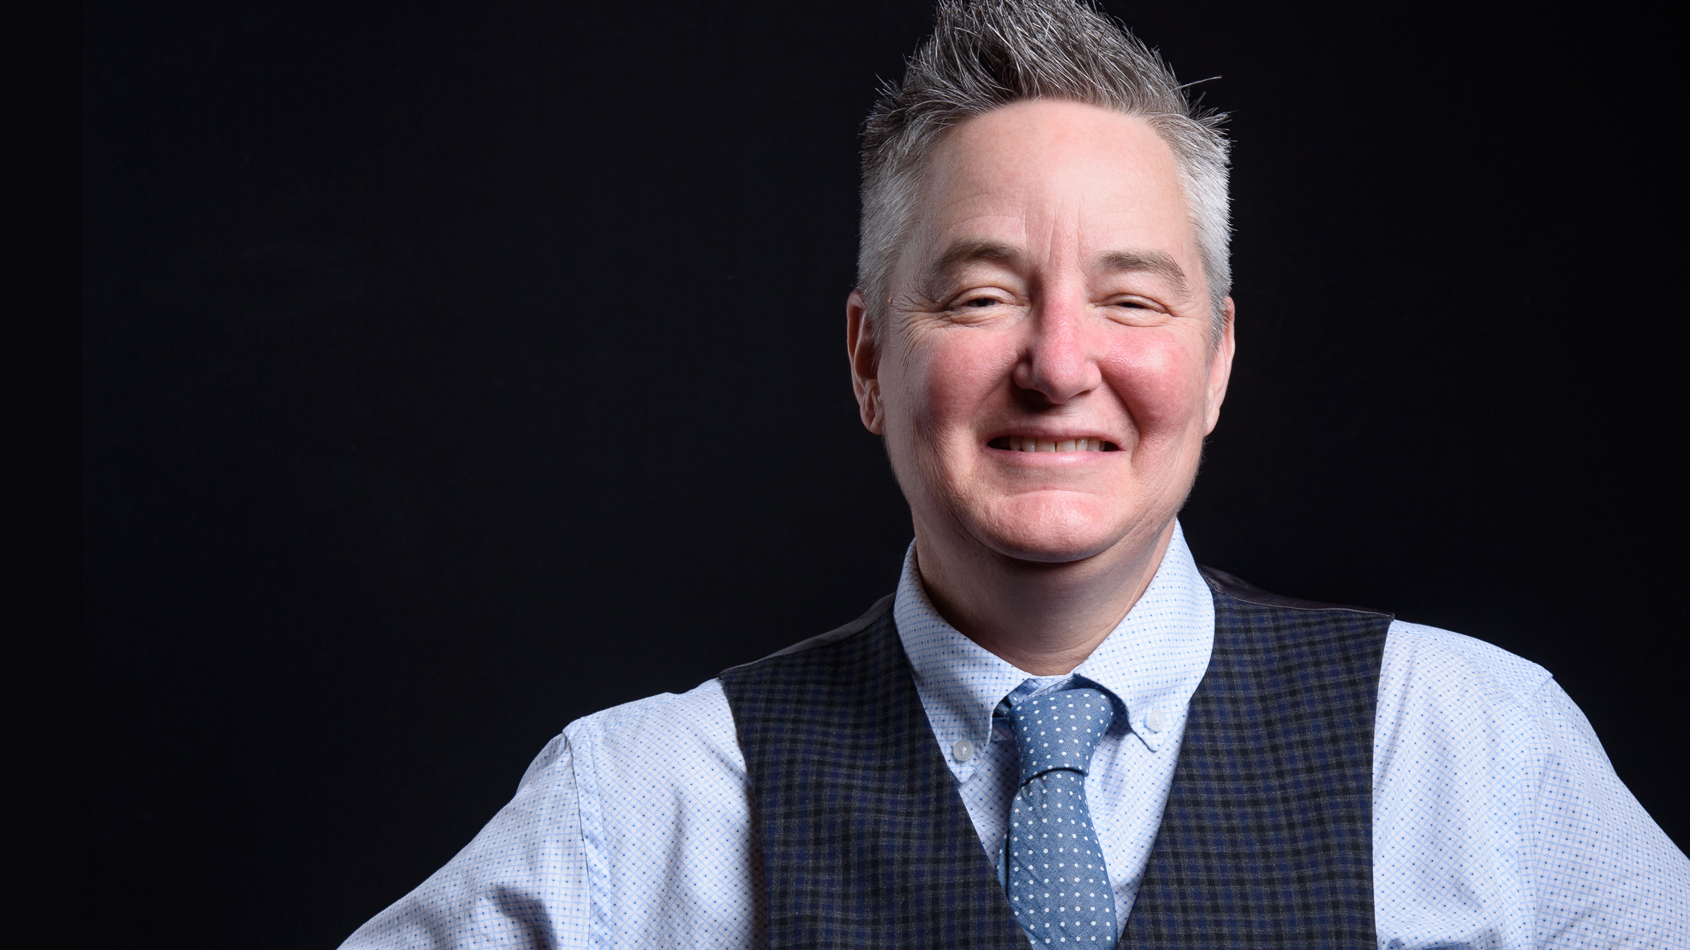
“What happens
to libraries and librarians when machines can
read all the
books?”
Feral Librarian. March 16, 2017
Chris Bourg
Director of Libraries
MIT

Slide 33
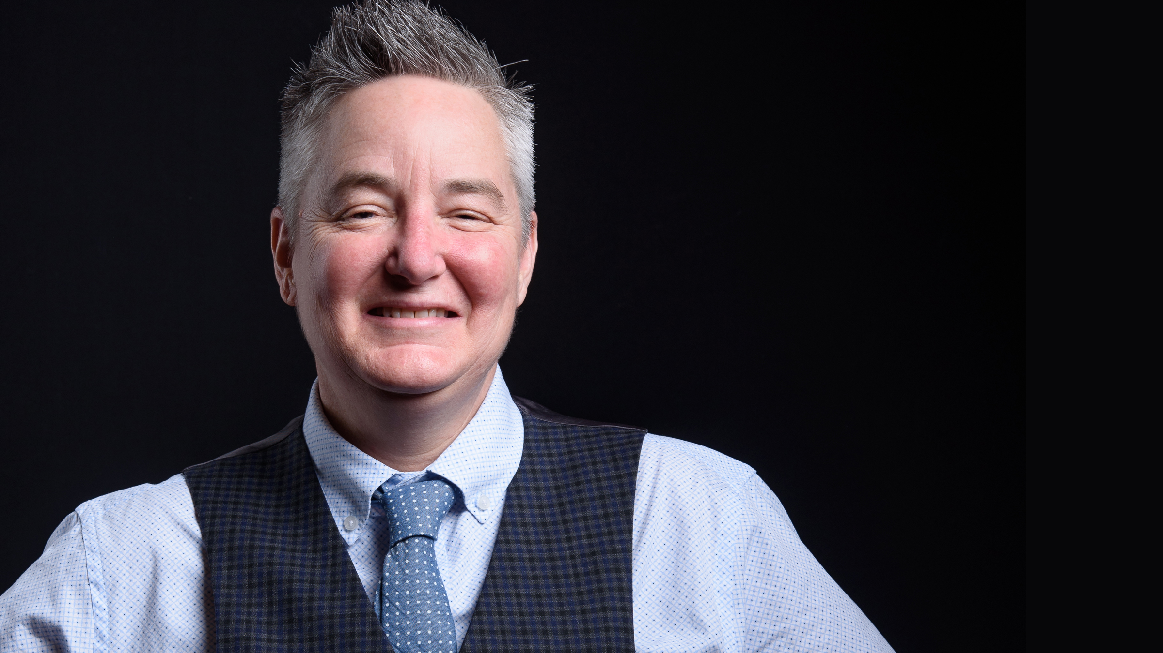
“I think we would be wise to start thinking now about machines and algorithms as a new kind of patron”
Notes:
“I think we would be wise to start thinking now about machines and algorithms as a new kind of patron — a patron that doesn’t replace human patrons, but has some different needs and might require a different set of skills and a different way of thinking about how our resources could be used.”

Slide 34

Lisa Gitelman
New York University

Slide 35
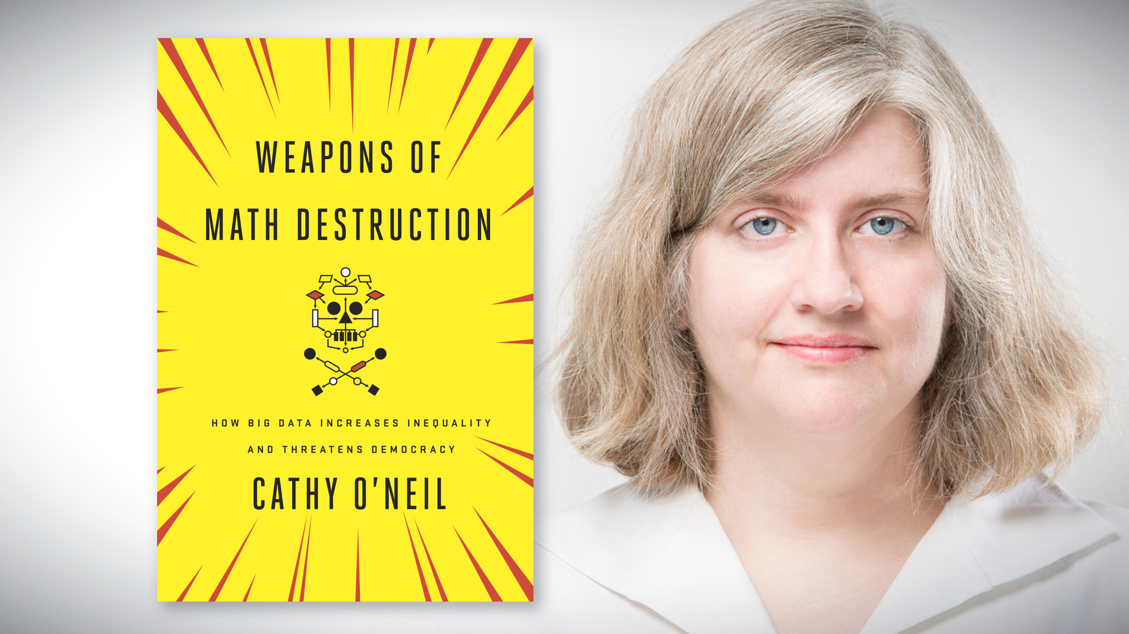

Slide 36
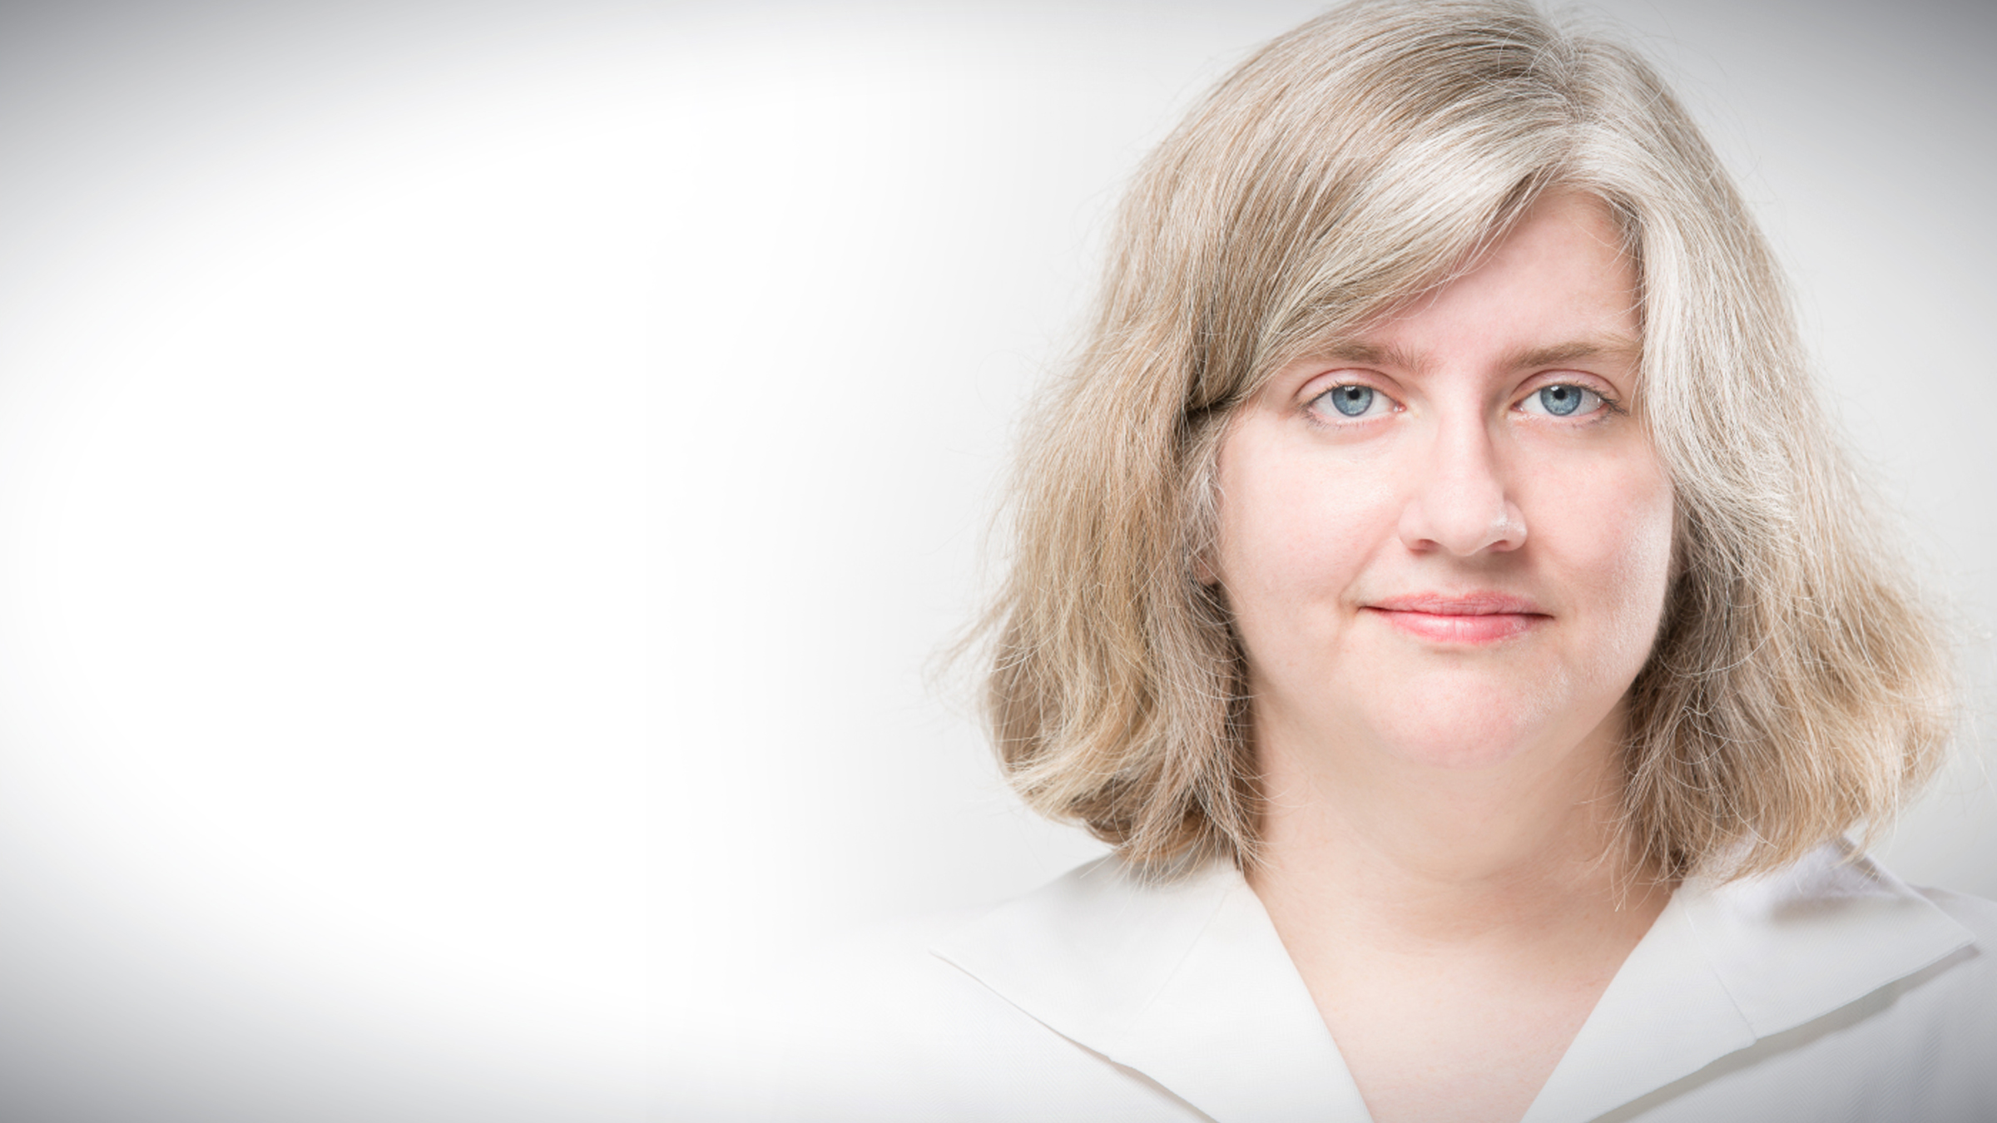
“The Ivory Tower
can’t keep ignoring tech”
New York Times. November 14, 2017
“Academics have been asleep at the wheel”
“We urgently need an academic institute focused on algorithmic accountability.”

Slide 37

“What does ‘information literacy’ even mean these days?”

Slide 38
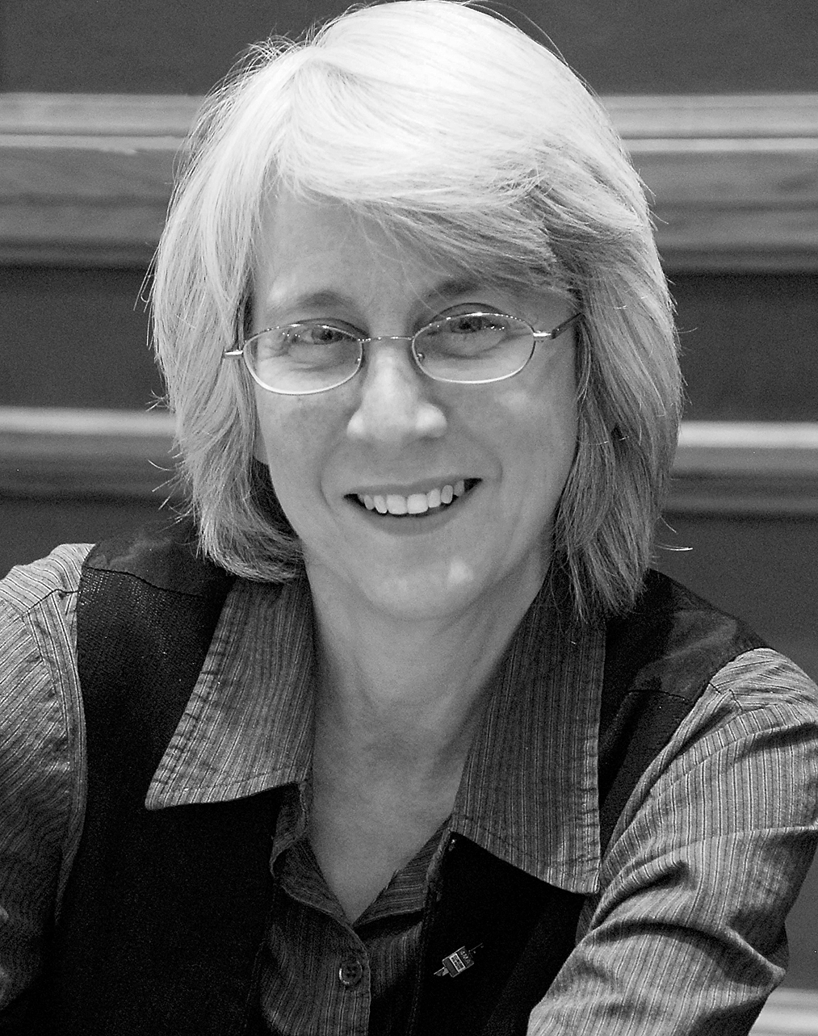
“I don’t even know
where to start.”
Barbara Fister
November 13, 2017
Library Babel Fish
Notes:
“Until this year I thought the fundamentals students needed to know – how to frame a question, how to think critically about what you find, how to weigh divergent arguments and create your own with a sense of integrity – were basically unchanging. But the world we’ve found ourselves in now, one where we’re being given personalized bodies of knowledge created by propagandists and bots and artificial intelligence, all locked up in corporate black boxes – I don’t even know where to start.”

Slide 39
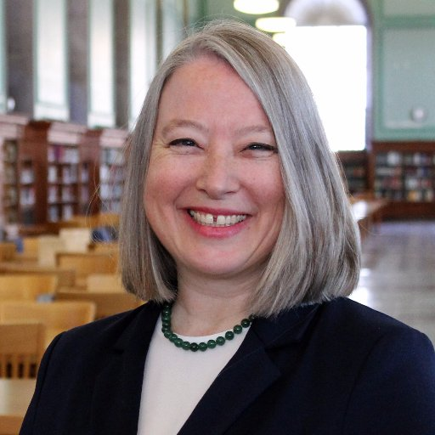
“RE:Search – Unpacking the algorithms that shape our UX.”
Lisa Hinchliffe
University of Illinois at Urbana Champaign
Notes:
Co-PI on a Montana State University IMLS funded project on algorithmic awareness for librarians

Slide 40
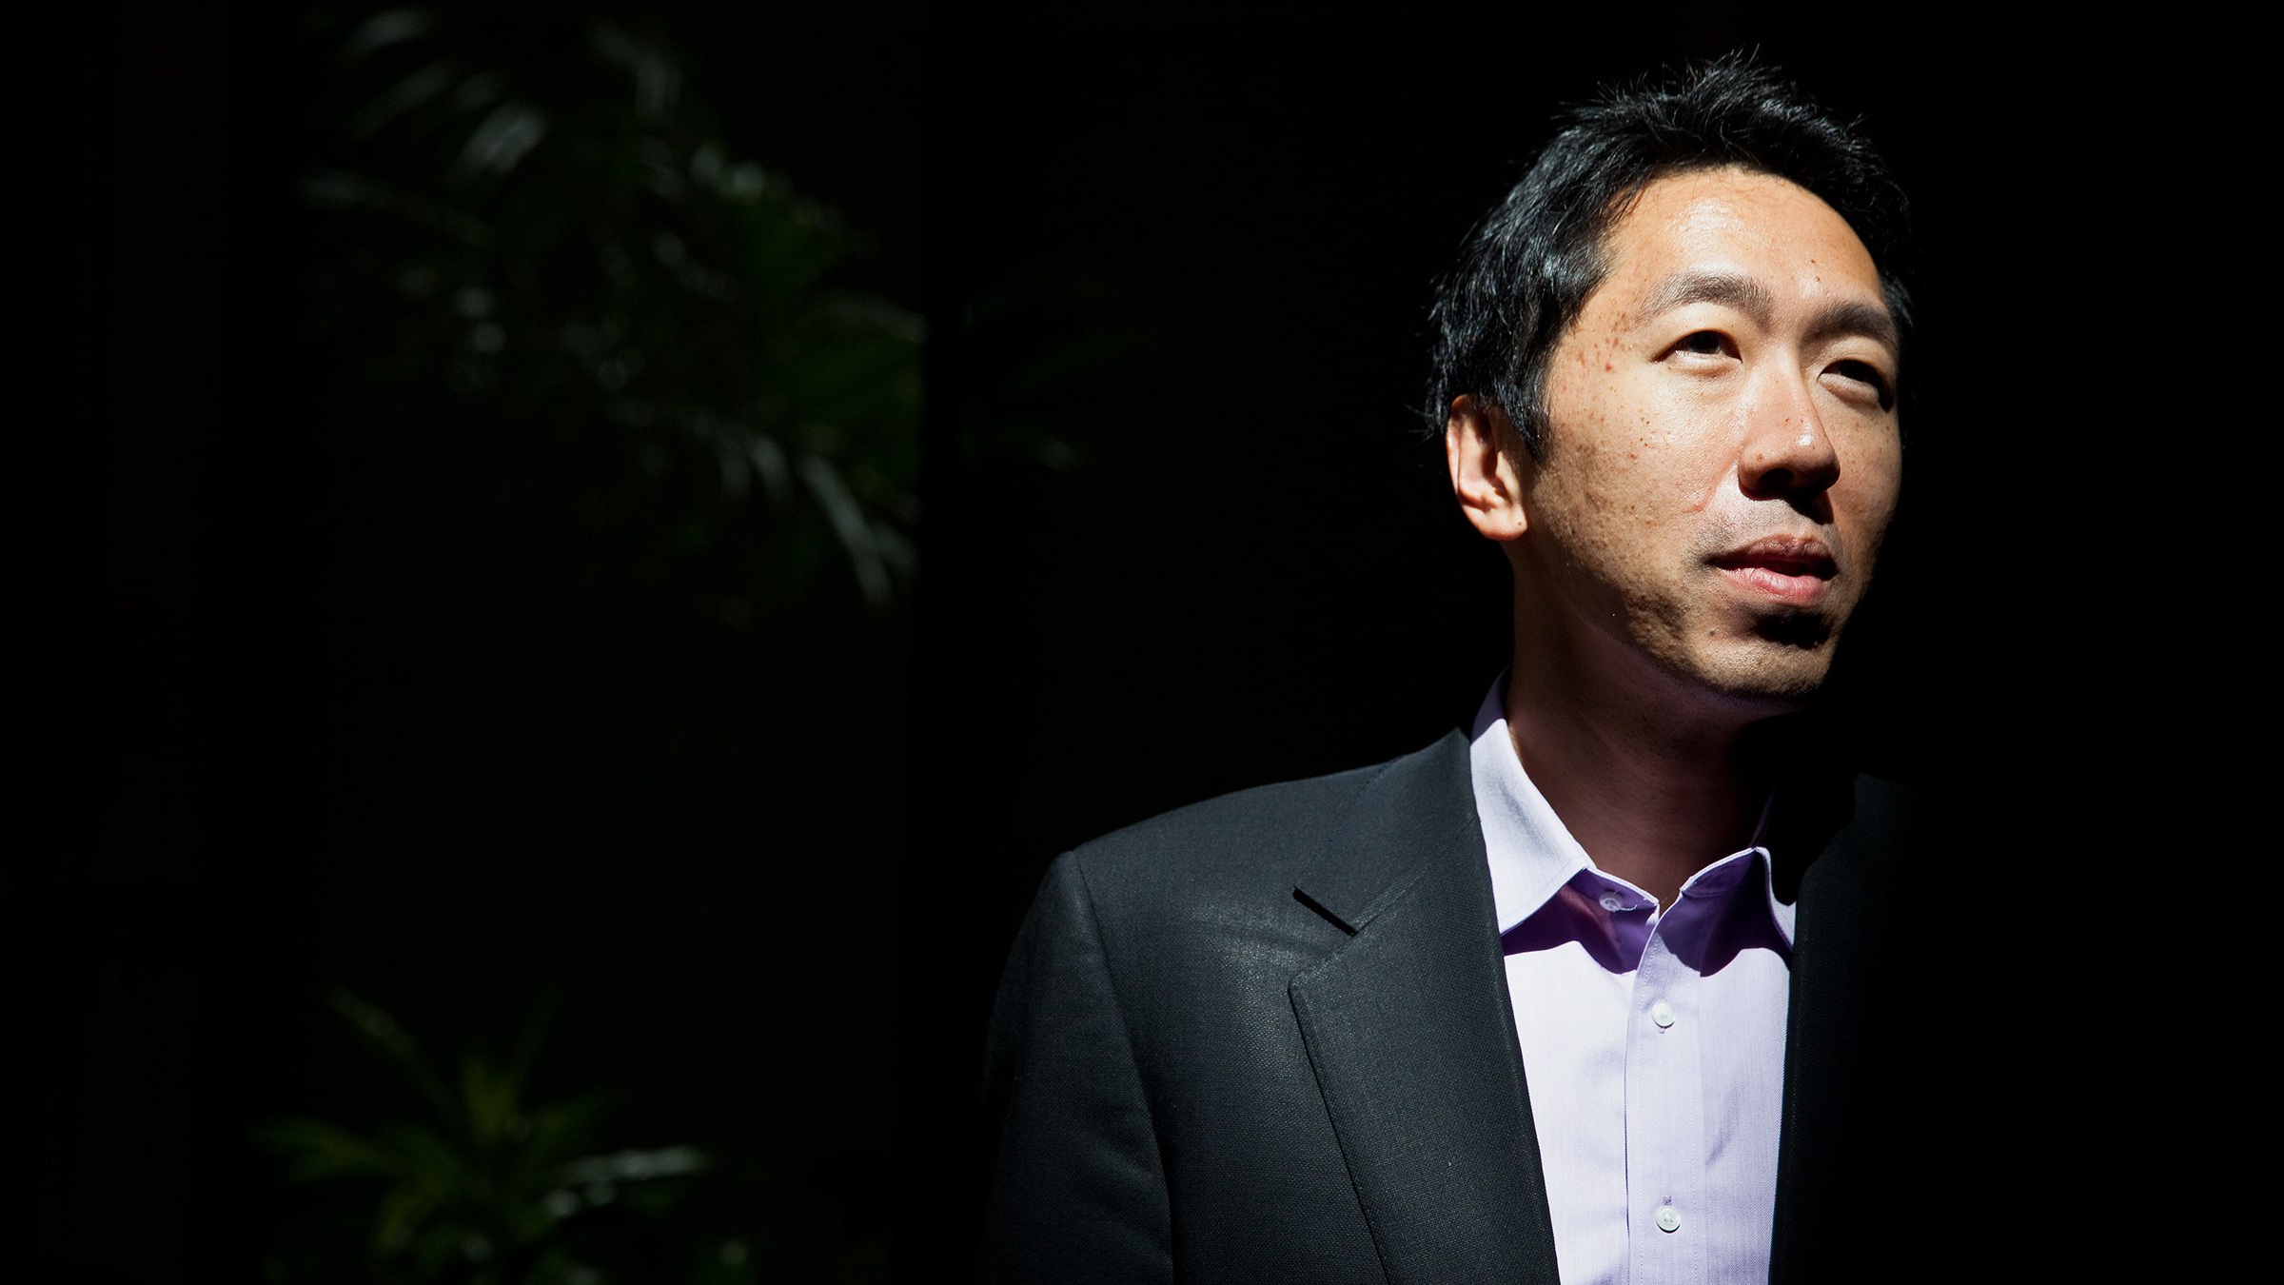
“AI is the new electricity.”
Andrew Ng, Stanford University
(former Chief Scientist, Baidu)
Notes:
Economists call General Purpose Technologies: writing, steam engine,

Slide 41
“How many feet are there in a light-year ?”

Slide 42
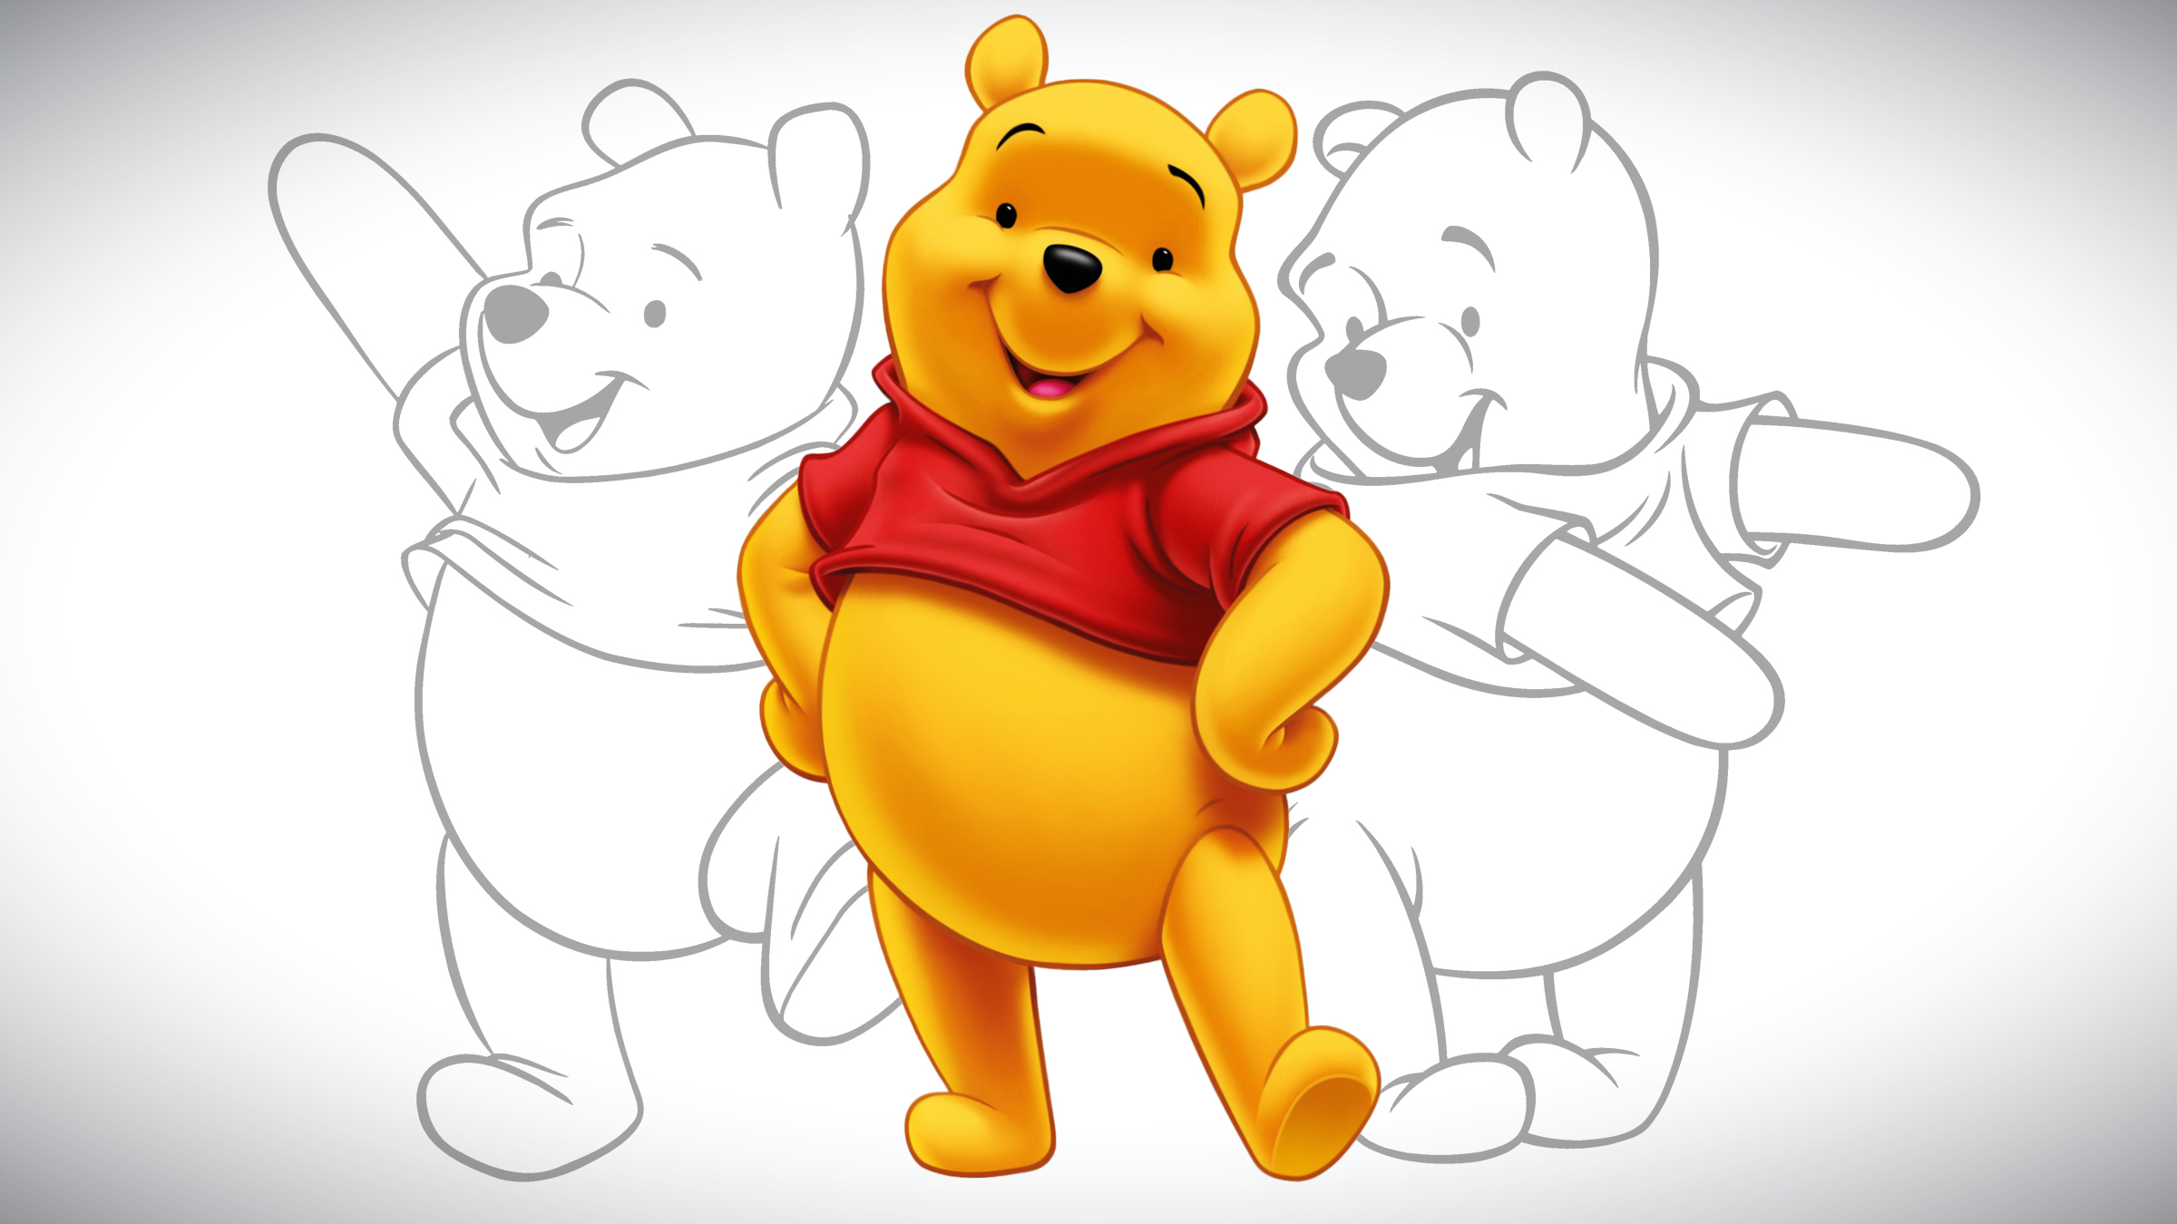

Slide 43

AI Challenges
Overfitting: rush to judgment
Dimensionality: information overload
Hand engineering features: metadata
Explore & Exploit : curiosity and selection
Reward: goal specification
Bias & discrimination: data integrity
Notes:
Sound familiar? We know this stuff. Different context, different terminology; same issues. Structured data -> Scholars Portal

Slide 44
Margaret Beckman
Chief Librarian (1971-1984)
University of Guelph

Slide 45

Notes:
Autonomous weapons research at US iSchoolWe are being presented with a challenge and an opportunity; Perhaps not the ones we wanted but the one that has arrived.
And a challenge for which we have the expertise and capacity

Slide 46





Slide 47

"Thinking is
trying to think
the unthinkable:
thinking the thinkable
is not worth the effort."
Hélène Cixous.
Three Steps on the Ladder of Writing

Slide 48
Make Things Happen

Slide 49


