Slide 1

The livestream will begin at 9:30.
ocul.on.ca/spday/2017/agenda
Thanks for waiting!

Slide 3


Welcome
Vivian Lewis
Past OCUL Chair

Slide 5
OCUL update
John Barnett, Executive Director, OCUL
December 8, 2017

Slide 6
What’s new?
Collaborative Futures
Strategic planning
New Initiatives Funding
Communities
Outstanding Contribution Award

Slide 7
Collaborative Futures
13 universities participating
3 more hoping to do so
RFP issued!
Supplier evaluation
Staffing secondments
More communication

Slide 8
Strategic planning
Subcommittee of Directors + OCUL Executive Director
Based on feedback, revised vision & mission statements + new strategic directives
Reviewed by OCUL-PA, OCUL EXEC, & OCUL Directors
More work to be done . . .

Slide 9
It’s NIFty
New Initiatives Fund – Annual funding by OCUL libraries to support projects & proposals
  OCUL
  Scholars Portal
  OCUL Committees
  OCUL Communities
Proposals due in fall
How about spring, too?
Past examples
  Topographical maps
  Books platform redevelopment
  Government information digitization
Recently funded
  Government information digitization (Gov Info Community)
  Historical census data (Data Community)
  Gov & related literature web collection (OCUL-IR)

Slide 10
Communities
New Makerspace Community
  Approved November 2017
  Dwayne Collins, Trent University, Moderator
Easy to create a Community
  Terms of reference
  Plan of activity
  Membership: at least 10 library staff from 1/3rd of OCUL institutions (that’s 7!)
  Moderator
The community can be what you want it to be
  Dedicated to carrying out initiatives & projects
    With OCUL & Scholars Portal
    Or without OCUL & Scholars Portal
  A forum for sharing ideas
  A community of practice
  A venue for professional development
  Short- or long-term

Slide 11
Outstanding!
OCUL Outstanding Contribution Award
  Individuals or teams can be nominated
  Notable contributions to OCUL vision & strategic priorities
    Does not have to be an OCUL or SP project
  No award for a couple of years
  Multiple nominations this year
  Determining criteria
  Announcement(s) pending . . .

Slide 12
Be in touch
John Barnett, Executive Director
Nur Artok, Business Officer
Jacqueline Cato, Information Resources Coordinator
Rea Devakos, Projects Officer
Anika Ervin-Ward, Administration & Communications Coordinator
Carol Stephenson, E-Resources Consultant
Collaborative Futures staffing? TBA
https://ocul.on.ca/contact

Slide 13
Permafrost
Grant Hurley
Digital Preservation Librarian

Slide 14
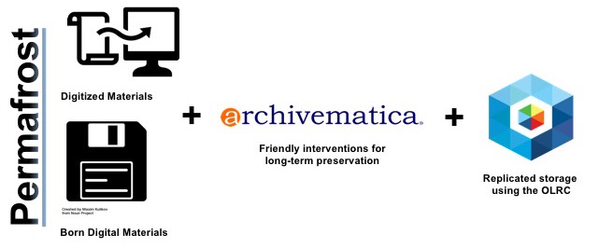
What is Permafrost?

Slide 15
What is Permafrost?
Readiness interviews & content inventories
Workflows & documentation
Training (in person & online)
Tool & resource development
Research & testing

Slide 16
The Pilot
Phase 1 – January-September 2017
  Collaboration with Lakehead University Library
  Tested basic system and workflow
Phase 2 – to May 2018
  4 new collaborators: Laurier, UOIT, University of Toronto Archives, Waterloo
  Continued testing; developing service model documentation and more complex workflows
  Tool & resource development

Slide 17
Pilot Process
Readiness and needs analysis interview
Content inventory
3. Test sets
  Identify
  Prepare and package
  Process
  Validate
Ongoing:
Consultation/assessment
Troubleshooting
Access strategies
Tool testing
Adjust & document workflows

Slide 18
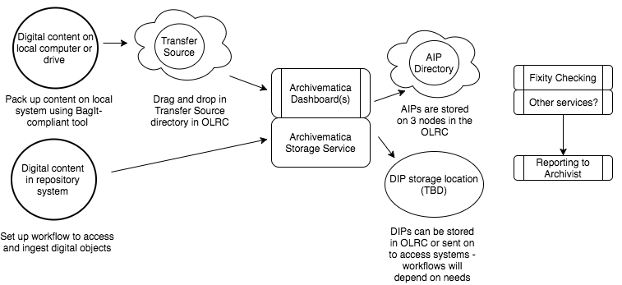
Basic Workflow

Slide 19
Service Model
Scholars Portal
Archivematica setup, installation and maintenance
Initial onboarding, testing and setup support, including readiness interview/consultations
Ongoing troubleshooting support
Provides training resources, tools, reporting data on stored packages
Assists with preservation actions over time

Slide 20
Service Model
Preserving Institution
Actively uses the service
Manages staff uses of the system, access to the system and data
Determines the scope of content to be preserved
Determines preservation policies and procedures with SP input where requested
Validates outputs
Initiates preservation actions over time

Slide 21
Pricing Schedule
Modular based on use and needs
Cost recovery approach: all funds go back into the service
One-time only costs:
Setup: $2500 for systems and support time
Training (optional): $300/day in person; $65/hr online

Slide 22
Pricing Schedule: Annual Costs
Hardware
Small @ $700 (2 cores / 4GB memory / 100 GB space)
Medium @ $1400 (4 cores / 8GB memory / 200 GB space)
Large @ $2800 (8 cores / 16GB memory / 400 GB space)
Storage
@ OCUL rate: $320/TB
Technical Support (Based on FTE)
Up to 5,000 - $1000/yr
5,000 – 15,000 - $2000/yr
15,000-30,000 - $4,000/yr
30,000-45,000 - $6000/yr
45,0000 and up - $8,000/yr

Slide 23
Pricing Example
You’re a 14,000 FTE university with about 1TB of digital assets to preserve. Your staff is not familiar with Archivematica.
One time only costs: Setup + 1 day of training = $2800
Yearly costs: 1 medium machine, 2 TB of storage used, technical support @ $2000 = $4040 annually

Slide 24
After the Pilot: Production!
Launches May 2018
Website in progress
Until then:
Readiness interview, anyone?
Sandbox available for all OCUL members
Documentation online @ Spotdocs

Slide 25
Get in Touch!
grant@scholarsportal.info | 416-978-5648

Slide 26
Books Redevelopment
Bartek Kawula
Books Redevelopment Team

Slide 27
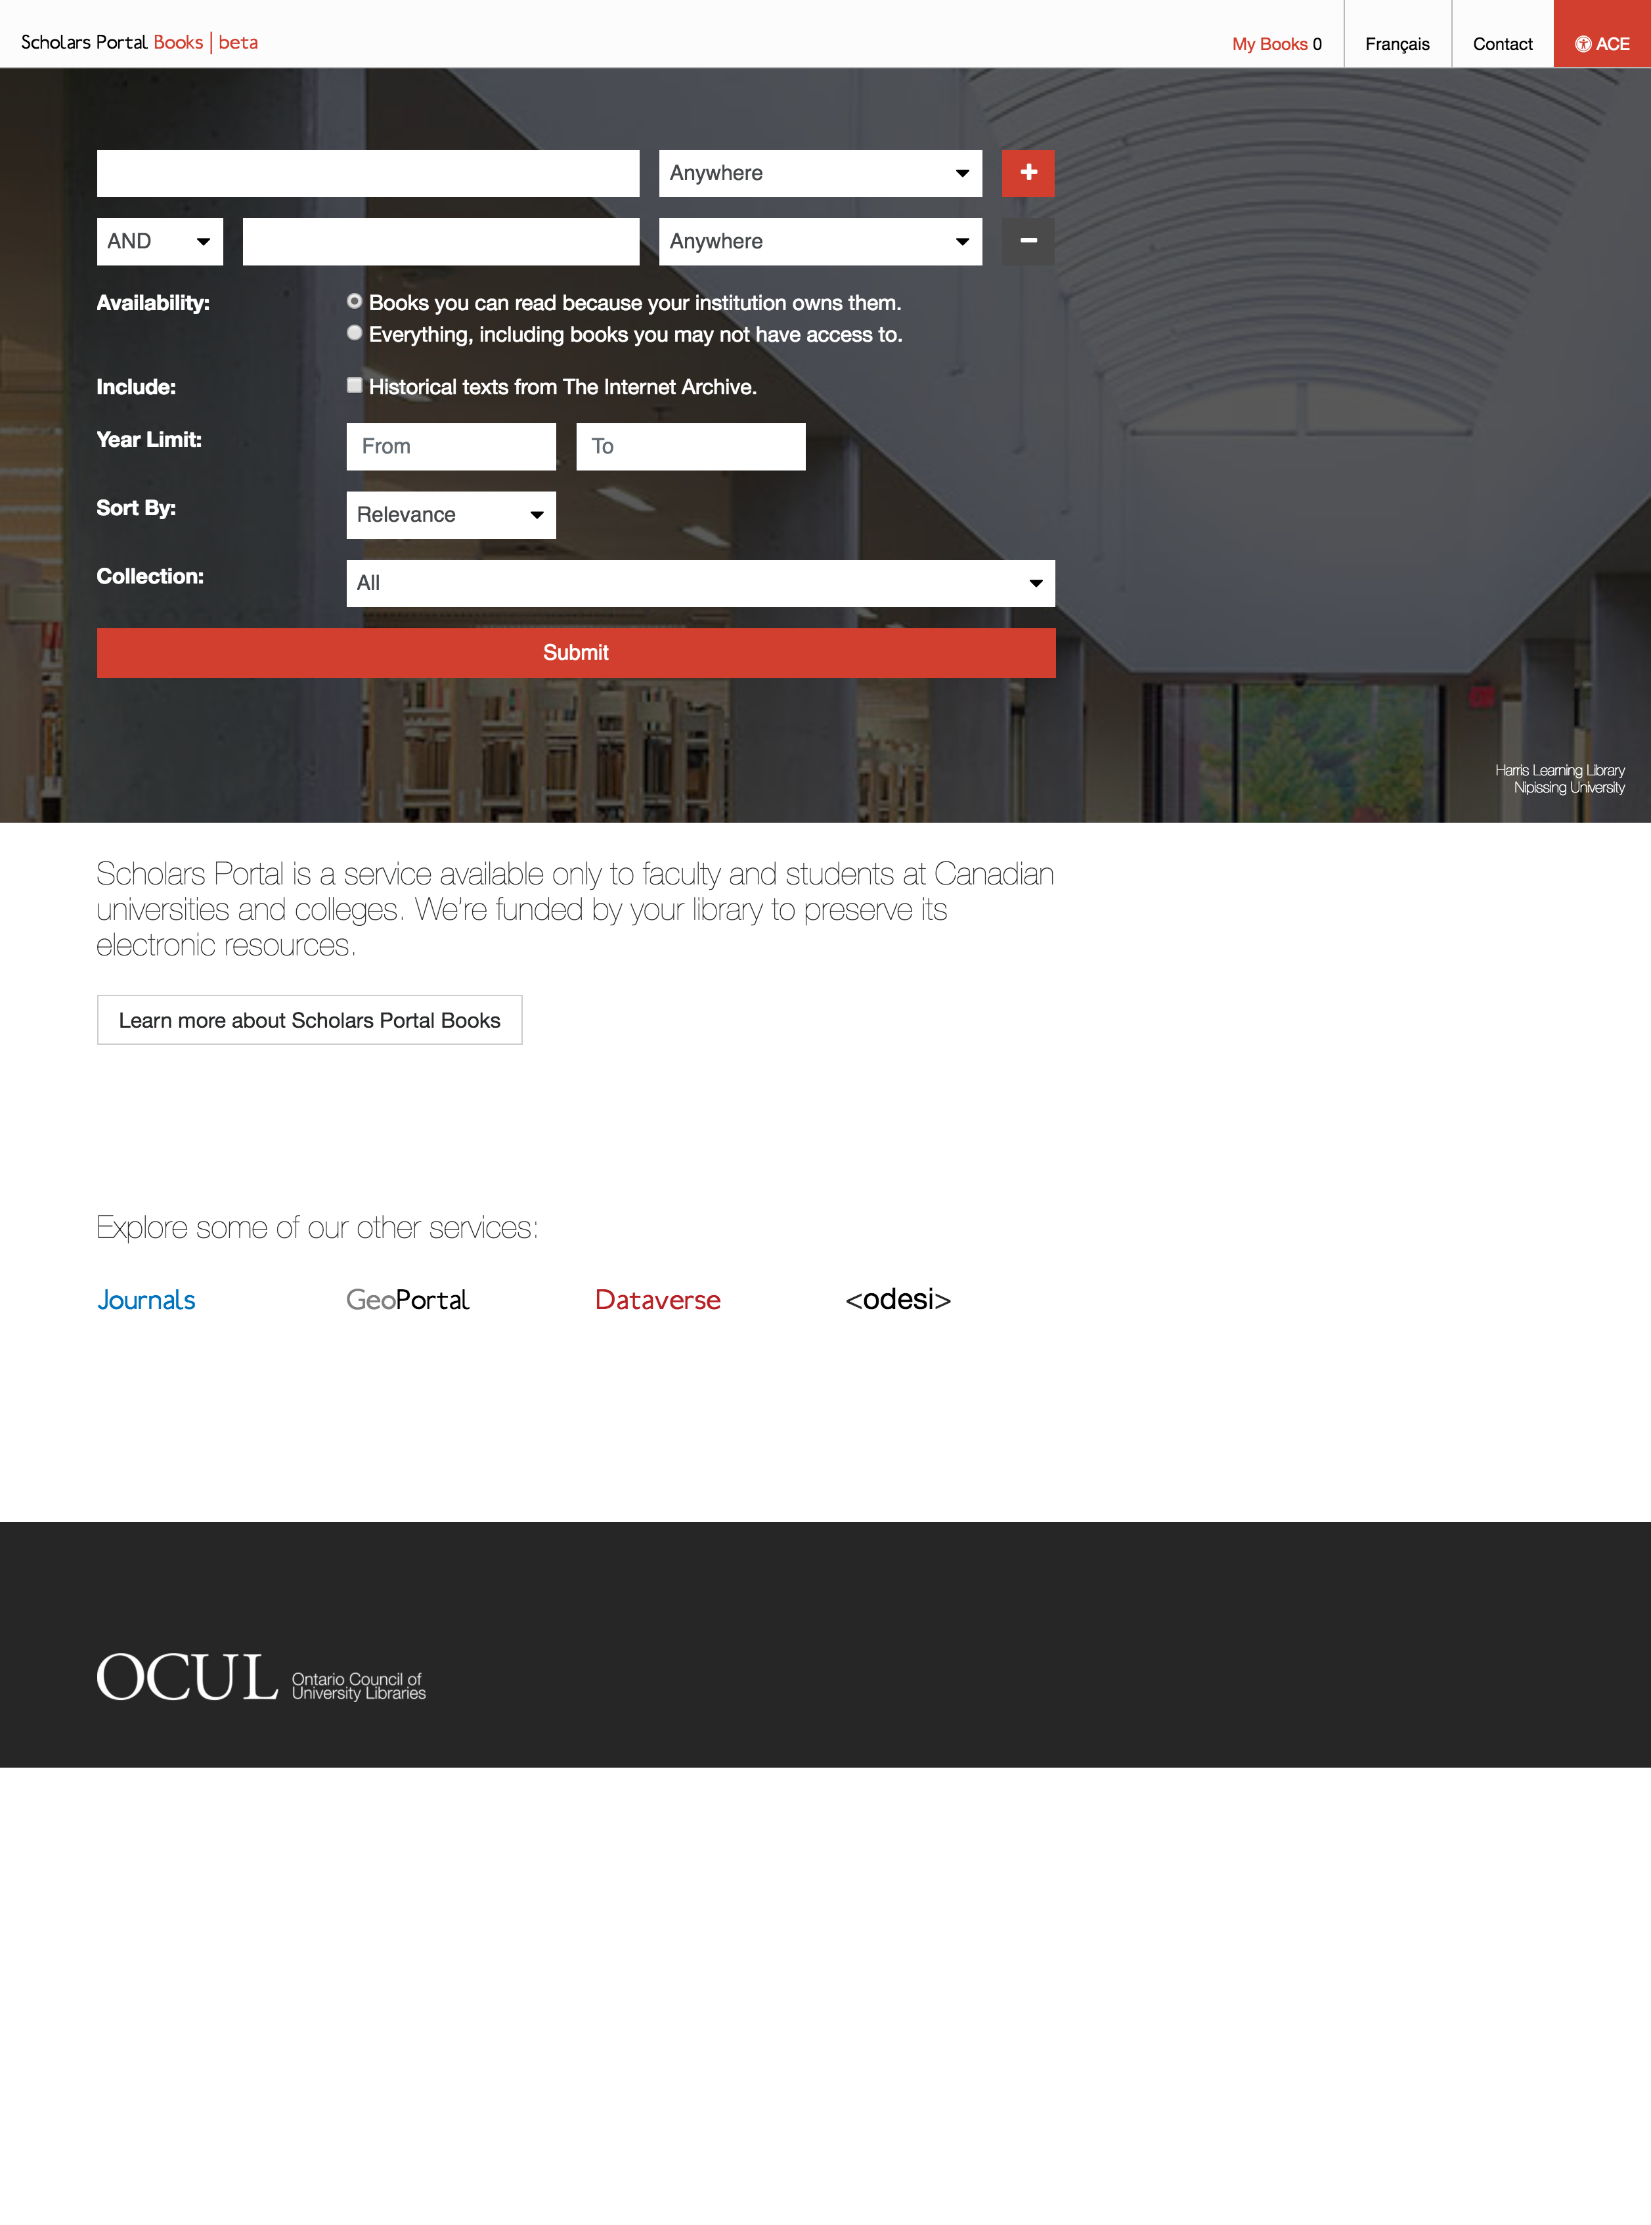
Books Redevelopment

Slide 28
Background
2008 OCUL procures ebrary platform (ISIS).
2009 Scholars Portal launches Books.
2011 ProQuest buys ebrary. Support stops.
2013 Adobe Content Server.
2014 Accessible Content E-Portal (ACE).
Business requirements gathered.
Redevelopment work begins.

Slide 29
Lots of challenges!

Slide 30
#1 – Migrating metadata
MARC
ONIX
APA
Business Expert Press
Brill
Cambridge
Morgan & Claypool
Harvard
IEEE
ITER
Karger
LWW XML
Oxford XML
Sage
Springer
Wiley
BITS

Slide 31
#2 - Collections & entitlements

Slide 32
#3 – Translating licenses into UX

Slide 33
#4 – Delivering print-centric content online

Slide 34
Demo
https://booksbeta.scholarsportal.info

Slide 35
Books Redevelopment Phase 1 Completion
TASK | Dec | Jan | Feb | Mar | Apr | May | Jun | Jul | Aug | Sep | Oct | Nov
ISIS loading
BITS loading
ISIS platform in production |  |  |  |  |  |  |  | Do not resuscitate!!!!
Beta platform in production
Platform in production
Prepare ISIS platform for demotion
End User Testing & Feedback
ACE Testing
In Text Searching
Statistics
HTML Generation
HTML Backlog
Admintool work
Admintool testing
Shibboleth
ITER integration

Slide 36
Questions & Feedback?
bartek@scholarsportal.info

Slide 37
Looking Ahead
New Partnerships
Alan Darnell

Slide 38
Understanding the Implications of Collaborative Futures
Enhanced bibliographic management
Supporting OCUL libraries developing Alternative and Open publishing programs
For RACER and SFX and other SP services
Entitlement management, holdings reporting, LOD
Enhanced OJS support. OER services, grey literature, government documents
Expanding our digital preservation services
ownCloud pilot, CANOPUS project, TDR for Books, web archiving
Developing support tools for OCUL libraries implementing RDM services
Enhancements to Dataverse, support for large datasets, statistics, CAF integration
1
2
Focus Areas
3
4
5

Slide 39
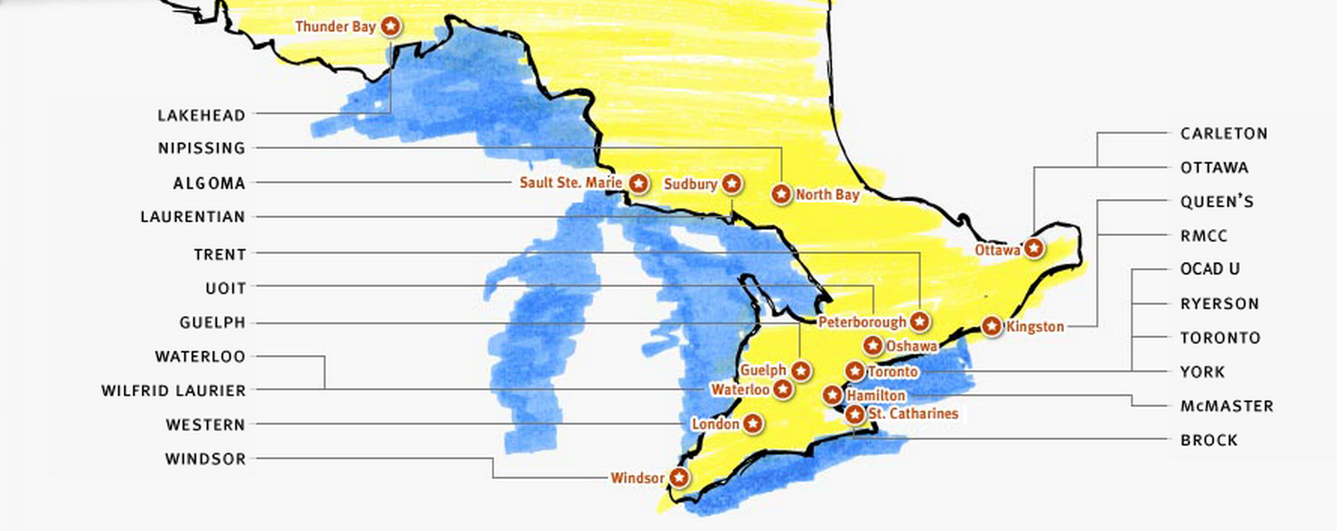

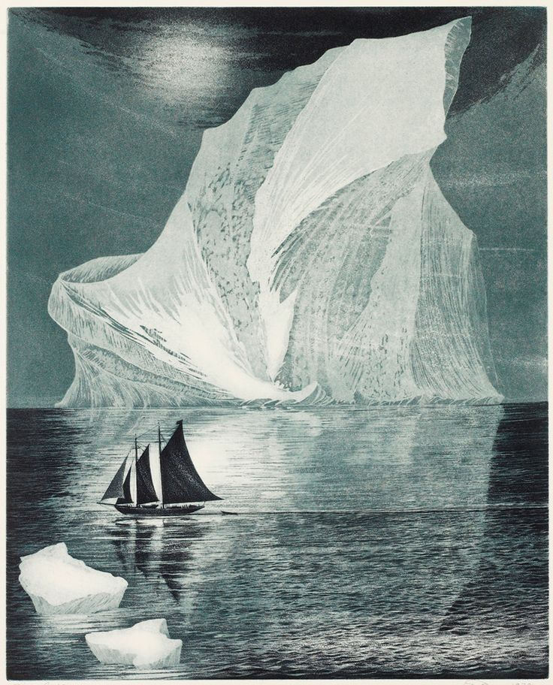


No library (or consortium) is an island…

Slide 40

Building Shared Library Infrastructure at a National Level
Dataverse North and Portage
CRKN Trusted Digital Repository
National preservation storage pilot

Slide 41
Questions?
slido.com
#spday17

Slide 42
We’re on break!
The livestream will resume in a few minutes.

